Slide 1
Transcriptional Analysis of Human Skin Lesions Identifies Tryptophan-2,3-Deoxygenase as a Restriction Factor for Cutaneous Leishmania
By: Vasco Rodrigues et al., 2019
Presented by John Njogu

Slide 2
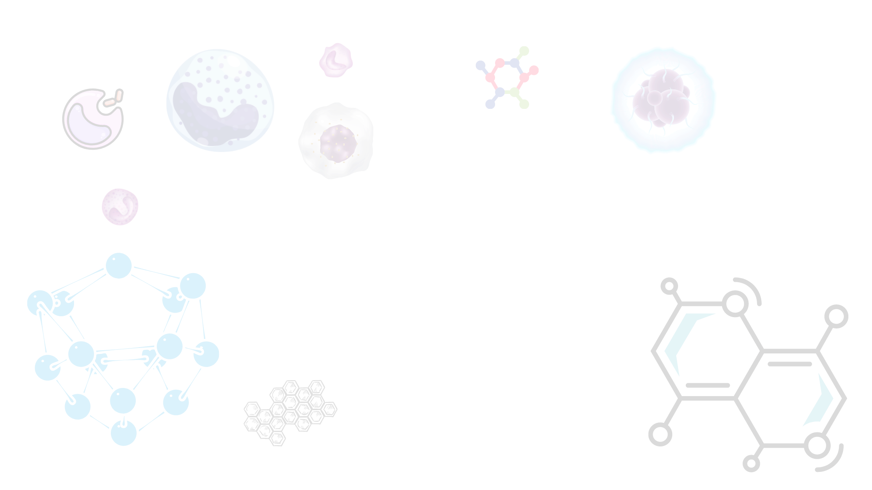
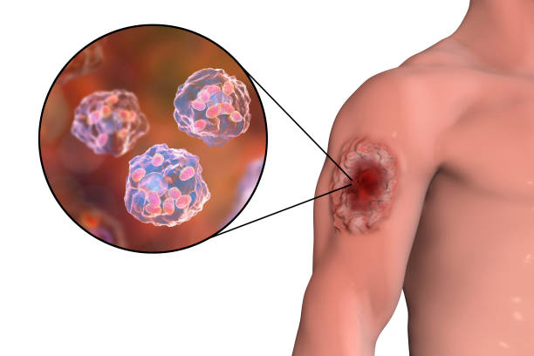
Background
Vector Borne disease (female sandflies)
Causative agents protozoa of genus Leishmania
Types visceral and cutaneous
Morphological characteristics of protozoa is indistinguishable
Estimated 700,000 - 1 million annually globally
Notes:
In kenya about 4,000 are affected annually but about 5,000,000 are at risk as shown by a recent paper done by Everlyne Wambui on characterization of VL in marsabit

Slide 3
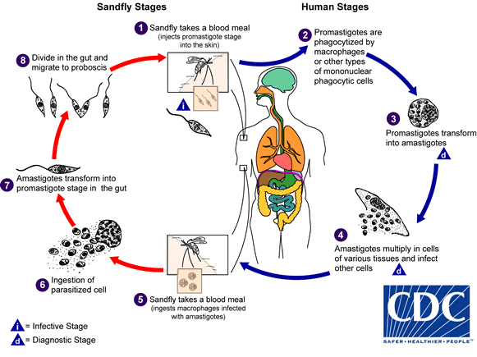
Life-cycle

Slide 4
Objectives
To provide insights into factors that impact cutaneous leishmaniasis pathology
Identify new genes that are differentially expressed between normal and skin lesions
Identify genes whose expression in lesions is impacted by the parasite load
To identify gene signatures that allow the distinction between the leishmania species

Slide 5
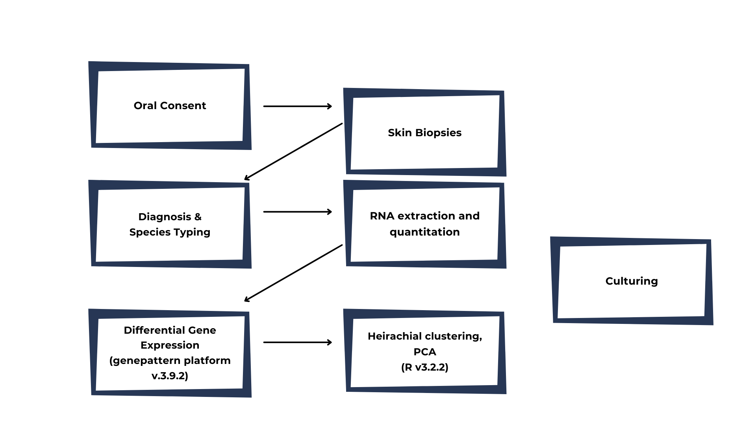
Materials and methods
Notes:
Internal transcriber sequence 1
Comparative marker selection package on the genepattern platform

Slide 6
Results
Species typed - L.major and L.tropica
DEGs associated with CL
A total of 170 genes
71 immune response
44 interferon stimulated genes
47 metabolic roles in immune cell activation
8 epidermal integrity and barrier function
Notes:
The genes were categorized according to the biological processes they are involved in
Identify new genes
Define gene signatures
Identify genes whose expression is impacted by parasite load

Slide 7
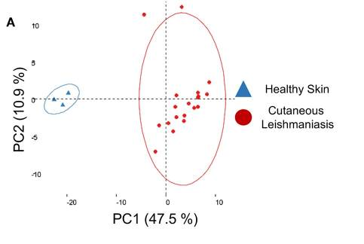
A PCA plot of the whole gene set
Notes:
PCA resolved the samples into two groups healthy and lesions

Slide 8
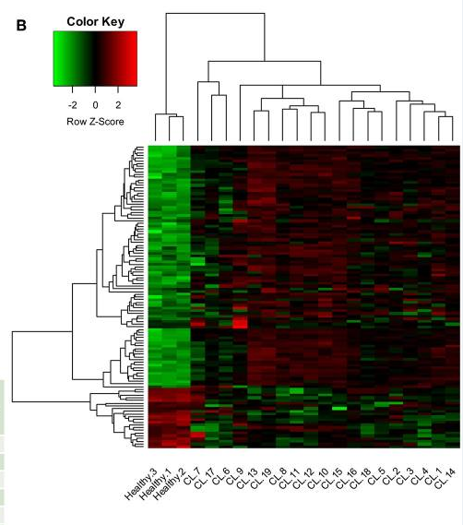
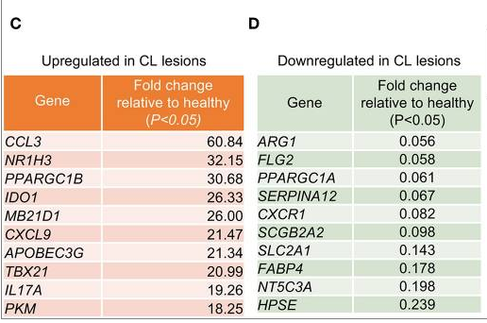
Clustered heatmap of skin biopsies
10 genes
10 genes
Notes:
When normal and CL are compared, CL bear elevated levels of transcripts involved in the immune response and conversely significant downregulation of transcripts involved in epidermal integrity and arginine and fatty acid metabolism
A total of 111 genes were differentially expressed. 89 upregulated and 22 downregulated
Conclusion leish induces recruitment of immune cells to the site of infection

Slide 9
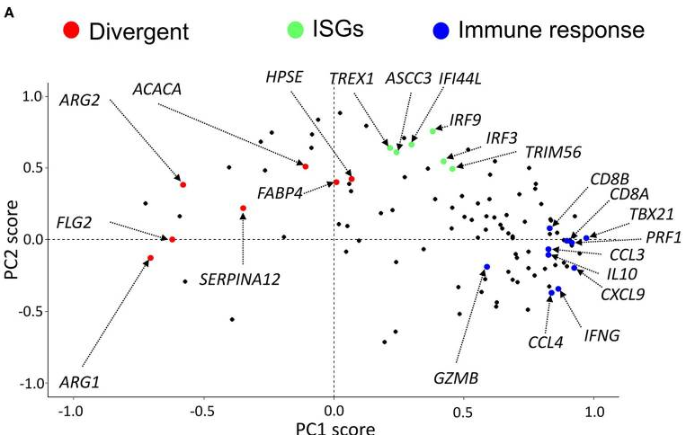
Individual gene contribution to the PC
Notes:
Checked individual contribution of the 111 genes to the variation from the normal which was about 47% variance
This would allow to check for co-suppression or co-induction
They needed to check if the particular groups correlated with each other
Divergent genes were genes that were downregulated in the lesions

Slide 10
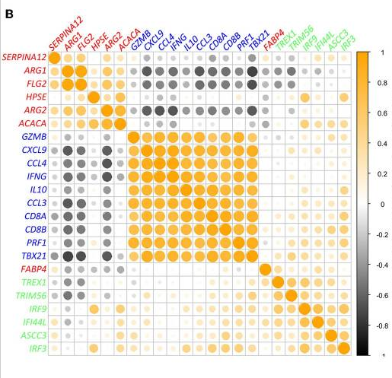
Notes:
They conducted a pearson correlation on each of the 111 genesets
The Immune response genes clustered together and also the rest
Little association between ISGs and Immune response group

Slide 11
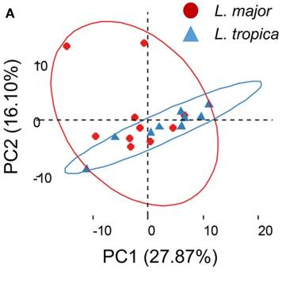
PCA analysis of the Infected
Notes:
Transcriptional profiles of lesions caused by by L.major and L.tropica was very similar i.e. no significant distinction between the two

Slide 12
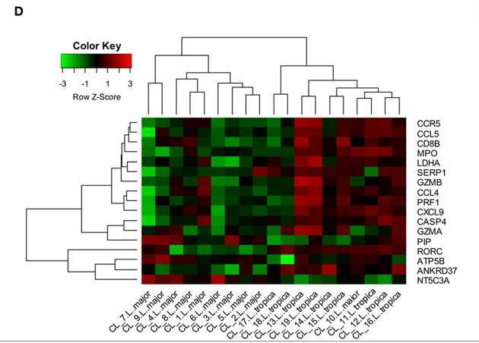
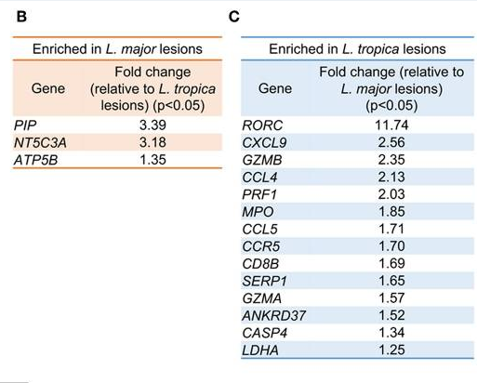
Transcriptional profile
3 genes
14 genes
Notes:
When comparing the 10 samples of L.major vs the 9 of L.tropica
3 genes were upregulated in L.major and were functionally non-related
14 genes were upreg in L.tropica and play a role in CD8+ T cell immune response
Conclusion the two have similar gene signatures but L.tropica presented an aggravated inflammatory/cytotoxic profile

Slide 13
Recent studies had suggested that parasite load in lesions impacts the type and magnitude of the immune response induced during Cutaneous Leishmaniasis caused by L. braziliensis by Christensen et al., 2016
Notes:
The variations in the parasite transcripts across the patients samples was not due to the infecting species, patients age or patient’s gender
They proceeded to correlate genes transcripts with the expression levels of the KPM11 and RRNA 45

Slide 14
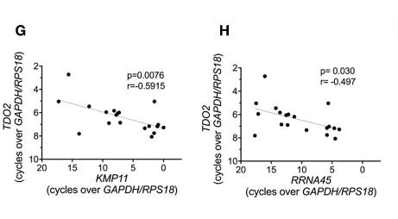
Correlation between transcript levels
Notes:
Why did they chose the KMP11 and RRNA 45 genes to analyse parasite load?
Plotted pearson correlations between the host genes whose expression was either positively or negatively correlated to the parasite load
- a total of 7 genes were positively correlated mRNA of KPM11 and RRNA 45 such as IL10 and IL4
Only TDO was negatively correlated to the 2 genes

Slide 15
Conclusion
TDO inhibits parasite proliferation
The Genes encoding epidermal integrity, arginine and fatty acid metabolism are downregulated during infection
The L.tropica infected Lesions have an aggravated inflammatory profile as compared to L.major
More research on the mechanism of TDO inhibition to leishmania needs to be done
More research needs to be done in between the species i.e. pathology comparisons
Resistance studies

Slide 16
Thank You

