Slide 1
Chapter 32 Multithreading and Parallel Programming
Reading: Chapter 12 of the 11th Edition of Horstmann
Chapter 14 of the 10th Edition of Horstmann
Chapter 20 of Dietel & Dietel
Sun Java Tutorial – Concurrency:
  http://java.sun.com/docs/books/tutorial/essential/concurrency/

Slide 2
Objectives
To get an overview of multithreading (§32.2).
To develop task classes by implementing the Runnable interface (§32.3).
To create threads to run tasks using the Thread class (§32.3).
To control threads using the methods in the Thread class (§32.4).
To control animations using threads and use Platform.runLater to run the code in application thread (§32.5).
To execute tasks in a thread pool (§32.6).
To use synchronized methods or blocks to synchronize threads to avoid race conditions (§32.7).
To synchronize threads using locks (§32.8).
To facilitate thread communications using conditions on locks (§§32.9–32.10).
To use blocking queues to synchronize access to an array queue, linked queue, and priority queue (§32.11).
To restrict the number of accesses to a shared resource using semaphores (§32.12).
To use the resource-ordering technique to avoid deadlocks (§32.13).
To describe the life cycle of a thread (§32.14).
To create synchronized collections using the static methods in the Collections class (§32.15).
To develop parallel programs using the Fork/Join Framework (§32.16).

Slide 3
A single threaded program
class ABC
{
….
  public void main(..)
  {
  …
  ..
  }
}
begin
body
end

Slide 4
A Multithreaded Program
Main Thread
start
start
start
Thread A
Thread B
Thread C
Threads may switch or exchange data/results

Slide 5
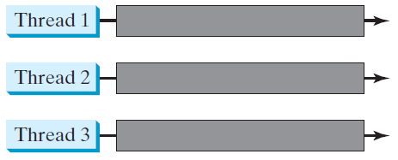
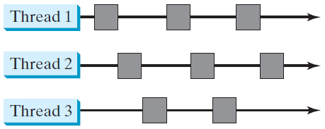
Threads Concept
Multiple threads on multiple CPUs
Multiple threads sharing a single CPU

Slide 6
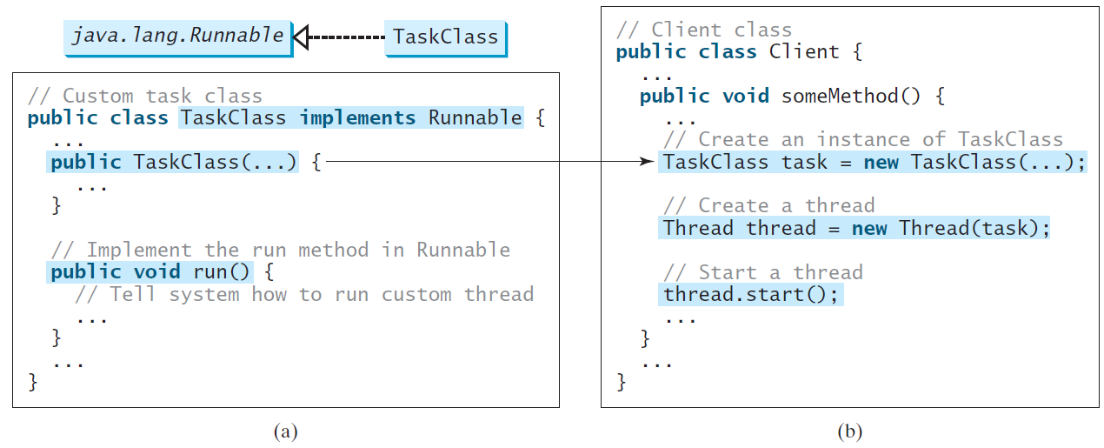
Creating Tasks and Threads

Slide 7
Example:
Using the Runnable Interface to Create and Launch Threads
Objective: Create and run three threads:
  The first thread prints the letter a 100 times.
  The second thread prints the letter b 100 times.
  The third thread prints the integers 1 through 100.
TaskThreadDemo

Slide 8
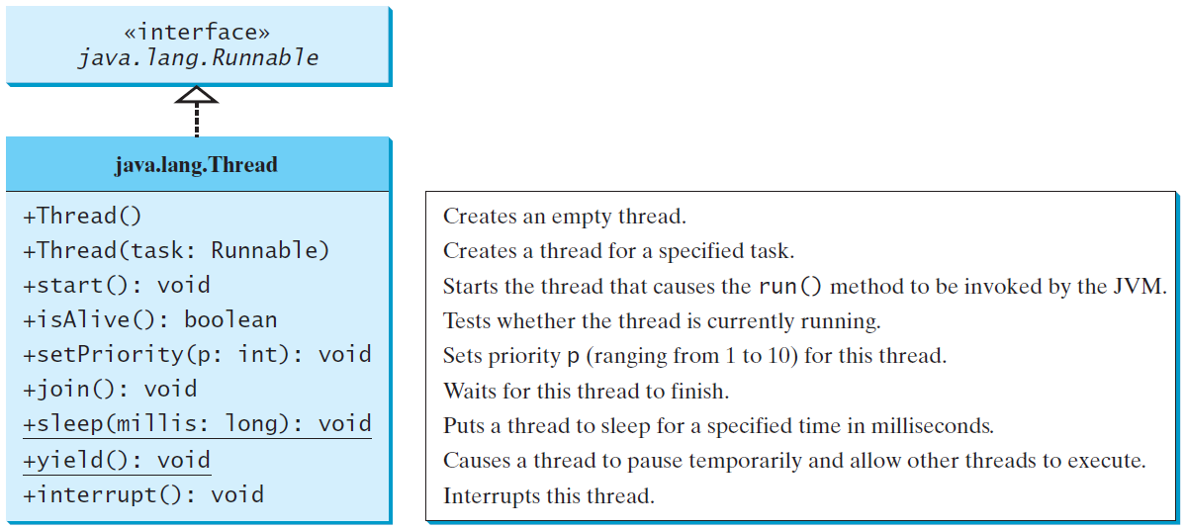
The Thread Class

Slide 9
The Static yield() Method
You can use the yield() method to temporarily release time for other threads. For example, suppose you modify the code in Lines 53-57 in TaskThreadDemo.java as follows:
  public void run() {
  for (int i = 1; i <= lastNum; i++) {
  System.out.print(" " + i);
  Thread.yield();
  }
  }
Every time a number is printed, the print100 thread is yielded. So, the numbers are printed after the characters.

Slide 10
The Static sleep(milliseconds) Method
The sleep(long mills) method puts the thread to sleep for the specified time in milliseconds. For example, suppose you modify the code in Lines 53-57 in TaskThreadDemo.java as follows:
  public void run() {
  for (int i = 1; i <= lastNum; i++) {
  System.out.print(" " + i);
  try {
  if (i >= 50) Thread.sleep(1);
  }
  catch (InterruptedException ex) {
  }
  }
  }
Every time a number (>= 50) is printed, the print100 thread is put to sleep for 1 millisecond.

Slide 11
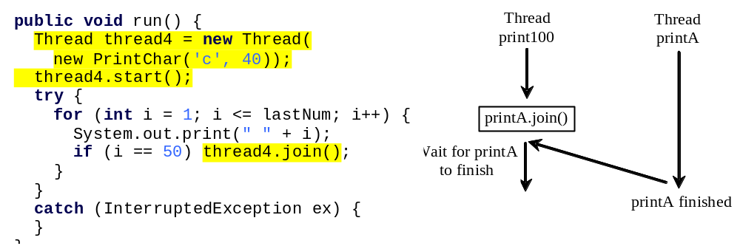
The join() Method
You can use the join() method to force one thread to wait for another thread to finish. For example, suppose you modify the code in Lines 53-57 in TaskThreadDemo.java as follows:
The numbers after 50 are printed after thread printA is finished.

Slide 12
isAlive(), interrupt(), and isInterrupted()
The isAlive() method is used to find out the state of a thread. It returns true if a thread is in the Ready, Blocked, or Running state; it returns false if a thread is new and has not started or if it is finished.
The interrupt() method interrupts a thread in the following way: If a thread is currently in the Ready or Running state, its interrupted flag is set; if a thread is currently blocked, it is awakened and enters the Ready state, and an java.io.InterruptedException is thrown.
The isInterrupt() method tests whether the thread is interrupted.

Slide 13
The deprecated stop(), suspend(), and resume() Methods
NOTE: The Thread class also contains the stop(), suspend(), and resume() methods. As of Java 2, these methods are deprecated (or outdated) because they are known to be inherently unsafe. You should assign null to a Thread variable to indicate that it is stopped rather than use the stop() method.

Slide 14
Life Cycle of Thread
new
start()
I/O completed
ready
suspend()
Time expired/
interrupted
notify()
sleeping
blocked
waiting
dispatch
sleep()
wait()
suspend()
running
Block on I/O
completion
stop()
dead

Slide 15
Thread Priority
Each thread is assigned a default priority of Thread.NORM_PRIORITY. You can reset the priority using setPriority(int priority).
Some constants for priorities include Thread.MIN_PRIORITY Thread.MAX_PRIORITY Thread.NORM_PRIORITY

Slide 16
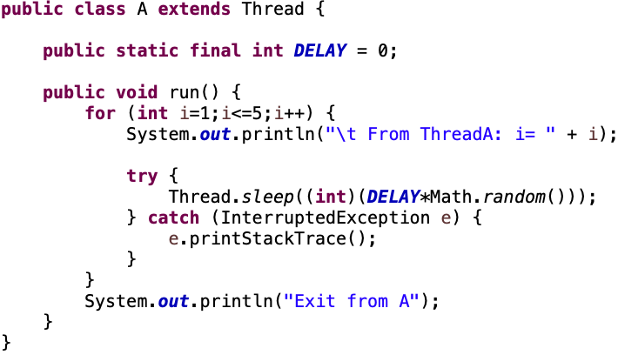
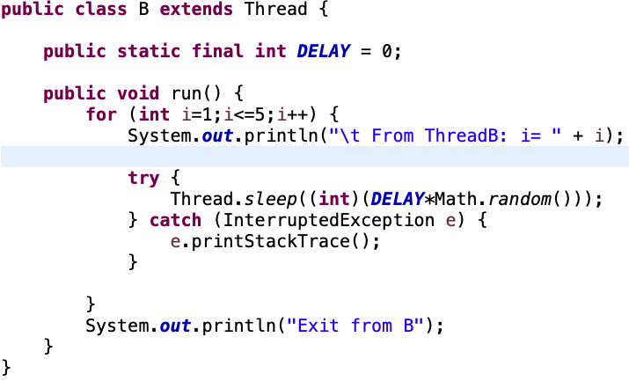
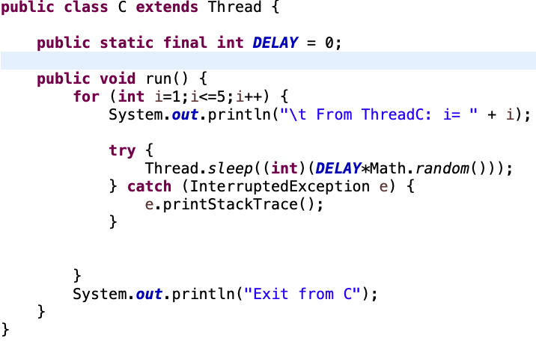
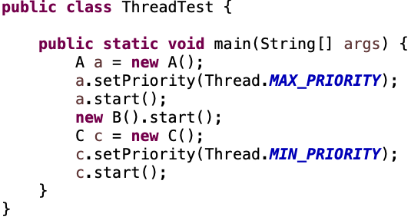
Three Threads Example

Slide 17
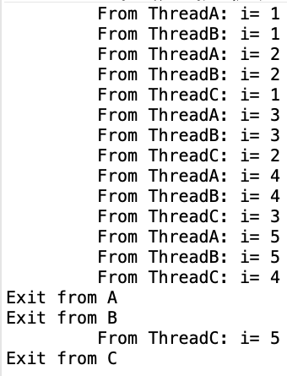
Three Threads
We can see the output intertwined. Priority won’t make that much of a difference for 5 steps
If we raise that to 500 steps, we will see the priority settings affect outcomes

Slide 18
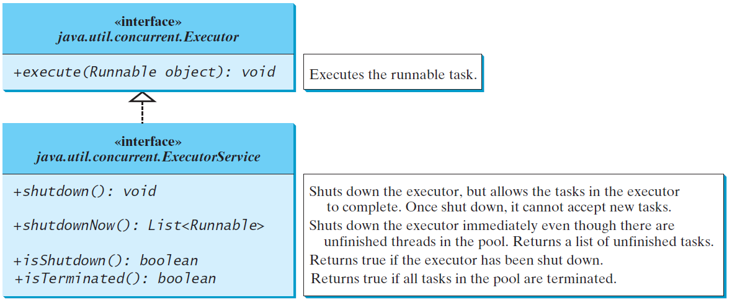
Thread Pools
Starting a new thread for each task could limit throughput and cause poor performance. A thread pool is ideal to manage the number of tasks executing concurrently. JDK 1.5 uses the Executor interface for executing tasks in a thread pool and the ExecutorService interface for managing and controlling tasks. ExecutorService is a subinterface of Executor.

Slide 19
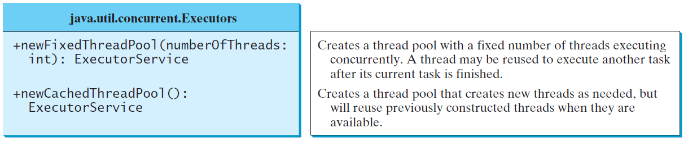
Creating Executors
To create an Executor object, use the static methods in the Executors class.
ExecutorDemo

Slide 20
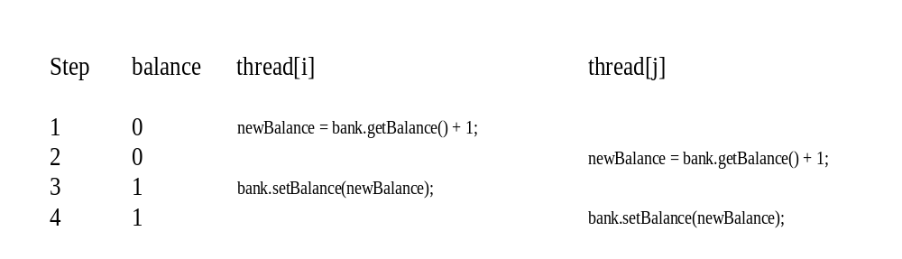
Thread Synchronization
A shared resource may be corrupted if it is accessed simultaneously by multiple threads. For example, two unsynchronized threads accessing the same bank account may cause conflict.

Slide 21
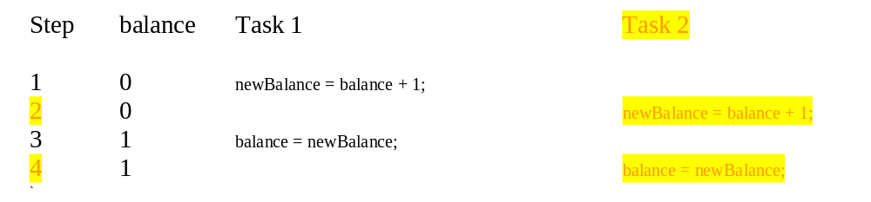
Race Condition
What, then, caused the error in the example? Here is a possible scenario:
The effect of this scenario is that Task 1 did nothing, because in Step 4 Task 2 overrides Task 1's result. Obviously, the problem is that Task 1 and Task 2 are accessing a common resource in a way that causes conflict. This is a common problem known as a race condition in multithreaded programs. A class is said to be thread-safe if an object of the class does not cause a race condition in the presence of multiple threads. As demonstrated in the preceding example, the Account class is not thread-safe.

Slide 22
Accessing Shared Resources
Applications Access to Shared Resources need to be coordinated.
  Printer (two person jobs cannot be printed at the same time)
  Simultaneous operations on your bank account.
  Can the following operations be done at the same time on the same account?
    Deposit()
    Withdraw()
    Enquire()

Slide 23
Bank Example
Many accounts, many threads accessing those accounts
To transfer:
  subtract value of transfer from transfer source account
  Add value of transfer to transfer destination account
  Report the total balance – should be the same!
Accounts
Threads
Transfer from 0 to 1
0
A
1
B
2
Transfer from 3 to 4
3
4

Slide 24
Bank Example, cont.
You’re (mostly) fine until
Accounts
Threads
Transfer from 0 to 1
0
A
Transfer from 0 to 2
1
B
2
Transfer from 2 to 1
C
3
D
Transfer from 4 to 3
4

Slide 25
What’s happening here?
TransferThread1
TransferThread2
accounts[to]
Thread 1 register
Thread 2 register
load
5000
5000
add
5500
5000
load
5000
5000
add
5900
5000
store
5900
5900
store
5500
5500

Slide 26
The synchronized keyword
To avoid race conditions, more than one thread must be prevented from simultaneously entering certain part of the program, known as critical region. The critical region in the Listing 32.5 is the entire deposit method. You can use the synchronized keyword to synchronize the method so that only one thread can access the method at a time. There are several ways to correct the problem in Listing 32.5, one approach is to make Account thread-safe by adding the synchronized keyword in the deposit method in Line 45 as follows:
  public synchronized void deposit(double amount)

Slide 27
Synchronizing Instance Methods and Static Methods
A synchronized method acquires a lock before it executes. In the case of an instance method, the lock is on the object for which the method was invoked. In the case of a static method, the lock is on the class. If one thread invokes a synchronized instance method (respectively, static method) on an object, the lock of that object (respectively, class) is acquired first, then the method is executed, and finally the lock is released. Another thread invoking the same method of that object (respectively, class) is blocked until the lock is released.

Slide 28
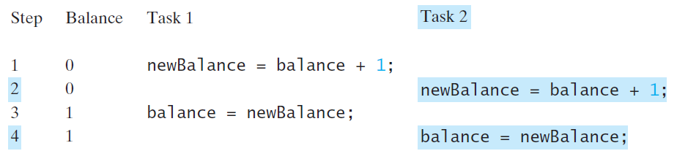
Synchronizing Instance Methods and Static Methods
With the deposit method synchronized, the preceding scenario cannot happen. If Task 2 starts to enter the method, and Task 1 is already in the method, Task 2 is blocked until Task 1 finishes the method.

Slide 29
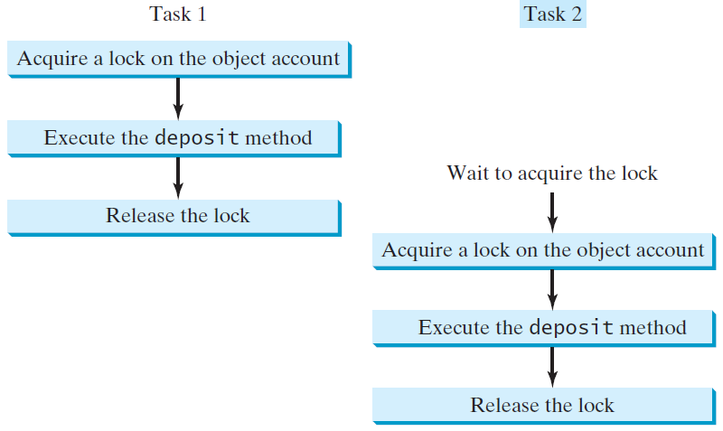
Synchronizing Tasks

Slide 30
Synchronizing Statements
Invoking a synchronized instance method of an object acquires a lock on the object, and invoking a synchronized static method of a class acquires a lock on the class. A synchronized statement can be used to acquire a lock on any object, not just this object, when executing a block of the code in a method. This block is referred to as a synchronized block. The general form of a synchronized statement is as follows:
  synchronized (expr) {
  statements;
  }
The expression expr must evaluate to an object reference. If the object is already locked by another thread, the thread is blocked until the lock is released. When a lock is obtained on the object, the statements in the synchronized block are executed, and then the lock is released.

Slide 31
Synchronizing Statements vs. Methods
Any synchronized instance method can be converted into a synchronized statement. Suppose that the following is a synchronized instance method:
  public synchronized void xMethod() {
  // method body
  }
This method is equivalent to
  public void xMethod() {
  synchronized (this) {
  // method body
  }
  }

Slide 32
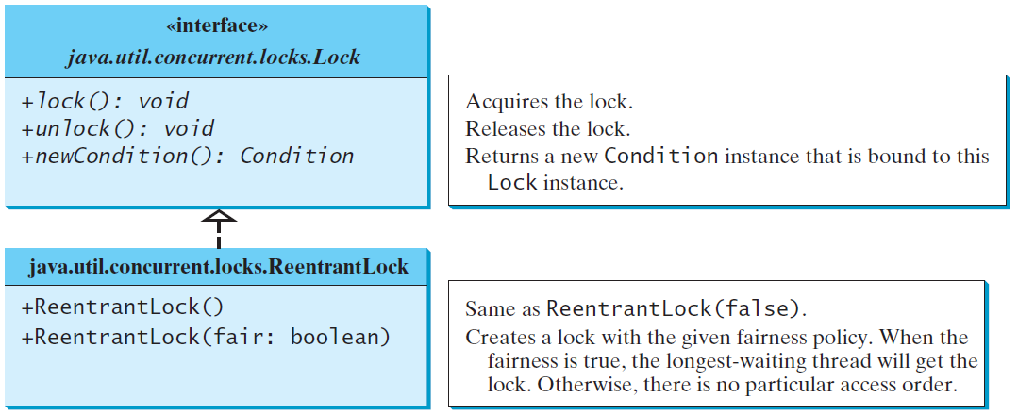
Synchronization Using Locks
A synchronized instance method implicitly acquires a lock on the instance before it executes the method.
JDK 1.5 enables you to use locks explicitly. The new locking features are flexible and give you more control for coordinating threads. A lock is an instance of the Lock interface, which declares the methods for acquiring and releasing locks. A lock may also use the newCondition() method to create any number of Condition objects, which can be used for thread communications.

Slide 33
Fairness Policy
ReentrantLock is a concrete implementation of Lock for creating mutual exclusive locks. You can create a lock with the specified fairness policy. True fairness policies guarantee the longest-wait thread to obtain the lock first. False fairness policies grant a lock to a waiting thread without any access order. Programs using fair locks accessed by many threads may have poor overall performance than those using the default setting, but have smaller variances in times to obtain locks and guarantee lack of starvation.

Slide 34
Example: Using Locks
This example revises AccountWithoutSync.java to synchronize the account modification using explicit locks.
AccountWithSyncUsingLock

Slide 35
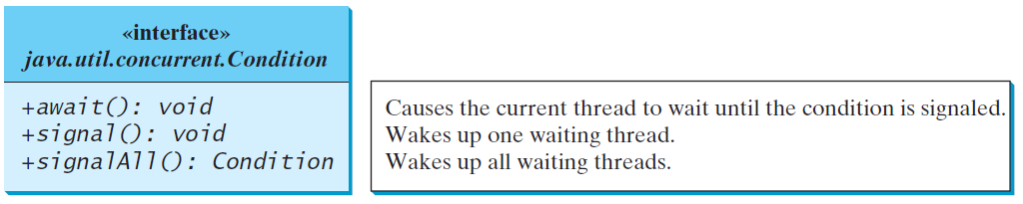
Cooperation Among Threads
The conditions can be used to facilitate communications among threads. A thread can specify what to do under a certain condition. Conditions are objects created by invoking the newCondition() method on a Lock object. Once a condition is created, you can use its await(), signal(), and signalAll() methods for thread communications. The await() method causes the current thread to wait until the condition is signaled. The signal() method wakes up one waiting thread, and the signalAll() method wakes all waiting threads.

Slide 36
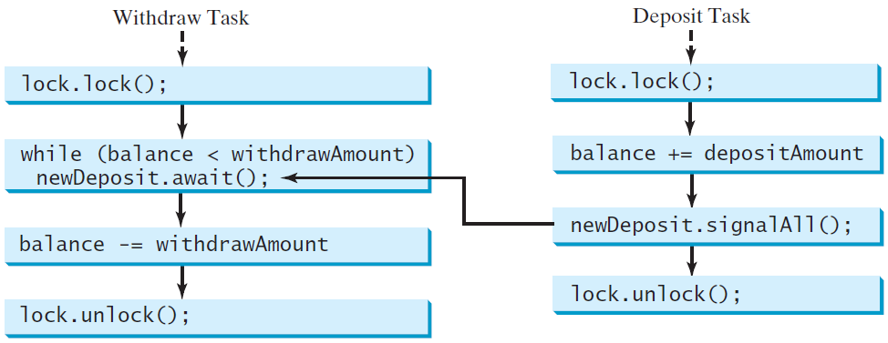
Cooperation Among Threads
To synchronize the operations, use a lock with a condition: newDeposit (i.e., new deposit added to the account). If the balance is less than the amount to be withdrawn, the withdraw task will wait for the newDeposit condition. When the deposit task adds money to the account, the task signals the waiting withdraw task to try again.

Slide 37
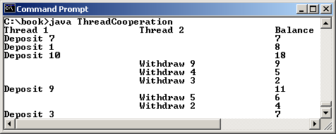
Example: Thread Cooperation
Write a program that demonstrates thread cooperation. Suppose that you create and launch two threads, one deposits to an account, and the other withdraws from the same account. The second thread has to wait if the amount to be withdrawn is more than the current balance in the account. Whenever new fund is deposited to the account, the first thread notifies the second thread to resume. If the amount is still not enough for a withdrawal, the second thread has to continue to wait for more fund in the account. Assume the initial balance is 0 and the amount to deposit and to withdraw is randomly generated.
ThreadCooperation

Slide 38
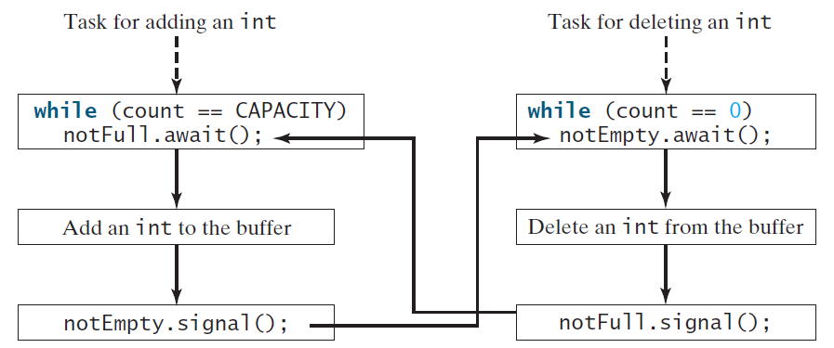
Case Study: Producer/Consumer (Optional)
Consider the classic Consumer/Producer example. Suppose you use a buffer to store integers. The buffer size is limited. The buffer provides the method write(int) to add an int value to the buffer and the method read() to read and delete an int value from the buffer. To synchronize the operations, use a lock with two conditions: notEmpty (i.e., buffer is not empty) and notFull (i.e., buffer is not full). When a task adds an int to the buffer, if the buffer is full, the task will wait for the notFull condition. When a task deletes an int from the buffer, if the buffer is empty, the task will wait for the notEmpty condition.

Slide 39
Case Study: Producer/Consumer (Optional)
Listing 32.8 presents the complete program. The program contains the Buffer class (lines 43-89) and two tasks for repeatedly producing and consuming numbers to and from the buffer (lines 15-41). The write(int) method (line 58) adds an integer to the buffer. The read() method (line 75) deletes and returns an integer from the buffer.
For simplicity, the buffer is implemented using a linked list (lines 48-49). Two conditions notEmpty and notFull on the lock are created in lines 55-56. The conditions are bound to a lock. A lock must be acquired before a condition can be applied. If you use the wait() and notify() methods to rewrite this example, you have to designate two objects as monitors.
ConsumerProducer

Slide 40
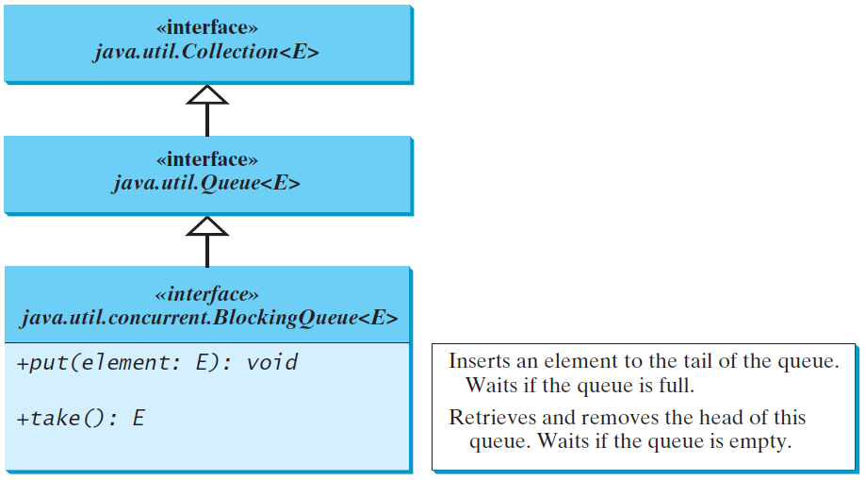
Blocking Queues (Optional)
§22.8 introduced queues and priority queues. A blocking queue causes a thread to block when you try to add an element to a full queue or to remove an element from an empty queue.

Slide 41
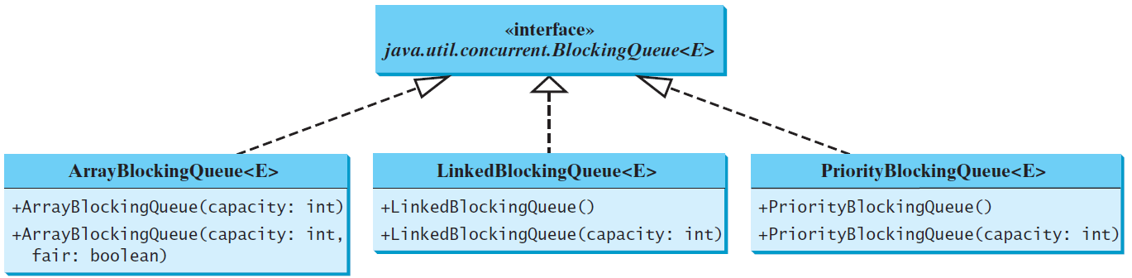
Concrete Blocking Queues
Three concrete blocking queues ArrayBlockingQueue, LinkedBlockingQueue, and PriorityBlockingQueue are supported in JDK 1.5. All are in the java.util.concurrent package. ArrayBlockingQueue implements a blocking queue using an array. You have to specify a capacity or an optional fairness to construct an ArrayBlockingQueue. LinkedBlockingQueue implements a blocking queue using a linked list. You may create an unbounded or bounded LinkedBlockingQueue. PriorityBlockingQueue is a priority queue. You may create an unbounded or bounded priority queue.

Slide 42
Producer/Consumer Using Blocking Queues
The program gives an example of using an ArrayBlockingQueue for the Consumer/Producer problem.
ConsumerProducerUsingBlockingQueue

Slide 43
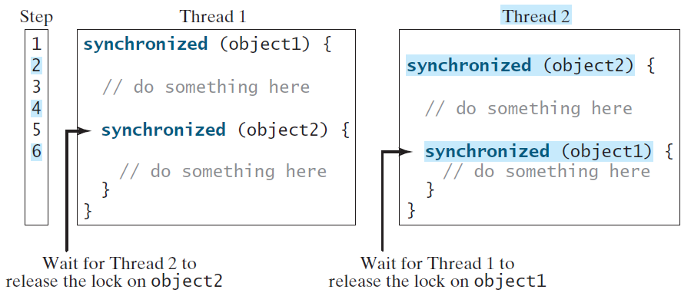
Deadlock
Sometimes two or more threads need to acquire the locks on several shared objects. This could cause deadlock, in which each thread has the lock on one of the objects and is waiting for the lock on the other object. Consider the scenario with two threads and two objects. Thread 1 acquired a lock on object1 and Thread 2 acquired a lock on object2. Now Thread 1 is waiting for the lock on object2 and Thread 2 for the lock on object1. The two threads wait for each other to release the in order to get the lock, and neither can continue to run.

Slide 44
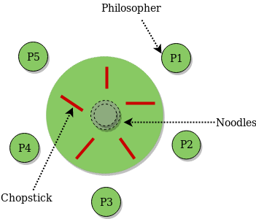
The Dining Philosopher Problem
To eat, each philosopher follows the same process: pick up the right chopstick, then pick up the left chopstick, then start eating

Slide 45
Preventing Deadlock
Deadlock can be easily avoided by using a simple technique known as resource ordering. With this technique, you assign an order on all the objects whose locks must be acquired and ensure that each thread acquires the locks in that order. For the example, suppose the objects are ordered as object1 and object2. Using the resource ordering technique, Thread 2 must acquire a lock on object1 first, then on object2. Once Thread 1 acquired a lock on object1, Thread 2 has to wait for a lock on object1. So Thread 1 will be able to acquire a lock on object2 and no deadlock would occur.

Slide 46
When a method is synchronized
TransferThread1
TransferThread2
accounts[to]
Thread 1 register
Thread 2 register
load
5000
5000
add
5500
5000
store
5500
5500
load
5500
5500
add
6400
5500
store
6400
6400

Slide 47
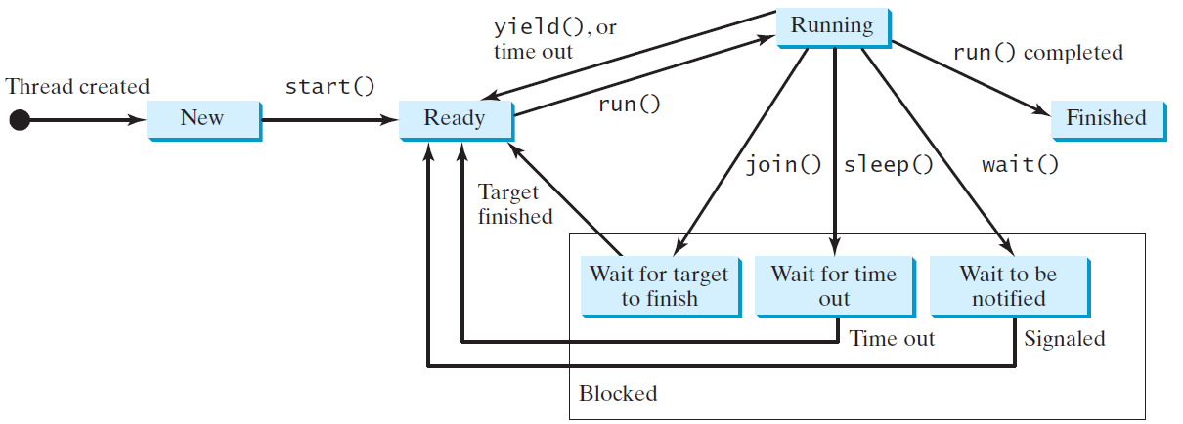
Thread States
A thread can be in one of five states: New, Ready, Running, Blocked, or Finished.

Slide 48
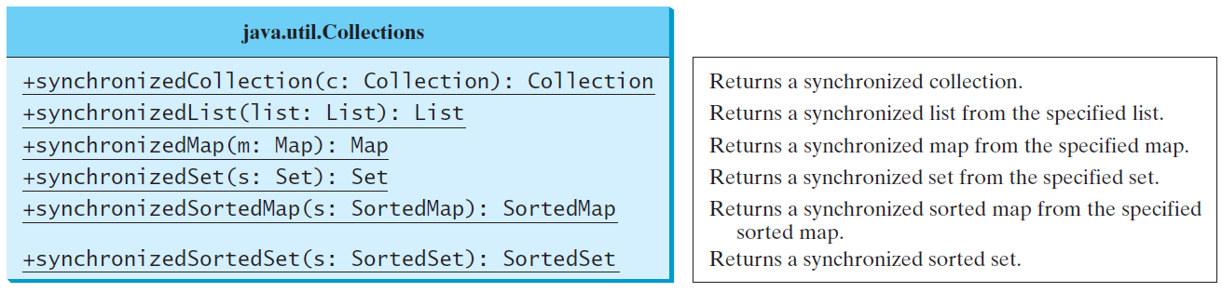
Synchronized Collections
The classes in the Java Collections Framework are not thread-safe, i.e., the contents may be corrupted if they are accessed and updated concurrently by multiple threads. You can protect the data in a collection by locking the collection or using synchronized collections.
The Collections class provides six static methods for wrapping a collection into a synchronized version. The collections created using these methods are called synchronization wrappers.

Slide 49
The Fork/Join Framework
The widespread use of multicore systems has created a revolution in software. In order to benefit from multiple processors, software needs to run in parallel.
JDK 7 introduces the new Fork/Join Framework for parallel programming, which utilizes the multicore processors.

Slide 50
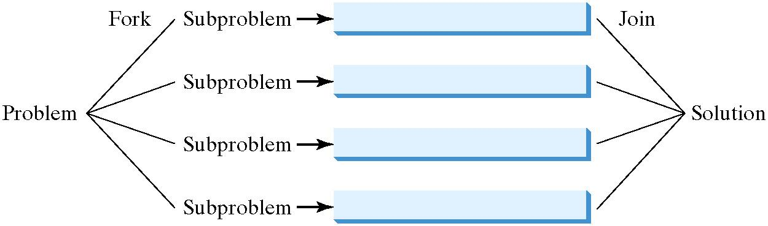
The Fork/Join Framework
The Fork/Join Framework is used for parallel programming in Java.
In JDK 7’s Fork/Join Framework, a fork can be viewed as an independent task that runs on a thread.

Slide 51
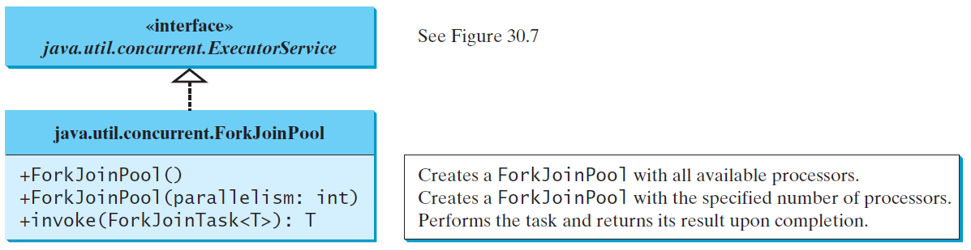
ForkJoinTask and ForkJoinPool
The framework defines a task using the ForkJoinTask class, and executes a task in an instance of ForkJoinPool.

Slide 52
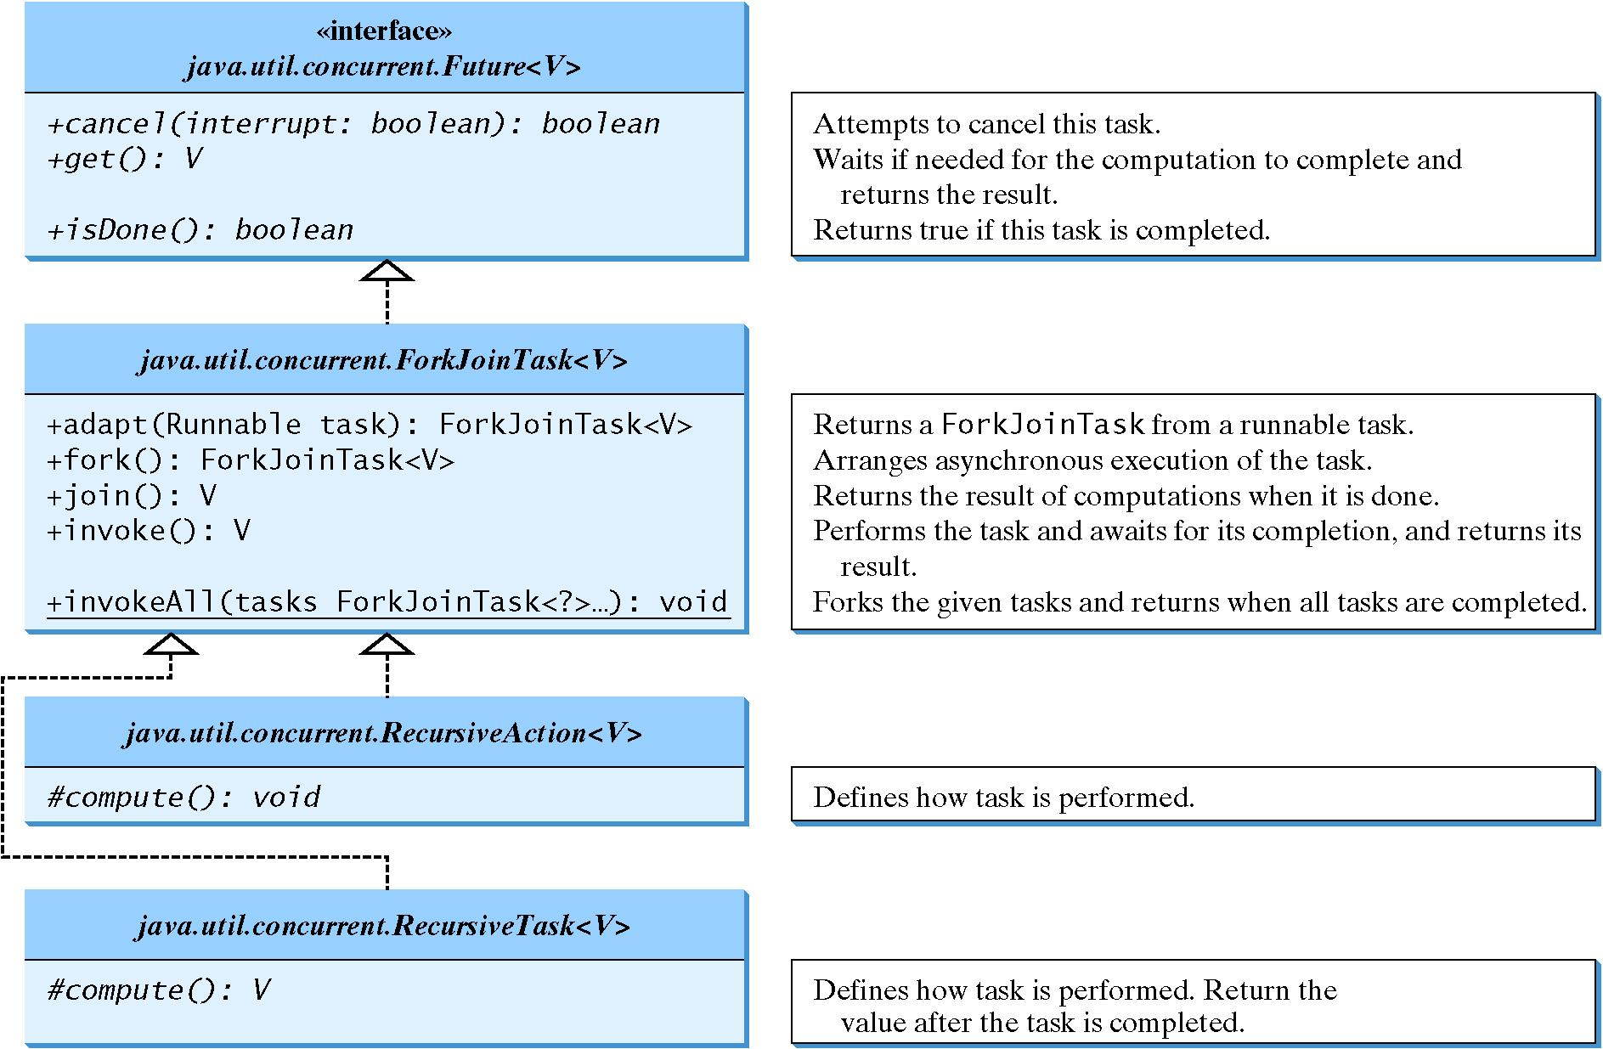
ForkJoinTask

Slide 53
Multithread Architectures
The server: Master/worker
The peer model
The thread pipeline

Slide 54
Multithreaded MathServer
Multithreaded
MathServer
(sin, cos, sqrt, etc.)
A Client Program
What is sqrt(10)?
“sqrt 4.0”
“2.0”
A Client Program
What is sin(10)?
A Client
Program in “C”
What is sin(10)?
A Client
Program in “C++”
What is sin(10)?

Slide 55
A Multithreaded Program
MathThreads
start
start
start
MathSin
MathCos
MathTan
join
join
join
MathThreads

Slide 56
Thread concurrency/operation models
The master/worker model
The peer model
A thread pipeline

Slide 57
The master/worker model
Program
Workers
Resources
taskX
Files
Master
Databases
taskY
Input (Stream)
main ( )
Disks
taskZ
Special
Devices

Slide 58
The peer model
Program
Workers
Resources
Input
taskX
Files
Databases
taskY
Disks
taskZ
Special
Devices

Slide 59
A thread pipeline
A thread pipeline
Program
Filter Threads
Stage 1
Stage 2
Stage 3
Input (Stream)
Resources
Files
Files
Files
Databases
Databases
Databases
Disks
Disks
Disks
Special Devices
Special Devices
Special Devices

