Slide 1
Week 2: Elementary Programming

Slide 2
Recap: Last Week
How Java Works: the history of Java, the JVM, and Bytecode
Writing your first Java program
Tracing program execution

Slide 3
This week
Variables and Datatypes
Procedural Programming
Control flow statements
Maybe:
  Arrays and Strings

Slide 4
Motivations
In the preceding chapter, you learned how to create, compile, and run a Java program. Starting from this chapter, you will learn how to solve practical problems programmatically. Through these problems, you will learn Java primitive data types and related subjects, such as variables, constants, data types, operators, expressions, and input and output.

Slide 5
Objectives
To write Java programs to perform simple computations (§2.2).
To obtain input from the console using the Scanner class (§2.3).
To use identifiers to name variables, constants, methods, and classes (§2.4).
To use variables to store data (§§2.5–2.6).
To program with assignment statements and assignment expressions (§2.6).
To use constants to store permanent data (§2.7).
To name classes, methods, variables, and constants by following their naming conventions (§2.8).
To explore Java numeric primitive data types: byte, short, int, long, float, and double (§2.9).
To read a byte, short, int, long, float, or double value from the keyboard (§2.9.1).
To perform operations using operators +, -, *, /, and % (§2.9.2).
To perform exponent operations using Math.pow(a, b) (§2.9.3).
To write integer literals, floating-point literals, and literals in scientific notation (§2.10).
To use JShell to quickly test Java code (§2.11).
To write and evaluate numeric expressions (§2.12).
To obtain the current system time using System.currentTimeMillis() (§2.13).
To use augmented assignment operators (§2.14).
To distinguish between postincrement and preincrement and between postdecrement and predecrement (§2.15).
To cast the value of one type to another type (§2.16).
To describe the software development process and apply it to develop the loan payment program (§2.17).
To write a program that converts a large amount of money into smaller units (§2.18).
To avoid common errors and pitfalls in elementary programming (§2.19).

Slide 6
Identifiers
An identifier is a sequence of characters that consist of letters, digits, underscores (_), and dollar signs ($).
An identifier must start with a letter, an underscore (_), or a dollar sign ($). It cannot start with a digit.
An identifier cannot be a reserved word. (See https://docs.oracle.com/javase/tutorial/java/nutsandbolts/_keywords.html for a list of reserved words).
An identifier cannot be true, false, or
null.
An identifier can be of any length.

Slide 7
Variables
// Compute the first area
radius = 1.0;
area = radius * radius * 3.14159;
System.out.println("The area is “ + area + " for radius "+radius);
// Compute the second area
radius = 2.0;
area = radius * radius * 3.14159;
System.out.println("The area is “ + area + " for radius "+radius);

Slide 8
Declaring Variables
int x; // Declare x to be an
// integer variable;
double radius; // Declare radius to
// be a double variable;
char a; // Declare a to be a
// character variable;

Slide 9
Assignment Statements
x = 1; // Assign 1 to x;
radius = 1.0; // Assign 1.0 to radius;
a = 'A'; // Assign 'A' to a;

Slide 10
Declaring and Initializing in One Step
int x = 1;
double d = 1.4;

Slide 11
Named Constants
final datatype CONSTANTNAME = VALUE;
final double PI = 3.14159;
final int SIZE = 3;

Slide 12
Naming Conventions
Choose meaningful and descriptive names.
Variables and method names:
  Use lowercase. If the name consists of several words, concatenate all in one, use lowercase for the first word, and capitalize the first letter of each subsequent word in the name. For example, the variables radius and area, and the method computeArea.

Slide 13
Naming Conventions, cont.
Class names:
  Capitalize the first letter of each word in the name. For example, the class name ComputeArea.
Constants:
  Capitalize all letters in constants, and use underscores to connect words. For example, the constant PI and MAX_VALUE

Slide 14

Numerical Data Types

Slide 15

Numeric Operators

Slide 16
Integer Division
+, -, *, /, and %
5 / 2 yields an integer 2.
5.0 / 2 yields a double value 2.5
5 % 2 yields 1 (the remainder of the division)

Slide 17

Remainder Operator
Remainder is very useful in programming. For example, an even number % 2 is always 0 and an odd number % 2 is always 1. So you can use this property to determine whether a number is even or odd. Suppose today is Saturday and you and your friends are going to meet in 10 days. What day is in 10 days? You can find that day is Tuesday using the following expression:

Slide 18
Problem: Displaying Time
Write a program that obtains minutes and remaining seconds from seconds.
DisplayTime

Slide 19
Our operations are part of Procedural Programming
These operations are functions (or procedures) which take arguments and return results
  Or they can have side effects, such as printing out results
While Java is an object-oriented language, it relies on procedural programming concepts and structure

Slide 20
NOTE
Calculations involving floating-point numbers are approximated because these numbers are not stored with complete accuracy. For example,
System.out.println(1.0 - 0.1 - 0.1 - 0.1 - 0.1 - 0.1);
displays 0.5000000000000001, not 0.5, and
System.out.println(1.0 - 0.9);
displays 0.09999999999999998, not 0.1. Integers are stored precisely. Therefore, calculations with integers yield a precise integer result.

Slide 21
Exponent Operations
System.out.println(Math.pow(2, 3));
// Displays 8.0
System.out.println(Math.pow(4, 0.5));
// Displays 2.0
System.out.println(Math.pow(2.5, 2));
// Displays 6.25
System.out.println(Math.pow(2.5, -2));
// Displays 0.16

Slide 22
Number Literals
A literal is a constant value that appears directly in the program. For example, 34, 1,000,000, and 5.0 are literals in the following statements:
int i = 34;
long x = 1000000;
double d = 5.0;

Slide 23
Integer Literals
An integer literal can be assigned to an integer variable as long as it can fit into the variable. A compilation error would occur if the literal were too large for the variable to hold. For example, the statement byte b = 1000 would cause a compilation error, because 1000 cannot be stored in a variable of the byte type.
An integer literal is assumed to be of the int type, whose value is between -2³¹ (-2147483648) to 2³¹–1 (2147483647). To denote an integer literal of the long type, append it with the letter L or l. L is preferred because l (lowercase L) can easily be confused with 1 (the digit one).

Slide 24
Floating-Point Literals
Floating-point literals are written with a decimal point. By default, a floating-point literal is treated as a double type value. For example, 5.0 is considered a double value, not a float value. You can make a number a float by appending the letter f or F, and make a number a double by appending the letter d or D. For example, you can use 100.2f or 100.2F for a float number, and 100.2d or 100.2D for a double number.

Slide 25
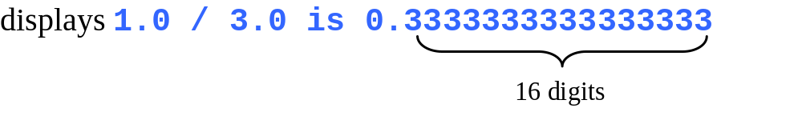
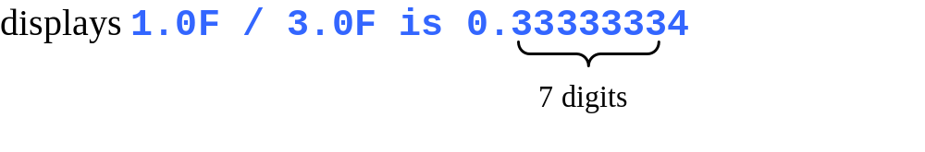
double vs. float
The double type values are more accurate than the float type values. For example,
System.out.println("1.0 / 3.0 is " + 1.0 / 3.0);
System.out.println("1.0F / 3.0F is " + 1.0F / 3.0F);

Slide 26
Scientific Notation
Floating-point literals can also be specified in scientific notation, for example, 1.23456e+2, same as 1.23456e2, is equivalent to 123.456, and 1.23456e-2 is equivalent to 0.0123456. E (or e) represents an exponent and it can be either in lowercase or uppercase.

Slide 27

Arithmetic Expressions
is translated to
(3+4*x)/5 – 10*(y-5)*(a+b+c)/x + 9*(4/x + (9+x)/y)

Slide 28

How to Evaluate an Expression
Though Java has its own way to evaluate an expression behind the scene, the result of a Java expression and its corresponding arithmetic expression are the same. Therefore, you can safely apply the arithmetic rule for evaluating a Java expression.
PEMDAS!

Slide 29

Problem: Converting Temperatures
Write a program that converts a Fahrenheit degree to Celsius using the formula:
Note: you have to write
celsius = (5.0 / 9) * (fahrenheit – 32)
FahrenheitToCelsius

Slide 30

Problem: Displaying Current Time
Write a program that displays current time in GMT in the format hour:minute:second such as 1:45:19.
The currentTimeMillis method in the System class returns the current time in milliseconds since the midnight, January 1, 1970 GMT. (1970 was the year when the Unix operating system was formally introduced.) You can use this method to obtain the current time, and then compute the current second, minute, and hour as follows.
ShowCurrentTime

Slide 31
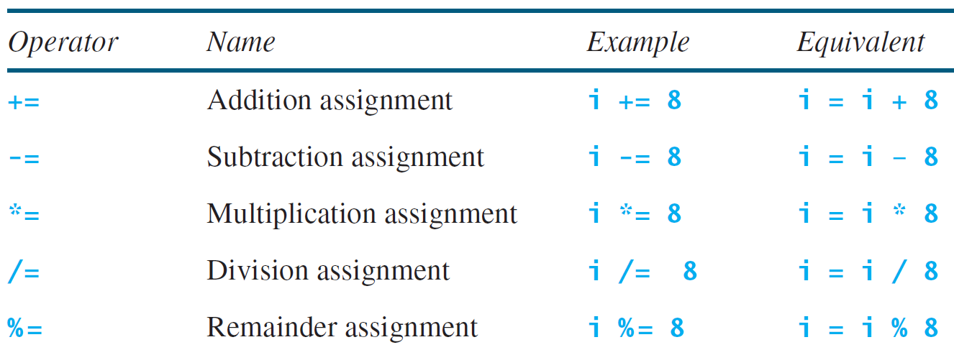
Augmented Assignment Operators

Slide 32
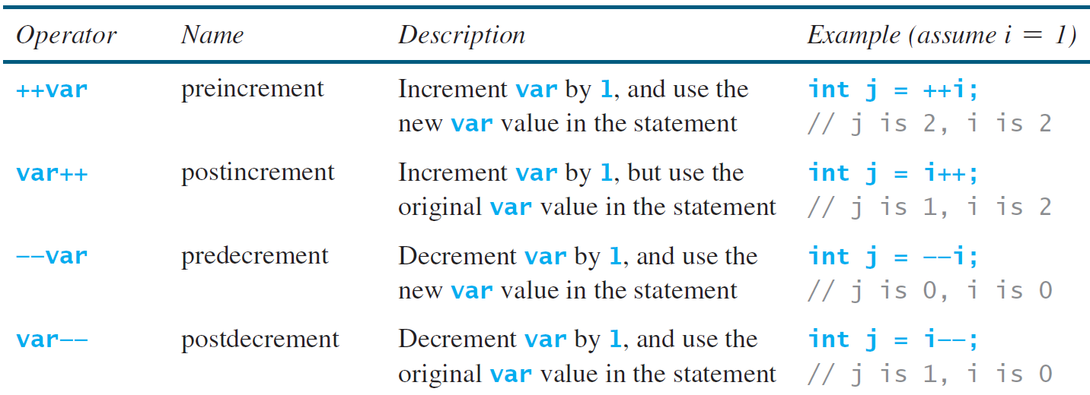
Increment and
Decrement Operators

Slide 33


Increment and
Decrement Operators, cont.

Slide 34
Increment and
Decrement Operators, cont.
Using increment and decrement operators makes expressions short, but it also makes them complex and difficult to read. Avoid using these operators in expressions that modify multiple variables, or the same variable for multiple times such as this: int k = ++i + i.

Slide 35
Assignment Expressions and Assignment Statements
Prior to Java 2, all the expressions can be used as statements. Since Java 2, only the following types of expressions can be statements:
variable op= expression; // Where op is +, -, *, /, or %
++variable;
variable++;
--variable;
variable--;

Slide 36
Numeric Type Conversion
Consider the following statements:
byte i = 100;
long k = i * 3 + 4;
double d = i * 3.1 + k / 2;

Slide 37
Conversion Rules
When performing a binary operation involving two operands of different types, Java automatically converts the operand based on the following rules:
1. If one of the operands is double, the other is converted into double.
2. Otherwise, if one of the operands is float, the other is converted into float.
3. Otherwise, if one of the operands is long, the other is converted into long.
4. Otherwise, both operands are converted into int.

Slide 38
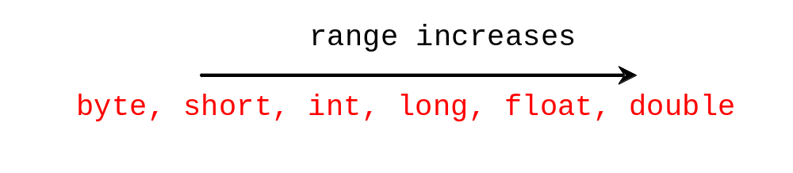
Type Casting
Implicit casting
double d = 3; (type widening)
Explicit casting
int i = (int)3.0; (type narrowing)
int i = (int)3.9; (Fraction part is truncated)
What is wrong? int x = 5 / 2.0;

Slide 39
Problem: Keeping Two Digits After Decimal Points
Write a program that displays the sales tax with two digits after the decimal point.
SalesTax

Slide 40

Problem:
Computing Loan Payments
This program lets the user enter the interest rate, number of years, and loan amount, and computes monthly payment and total payment.
ComputeLoan

Slide 41
Problem: Monetary Units
This program lets the user enter the amount in decimal representing dollars and cents and output a report listing the monetary equivalent in single dollars, quarters, dimes, nickels, and pennies. Your program should report maximum number of dollars, then the maximum number of quarters, and so on, in this order.
ComputeChange

Slide 42
Common Errors and Pitfalls
Common Error 1: Undeclared/Uninitialized Variables and Unused Variables
Common Error 2: Integer Overflow
Common Error 3: Round-off Errors
Common Error 4: Unintended Integer Division
Common Error 5: Redundant Input Objects
Common Pitfall 1: Redundant Input Objects

Slide 43
Common Error 1: Undeclared/Uninitialized Variables and Unused Variables
double interestRate = 0.05;
double interest = interestrate * 45;

Slide 44
Common Error 2: Integer Overflow
int value = 2147483647 + 1;
// value will actually be -2147483648

Slide 45
Common Error 3: Round-off Errors
System.out.println(1.0 - 0.1 - 0.1 - 0.1 - 0.1 - 0.1);
System.out.println(1.0 - 0.9);

Slide 46
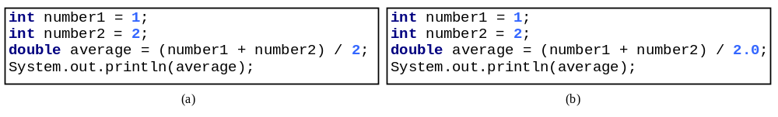
Common Error 4: Unintended Integer Division

Slide 47
Common Pitfall 1: Redundant Input Objects
Scanner input = new Scanner(System.in);
System.out.print("Enter an integer: ");
int v1 = input.nextInt();
Scanner input1 = new Scanner(System.in);
System.out.print("Enter a double value: ");
double v2 = input1.nextDouble();

Slide 48
Casting in an Augmented Expression
In Java, an augmented expression of the form x1 op= x2 is implemented as x1 = (T)(x1 op x2), where T is the type for x1. Therefore, the following code is correct.
int sum = 0;
sum += 4.5; // sum becomes 4 after this statement
sum += 4.5 is equivalent to sum = (int)(sum + 4.5).

Slide 49
Control Statements: Controlling the flow of execution
So you’ve seen how to assign values to variables
What we want to do is make different decisions depending on what the value of the variables are
Example:
  IF the temperature is less than 65 degrees F, THEN wear a jacket ELSE wear a tshirt

Slide 50
If statement control flow
temp = thermometer reading
Temp < 65 ?
Wear a tshirt
N
Y
Wear a jacket

Slide 51
The boolean Type and Operators
Often in a program you need to compare two values, such as whether i is greater than j. Java provides six comparison operators (also known as relational operators) that can be used to compare two values. The result of the comparison is a Boolean value: true or false.
boolean b = (1 > 2);

Slide 52
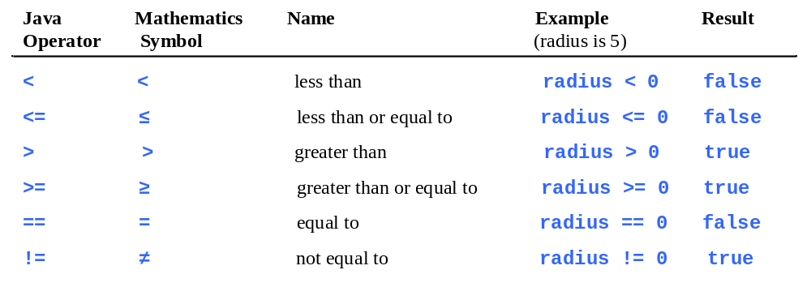
Relational Operators

Slide 53
Problem: A Simple Math Learning Tool
This example creates a program to let a first grader practice additions. The program randomly generates two single-digit integers number1 and number2 and displays a question such as “What is 7 + 9?” to the student. After the student types the answer, the program displays a message to indicate whether the answer is true or false.
AdditionQuiz

Slide 54
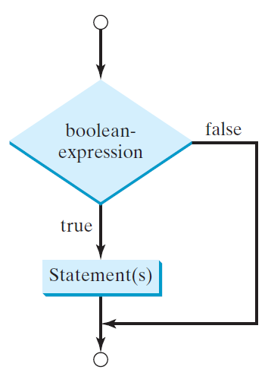
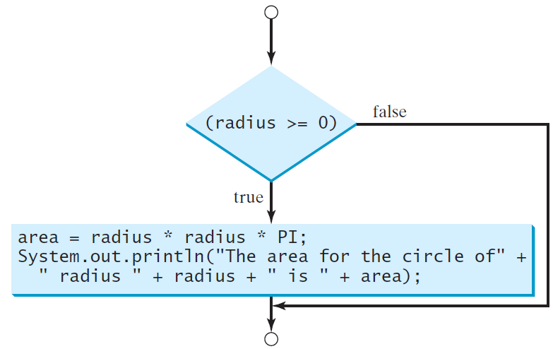
One-way if Statements
if (radius >= 0) {
area = radius * radius * PI;
System.out.println("The area"
+ " for the circle of radius "
+ radius + " is " + area);
}
if (boolean-expression) {
statement(s);
}

Slide 55


Note

Slide 56
Simple if Demo
Write a program that prompts the user to enter an integer. If the number is a multiple of 5, print HiFive. If the number is divisible by 2, print HiEven.
SimpleIfDemo

Slide 57
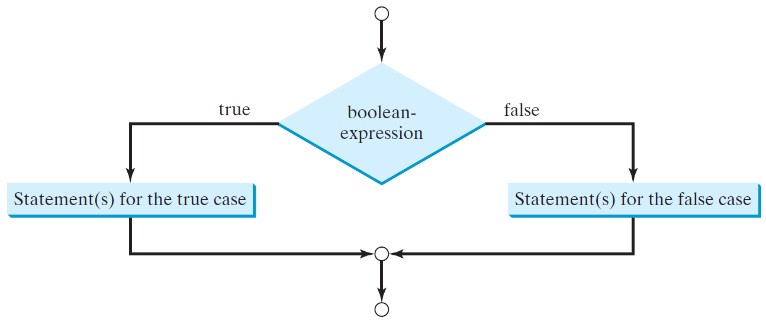
The Two-way if Statement
if (boolean-expression) {
statement(s)-for-the-true-case;
}
else {
statement(s)-for-the-false-case;
}

Slide 58
if-else Example
if (radius >= 0) {
area = radius * radius * 3.14159;
System.out.println("The area for the “
+ “circle of radius " + radius +
" is " + area);
}
else {
System.out.println("Negative input");
}

Slide 59
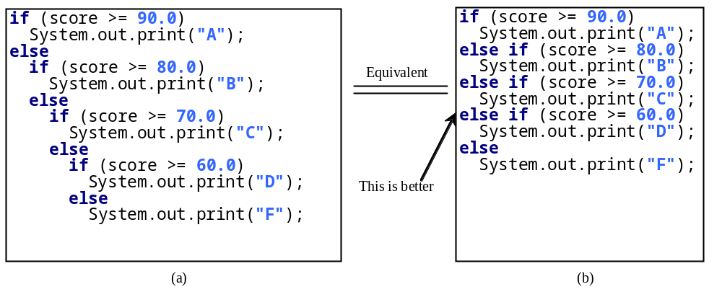
Multiple Alternative if Statements

Slide 60
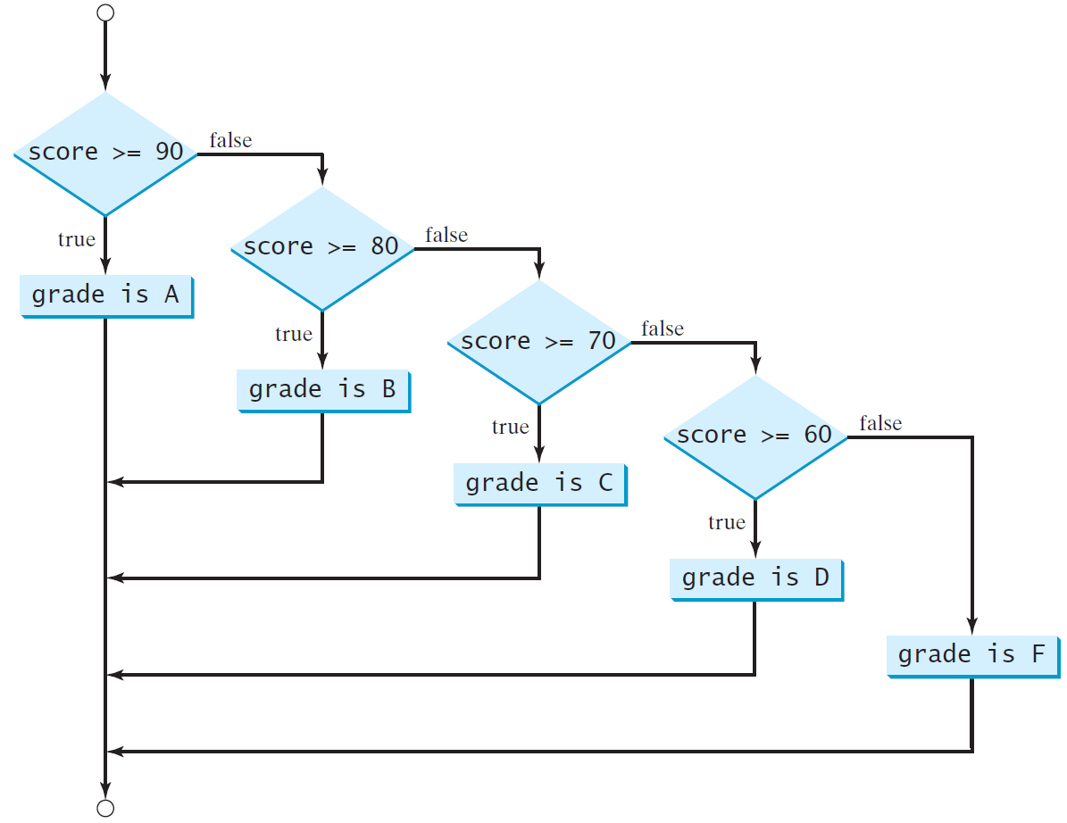
Multi-Way if-else Statements

Slide 61
Trace if-else statement
animation
Suppose score is 70.0
The condition is false
if (score >= 90.0)
System.out.print("A");
else if (score >= 80.0)
System.out.print("B");
else if (score >= 70.0)
System.out.print("C");
else if (score >= 60.0)
System.out.print("D");
else
System.out.print("F");

Slide 62
Trace if-else statement
animation
Suppose score is 70.0
The condition is false
if (score >= 90.0)
System.out.print("A");
else if (score >= 80.0)
System.out.print("B");
else if (score >= 70.0)
System.out.print("C");
else if (score >= 60.0)
System.out.print("D");
else
System.out.print("F");

Slide 63
Trace if-else statement
animation
Suppose score is 70.0
The condition is true
if (score >= 90.0)
System.out.print("A");
else if (score >= 80.0)
System.out.print("B");
else if (score >= 70.0)
System.out.print("C");
else if (score >= 60.0)
System.out.print("D");
else
System.out.print("F");

Slide 64
Trace if-else statement
animation
Suppose score is 70.0
grade is C
if (score >= 90.0)
System.out.print("A");
else if (score >= 80.0)
System.out.print("B");
else if (score >= 70.0)
System.out.print("C");
else if (score >= 60.0)
System.out.print("D");
else
System.out.print("F");

Slide 65
Trace if-else statement
animation
Suppose score is 70.0
Exit the if statement
if (score >= 90.0)
System.out.print("A");
else if (score >= 80.0)
System.out.print("B");
else if (score >= 70.0)
System.out.print("C");
else if (score >= 60.0)
System.out.print("D");
else
System.out.print("F");

Slide 66
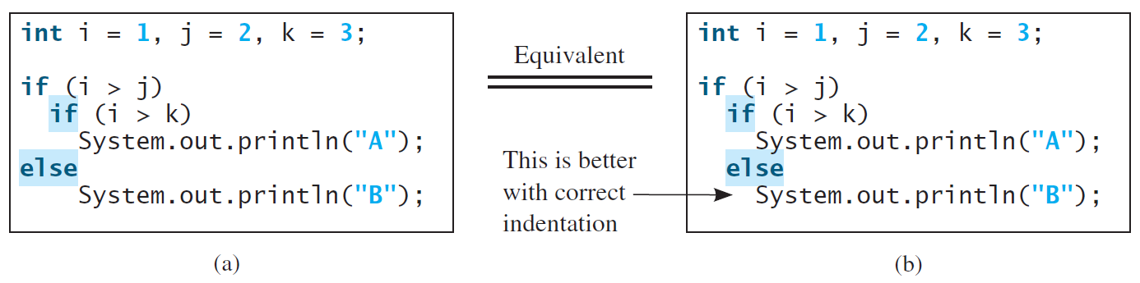
Note
The else clause matches the most recent if clause in the same block.

Slide 67
Note, cont.
Nothing is printed from the preceding statement. To force the else clause to match the first if clause, you must add a pair of braces:
int i = 1;
int j = 2;
int k = 3;
if (i > j) {
if (i > k)
System.out.println("A");
}
else
System.out.println("B");
This statement prints B.

Slide 68
Common Errors
Adding a semicolon at the end of an if clause is a common mistake.
if (radius >= 0);
{
area = radius*radius*PI;
System.out.println(
"The area for the circle of radius " +
radius + " is " + area);
}
This mistake is hard to find, because it is not a compilation error or a runtime error, it is a logic error.
This error often occurs when you use the next-line block style.
Wrong

Slide 69

TIP

Slide 70

CAUTION

Slide 71
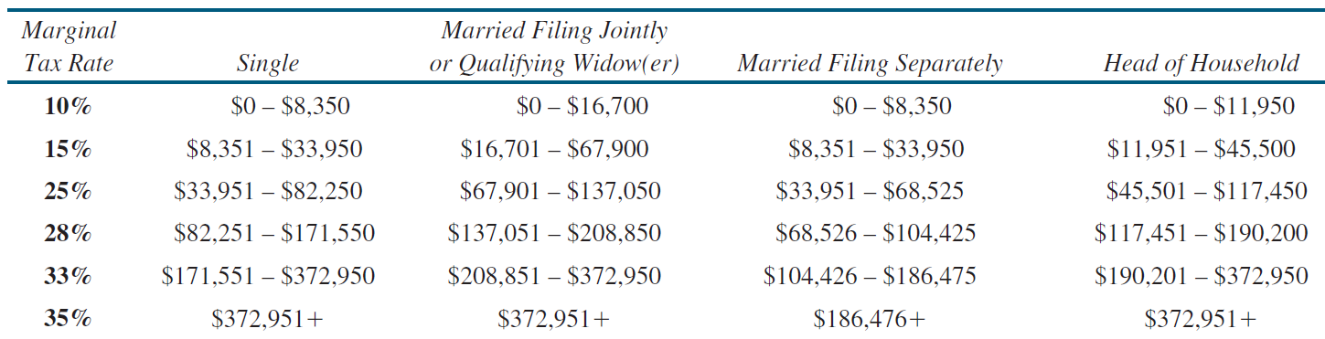
Problem: Computing Taxes
The US federal personal income tax is calculated based on the filing status and taxable income. There are four filing statuses: single filers, married filing jointly, married filing separately, and head of household. The tax rates for 2009 are shown below.

Slide 72
Problem: Computing Taxes, cont.
if (status == 0) {
// Compute tax for single filers
}
else if (status == 1) {
// Compute tax for married file jointly
// or qualifying widow(er)
}
else if (status == 2) {
// Compute tax for married file separately
}
else if (status == 3) {
// Compute tax for head of household
}
else {
// Display wrong status
}
ComputeTax

Slide 73
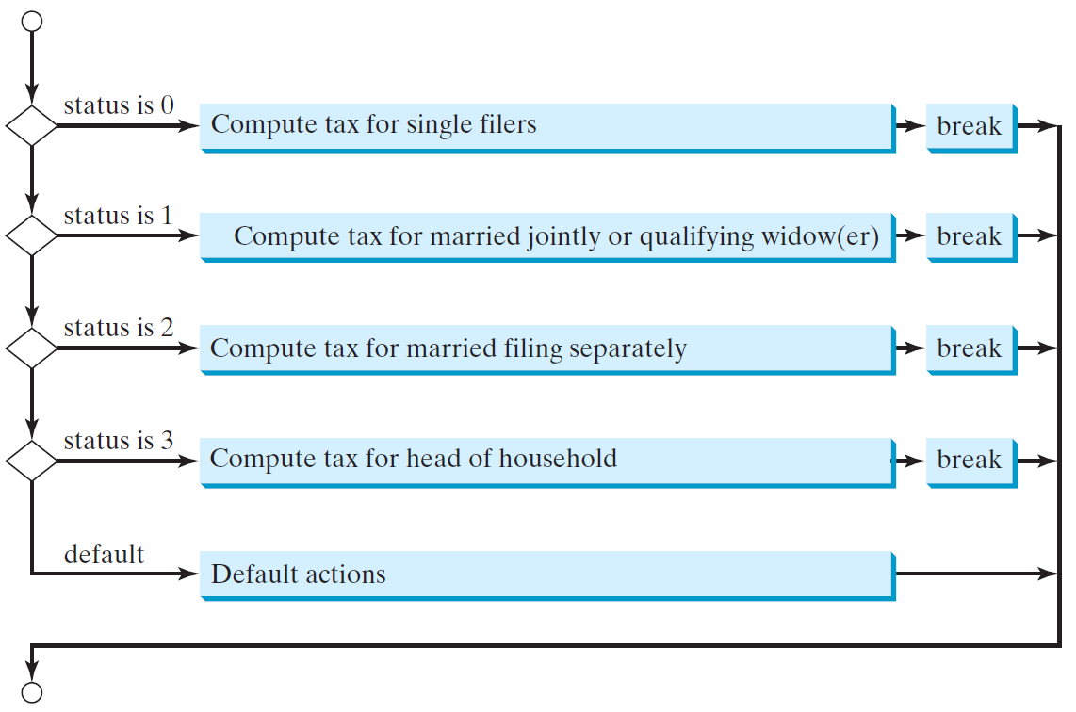
switch Statement Flow Chart

Slide 74
switch Statement Rules
The switch-expression must yield a value of char, byte, short, or int type and must always be enclosed in parentheses.
switch (switch-expression) {
case value1: statement(s)1;
break;
case value2: statement(s)2;
break;
…
case valueN: statement(s)N;
break;
default: statement(s)-for-default;
}
The value1, ..., and valueN must have the same data type as the value of the switch-expression. The resulting statements in the case statement are executed when the value in the case statement matches the value of the switch-expression. Note that value1, ..., and valueN are constant expressions, meaning that they cannot contain variables in the expression, such as 1 + x.

Slide 75
switch Statement Rules
The keyword break is optional, but it should be used at the end of each case in order to terminate the remainder of the switch statement. If the break statement is not present, the next case statement will be executed.
switch (switch-expression) {
case value1: statement(s)1;
break;
case value2: statement(s)2;
break;
…
case valueN: statement(s)N;
break;
default: statement(s)-for-default;
}
The default case, which is optional, can be used to perform actions when none of the specified cases matches the switch-expression.
When the value in a case statement matches the value of the switch-expression, the statements starting from this case are executed until either a break statement or the end of the switch statement is reached.

Slide 76
Trace switch statement
animation
Suppose day is 2:
switch (day) {
case 1:
case 2:
case 3:
case 4:
case 5: System.out.println("Weekday"); break;
case 0:
case 6: System.out.println("Weekend");
}

Slide 77
Trace switch statement
animation
Match case 2
switch (day) {
case 1:
case 2:
case 3:
case 4:
case 5: System.out.println("Weekday"); break;
case 0:
case 6: System.out.println("Weekend");
}

Slide 78
Trace switch statement
animation
Fall through case 3
switch (day) {
case 1:
case 2:
case 3:
case 4:
case 5: System.out.println("Weekday"); break;
case 0:
case 6: System.out.println("Weekend");
}

Slide 79
Trace switch statement
animation
Fall through case 4
switch (day) {
case 1:
case 2:
case 3:
case 4:
case 5: System.out.println("Weekday"); break;
case 0:
case 6: System.out.println("Weekend");
}

Slide 80
Trace switch statement
animation
Fall through case 5
switch (day) {
case 1:
case 2:
case 3:
case 4:
case 5: System.out.println("Weekday"); break;
case 0:
case 6: System.out.println("Weekend");
}

Slide 81
Trace switch statement
animation
Encounter break
switch (day) {
case 1:
case 2:
case 3:
case 4:
case 5: System.out.println("Weekday"); break;
case 0:
case 6: System.out.println("Weekend");
}

Slide 82
Trace switch statement
animation
Exit the statement
switch (day) {
case 1:
case 2:
case 3:
case 4:
case 5: System.out.println("Weekday"); break;
case 0:
case 6: System.out.println("Weekend");
}

Slide 83
Logical Operators
Operator | Name | Description
! | not | logical negation
&& | and | logical conjunction
|| | or | logical disjunction
^ | exclusive or | logical exclusion

Slide 84
Truth Table for Operator !
p | !p | Example (assume age = 24, weight = 140)
true | false | !(age > 18) is false, because (age > 18) is true.
false | true | !(weight == 150) is true, because (weight == 150) is false.

Slide 85
Truth Table for Operator &&
p₁ | p₂ | p₁ && p₂ | Example (assume age = 24, weight = 140)
false | false | false | (age <= 18) && (weight < 140) is false, because both conditions are both false.
false | true | false
true | false | false | (age > 18) && (weight > 140) is false, because (weight > 140) is false.
true | true | true | (age > 18) && (weight >= 140) is true, because both (age > 18) and (weight >= 140) are true.

Slide 86
Truth Table for Operator ||
p₁ | p₂ | p₁ || p₂ | Example (assume age = 24, weihgt = 140)
false | false | false
false | true | true | (age > 34) || (weight <= 140) is true, because (age > 34) is false, but (weight <= 140) is true.
true | false | true | (age > 14) || (weight >= 150) is false, because (age > 14) is true.
true | true | true

Slide 87
Truth Table for Operator ^
p₁ | p₂ | p₁ ^ p₂ | Example (assume age = 24, weight = 140)
false | false | false | (age > 34) ^ (weight > 140) is true, because (age > 34) is false and (weight > 140) is false.
false | true | true | (age > 34) ^ (weight >= 140) is true, because (age > 34) is false but (weight >= 140) is true.
true | false | true | (age > 14) ^ (weight > 140) is true, because (age > 14) is true and (weight > 140) is false.
true | true | false

Slide 88
Examples
Here is a program that checks whether a number is divisible by 2 and 3, whether a number is divisible by 2 or 3, and whether a number is divisible by 2 or 3 but not both:
TestBooleanOperators

Slide 89
Examples
System.out.println("Is " + number + " divisible by 2 and 3? " +
((number % 2 == 0) && (number % 3 == 0)));
System.out.println("Is " + number + " divisible by 2 or 3? " +
((number % 2 == 0) || (number % 3 == 0)));
System.out.println("Is " + number +
" divisible by 2 or 3, but not both? " +
((number % 2 == 0) ^ (number % 3 == 0)));
TestBooleanOperators

Slide 90
Control Statements: Loops
Suppose that you need to print a string (e.g., "Welcome to Java!") a hundred times. It would be tedious to have to write the following statement a hundred times:
System.out.println("Welcome to Java!");
So, how do you solve this problem?

Slide 91
Loops: The Problem
Problem:
System.out.println("Welcome to Java!");
System.out.println("Welcome to Java!");
System.out.println("Welcome to Java!");
System.out.println("Welcome to Java!");
System.out.println("Welcome to Java!");
System.out.println("Welcome to Java!");
…
…
…
System.out.println("Welcome to Java!");
System.out.println("Welcome to Java!");
System.out.println("Welcome to Java!");
100 times

Slide 92
Introducing while Loops
int count = 0;
while (count < 100) {
System.out.println("Welcome to Java");
count++;
}

Slide 93
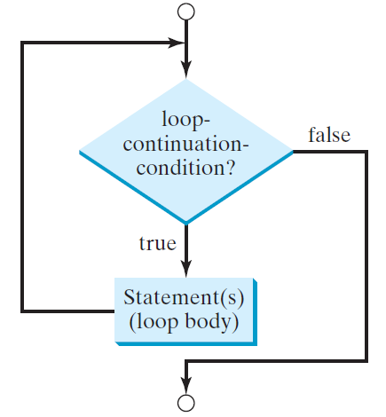
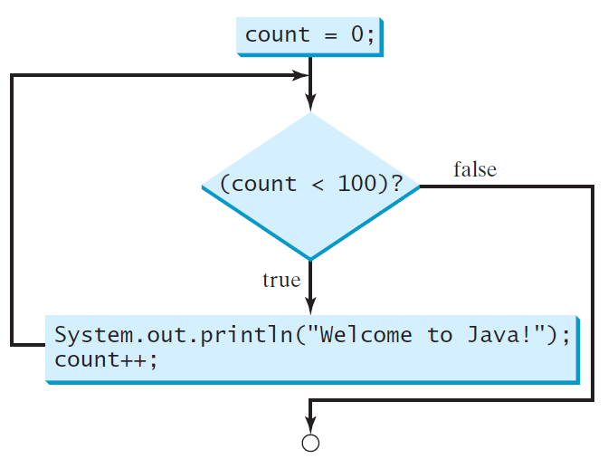
while Loop Flow Chart
int count = 0;
while (count < 100) {
System.out.println("Welcome to Java!");
count++;
}
while (loop-continuation-condition) {
// loop-body;
Statement(s);
}

Slide 94
Trace while Loop
animation
Initialize count
int count = 0;
while (count < 2) {
System.out.println("Welcome to Java!");
count++;
}

Slide 95
Trace while Loop, cont.
animation
(count < 2) is true
int count = 0;
while (count < 2) {
System.out.println("Welcome to Java!");
count++;
}

Slide 96
Trace while Loop, cont.
animation
Print Welcome to Java
int count = 0;
while (count < 2) {
System.out.println("Welcome to Java!");
count++;
}

Slide 97
Trace while Loop, cont.
animation
Increase count by 1
count is 1 now
int count = 0;
while (count < 2) {
System.out.println("Welcome to Java!");
count++;
}

Slide 98
Trace while Loop, cont.
animation
(count < 2) is still true since count is 1
int count = 0;
while (count < 2) {
System.out.println("Welcome to Java!");
count++;
}

Slide 99
Trace while Loop, cont.
animation
Print Welcome to Java
int count = 0;
while (count < 2) {
System.out.println("Welcome to Java!");
count++;
}

Slide 100
Trace while Loop, cont.
animation
Increase count by 1
count is 2 now
int count = 0;
while (count < 2) {
System.out.println("Welcome to Java!");
count++;
}

Slide 101
Trace while Loop, cont.
animation
(count < 2) is false since count is 2 now
int count = 0;
while (count < 2) {
System.out.println("Welcome to Java!");
count++;
}

Slide 102
Trace while Loop
animation
The loop exits. Execute the next statement after the loop.
int count = 0;
while (count < 2) {
System.out.println("Welcome to Java!");
count++;
}

Slide 103
Ending a Loop with a Sentinel Value
Often the number of times a loop is executed is not predetermined. You may use an input value to signify the end of the loop. Such a value is known as a sentinel value.
Write a program that reads and calculates the sum of an unspecified number of integers. The input 0 signifies the end of the input.
SentinelValue

Slide 104
Caution
Don’t use floating-point values for equality checking in a loop control. Since floating-point values are approximations for some values, using them could result in imprecise counter values and inaccurate results. Consider the following code for computing 1 + 0.9 + 0.8 + ... + 0.1:
double item = 1; double sum = 0;
while (item != 0) { // No guarantee item will be 0
sum += item;
item -= 0.1;
}
System.out.println(sum);

Slide 105
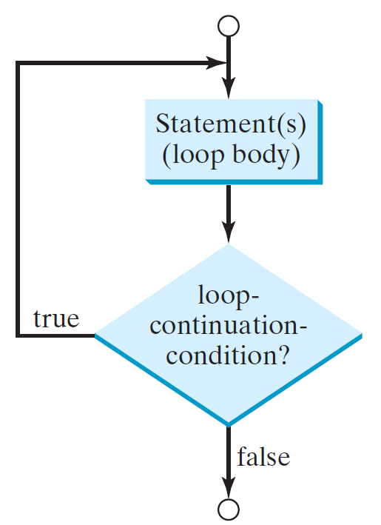
do-while Loop
do {
// Loop body;
Statement(s);
} while (loop-continuation-condition);

Slide 106
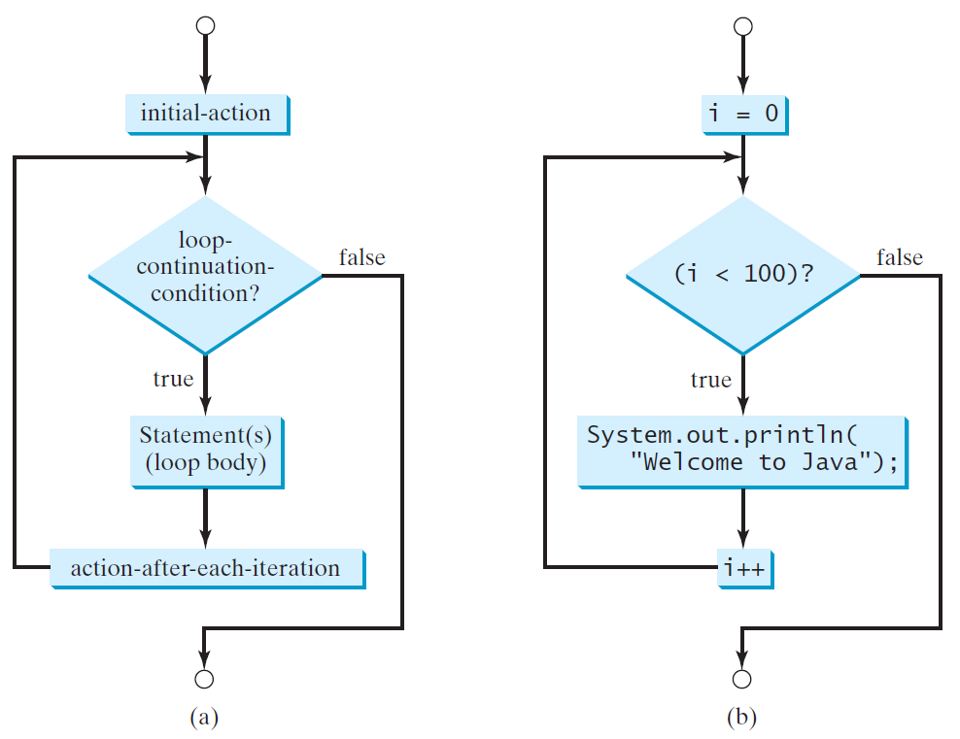
for Loops
for (initial-action; loop-continuation-condition; action-after-each-iteration) {
// loop body;
Statement(s);
}
int i;
for (i = 0; i < 100; i++) {
System.out.println(
"Welcome to Java!");
}

Slide 107
Trace for Loop
animation
Declare i
int i;
for (i = 0; i < 2; i++) {
System.out.println(
"Welcome to Java!");
}

Slide 108
Trace for Loop, cont.
animation
Execute initializer
i is now 0
int i;
for (i = 0; i < 2; i++) {
System.out.println(
"Welcome to Java!");
}

Slide 109
Trace for Loop, cont.
animation
(i < 2) is true
since i is 0
int i;
for (i = 0; i < 2; i++) {
System.out.println( "Welcome to Java!");
}

Slide 110
Trace for Loop, cont.
animation
Print Welcome to Java
int i;
for (i = 0; i < 2; i++) {
System.out.println("Welcome to Java!");
}

Slide 111
Trace for Loop, cont.
animation
Execute adjustment statement
i now is 1
int i;
for (i = 0; i < 2; i++) {
System.out.println("Welcome to Java!");
}

Slide 112
Trace for Loop, cont.
animation
(i < 2) is still true
since i is 1
int i;
for (i = 0; i < 2; i++) {
System.out.println("Welcome to Java!");
}

Slide 113
Trace for Loop, cont.
animation
Print Welcome to Java
int i;
for (i = 0; i < 2; i++) {
System.out.println("Welcome to Java!");
}

Slide 114
Trace for Loop, cont.
animation
Execute adjustment statement
i now is 2
int i;
for (i = 0; i < 2; i++) {
System.out.println("Welcome to Java!");
}

Slide 115
Trace for Loop, cont.
animation
(i < 2) is false
since i is 2
int i;
for (i = 0; i < 2; i++) {
System.out.println("Welcome to Java!");
}

Slide 116
Trace for Loop, cont.
animation
Exit the loop. Execute the next statement after the loop
int i;
for (i = 0; i < 2; i++) {
System.out.println("Welcome to Java!");
}

Slide 117
Note
The initial-action in a for loop can be a list of zero or more comma-separated expressions. The action-after-each-iteration in a for loop can be a list of zero or more comma-separated statements. Therefore, the following two for loops are correct. They are rarely used in practice, however.
  for (int i = 1; i < 100; System.out.println(i++));
  for (int i = 0, j = 0; (i + j < 10); i++, j++) {
  // Do something
  }

Slide 118

Note
If the loop-continuation-condition in a for loop is omitted, it is implicitly true. Thus the statement given below in (a), which is an infinite loop, is correct. Nevertheless, it is better to use the equivalent loop in (b) to avoid confusion:

Slide 119
Caution
Adding a semicolon at the end of the for clause before the loop body is a common mistake, as shown below:
Logic Error
for (int i=0; i<10; i++);
{
System.out.println("i is " + i);
}

Slide 120
Caution, cont.
Similarly, the following loop is also wrong:
int i=0;
while (i < 10);
{
System.out.println("i is " + i);
i++;
}
In the case of the do loop, the following semicolon is needed to end the loop.
int i=0;
do {
System.out.println("i is " + i);
i++;
} while (i<10);
Logic Error
Correct

Slide 121


Which Loop to Use?
The three forms of loop statements, while, do-while, and for, are expressively equivalent; that is, you can write a loop in any of these three forms. For example, a while loop in (a) in the following figure can always be converted into the following for loop in (b):
A for loop in (a) in the following figure can generally be converted into the following while loop in (b) except in certain special cases (see Review Question 3.19 for one of them):

Slide 122
Recommendations
Use the one that is most intuitive and comfortable for you. In general, a for loop may be used if the number of repetitions is known, as, for example, when you need to print a message 100 times. A while loop may be used if the number of repetitions is not known, as in the case of reading the numbers until the input is 0. A do-while loop can be used to replace a while loop if the loop body has to be executed before testing the continuation condition.

Slide 123
Nested Loops
Problem: Write a program that uses nested for loops to print a multiplication table.
MultiplicationTable

Slide 124
Minimizing Numerical Errors
Numeric errors involving floating-point numbers are inevitable. This section discusses how to minimize such errors through an example.
Here is an example that sums a series that starts with 0.01 and ends with 1.0. The numbers in the series will increment by 0.01, as follows: 0.01 + 0.02 + 0.03 and so on.
TestSum

Slide 125
Problem:
Finding the Greatest Common Divisor
Problem: Write a program that prompts the user to enter two positive integers and finds their greatest common divisor.
Solution: Suppose you enter two integers 4 and 2, their greatest common divisor is 2. Suppose you enter two integers 16 and 24, their greatest common divisor is 8. So, how do you find the greatest common divisor? Let the two input integers be n1 and n2. You know number 1 is a common divisor, but it may not be the greatest commons divisor. So you can check whether k (for k = 2, 3, 4, and so on) is a common divisor for n1 and n2, until k is greater than n1 or n2.
GreatestCommonDivisor

Slide 126
Problem: Predicting the Future Tuition
Problem: Suppose that the tuition for a university is $10,000 this year and tuition increases 7% every year. In how many years will the tuition be doubled?
FutureTuition

Slide 127
Problem: Predicating the Future Tuition
double tuition = 10000; int year = 0 // Year 0
tuition = tuition * 1.07; year++; // Year 1
tuition = tuition * 1.07; year++; // Year 2
tuition = tuition * 1.07; year++; // Year 3
...

Slide 128
Case Study: Converting Decimals to Hexadecimals
Hexadecimals are often used in computer systems programming (see Appendix F for an introduction to number systems). How do you convert a decimal number to a hexadecimal number? To convert a decimal number d to a hexadecimal number is to find the hexadecimal digits h_{n}, h_{n-1}, h_{n-2}, ... , h₂, h₁, and h₀ such that
These hexadecimal digits can be found by successively dividing d by 16 until the quotient is 0. The remainders are h₀, h₁, h₂, ... , h_{n-2}, h_{n-1}, and h_{n}.
Dec2Hex

Slide 129

Problem: Monte Carlo Simulation
Companion Website
The Monte Carlo simulation refers to a technique that uses random numbers and probability to solve problems. This method has a wide range of applications in computational mathematics, physics, chemistry, and finance. This section gives an example of using the Monto Carlo simulation for estimating π.
circleArea / squareArea = π / 4.
π can be approximated as 4 * numberOfHits / numberOfTrials
MonteCarloSimulation

Slide 130
Using break and continue
Examples for using the break and continue keywords:
TestBreak.java
TestBreak
TestContinue.java
TestContinue

Slide 131
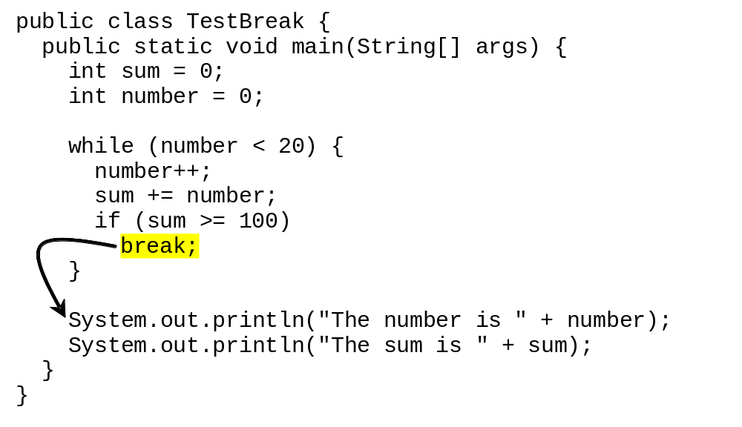
break

Slide 132
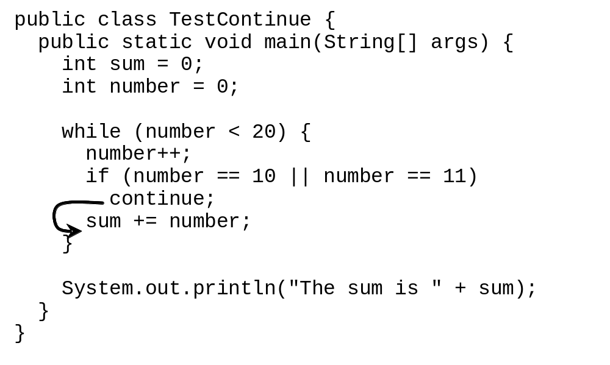
continue

Slide 133
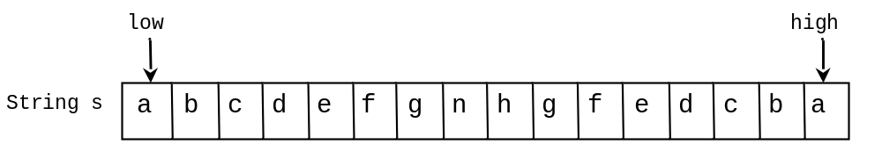
Problem: Checking Palindrome
A string is a palindrome if it reads the same forward and backward. The words “mom,” “dad,” and “noon,” for instance, are all palindromes.
The problem is to write a program that prompts the user to enter a string and reports whether the string is a palindrome. One solution is to check whether the first character in the string is the same as the last character. If so, check whether the second character is the same as the second-to-last character. This process continues until a mismatch is found or all the characters in the string are checked, except for the middle character if the string has an odd number of characters.
Palindrome

Slide 134
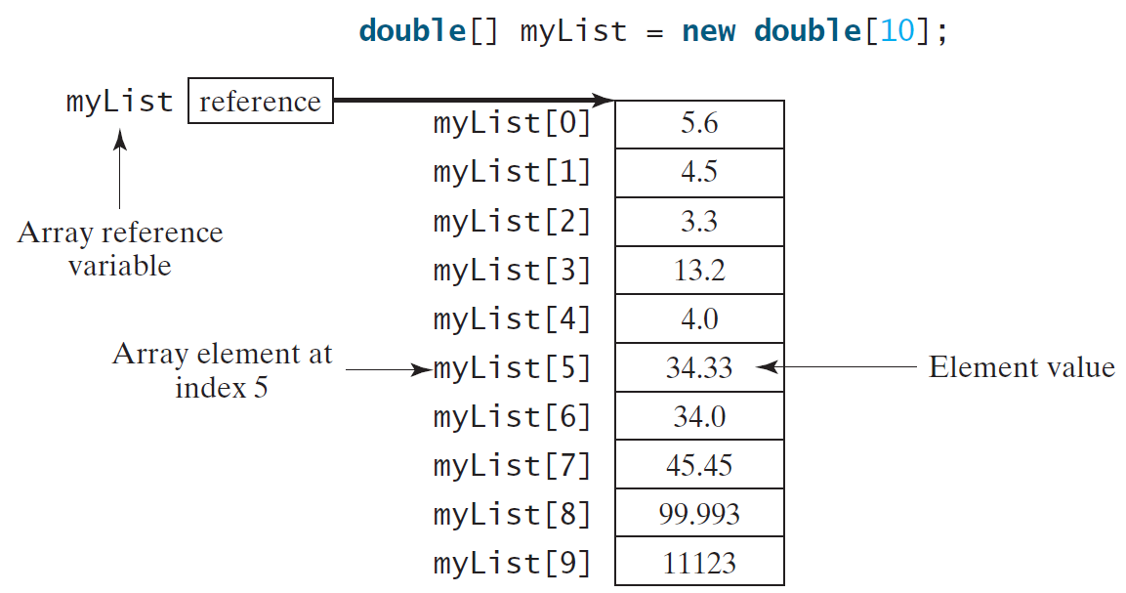
Introducing Arrays
Array is a data structure that represents a collection of the same types of data.

Slide 135
Declaring Array Variables
datatype[] arrayRefVar;
Example:
double[] myList;
datatype arrayRefVar[]; // This style is allowed, but not preferred
Example:
double myList[];

Slide 136
Creating Arrays
arrayRefVar = new datatype[arraySize];
Example:
myList = new double[10];
myList[0] references the first element in the array.
myList[9] references the last element in the array.

Slide 137
Declaring and Creating in One Step
datatype[] arrayRefVar = new
datatype[arraySize];
double[] myList = new double[10];
datatype arrayRefVar[] = new
datatype[arraySize];
double myList[] = new double[10];

Slide 138
The Length of an Array
Once an array is created, its size is fixed. It cannot be changed. You can find its size using
    arrayRefVar.length
For example,
    myList.length returns 10

Slide 139
Default Values
When an array is created, its elements are assigned the default value of
  0 for the numeric primitive data types,
  '\u0000' for char types, and
  false for boolean types.

Slide 140
Indexed Variables
The array elements are accessed through the index. The array indices are 0-based, i.e., it starts from 0 to arrayRefVar.length-1. In the example in Figure 6.1, myList holds ten double values and the indices are from 0 to 9.
Each element in the array is represented using the following syntax, known as an indexed variable:
  arrayRefVar[index];

Slide 141
Using Indexed Variables
After an array is created, an indexed variable can be used in the same way as a regular variable. For example, the following code adds the value in myList[0] and myList[1] to myList[2].
  myList[2] = myList[0] + myList[1];

Slide 142
Array Initializers
Declaring, creating, initializing in one step:
double[] myList = {1.9, 2.9, 3.4, 3.5};
This shorthand syntax must be in one statement.

Slide 143
Declaring, creating, initializing Using the Shorthand Notation
double[] myList = {1.9, 2.9, 3.4, 3.5};
This shorthand notation is equivalent to the following statements:
double[] myList = new double[4];
myList[0] = 1.9;
myList[1] = 2.9;
myList[2] = 3.4;
myList[3] = 3.5;

Slide 144
CAUTION
Using the shorthand notation, you have to declare, create, and initialize the array all in one statement. Splitting it would cause a syntax error. For example, the following is wrong:
  double[] myList;
  myList = {1.9, 2.9, 3.4, 3.5};

Slide 145
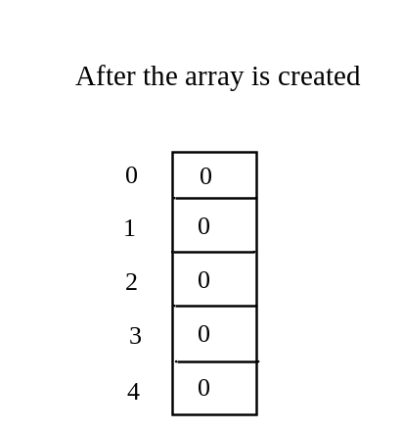
Trace Program with Arrays
animation
Declare array variable values, create an array, and assign its reference to values
public class Test {
public static void main(String[] args) {
int[] values = new int[5];
for (int i = 1; i < 5; i++) {
values[i] = i + values[i-1];
}
values[0] = values[1] + values[4];
}
}

Slide 146
Trace Program with Arrays
animation
i becomes 1
public class Test {
public static void main(String[] args) {
int[] values = new int[5];
for (int i = 1; i < 5; i++) {
values[i] = i + values[i-1];
}
values[0] = values[1] + values[4];
}
}

Slide 147
Trace Program with Arrays
animation
i (=1) is less than 5
public class Test {
public static void main(String[] args) {
int[] values = new int[5];
for (int i = 1; i < 5; i++) {
values[i] = i + values[i-1];
}
values[0] = values[1] + values[4];
}
}

Slide 148
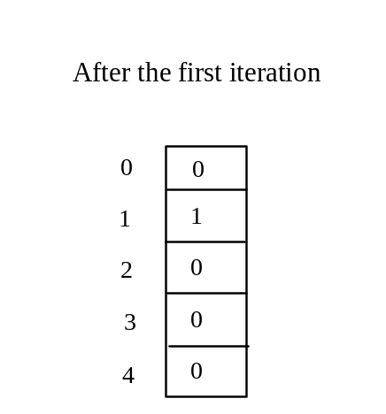
Trace Program with Arrays
animation
After this line is executed, value[1] is 1
public class Test {
public static void main(String[] args) {
int[] values = new int[5];
for (int i = 1; i < 5; i++) {
values[i] = i + values[i-1];
}
values[0] = values[1] + values[4];
}
}

Slide 149
Trace Program with Arrays
animation
After i++, i becomes 2
public class Test {
public static void main(String[] args) {
int[] values = new int[5];
for (int i = 1; i < 5; i++) {
values[i] = i + values[i-1];
}
values[0] = values[1] + values[4];
}
}

Slide 150
Trace Program with Arrays
animation
i (= 2) is less than 5
public class Test {
public static void main(String[] args) {
int[] values = new int[5];
for (int i = 1; i < 5; i++) {
values[i] = i + values[i-1];
}
values[0] = values[1] + values[4];
}
}

Slide 151
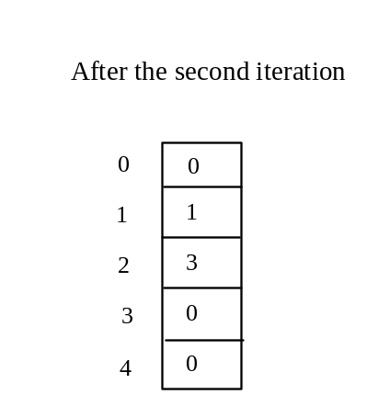
Trace Program with Arrays
animation
After this line is executed,
values[2] is 3 (2 + 1)
public class Test {
public static void main(String[] args) {
int[] values = new int[5];
for (int i = 1; i < 5; i++) {
values[i] = i + values[i-1];
}
values[0] = values[1] + values[4];
}
}

Slide 152
Trace Program with Arrays
animation
After this, i becomes 3.
public class Test {
public static void main(String[] args) {
int[] values = new int[5];
for (int i = 1; i < 5; i++) {
values[i] = i + values[i-1];
}
values[0] = values[1] + values[4];
}
}

Slide 153
Trace Program with Arrays
animation
i (=3) is still less than 5.
public class Test {
public static void main(String[] args) {
int[] values = new int[5];
for (int i = 1; i < 5; i++) {
values[i] = i + values[i-1];
}
values[0] = values[1] + values[4];
}
}

Slide 154
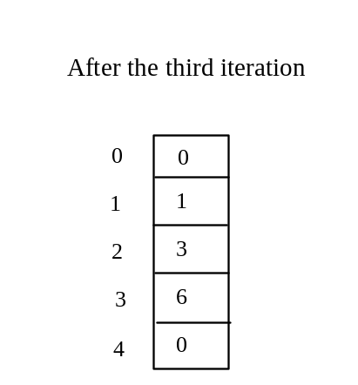
Trace Program with Arrays
animation
After this line, values[3] becomes 6 (3 + 3)
public class Test {
public static void main(String[] args) {
int[] values = new int[5];
for (int i = 1; i < 5; i++) {
values[i] = i + values[i-1];
}
values[0] = values[1] + values[4];
}
}

Slide 155

Trace Program with Arrays
animation
After this, i becomes 4
public class Test {
public static void main(String[] args) {
int[] values = new int[5];
for (int i = 1; i < 5; i++) {
values[i] = i + values[i-1];
}
values[0] = values[1] + values[4];
}
}

Slide 156
Trace Program with Arrays
animation
i (=4) is still less than 5
public class Test {
public static void main(String[] args) {
int[] values = new int[5];
for (int i = 1; i < 5; i++) {
values[i] = i + values[i-1];
}
values[0] = values[1] + values[4];
}
}

Slide 157
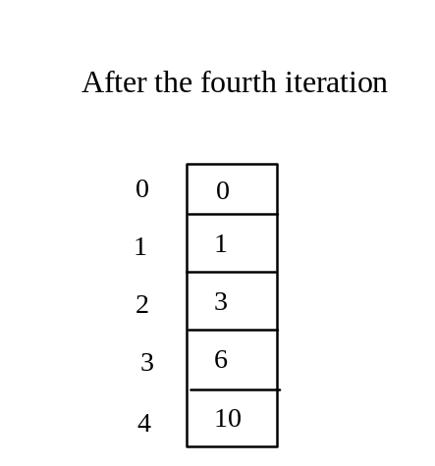
Trace Program with Arrays
animation
After this, values[4] becomes 10 (4 + 6)
public class Test {
public static void main(String[] args) {
int[] values = new int[5];
for (int i = 1; i < 5; i++) {
values[i] = i + values[i-1];
}
values[0] = values[1] + values[4];
}
}

Slide 158
Trace Program with Arrays
animation
After i++, i becomes 5
public class Test {
public static void main(String[] args) {
int[] values = new int[5];
for (int i = 1; i < 5; i++) {
values[i] = i + values[i-1];
}
values[0] = values[1] + values[4];
}
}

Slide 159
Trace Program with Arrays
animation
i ( =5) < 5 is false. Exit the loop
public class Test {
public static void main(String[] args) {
int[] values = new int[5];
for (int i = 1; i < 5; i++) {
values[i] = i + values[i-1];
}
values[0] = values[1] + values[4];
}
}

Slide 160
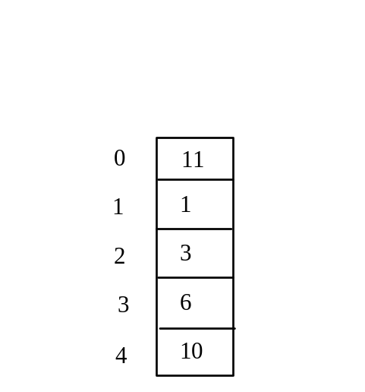
Trace Program with Arrays
animation
After this line, values[0] is 11 (1 + 10)
public class Test {
public static void main(String[] args) {
int[] values = new int[5];
for (int i = 1; i < 5; i++) {
values[i] = i + values[i-1];
}
values[0] = values[1] + values[4];
}
}

Slide 161
Processing Arrays
See the examples in the text.
(Initializing arrays with input values)
(Initializing arrays with random values)
(Printing arrays)
(Summing all elements)
(Finding the largest element)
(Finding the smallest index of the largest element)
(Random shuffling)
(Shifting elements)

Slide 162
Initializing arrays with input values
java.util.Scanner input = new java.util.Scanner(System.in);
System.out.print("Enter " + myList.length + " values: ");
for (int i = 0; i < myList.length; i++)
myList[i] = input.nextDouble();

Slide 163
Initializing arrays with random values
for (int i = 0; i < myList.length; i++) {
myList[i] = Math.random() * 100;
}

Slide 164
Printing arrays
for (int i = 0; i < myList.length; i++) {
System.out.print(myList[i] + " ");
}

Slide 165
Summing all elements
double total = 0;
for (int i = 0; i < myList.length; i++) {
total += myList[i];
}

Slide 166
Finding the largest element
double max = myList[0];
for (int i = 1; i < myList.length; i++) {
if (myList[i] > max) max = myList[i];
}

Slide 167
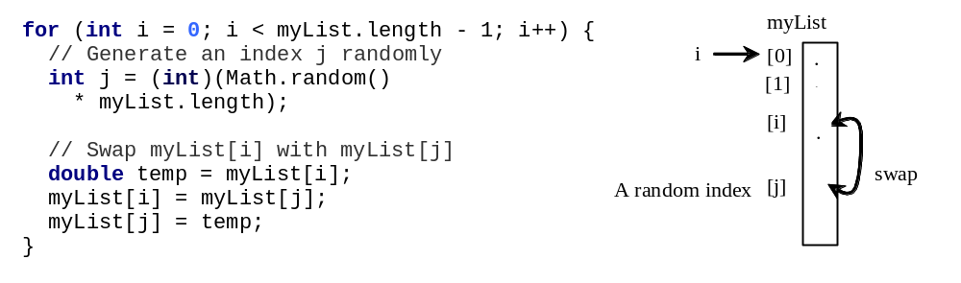
Random shuffling

Slide 168
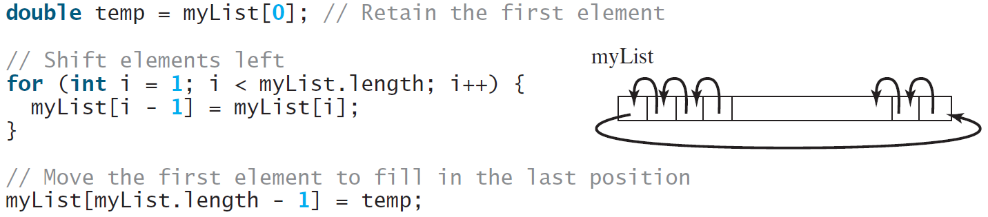
Shifting Elements

Slide 169
Enhanced for Loop (for-each loop)
JDK 1.5 introduced a new for loop that enables you to traverse the complete array sequentially without using an index variable. For example, the following code displays all elements in the array myList:
  for (double value: myList)
  System.out.println(value);
In general, the syntax is
  for (elementType value: arrayRefVar) {
  // Process the value
  }
You still have to use an index variable if you wish to traverse the array in a different order or change the elements in the array.

Slide 170
Analyze Numbers
Read one hundred numbers, compute their average, and find out how many numbers are above the average.
AnalyzeNumbers

Slide 171
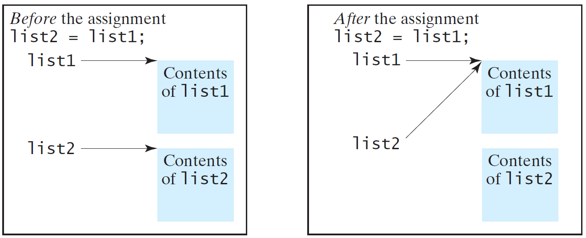
Copying Arrays
Often, in a program, you need to duplicate an array or a part of an array. In such cases you could attempt to use the assignment statement (=), as follows:
list2 = list1;

Slide 172
Copying Arrays
Using a loop:
int[] sourceArray = {2, 3, 1, 5, 10};
int[] targetArray = new int[sourceArray.length];
for (int i = 0; i < sourceArrays.length; i++)
targetArray[i] = sourceArray[i];

Slide 173
The arraycopy Utility
arraycopy(sourceArray, src_pos, targetArray, tar_pos, length);
Example:
System.arraycopy(sourceArray, 0, targetArray, 0, sourceArray.length);

Slide 174
Passing Arrays to Methods
public static void printArray(int[] array) {
for (int i = 0; i < array.length; i++) {
System.out.print(array[i] + " ");
}
}
Invoke the method
int[] list = {3, 1, 2, 6, 4, 2};
printArray(list);
Invoke the method
printArray(new int[]{3, 1, 2, 6, 4, 2});
Anonymous array

Slide 175
Anonymous Array
  The statement
    printArray(new int[]{3, 1, 2, 6, 4, 2});
  creates an array using the following syntax:
    new dataType[]{literal0, literal1, ..., literalk};
  There is no explicit reference variable for the array. Such array is called an anonymous array.

Slide 176
Pass By Value
Java uses pass by value to pass arguments to a method. There are important differences between passing a value of variables of primitive data types and passing arrays.
For a parameter of a primitive type value, the actual value is passed. Changing the value of the local parameter inside the method does not affect the value of the variable outside the method.
For a parameter of an array type, the value of the parameter contains a reference to an array; this reference is passed to the method. Any changes to the array that occur inside the method body will affect the original array that was passed as the argument.

Slide 177
Passing Arrays as Arguments
Objective: Demonstrate differences of passing primitive data type variables and array variables.
TestPassArray

Slide 178
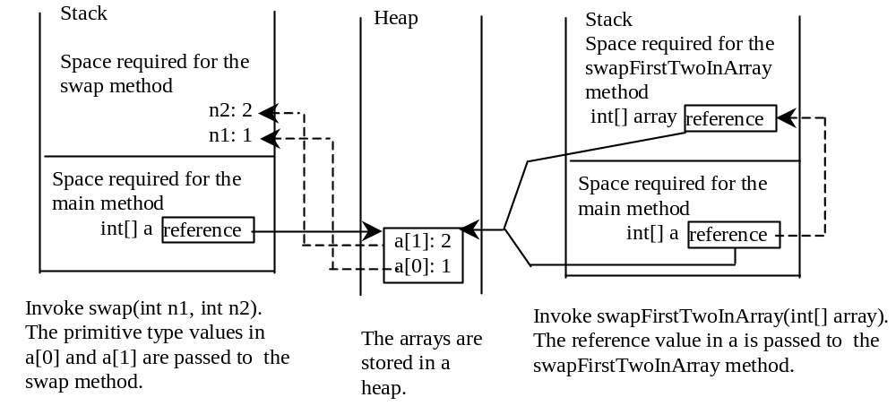
Example, cont.

Slide 179
Returning an Array from a Method
public static int[] reverse(int[] list) {
int[] result = new int[list.length];
for (int i = 0, j = result.length - 1;
i < list.length; i++, j--) {
result[j] = list[i];
}
return result;
}
list
result
int[] list1 = {1, 2, 3, 4, 5, 6};
int[] list2 = reverse(list1);

Slide 180
Trace the reverse Method
animation
int[] list1 = {1, 2, 3, 4, 5, 6};
int[] list2 = reverse(list1);
Declare result and create array
public static int[] reverse(int[] list) {
int[] result = new int[list.length];
for (int i = 0, j = result.length - 1;
i < list.length; i++, j--) {
result[j] = list[i];
}
return result;
}
list
1
2
3
4
5
6
result
0
0
0
0
0
0

Slide 181
Trace the reverse Method, cont.
animation
int[] list1 = {1, 2, 3, 4, 5, 6};
int[] list2 = reverse(list1);
i = 0 and j = 5
public static int[] reverse(int[] list) {
int[] result = new int[list.length];
for (int i = 0, j = result.length - 1;
i < list.length; i++, j--) {
result[j] = list[i];
}
return result;
}
list
1
2
3
4
5
6
result
0
0
0
0
0
0

Slide 182
Trace the reverse Method, cont.
animation
int[] list1 = {1, 2, 3, 4, 5, 6};
int[] list2 = reverse(list1);
i (= 0) is less than 6
public static int[] reverse(int[] list) {
int[] result = new int[list.length];
for (int i = 0, j = result.length - 1;
i < list.length; i++, j--) {
result[j] = list[i];
}
return result;
}
list
1
2
3
4
5
6
result
0
0
0
0
0
0

Slide 183
Trace the reverse Method, cont.
animation
int[] list1 = {1, 2, 3, 4, 5, 6};
int[] list2 = reverse(list1);
i = 0 and j = 5
Assign list[0] to result[5]
public static int[] reverse(int[] list) {
int[] result = new int[list.length];
for (int i = 0, j = result.length - 1;
i < list.length; i++, j--) {
result[j] = list[i];
}
return result;
}
list
1
2
3
4
5
6
result
0
0
0
0
0
1

Slide 184
Trace the reverse Method, cont.
animation
int[] list1 = {1, 2, 3, 4, 5, 6};
int[] list2 = reverse(list1);
After this, i becomes 1 and j becomes 4
public static int[] reverse(int[] list) {
int[] result = new int[list.length];
for (int i = 0, j = result.length - 1;
i < list.length; i++, j--) {
result[j] = list[i];
}
return result;
}
list
1
2
3
4
5
6
result
0
0
0
0
0
1

Slide 185
Trace the reverse Method, cont.
animation
int[] list1 = {1, 2, 3, 4, 5, 6};
int[] list2 = reverse(list1);
i (=1) is less than 6
public static int[] reverse(int[] list) {
int[] result = new int[list.length];
for (int i = 0, j = result.length - 1;
i < list.length; i++, j--) {
result[j] = list[i];
}
return result;
}
list
1
2
3
4
5
6
result
0
0
0
0
0
1

Slide 186
Trace the reverse Method, cont.
animation
int[] list1 = {1, 2, 3, 4, 5, 6};
int[] list2 = reverse(list1);
i = 1 and j = 4
Assign list[1] to result[4]
public static int[] reverse(int[] list) {
int[] result = new int[list.length];
for (int i = 0, j = result.length - 1;
i < list.length; i++, j--) {
result[j] = list[i];
}
return result;
}
list
1
2
3
4
5
6
result
0
0
0
0
2
1

Slide 187
Trace the reverse Method, cont.
animation
int[] list1 = {1, 2, 3, 4, 5, 6};
int[] list2 = reverse(list1);
After this, i becomes 2 and j becomes 3
public static int[] reverse(int[] list) {
int[] result = new int[list.length];
for (int i = 0, j = result.length - 1;
i < list.length; i++, j--) {
result[j] = list[i];
}
return result;
}
list
1
2
3
4
5
6
result
0
0
0
0
2
1

Slide 188
Trace the reverse Method, cont.
animation
int[] list1 = {1, 2, 3, 4, 5, 6};
int[] list2 = reverse(list1);
i (=2) is still less than 6
public static int[] reverse(int[] list) {
int[] result = new int[list.length];
for (int i = 0, j = result.length - 1;
i < list.length; i++, j--) {
result[j] = list[i];
}
return result;
}
list
1
2
3
4
5
6
result
0
0
0
0
2
1

Slide 189
Trace the reverse Method, cont.
animation
int[] list1 = {1, 2, 3, 4, 5, 6};
int[] list2 = reverse(list1);
i = 2 and j = 3
Assign list[i] to result[j]
public static int[] reverse(int[] list) {
int[] result = new int[list.length];
for (int i = 0, j = result.length - 1;
i < list.length; i++, j--) {
result[j] = list[i];
}
return result;
}
list
1
2
3
4
5
6
result
0
0
0
3
2
1

Slide 190
Trace the reverse Method, cont.
animation
int[] list1 = {1, 2, 3, 4, 5, 6};
int[] list2 = reverse(list1);
After this, i becomes 3 and j becomes 2
public static int[] reverse(int[] list) {
int[] result = new int[list.length];
for (int i = 0, j = result.length - 1;
i < list.length; i++, j--) {
result[j] = list[i];
}
return result;
}
list
1
2
3
4
5
6
result
0
0
0
3
2
1

Slide 191
Trace the reverse Method, cont.
animation
int[] list1 = {1, 2, 3, 4, 5, 6};
int[] list2 = reverse(list1);
i (=3) is still less than 6
public static int[] reverse(int[] list) {
int[] result = new int[list.length];
for (int i = 0, j = result.length - 1;
i < list.length; i++, j--) {
result[j] = list[i];
}
return result;
}
list
1
2
3
4
5
6
result
0
0
0
3
2
1

Slide 192
Trace the reverse Method, cont.
animation
int[] list1 = {1, 2, 3, 4, 5, 6};
int[] list2 = reverse(list1);
i = 3 and j = 2
Assign list[i] to result[j]
public static int[] reverse(int[] list) {
int[] result = new int[list.length];
for (int i = 0, j = result.length - 1;
i < list.length; i++, j--) {
result[j] = list[i];
}
return result;
}
list
1
2
3
4
5
6
result
0
0
4
3
2
1

Slide 193
Trace the reverse Method, cont.
animation
int[] list1 = {1, 2, 3, 4, 5, 6};
int[] list2 = reverse(list1);
After this, i becomes 4 and j becomes 1
public static int[] reverse(int[] list) {
int[] result = new int[list.length];
for (int i = 0, j = result.length - 1;
i < list.length; i++, j--) {
result[j] = list[i];
}
return result;
}
list
1
2
3
4
5
6
result
0
0
4
3
2
1

Slide 194
Trace the reverse Method, cont.
animation
int[] list1 = {1, 2, 3, 4, 5, 6};
int[] list2 = reverse(list1);
i (=4) is still less than 6
public static int[] reverse(int[] list) {
int[] result = new int[list.length];
for (int i = 0, j = result.length - 1;
i < list.length; i++, j--) {
result[j] = list[i];
}
return result;
}
list
1
2
3
4
5
6
result
0
0
4
3
2
1

Slide 195
Trace the reverse Method, cont.
animation
int[] list1 = {1, 2, 3, 4, 5, 6};
int[] list2 = reverse(list1);
i = 4 and j = 1
Assign list[i] to result[j]
public static int[] reverse(int[] list) {
int[] result = new int[list.length];
for (int i = 0, j = result.length - 1;
i < list.length; i++, j--) {
result[j] = list[i];
}
return result;
}
list
1
2
3
4
5
6
result
0
5
4
3
2
1

Slide 196
Trace the reverse Method, cont.
animation
int[] list1 = {1, 2, 3, 4, 5, 6};
int[] list2 = reverse(list1);
After this, i becomes 5 and j becomes 0
public static int[] reverse(int[] list) {
int[] result = new int[list.length];
for (int i = 0, j = result.length - 1;
i < list.length; i++, j--) {
result[j] = list[i];
}
return result;
}
list
1
2
3
4
5
6
result
0
5
4
3
2
1

Slide 197
Trace the reverse Method, cont.
animation
int[] list1 = {1, 2, 3, 4, 5, 6};
int[] list2 = reverse(list1);
i (=5) is still less than 6
public static int[] reverse(int[] list) {
int[] result = new int[list.length];
for (int i = 0, j = result.length - 1;
i < list.length; i++, j--) {
result[j] = list[i];
}
return result;
}
list
1
2
3
4
5
6
result
0
5
4
3
2
1

Slide 198
Trace the reverse Method, cont.
animation
int[] list1 = {1, 2, 3, 4, 5, 6};
int[] list2 = reverse(list1);
i = 5 and j = 0
Assign list[i] to result[j]
public static int[] reverse(int[] list) {
int[] result = new int[list.length];
for (int i = 0, j = result.length - 1;
i < list.length; i++, j--) {
result[j] = list[i];
}
return result;
}
list
1
2
3
4
5
6
result
6
5
4
3
2
1

Slide 199
Trace the reverse Method, cont.
animation
int[] list1 = {1, 2, 3, 4, 5, 6};
int[] list2 = reverse(list1);
After this, i becomes 6 and j becomes -1
public static int[] reverse(int[] list) {
int[] result = new int[list.length];
for (int i = 0, j = result.length - 1;
i < list.length; i++, j--) {
result[j] = list[i];
}
return result;
}
list
1
2
3
4
5
6
result
6
5
4
3
2
1

Slide 200
Trace the reverse Method, cont.
animation
int[] list1 = {1, 2, 3, 4, 5, 6};
int[] list2 = reverse(list1);
i (=6) < 6 is false. So exit the loop.
public static int[] reverse(int[] list) {
int[] result = new int[list.length];
for (int i = 0, j = result.length - 1;
i < list.length; i++, j--) {
result[j] = list[i];
}
return result;
}
list
1
2
3
4
5
6
result
6
5
4
3
2
1

Slide 201
Trace the reverse Method, cont.
animation
int[] list1 = {1, 2, 3, 4, 5, 6};
int[] list2 = reverse(list1);
Return result
public static int[] reverse(int[] list) {
int[] result = new int[list.length];
for (int i = 0, j = result.length - 1;
i < list.length; i++, j--) {
result[j] = list[i];
}
return result;
}
list
1
2
3
4
5
6
list2
result
6
5
4
3
2
1

Slide 202
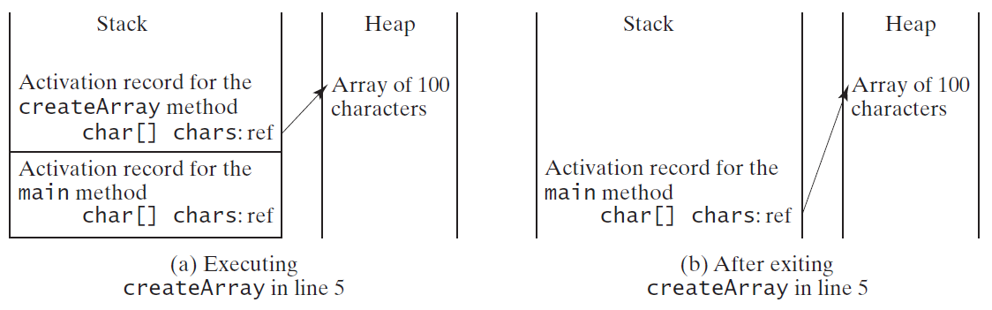
Problem: Counting Occurrence of Each Letter
Generate 100 lowercase letters randomly and assign to an array of characters.
Count the occurrence of each letter in the array.
CountLettersInArray

Slide 203
Variable-Length Arguments
You can pass a variable number of arguments of the same type to a method.
VarArgsDemo

Slide 204
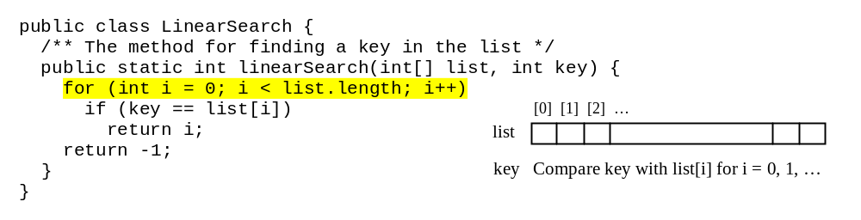
Searching Arrays
Searching is the process of looking for a specific element in an array; for example, discovering whether a certain score is included in a list of scores. Searching is a common task in computer programming. There are many algorithms and data structures devoted to searching. In this section, two commonly used approaches are discussed, linear search and binary search.

Slide 205
Linear Search
The linear search approach compares the key element, key, sequentially with each element in the array list. The method continues to do so until the key matches an element in the list or the list is exhausted without a match being found. If a match is made, the linear search returns the index of the element in the array that matches the key. If no match is found, the search returns -1.

Slide 206
Linear Search Animation
animation
Key
List
3
6 | 4 | 1 | 9 | 7 | 3 | 2 | 8
3
6 | 4 | 1 | 9 | 7 | 3 | 2 | 8
3
6 | 4 | 1 | 9 | 7 | 3 | 2 | 8
3
6 | 4 | 1 | 9 | 7 | 3 | 2 | 8
3
6 | 4 | 1 | 9 | 7 | 3 | 2 | 8
3
6 | 4 | 1 | 9 | 7 | 3 | 2 | 8

Slide 207
Linear Search Animation
animation
https://liveexample.pearsoncmg.com/dsanimation/LinearSearcheBook.html

Slide 208
From Idea to Solution
/** The method for finding a key in the list */
public static int linearSearch(int[] list, int key) {
for (int i = 0; i < list.length; i++)
if (key == list[i])
return i;
return -1;
}
Trace the method
int[] list = {1, 4, 4, 2, 5, -3, 6, 2};
int i = linearSearch(list, 4); // returns 1
int j = linearSearch(list, -4); // returns -1
int k = linearSearch(list, -3); // returns 5

Slide 209
The Arrays.sort Method
Since sorting is frequently used in programming, Java provides several overloaded sort methods for sorting an array of int, double, char, short, long, and float in the java.util.Arrays class. For example, the following code sorts an array of numbers and an array of characters.
  double[] numbers = {6.0, 4.4, 1.9, 2.9, 3.4, 3.5};
  java.util.Arrays.sort(numbers);
  char[] chars = {'a', 'A', '4', 'F', 'D', 'P'};
  java.util.Arrays.sort(chars);
Java 8 now provides Arrays.parallelSort(list) that utilizes the multicore for fast sorting.

Slide 210
The Arrays.toString(list) Method
The Arrays.toString(list) method can be used to return a string representation for the list.

