Slide 1
Week 3: Strings, Objects, and Classes

Slide 2
String Objectives
To represent strings using the String objects (§4.4).
To return the string length using the length() method (§4.4.1).
To return a character in the string using the charAt(i) method (§4.4.2).
To use the + operator to concatenate strings (§4.4.3).
To read strings from the console (§4.4.4).
To read a character from the console (§4.4.5).
To compare strings using the equals method and the compareTo methods (§4.4.6).
To obtain substrings (§4.4.7).
To find a character or a substring in a string using the indexOf method (§4.4.8).
To program using characters and strings (GuessBirthday) (§4.5.1).
To convert a hexadecimal character to a decimal value (HexDigit2Dec) (§4.5.2).
To revise the lottery program using strings (LotteryUsingStrings) (§4.5.3).
To format output using the System.out.printf method (§4.6).

Slide 3
The String Type
The char type only represents one character. To represent a string of characters, use the data type called String. For example,
String message = "Welcome to Java";
String is actually a predefined class in the Java library just like the System class and Scanner class. The String type is not a primitive type. It is known as a reference type. Any Java class can be used as a reference type for a variable. Reference data types will be thoroughly discussed in Chapter 9, “Objects and Classes.” For the time being, you just need to know how to declare a String variable, how to assign a string to the variable, how to concatenate strings, and to perform simple operations for strings.

Slide 4
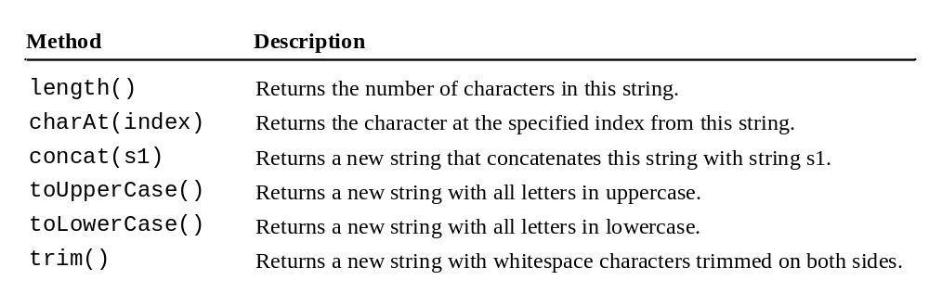
Simple Methods for String Objects

Slide 5
Simple Methods for String Objects
Strings are objects in Java. The methods in the preceding table can only be invoked from a specific string instance. For this reason, these methods are called instance methods. A non-instance method is called a static method. A static method can be invoked without using an object. All the methods defined in the Math class are static methods. They are not tied to a specific object instance. The syntax to invoke an instance method is
referenceVariable.methodName(arguments).

Slide 6
Getting String Length
String message = "Welcome to Java";
System.out.println("The length of " + message + " is "
+ message.length());

Slide 7
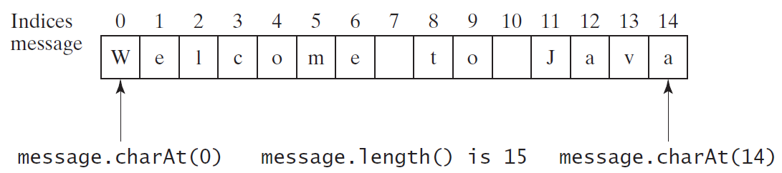
Getting Characters from a String
String message = "Welcome to Java";
System.out.println("The first character in message is "
+ message.charAt(0));

Slide 8
Converting Strings
"Welcome".toLowerCase() returns a new string, welcome.
"Welcome".toUpperCase() returns a new string, WELCOME.
" Welcome ".trim() returns a new string, Welcome.

Slide 9
String Concatenation
String s3 = s1.concat(s2); or String s3 = s1 + s2;
// Three strings are concatenated
String message = "Welcome " + "to " + "Java";
// String Chapter is concatenated with number 2
String s = "Chapter" + 2; // s becomes Chapter2
// String Supplement is concatenated with character B
String s1 = "Supplement" + 'B'; // s1 becomes SupplementB

Slide 10
Reading a String from the Console
Scanner input = new Scanner(System.in);
System.out.print("Enter three words separated by spaces: ");
String s1 = input.next();
String s2 = input.next();
String s3 = input.next();
System.out.println("s1 is " + s1);
System.out.println("s2 is " + s2);
System.out.println("s3 is " + s3);

Slide 11
Reading a Character from the Console
Scanner input = new Scanner(System.in);
System.out.print("Enter a character: ");
String s = input.nextLine();
char ch = s.charAt(0);
System.out.println("The character entered is " + ch);

Slide 12
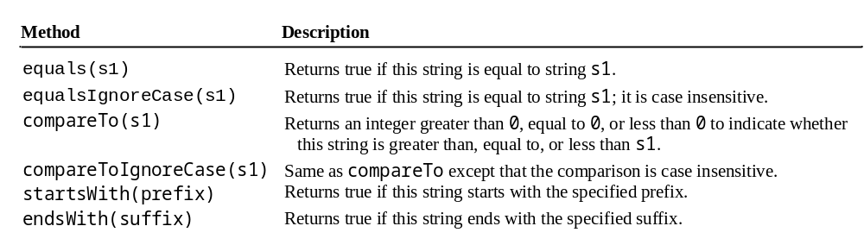
Comparing Strings
OrderTwoCities

Slide 13
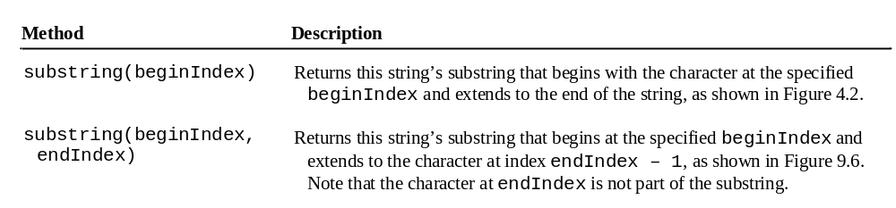
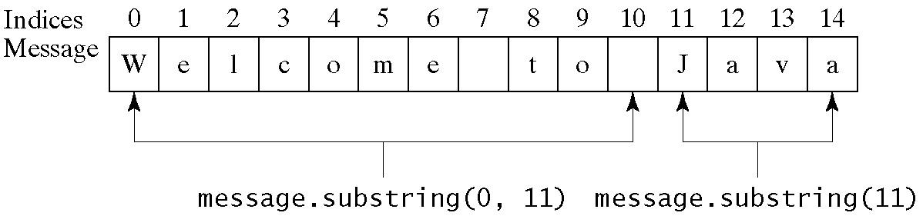
Obtaining Substrings

Slide 14
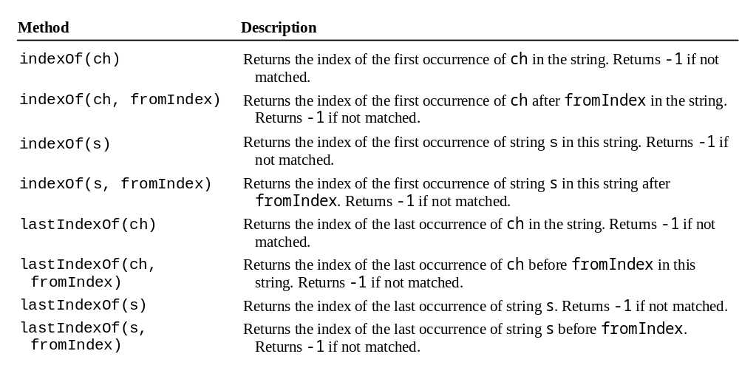
Finding a Character or a Substring in a String

Slide 15
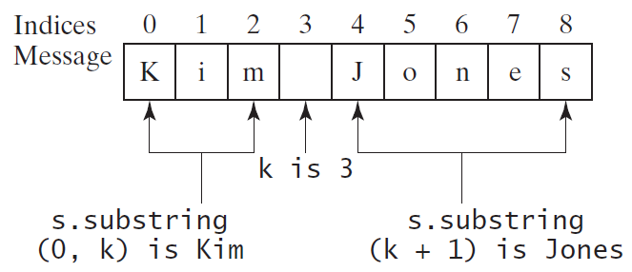
Finding a Character or a Substring in a String
int k = s.indexOf(' ');
String firstName = s.substring(0, k);
String lastName = s.substring(k + 1);

Slide 16
Conversion between Strings and Numbers
int intValue = Integer.parseInt(intString);
double doubleValue = Double.parseDouble(doubleString);
String s = number + "";

Slide 17
Case Study: Converting a Hexadecimal Digit to a Decimal Value
Write a program that converts a hexadecimal digit into a decimal value.
HexDigit2Dec

Slide 18
Formatting Output
Use the printf statement.
  System.out.printf(format, items);
Where format is a string that may consist of substrings and format specifiers. A format specifier specifies how an item should be displayed. An item may be a numeric value, character, boolean value, or a string. Each specifier begins with a percent sign.

Slide 19

Frequently-Used Specifiers
Specifier Output Example
%b a boolean value true or false
%c a character 'a'
%d a decimal integer 200
%f a floating-point number 45.460000
%e a number in standard scientific notation 4.556000e+01
%s a string "Java is cool"

Slide 20
FormatDemo
The example gives a program that uses printf to display a table.
FormatDemo

Slide 21

Objects: Motivations
After learning the preceding chapters, you are capable of solving many programming problems using selections, loops, methods, and arrays. However, these Java features are not sufficient for developing graphical user interfaces and large scale software systems. Suppose you want to develop a graphical user interface as shown below. How do you program it?

Slide 22
Objectives
To describe objects and classes, and use classes to model objects (§9.2).
To use UML graphical notation to describe classes and objects (§9.2).
To demonstrate how to define classes and create objects (§9.3).
To create objects using constructors (§9.4).
To access objects via object reference variables (§9.5).
To define a reference variable using a reference type (§9.5.1).
To access an object’s data and methods using the object member access operator (.) (§9.5.2).
To define data fields of reference types and assign default values for an object’s data fields (§9.5.3).
To distinguish between object reference variables and primitive data type variables (§9.5.4).
To use the Java library classes Date, Random, and Point2D (§9.6).
To distinguish between instance and static variables and methods (§9.7).
To define private data fields with appropriate get and set methods (§9.8).
To encapsulate data fields to make classes easy to maintain (§9.9).
To develop methods with object arguments and differentiate between primitive-type arguments and object-type arguments (§9.10).
To store and process objects in arrays (§9.11).
To create immutable objects from immutable classes to protect the contents of objects (§9.12).
To determine the scope of variables in the context of a class (§9.13).
To use the keyword this to refer to the calling object itself (§9.14).

Slide 23
OO Programming Concepts
Object-oriented programming (OOP) involves programming using objects. An object represents an entity in the real world that can be distinctly identified. For example, a student, a desk, a circle, a button, and even a loan can all be viewed as objects. An object has a unique identity, state, and behaviors. The state of an object consists of a set of data fields (also known as properties) with their current values. The behavior of an object is defined by a set of methods.

Slide 24

Objects
An object has both a state and behavior. The state defines the object, and the behavior defines what the object does.

Slide 25
Classes
Classes are constructs that define objects of the same type. A Java class uses variables to define data fields and methods to define behaviors. Additionally, a class provides a special type of methods, known as constructors, which are invoked to construct objects from the class.

Slide 26
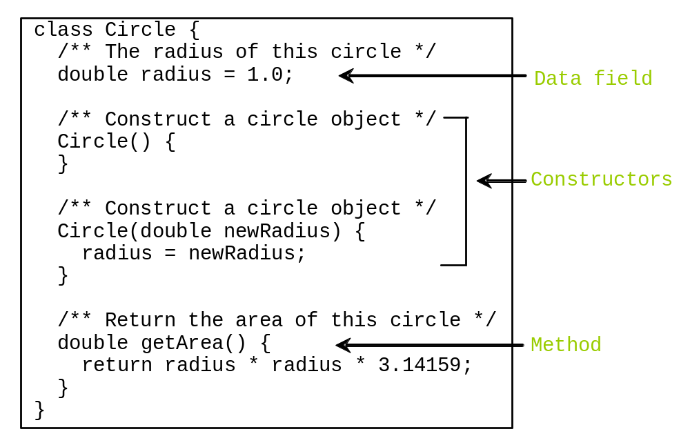
Classes

Slide 27
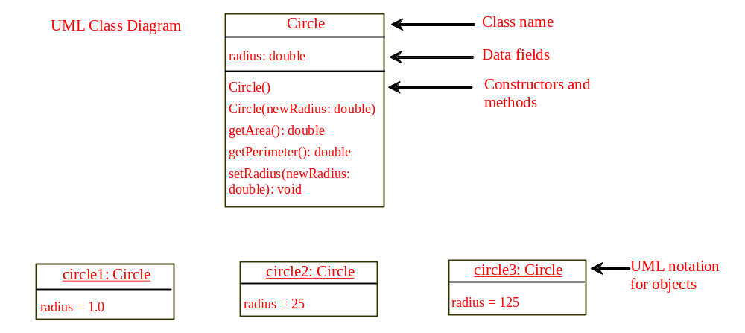
Unified Modelling Language (UML) Class Diagram

Slide 28
Example: Defining Classes and Creating Objects
Objective: Demonstrate creating objects, accessing data, and using methods.
TestSimpleCircle

Slide 29
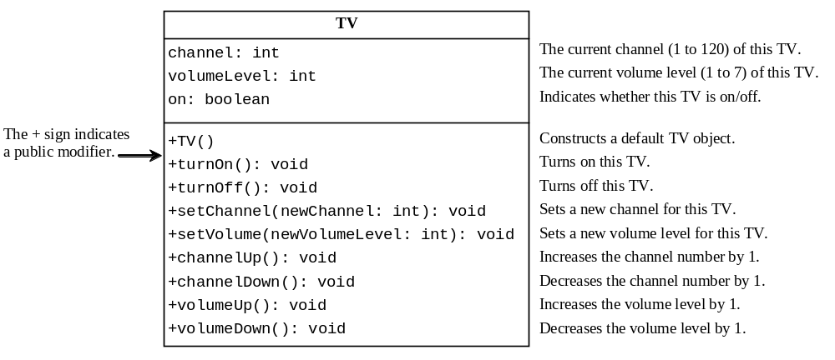
Example: Defining Classes and Creating Objects
TV
TestTV

Slide 30
Constructors
Constructors are a special kind of methods that are invoked to construct objects.
Circle() {
}
Circle(double newRadius) {
radius = newRadius;
}

Slide 31
Constructors, cont.
A constructor with no parameters is referred to as a no-arg constructor.
· Constructors must have the same name as the class itself.
· Constructors do not have a return type—not even void.
· Constructors are invoked using the new operator when an object is created. Constructors play the role of initializing objects.

Slide 32
Creating Objects Using Constructors
new ClassName();
Example:
new Circle();
new Circle(5.0);

Slide 33
Default Constructor
A class may be defined without constructors. In this case, a no-arg constructor with an empty body is implicitly defined in the class. This constructor, called a default constructor, is provided automatically only if no constructors are explicitly defined in the class.

Slide 34
Declaring Object Reference Variables
To reference an object, assign the object to a reference variable.
To declare a reference variable, use the syntax:
ClassName objectRefVar;
Example:
Circle myCircle;

Slide 35
Declaring/Creating Objects in a Single Step
ClassName objectRefVar = new ClassName();
Example:
Circle myCircle = new Circle();
Assign object reference
Create an object

Slide 36
Accessing Object’s Members
Referencing the object’s data:
objectRefVar.data
e.g., myCircle.radius
Invoking the object’s method:
objectRefVar.methodName(arguments)
e.g., myCircle.getArea()

Slide 37
Trace Code
animation
Declare myCircle
Circle myCircle = new Circle(5.0);
Circle yourCircle = new Circle();
yourCircle.radius = 100;
myCircle
no value

Slide 38

Trace Code, cont.
animation
Circle myCircle = new Circle(5.0);
Circle yourCircle = new Circle();
yourCircle.radius = 100;
myCircle
no value
Create a circle

Slide 39
Trace Code, cont.
animation
Circle myCircle = new Circle(5.0);
Circle yourCircle = new Circle();
yourCircle.radius = 100;
myCircle
reference value
Assign object reference to myCircle

Slide 40
Trace Code, cont.
animation
Circle myCircle = new Circle(5.0);
Circle yourCircle = new Circle();
yourCircle.radius = 100;
myCircle
reference value
yourCircle
no value
Declare yourCircle

Slide 41
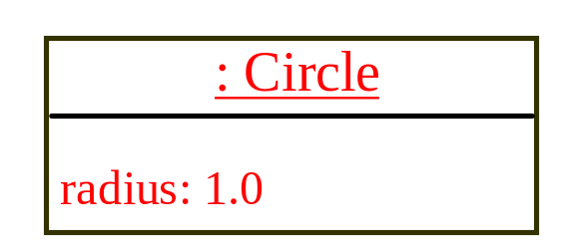
Trace Code, cont.
animation
Circle myCircle = new Circle(5.0);
Circle yourCircle = new Circle();
yourCircle.radius = 100;
myCircle
reference value
yourCircle
no value
Create a new Circle object

Slide 42

Trace Code, cont.
animation
Circle myCircle = new Circle(5.0);
Circle yourCircle = new Circle();
yourCircle.radius = 100;
myCircle
reference value
yourCircle
reference value
Assign object reference to yourCircle

Slide 43

Trace Code, cont.
animation
Circle myCircle = new Circle(5.0);
Circle yourCircle = new Circle();
yourCircle.radius = 100;
myCircle
reference value
yourCircle
reference value
Change radius in yourCircle

Slide 44
Caution
Recall that you use
  Math.methodName(arguments) (e.g., Math.pow(3, 2.5))
to invoke a method in the Math class. Can you invoke getArea() using SimpleCircle.getArea()? The answer is no. All the methods used before this chapter are static methods, which are defined using the static keyword. However, getArea() is non-static. It must be invoked from an object using
  objectRefVar.methodName(arguments) (e.g., myCircle.getArea()).
More explanations will be given in the section on “Static Variables, Constants, and Methods.”

Slide 45
Reference Data Fields
The data fields can be of reference types. For example, the following Student class contains a data field name of the String type.
public class Student {
String name; // name has default value null
int age; // age has default value 0
boolean isScienceMajor; // isScienceMajor has default value false
char gender; // c has default value '\u0000'
}

Slide 46
The null Value
If a data field of a reference type does not reference any object, the data field holds a special literal value, null.

Slide 47
Default Value for a Data Field
The default value of a data field is null for a reference type, 0 for a numeric type, false for a boolean type, and '\u0000' for a char type. However, Java assigns no default value to a local variable inside a method.
public class Test {
public static void main(String[] args) {
Student student = new Student();
System.out.println("name? " + student.name);
System.out.println("age? " + student.age);
System.out.println("isScienceMajor? " + student.isScienceMajor);
System.out.println("gender? " + student.gender);
}
}

Slide 48
Example
Java assigns no default value to a local variable inside a method.
public class Test {
public static void main(String[] args) {
int x; // x has no default value
String y; // y has no default value
System.out.println("x is " + x);
System.out.println("y is " + y);
}
}
Compile error: variable not initialized

Slide 49

Differences between Variables of
Primitive Data Types and Object Types

Slide 50

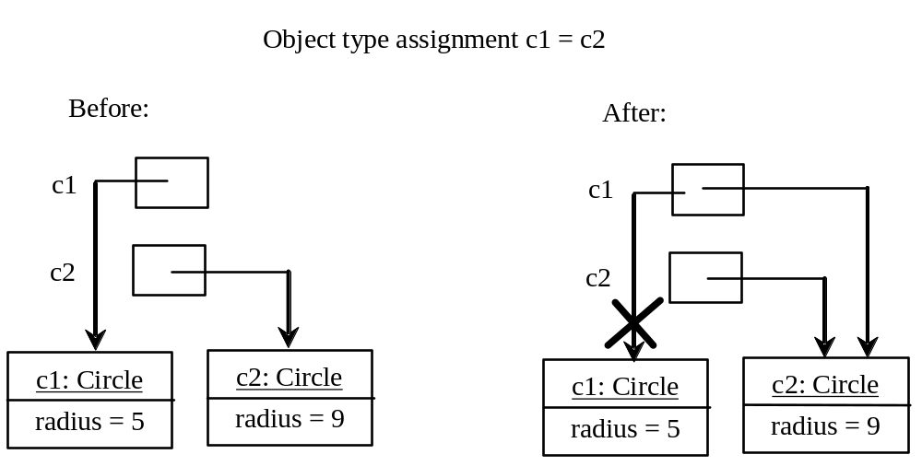
Copying Variables of Primitive Data Types and Object Types

Slide 51
Garbage Collection
As shown in the previous figure, after the assignment statement c1 = c2, c1 points to the same object referenced by c2. The object previously referenced by c1 is no longer referenced. This object is known as garbage. Garbage is automatically collected by JVM.

Slide 52
Garbage Collection, cont
TIP: If you know that an object is no longer needed, you can explicitly assign null to a reference variable for the object. The JVM will automatically collect the space if the object is not referenced by any variable.

Slide 53

The Date Class
Java provides a system-independent encapsulation of date and time in the java.util.Date class. You can use the Date class to create an instance for the current date and time and use its toString method to return the date and time as a string.

Slide 54
The Date Class Example
For example, the following code
  java.util.Date date = new java.util.Date();
  System.out.println(date.toString());
displays a string like Sun Mar 09 13:50:19 EST 2003.

Slide 55

The Random Class
You have used Math.random() to obtain a random double value between 0.0 and 1.0 (excluding 1.0). A more useful random number generator is provided in the java.util.Random class.

Slide 56
The Random Class Example
If two Random objects have the same seed, they will generate identical sequences of numbers. For example, the following code creates two Random objects with the same seed 3.
Random random1 = new Random(3);
System.out.print("From random1: ");
for (int i = 0; i < 10; i++)
System.out.print(random1.nextInt(1000) + " ");
Random random2 = new Random(3);
System.out.print("\nFrom random2: ");
for (int i = 0; i < 10; i++)
System.out.print(random2.nextInt(1000) + " ");
From random1: 734 660 210 581 128 202 549 564 459 961
From random2: 734 660 210 581 128 202 549 564 459 961

Slide 57
Instance
Variables, and Methods
Instance variables belong to a specific instance.
Instance methods are invoked by an instance of the class.

Slide 58
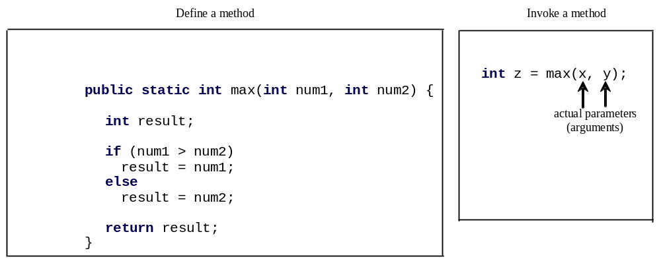
Defining Methods
A method is a collection of statements that are grouped together to perform an operation.

Slide 59

Defining Methods
A method is a collection of statements that are grouped together to perform an operation.

Slide 60
Method Signature
Method signature is the combination of the method name and the parameter list.

Slide 61
Formal Parameters
The variables defined in the method header are known as formal parameters.

Slide 62
Actual Parameters
When a method is invoked, you pass a value to the parameter. This value is referred to as actual parameter or argument.

Slide 63
Return Value Type
A method may return a value. The returnValueType is the data type of the value the method returns. If the method does not return a value, the returnValueType is the keyword void. For example, the returnValueType in the main method is void.

Slide 64
Calling Methods
Testing the max method
This program demonstrates calling a method max to return the largest of the int values
TestMax

Slide 65
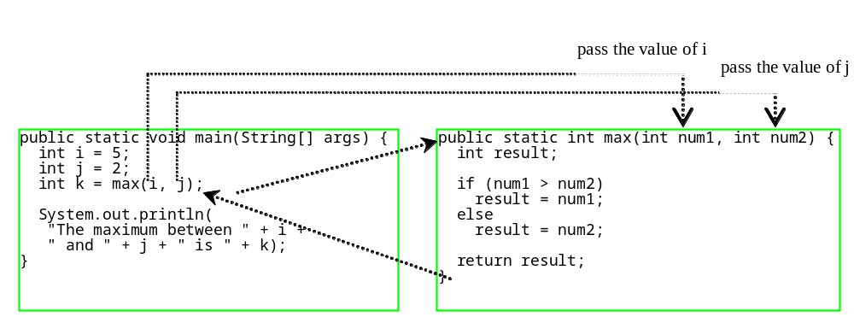
Calling Methods, cont.
animation

Slide 66

Trace Method Invocation
animation
i is now 5

Slide 67
Trace Method Invocation
animation
j is now 2

Slide 68
Trace Method Invocation
animation
invoke max(i, j)

Slide 69
Trace Method Invocation
animation
invoke max(i, j)
Pass the value of i to num1
Pass the value of j to num2

Slide 70
Trace Method Invocation
animation
declare variable result

Slide 71
Trace Method Invocation
animation
(num1 > num2) is true since num1 is 5 and num2 is 2

Slide 72
Trace Method Invocation
animation
result is now 5

Slide 73
Trace Method Invocation
animation
return result, which is 5

Slide 74
Trace Method Invocation
animation
return max(i, j) and assign the return value to k

Slide 75
Trace Method Invocation
animation
Execute the print statement

Slide 76

CAUTION
A return statement is required for a value-returning method. The method shown below in (a) is logically correct, but it has a compilation error because the Java compiler thinks it possible that this method does not return any value.
To fix this problem, delete if (n < 0) in (a), so that the compiler will see a return statement to be reached regardless of how the if statement is evaluated.

Slide 77
Reuse Methods from Other Classes
NOTE: One of the benefits of methods is for reuse. The max method can be invoked from any class besides TestMax. If you create a new class Test, you can invoke the max method using ClassName.methodName (e.g., TestMax.max).

Slide 78
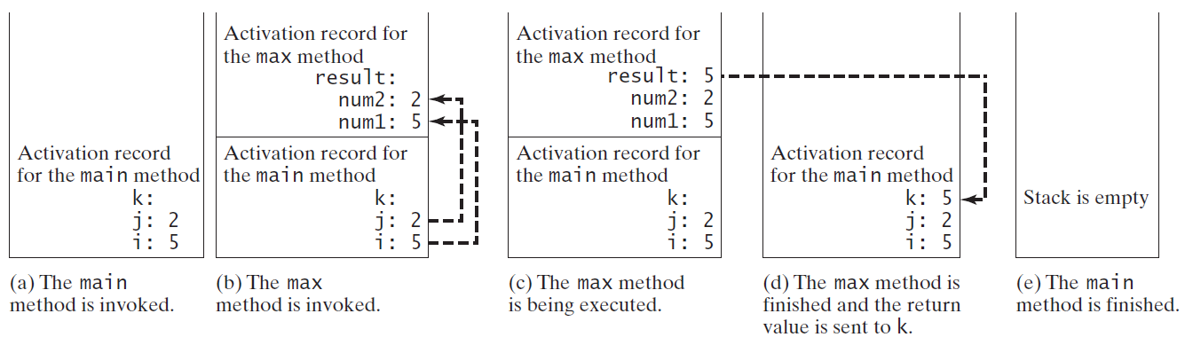
Call Stacks

Slide 79


Trace Call Stack
animation
i is declared and initialized

Slide 80
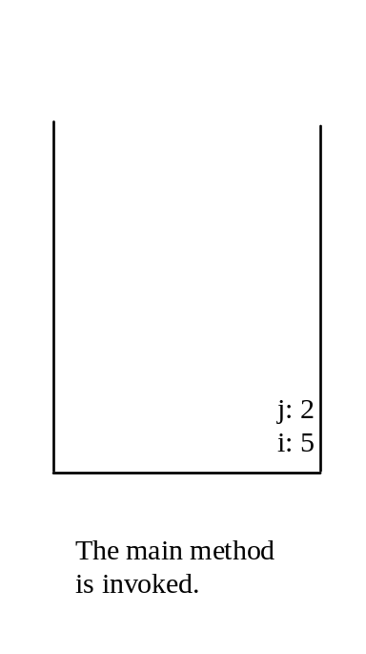
Trace Call Stack
animation
j is declared and initialized

Slide 81

Trace Call Stack
animation
Declare k

Slide 82
Trace Call Stack
animation
Invoke max(i, j)

Slide 83

Trace Call Stack
animation
pass the values of i and j to num1 and num2

Slide 84

Trace Call Stack
animation
Declare result

Slide 85
Trace Call Stack
animation
(num1 > num2) is true

Slide 86

Trace Call Stack
animation
Assign num1 to result

Slide 87

Trace Call Stack
animation
Return result and assign it to k

Slide 88

Trace Call Stack
animation
Execute print statement

Slide 89
void Method Example
This type of method does not return a value. The method performs some actions.
TestVoidMethod
TestReturnGradeMethod

Slide 90
Passing Parameters
public static void nPrintln(String message, int n) {
for (int i = 0; i < n; i++)
System.out.println(message);
}
Suppose you invoke the method using
  nPrintln(“Welcome to Java”, 5);
What is the output?
Suppose you invoke the method using
  nPrintln(“Computer Science”, 15);
What is the output?
Can you invoke the method using
  nPrintln(15, “Computer Science”);

Slide 91
Pass by Value
This program demonstrates passing values to the methods.
Increment

Slide 92
Pass by Value
Testing Pass by value
This program demonstrates passing values to the methods.
TestPassByValue

Slide 93
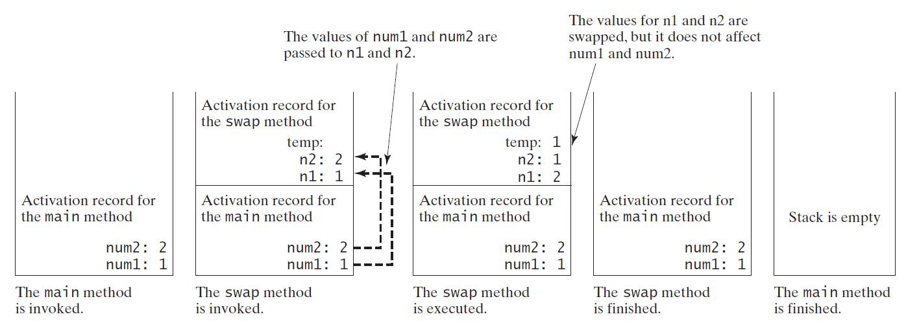
Pass by Value, cont.

Slide 94
Modularizing Code
Methods can be used to reduce redundant coding and enable code reuse. Methods can also be used to modularize code and improve the quality of the program.

Slide 95
Case Study: Converting Hexadecimals to Decimals
Write a method that converts a hexadecimal number into a decimal number.
ABCD =>
A*16^3 + B*16^2 + C*16^1+ D*16^0
= ((A*16 + B)*16 + C)*16+D
= ((10*16 + 11)*16 + 12)*16+13 = ?
Hex2Dec

Slide 96
Overloading Methods
Overloading the max Method
public static double max(double num1, double num2) {
if (num1 > num2)
return num1;
else
return num2;
}
TestMethodOverloading

Slide 97
Ambiguous Invocation
Sometimes there may be two or more possible matches for an invocation of a method, but the compiler cannot determine the most specific match. This is referred to as ambiguous invocation. Ambiguous invocation is a compile error.

Slide 98
Ambiguous Invocation
public class AmbiguousOverloading {
public static void main(String[] args) {
System.out.println(max(1, 2));
}
public static double max(int num1, double num2) {
if (num1 > num2)
return num1;
else
return num2;
}
public static double max(double num1, int num2) {
if (num1 > num2)
return num1;
else
return num2;
}
}

Slide 99
Scope of Local Variables
A local variable: a variable defined inside a method.
Scope: the part of the program where the variable can be referenced.
The scope of a local variable starts from its declaration and continues to the end of the block that contains the variable. A local variable must be declared before it can be used.

Slide 100
Scope of Local Variables, cont.
You can declare a local variable with the same name multiple times in different non-nesting blocks in a method, but you cannot declare a local variable twice in nested blocks.

Slide 101

Scope of Local Variables, cont.
A variable declared in the initial action part of a for loop header has its scope in the entire loop. But a variable declared inside a for loop body has its scope limited in the loop body from its declaration and to the end of the block that contains the variable.

Slide 102

Scope of Local Variables, cont.

Slide 103
Scope of Local Variables, cont.
// Fine with no errors
public static void correctMethod() {
int x = 1;
int y = 1;
// i is declared
for (int i = 1; i < 10; i++) {
x += i;
}
// i is declared again
for (int i = 1; i < 10; i++) {
y += i;
}
}

Slide 104
Scope of Local Variables, cont.
// With errors
public static void incorrectMethod() {
int x = 1;
int y = 1;
for (int i = 1; i < 10; i++) {
int x = 0;
x += i;
}
}

Slide 105

Method Abstraction
You can think of the method body as a black box that contains the detailed implementation for the method.

Slide 106
Static Variables, Constants, and Methods
Static variables are shared by all the instances of the class.
Static methods are not tied to a specific object.
Static constants are final variables shared by all the instances of the class.

Slide 107
Static Variables, Constants, and Methods, cont.
To declare static variables, constants, and methods, use the static modifier.

Slide 108
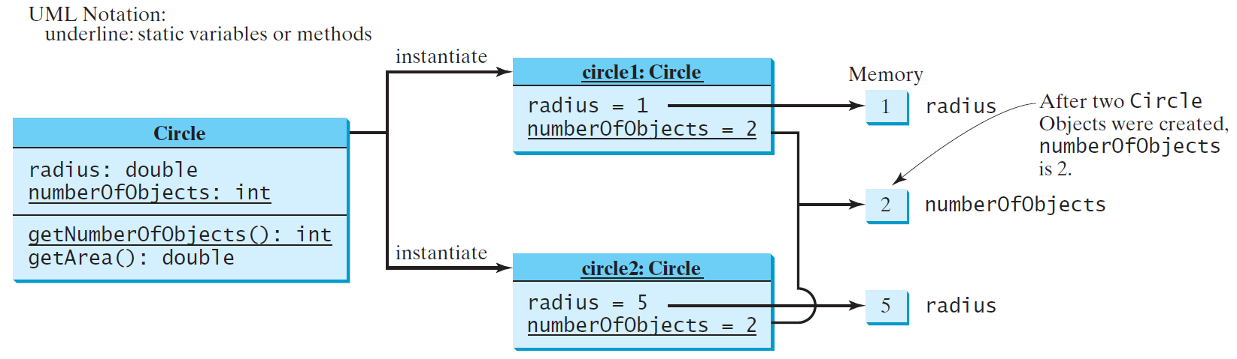
Static Variables, Constants, and Methods, cont.

Slide 109
Example of
Using Instance and Class Variables and Method
Objective: Demonstrate the roles of instance and class variables and their uses. This example adds a class variable numberOfObjects to track the number of Circle objects created.
CircleWithStaticMembers
TestCircleWithStaticMembers

Slide 110
Visibility Modifiers and
Accessor/Mutator Methods
By default, the class, variable, or method can be
accessed by any class in the same package.
public
The class, data, or method is visible to any class in any package.
private
The data or methods can be accessed only by the declaring class.
The get and set methods are used to read and modify private properties.

Slide 111

The private modifier restricts access to within a class, the default modifier restricts access to within a package, and the public modifier enables unrestricted access.

Slide 112

The default modifier on a class restricts access to within a package, and the public modifier enables unrestricted access.

Slide 113
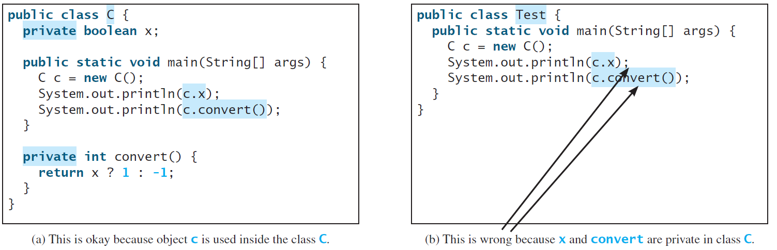
NOTE
An object cannot access its private members, as shown in (b). It is OK, however, if the object is declared in its own class, as shown in (a).

Slide 114
Why Data Fields Should Be private?
To protect data.
To make code easy to maintain.

Slide 115

Example of
Data Field Encapsulation
CircleWithPrivateDataFields
TestCircleWithPrivateDataFields

Slide 116
Passing Objects to Methods
Passing by value for primitive type value (the value is passed to the parameter)
Passing by value for reference type value (the value is the reference to the object)
TestPassObject

Slide 117
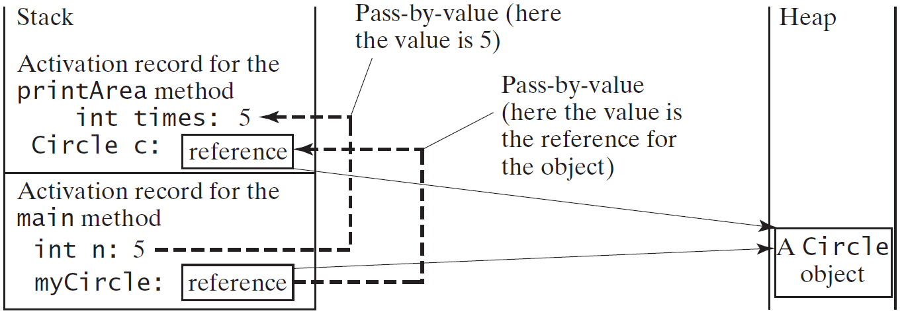
Passing Objects to Methods, cont.

Slide 118
Array of Objects
Circle[] circleArray = new Circle[10];
An array of objects is actually an array of reference variables. So invoking circleArray[1].getArea() involves two levels of referencing as shown in the next figure. circleArray references to the entire array. circleArray[1] references to a Circle object.

Slide 119

Array of Objects, cont.
Circle[] circleArray = new Circle[10];

Slide 120
Array of Objects, cont.
Summarizing the areas of the circles
TotalArea

Slide 121
Immutable Objects and Classes
If the contents of an object cannot be changed once the object is created, the object is called an immutable object and its class is called an immutable class. If you delete the set method in the Circle class in Listing 8.10, the class would be immutable because radius is private and cannot be changed without a set method.
A class with all private data fields and without mutators is not necessarily immutable. For example, the following class Student has all private data fields and no mutators, but it is mutable.

Slide 122
Example
public class BirthDate {
private int year;
private int month;
private int day;
public BirthDate(int newYear,
int newMonth, int newDay) {
year = newYear;
month = newMonth;
day = newDay;
}
public void setYear(int newYear) {
year = newYear;
}
}
public class Student {
private int id;
private BirthDate birthDate;
public Student(int ssn,
int year, int month, int day) {
id = ssn;
birthDate = new BirthDate(year, month, day);
}
public int getId() {
return id;
}
public BirthDate getBirthDate() {
return birthDate;
}
}
public class Test {
public static void main(String[] args) {
Student student = new Student(111223333, 1970, 5, 3);
BirthDate date = student.getBirthDate();
date.setYear(2010); // Now the student birth year is changed!
}
}

Slide 123
What Class is Immutable?
For a class to be immutable, it must mark all data fields private and provide no mutator methods and no accessor methods that would return a reference to a mutable data field object.

Slide 124
Scope of Variables
The scope of instance and static variables is the entire class. They can be declared anywhere inside a class.
The scope of a local variable starts from its declaration and continues to the end of the block that contains the variable. A local variable must be initialized explicitly before it can be used.

Slide 125
The this Keyword
The this keyword is the name of a reference that refers to an object itself. One common use of the this keyword is reference a class’s hidden data fields.
Another common use of the this keyword to enable a constructor to invoke another constructor of the same class.

Slide 126

Reference the Hidden Data Fields

Slide 127

Calling Overloaded Constructor

