Slide 1
Abstract Classes and Interfaces Generics
Reading: Liang, Chapter 13 and Chapter 17
Horstmann, Chapter 6.1, Chapter 8
Bonus: Number objects, Integer pool, and the String pool

Slide 2
Midterm
Don’t worry, it’s not hard
10 questions about Java
Explain your reasoning. This is takehome, so there aren’t any “show what this method outputs” questions, because you could just run that code yourself.
Two programming questions

Slide 3
Wrapper Classes
Boolean
Character
Short
Byte
Integer
Long
Float
Double
NOTE: (1) The wrapper classes do not have no-arg constructors. (2) The instances of all wrapper classes are immutable, i.e., their internal values cannot be changed once the objects are created.
3

Slide 4
The Integer and Double Classes
4

Slide 5
The Integer Class and the Double Class
Constructors
Class Constants MAX_VALUE, MIN_VALUE
Conversion Methods
5

Slide 6
Numeric Wrapper Class Constructors
You can construct a wrapper object either from a primitive data type value or from a string representing the numeric value. The constructors for Integer and Double are:
public Integer(int value)
public Integer(String s)
public Double(double value)
public Double(String s)
6

Slide 7
Numeric Wrapper Class Constants
Each numerical wrapper class has the constants MAX_VALUE and MIN_VALUE. MAX_VALUE represents the maximum value of the corresponding primitive data type. For Byte, Short, Integer, and Long, MIN_VALUE represents the minimum byte, short, int, and long values. For Float and Double, MIN_VALUE represents the minimum positive float and double values. The following statements display the maximum integer (2,147,483,647), the minimum positive float (1.4E-45), and the maximum double floating-point number (1.79769313486231570e+308d).
7

Slide 8
Conversion Methods
Each numeric wrapper class implements the abstract methods doubleValue, floatValue, intValue, longValue, and shortValue, which are defined in the Number class. These methods “convert” objects into primitive type values.
8

Slide 9
The Static valueOf Methods
The numeric wrapper classes have a useful class method, valueOf(String s). This method creates a new object initialized to the value represented by the specified string. For example:
Double doubleObject = Double.valueOf("12.4");
Integer integerObject = Integer.valueOf("12");
9

Slide 10
The Methods for Parsing Strings into Numbers
You have used the parseInt method in the Integer class to parse a numeric string into an int value and the parseDouble method in the Double class to parse a numeric string into a double value. Each numeric wrapper class has two overloaded parsing methods to parse a numeric string into an appropriate numeric value.
10

Slide 11
Automatic Conversion Between Primitive Types and Wrapper Class Types
JDK 1.5 allows primitive type and wrapper classes to be converted automatically. For example, the following statement in (a) can be simplified as in (b):
Integer[] intArray = {1, 2, 3};
System.out.println(intArray[0] + intArray[1] + intArray[2]);
Unboxing
11

Slide 12
BigInteger and BigDecimal
If you need to compute with very large integers or high precision floating-point values, you can use the BigInteger and BigDecimal classes in the java.math package. Both are immutable. Both extend the Number class and implement the Comparable interface.
12

Slide 13
BigInteger and BigDecimal
BigInteger a = new BigInteger("9223372036854775807");
BigInteger b = new BigInteger("2");
BigInteger c = a.multiply(b); // 9223372036854775807 * 2
System.out.println(c);
LargeFactorial
BigDecimal a = new BigDecimal(1.0);
BigDecimal b = new BigDecimal(3);
BigDecimal c = a.divide(b, 20, BigDecimal.ROUND_UP);
System.out.println(c);
13

Slide 14
The String Pool and the Integer Pool
Remember if you create two Strings with the name value, they won’t be the same string:
String a = new String(“Hello!”);
String b = new String(“Hello!”);
System.out.println(a == b); // prints “false”
But if you declare strings as literals, the compiler implicitly instantiates that String, and every other time it encounters that String literal, it retrieves it from the same place:
String c = Hello!”;
String d = Hello!”;
System.out.println(c == d); // prints “true” (!)

Slide 15
The String Pool
What Java does is store all these String literals in a place called the “String pool”, so it does not duplicate and recreate String literals when they’re encountered. c and d here will point to the same String literal
String c = “Hello!”;
String d = “Hello!”;
String e = “Goodbye!”;
String f = new String(“Goodbye!”);
String g = new String(“Goodbye!”);
c d
e f
Goodbye!!
“Hello!”
“Goodbye!”
g
Goodbye!!

Slide 16
The Integer Pool
Works like the String Pool, except that explicitly creating new Integer objects are all drawn from the Integer pool for all Integers from -128 to 127
Integer i = new Integer(12);
Integer j = new Integer(12);
System.out.println(i == j); // prints “true”
Integer m = new Integer(999);
Integer n = new Integer(999);
System.out.println(m == n); // prints “false”

Slide 17
Motivations
An interface is for defining common behavior for classes (including unrelated classes). Before discussing interfaces, we introduce a closely related subject: abstract classes.
17

Slide 18
Objectives
To design and use abstract classes (§13.2).
To generalize numeric wrapper classes, BigInteger, and BigDecimal using the abstract Number class (§13.3).
To process a calendar using the Calendar and GregorianCalendar classes (§13.4).
To specify common behavior for objects using interfaces (§13.5).
To define interfaces and define classes that implement interfaces (§13.5).
To define a natural order using the Comparable interface (§13.6).
To make objects cloneable using the Cloneable interface (§13.7).
To explore the similarities and differences among concrete classes, abstract classes, and interfaces (§13.8).
18

Slide 19
abstract method in abstract class
An abstract method cannot be contained in a nonabstract class. If a subclass of an abstract superclass does not implement all the abstract methods, the subclass must be defined abstract. In other words, in a nonabstract subclass extended from an abstract class, all the abstract methods must be implemented, even if they are not used in the subclass.
19

Slide 20
object cannot be created from abstract class
An abstract class cannot be instantiated using the new operator, but you can still define its constructors, which are invoked in the constructors of its subclasses. For instance, the constructors of GeometricObject are invoked in the Circle class and the Rectangle class.
20

Slide 21
abstract class without abstract method
A class that contains abstract methods must be abstract. However, it is possible to define an abstract class that contains no abstract methods. In this case, you cannot create instances of the class using the new operator. This class is used as a base class for defining a new subclass.
21

Slide 22
superclass of abstract class may be concrete
A subclass can be abstract even if its superclass is concrete. For example, the Object class is concrete, but its subclasses, such as GeometricObject, may be abstract.
22

Slide 23
concrete method overridden to be abstract
A subclass can override a method from its superclass to define it abstract. This is rare, but useful when the implementation of the method in the superclass becomes invalid in the subclass. In this case, the subclass must be defined abstract.
23

Slide 24
abstract class as type
You cannot create an instance from an abstract class using the new operator, but an abstract class can be used as a data type. Therefore, the following statement, which creates an array whose elements are of GeometricObject type, is correct.
GeometricObject[] geo = new GeometricObject[10];
24

Slide 25
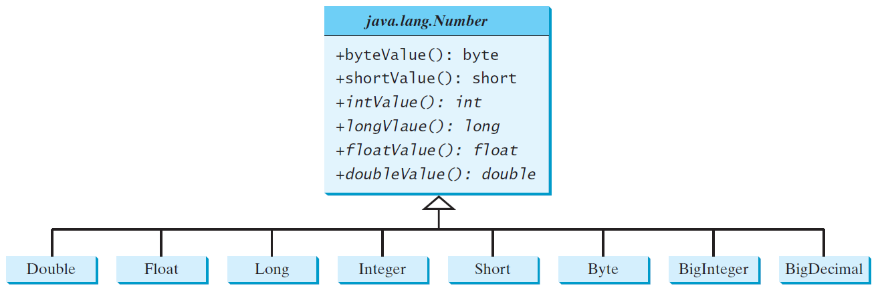
Case Study: the Abstract Number Class
LargestNumbers
Run
25

Slide 26
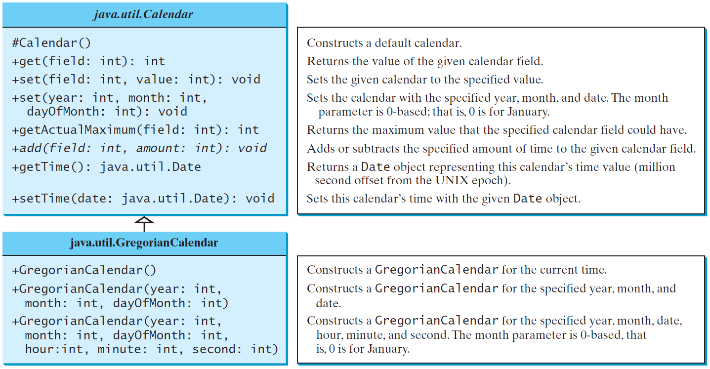
The Abstract Calendar Class and Its GregorianCalendar subclass
26

Slide 27
The Abstract Calendar Class and Its GregorianCalendar subclass
An instance of java.util.Date represents a specific instant in time with millisecond precision. java.util.Calendar is an abstract base class for extracting detailed information such as year, month, date, hour, minute and second from a Date object. Subclasses of Calendar can implement specific calendar systems such as Gregorian calendar, Lunar Calendar and Jewish calendar. Currently, java.util.GregorianCalendar for the Gregorian calendar is supported in the Java API.
27

Slide 28
The GregorianCalendar Class
You can use new GregorianCalendar() to construct a default GregorianCalendar with the current time and use new GregorianCalendar(year, month, date) to construct a GregorianCalendar with the specified year, month, and date. The month parameter is 0-based, i.e., 0 is for January.
28

Slide 29
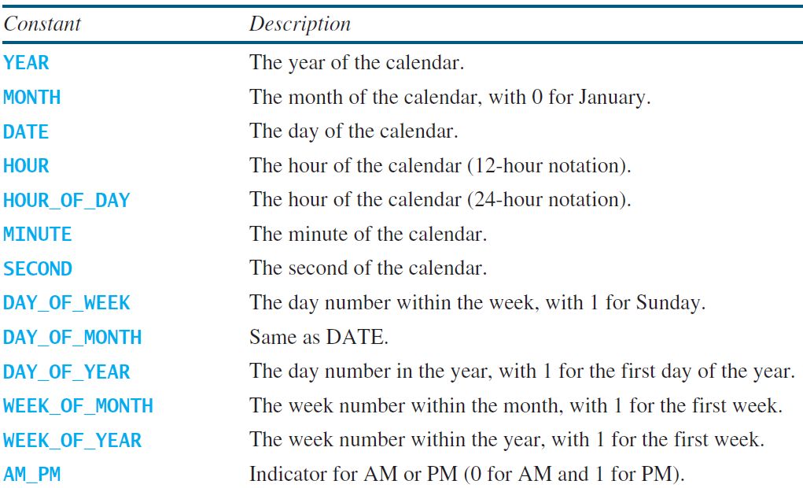
The get Method in Calendar Class
The get(int field) method defined in the Calendar class is useful to extract the date and time information from a Calendar object. The fields are defined as constants, as shown in the following.
29

Slide 30
Interfaces
What is an interface?
Why is an interface useful?
How do you define an interface?
How do you use an interface?
30

Slide 31
What is an interface? Why is an interface useful?
An interface is a classlike construct that contains only constants and abstract methods. In many ways, an interface is similar to an abstract class, but the intent of an interface is to specify common behavior for objects. For example, you can specify that the objects are comparable, edible, cloneable using appropriate interfaces.
31

Slide 32
Define an Interface
To distinguish an interface from a class, Java uses the following syntax to define an interface:
public interface InterfaceName {
constant declarations;
abstract method signatures;
}
Example:
public interface Edible {
/** Describe how to eat */
public abstract String howToEat();
}
32

Slide 33
Interface is a Special Class
An interface is treated like a special class in Java. Each interface is compiled into a separate bytecode file, just like a regular class. Like an abstract class, you cannot create an instance from an interface using the new operator, but in most cases you can use an interface more or less the same way you use an abstract class. For example, you can use an interface as a data type for a variable, as the result of casting, and so on.
33

Slide 34
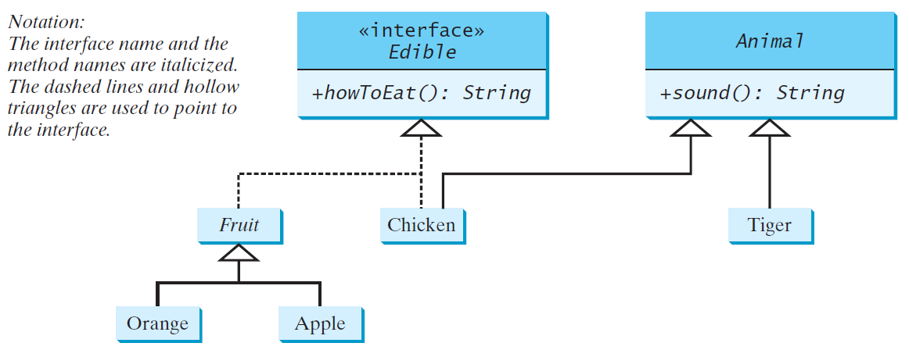
Example
You can now use the Edible interface to specify whether an object is edible. This is accomplished by letting the class for the object implement this interface using the implements keyword. For example, the classes Chicken and Fruit implement the Edible interface (See TestEdible).
Edible
TestEdible
Run
34

Slide 35
Omitting Modifiers in Interfaces
All data fields are public final static and all methods are public abstract in an interface. For this reason, these modifiers can be omitted, as shown below:
A constant defined in an interface can be accessed using syntax InterfaceName.CONSTANT_NAME (e.g., T1.K).
35

Slide 36
Example: The Comparable Interface
// This interface is defined in
// java.lang package
package java.lang;
public interface Comparable<E> {
public int compareTo(E o);
}
36

Slide 37
The toString, equals, and hashCode Methods
Each wrapper class overrides the toString, equals, and hashCode methods defined in the Object class. Since all the numeric wrapper classes and the Character class implement the Comparable interface, the compareTo method is implemented in these classes.
37

Slide 38
Integer and BigInteger Classes
String and Date Classes
38

Slide 39
Example
1 System.out.println(new Integer(3).compareTo(new Integer(5)));
2 System.out.println("ABC".compareTo("ABE"));
3 java.util.Date date1 = new java.util.Date(2013, 1, 1);
4 java.util.Date date2 = new java.util.Date(2012, 1, 1);
5 System.out.println(date1.compareTo(date2));
39

Slide 40
The Cloneable Interfaces
Marker Interface: An empty interface.
A marker interface does not contain constants or methods. It is used to denote that a class possesses certain desirable properties. A class that implements the Cloneable interface is marked cloneable, and its objects can be cloned using the clone() method defined in the Object class.
package java.lang;
public interface Cloneable {
}
40

Slide 41
Examples
Many classes (e.g., Date and Calendar) in the Java library implement Cloneable. Thus, the instances of these classes can be cloned. For example, the following code
Calendar calendar = new GregorianCalendar(2003, 2, 1);
Calendar calendarCopy = (Calendar)calendar.clone();
System.out.println("calendar == calendarCopy is " +
(calendar == calendarCopy));
System.out.println("calendar.equals(calendarCopy) is " +
calendar.equals(calendarCopy));
displays
calendar == calendarCopy is false
calendar.equals(calendarCopy) is true
41
Notes:
41

Slide 42
Implementing Cloneable Interface
To define a custom class that implements the Cloneable interface, the class must override the clone() method in the Object class. The following code defines a class named House that implements Cloneable and Comparable.
House
42
Notes:
42

Slide 43
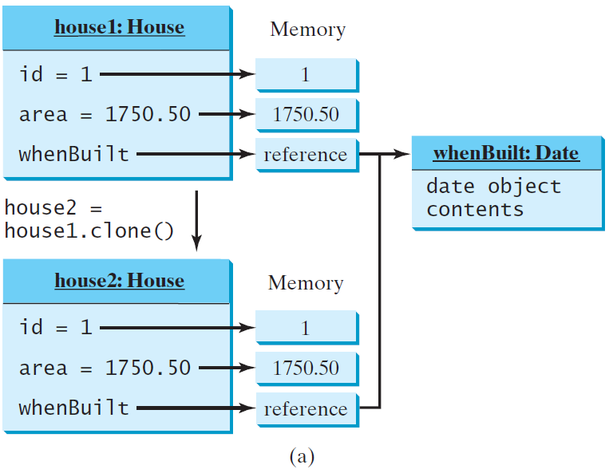
Shallow vs. Deep Copy
House house1 = new House(1, 1750.50);
House house2 = (House)house1.clone();
Shallow Copy
43
Notes:
43

Slide 44
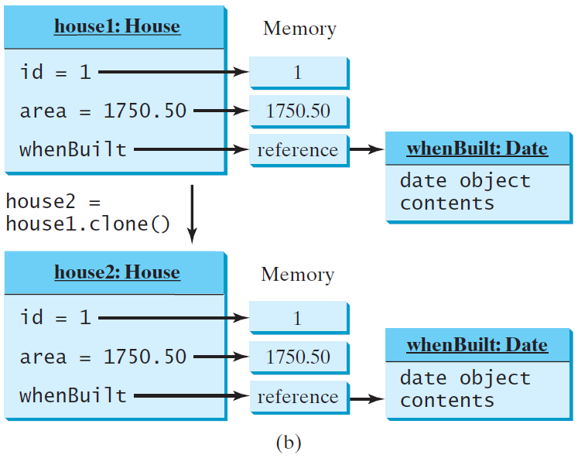
Shallow vs. Deep Copy
House house1 = new House(1, 1750.50);
House house2 = (House)house1.clone();
Deep Copy
44
Notes:
44

Slide 45
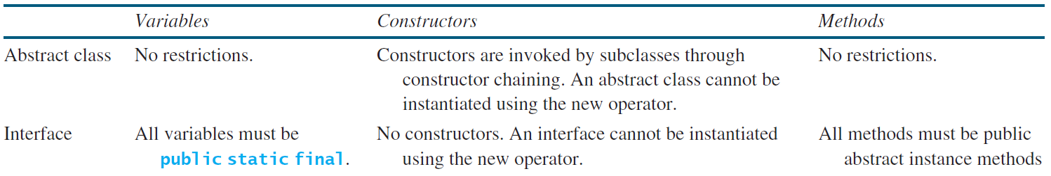
Interfaces vs. Abstract Classes
In an interface, the data must be constants; an abstract class can have all types of data.
Each method in an interface has only a signature without implementation; an abstract class can have concrete methods.
45

Slide 46
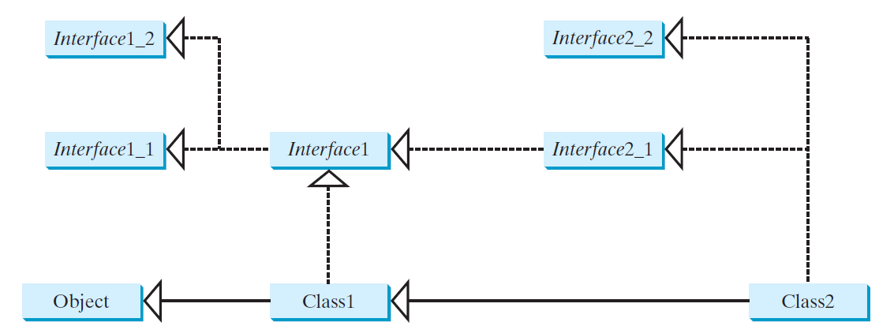
Interfaces vs. Abstract Classes, cont.
All classes share a single root, the Object class, but there is no single root for interfaces. Like a class, an interface also defines a type. A variable of an interface type can reference any instance of the class that implements the interface. If a class extends an interface, this interface plays the same role as a superclass. You can use an interface as a data type and cast a variable of an interface type to its subclass, and vice versa.
Suppose that c is an instance of Class2. c is also an instance of Object, Class1, Interface1, Interface1_1, Interface1_2, Interface2_1, and Interface2_2.
46

Slide 47
Whether to use an interface or a class?
Abstract classes and interfaces can both be used to model common features. How do you decide whether to use an interface or a class? In general, a strong is-a relationship that clearly describes a parent-child relationship should be modeled using classes. For example, a staff member is a person. A weak is-a relationship, also known as an is-kind-of relationship, indicates that an object possesses a certain property. A weak is-a relationship can be modeled using interfaces. For example, all strings are comparable, so the String class implements the Comparable interface. You can also use interfaces to circumvent single inheritance restriction if multiple inheritance is desired. In the case of multiple inheritance, you have to design one as a superclass, and others as interface.
47

Slide 48
Next: Generics

Slide 49
Why Do You Get a Warning?
public class ShowUncheckedWarning {
public static void main(String[] args) {
java.util.ArrayList list =
new java.util.ArrayList();
list.add("Java Programming");
}
}
To understand the compile warning on this line, you need to learn JDK 1.6 generics.

Slide 50
Fix the Warning
public class ShowUncheckedWarning {
public static void main(String[] args) {
java.util.ArrayList<String> list =
new java.util.ArrayList<String>();
list.add("Java Programming");
}
}
`
No compile warning on this line.

Slide 51
What is Generics?
Generics is the capability to parameterize types. With this capability, you can define a class or a method with generic types that can be substituted using concrete types by the compiler. For example, you may define a generic stack class that stores the elements of a generic type. From this generic class, you may create a stack object for holding strings and a stack object for holding numbers. Here, strings and numbers are concrete types that replace the generic type.

Slide 52
Why Generics?
The key benefit of generics is to enable errors to be detected at compile time rather than at runtime. A generic class or method permits you to specify allowable types of objects that the class or method may work with. If you attempt to use the class or method with an incompatible object, a compile error occurs.

Slide 53
Generic Type
Generic Instantiation
Runtime error
Improves reliability
Compile error

Slide 54
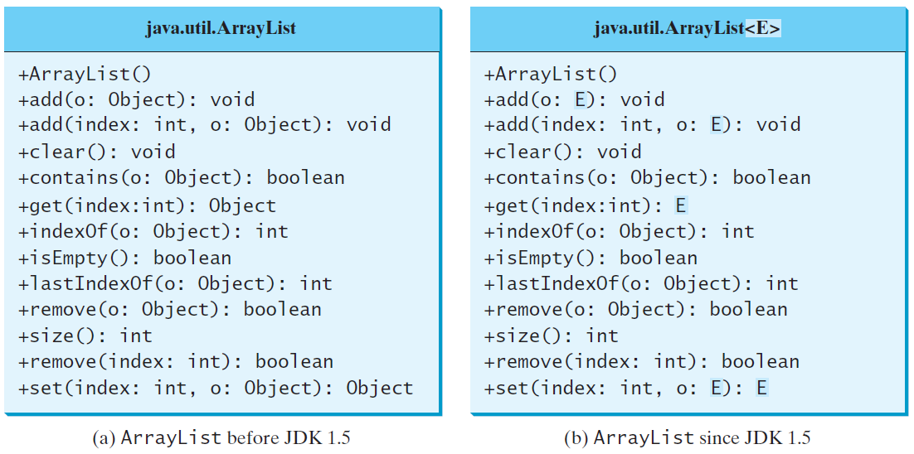
Generic ArrayList in JDK 1.5

Slide 55
Generic sort Method
Let n be an Integer object, s be a String object, and d be a Date object. All the following expressions are true.
The java.util.Arrays.sort(array) method requires that the elements in an array are instances of Comparable<E>.
SortComparableObjects
Run
55

Slide 56
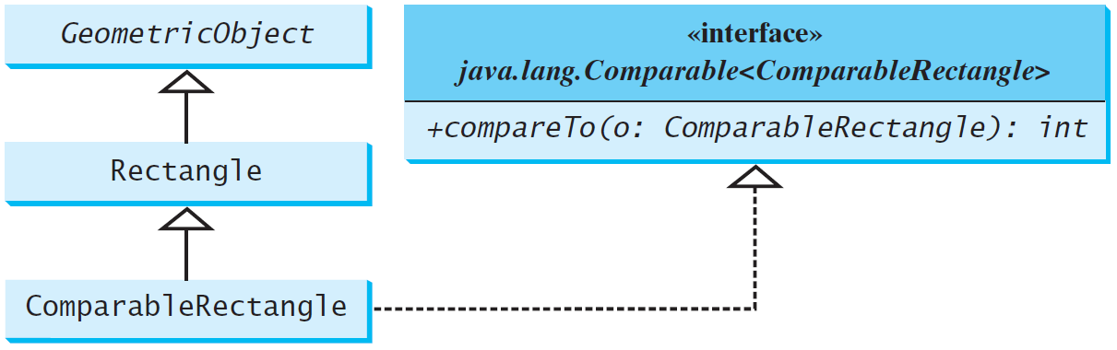
Defining Classes to Implement Comparable
ComparableRectangle
SortRectangles
Run
56
Notes:
56

Slide 57
No Casting Needed
ArrayList<Double> list = new ArrayList<>();
list.add(5.5); // 5.5 is automatically converted to new Double(5.5)
list.add(3.0); // 3.0 is automatically converted to new Double(3.0)
Double doubleObject = list.get(0); // No casting is needed
double d = list.get(1); // Automatically converted to double

Slide 58
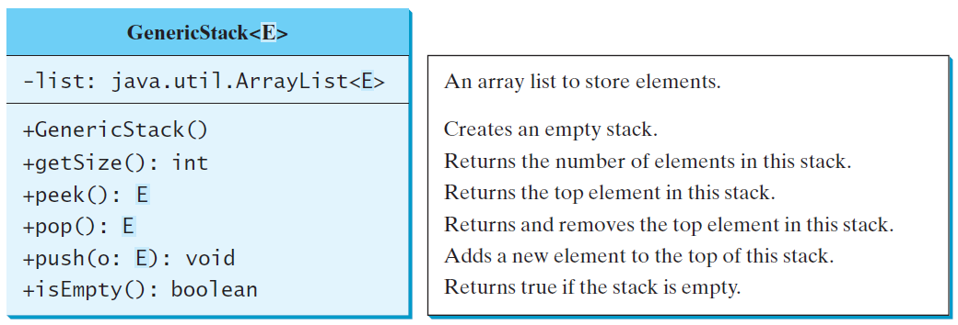
Declaring Generic Classes and Interfaces
GenericStack

Slide 59
Generic Methods
public static <E> void print(E[] list) {
for (int i = 0; i < list.length; i++)
System.out.print(list[i] + " ");
System.out.println();
}
public static void print(Object[] list) {
for (int i = 0; i < list.length; i++)
System.out.print(list[i] + " ");
System.out.println();
}

Slide 60
Bounded Generic Type
public static void main(String[] args ) {
Rectangle rectangle = new Rectangle(2, 2);
Circle circle = new Circle (2);
System.out.println("Same area? " + equalArea(rectangle, circle));
}
public static <E extends GeometricObject> boolean
equalArea(E object1, E object2) {
return object1.getArea() == object2.getArea();
}

Slide 61
Raw Type and Backward Compatibility
// raw type
ArrayList list = new ArrayList();
This is roughly equivalent to
ArrayList<Object> list = new ArrayList<Object>();

Slide 62
Caution: conflict interfaces
In rare occasions, a class may implement two interfaces with conflict information (e.g., two same constants with different values or two methods with same signature but different return type). This type of errors will be detected by the compiler.
62

Slide 63
Raw Type is Unsafe
// Max.java: Find a maximum object
public class Max {
/** Return the maximum between two objects */
public static Comparable max(Comparable o1, Comparable o2) {
if (o1.compareTo(o2) > 0)
return o1;
else
return o2;
}
}
Runtime Error:
Max.max("Welcome", 23);

Slide 64
Make it Safe
// Max1.java: Find a maximum object
public class Max1 {
/** Return the maximum between two objects */
public static <E extends Comparable<E>> E max(E o1, E o2) {
if (o1.compareTo(o2) > 0)
return o1;
else
return o2;
}
}
Max.max("Welcome", 23);

Slide 65
Wildcards
Why wildcards are necessary? See this example.
WildCardNeedDemo
? unbounded wildcard
? extends T bounded wildcard
? super T lower bound wildcard
AnyWildCardDemo
SuperWildCardDemo

Slide 66
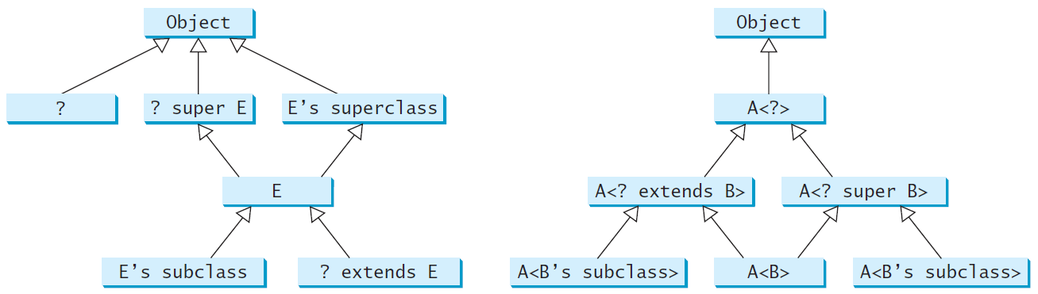
Generic Types and Wildcard Types

Slide 67
End

Slide 68
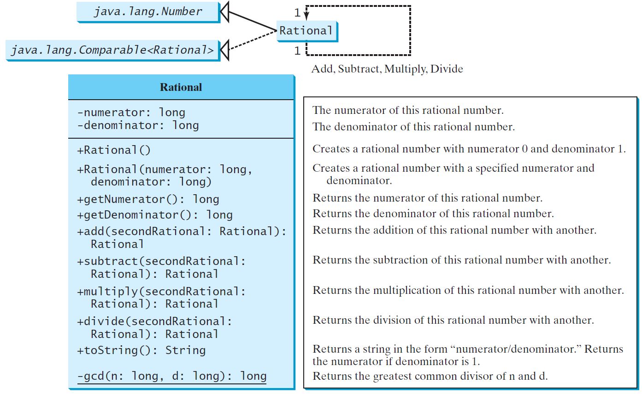
The Rational Class
Rational
TestRationalClass
Run
68

Slide 69
Designing a Class
(Coherence) A class should describe a single entity, and all the class operations should logically fit together to support a coherent purpose. You can use a class for students, for example, but you should not combine students and staff in the same class, because students and staff have different entities.

Slide 70
Designing a Class, cont.
(Separating responsibilities) A single entity with too many responsibilities can be broken into several classes to separate responsibilities. The classes String, StringBuilder, and StringBuffer all deal with strings, for example, but have different responsibilities. The String class deals with immutable strings, the StringBuilder class is for creating mutable strings, and the StringBuffer class is similar to StringBuilder except that StringBuffer contains synchronized methods for updating strings.

Slide 71
Designing a Class, cont.
Classes are designed for reuse. Users can incorporate classes in many different combinations, orders, and environments. Therefore, you should design a class that imposes no restrictions on what or when the user can do with it, design the properties to ensure that the user can set properties in any order, with any combination of values, and design methods to function independently of their order of occurrence.

Slide 72
Designing a Class, cont.
Provide a public no-arg constructor and override the equals method and the toString method defined in the Object class whenever possible.

Slide 73
Designing a Class, cont.
Follow standard Java programming style and naming conventions. Choose informative names for classes, data fields, and methods. Always place the data declaration before the constructor, and place constructors before methods. Always provide a constructor and initialize variables to avoid programming errors.

Slide 74
Using Visibility Modifiers
Each class can present two contracts – one for the users of the class and one for the extenders of the class. Make the fields private and accessor methods public if they are intended for the users of the class. Make the fields or method protected if they are intended for extenders of the class. The contract for the extenders encompasses the contract for the users. The extended class may increase the visibility of an instance method from protected to public, or change its implementation, but you should never change the implementation in a way that violates that contract.

Slide 75
Using Visibility Modifiers, cont.
A class should use the private modifier to hide its data from direct access by clients. You can use get methods and set methods to provide users with access to the private data, but only to private data you want the user to see or to modify. A class should also hide methods not intended for client use. The gcd method in the Rational class is private, for example, because it is only for internal use within the class.

Slide 76
Using the static Modifier
A property that is shared by all the instances of the class should be declared as a static property.

