Slide 1
Events, Inner Classes, Lambda Expressions
(and some minor GUI)

Slide 2
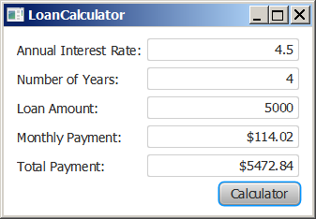
Motivations
Suppose you want to write a GUI program that lets the user enter a loan amount, annual interest rate, and number of years and click the Compute Payment button to obtain the monthly payment and total payment. How do you accomplish the task? You have to use event-driven programming to write the code to respond to the button-clicking event.
LoanCalculator
Run

Slide 3
Notes about GUI development
Some of you have done some basic GUI work for this class
We will address more advanced GUI development later
This lecture won’t require any significant GUI development experience if you don’t have any

Slide 4
Procedural vs. Event-Driven Programming
Procedural programming is executed in procedural order.
In event-driven programming, code is executed upon activation of events.

Slide 5
Event Driven Programming
Class1 code
Class2 code
Generate event
Wait for incoming event
React to event

Slide 6
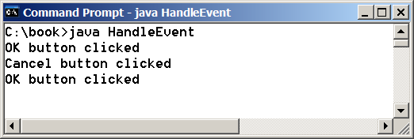
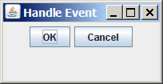
Taste of Event-Driven Programming
The example displays a button in the frame. A message is displayed on the console when a button is clicked.
HandleEvent
Run

Slide 7
Events
An event can be defined as a type of signal to the program that something has happened.
The event is generated by external user actions such as mouse movements, mouse clicks, or keystrokes.

Slide 8
TimerTask Example
TimePrinter
Timer
Timer sends events.
The TimePrinter is set to listen to events
from the Timer

Slide 9
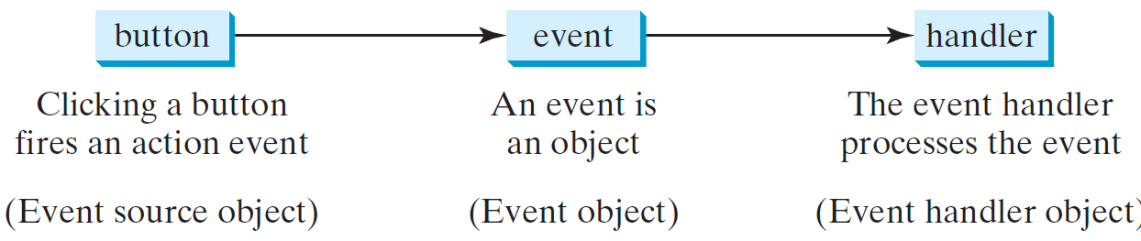
Handling GUI Events
Source object (e.g., button)
Listener object contains a method for processing the event.

Slide 10
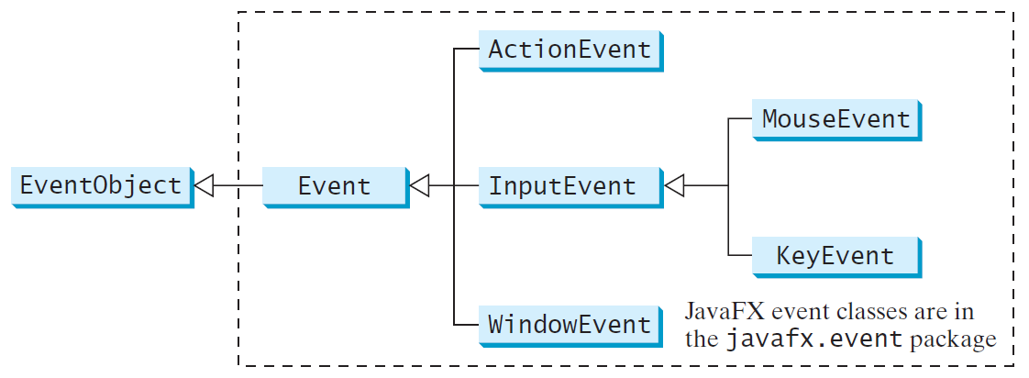
Event Classes

Slide 11
Event Information
An event object contains whatever properties are pertinent to the event. You can identify the source object of the event using the getSource() instance method in the EventObject class. The subclasses of EventObject deal with special types of events, such as button actions, window events, mouse movements, and keystrokes. Table 16.1 lists external user actions, source objects, and event types generated.

Slide 12
Inner Class Listeners
A listener class is designed specifically to create a listener object for a GUI component (e.g., a button). It will not be shared by other applications. So, it is appropriate to define the listener class inside the frame class as an inner class.

Slide 13
Inner Classes
Inner class: A class is a member of another class.
Advantages: In some applications, you can use an inner class to make programs simple.
An inner class can reference the data and methods defined in the outer class in which it nests, so you do not need to pass the reference of the outer class to the constructor of the inner class.
ShowInnerClass

Slide 14
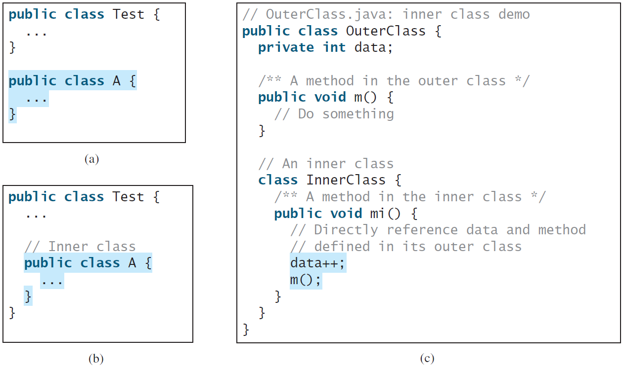
Inner Classes, cont.

Slide 15
Inner Classes (cont.)
Inner classes can make programs simple and concise.
An inner class supports the work of its containing outer class and is compiled into a class named OuterClassName$InnerClassName.class. For example, the inner class InnerClass in OuterClass is compiled into OuterClass$InnerClass.class.

Slide 16
Inner Classes (cont.)
An inner class can be declared public, protected, or private subject to the same visibility rules applied to a member of the class.
An inner class can be declared static. A static inner class can be accessed using the outer class name. A static inner class cannot access nonstatic members of the outer class

Slide 17
Lambda Expressions
A lambda expression is an unnamed function you can pass as an argument
This isn’t that weird! You already pass unnamed parameters as arguments!
String myString = “Hello!”;
System.out.println(myString); ← named parameter
System.out.println(“Goodbye!”) ← unnamed parameter

Slide 18
Lambda Expressions, cont.
When we declare a function/method:
Just eliminate all the names involved:
public int compare(String first, String record) {
return first.length() – second.length();
}
(String first, String record) ->
return first.length() – second.length();

Slide 19
Lambda Expressions, cont.
Many Java methods take a functional interface as an argument
  Remember sorting? A sort method takes a function explaining how to sort.

Slide 20
Basic Syntax for a Lambda Expression
The basic syntax for a lambda expression is either
(type1 param1, type2 param2, ...) -> expression
or
(type1 param1, type2 param2, ...) -> { statements; }
The data type for a parameter may be explicitly declared or implicitly inferred by the compiler. The parentheses can be omitted if there is only one parameter without an explicit data type.

Slide 21
Example: iterating through an Array
List<Integer> intList = Arrays.asList(1,2,3);
for (Integer i in intList)
System.out.println(i);
// or we can write it like this in Java8
intList.forEach(new Consumer<Integer>() {
public void accept(Integer i) {
System.out.println(i);
}
});
// Lambdas mean we don’t have to write out
// the function
intList.forEach((Integer i) -> System.out.println(i));

Slide 22
Lambda Syntax Options
Examples from
lambdafaq.org
Lambda Syntax
  (parameters) -> expression
  Or (parameters) -> {statements;}
    Parameter types may be inferred
    Parentheses may be omitted for a single inferred-type parameter
Examples
(int x, int y) -> x + y // takes two integers and returns their sum
(x, y) -> x - y // takes two numbers and returns their difference
() -> 42 // takes no values and returns 42
(String s) -> System.out.println(s) // takes a string, prints its value
x -> 2 * x // takes a number and returns the result of doubling it
c -> { int s = c.size(); c.clear(); return s; } // takes a collection,
// clears it, and returns its previous size

Slide 23
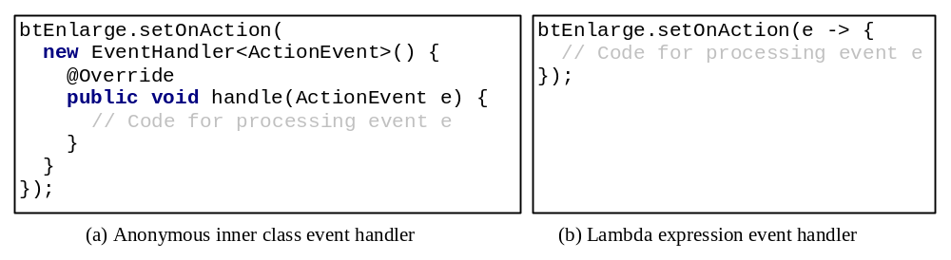
Simplifying Event Handing Using Lambda Expressions
And that applies to Event Handling, as well.

Slide 24
Single Abstract Method Interface (SAM)
The statements in the lambda expression is all for that method. If it contains multiple methods, the compiler will not be able to compile the lambda expression. So, for the compiler to understand lambda expressions, the interface must contain exactly one abstract method. Such an interface is known as a functional interface, or a Single Abstract Method (SAM) interface.
AnonymousHandlerDemo
Run

Slide 25
SAM Interface examples
// in java.util package
interface Comparator<T> { boolean compare(T x, T y); }
// java.awt.event package:
interface ActionListener { void actionPerformed(ActionEvent e); }
// java.io package
interface FileFilter { boolean accept(File pathName); }

