Slide 1
Collections Reading:
Liang Chapter 20-21, Horstmann Chapter 9 & 5.2: Lists, Stacks, Queues, and Priority Queues;
Sets and Maps
Graphics Reading:
Deitel & Deitel Chapter 13
Horstman Chapter 10.2

Slide 2
Graphics: Introduction
Overview capabilities for drawing two-dimensional shapes, controlling colors and controlling fonts.
One of Java’s initial appeals was its support for graphics that enabled programmers to visually enhance their applications.
Java now contains many more sophisticated drawing capabilities as part of the Java 2D™ API.
Figure 15.1 shows a portion of the Java class hierarchy that includes several of the basic graphics classes and Java 2D API classes and interfaces covered in this chapter.

Slide 3
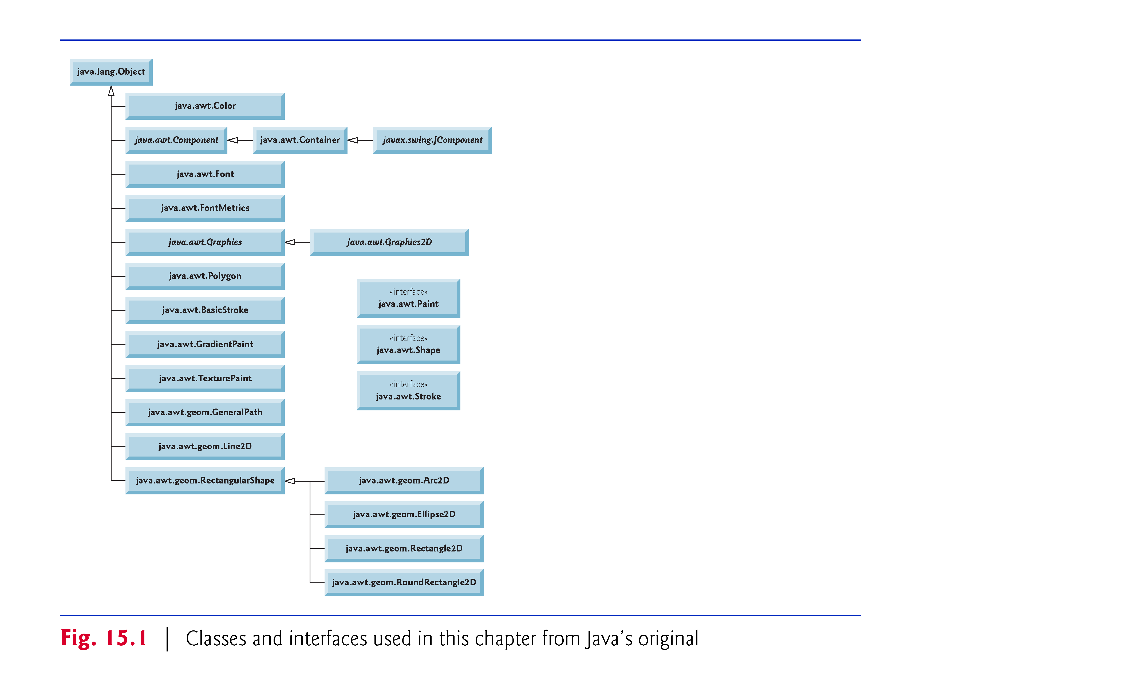

Slide 4
Introduction (cont.)
Class Color contains methods and constants for manipulating colors.
Class JComponent contains method paintComponent, which is used to draw graphics on a component.
Class Font contains methods and constants for manipulating fonts.
Class FontMetrics contains methods for obtaining font information.
Class Graphics contains methods for drawing strings, lines, rectangles and other shapes.
Class Graphics2D, which extends class Graphics, is used for drawing with the Java 2D API.

Slide 5
15.1 Introduction (cont.)
© Copyright 1992-2012 by Pearson Education, Inc. All Rights Reserved.
Class Polygon contains methods for creating polygons. The bottom half of the figure lists several classes and interfaces from the Java 2D API.
Class BasicStroke helps specify the drawing characteristics of lines.
Classes GradientPaint and TexturePaint help specify the characteristics for filling shapes with colors or patterns.
Classes GeneralPath, Line2D, Arc2D, Ellipse2D, Rectangle2D and RoundRectangle2D represent several Java 2D shapes.

Slide 6
15.1 Introduction (cont.)
© Copyright 1992-2012 by Pearson Education, Inc. All Rights Reserved.
Coordinate system (Fig. 15.2)
  a scheme for identifying every point on the screen.
The upper-left corner of a GUI component (e.g., a window) has the coordinates (0, 0).
A coordinate pair is composed of an x-coordinate (the horizontal coordinate) and a y-coordinate (the vertical coordinate).
  x-coordinates from left to right.
  y-coordinates from top to bottom.
The x-axis describes every horizontal coordinate, and the y-axis every vertical coordinate.
Coordinate units are measured in pixels.
  A pixel is a display monitor’s smallest unit of resolution.

Slide 7
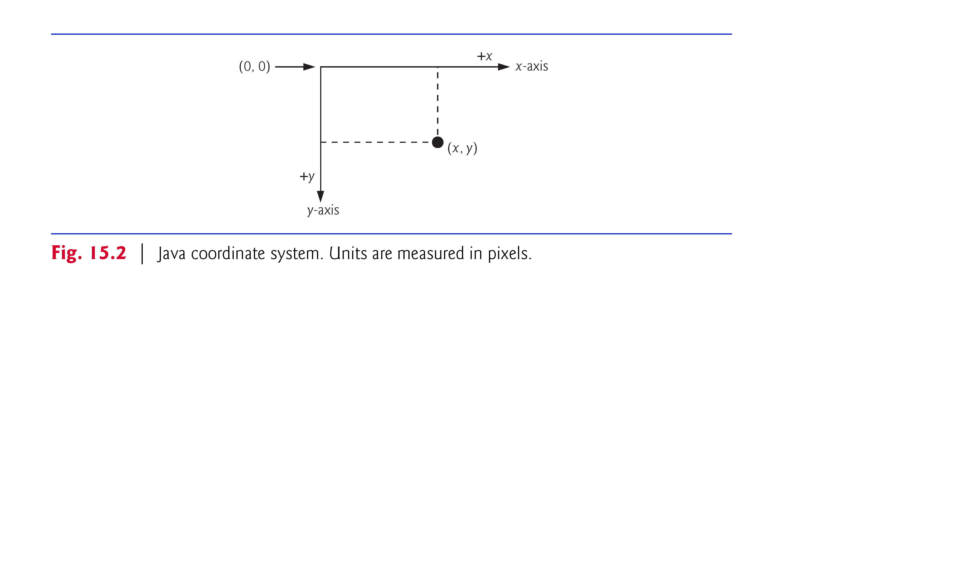
© Copyright 1992-2012 by Pearson Education, Inc. All Rights Reserved.

Slide 8
Graphics Contexts and Graphics Objects
A graphics context enables drawing on the screen.
A Graphics object manages a graphics context and draws pixels on the screen.
Graphics objects contain methods for drawing, font manipulation, color manipulation and the like.
Class JComponent (package javax.swing) contains a paintComponent for drawing graphics.
  Takes a Graphics object as an argument.
  Passed to the paintComponent method by the system when a lightweight Swing component needs to be repainted.

Slide 9
Graphics Contexts and Graphics Objects (cont.)
© Copyright 1992-2012 by Pearson Education, Inc. All Rights Reserved.
When you create a GUI-based application, one of those threads is known as the event-dispatch thread (EDT) and it is used to process all GUI events.
All drawing and manipulation of GUI components should be performed in that thread.
The application container calls method paintComponent (in the EDT) for each lightweight component as the GUI is displayed.
If you need paintComponent to execute, you can call method repaint, which is inherited by all JComponents indirectly from class Component (package java.awt).

Slide 10
Color Control
© Copyright 1992-2012 by Pearson Education, Inc. All Rights Reserved.
Class Color declares methods and constants for manipulating colors in a Java program.
The predeclared color constants are summarized in Fig. 15.3, and several color methods and constructors are summarized in Fig. 15.4.
Two of the methods in Fig. 15.4 are Graphics methods that are specific to colors.

Slide 11
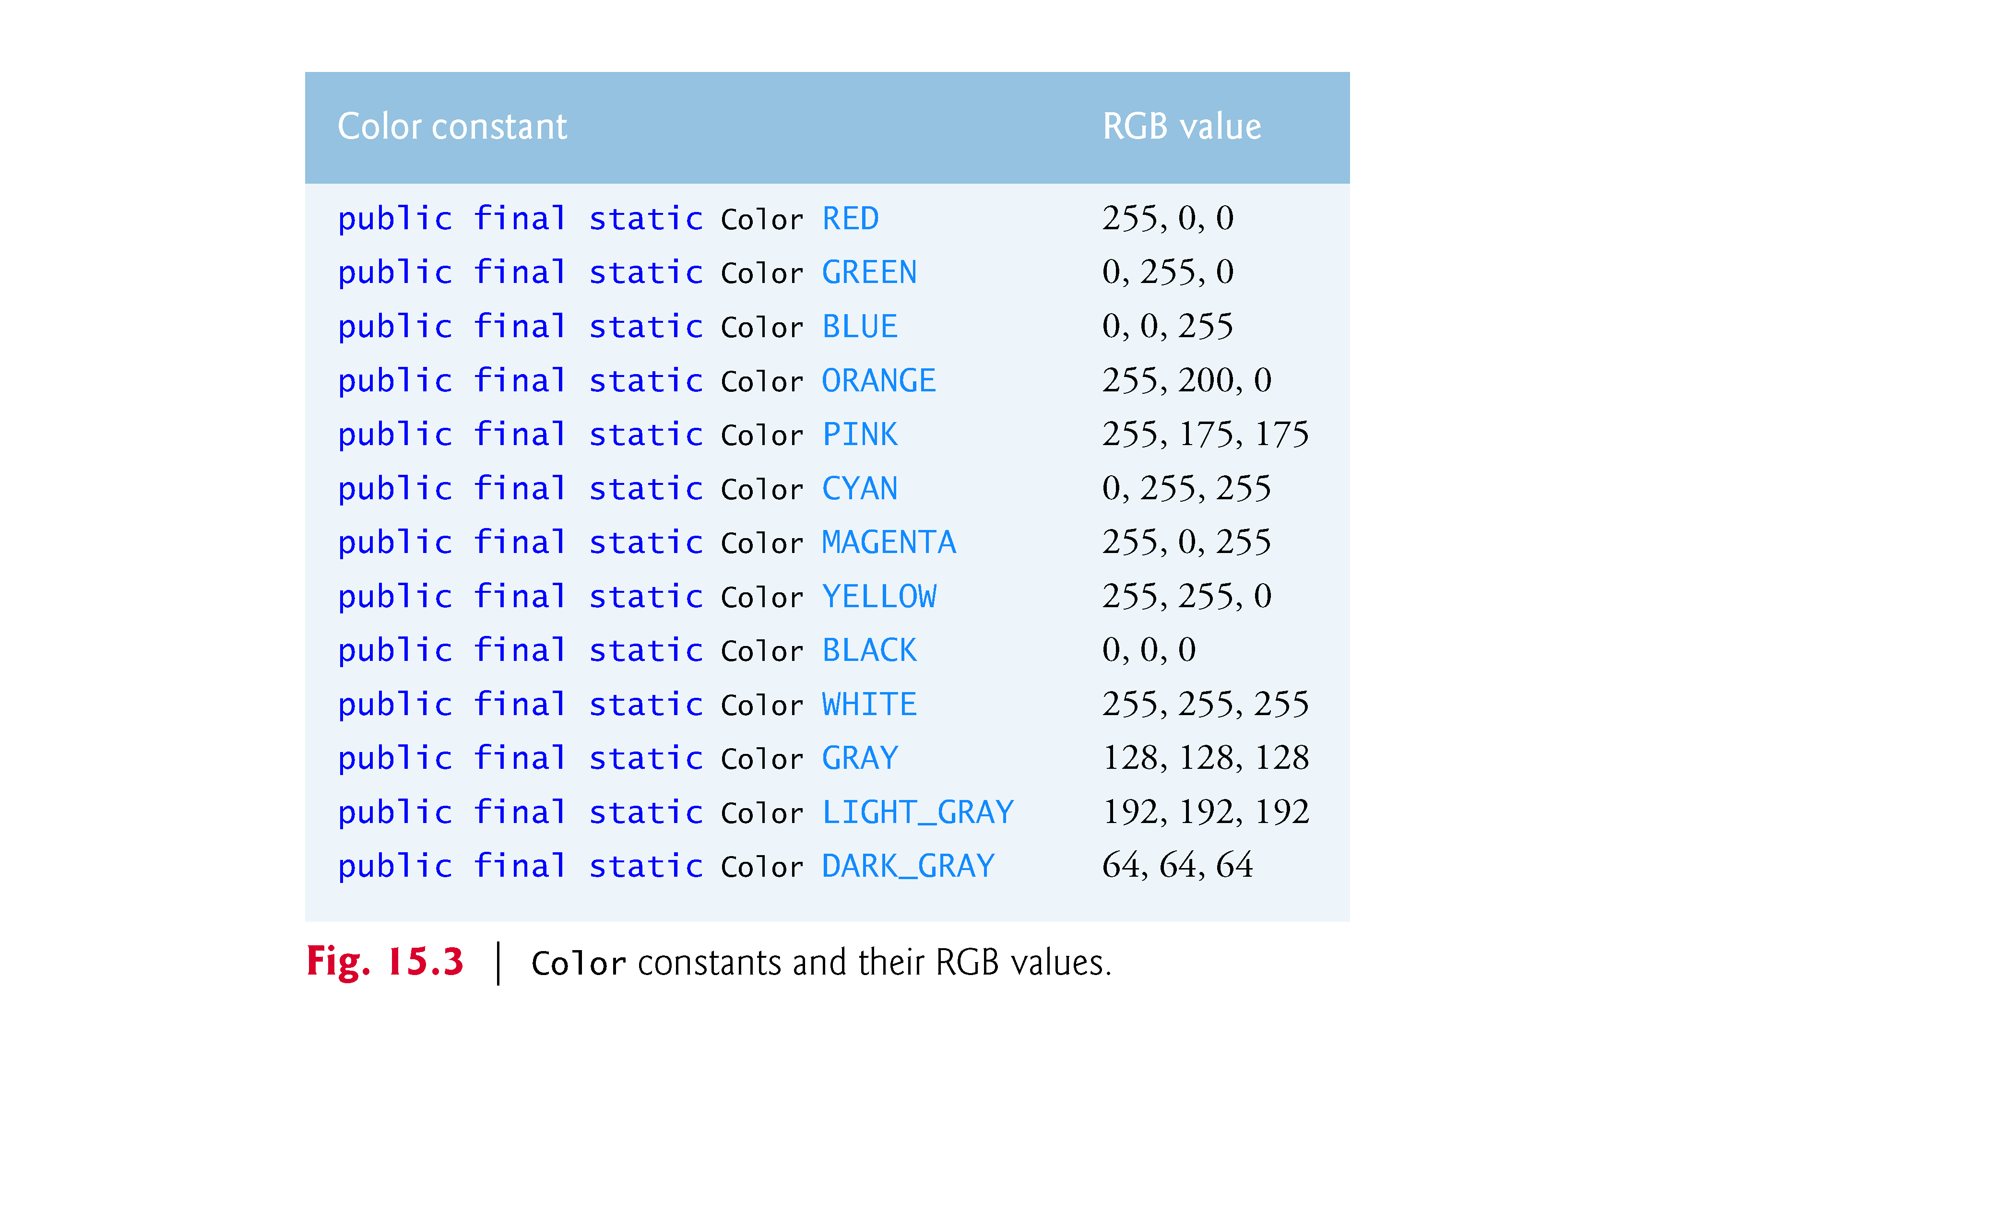
© Copyright 1992-2012 by Pearson Education, Inc. All Rights Reserved.

Slide 12
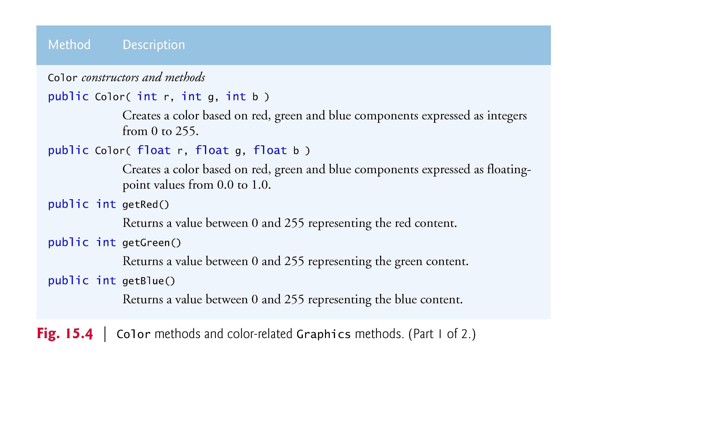
© Copyright 1992-2012 by Pearson Education, Inc. All Rights Reserved.

Slide 13
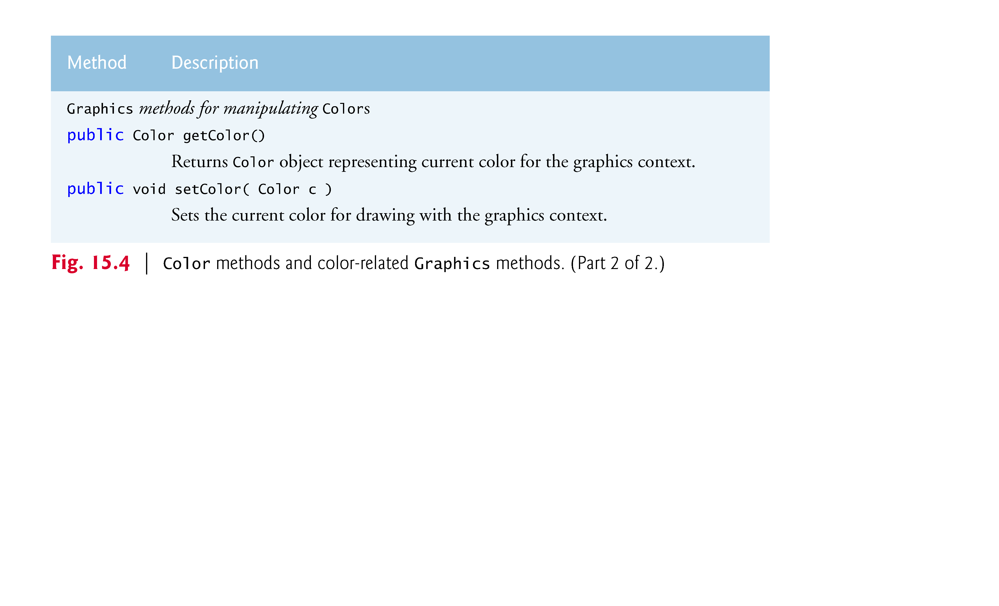
© Copyright 1992-2012 by Pearson Education, Inc. All Rights Reserved.

Slide 14
15.3 Color Control (cont.)
© Copyright 1992-2012 by Pearson Education, Inc. All Rights Reserved.
Every color is created from a red, a green and a blue component.
  RGB values: Integers in the range from 0 to 255, or floating-point values in the range 0.0 to 1.0.
  Specifies the amount of red, the second the amount of green and the third the amount of blue.
  Larger values == more of that particular color.
  Approximately 16.7 million colors.
Graphics method getColor returns a Color object representing the current drawing color.
Graphics method setColor sets the current drawing color.

Slide 15
15.3 Color Control (cont.)
© Copyright 1992-2012 by Pearson Education, Inc. All Rights Reserved.
Graphics method fillRect draws a filled rectangle in the current color.
Four arguments:
  The first two integer values represent the upper-left x-coordinate and upper-left y-coordinate, where the Graphics object begins drawing the rectangle.
  The third and fourth arguments are nonnegative integers that represent the width and the height of the rectangle in pixels, respectively.
A rectangle drawn using method fillRect is filled by the current color of the Graphics object.
Graphics method drawString draws a String in the current color.

Slide 16
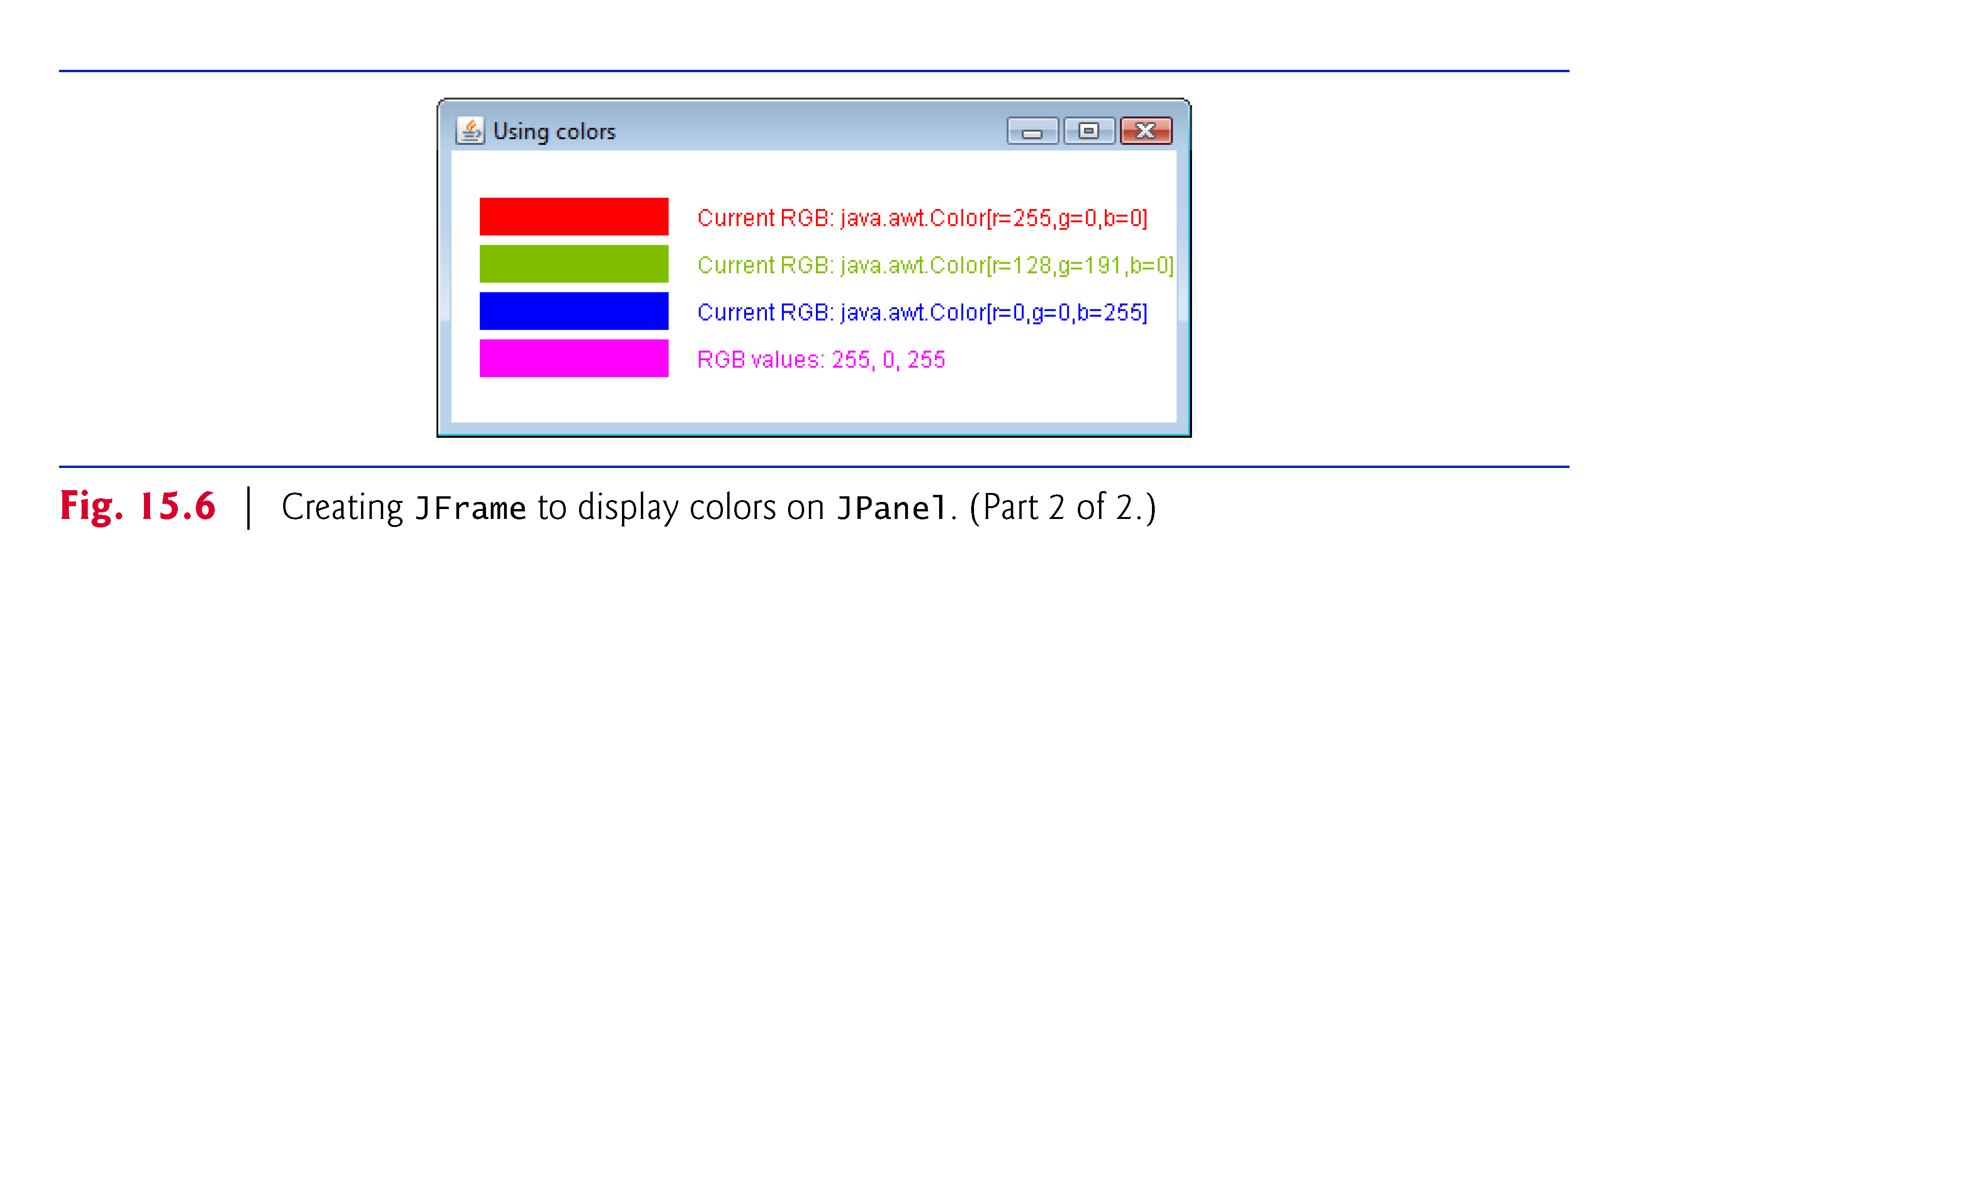
© Copyright 1992-2012 by Pearson Education, Inc. All Rights Reserved.

Slide 17
Drawing Lines, Rectangles and Ovals
© Copyright 1992-2012 by Pearson Education, Inc. All Rights Reserved.
This section presents Graphics methods for drawing lines, rectangles and ovals.
The methods and their parameters are summarized in Fig. 15.17.

Slide 18
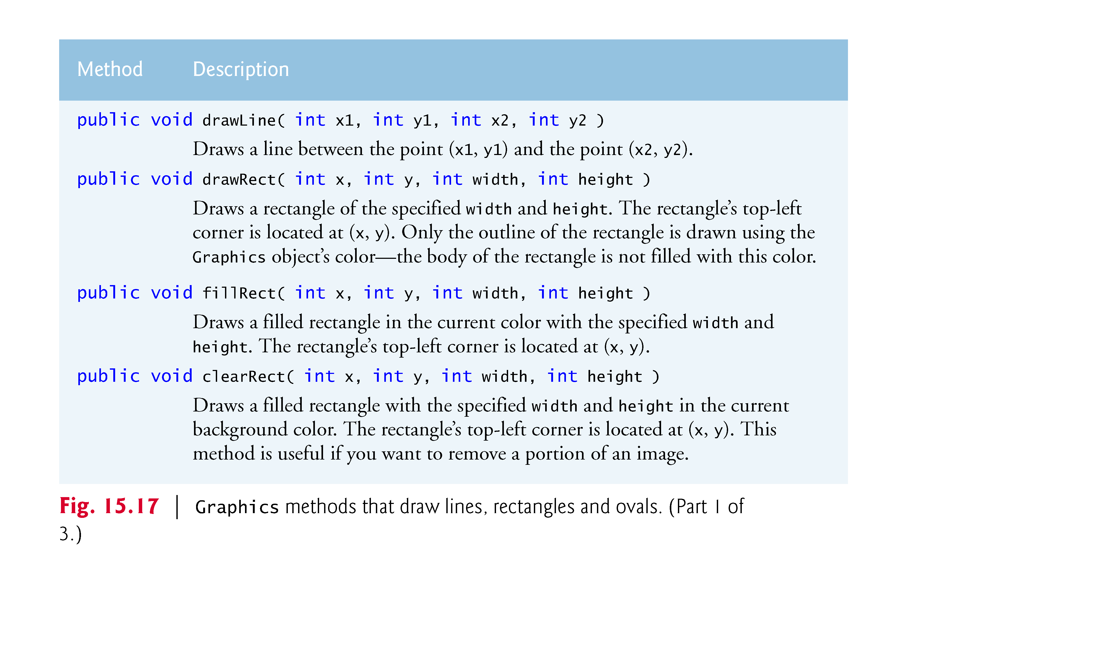

Slide 19
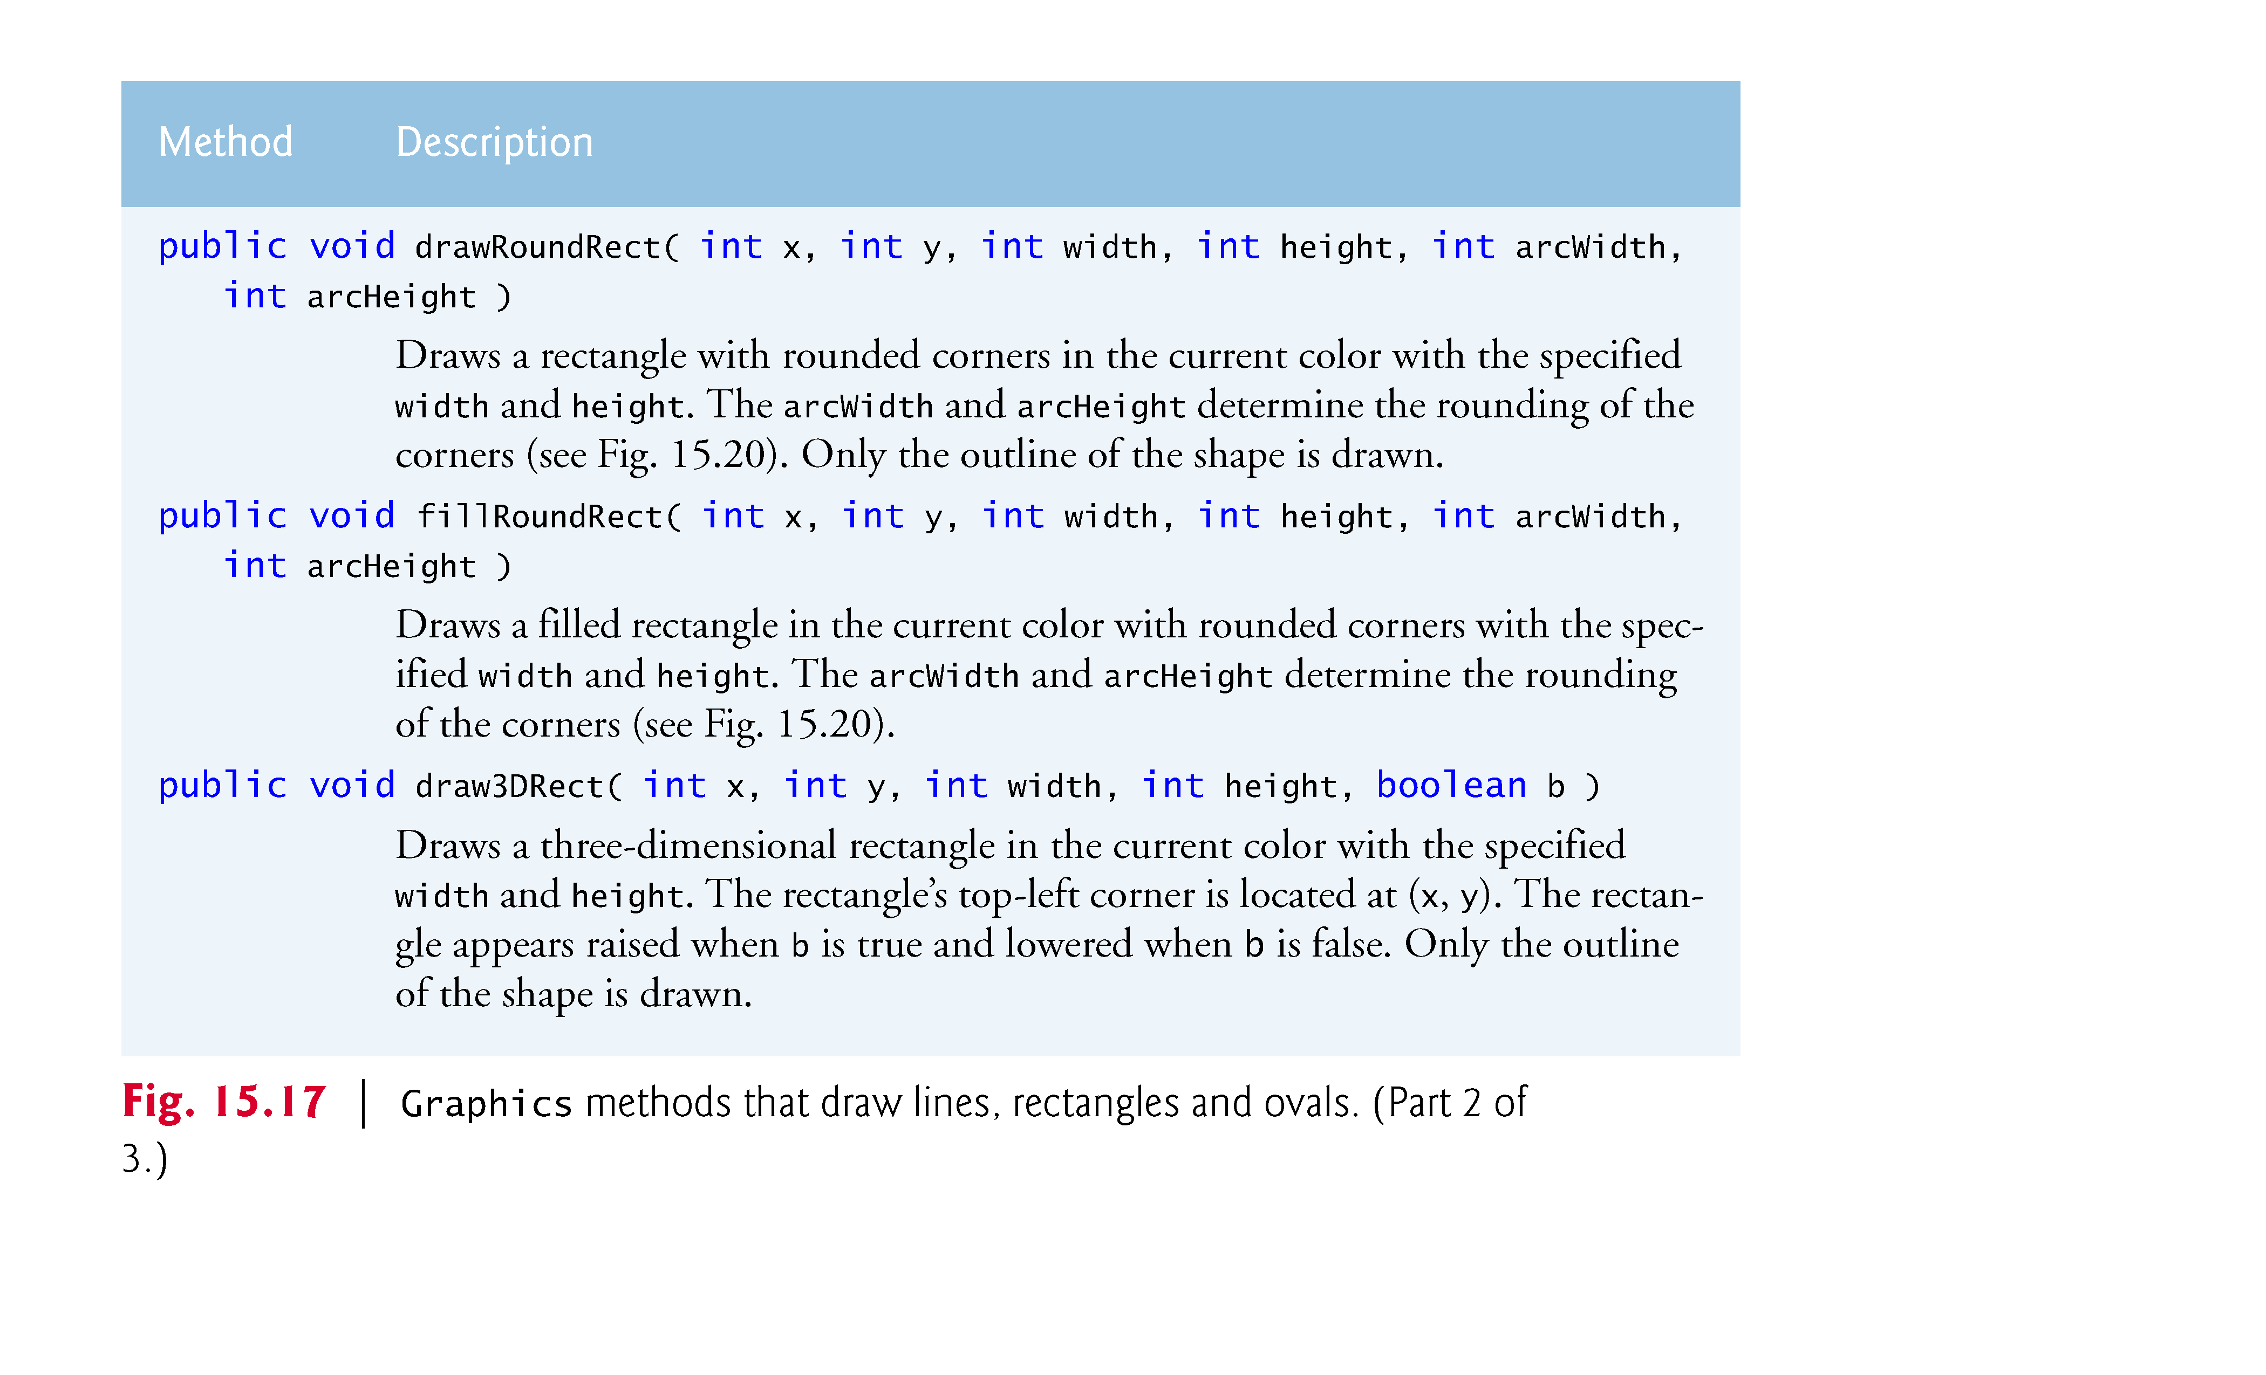

Slide 20
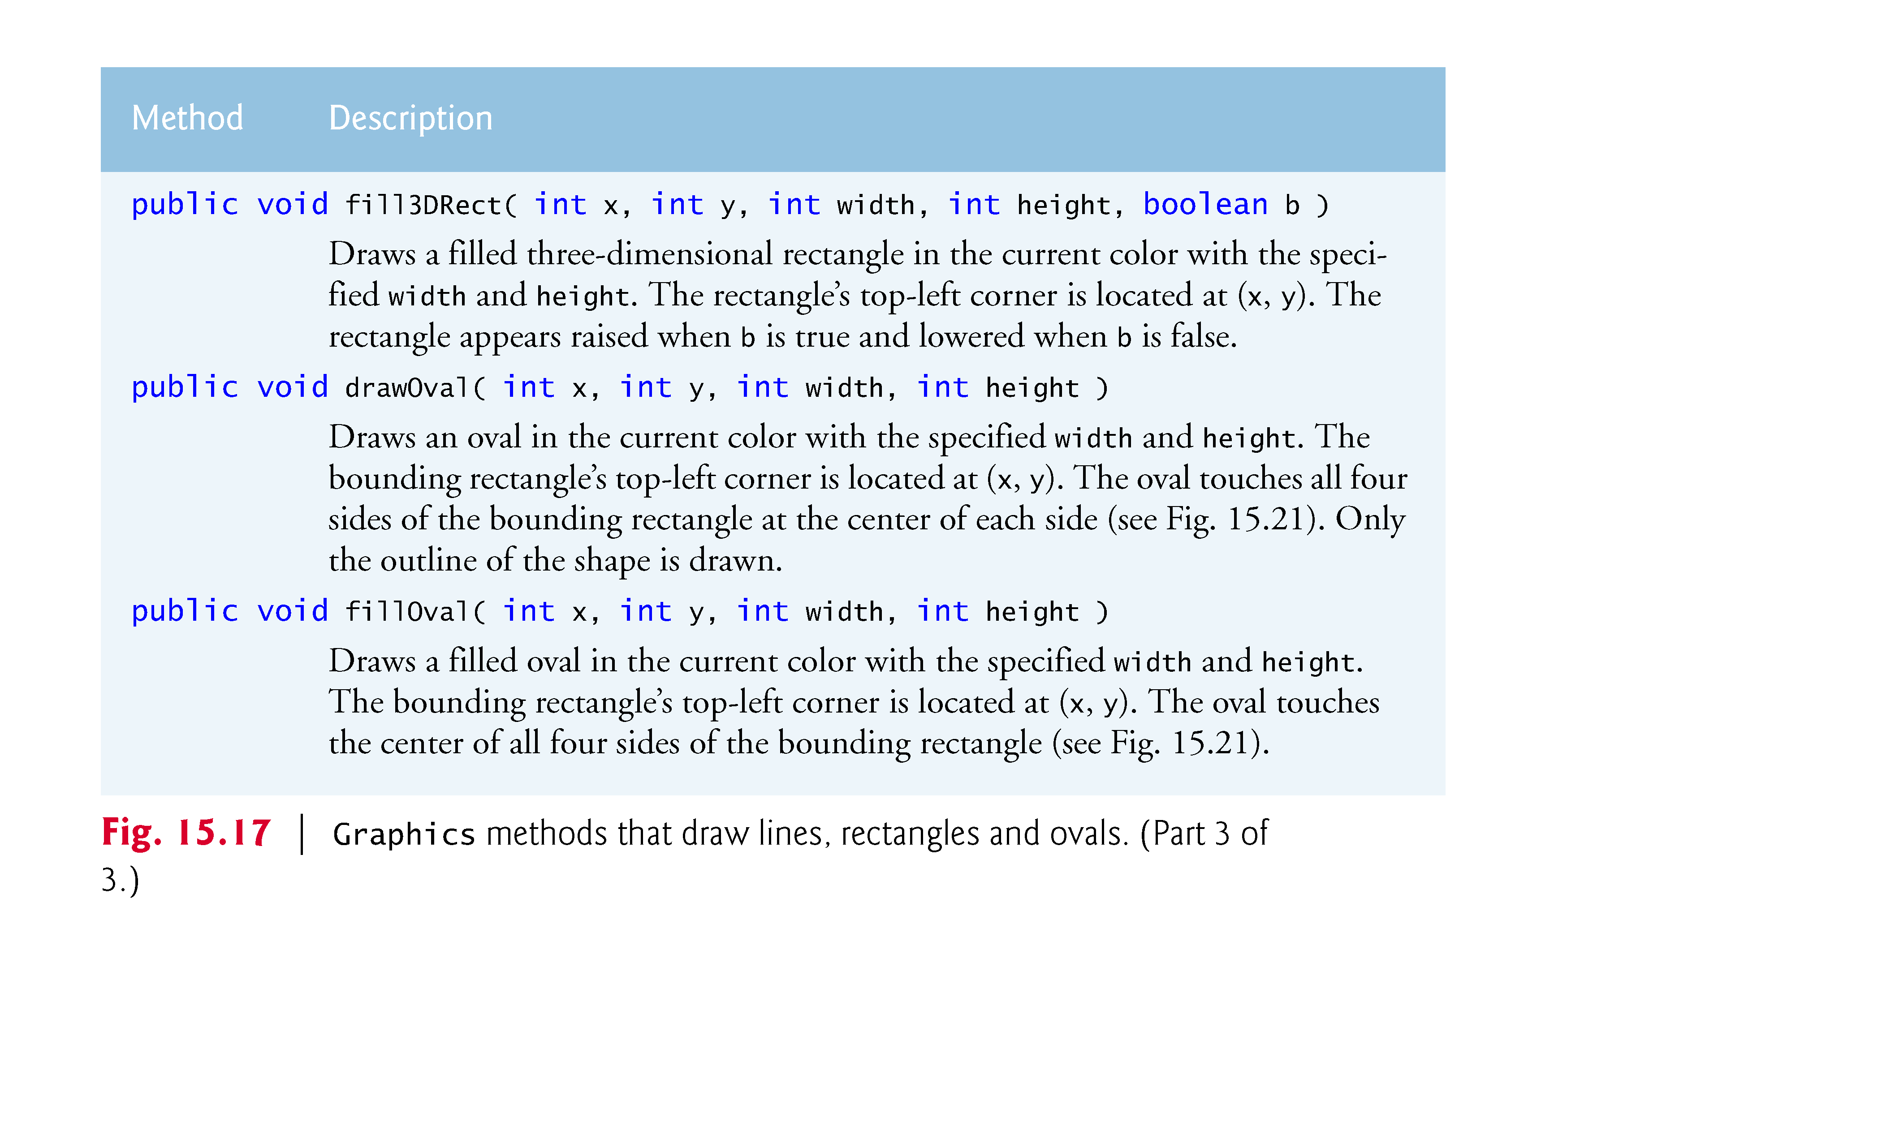

Slide 22
Adding Images
Two relevant classes here:
  javax.swing.ImageIcon
  javax.swing.Image
The ImageIcon class has a constructor ImageIcon(String) that takes a file and returns an Image
In the paintComponent method, g.drawImage takes an Image and coordinates where to draw it

Slide 23
Drawing Lines, Rectangles and Ovals (cont.)
Figure 15.20 labels the arc width, arc height, width and height of a rounded rectangle. Using the same value for the arc width and arc height produces a quarter-circle at each corner.
When the arc width, arc height, width and height have the same values, the result is a circle. If the values for width and height are the same and the values of arcWidth and arcHeight are 0, the result is a square.
Figure 15.21 shows an oval bounded by a rectangle.

Slide 24
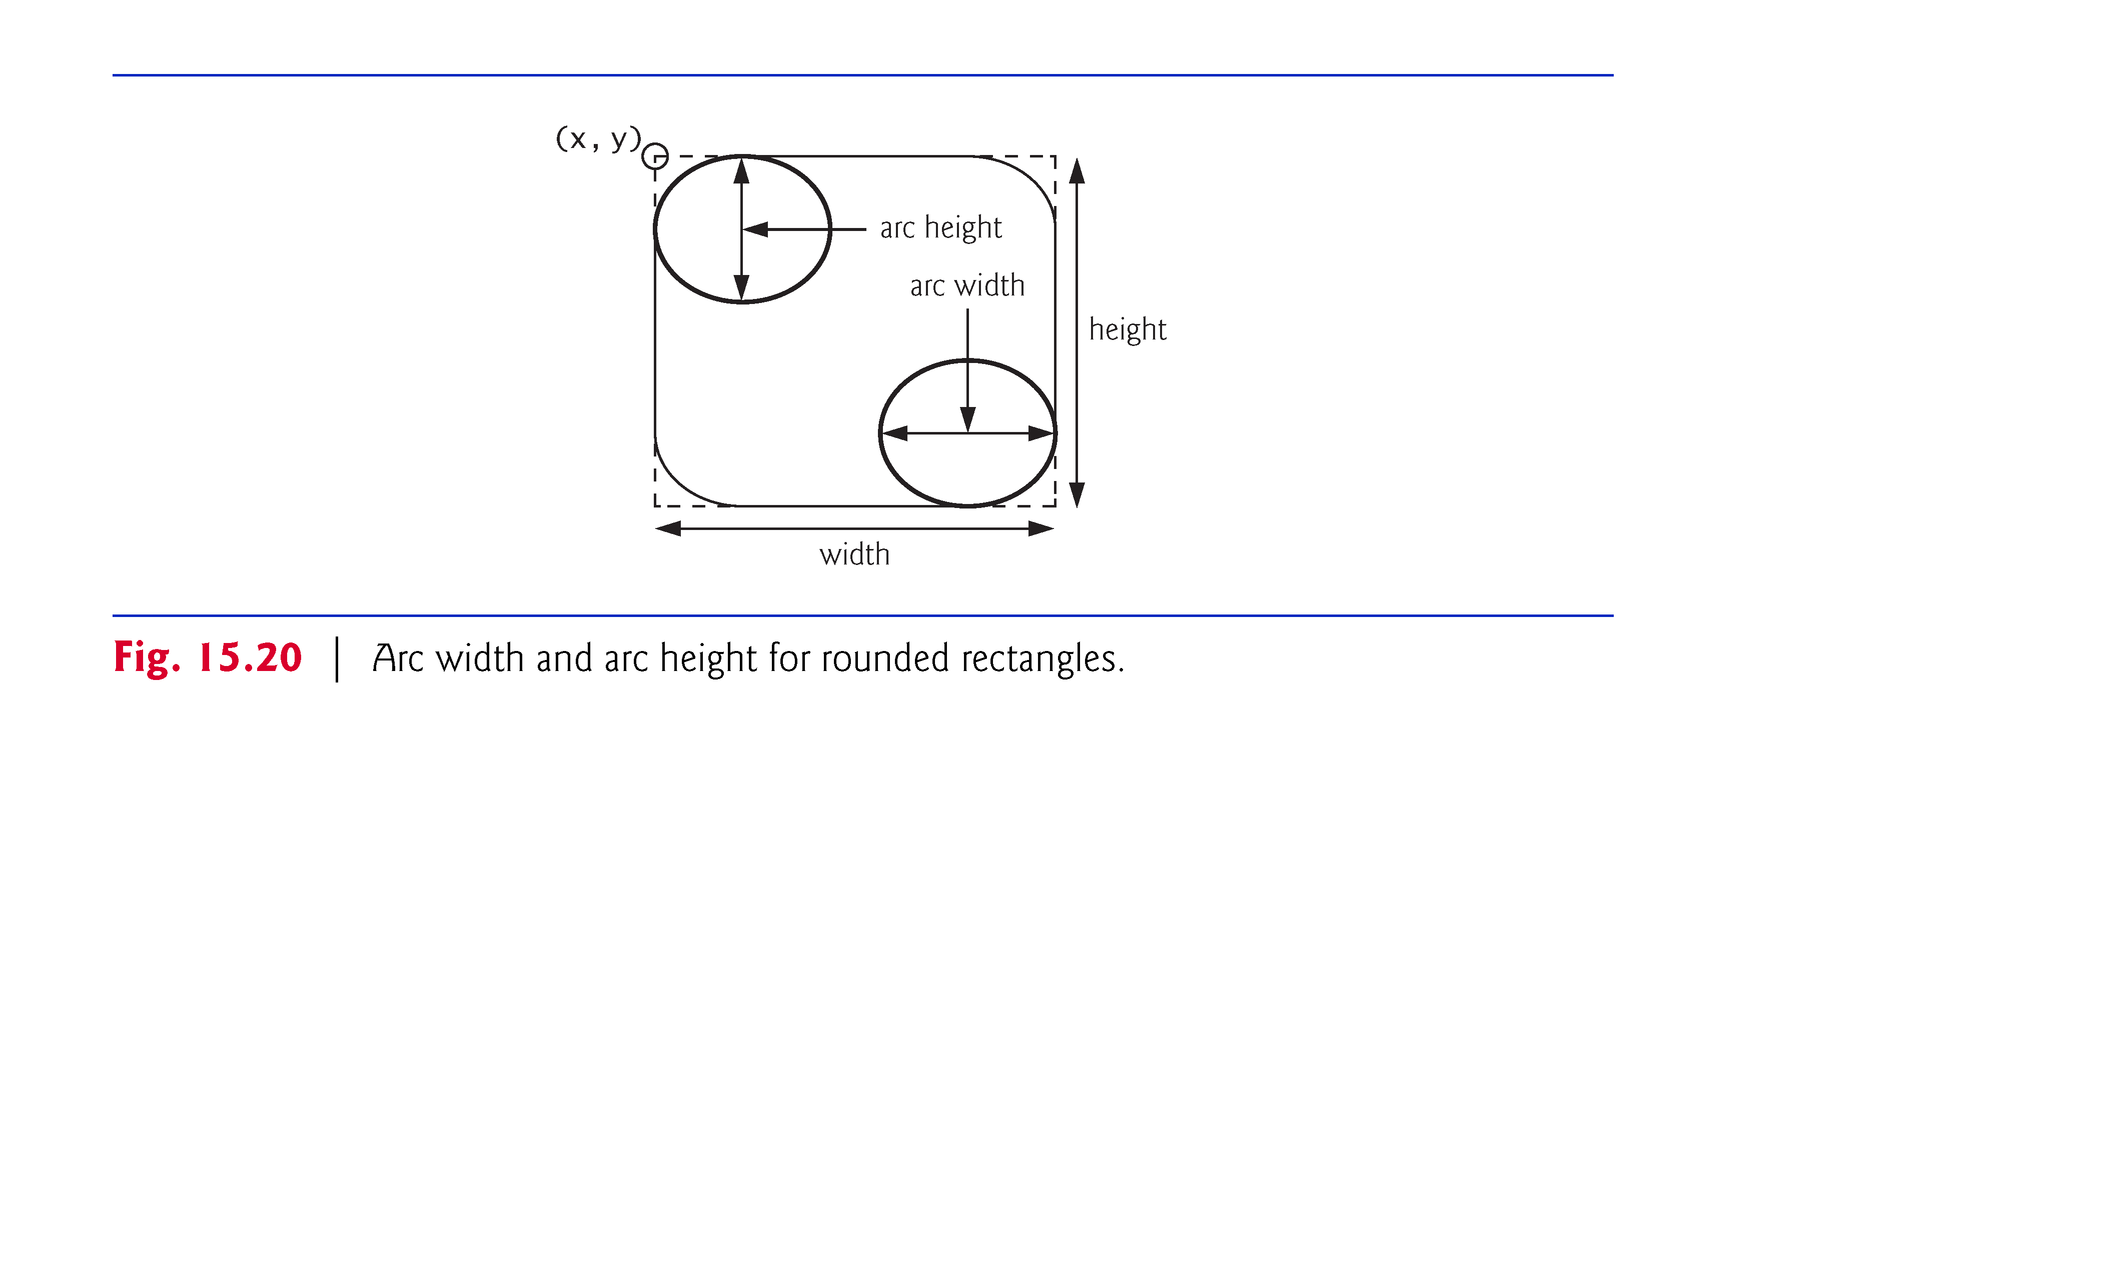

Slide 25
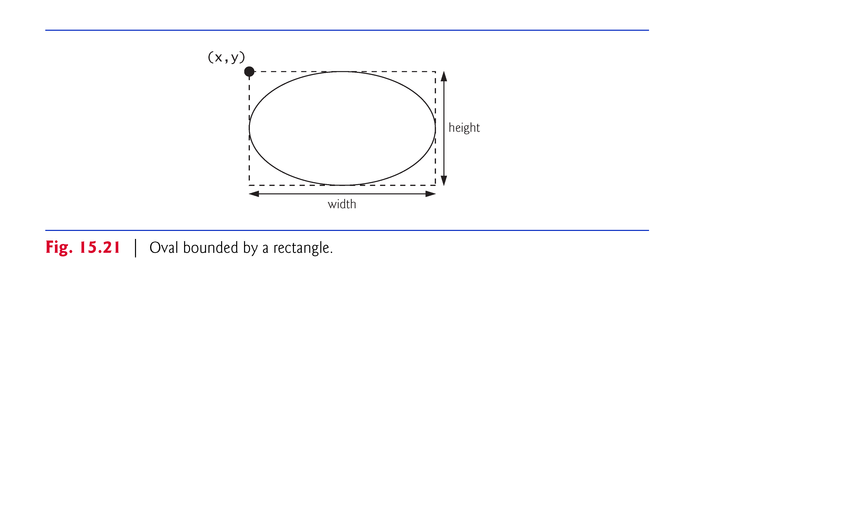
© Copyright 1992-2012 by Pearson Education, Inc. All Rights Reserved.

Slide 26
Objectives
To explore the relationship between interfaces and classes in the Java Collections Framework hierarchy (§20.2).
To use the common methods defined in the Collection interface for operating collections (§20.2).
To use the Iterator interface to traverse the elements in a collection (§20.3).
To use a for-each loop to traverse the elements in a collection (§20.3).
To explore how and when to use ArrayList or LinkedList to store elements (§20.4).
To compare elements using the Comparable interface and the Comparator interface (§20.5).
To use the static utility methods in the Collections class for sorting, searching, shuffling lists, and finding the largest and smallest element in collections (§20.6).
To develop a multiple bouncing balls application using ArrayList (§20.7).
To distinguish between Vector and ArrayList and to use the Stack class for creating stacks (§20.8).
To explore the relationships among Collection, Queue, LinkedList, and PriorityQueue and to create priority queues using the PriorityQueue class (§20.9).
To use stacks to write a program to evaluate expressions (§20.10).

Slide 27
Java Collection Framework hierarchy
A collection is a container object that holds a group of objects, often referred to as elements. The Java Collections Framework supports three types of collections, named lists, sets, and maps.

Slide 28
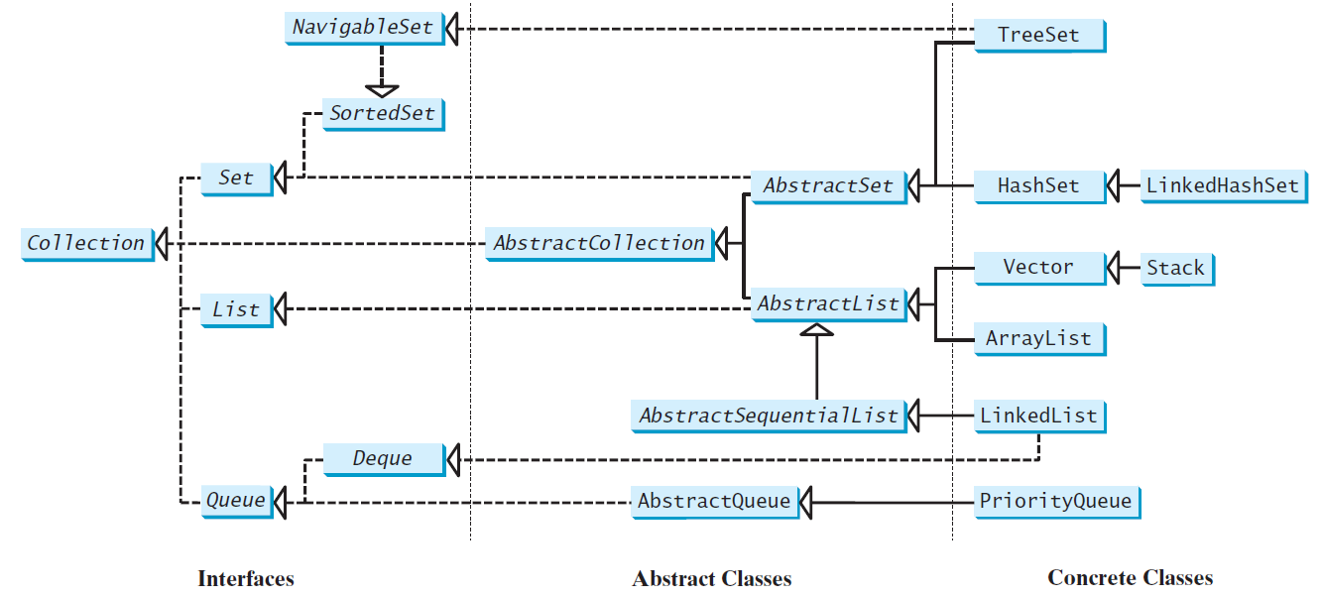
Java Collection Framework hierarchy, cont.
Set and List are subinterfaces of Collection.

Slide 29
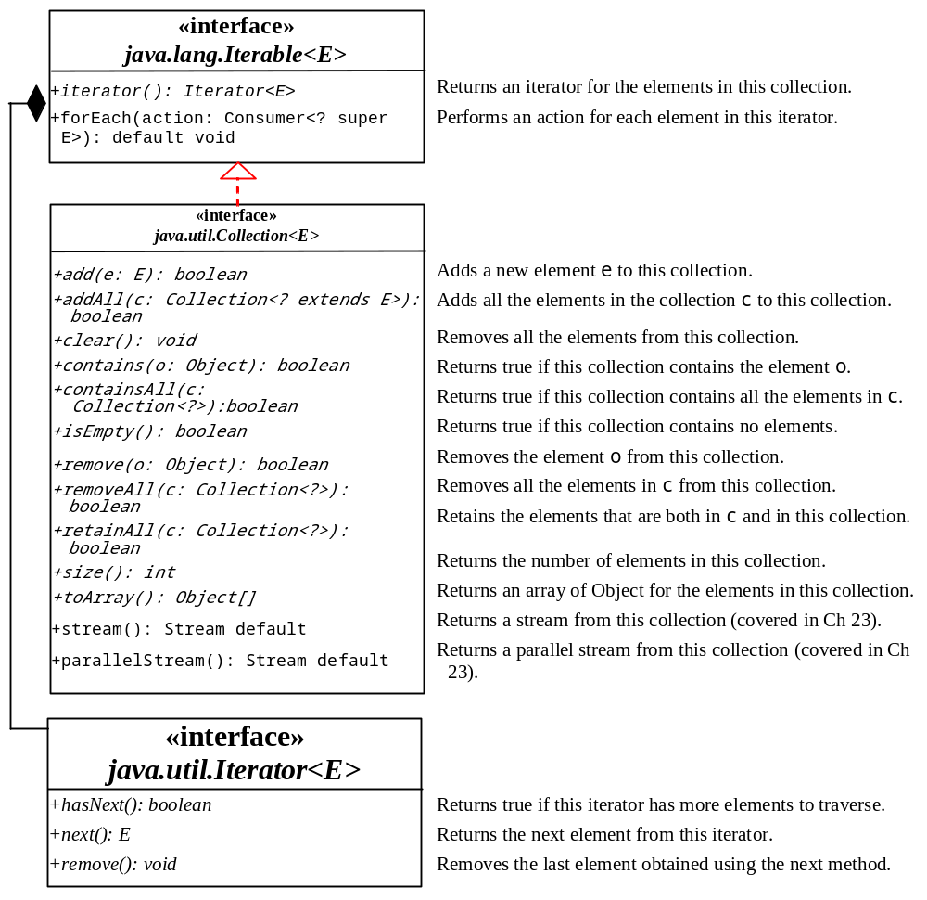
The Collection Interface
The Collection interface is for manipulating a collection of objects.

Slide 30
The List Interface
A list stores elements in a sequential order, and allows the user to specify where the element is stored. The user can access the elements by index.

Slide 31
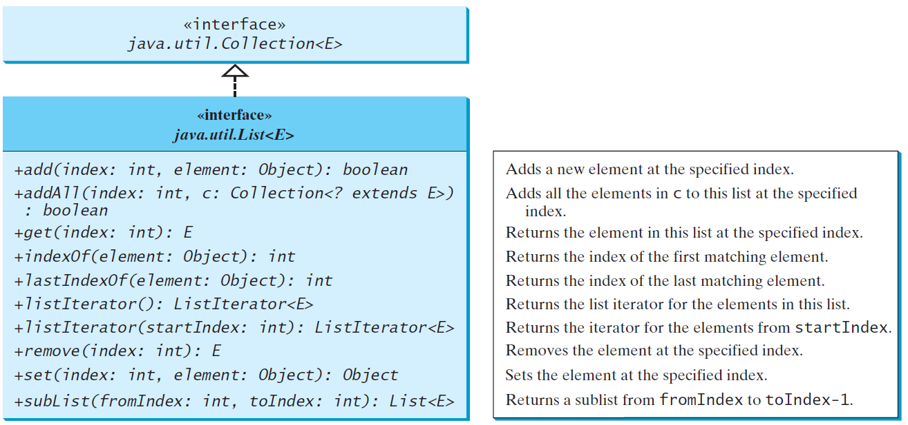
The List Interface, cont.

Slide 32
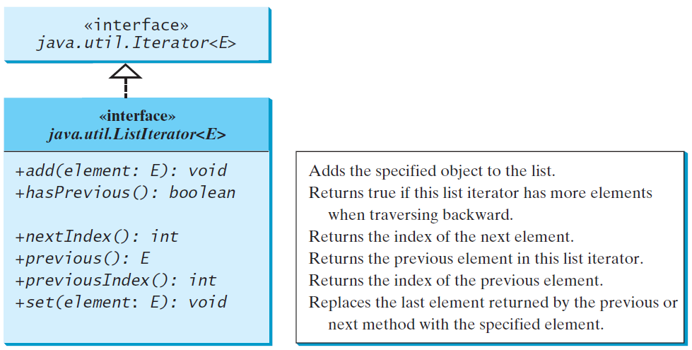
The List Iterator

Slide 33
ArrayList and LinkedList
The ArrayList class and the LinkedList class are concrete implementations of the List interface. Which of the two classes you use depends on your specific needs. If you need to support random access through an index without inserting or removing elements from any place other than the end, ArrayList offers the most efficient collection. If, however, your application requires the insertion or deletion of elements from any place in the list, you should choose LinkedList. A list can grow or shrink dynamically. An array is fixed once it is created. If your application does not require insertion or deletion of elements, the most efficient data structure is the array.

Slide 34
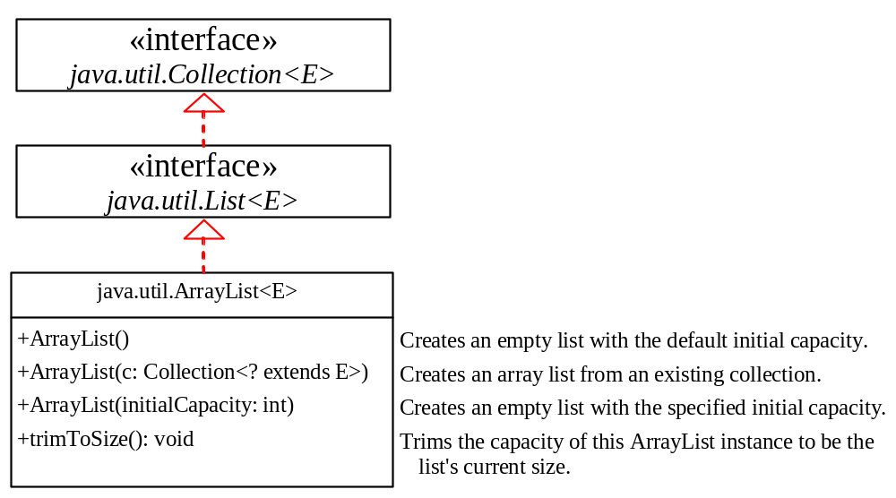
java.util.ArrayList

Slide 35
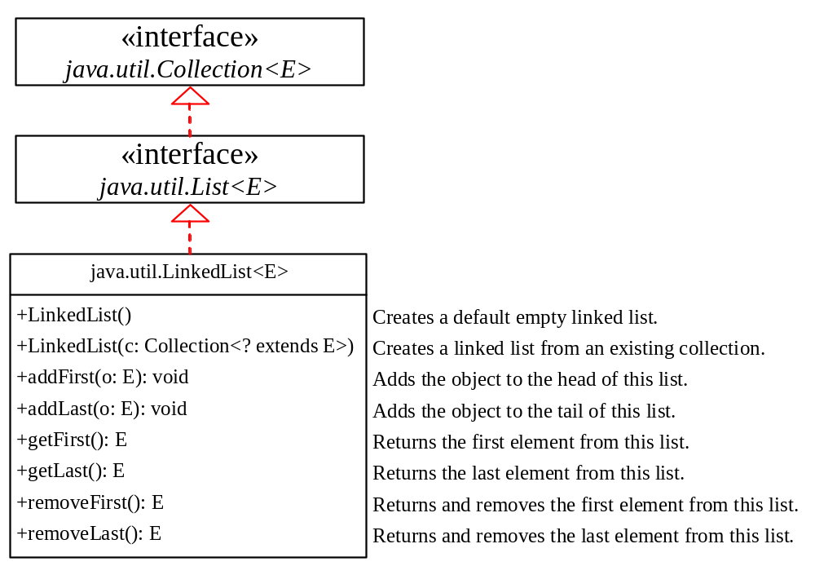
java.util.LinkedList

Slide 36
Example: Using ArrayList and LinkedList
This example creates an array list filled with numbers, and inserts new elements into the specified location in the list. The example also creates a linked list from the array list, inserts and removes the elements from the list. Finally, the example traverses the list forward and backward.
TestArrayAndLinkedList
Run

Slide 37
The Comparator Interface
Sometimes you want to compare the elements of different types. The elements may not be instances of Comparable or are not comparable. You can define a comparator to compare these elements. To do so, define a class that implements the java.util.Comparator interface. The Comparator interface has the compare method for comparing two objects.

Slide 38
The Comparator Interface
public int compare(Object element1, Object element2)
Returns a negative value if element1 is less than element2, a positive value if element1 is greater than element2, and zero if they are equal.
import java.util.Comparator;
public class GeometricObjectComparator implements Comparator<GeometricObject>, java.io.Serializable {
public int compare(GeometricObject o1, GeometricObject o2) {
return o1.getArea() > o2.getArea() ? 1 : o1.getArea() == o2.getArea() ? 0 : -1;
}
}

Slide 39
Other Comparator Examples
public class SortStringByLength {
public static void main(String[] args) {
String[] cities = {"Atlanta", "Savannah", "New York", "Dallas"};
java.util.Arrays.sort(cities, new MyComparator());
for (String s : cities) {
System.out.print(s + " ");
}
}
public static class MyComparator implements java.util.Comparator<String> {
@Override
public int compare(String s1, String s2) {
return s1.length() - s2.length();
}
}
}

Slide 40
The Collections Class
The Collections class contains various static methods for operating on collections and maps, for creating synchronized collection classes, and for creating read-only collection classes.

Slide 41
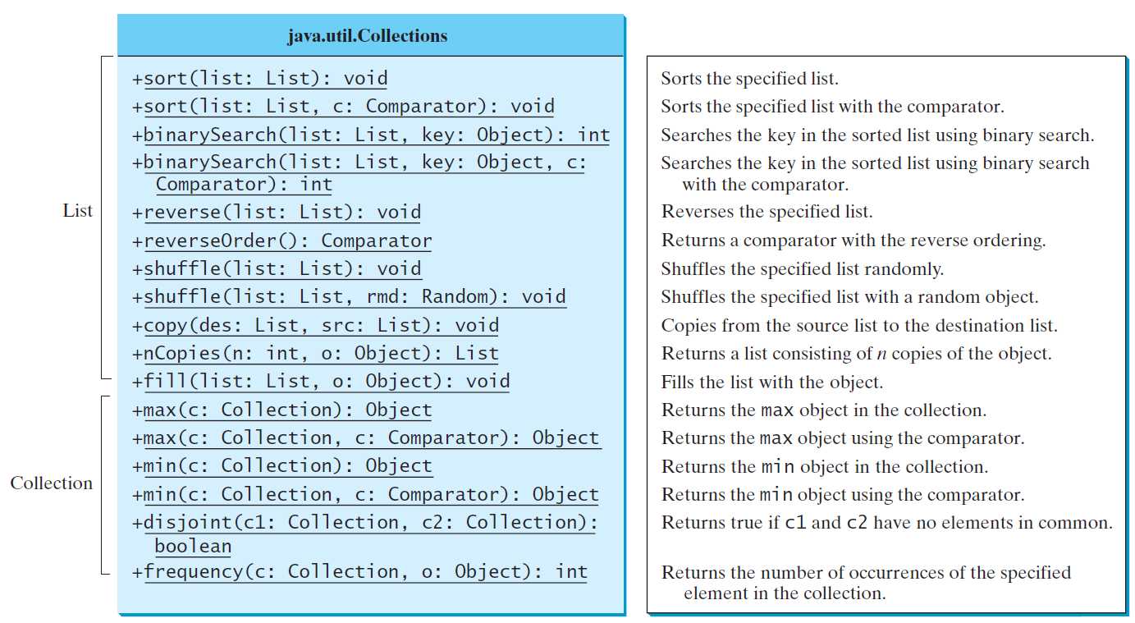
The Collections Class UML Diagram

Slide 42
The Vector and Stack Classes
The Java Collections Framework was introduced with Java 2. Several data structures were supported prior to Java 2. Among them are the Vector class and the Stack class. These classes were redesigned to fit into the Java Collections Framework, but their old-style methods are retained for compatibility. This section introduces the Vector class and the Stack class.

Slide 43
The Vector Class
In Java 2, Vector is the same as ArrayList, except that Vector contains the synchronized methods for accessing and modifying the vector. None of the new collection data structures introduced so far are synchronized. If synchronization is required, you can use the synchronized versions of the collection classes. These classes are introduced later.

Slide 44
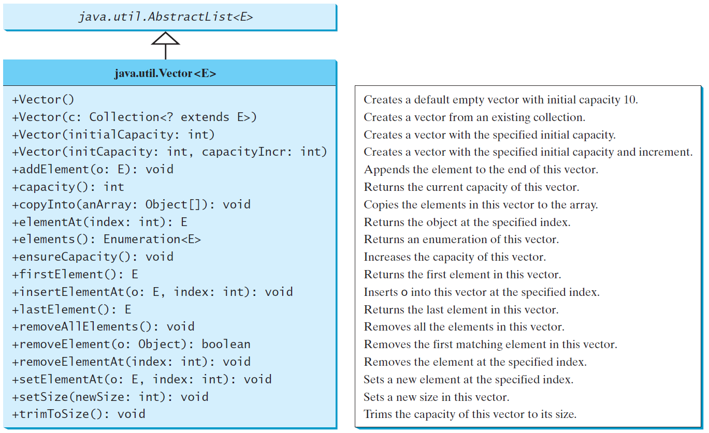
The Vector Class, cont.

Slide 45
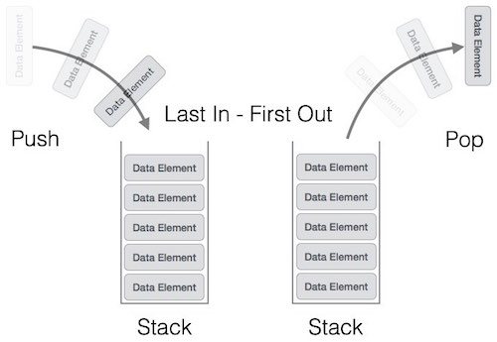
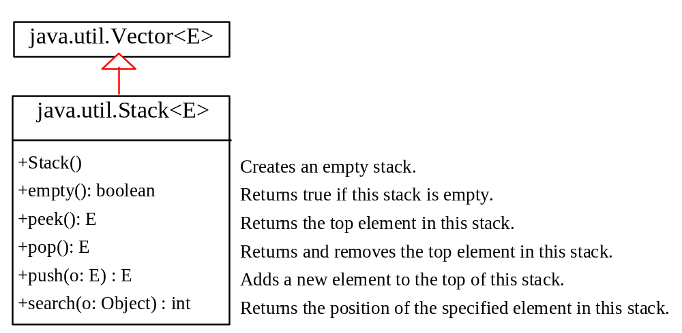
The Stack Class
The Stack class represents a last-in-first-out stack of objects. The elements are accessed only from the top of the stack. You can retrieve, insert, or remove an element from the top of the stack.

Slide 46
Queues and Priority Queues
A queue is a first-in/first-out data structure. Elements are appended to the end of the queue and are removed from the beginning of the queue. In a priority queue, elements are assigned priorities. When accessing elements, the element with the highest priority is removed first.

Slide 47
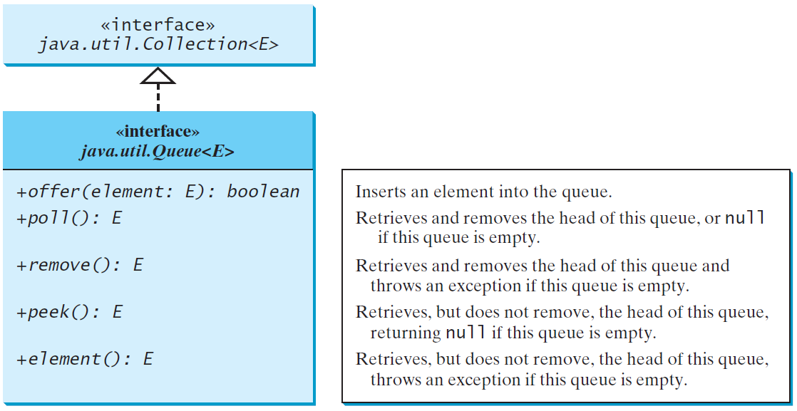
The Queue Interface
Back
Front
remove
offer

Slide 48
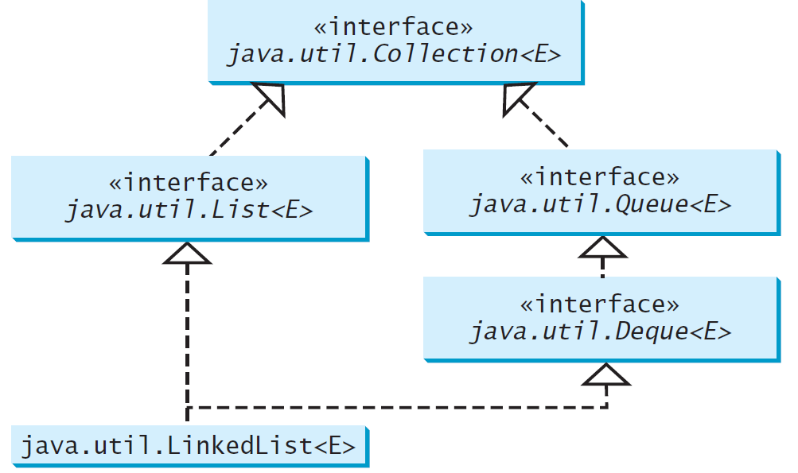
Using LinkedList for Queue

Slide 49
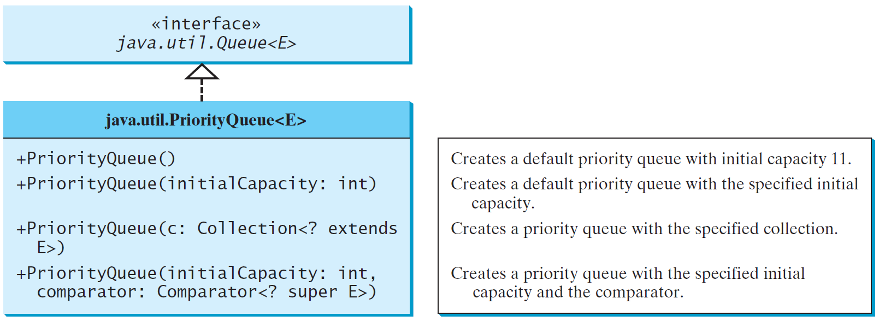
The PriorityQueue Class
PriorityQueueDemo
Run

Slide 50
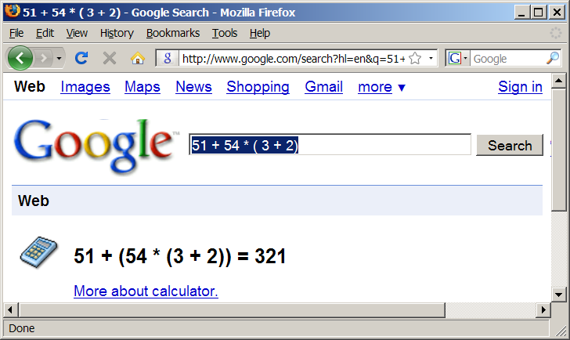
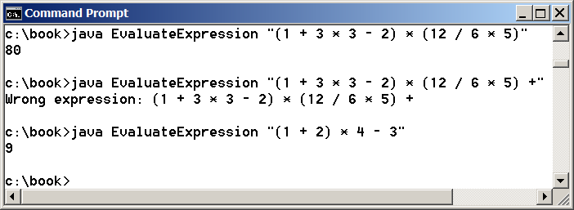
Case Study: Evaluating Expressions
Stacks can be used to evaluate expressions.
Evaluate Expression
Run

Slide 51
Algorithm
Phase 1: Scanning the expression
The program scans the expression from left to right to extract operands, operators, and the parentheses.
1.1. If the extracted item is an operand, push it to operandStack.
1.2. If the extracted item is a + or - operator, process all the operators at the top of operatorStack and push the extracted operator to operatorStack.
1.3. If the extracted item is a * or / operator, process the * or / operators at the top of operatorStack and push the extracted operator to operatorStack.
1.4. If the extracted item is a ( symbol, push it to operatorStack.
1.5. If the extracted item is a ) symbol, repeatedly process the operators from the top of operatorStack until seeing the ( symbol on the stack.
Phase 2: Clearing the stack
Repeatedly process the operators from the top of operatorStack until operatorStack is empty.

Slide 52
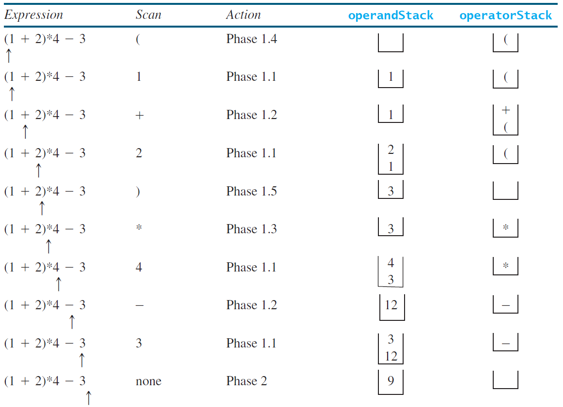
Example

Slide 53
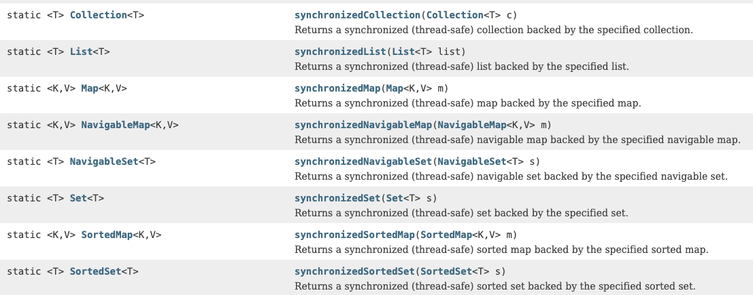
Synchronized Collections
Static methods from the java.util.Collections class:

Slide 54
Next: Sets and Maps

Slide 55
Objectives
To store unordered, nonduplicate elements using a set (§21.2).
To explore how and when to use HashSet (§21.2.1), LinkedHashSet (§21.2.2), or TreeSet (§21.2.3) to store elements.
To compare performance of sets and lists (§21.3).
To use sets to develop a program that counts the keywords in a Java source file (§21.4).
To tell the differences between Collection and Map and describe when and how to use HashMap, LinkedHashMap, and TreeMap to store values associated with keys (§21.5).
To use maps to develop a program that counts the occurrence of the words in a text (§21.6).
To obtain singleton sets, lists, and maps, and unmodifiable sets, lists, and maps, using the static methods in the Collections class (§21.7).

Slide 56
Motivations
The “No-Fly” list is a list, created and maintained by the U.S. government’s Terrorist Screening Center, of people who are not permitted to board a commercial aircraft for travel in or out of the United States. Suppose we need to write a program that checks whether a person is on the No-Fly list. You can use a list to store names in the No-Fly list. However, a more efficient data structure for this application is a set.
Suppose your program also needs to store detailed information about terrorists in the No-Fly list. The detailed information such as gender, height, weight, and nationality can be retrieved using the name as the key. A map is an efficient data structure for such a task.

Slide 57
The Set Interface
The Set interface extends the Collection interface. It does not introduce new methods or constants, but it stipulates that an instance of Set contains no duplicate elements. The concrete classes that implement Set must ensure that no duplicate elements can be added to the set. That is no two elements e1 and e2 can be in the set such that e1.equals(e2) is true.

Slide 58
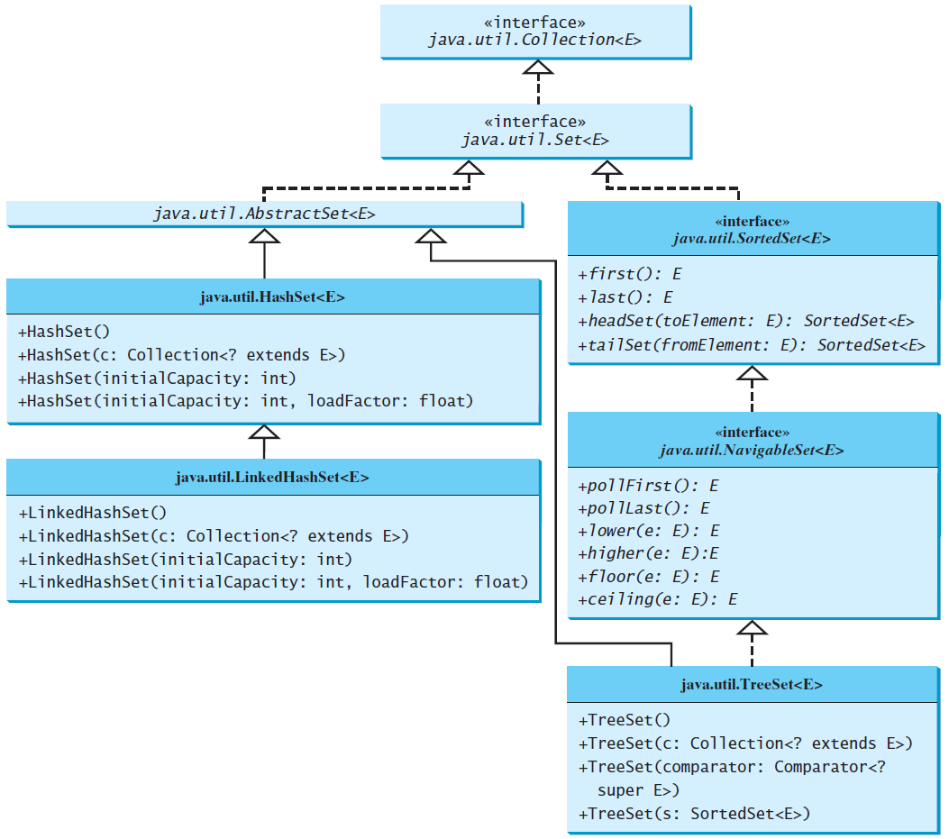
The Set Interface Hierarchy

Slide 59
The AbstractSet Class
The AbstractSet class is a convenience class that extends AbstractCollection and implements Set. The AbstractSet class provides concrete implementations for the equals method and the hashCode method. The hash code of a set is the sum of the hash code of all the elements in the set. Since the size method and iterator method are not implemented in the AbstractSet class, AbstractSet is an abstract class.

Slide 60
The HashSet Class
The HashSet class is a concrete class that implements Set. It can be used to store duplicate-free elements. For efficiency, objects added to a hash set need to implement the hashCode method in a manner that properly disperses the hash code.

Slide 61
Example: Using HashSet and Iterator
This example creates a hash set filled with strings, and traverses the elements.
TestHashSet
Run

Slide 62
Example: Using LinkedHashSet
This example creates a hash set filled with strings, and uses an iterator to traverse the elements in the list.
TestLinkedHashSet
Run

Slide 63
The SortedSet Interface and the TreeSet Class
SortedSet is a subinterface of Set, which guarantees that the elements in the set are sorted. TreeSet is a concrete class that implements the SortedSet interface. You can use an iterator to traverse the elements in the sorted order. The elements can be sorted in two ways.

Slide 64
The SortedSet Interface and the TreeSet Class, cont.
One way is to use the Comparable interface.
The other way is to specify a comparator for the elements in the set if the class for the elements does not implement the Comparable interface, or you don’t want to use the compareTo method in the class that implements the Comparable interface. This approach is referred to as order by comparator.

Slide 65
Example: Using TreeSet to Sort Elements in a Set
This example creates a hash set filled with strings, and then creates a tree set for the same strings. The strings are sorted in the tree set using the compareTo method in the Comparable interface. The example also creates a tree set of geometric objects. The geometric objects are sorted using the compare method in the Comparator interface.
TestTreeSet
Run

Slide 66
Example: The Using Comparator to Sort Elements in a Set
Write a program that demonstrates how to sort elements in a tree set using the Comparator interface. The example creates a tree set of geometric objects. The geometric objects are sorted using the compare method in the Comparator interface.
TestTreeSetWithComparator
Run

Slide 67
Performance of Sets and Lists
TestTreeSetWithComparator
Run

Slide 68
Case Study: Counting Keywords
This section presents an application that counts the number of the keywords in a Java source file.
CountKeywords
Run

Slide 69
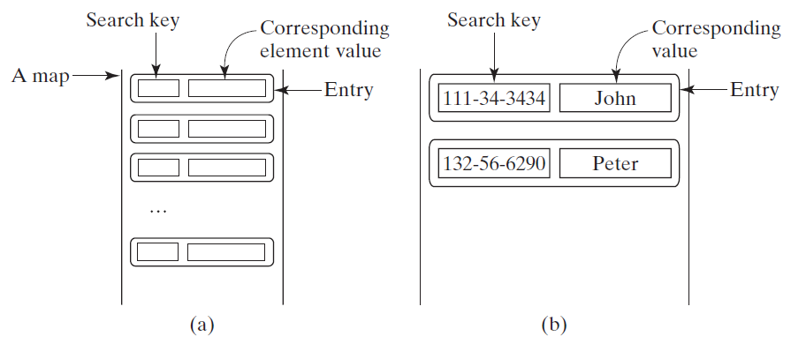
The Map Interface
The Map interface maps keys to the elements. The keys are like indexes. In List, the indexes are integer. In Map, the keys can be any objects.

Slide 70
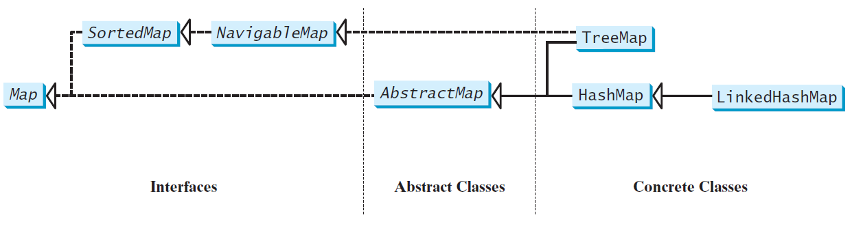
Map Interface and Class Hierarchy
An instance of Map represents a group of objects, each of which is associated with a key. You can get the object from a map using a key, and you have to use a key to put the object into the map.

Slide 71
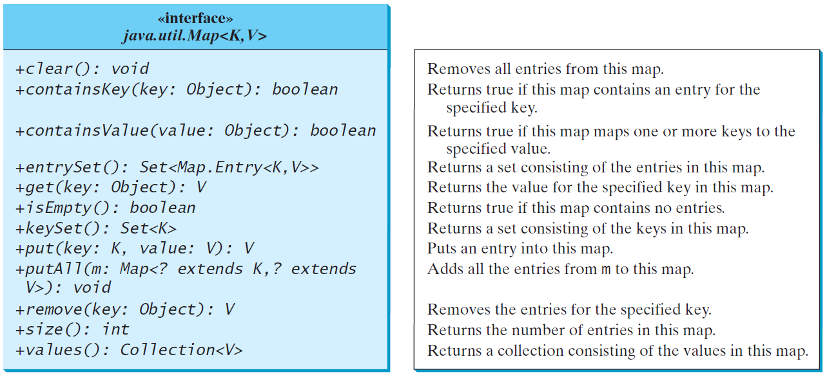
The Map Interface UML Diagram

Slide 72
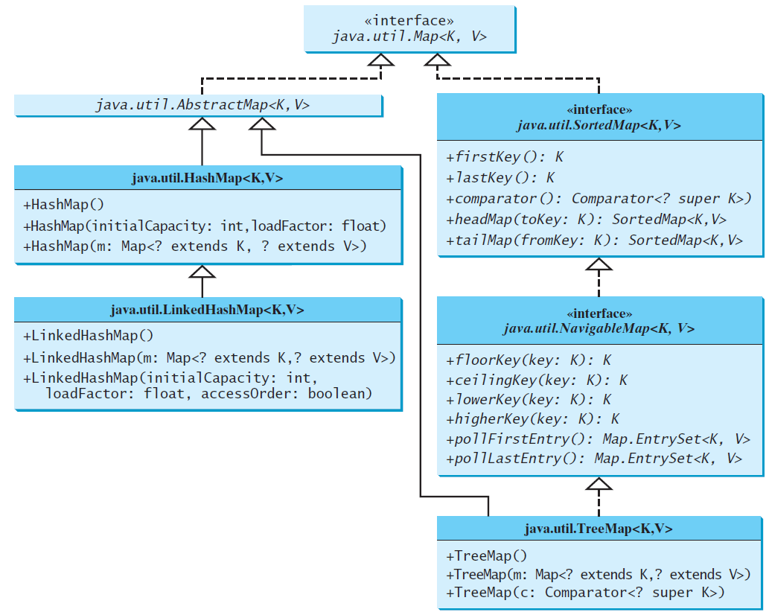
Concrete Map Classes

Slide 73
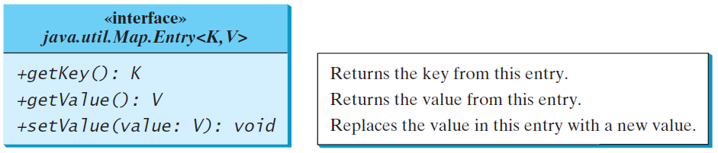
Entry

Slide 74
HashMap and TreeMap
The HashMap and TreeMap classes are two concrete implementations of the Map interface. The HashMap class is efficient for locating a value, inserting a mapping, and deleting a mapping. The TreeMap class, implementing SortedMap, is efficient for traversing the keys in a sorted order.

Slide 75
LinkedHashMap
LinkedHashMap was introduced in JDK 1.4. It extends HashMap with a linked list implementation that supports an ordering of the entries in the map. The entries in a HashMap are not ordered, but the entries in a LinkedHashMap can be retrieved in the order in which they were inserted into the map (known as the insertion order), or the order in which they were last accessed, from least recently accessed to most recently (access order). The no-arg constructor constructs a LinkedHashMap with the insertion order. To construct a LinkedHashMap with the access order, use the LinkedHashMap(initialCapacity, loadFactor, true).

Slide 76
Example: Using HashMap and TreeMap
This example creates a hash map that maps borrowers to mortgages. The program first creates a hash map with the borrower’s name as its key and mortgage as its value. The program then creates a tree map from the hash map, and displays the mappings in ascending order of the keys.
TestMap
Run

Slide 77
Case Study: Counting the Occurrences of Words in a Text
This program counts the occurrences of words in a text and displays the words and their occurrences in ascending order of the words. The program uses a hash map to store a pair consisting of a word and its count. For each word, check whether it is already a key in the map. If not, add the key and value 1 to the map. Otherwise, increase the value for the word (key) by 1 in the map. To sort the map, convert it to a tree map.
CountOccurrenceOfWords
Run

Slide 78
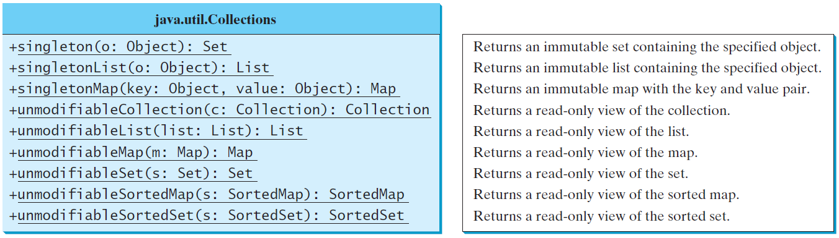
The Singleton and Unmodifiable Collections

