Slide 1
Java Database Programming
April 25, 2020

Slide 2

This Lecture has Everything
Connections/IO
Collections
Iterators
GUIs

Slide 3
Objectives
To understand the concept of database and database management systems (§34.2).
To understand the relational data model: relational data structures, constraints, and languages (§34.2).
To use SQL to create and drop tables, and to retrieve and modify data (§34.3).
To learn how to load a driver, connect to a database, execute statements, and process result sets using JDBC (§34.4).
To use prepared statements to execute precompiled SQL statements (§34.5).
To use callable statements to execute stored SQL procedures and functions (§34.6).
To explore database metadata using the DatabaseMetaData and ResultSetMetaData interfaces (§34.7).

Slide 4
Readings
SQL and Relational Databases:
  Lemahieu, W., Seppe, V.B., Baesens, B. (2018). Principles of database management, Chapter 7
JDBC Programming:
  Horstmann, Core Java, Chapter 5
  Dietel & Dietel, Java SE8 for Programmers, Chapter 21
  Liang, Introduction to Java, Chapter 34 (online)

Slide 5
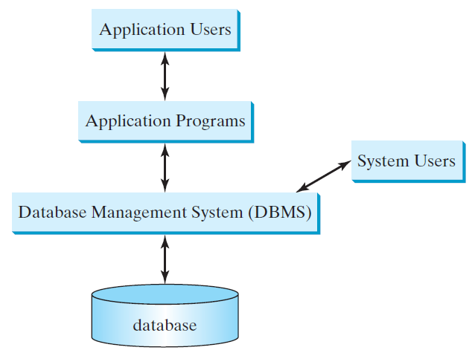
What is a Database System?
e.g., Access, MySQL, Oracle, and MS SQL Server

Slide 6
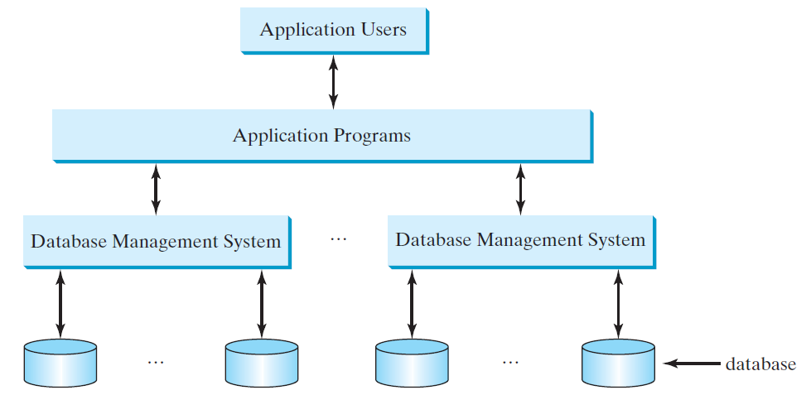
Database Application Systems

Slide 7
Rational Database and Relational Data Model
Most of today’s database systems are relational database systems, based on the relational data model. A relational data model has three key A relational data model has three key components: structure, integrity and languages.
Structure defines the representation of the data.
Integrity imposes constraints on the data.
Language provides the means for accessing and manipulating data.

Slide 8
Relational Structure
A relational database consists of a set of relations. A relation has two things in one: a schema and an instance of the schema. The schema defines the relation and an instance is the content of the relation at a given time. An instance of a relation is nothing more than a table with rows and named columns. For convenience with no confusion, we refer instances of relations as just relations or tables.

Slide 9
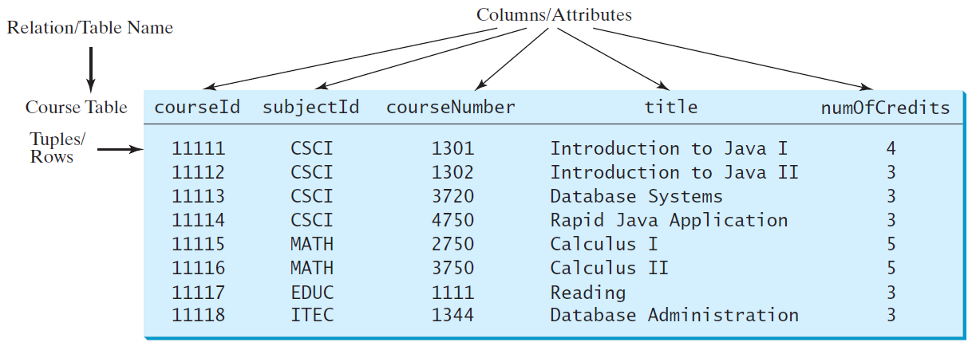
Course Table

Slide 10
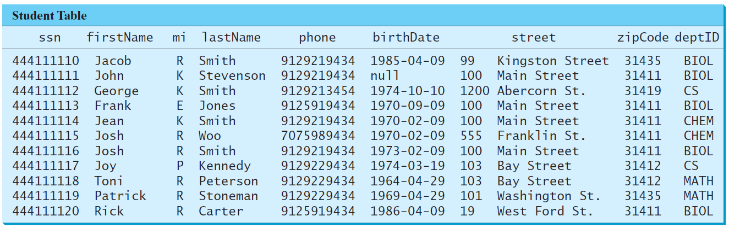
Student Table

Slide 11
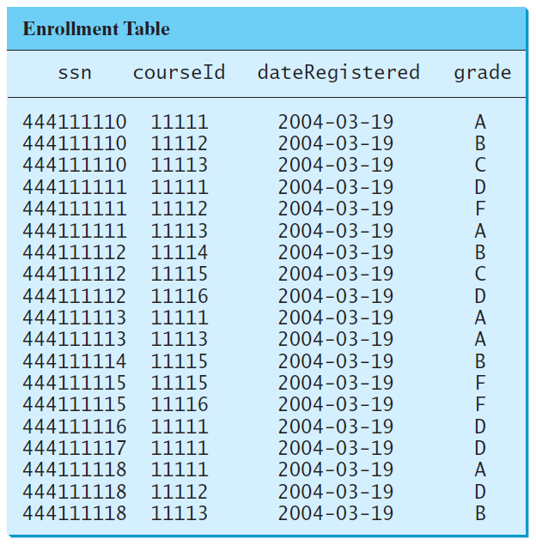
Enrollment Table

Slide 12
Table vs. File
NOTE:
A table or a relation is not same as a file. Most of the relational database systems store multiple tables in a file.

Slide 13
Integrity Constraints
An integrity constraint imposes a condition that all legal instances of the relations must satisfy. In general, there are three types of constraints: domain constraint, primary key constraint, and foreign key constraint. Domain constraints and primary key constraints are known as intra-relational constraints, meaning that a constraint involves only one relation. The foreign key constraint is known as inter-relational, meaning that a constraint involves more than one relation.

Slide 14
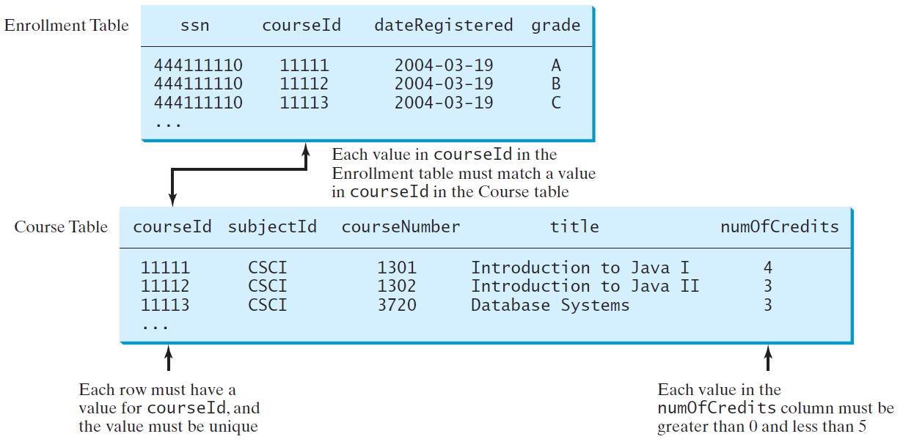
Domain Constraints

Slide 15
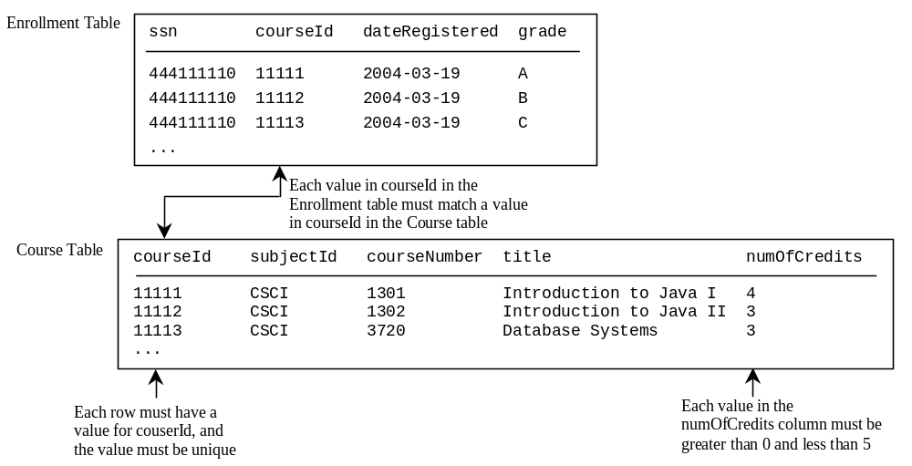
Primary Key Constraints
Primary key constraint

Slide 16
Foreign Key Constraints
Foreign key constraint

Slide 17
Domain Constraints
Domain constraints specify the permissible values for an attribute. Domains can be specified using standard data types such as integers, floating-point numbers, fixed-length strings, and variant-length strings. The standard data type specifies a broad range of values. Additional constraints can be specified to narrow the ranges. You can also specify whether an attribute can be null.

Slide 18
Domain Constraints Example
create table Course (
courseId char(5),
subjectId char(4) not null,
courseNumber integer,
title varchar(50) not null,
numOfCredits integer,
constraint greaterThanOne
check (numOfCredits >= 1));
create table Course(
subjectCode char(4) not null,
courseNumber int not null,
title varchar(50) not null,
numOfCredits int not null
constraint greaterThanOne
check (numOfCredits >= 1));

Slide 19
Superkey
Superkey
Key
Candidate key
Primary key
A superkey is an attribute or a set of attributes that uniquely identify the relation. That is, no two tuples have the same values on the superkey. By definition, a relation consists of a set of distinct tuples. The set of all attributes in the relation forms a superkey.

Slide 20
Key and Candidate Key
Superkey
Key
Candidate key
Primary key
A key K is a minimal superkey, meaning that any proper subset of K is not a superkey. It is possible that a relation has several keys. In this case, each of the keys is called a candidate key.

Slide 21
Primary Key
Superkey
Key
Candidate key
Primary key
The primary key is one of the candidate keys designated by the database designer. The primary key is often used to identify tuples in a relation.
create table Course(
subjectCode char(4),
courseNumber int,
title varchar(50), numOfCredits int
constraint greaterThanOne check (numOfCredits >= 1),
primary key (subjectCode, courseNumber));

Slide 22
Primary Key
The primary key is one of the candidate keys designated by the database designer. The primary key is often used to identify tuples in a relation.
create table Course (
courseId char(5),
subjectId char(4) not null,
courseNumber integer,
title varchar(50) not null,
numOfCredits integer,
primary key (courseId)
);

Slide 23
Primary Key Constraints
The primary key constraint specifies that the primary key value of a tuple cannot be null and no two tuples in the relation can have the same value on the primary key. The DBMS enforces the primary key constraint. For example, if you attempt to insert a record with the same primary key as an existing record in the table, the DBMS would report an error and reject the operation.

Slide 24
Foreign Key Constraints
In a relational database, data are related. Tuples in a relation are related and tuples in different relations are related through their common attributes. Informally speaking, the common attributes are foreign keys. The foreign key constraints define the relationships among relations.

Slide 25
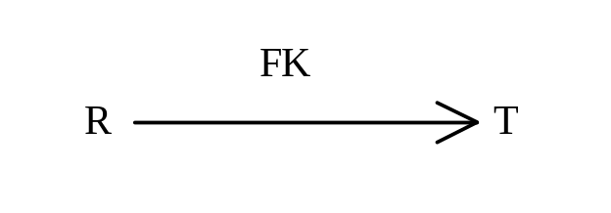
Foreign Key Constraints Formal Definition
Formally, a set of attributes FK is a foreign key in a relation R that references relation T if it satisfies the following two rules:
The attributes in FK have the same domain as the primary key in T.
A non-null value on FK in R must match a primary key value in T.

Slide 26
Foreign Key Example
create table Enrollment (
ssn char(9),
courseId char(5),
dateRegistered date,
grade char(1),
primary key (ssn, courseId),
foreign key (ssn) references Student,
foreign key (courseId) references Course
);

Slide 27
Foreign Key Discussion
A foreign key is not necessarily the primary key or part of the primary in the relation. For example, subjectCode is a foreign key in the Course table that references the Subject table, but it is not the primary key in Course. departmentCode is a foreign key in the Subject table that references Department, but it is not the primary key in Subject.

Slide 28
Foreign Key Discussion, cont.
The referencing relation and the referenced relation may be the same table. For example, supervisorId is a foreign key in Faculty that references facultyId in Faculty.

Slide 29
Foreign Key Discussion, cont.
The foreign key is not necessary to have the same name as its referenced primary key as long as they have the same domain. For example, headId is a foreign key in Department that references facultyId in Faculty.

Slide 30
Foreign Key Discussion, cont.
A relation may have more than one foreign key. For example, headId and collegeCode are both foreign keys in Department.

Slide 31
SQL
Structured Query Language, pronounced S-Q-L, or Sequel
To access or write applications for database systems, you need to use the Structured Query Language (SQL). SQL is the universal language for accessing relational database systems. Application programs may allow users to access database without directly using SQL, but these applications themselves must use SQL to access the database.

Slide 32
Examples of simple SQL statements
Create table
Drop table
Describe table
Select
Insert
Delete
Update
create table Course (
courseId char(5),
subjectId char(4) not null,
courseNumber integer,
title varchar(50) not null,
numOfCredits integer,
primary key (courseId)
);
create table Student (
ssn char(9),
firstName varchar(25),
mi char(1),
lastName varchar(25),
birthDate date,
street varchar(25),
phone char(11),
zipCode char(5),
deptId char(4),
primary key (ssn)
);

Slide 33
Examples of simple SQL statements
Create table
Drop table
Describe table
Select
Insert
Delete
Update
drop table Enrollment;
drop table Course;
drop table Student;

Slide 34
Examples of simple SQL statements
Create table
Drop table
Describe table
Select
Insert
Delete
Update
describe Course; -- Oracle

Slide 35
Examples of simple SQL statements
Create table
Drop table
Describe table
Select
Insert
Delete
Update
select firstName, mi, lastName
from Student
where deptId = 'CS';
select firstName, mi, lastName
from Student
where deptId = 'CS' and zipCode = '31411';
select *
from Student
where deptId = 'CS' and zipCode = '31411';

Slide 36
Examples of simple SQL statements
Create table
Drop table
Describe table
Select
Insert
Delete
Update
insert into Course (courseId, subjectId, courseNumber, title)
values ('11113', 'CSCI', '3720', 'Database Systems', 3);

Slide 37
Examples of simple SQL statements
Create table
Drop table
Describe table
Select
Insert
Update
Delete
update Course
set numOfCredits = 4
where title = 'Database Systems';

Slide 38
Examples of simple SQL statements
Create table
Drop table
Describe table
Select
Insert
Update
Delete
delete Course
where title = 'Database System';

Slide 39
Why Java for Database Programming?
First, Java is platform independent. You can develop platform-independent database applications using SQL and Java for any relational database systems.
Second, the support for accessing database systems from Java is built into Java API, so you can create database applications using all Java code with a common interface.
Third, Java is taught in almost every university either as the first programming language or as the second programming language.

Slide 40
Database Applications Using Java
  GUI
  Client/Server
  Server-Side programming

Slide 41
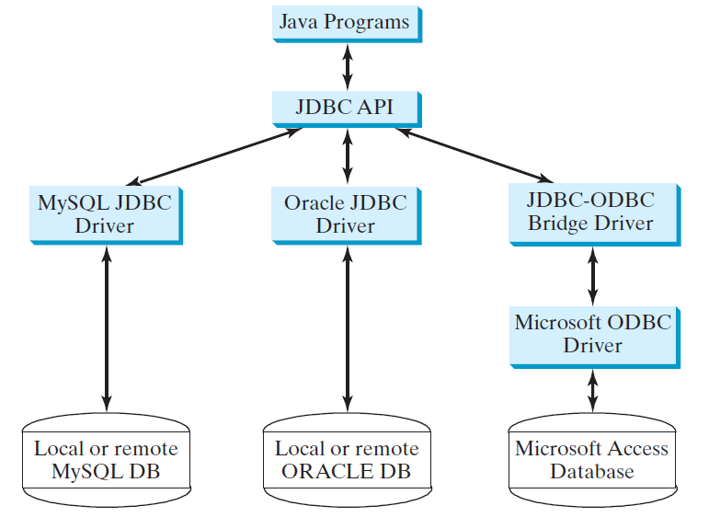
The Architecture of JDBC

Slide 42
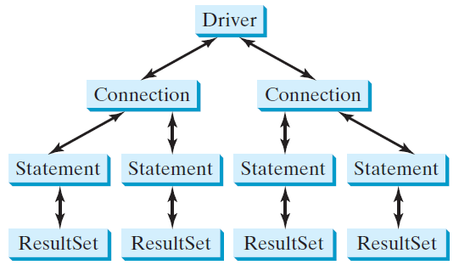
The JDBC Interfaces
Loading drivers
Establishing connections
Creating and executing statements
Processing ResultSet

Slide 43
Developing JDBC Programs
Loading drivers
Establishing connections
Creating and executing statements
Processing ResultSet
Statement to load a driver:
  Class.forName("JDBCDriverClass");
A driver is a class. For example:
Database Driver Class Source
Access sun.jdbc.odbc.JdbcOdbcDriver Already in JDK
MySQL com.mysql.jdbc.Driver Website
Oracle oracle.jdbc.driver.OracleDriver Website
The JDBC-ODBC driver for Access is bundled in JDK.
MySQL driver class is in mysqljdbc.jar
Oracle driver class is in classes12.jar
To use the MySQL and Oracle drivers, you have to add mysqljdbc.jar and classes12.jar in the classpath using the following DOS command on Windows:
classpath=%classpath%;c:\book\mysqljdbc.jar;c:\book\classes12.jar

Slide 44
Developing JDBC Programs
Loading drivers
Establishing connections
Creating and executing statements
Processing ResultSet
Connection connection = DriverManager.getConnection(databaseURL);
Database URL Pattern
Access jdbc:odbc:dataSource
MySQL jdbc:mysql://hostname/dbname
Oracle jdbc:oracle:thin:@hostname:port#:oracleDBSID
Examples:
For Access:
  Connection connection = DriverManager.getConnection
  ("jdbc:odbc:ExampleMDBDataSource");
For MySQL:
  Connection connection = DriverManager.getConnection
  ("jdbc:mysql://localhost/test");
For Oracle:
  Connection connection = DriverManager.getConnection
  ("jdbc:oracle:thin:@liang.armstrong.edu:1521:orcl", "scott", "tiger");
See Supplement IV.D for creating an ODBC data source

Slide 45
Developing JDBC Programs
Loading drivers
Establishing connections
Creating and executing statements
Processing ResultSet
Creating statement:
  Statement statement = connection.createStatement();
Executing statement (for update, delete, insert):
  statement.executeUpdate
  ("create table Temp (col1 char(5), col2 char(5))");
Executing statement (for select):
  // Select the columns from the Student table
  ResultSet resultSet = statement.executeQuery
  ("select firstName, mi, lastName from Student where lastName "
  + " = 'Smith'");

Slide 46
Developing JDBC Programs
Loading drivers
Establishing connections
Creating and executing statements
Processing ResultSet
Executing statement (for select):
  // Select the columns from the Student table
  ResultSet resultSet = stmt.executeQuery
  ("select firstName, mi, lastName from Student where lastName "
  + " = 'Smith'");
Processing ResultSet (for select):
  // Iterate through the result and print the student names
  while (resultSet.next())
  System.out.println(resultSet.getString(1) + " " + resultSet.getString(2)
  + ". " + resultSet.getString(3));

Slide 47
But for our purposes
I’m not going to turn this into a week where we all try to get MySQL working
So we’re using sqlite. Look it up: https://www.sqlitetutorial.net/
For Mac and Linux users, you already have it installed

Slide 48
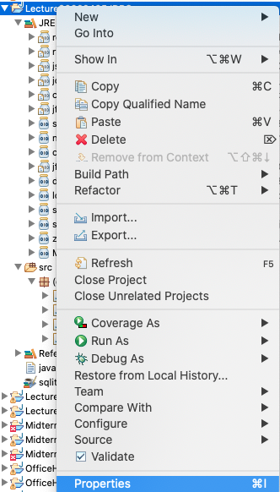
Basic sqlite setup with Eclipse
I’ve included the file sqlite-jdbc-3.30.1.jar in the code for today
To import it to your project, right-click on your Project and click “Properties…”

Slide 49
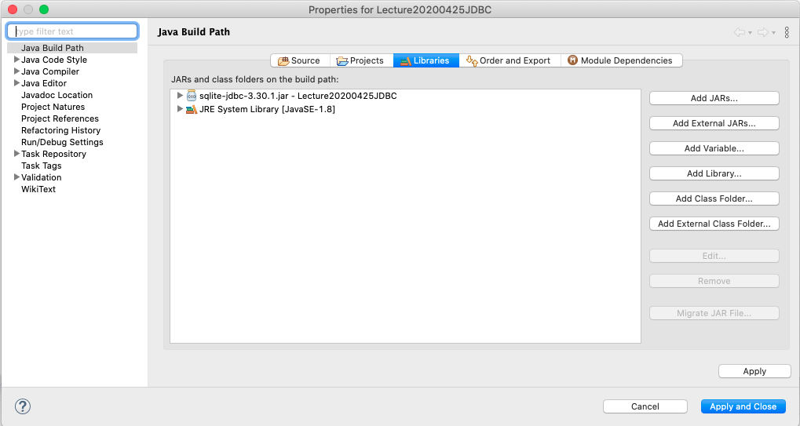
Sqlite Setup
Then click the “Libraries” tab at the top and “Add JARs” and then select the sqlite-jdbc-3.30.1.jar file

Slide 50
Using Sqlite in Java
Set up the connection in Java
Connection connection = DriverManager.getConnection
("jdbc:sqlite:javabook.db");
Then you can use the connection like you would with any other Database Driver. The code and commands are the same

Slide 51
Simple JDBC Example
  import java.sql.*;
  public class SimpleJdbc {
  public static void main(String[] args)
  throws SQLException, ClassNotFoundException {
  // Load the JDBC driver
  Class.forName("com.mysql.jdbc.Driver");
  System.out.println("Driver loaded");
  // Establish a connection
  Connection connection = DriverManager.getConnection
  ("jdbc:mysql://localhost/test");
  System.out.println("Database connected");
  // Create a statement
  Statement statement = connection.createStatement();
  // Execute a statement
  ResultSet resultSet = statement.executeQuery
  ("select firstName, mi, lastName from Student where lastName "
  + " = 'Smith'");
  // Iterate through the result and print the student names
  while (resultSet.next())
  System.out.println(resultSet.getString(1) + "\t" +
  resultSet.getString(2) + "\t" + resultSet.getString(3));
  // Close the connection
  connection.close();
  }
  }
SimpleJdbc
Run

Slide 52
Example:
Accessing Database from Java Swing
This example demonstrates connecting to a database from a GUI

Slide 53
Processing Statements
Once a connection to a particular database is established, it can be used to send SQL statements from your program to the database. JDBC provides the Statement, PreparedStatement, and CallableStatement interfaces to facilitate sending statements to a database for execution and receiving execution results from the database.

Slide 54
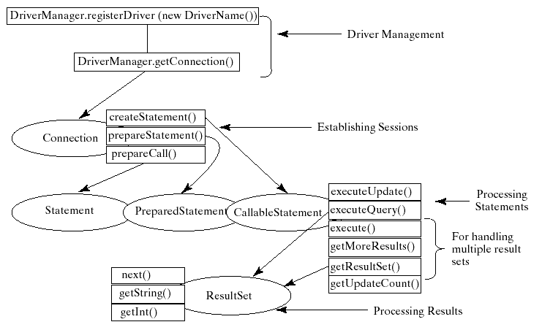
Processing Statements Diagram

Slide 55
The execute, executeQuery, and executeUpdate Methods
The methods for executing SQL statements are execute, executeQuery, and executeUpdate, each of which accepts a string containing a SQL statement as an argument. This string is passed to the database for execution. The execute method should be used if the execution produces multiple result sets, multiple update counts, or a combination of result sets and update counts.

Slide 56
The execute, executeQuery, and executeUpdate Methods, cont.
The executeQuery method should be used if the execution produces a single result set, such as the SQL select statement. The executeUpdate method should be used if the statement results in a single update count or no update count, such as a SQL INSERT, DELETE, UPDATE, or DDL statement.

Slide 57
PreparedStatement
The PreparedStatement interface is designed to execute dynamic SQL statements and SQL-stored procedures with IN parameters. These SQL statements and stored procedures are precompiled for efficient use when repeatedly executed.
Statement pstmt = connection.prepareStatement
("insert into Student (firstName, mi, lastName) +
values (?, ?, ?)");

Slide 58
Retrieving Database Metadata
Database metadata is the information that describes database itself. JDBC provides the DatabaseMetaData interface for obtaining database wide information and the ResultSetMetaData interface for obtaining the information on the specific ResultSet.

Slide 59
DatabaseMetadata, cont.
The DatabaseMetaData interface provides more than 100 methods for getting database metadata concerning the database as a whole. These methods can be divided into three groups: for retrieving general information, for finding database capabilities, and for getting object descriptions.

Slide 60
General Information
The general information includes the URL, username, product name, product version, driver name, driver version, available functions, available data types and so on.

Slide 61
Obtaining Database Capabilities
The examples of the database capabilities are whether the database supports the GROUP BY operator, the ALTER TABLE command with add column option, supports entry-level or full ANSI92 SQL grammar.

Slide 62
Obtaining Object Descriptions
the examples of the database objects are tables, views, and procedures.

Slide 63
Examples
  DatabaseMetaData dbMetaData = connection.getMetaData();
  System.out.println("database URL: " + dbMetaData.getURL());
  System.out.println("database username: " +
  dbMetaData.getUserName());
  System.out.println("database product name: " +
  dbMetaData.getDatabaseProductName());
  System.out.println("database product version: " +
  dbMetaData.getDatabaseProductVersion());
  System.out.println("JDBC driver name: " +
  dbMetaData.getDriverName());
  System.out.println("JDBC driver version: " +
  dbMetaData.getDriverVersion());
  System.out.println("JDBC driver major version: " +
  new Integer(dbMetaData.getDriverMajorVersion()));
  System.out.println("JDBC driver minor version: " +
  new Integer(dbMetaData.getDriverMinorVersion()));
  System.out.println("Max number of connections: " +
  new Integer(dbMetaData.getMaxConnections()));
  System.out.println("MaxTableNameLentgh: " +
  new Integer(dbMetaData.getMaxTableNameLength()));
  System.out.println("MaxColumnsInTable: " +
  new Integer(dbMetaData.getMaxColumnsInTable()));
  connection.close();
Sample run on next slide

Slide 64
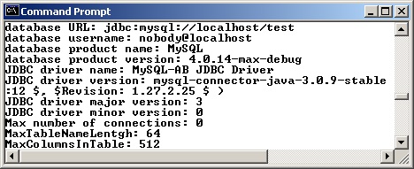
Sample Run

