Slide 1

Homicide over the past decade Project 4 Data Analysis SMU Data Science
Project Team Student Members :
Carlos Delarosa
Raj Agrawal
Ann Ly
John Banowsky
Faculty :
Alex Booth - Instructure
Sherhone Grant - TA
Sean Fleming - SSM
Date :
07-SEP-2023
DRAFT

Slide 2
project title & Description
Title - “Homicides over the past decade”
We have selected above as our Title / theme to perform the data analysis
PROJECT 4 - Our main purpose is to use a standard dataset and utilize various tools that we learn so far i.e. – machine learning, Tableau
Ability to connect to a file set
Ability to fetch data and organize them with various useable data frame
Perform supervised model / predictions
To use correlation and create various Bar, Donut, line charts using Tableau
Data Collection- The Washington Post collected data on more than 52,000 criminal homicides over the past decade in 50 of the largest American cities. The data included the location of the killing, whether an arrest was made and, in most cases, basic demographic information about each victim. Reporters received data in many formats, including paper, and worked for months to clean and standardize it, comparing homicide counts and aggregate closure rates with FBI data to ensure the records were as accurate as possible.

Slide 3
Inspiration
Why did you decide to use that topic? Inspiration, etc.
Carlos – My inspiration is to analyzing a homicides dataset to investigate how victim age influences arrest outcomes in cases
Raj – To learn more about homicides dataset and related investigation, and used acquired knowledge of the data science bootcamp for the data analysis. Eventually, participate in the volunteer program to help community to serve better.
Ann – I am interested in knowing more about the shared factors among all the homicide cases.
John – Homicides are never a good thing. Having a better understanding of which populations are affected will help us better address homicide to protect these demographics.

Slide 4
Team Members
Project Team Student Members :
Carlos Delarosa
Raj Agrawal
Ann Ly
John Banowsky
Faculty :
Alex Booth - Instructure
Sherhone Grant - TA
Sean Fleming - SSM

Slide 5

About Dataset
Source of DATASET – Kaggle.com
File Name 1 - homicide-data.csv (size : ~5MB ; ~52,000 records))
Links are listed as below----
https://www.kaggle.com/datasets/joebeachcapital/homicides
uid | reported_date | victim_last | victim_first | victim_race | victim_age | victim_sex | city | state | lat | lon | disposition
Alb-000001 | 20100504 | GARCIA | JUAN | Hispanic | 78 | Male | Albuquerque | NM | 35.0957885 | -106.5385549 | Closed without arrest
Alb-000002 | 20100216 | MONTOYA | CAMERON | Hispanic | 17 | Male | Albuquerque | NM | 35.0568104 | -106.715321 | Closed by arrest
Alb-000003 | 20100601 | SATTERFIELD | VIVIANA | White | 15 | Female | Albuquerque | NM | 35.086092 | -106.695568 | Closed without arrest
Alb-000004 | 20100101 | MENDIOLA | CARLOS | Hispanic | 32 | Male | Albuquerque | NM | 35.0784929 | -106.5560938 | Closed by arrest
Alb-000005 | 20100102 | MULA | VIVIAN | White | 72 | Female | Albuquerque | NM | 35.1303568 | -106.5809862 | Closed without arrest
Alb-000006 | 20100126 | BOOK | GERALDINE | White | 91 | Female | Albuquerque | NM | 35.15111 | -106.537797 | Open/No arrest
Alb-000007 | 20100127 | MALDONADO | DAVID | Hispanic | 52 | Male | Albuquerque | NM | 35.1117847 | -106.7126144 | Closed by arrest
Alb-000008 | 20100127 | MALDONADO | CONNIE | Hispanic | 52 | Female | Albuquerque | NM | 35.1117847 | -106.7126144 | Closed by arrest
Alb-000009 | 20100130 | MARTIN-LEYVA | GUSTAVO | White | 56 | Male | Albuquerque | NM | 35.0753799 | -106.5534583 | Open/No arrest
Alb-000010 | 20100210 | HERRERA | ISRAEL | Hispanic | 43 | Male | Albuquerque | NM | 35.0659296 | -106.5722875 | Open/No arrest

Slide 6
Expected Outcome of the data analysis
Expected Outcome - of the data analysis
What are at least THREE research questions you want to explore/answer in this data source?
How race / age data summaries
Homicide over a period of time
Census data merge with homicide data to see population / demographic
Additional Research Questions to Answer
TBD

Slide 7

Color Palette
color Palette

Slide 8
Breakdown of tasks
Carlos
1. Web development / hosting
Writeups
Raj
1. Tableau Dashboard
Writeups
Ann
1. Machine Learning
Upload to the GIT
John
1. Data cleanup – organize the main data frame
2. Machine Learning
Timeline of the Project 4
Week1 (9/7/2023) – Start gathering data / links ; data cleanup activities
Week2 (9/11/2023) –ML, Tableau & conclusion

Slide 9

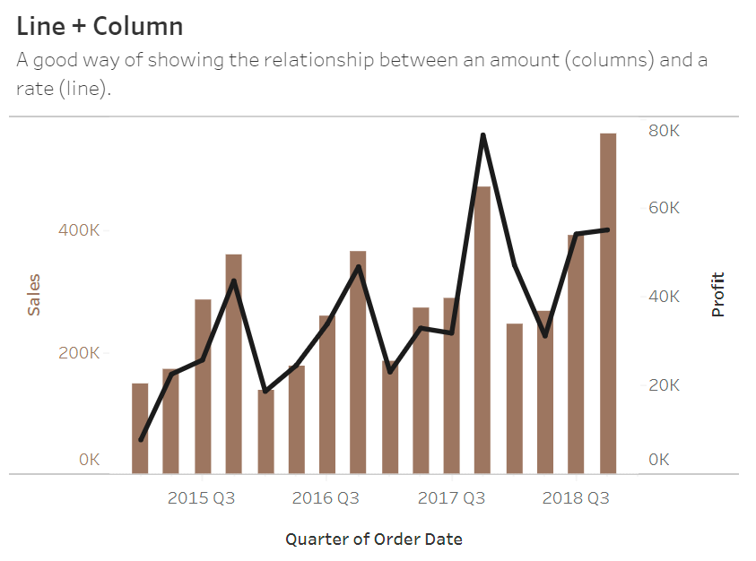
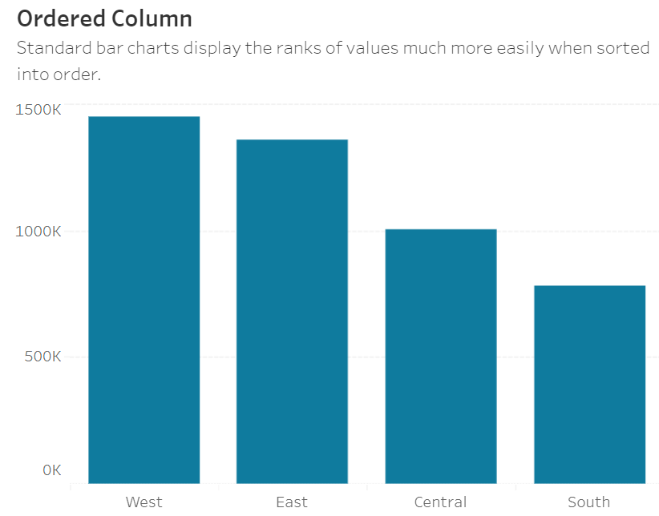
Sample of visuals
Correlation
Show the relationship between two or more variables. Be mindful that, unless you tell them otherwise, many readers will assume the relationships you show them to be causal (i.e., one causes the other).
Line + Column
A good way of showing the relationship between an amount (columns) and a rate (line).
Ranking
Use where an item’s position in an ordered list is more important than its absolute or relative value. Don’t be afraid to highlight the points of interest.
Ordered Column
Standard bar charts display the ranks of values much more easily when sorted into order.

Slide 10
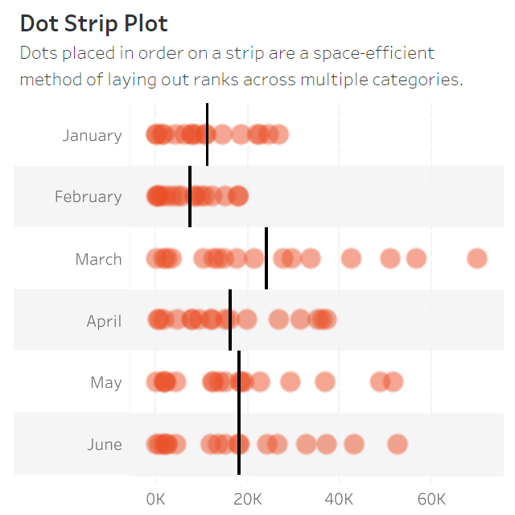
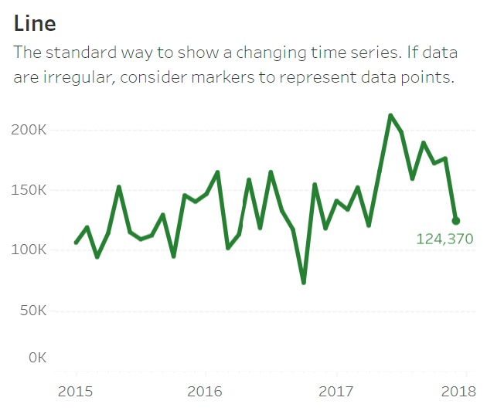
Sample of visuals
Distribution
Show values in a dataset and how often they occur. The shape (or ‘skew’) of a distribution can be a memorable way of highlighting the lack of uniformity or equality in the data.
Dot Strip Plot
Dots placed in order on a strip are a space-efficient method of laying out ranks across multiple categories.
Change over Time
Give emphasis to changing trends. These can be short (intra-day) movements or extended series traversing decades or centuries: Choosing the correct time period is important to provide suitable context for the reader.
Line
The standard way to show a changing time series. If data are irregular, consider markers to represent data points.

Slide 11
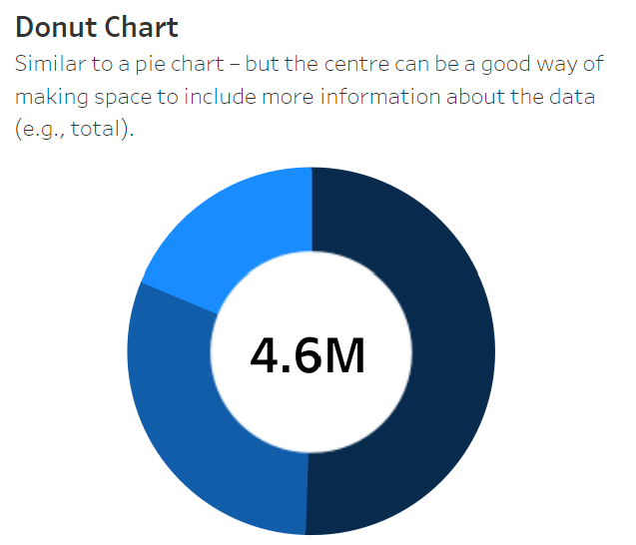
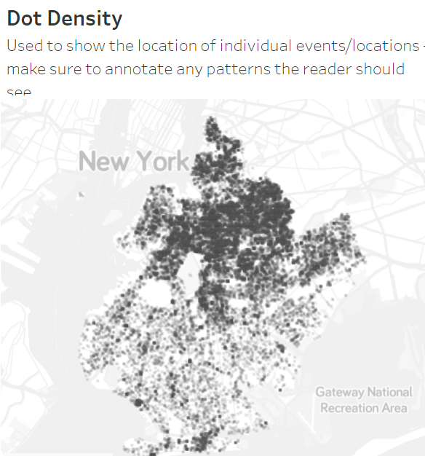
Sample of visuals
Part-to-Whole
Show how a single entity can be broken down into its component elements. If the reader’s interest is solely in the size of the components, consider a magnitude-type chart instead.
Donut Chart
Similar to a pie chart – but the centre can be a good way of making space to include more information about the data (e.g., total).
Spatial
Used only when precise locations or geographical patterns in data are more important to the reader than anything else.
Dot Density
Used to show the location of individual events/locations – make sure to annotate any patterns the reader should see.
Heat Map
Grid-based data values mapped with an intensity color scale. As choropleth map – but not snapped to an admin/political unit.

Slide 12
Thank You
Q&A

Slide 13

Thank You
Q&A

