Slide 1
DispatchHub
Digital Dispatch Experience

Slide 2
About me
DispatchHub is an intelligent multi-retailer last-mile delivery and dispatch management engine engineered for Kenya (Nairobi metropolitan area). It interconnects the primary delivery stakeholders:
🏪 Retailer Staff
🎯 Central Dispatcher (/dispatcher)
⚡ EV Delivery Rider (/rider)
🔍 Public Customer Tracker (/track)

Slide 3
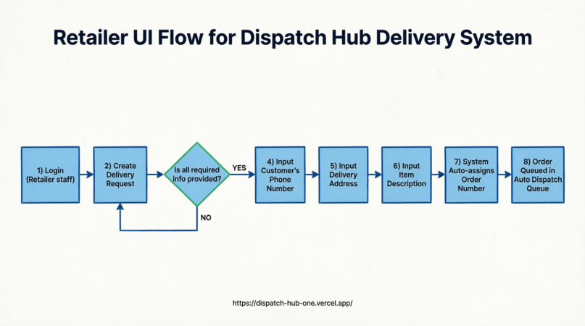
User experience

Slide 4
Portfolio samples

Slide 5
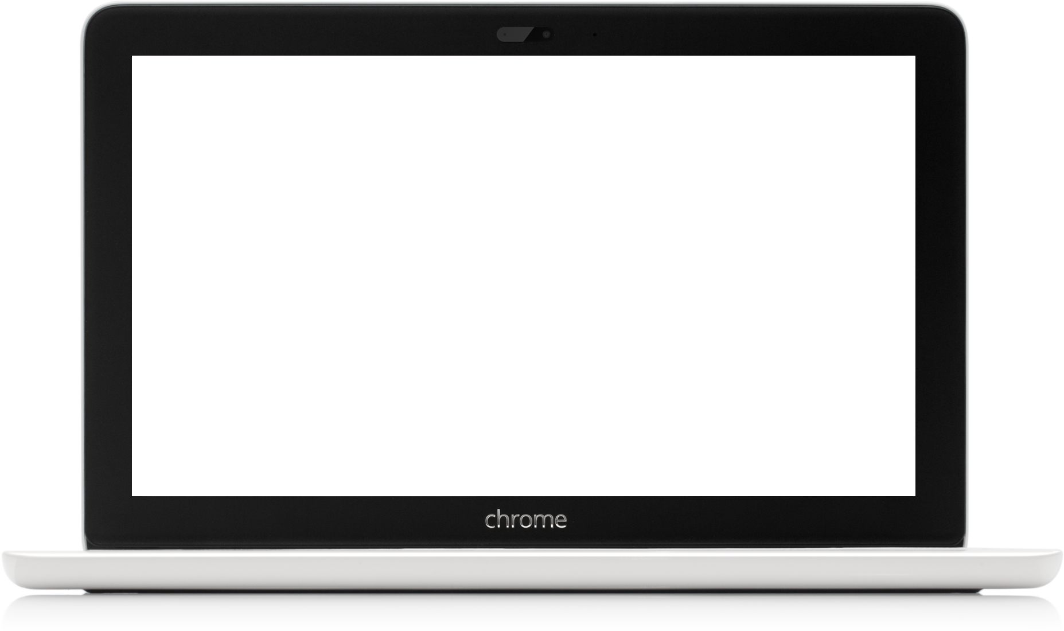
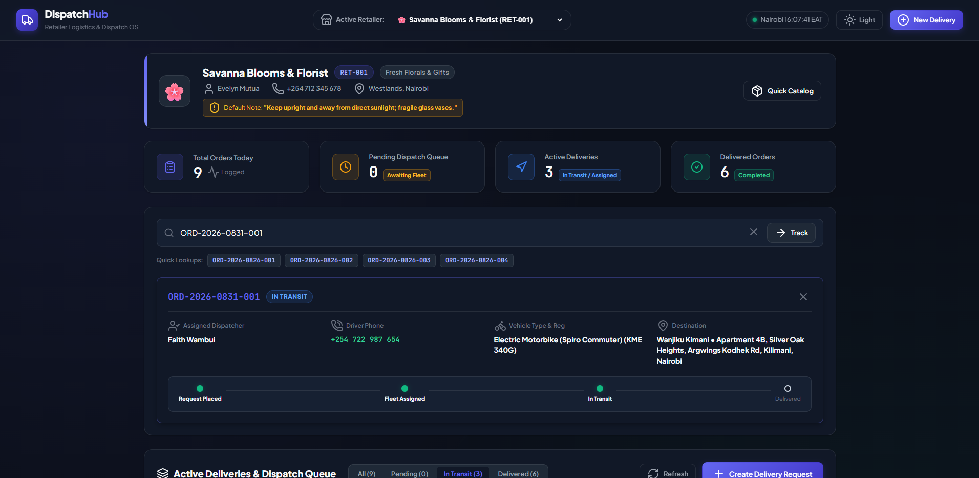
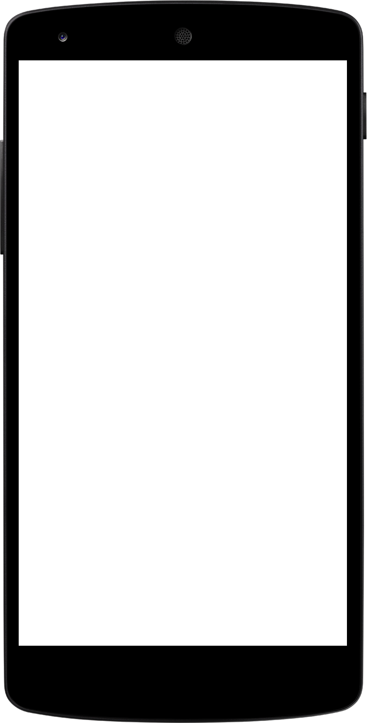
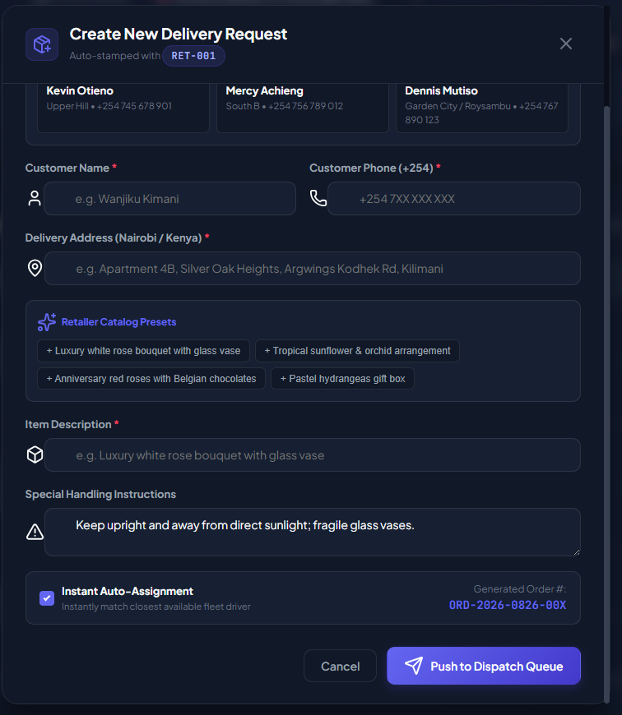
DispatchHub
Onestop spot for all your delivery needs

Slide 6
Overview
DispatchHub is a subscription-based delivery management platform designed to create a trusted ecosystem connecting Retailers, Dispatchers, Riders, and Customers. It streamlines the entire delivery lifecycle—from order creation to final confirmation—ensuring real-time visibility and secure transactions for all parties involved.

Slide 7
Key User Roles & Functions
Retailer Staff:
Logs into a backend system to create delivery requests (capturing customer name, phone, address, and item description).
Views an automated dispatcher dashboard to monitor open requests.
Can edit, delete, or track orders via a status bar using an auto-assigned order number.

Slide 8
Dispatcher
Manages open requests and assigns them to available riders (supports both manual and automated assignment).
Rider
Views assigned deliveries and updates real-time status (e.g., Assigned → Picked Up → Delivered).
Accepts/rejects orders and scans QR codes for order confirmation.
Provides location tracking during transit.

Slide 9
Customer
Tracks orders without logging in by entering an order number on the landing page.
Receives SMS/Email notifications regarding delivery status.
Gets payment prompts upon QR scan/code entry and benefits from Cash on Delivery (COD) options inclusive of delivery fees.
Core Features
Real-Time Syncing: Ensures all stakeholders see up-to-date request and status information instantly.
Auto-Dispatch Queue: New retailer requests are automatically queued and assigned order numbers for efficient processing.
Order Confirmation: Utilizes QR code scanning for secure handover and payment verification.
Trust & Transparency: Designed to build trust regarding goods, service quality, and money handling across the platform.

Slide 10
Business Model
Subscription-Based Platform.
Retailers: Pay a commission on sales.
Riders: Pay through a commission on deliveries.
Customers: Enjoy flexible payment options, including Cash on Delivery.

