Slide 1
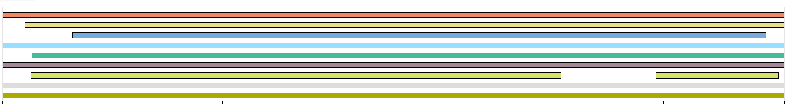
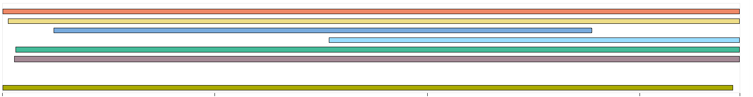
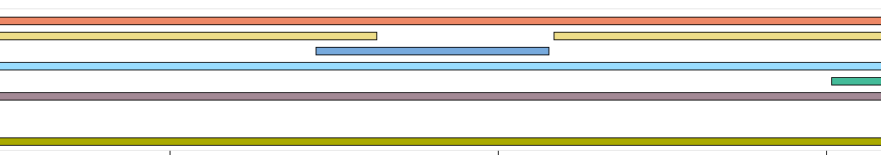
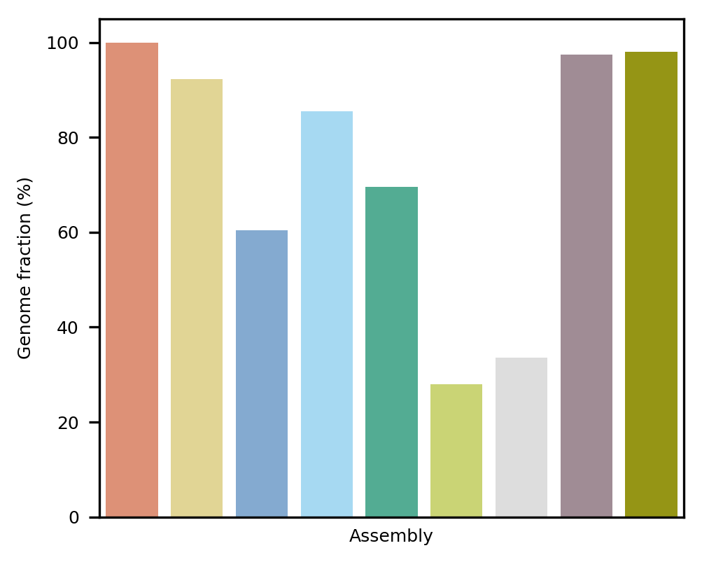
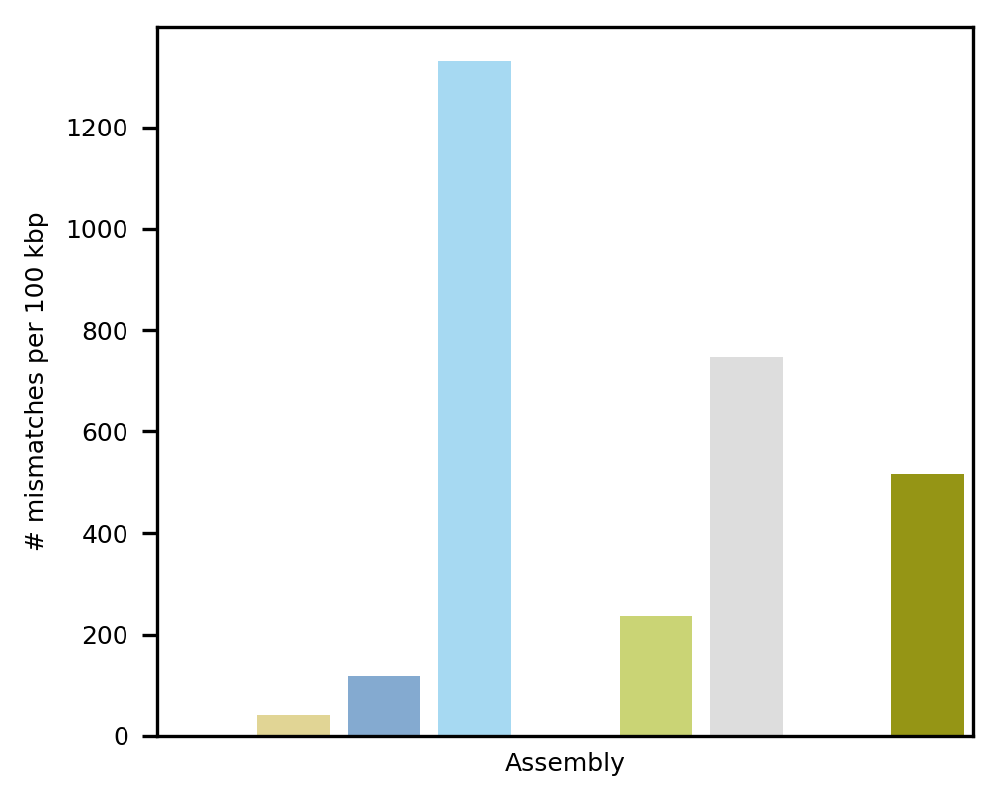
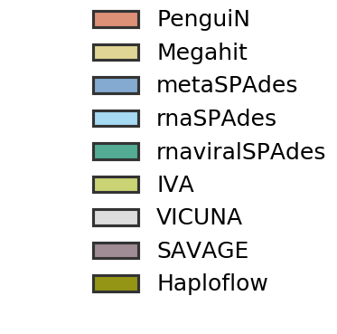
A
PenguiN
Megahit
metaSPAdes
rnaSPAdes
rnaviralSPAdes
SAVAGE
IVA
VICUNA
Haploflow
Contigs aligned to MF973193.1
0
2
4
6
7.1kbp
PenguiN
Megahit
metaSPAdes
rnaSPAdes
rnaviralSPAdes
SAVAGE
IVA
VICUNA
Haploflow
Contigs aligned to MF973194.1
0
2
4
6
6.94kbp
Contigs aligned to MN749156.1
PenguiN
Megahit
metaSPAdes
rnaSPAdes
rnaviralSPAdes
SAVAGE
IVA
VICUNA
Haploflow
0
2
4
6
7.14kbp
B
C
Figure 2

