Slide 1
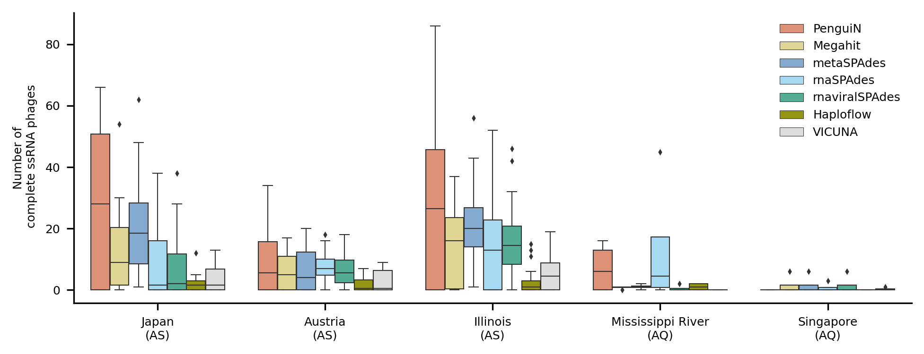



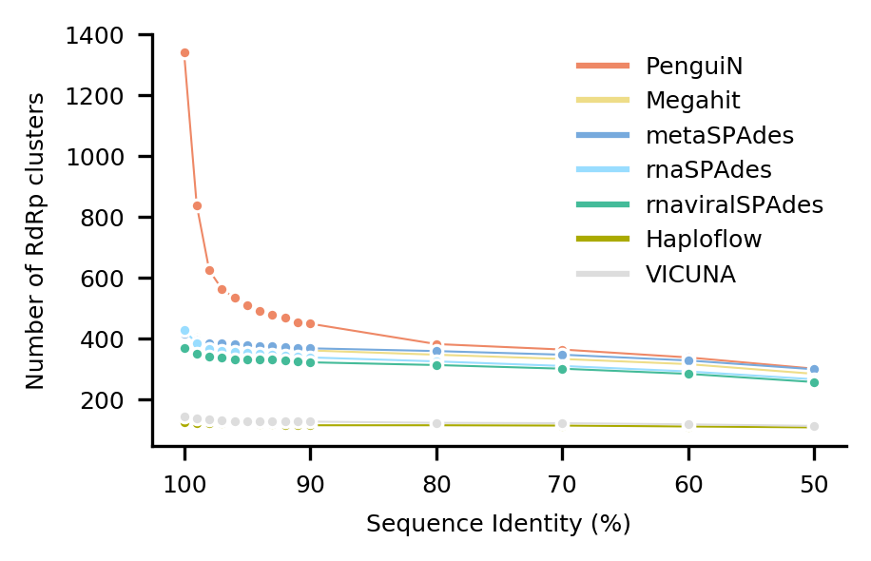



A
B
C
PenguiN
68.96%
31.04%
66.17%
33.83%
68.45%
31.55%
62.12%
37.88%
70.67%
29.33%
65.08%
34.92%
Megahit
metaSPAdes
rnaSPAdes
67.31%
32.69%
92.13%
7.87%
85.05%
14.95%
82.22%
17.78%
93.50%
6.50%
87.59%
12.41%
rnaviralSPAdes
Haploflow
VICUNA

