Slide 1
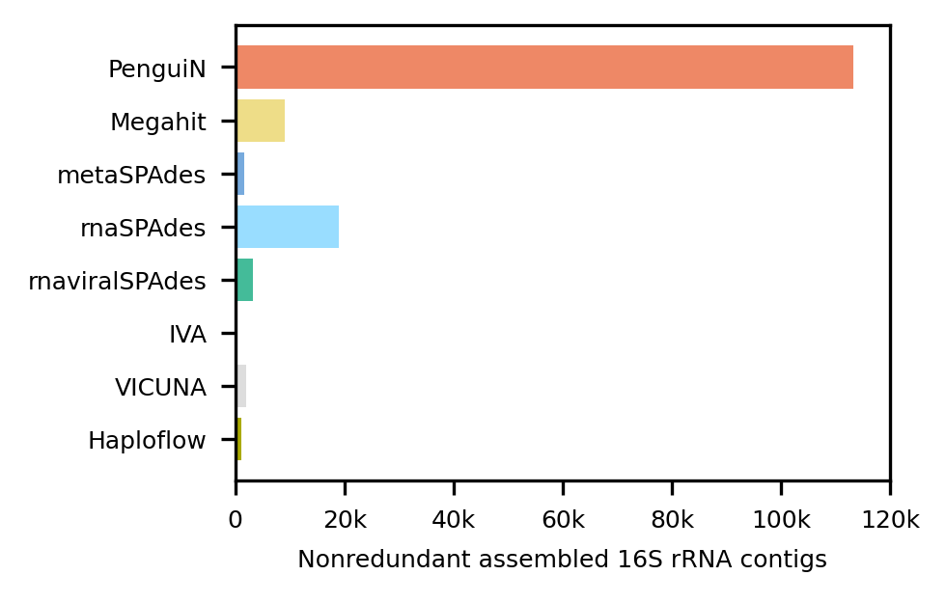
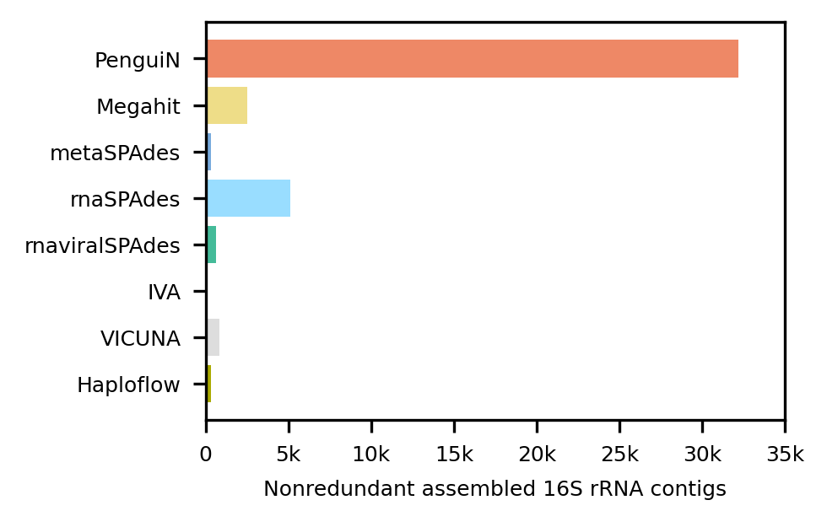
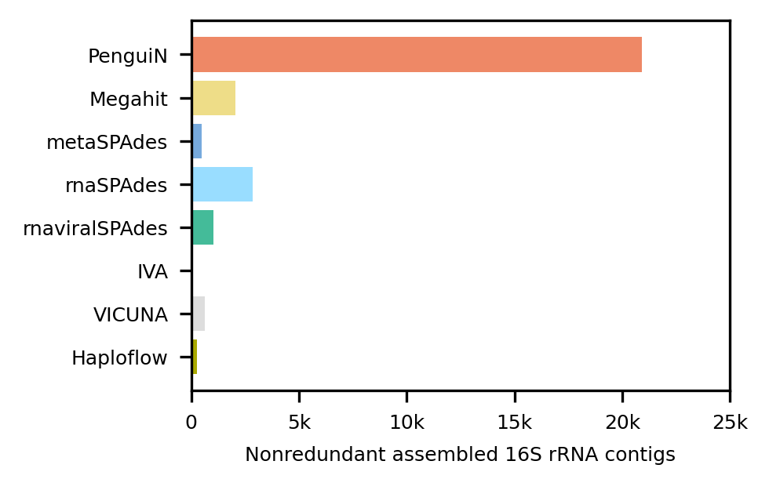
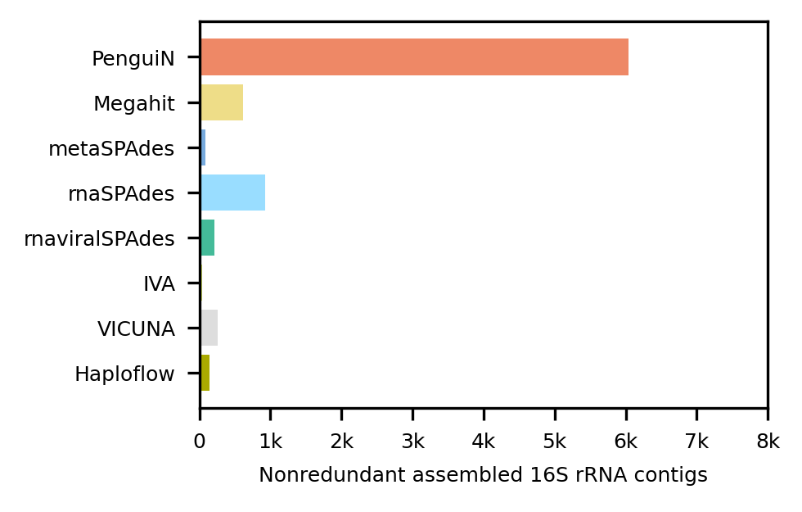
A
RFAM matches (min coverage 50%)
B
RFAM matches (min coverage 80%)
C
RFAM ∩ SILVA matches (min coverage 50%)
D
RFAM ∩ SILVA matches (min coverage 80%)

