Slide 1
The best place to live: Boston neighborhoods crime rate and venue data

Slide 2
Determine Boston neighborhood to live:
Crime rate
Venues proximity

Slide 3
Used data and tools:
https://data.boston.gov/ :
https://data.boston.gov/dataset/planning-districts
https://data.boston.gov/dataset/boston-police-stations
https://data.boston.gov/dataset/crime-incident-reports-august-2015-to-date-source-new-system
https://data.boston.gov/dataset/public-libraries/resource/ce600f93-20ee-446d-89fd-0f0a92d6f24e
Foursquare API
Folium
IBM Watson Studio

Slide 4
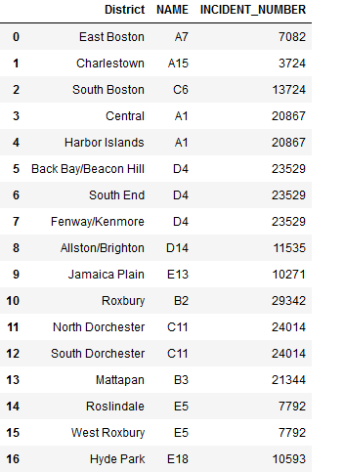
Data processing:
Merging datasets for crime rate choropleth map:

Slide 5
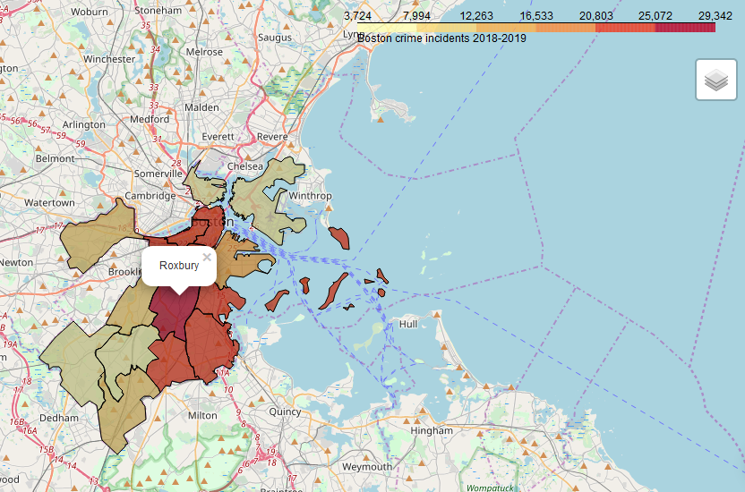
Data processing:
Creating crime rate choropleth map:

Slide 6
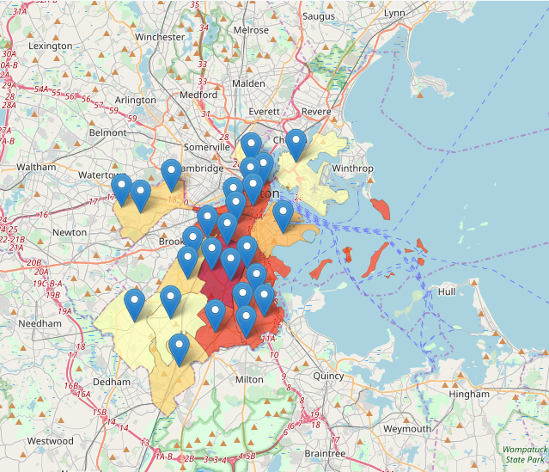
Data processing:
Visualizing community centers as coordinates for Foursquare data retrieval:

Slide 7
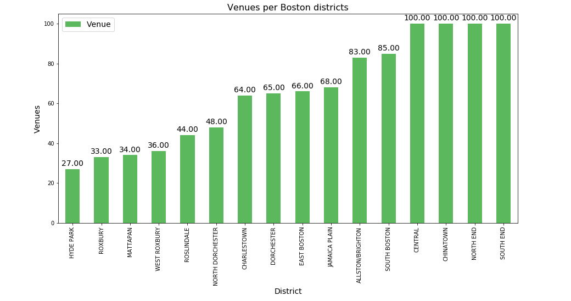
Number received venues per neighborhoods:

Slide 8
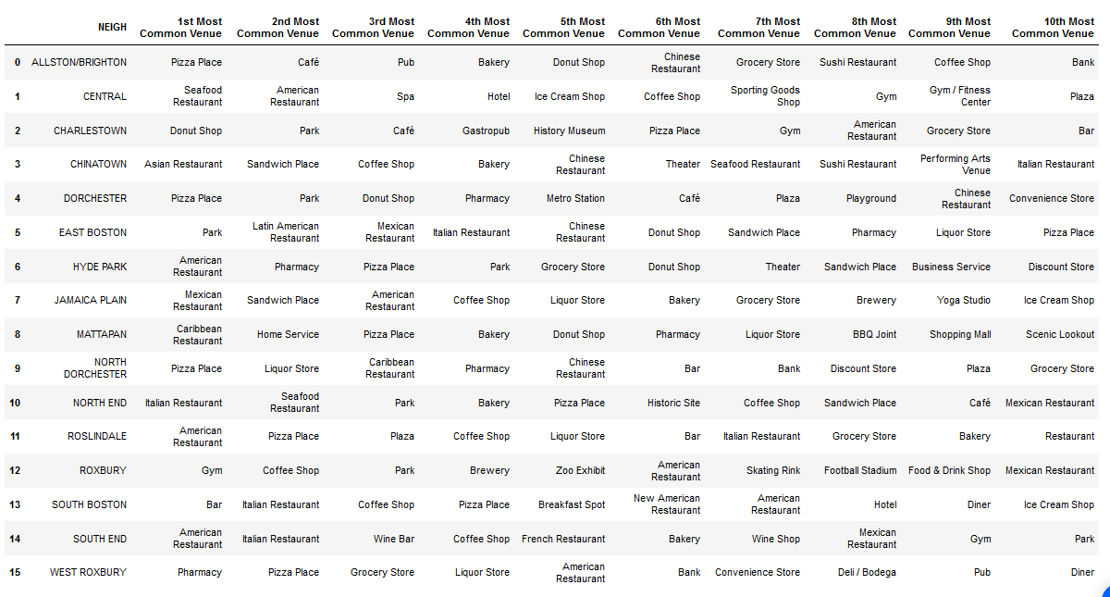
Top 10 venues per neighborhoods:

Slide 9
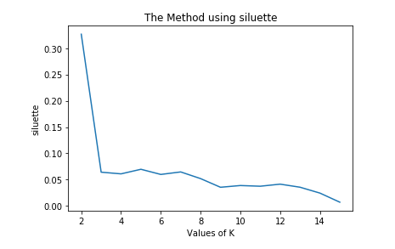
K-mean clustering:
Common venues
Narrow down from separate neighborhoods to the similar areas
Optimal k calcilation:

Slide 10
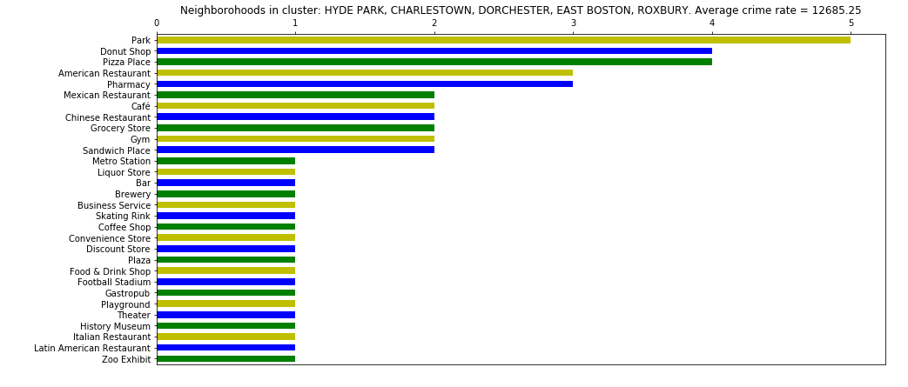
K-mean clustering:
Cluster 0:

Slide 11
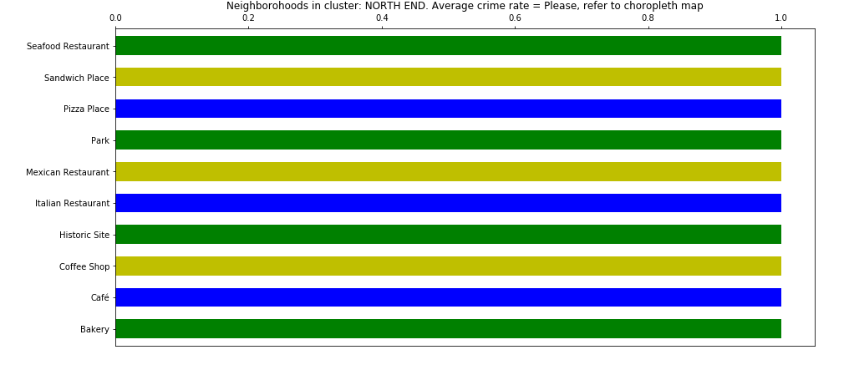
K-mean clustering:
Cluster 1:

Slide 12
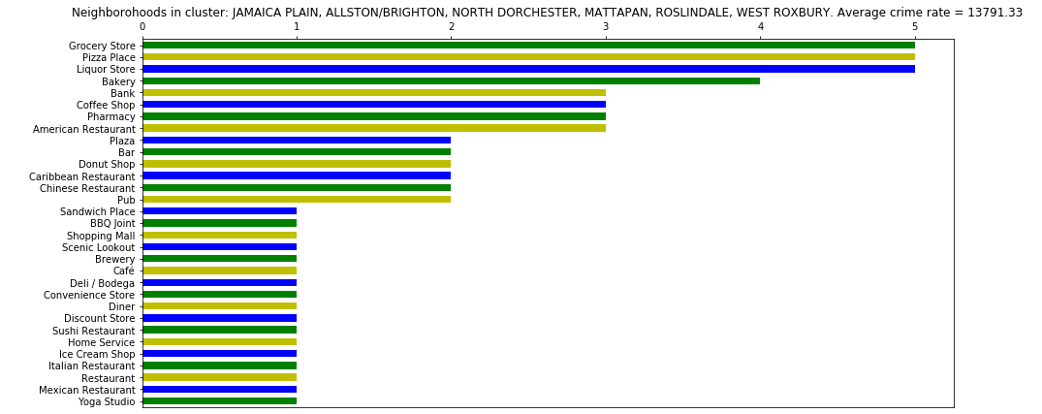
K-mean clustering:
Cluster 2:

Slide 13
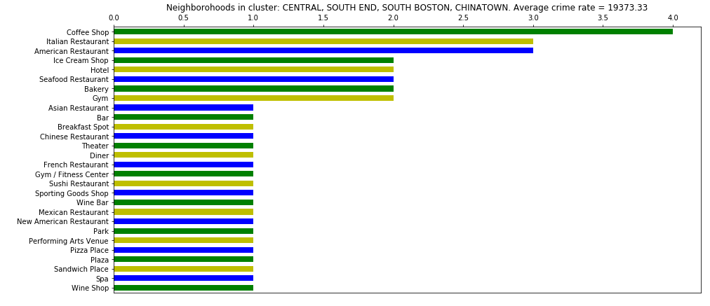
K-mean clustering:
Cluster 3:

Slide 14
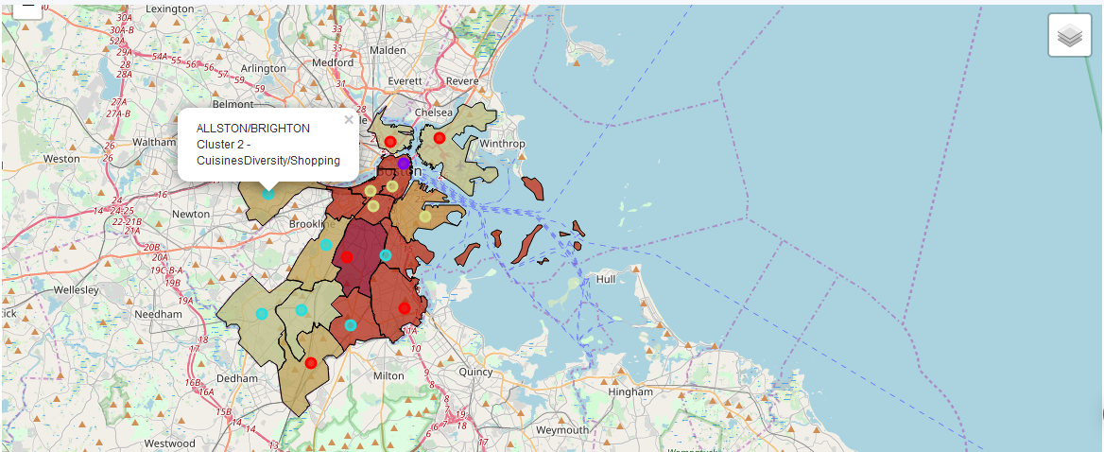
K-mean clustering:
Final map:

Slide 15
Results:
Choropleth map with crime rate created
Homogenous neighborhood clusters are formed and visualized
The best neighborhoods are not in centre and not Roxbury.
Subjects to future study:
Automation retrieval and parsing data
Measurement of polygon centers
Automation of cluster analysis

