Slide 1
SCALLOP/INF1 analysis
https://github.com/jinghuazhao/INF
29/11/2018

Slide 2
Outlines
A initial look at INTERVAL.
Meta-analysis:
Summary data from EGCUT, INTERVAL, NSPHS, ORCADES, STABILITY, STANLEY, VIS.
METAL (WEIGHTS >= 50, SCHEME STDERR).
Highlights:
Results for two benchmarks.
PLINK –clump and GCTA –cojo-slct.
cis-/trans- classifications (now available as a generic R function).

Slide 3
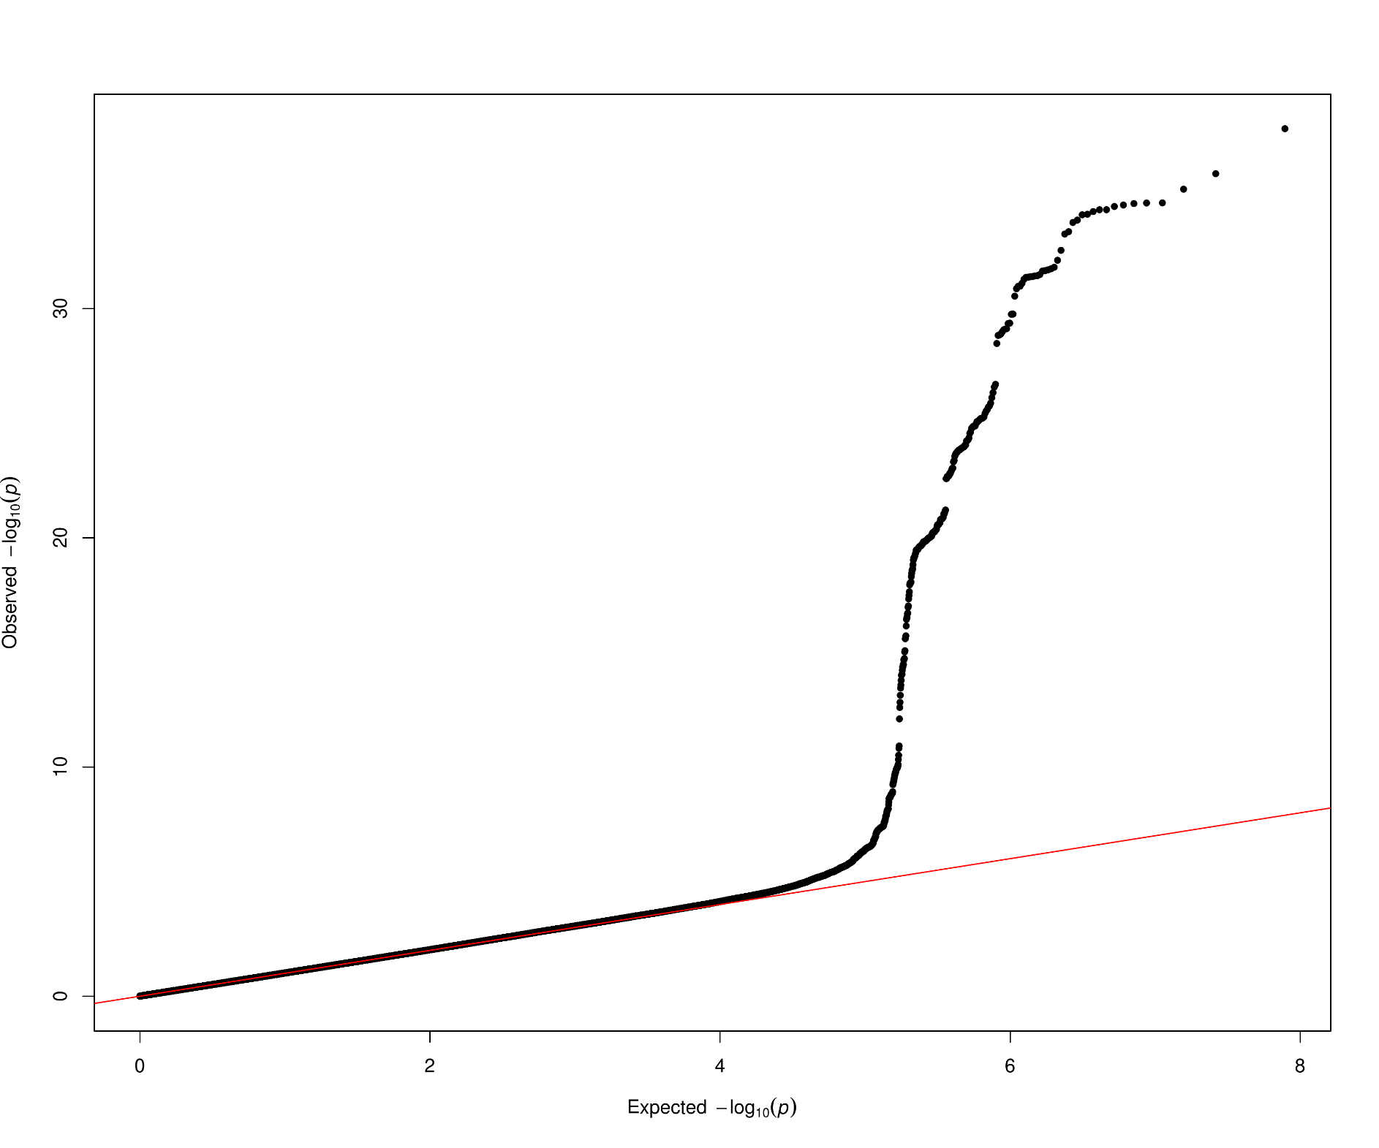
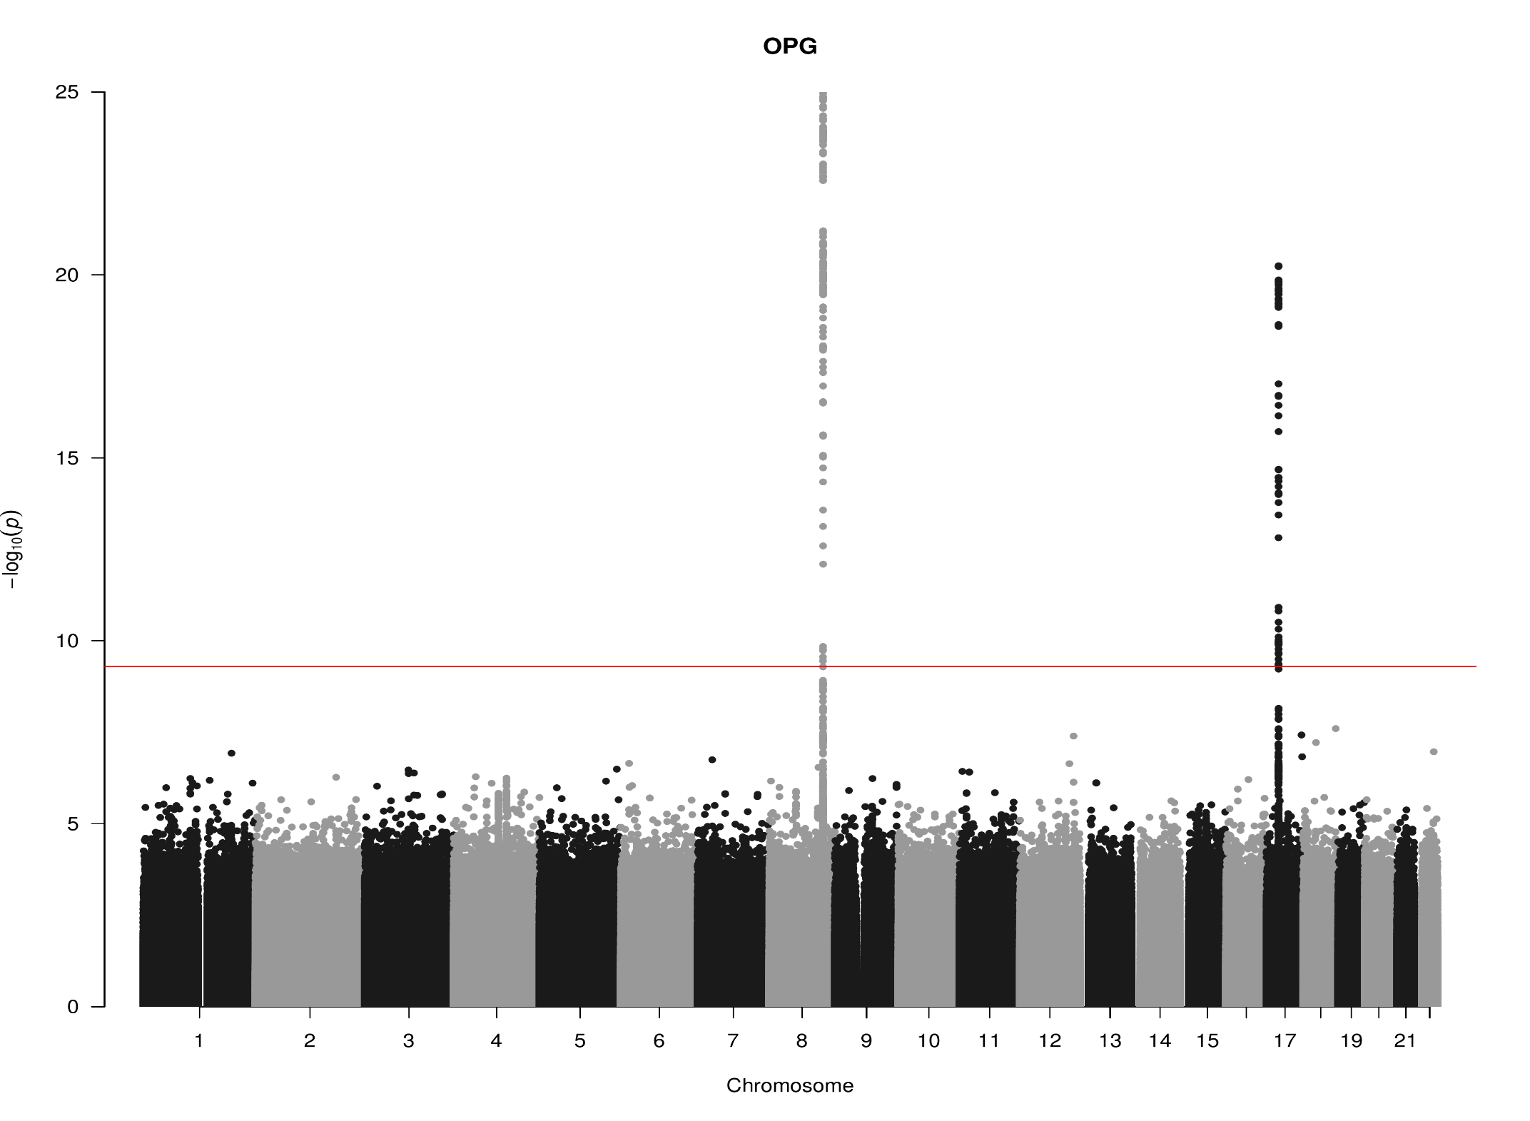
TNFRSF11B, chr8:119935796-119964439 (OPG)

Slide 4
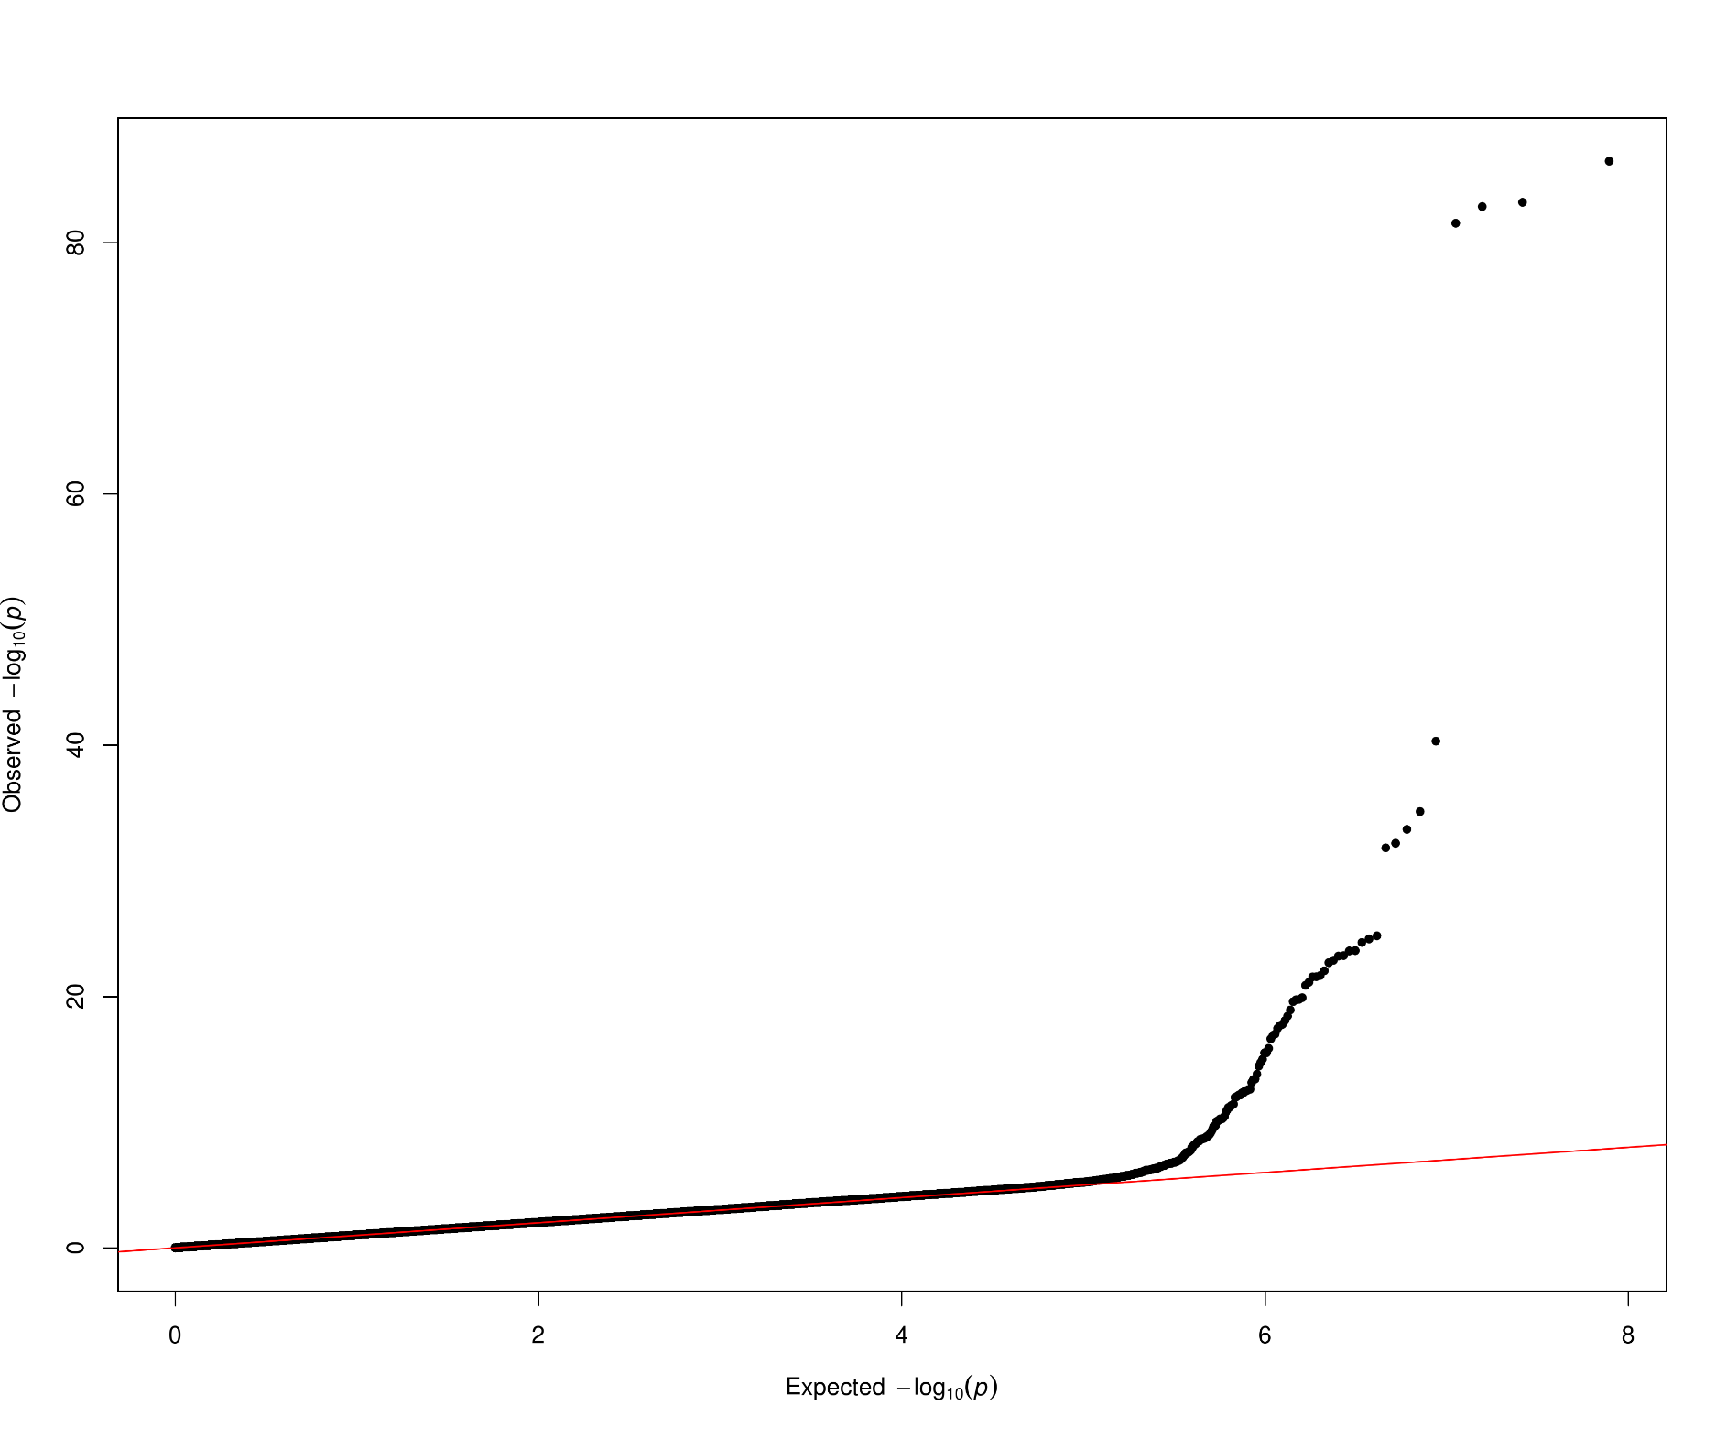
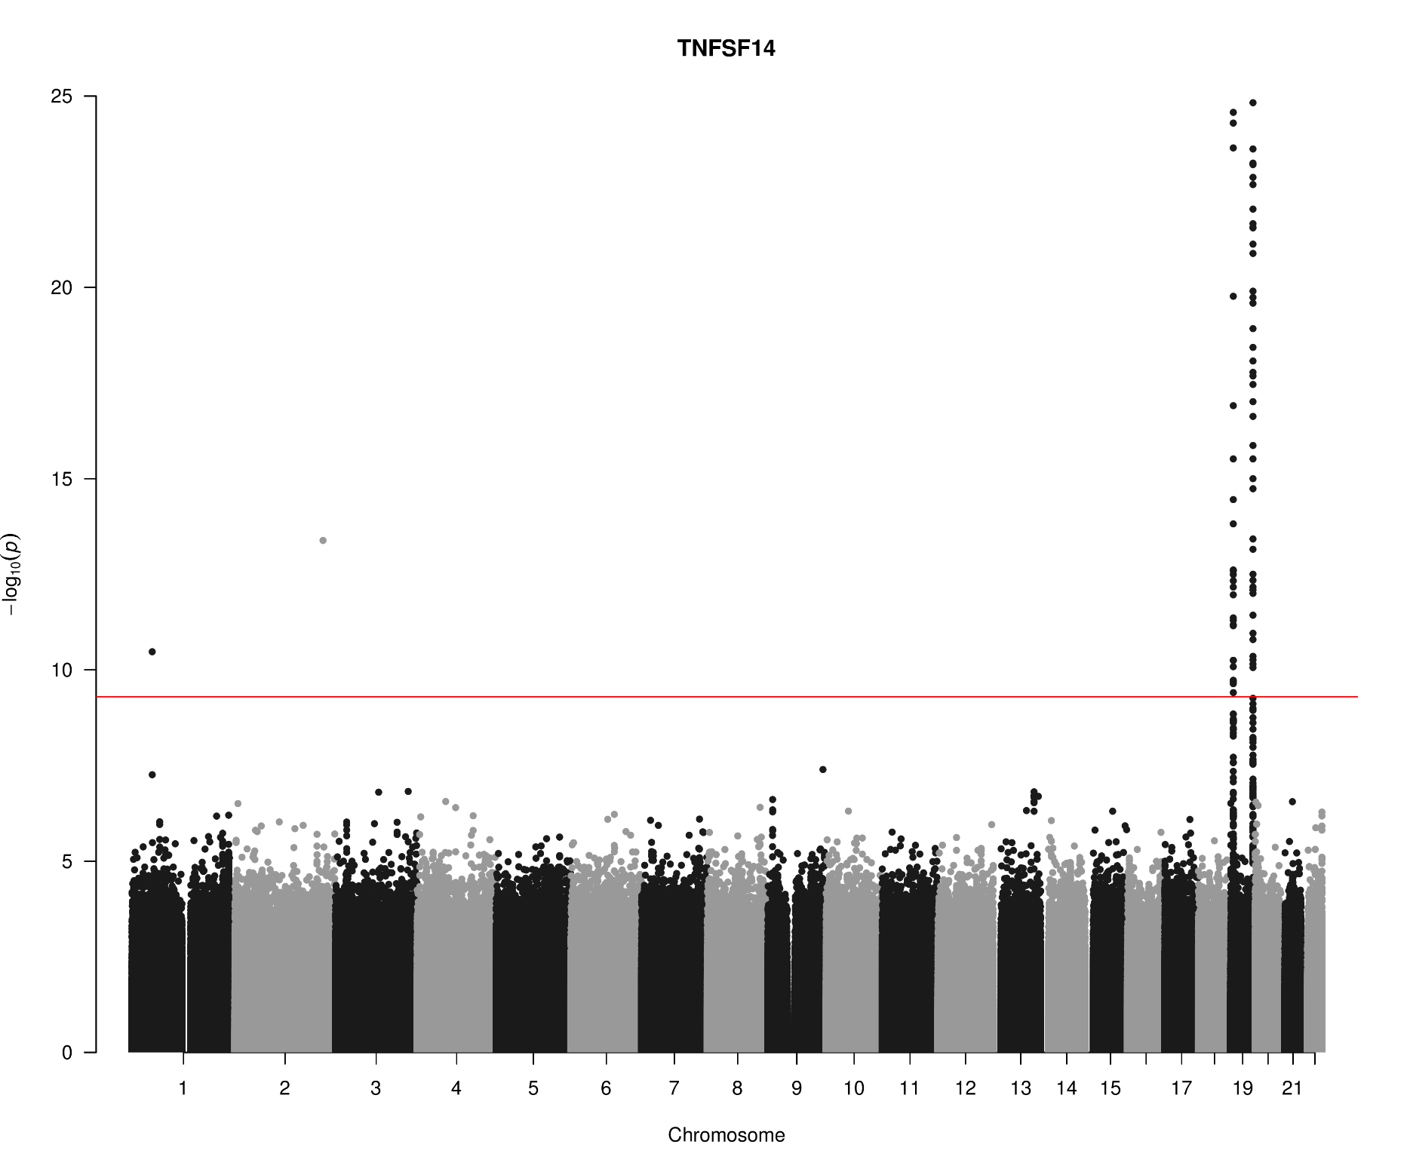
TNFSF14, chr19:6663148-6670599 (TNFSF14)

Slide 5
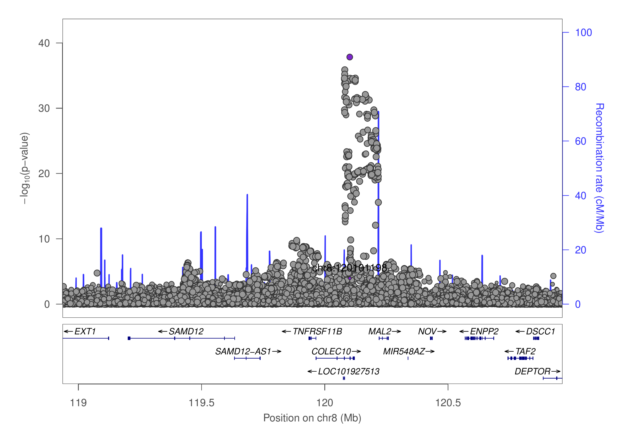
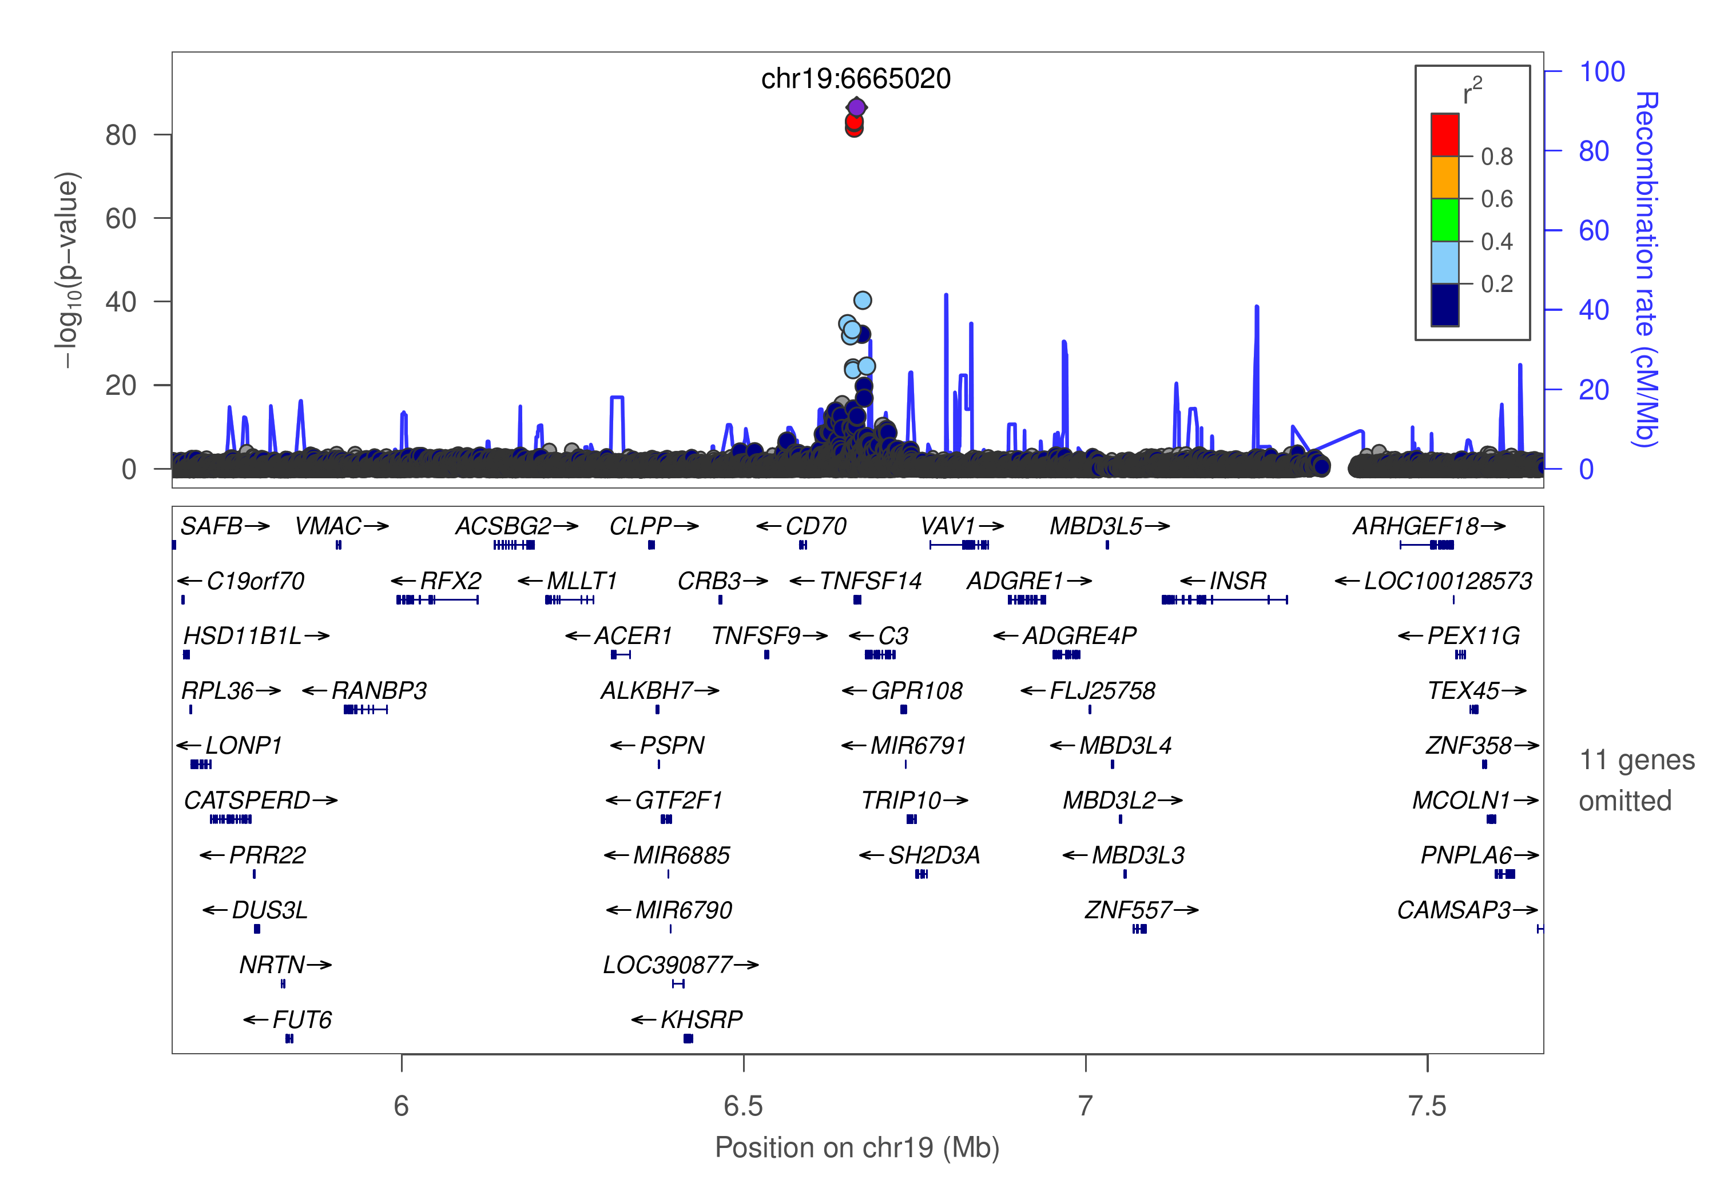
OPG/TNFSF14

Slide 6
GCTA –cojo-slct: A ~ increasing level (p=7.0e-21)
Protein | snp | refa | freq | b | se | p | n | bj | bj_se | pj
OPG | chr8:119867209_A_C | A | 0.1039 | 0.172 | 0.0277 | 5.22E-10 | 9892.77 | 0.206094 | 0.027873 | 1.42E-13
OPG | chr8:120081031_C_T | T | 0.5581 | -0.1588 | 0.0126 | 1.34E-36 | 17960.5 | -0.16752 | 0.01271 | 0
OPG | chr17:26694861_A_G | A | 0.4748 | -0.1165 | 0.0124 | 5.98E-21 | 18414.6 | -0.1165 | 0.012429 | 7.05E-21
TNFSF14 | chr19:593734_A_G | A | 0.0017 | 1.0699 | 0.2851 | 0.000175 | 5255.19 | 1.86978 | 0.290836 | 1.28E-10
TNFSF14 | chr19:1227505_C_T | T | 0.0038 | 0.5254 | 0.1936 | 0.006658 | 5115.54 | 8.7433 | 0.295469 | 0
TNFSF14 | chr19:1403959_C_G | C | 0.0396 | 0.0811 | 0.0425 | 0.05621 | 10576.4 | 0.359616 | 0.043192 | 8.37E-17
TNFSF14 | chr19:3932314_C_T | T | 0.0102 | 0.2737 | 0.1072 | 0.01071 | 6258.25 | 3.12785 | 0.137414 | 0
TNFSF14 | chr19:6641765_C_T | T | 0.0429 | -0.474 | 0.0648 | 2.46E-13 | 4162.6 | -1.58862 | 0.077673 | 0
TNFSF14 | chr19:6665020_C_T | T | 0.1024 | -0.5329 | 0.0269 | 0 | 10535.2 | -0.85562 | 0.033295 | 0
TNFSF14 | chr19:6673889_A_G | A | 0.1109 | -0.5374 | 0.0401 | 0 | 4404.95 | -0.76622 | 0.047387 | 0
TNFSF14 | chr19:6704670_C_T | T | 0.8479 | -0.1313 | 0.0219 | 2.10E-09 | 11714.3 | -0.26149 | 0.022204 | 5.14E-32
TNFSF14 | chr19:8094596_A_G | A | 0.0071 | 0.2025 | 0.1137 | 0.07481 | 7972.04 | 1.34322 | 0.117358 | 2.48E-30
TNFSF14 | chr19:8120283_A_G | A | 0.0025 | -0.7169 | 0.2159 | 0.000897 | 6241.91 | -13.3586 | 0.436703 | 0
TNFSF14 | chr19:13181330_A_G | A | 0.0065 | 0.2745 | 0.1308 | 0.03589 | 6574.33 | 8.92649 | 0.279624 | 0
TNFSF14 | chr19:14165598_C_T | T | 0.0631 | 0.0871 | 0.0505 | 0.08456 | 4818.25 | 0.548355 | 0.053235 | 6.99E-25
TNFSF14 | chr19:22506594_A_G | A | 0.0021 | -0.5409 | 0.2331 | 0.0203 | 6377.98 | -9.8455 | 0.36829 | 0
TNFSF14 | chr19:54324995_G_T | T | 0.2437 | 0.1635 | 0.0161 | 2.43E-24 | 15109.3 | 0.1635 | 0.016154 | 4.45E-24

Slide 7
SNP information (PhenoScanner) chr17:26694861 rs704: Kwan JS, et al. (2014), Hum Mol Genet, PMID25080503, allele G ~ decrease of Osteoprotegerin levels (p=1e-9).
SNP | rsID | Pos (hg19) | Alleles
chr8:119867209 | rs149577650 | chr8:119867209 | A/C
chr8:120081031 | rs2247769 | chr8:120081031 | C/T
chr17:26694861 | rs704 | chr17:26694861 | G/A
chr19:593734 | rs113083835 | chr19:593734 | A/G
chr19:1227505 | rs7259447 | chr19:1227505 | C/T
chr19:1403959 | chr19:1403959 | chr19:1403959 | C/G
chr19:3932314 | rs149200741 | chr19:3932314 | C/T
chr19:6641765 | rs56029314 | chr19:6641765 | C/T
chr19:6665020 | rs344560 | chr19:6665020 | T/C
chr19:6673889 | rs6510917 | chr19:6673889 | A/G
chr19:6704670 | rs11085195 | chr19:6704670 | T/C
chr19:8094596 | rs142682195 | chr19:8094596 | A/G
chr19:8120283 | chr19:8120283 | chr19:8120283 | NA
chr19:13181330 | chr19:13181330 | chr19:13181330 | NA
chr19:14165598 | rs56361194 | chr19:14165598 | C/T
chr19:22506594 | rs193135521 | chr19:22506594 | A/G
chr19:54324995 | rs4632248 | chr19:54324995 | G/T

Slide 8
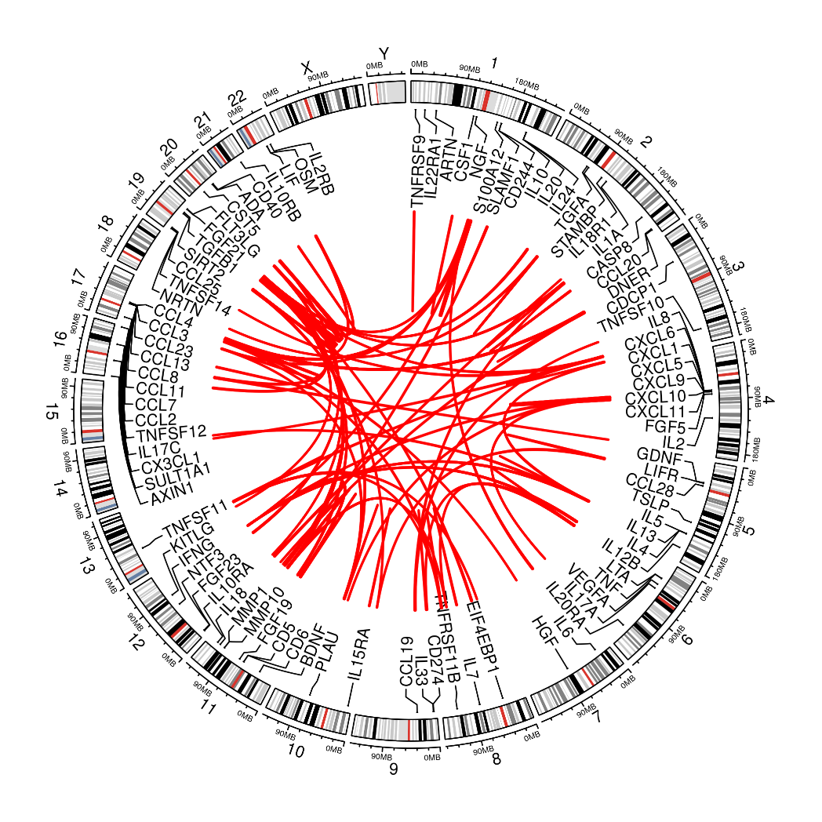
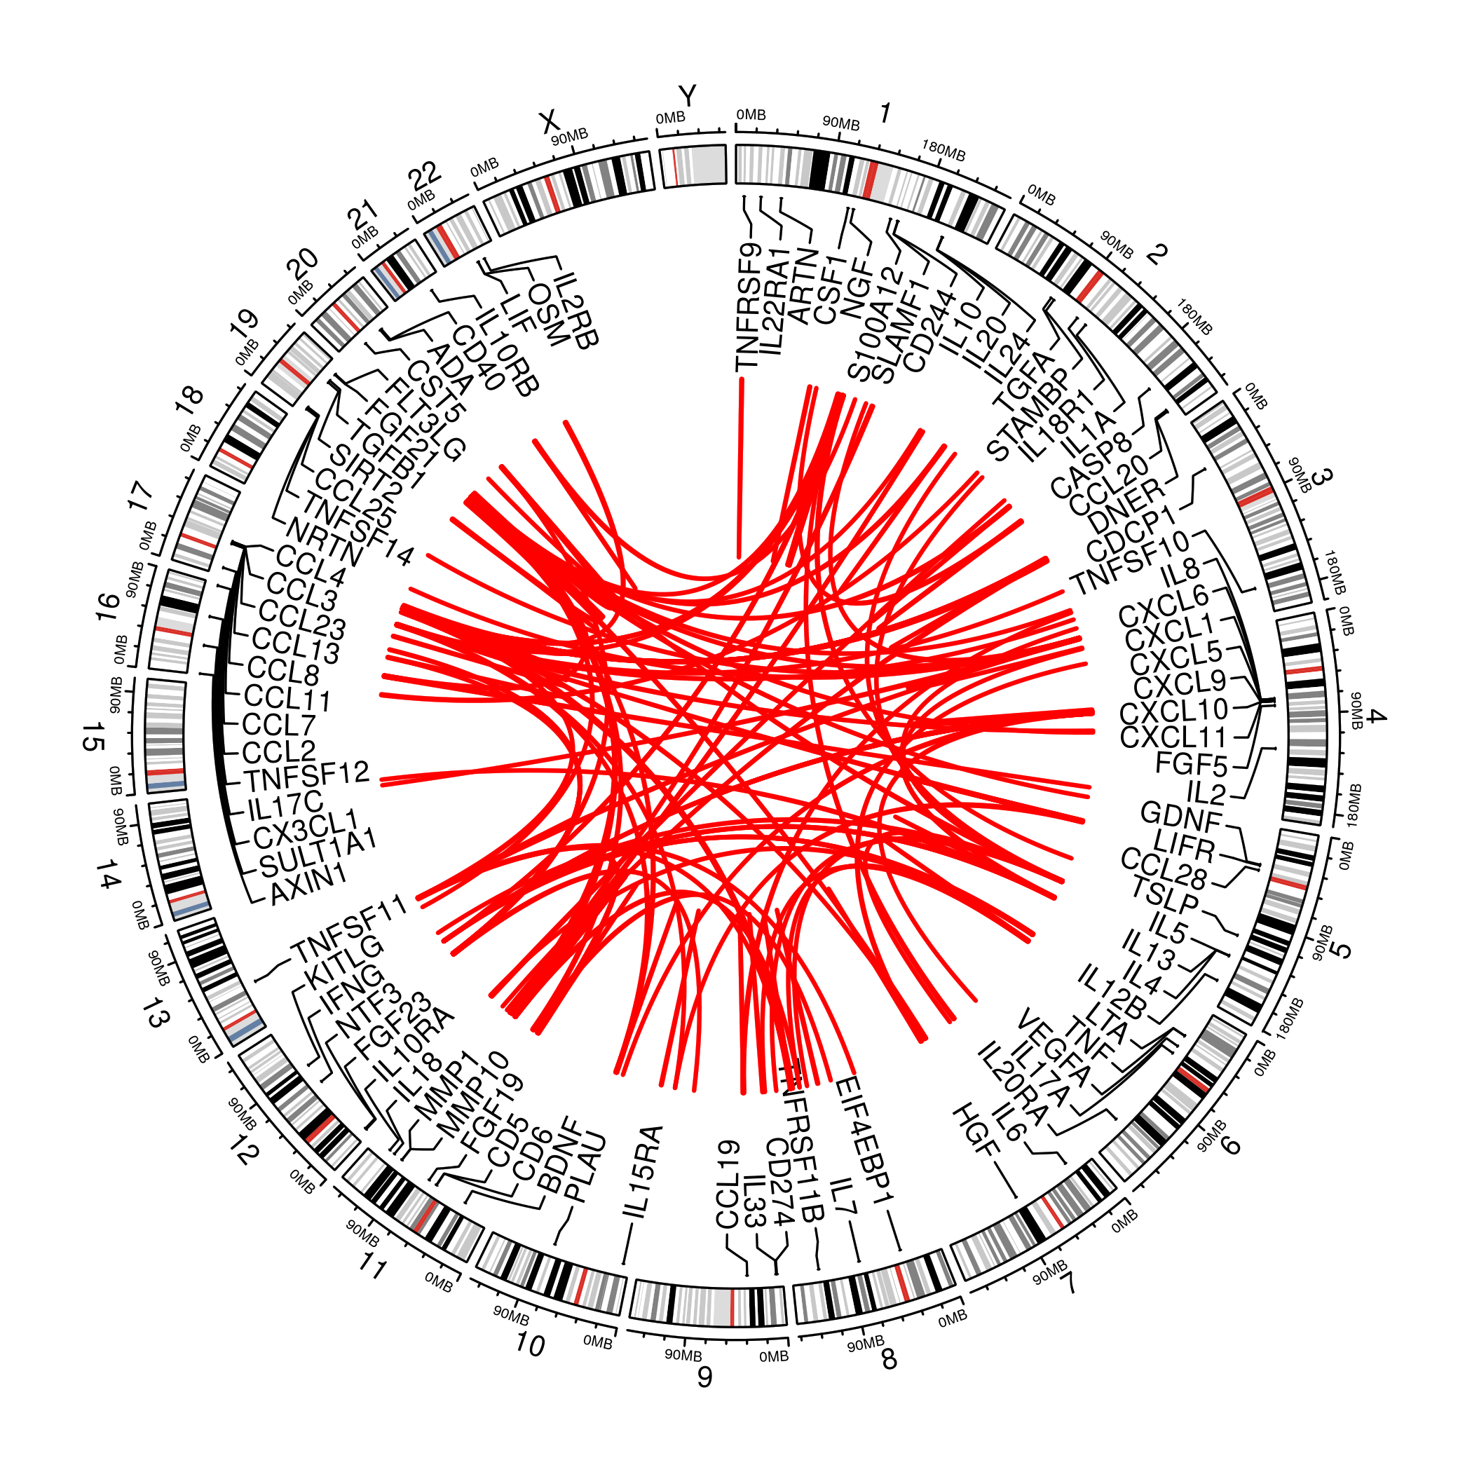
cis-/trans- classification (INTERVAL[58/68]/INF1[55/102])

Slide 9
A brief summary
It is still at a very early stage of the analysis.
Results from INTERVAL and benchmarks from meta-analysis were reassuring.
This was based on stricter criteria on –ld-r2 of the PLINK –clump procedure which was somewhat hampered is its inability to handle small p-value.
It is worthwhile to explore approaches.
There will be further effort on the meta-analysis QC.

Slide 10
On next steps
KORA individual level data analysis will be conducted centrally.
Additional studies such as COMBINE will be added.
For cohorts contributing results on PLINK, information such as effect allele (frequency), imputation quality is recommended on a per-cohort basis via qctool as noted in SCALLOP_INF_I_analysis_plan.md.
The QC will be refined and downstream analysis strengthened -- the experiments were based on 1000Genomes extracted from LocusZoom 1.4 at tryggve when there was issues with the up-/down-load. A more desirable reference panel would be INTERVAL, UKBiobank, both involving HRC+UK10K. Finemapping is set to involve PLINK, GCTA, finemap, and JAM, among others.

