Slide 1
SCALLOP/INF1 discovery analysis
15/8/2019

Slide 2
Outlines
Meta-analysis
Generation of GWA summary statistics with filters on GWA p, I^2 and effects (csd3, /rds/project/jmmh2/rds-jmmh2-projects/olink_proteomics/scallop/INF/METAL).
Q-Q/Manhattan/(cis-)LocusZoom plots (directory qml/)
Steps of discovery analysis
Selection of sentinels
Forest and LocusZoom plots on and around sentinels
Joint/conditional analysis on each locus
Variance explained by sentinels
IL.18R1 and IL.6 Examples
finemap (see IL.6 results with default k=5, k=10 more preferable?)
Related results
Experimental results

Slide 3
Selection of sentinels
Three types (single variant for HLA region + no exclusion of regions of high LD) and an iteration indicates a new function call:
Type I. The whole collection of genomewide significant variants is within +/- 1Mb, e.g., variants in LD at a cis region.
Type II. A candidate in the collection has no variants beyond +1 Mb so start new iteration with variant next to the flanking region, e.g., two trans signals.
Type III. A region containing candidate sentinel can be merged with next for a new iteration, e.g., multiple trans signals.
Findings: 166 sentinels = 138 Type I + 4 Type II + 24 Type III = 57 cis + 109 trans (directory sentinels/)
circos plot
forest plots
+/- 1Mb LocusZoom plots (directory lz/)
Proportion of variance explained (PVE)
https://github.com/statgen/swiss appears to implement similar algorithm, i.e., swiss --dist-clump --clump-dist 1000000

Slide 4
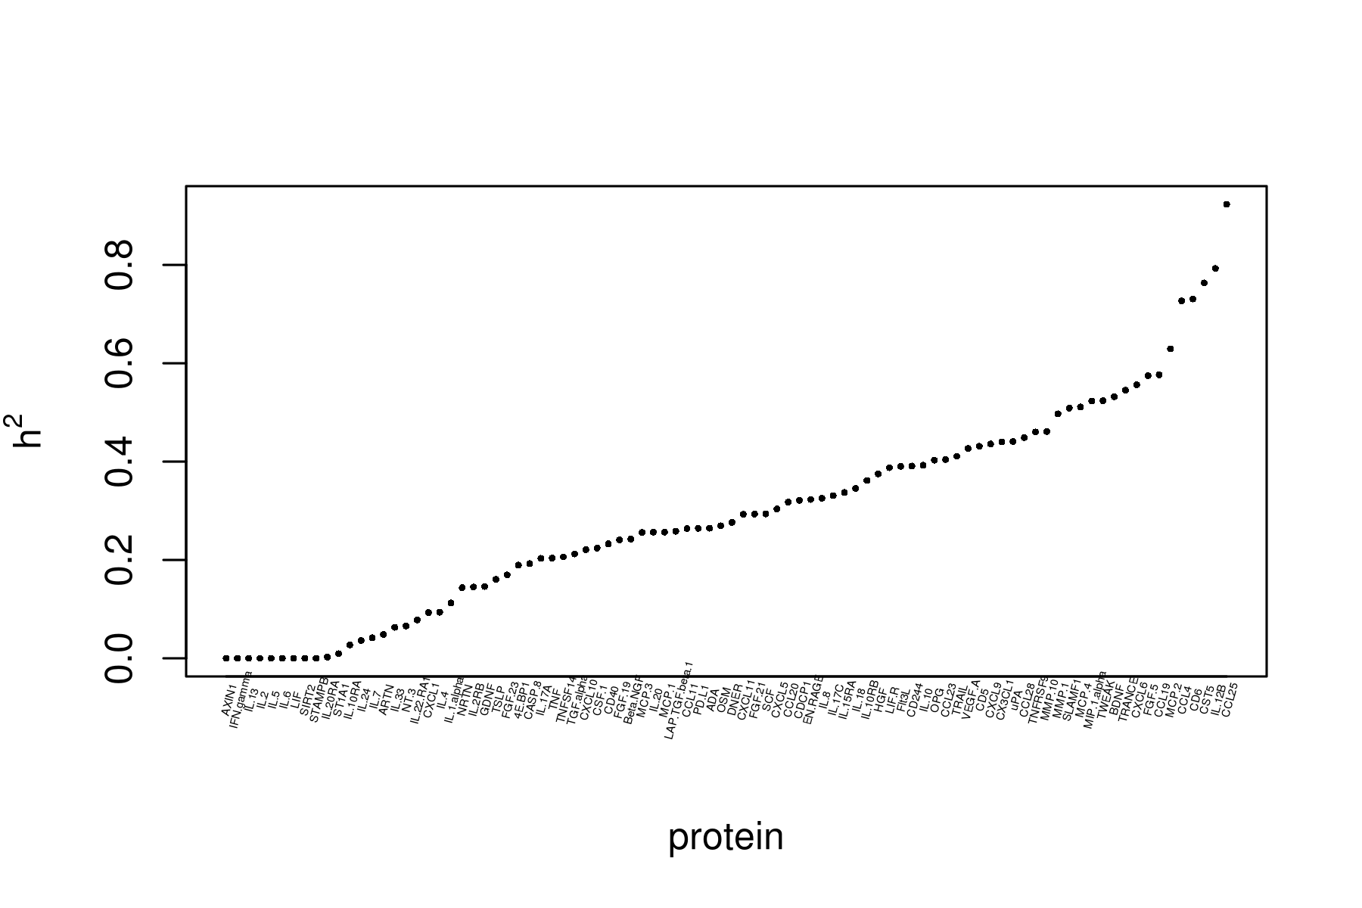
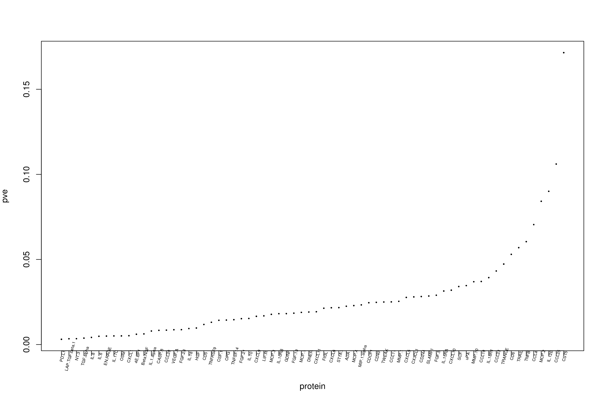
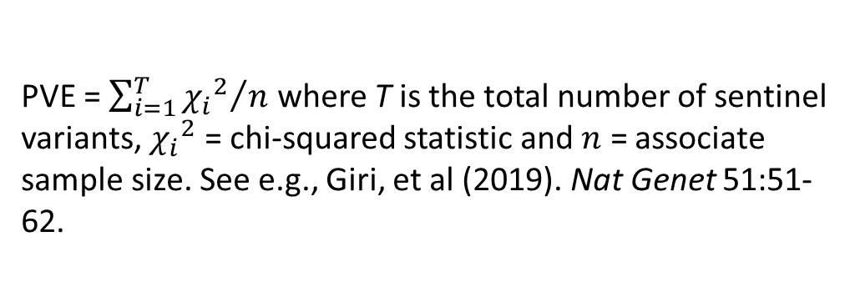
Figure 2. Heritability (left) and PVE (right)
Estimated through genomic heritability (INTERVAL) with adjustment for age, sex and PCs.
PVE = $\sum_{i=1}^{T}{{{χ_{i}}^{2}}/n}$ where T is the total number of sentinel variants, ${χ_{i}}^{2}$ = chi-squared statistic and $n$ = associate sample size. See e.g., Giri, et al (2019). Nat Genet 51:51-62.

Slide 5
Joint/conditional analysis via GCTA –cojo-slct
Using the agreed (default) parameters
--extract-region-snp <sentinel> 1000 –cojo-collinear 0.9
INTERVAL imputed data as used in the INF1 analysis, which is appropriate according to GCTA documentation (N > 4,000)
Results (directory cojo-slct/)
235 cis + 144 trans = 379 signals which correspond to (187 cis + 125 trans =) 312 primary and (48 cis + 19 trans =) 67 secondary signals
Credible sets
circos plot

Slide 6
Table 1. Classification of signals
 | Cis | Trans | Total
Primary | 187 | 125 | 312
Secondary | 48 | 19 | 67
Total | 235 | 144 | 379

Slide 7
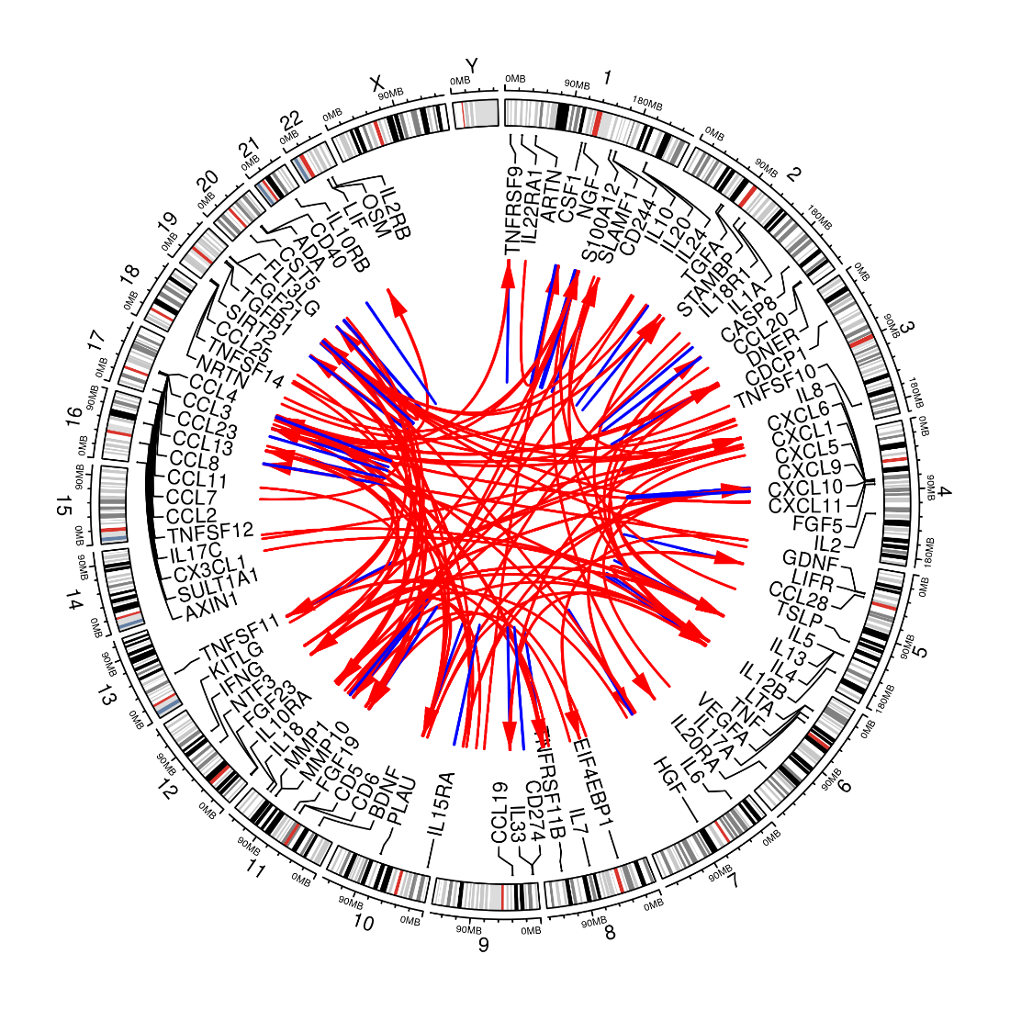
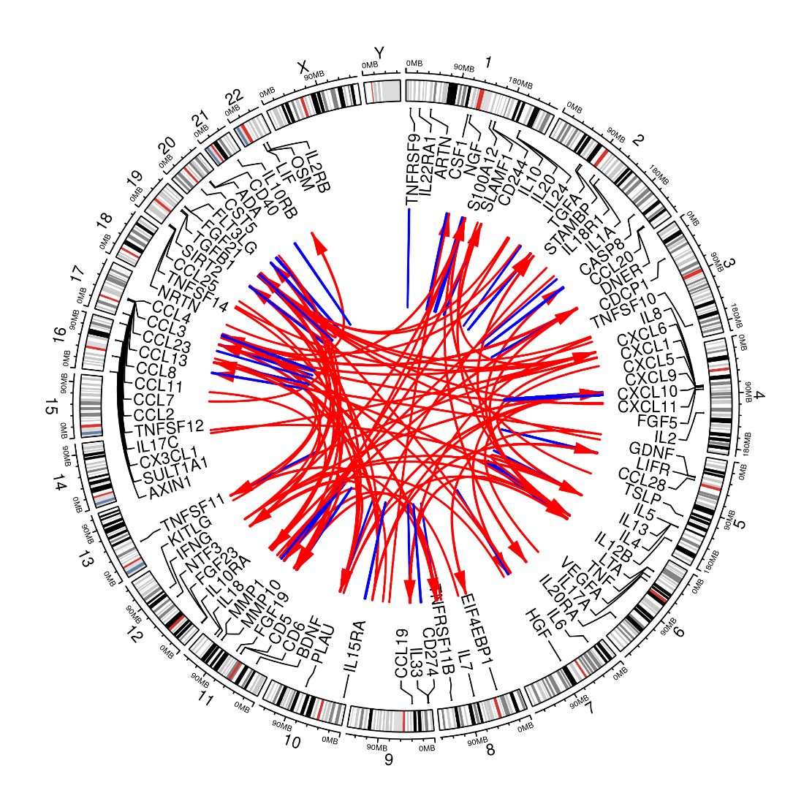
Figure 1. Circos plots for cis/trans signals.
Left – sentinels, Right –cojo-slct

Slide 8
IL.18R1 example
Background. There are 15 cis signals (chr2) for this protein.
Aim. To understand independent signals obtained from GCTA –cojo-slct.
Approach. To use INTERVAL individual level data in a joint (linear regression) model containing SNPs from –cojo-slct.
Results (directory IL.18R1/INTERVAL/default). Four variants were identified from GCTA and three turned to be significant in the joint model.

Slide 9
finemap v1.3.1 outputs
1. a list of potential causal configurations together with their posterior probabilities (PP) and Bayes factors (BF), 2. the PP marginalised over the causal configurations that individual variants are causal, and 3. the PP that there is a specific number (e.g., 1 ~ 5) of statistically independent associations in each region.
config - posterior summaries for each causal configuration.
snp – variant level GWAS sumstats and model-averaged posterior summaries: prob = marginal Posterior Inclusion Probabilities (PIP), the PP that this variant is causal; group = group number; group_prob = PP the group has >= 1 causal variant; corr_group = r with sentinel of the group; mean/sd = posterior effect size/std from all configurations or _incl from causal inclusion configurations.
cred - 95% credible sets for each causal signal conditional on other causal signals in the genomic region together with conditional PIP for each variant.
log – P(k|data) for k causal variants.
dose - binary data to track information on analysis.

Slide 10
IL.6 example
IL.6 (encoded by IL6 on Chr7) can be used as a benchmark – GWAS has confirmed no cis but a trans signal at Chr1.
The output (directory finemap/) has been assembled into .xlsx containing snpid-rsid correspondence, .snp, .c(on)f(i)g, .cred, respectively. Note the the sentinel is among the top of .snp and in .cred and configuration has posterior probability = 1 and the largest log10(BF). chr1:154464572_A_G (rs4478801, also the sentinel as in the LocusZoom plot), chr1:154492432_C_T (rs4518898), chr1:154504702_A_G (rs60255122), chr1:154512077_C_T (rs73023346), chr1:154514092_C_T (rs72999419). The huge odds in configurations 2 and 3 also contain the sentinel.

Slide 11
Experimental results
The compromise between genomewide joint/conditional analysis and approximately independent LD – the results were largely satisfactory but appeared suboptimal where the peaks were at times cut into two neighbouring blocks.
A pruned reference panel (r2=0.8) for the lack of –ld-r2 in GCTA –cojo-slct, the need of LD pruning for JAM, and the prospect of easier interpretation of finemap results -- not set as a priority since both GCTA and finemap already worked. For IL.18R1,
four variants were obtained from INTERVAL GCTA –cojo-slct (directory IL.18R1/INTERVAL/r2-0.8-pruned/).
Unfortunately JAM does not select the sentinel and seemed in favour of smaller set of variants.
finemap credible sets contains the sentinel in the pruned set.

Slide 12
In silico results
sentinels() for sentinel selection is part of R/gap.
cs() for credible sets is part of R/gap.
While unpruned reference is possible for GCTA and finemap, the pruned version is also OK to include JAM. The alignment of effect allele for finemap and use of R rbgen/plink2R for JAM reference file as well as missing data imputation are eventually brought to control.
The handling of alleles should facilitate other downstream analysis such as MR/colocalisation otherwise seen to be difficult.

Slide 13
Comparisons
The CAD results were from both fixed and random effects model.
GCTA --cojo-cond <sentinel> (directory cojo-cond1/) does not select all the variants stochastically but for assurance and sentinel selection is required.
A version of –cojo-cond was implemented by the CKDGen (Wuttke, et al. (2019). Nat Genet 51: 957–972 ) which uses results from –cojo-slct followed by –cojo-cond on these to be used by R/gtx for credible sets. While this is more in line with the Maller et al (2012). Nat Genet 44: 1294–1301 and/or Wakefield’s approach of credible sets (i.e., independent contributions). It appears viable though –gcta-slct gives these.

Slide 14
Other notes
The SomaLogic paper ran a joint model for sentinels which failed to be selected by –cojo-slct, see https://github.com/jinghuazhao/SomaLogic/blob/master/doc/Methods.md.
This is only possible with INTERVAL/KORA individual level data.

Slide 15
Further work
More on annotation, e.g., PhenoScanner.
More on PP (and haplotype analysis?). Note Ulirsch JC, et al. (2019) Nat Genet 51:683–693. with dosage rather than hard-called genotypes (as in GCTA –cojo-slct) for finemap.
Pleiotropic effects and pathways, e.g, ProGeM.
Integration of coloc and MR analysis for coherent interpretation.

Slide 16
PhenoScanner
Full functionality as with Cardio is yet to be established on csd3.
Individual results can be done with R package from GitHub repository phenoscanner/phenoscanner and/or the web interface.

Slide 17
GSMR (directory gsmr/)
GSMR as part of GCTA can be quickly done compared to R/MendelianRandomization and R/TwoSampleMR. However, overall the effect size plots appear to be largely suggestive.
The CAD summary statistics from Nikpey M, et al (2015). Nat Genet 47:1121-1130. Most striking with LIF.R
The UKB FEV1 summary statistics from Shrine et al. (2019). Nat Genet 51: 481–49. Most striking with CCL19 nevertheless only form seven variants so not shown on the effect size plots.
Possible candidate. IL.12B, PD.L1?

Slide 18
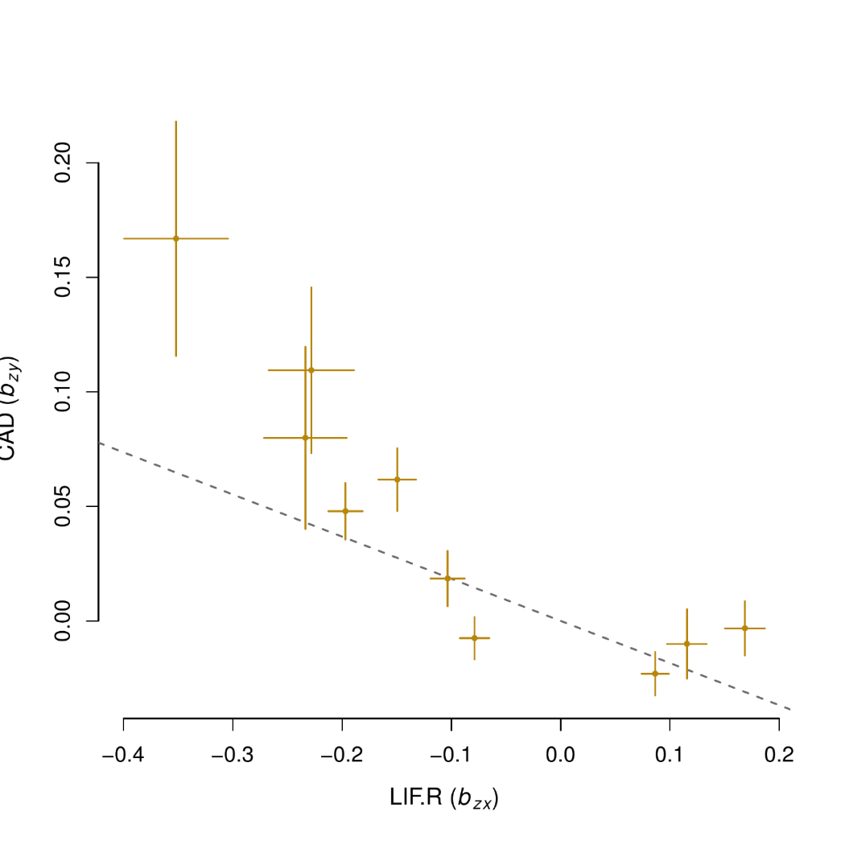
Figure 3. Effect size plot for LIF.R and CAD

