Slide 1
SCALLOP/INF1 analysis
https://github.com/jinghuazhao/INF
12/4/2019

Slide 2
Studies
Name | Website | Design | N | Institution
NSPHS | www.ncbi.nlm.nih.gov/pubmed/20568910 | population study Sweden | 866 | Uppsala
Pfizer.trials | www.pfizer.com | rheumatoid | 185 | Pfizer
STABILITY | https://clinicaltrials.gov/ct2/show/NCT00799903 | atherosclerosis | 2951 | Uppsala
STANLEY swe6 | www.ki.se/meb/stanleyswebic-studien | bipolar, depression | 300 | Karolinska
STANLEY lah1 | www.ki.se/meb/stanleyswebic-studien | bipolar, depression | 344 | Karolinska
BioFinder | http://biofinder.se | dementia | 1496 | Karolinska
COMBINE.RECOMBINE | www.combinesweden.se/ | rheumatoid | 860 | Karolinska
Estonian Biobank | www.geenivaramu.ee/en/access-biobank | population study Estonia | 487 | Tartu
INTERVAL | www.intervalstudy.org.uk/ | blood donors England | 4902 | Cambridge
KORA F4 | https://www.ncbi.nlm.nih.gov/pubmed/16032513/ | population study Germany | 1064 | Helmholz
ORCADES | https://www.ed.ac.uk/usher/molecular-epidemiology/our-studies/the-orkney-complex-disease-study | population isolate Orkney | 981 | Edinburgh
VIS | https://www.ed.ac.uk/usher/molecular-epidemiology/our-studies/croatian-studies | population isolate Croatia | 899 | Edinburgh
Total |  |  | 15335

Slide 3
Association analysis for KORA
Pilot with success/failure with BOLT-LMM on OPG/TNFSF14
Switch to SNPTEST on transformed measurement ~ age+sex+PC1-PC5
Exclusion of six related individuals
INFO score was compared between SNPTEST and qctool –snp-stats
Final sample size N=1064
Several disruptions on cardio/TRYGGVE and FGF.5 for #SNPs

Slide 4
Meta-analysis through METAL
Carried out on TRYGGVE with the latest release.
GC correction not considered on cohort level.
Based on effect size.
N>=10.
84% above LLOD.

Slide 5
A point on LLOD
An attempt was made by using llod/2.
Busy Manhattan plots is largely related to this.
Although higher MAF cutoff could do away with busy (excessive number of significant hits) Manhattan plots, the associate proteins with low >LLOD% were discarded.

Slide 6
>LLOD%
Protein | >LLOD% | Protein (continued) | >LLOD% (continued)
L.15RA | 0.841 | IL13 | 0.062
ST1A1 | 0.808 | IL.20RA | 0.057
MCP.3 | 0.804 | IL.24 | 0.051
FGF.5 | 0.652 | IL.20 | 0.046
AXIN1 | 0.425 | NRTN | 0.039
IL.17A | 0.380 | ARTN | 0.035
IL.17C | 0.369 | IL.1.alpha | 0.025
IL4 | 0.171 | IL.2RB | 0.023
IL5 | 0.162 | IL33 | 0.014
IL.10RA | 0.149 | IFN.gamma | 0.007
TNF | 0.096 | TSLP | 0.005
LIF | 0.064 | IL.22.RA1 | 0.003

Slide 7
Manhattan plots
QCGWAS only desirable for small number of (problematic) proteins.
Manhattan plots were produced for each protein from each cohort.
It indicates that sumstats are generally satisfactory.

Slide 8
Use of sumstats
Identification of independent signals with 1KG (built from LocusZoom 1.4 and also curated databases at cardio), UK10K+1KG (INTERVAL genotypes) and r2=0, 0.1 and contrast with INTERVAL.
PLINK –clump
GCTA –cojo
Manhattan/Q-Q/LocusZoom/forest plots, loose ends (rsid instead of SNPID and right allele labelling/effect size) for the latter two are being done.
Finemapping, LDSC analysis, pathway analysis?
Quantitative trait/disease outcomes, e.g., CVD, lung function.

Slide 9
Results
/scratch/jhz22/INF/
sumstats/INTERVAL on GWAS sumstats from INTERVAL
plots/ on Manhattan plots for participating cohorts
METAL/ on meta-analysed sumstats+Manhattan/Q-Q/LocusZoom plots
clumping/ on PLINK –clump analysis + forest plots (INF1.UK10K+1KG.r2-0.fp.pdf)
cojo/ on conditional analysis with 1KG, UK10K+1KG
cis/trans classification tables was generated via customised programs
https://github.com/jinghuazhao/INF/blob/master/doc/INF1.paper.xlsx collects clumping/cojo results
INTERVAL and INF1 share similarity in both number of signals and cis/trans classification, while UK10K+1KG reference panel gave more signals than 1KG. GCTA –cojo appears to be a good compromise between r2=0, 0.1

Slide 10
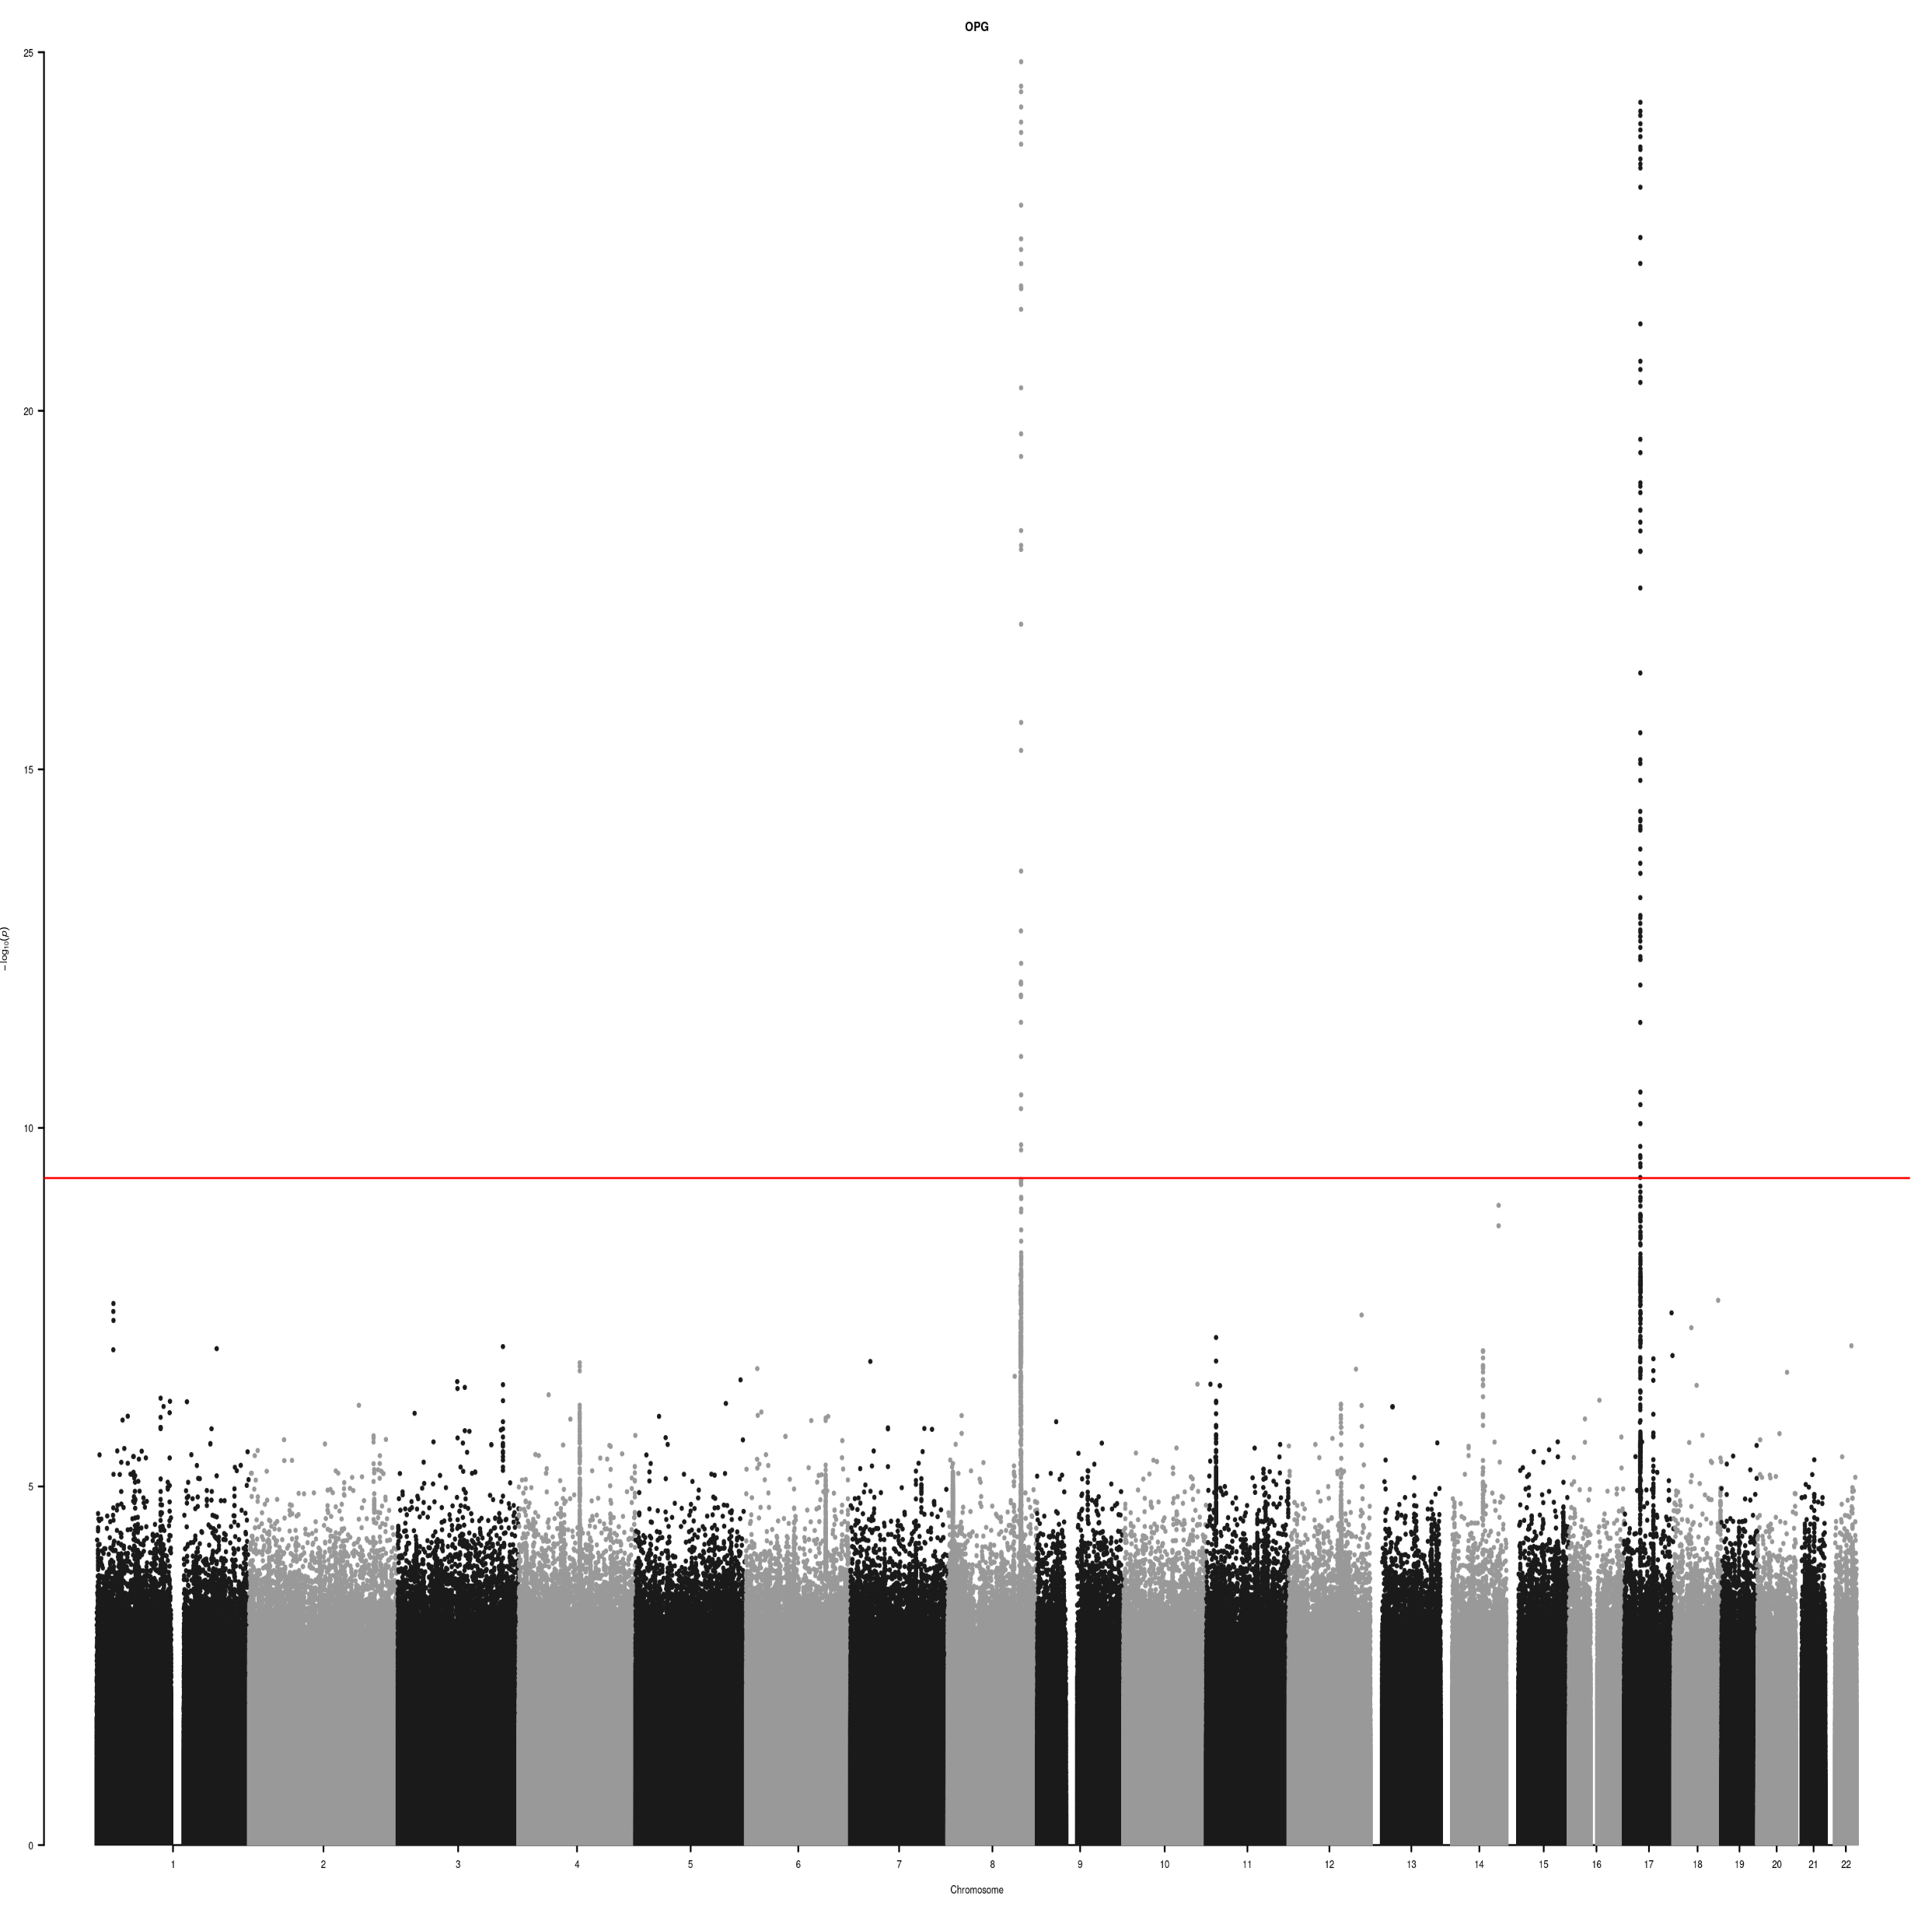
OPG Manhattan plot

Slide 11
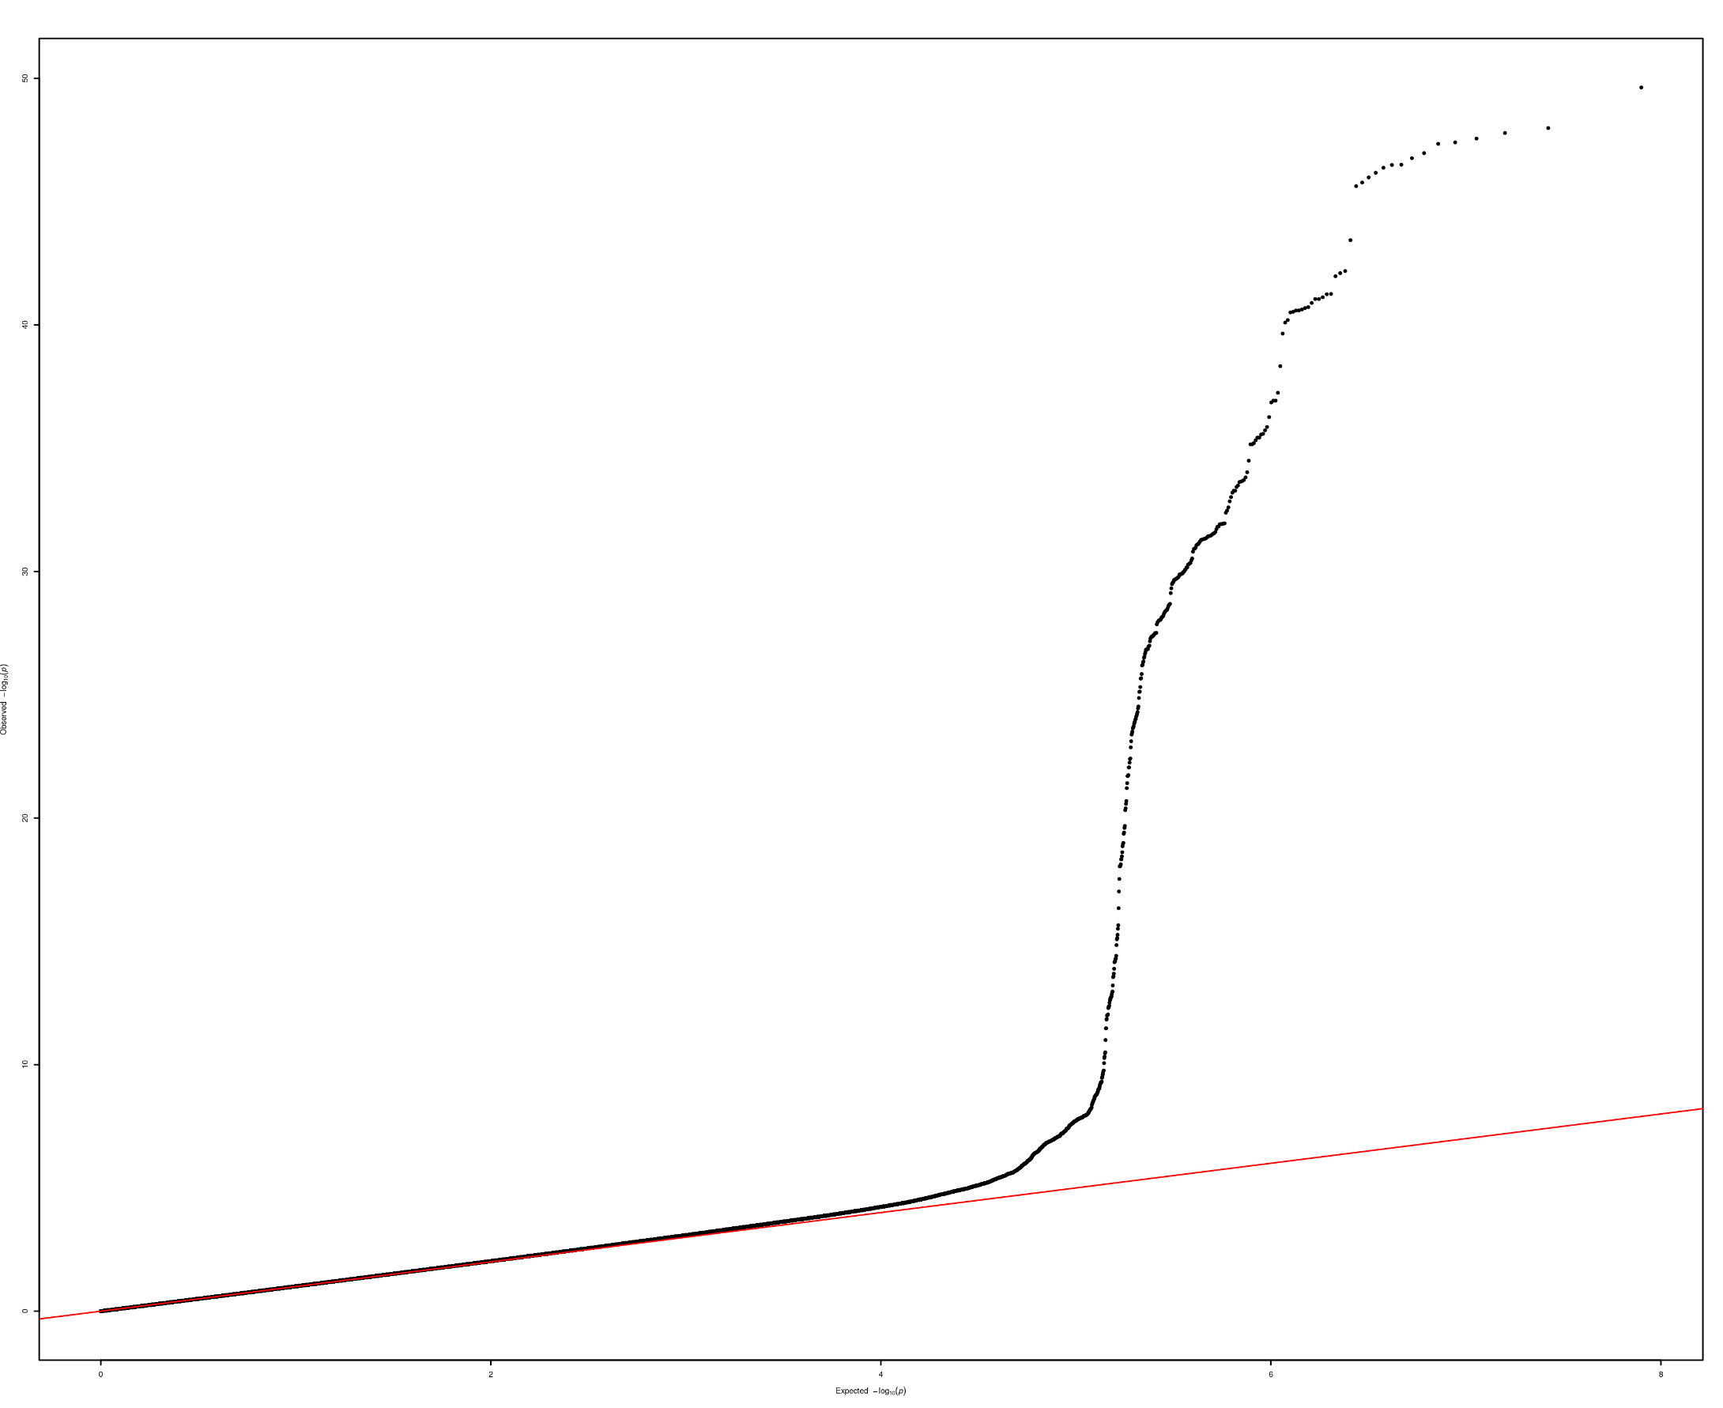
OPG Q-Q plot

Slide 12
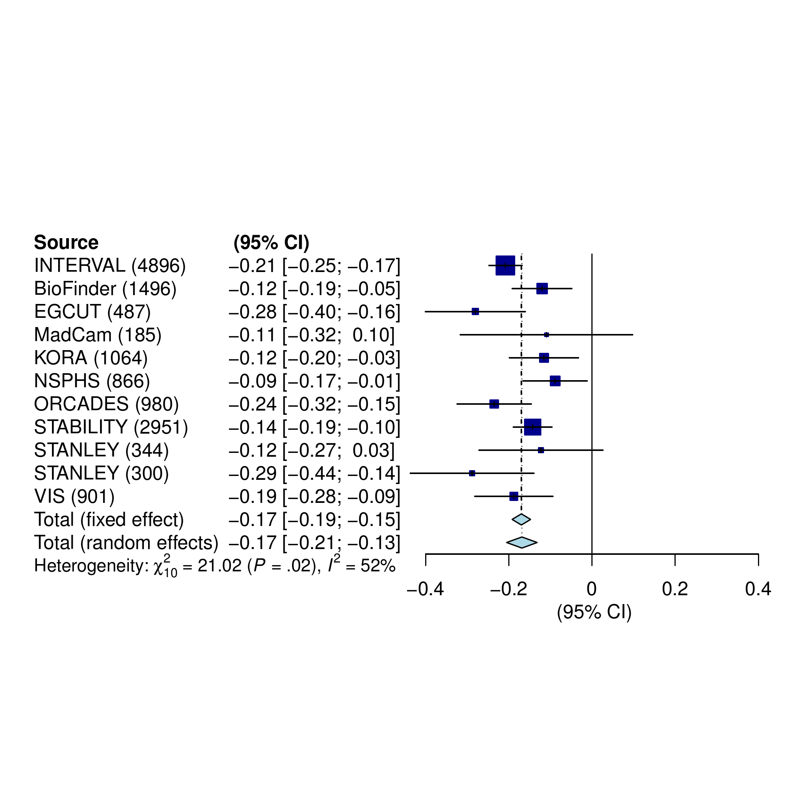
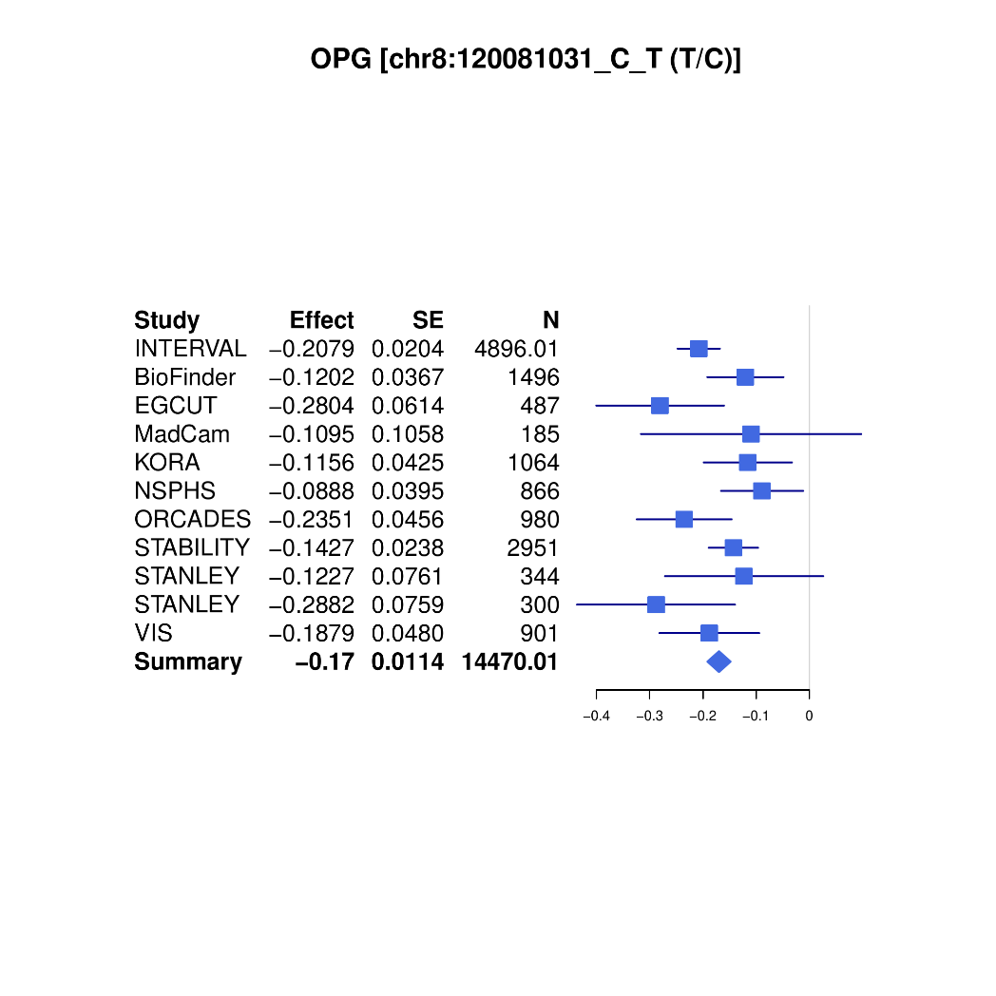
OPG forest plot

Slide 13
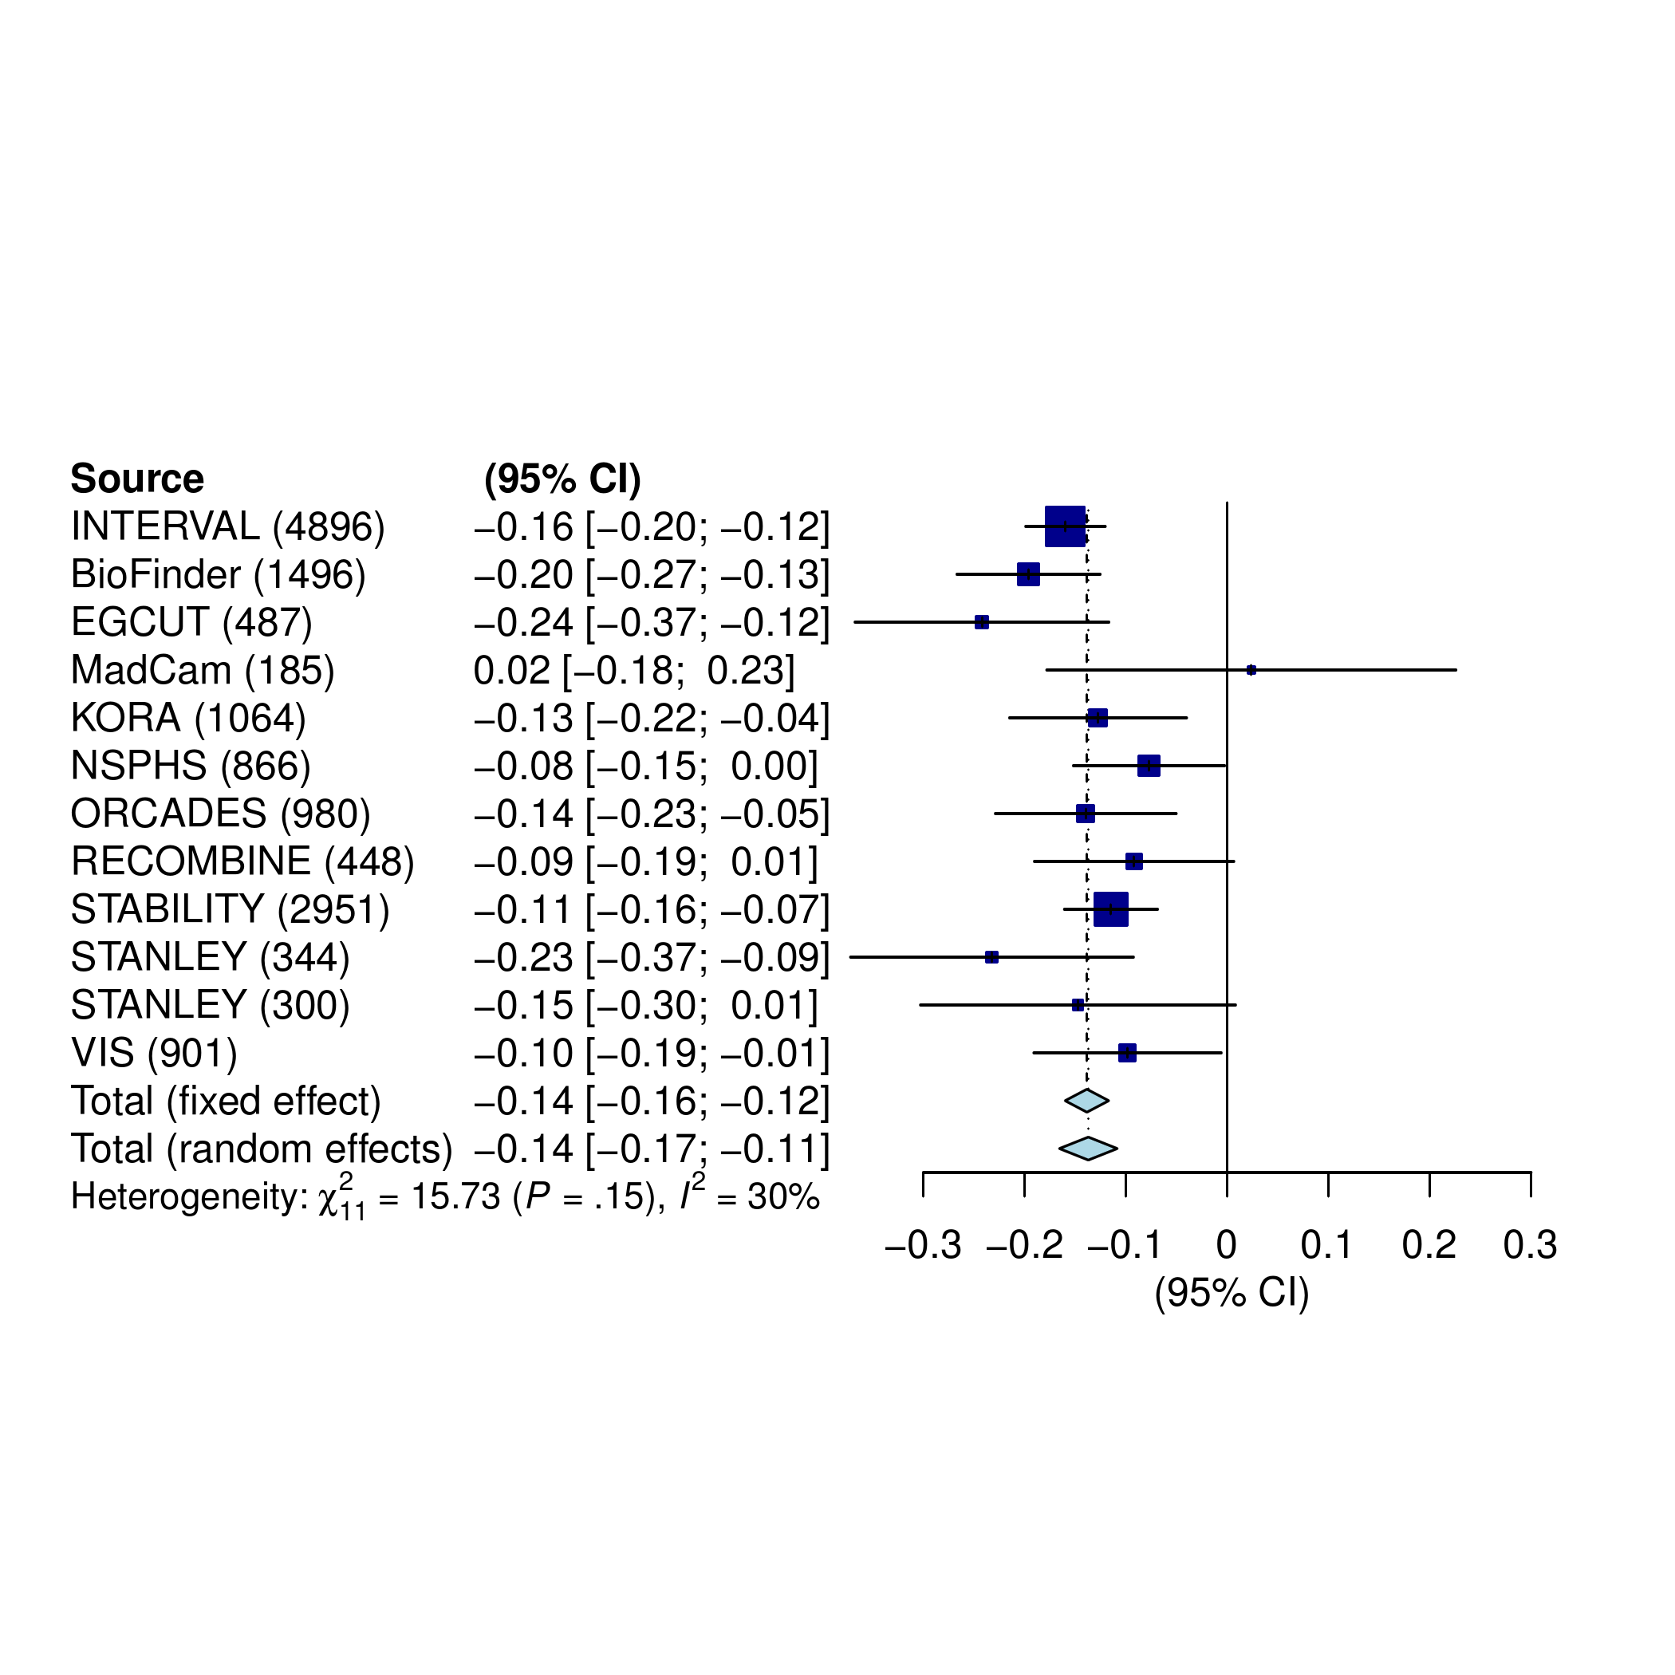
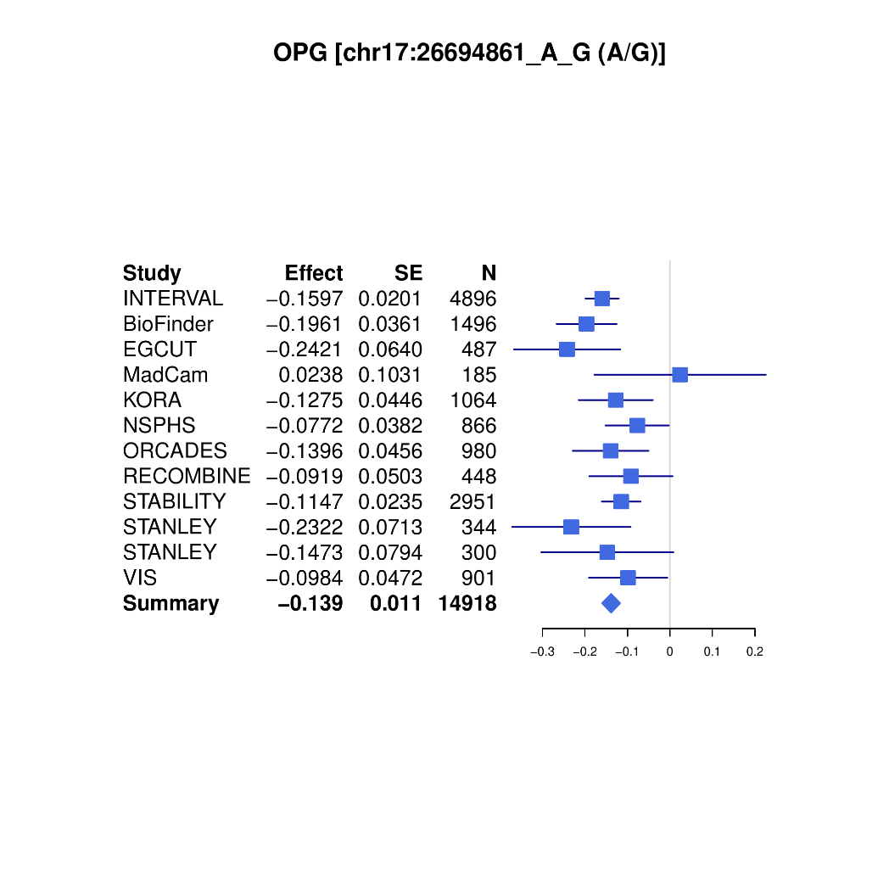
OPG forest plot

Slide 14
A general sketch of analysis
Discovery, replication – INTERVAL, meta-analysis, NSPHS.
GCTA –cojo analysis.
Power issues – plots of effect size from INTERVAL vs INF1 are helpful.
Additional information on genotyping and cohort characteristics needs to be requested.
Elementary summary statistics such as h2 from INTERVAL, with KORA relatively small for GCTA and possibly with INF1 for HESS.

Slide 15
Landmarks
27/3/19 – cross-reference with INTERVAL on INTERVAL genotype data, which showed great similarity with INF1, esp. w.r.t. cis signals.
8/3/19 – Recognition of MAF cutoff on IFN.gamma, IL.22.RA1, TSLP.
29/11/18 – 22 proteins with busy Manhattan plots.

Slide 16
A brief summary (29/11/18)
It is still at a very early stage of the analysis.
Results from INTERVAL and benchmarks from meta-analysis were reassuring.
This was based on stricter criteria on –ld-r2 of the PLINK –clump procedure which was somewhat hampered is its inability to handle small p-value.
It is worthwhile to explore approaches.
There will be further effort on the meta-analysis QC.

Slide 17
On next steps (29/11/18)
KORA individual level data analysis will be conducted centrally.
Additional studies such as COMBINE will be added.
For cohorts contributing results on PLINK, information such as effect allele (frequency), imputation quality is recommended on a per-cohort basis via qctool as noted in SCALLOP_INF_I_analysis_plan.md.
The QC will be refined and downstream analysis strengthened -- the experiments were based on 1000Genomes extracted from LocusZoom 1.4 at tryggve when there was issues with the up-/down-load. A more desirable reference panel would be INTERVAL, UKBiobank, both involving HRC+UK10K. Finemapping is set to involve PLINK, GCTA, finemap, and JAM, among others.

Slide 18
Updates I (8/3/19)
29 chromosomes remain to be analysed for KORA + ARTN reanalysing at TRYGGVE (smaller size). normalised level ~ age+sex+PC1-5+genotype under additive model with SNPTEST.
BioFinder, MadCam and RECOMBINE were available – these were from Anders beside STANLEY lah1/swe6 with qctool –snp-stats pending while MadCam has RSQ_IMP.
NSPHS has PLINK results but no qctool -snp-stats (in touch with Åsa Johansson on 21/2).
The number of problematic proteins was reduced from 22 to three, IFN.gamma, IL.22.RA1 and TSLP and then none with MAF set to MAF>0.1 for STABILITY (N=2,951), second to INTERVAL (N=4,996).

Slide 19
Updates II (8/3/19)
STANLEY added to meta-snalysis when per-SNP sample sizes are available from study description (results from PLINK dosage analysis, with INFO but no N).
INFO from qctool –snp-stats was added to INTERVAL.
Side projects: R/gap, FM-pipeline, EWAS-fusion, etc. updated and results from FM-pipeline but pending on validation.
INF1.paper.docx at INF/doc as placeholder for paper draft; cohort description needs to be added – an Excel spreadsheet was made available from the (updated) analysis plan and comments are welcome to consolidate.

Slide 20
Next steps (8/3/19)
Cohort-level QC, esp. MAF and INFO score.
Meta-analysis for all cohorts (leaving out RECOMBINE?), including Q-Q/Manhattan/forest/LocusZoom/chord plots – with cis/trans regions when appropriate.
To corroborate PLINK –clump with GCTA –cojo-slct.
Replication?
Downstream analysis, e.g., phenoscanner, MR, GSEA/pathway.

Slide 21
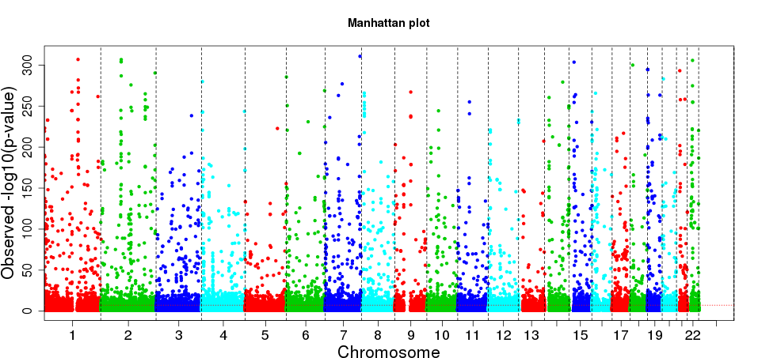
Manhattan plots

Slide 22
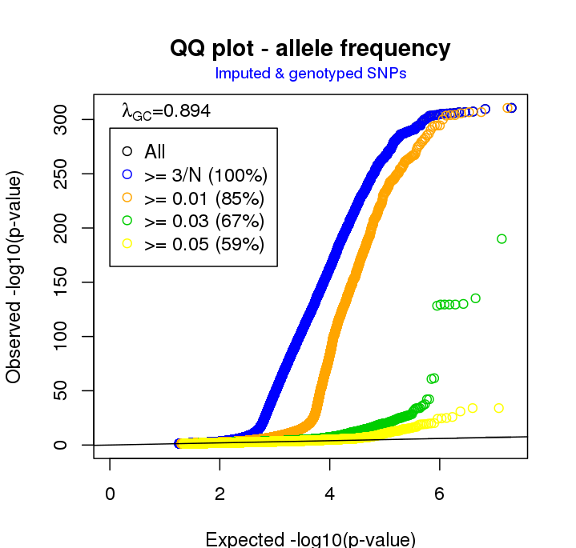
Q-Q plot

Slide 23
Points from discussion (8/3/19)
Cohort-specific sumstats for N, MAF, HWE, INFO in qctool –snp-stats
sumstats/Mantattan for cohorts with problematic proteins
Between-cohort MAF-MAF plots
P ~ N (for finemapping) and consistency, e.g. INTERVAL/STABILITY.
False negative for those in the CVD1 panel to phenoscanner
Chr19. NLRP12 from INTERVAL`
RECOMBINE experiment
Total # signals relative to other panels
Phenoscanner and eQTL

