Slide 1
SCALLOP/INF1 analysis
https://github.com/jinghuazhao/INF
12/11/2018

Slide 2
Outlines
Summary data from EGCUT, INTERVAL, NSPHS, ORCADES, STABILITY, STANLEY, VIS.
METAL (WEIGHTS >= 50, SCHEME STDERR).
PLINK –clumping and GCTA –cojo-slct.
Shown for TNFRSF11B, chr8:119935796-119964439 (OPG) and TNFSF14, chr19:6663148-6670599 (TNFSF14).

Slide 3
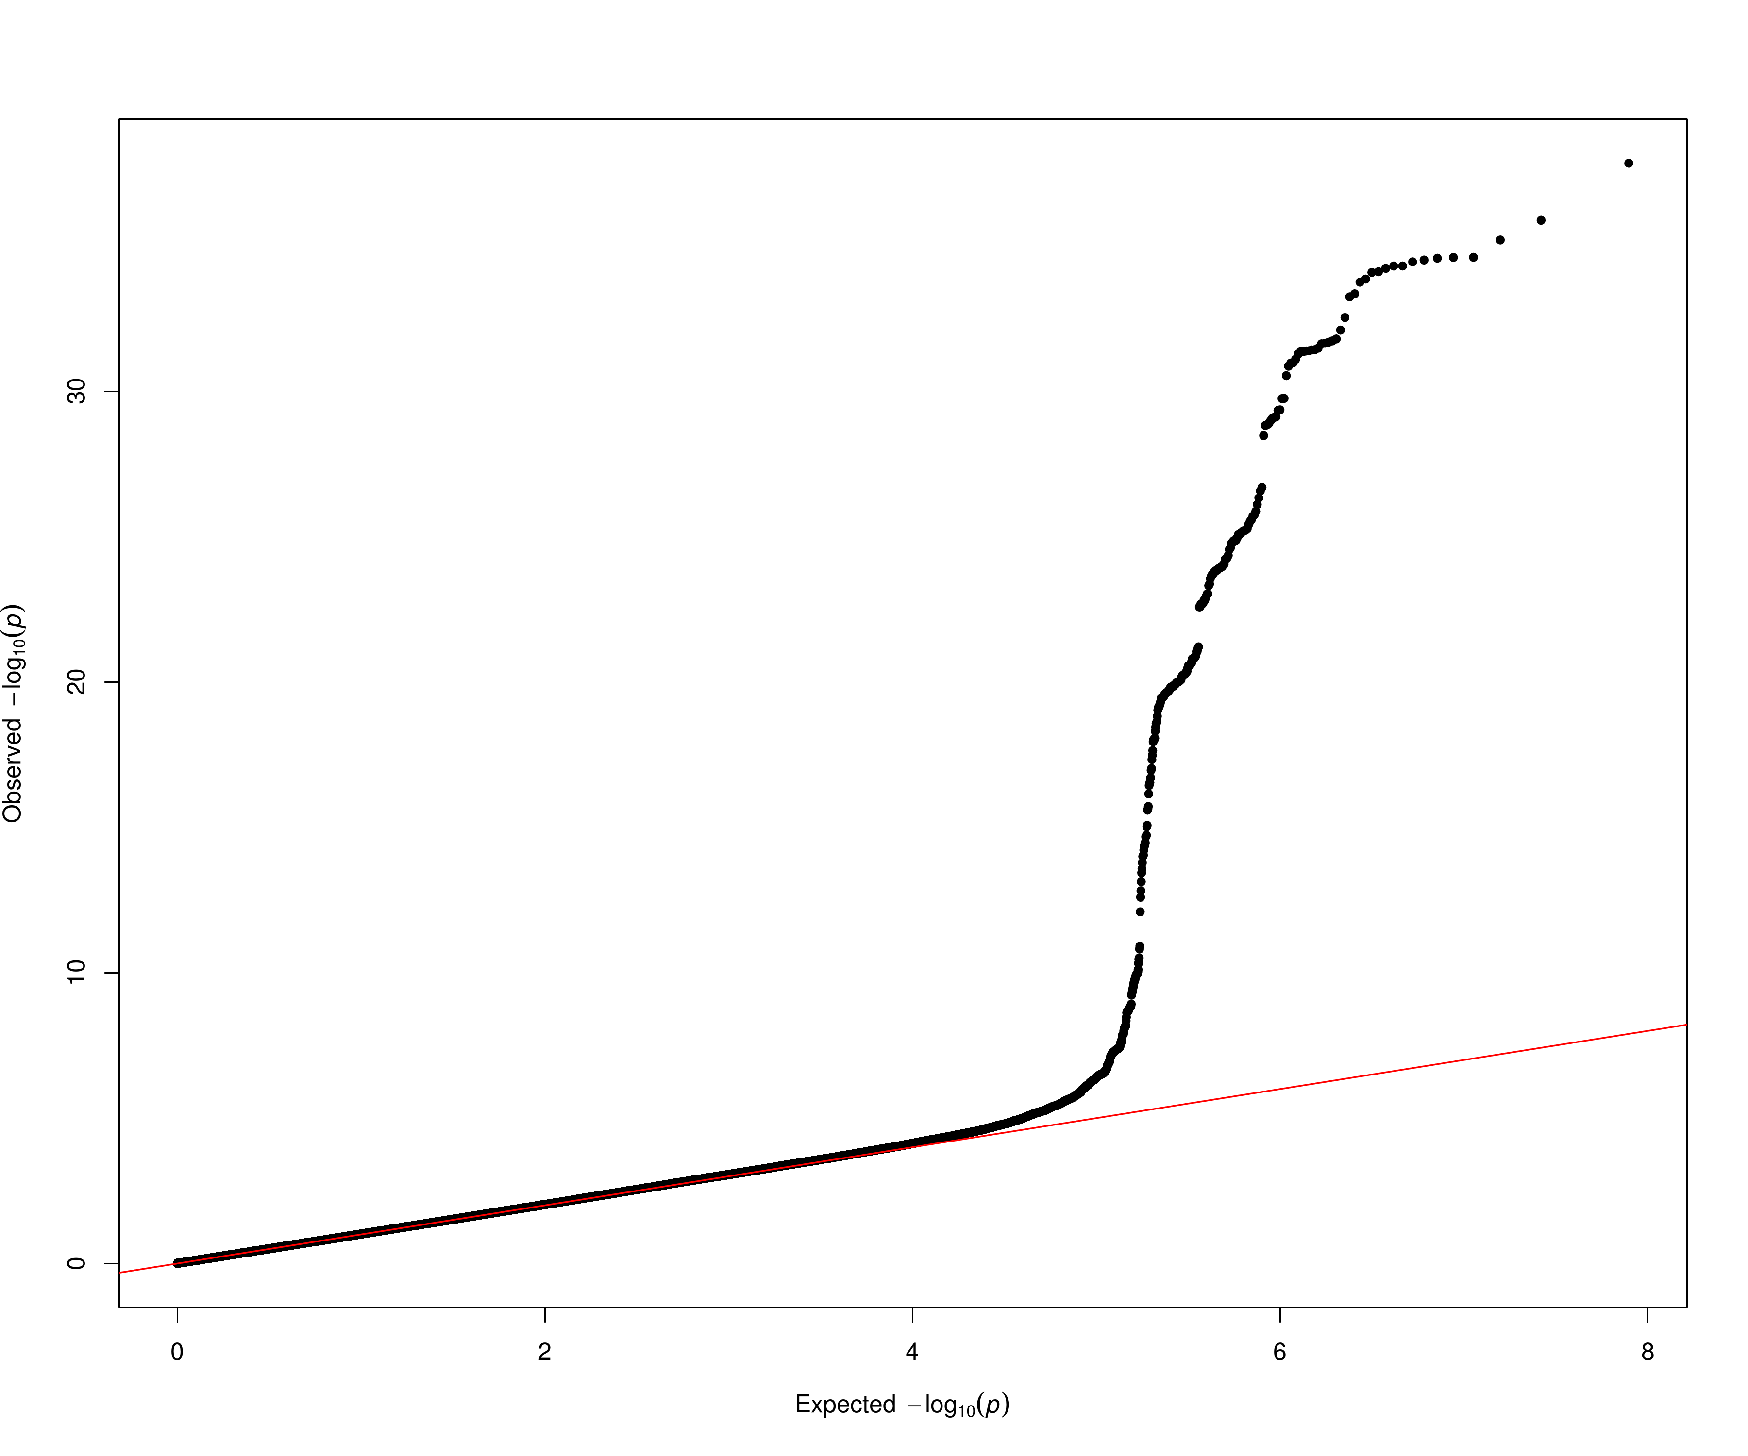
OPG

Slide 4
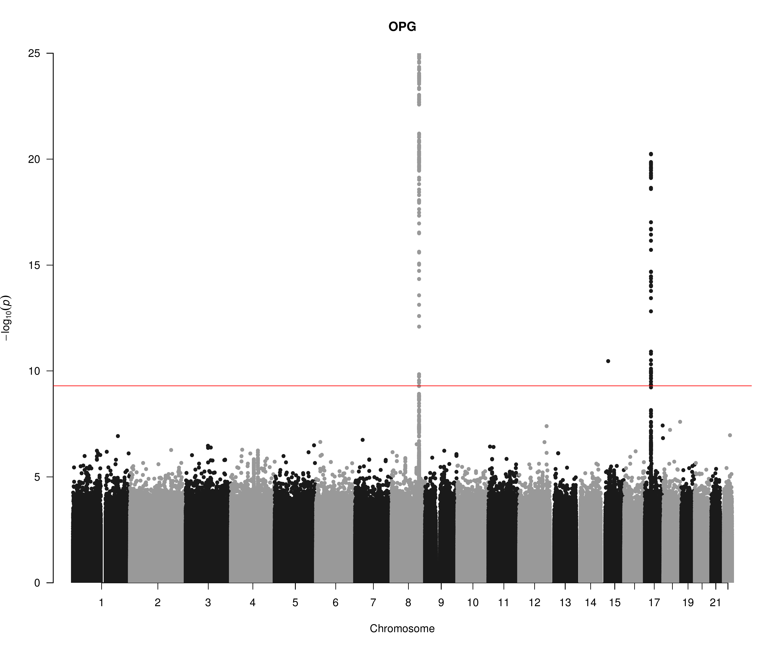
OPG

Slide 5
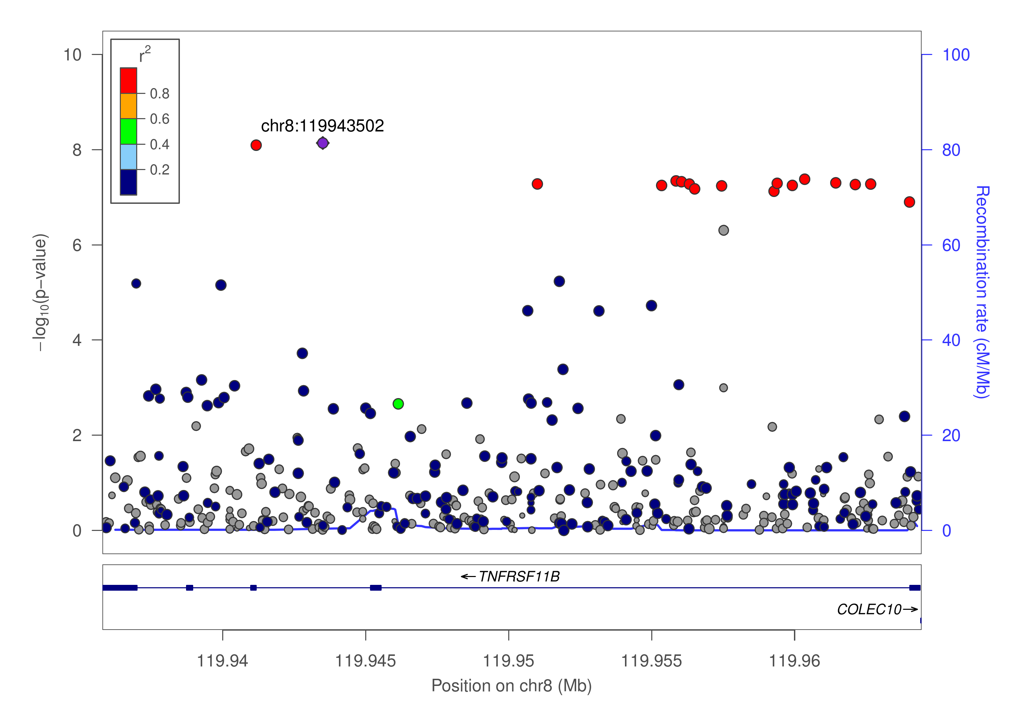
OPG

Slide 6
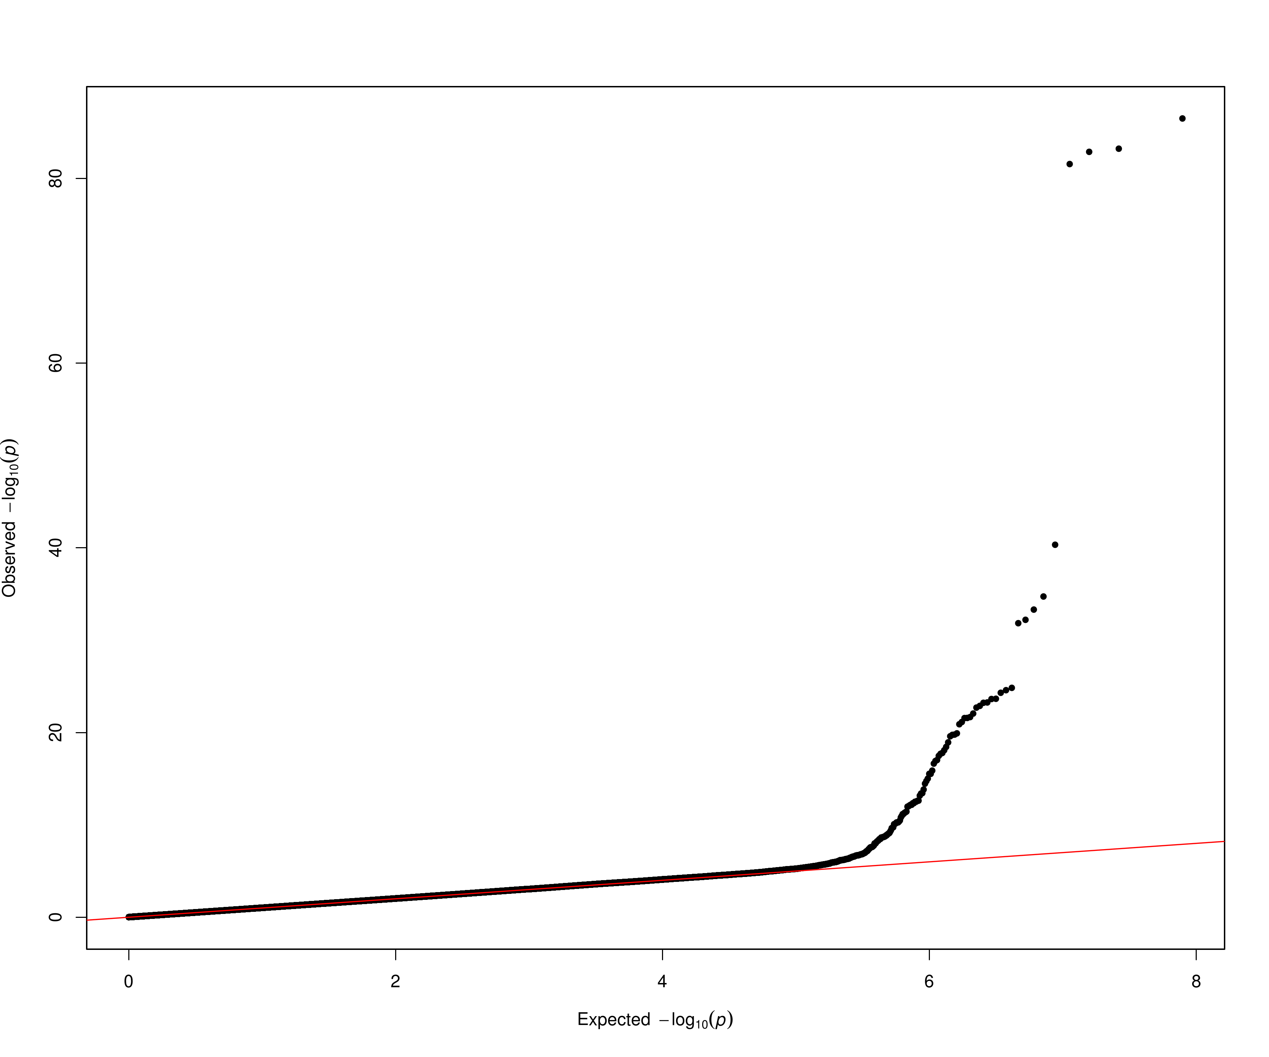
TNFSF14

Slide 7
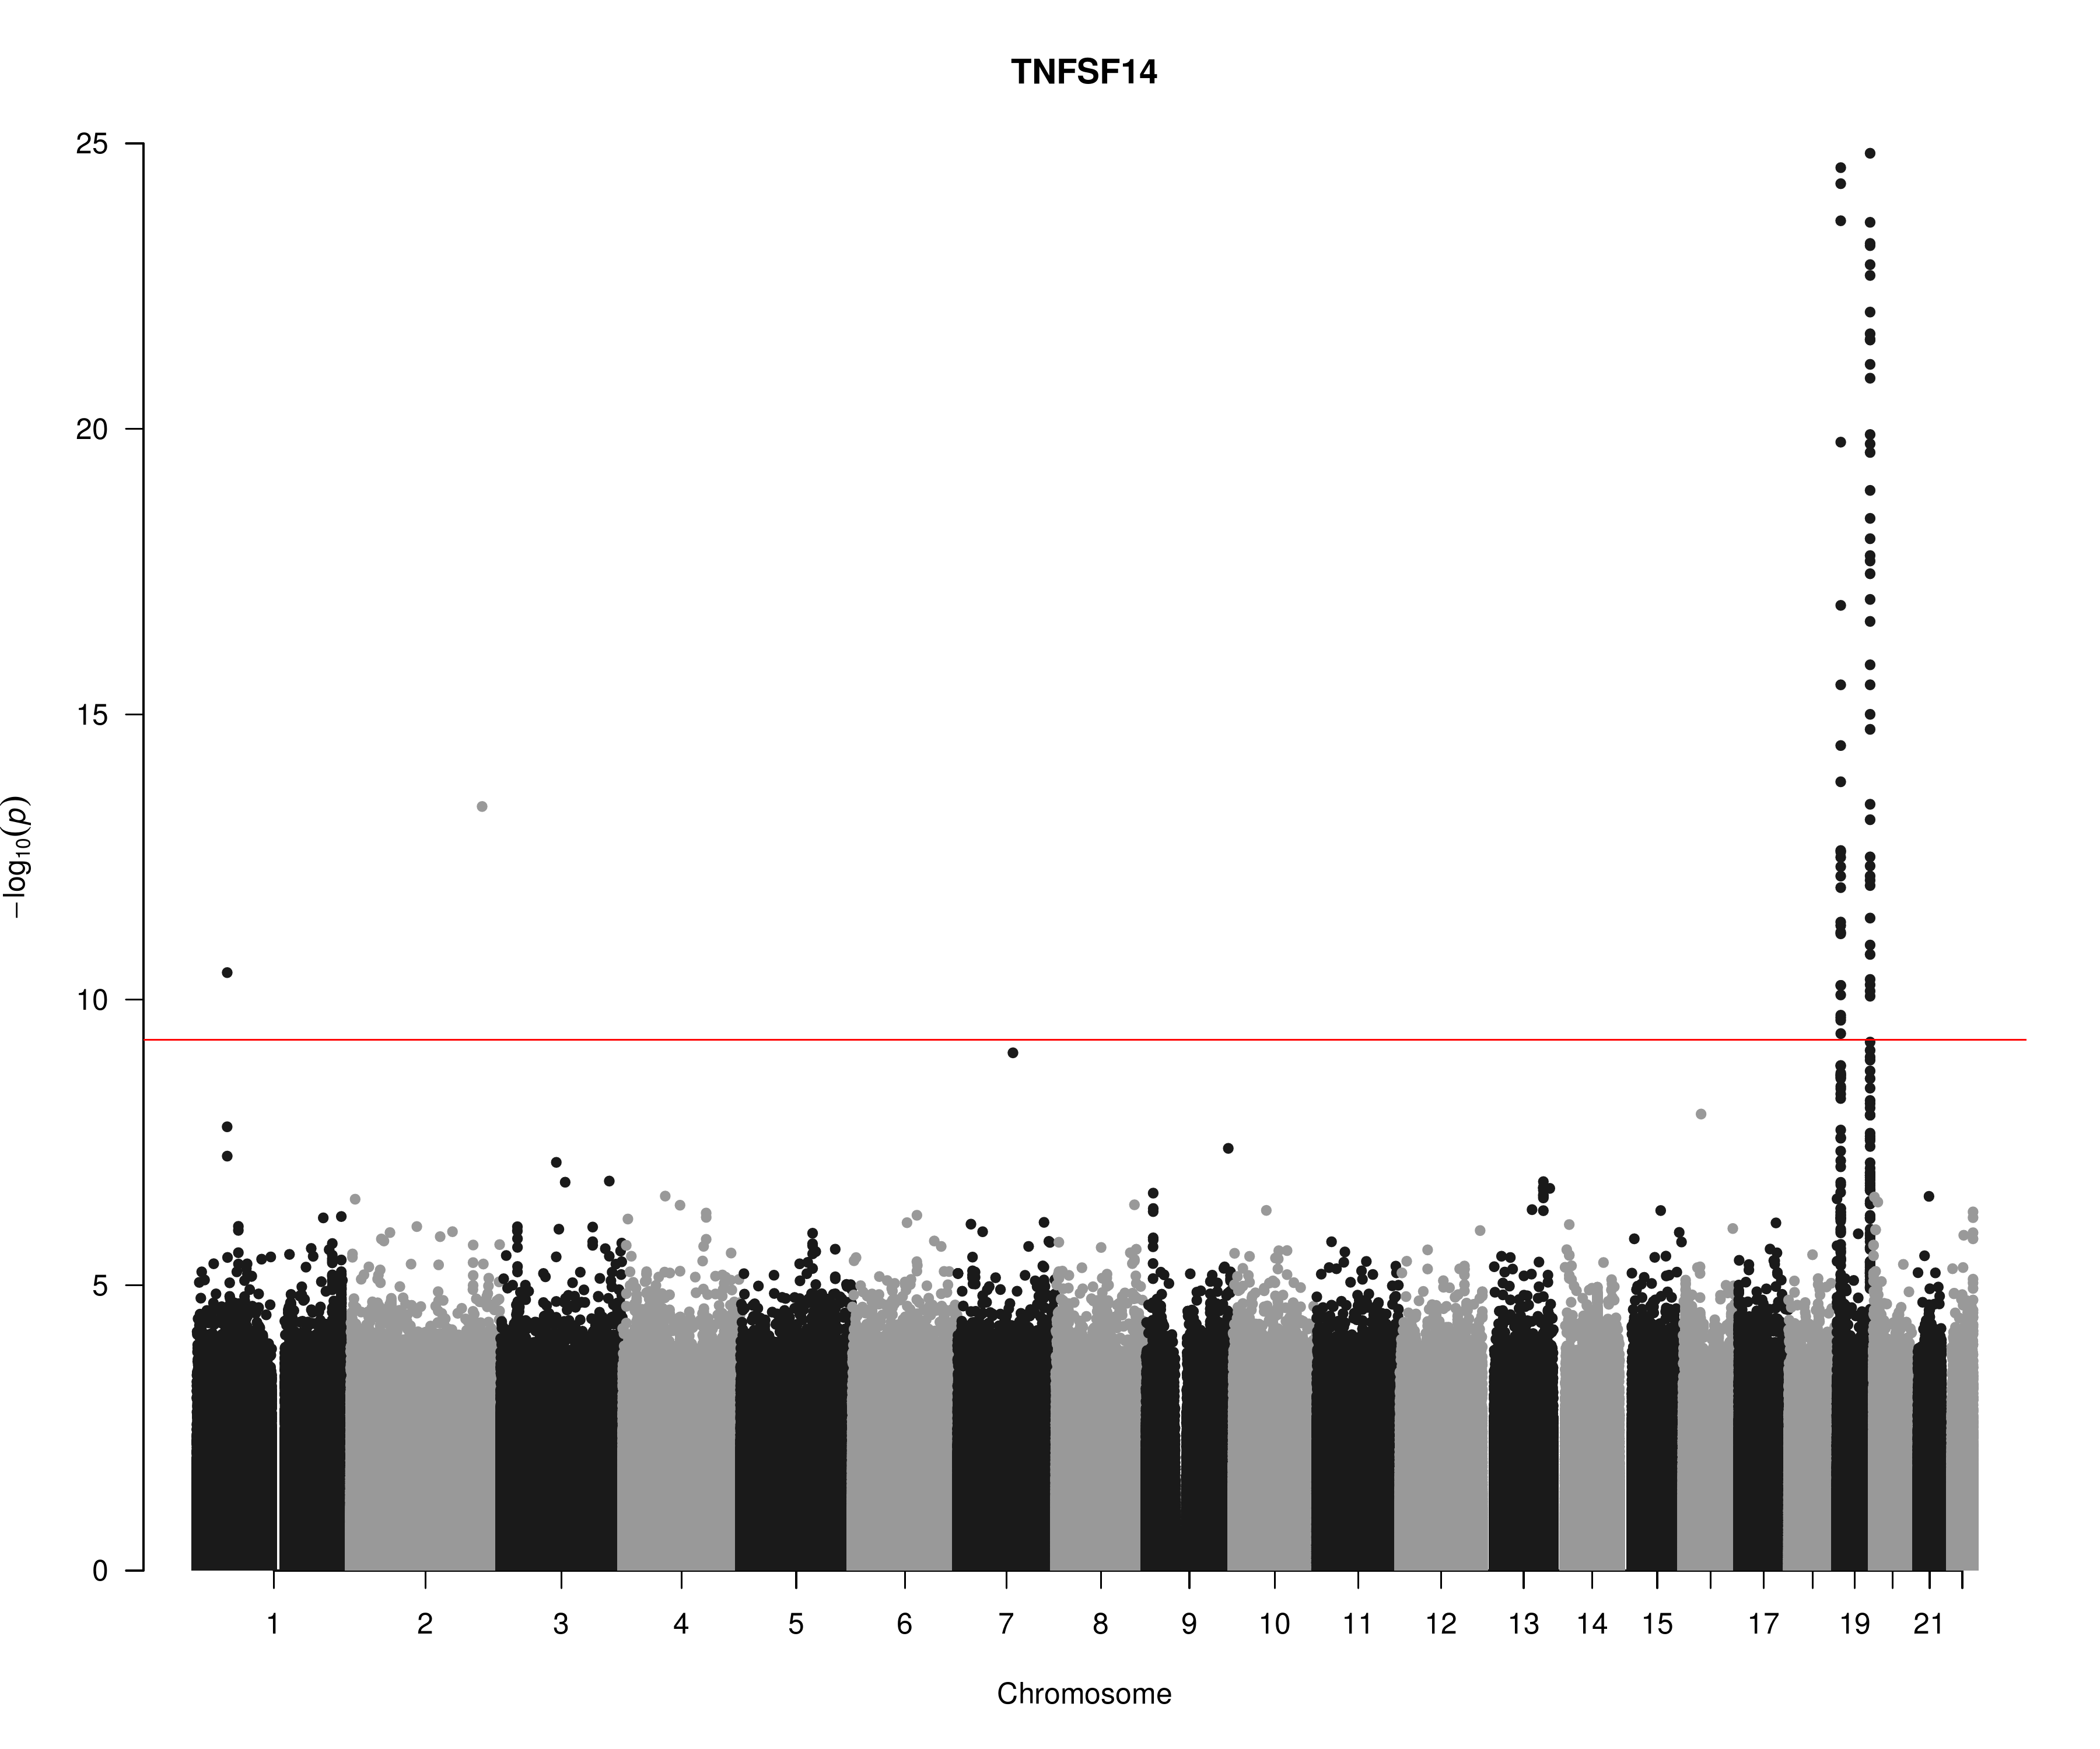
TNFSF14

Slide 8
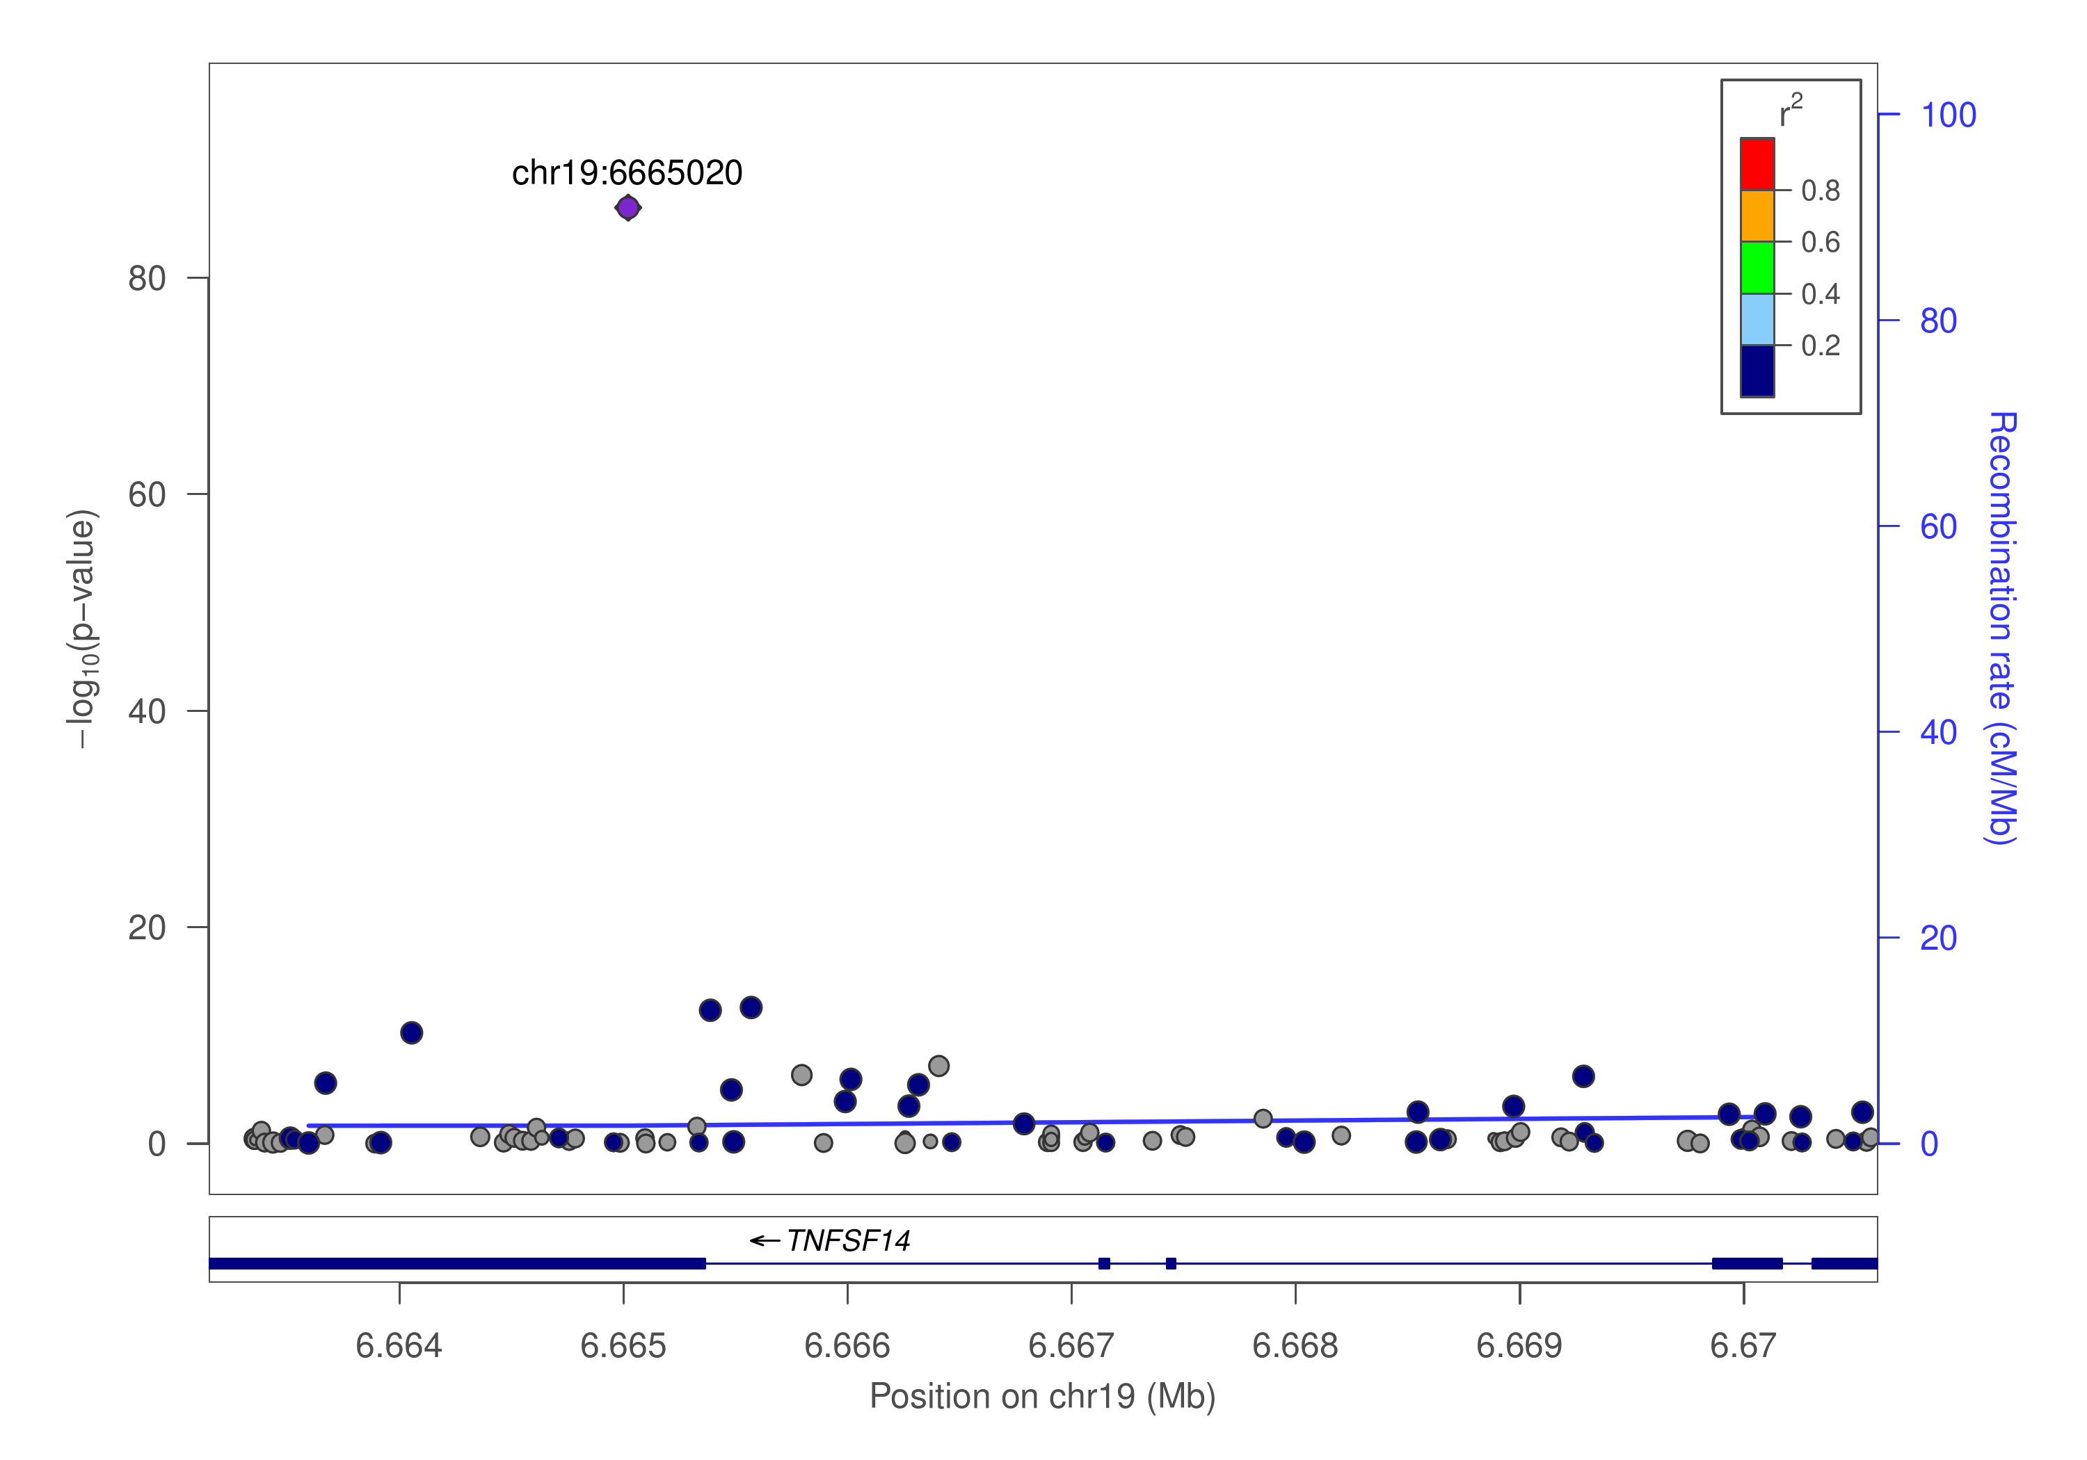
TNFSF14

Slide 9
cis/trans classification (jma.cojo results)
HGNC symbol (TARGET) | cis | trans | Total
TNFRSF11B (OPG) | 2 | 1 | 3
TNFSF14 (TNFSF14) | 4 | 9 | 13
Total | 6 | 10 | 16
prot | SNP | refA | freq | b | p | n | freq_geno | pJ
OPG | chr8:119867209_A_C | A | 0.1039 | 0.172 | 5.22E-10 | 9922.26 | 0.04672 | 1.42E-13
OPG | chr8:120081031_C_T | T | 0.5581 | -0.1588 | 1.34E-36 | 18014.3 | 0.560636 | 1.14E-39
OPG | chr17:26694861_A_G | A | 0.4748 | -0.1165 | 5.98E-21 | 18469.6 | 0.449304 | 7.05E-21
TNFSF14 | chr19:1227505_C_T | T | 0.0038 | 0.5254 | 0.006658 | 5131.59 | 0.000994 | 1.49E-189
TNFSF14 | chr19:1403959_C_G | C | 0.0396 | 0.0811 | 0.05621 | 10609.6 | 0.037773 | 1.68E-16
TNFSF14 | chr19:3932314_C_T | T | 0.0102 | 0.2737 | 0.01071 | 6277.87 | 0.001988 | 9.76E-114
TNFSF14 | chr19:6641765_C_T | T | 0.0429 | -0.474 | 2.46E-13 | 4175.8 | 0.017893 | 3.87E-91
TNFSF14 | chr19:6665020_C_T | T | 0.1024 | -0.5329 | 3.31E-87 | 10569.4 | 0.05169 | 1.18E-150
TNFSF14 | chr19:6673889_A_G | A | 0.1109 | -0.5374 | 4.79E-41 | 4419.3 | 0.026839 | 2.37E-52
TNFSF14 | chr19:6704670_C_T | T | 0.8479 | -0.1313 | 2.10E-09 | 11751.1 | 0.883698 | 2.73E-31
TNFSF14 | chr19:8094596_A_G | A | 0.0071 | 0.2025 | 0.07481 | 7997.02 | 0.001988 | 7.64E-30
TNFSF14 | chr19:8120283_A_G | A | 0.0025 | -0.7169 | 0.000897 | 6261.49 | 0.003976 | 2.52E-203
TNFSF14 | chr19:13181330_A_G | A | 0.0065 | 0.2745 | 0.03589 | 6594.93 | 0.000994 | 6.40E-221
TNFSF14 | chr19:14165598_C_T | T | 0.0631 | 0.0871 | 0.08456 | 4833.35 | 0.015905 | 3.01E-24
TNFSF14 | chr19:22506594_A_G | A | 0.0021 | -0.5409 | 0.0203 | 6397.97 | 0.002982 | 1.55E-155
TNFSF14 | chr19:54324995_G_T | T | 0.2437 | 0.1635 | 2.43E-24 | 15157 | 0.201789 | 4.45E-24

Slide 10
Points
KORA individual level data analysis will be conducted.
A couple of studies will be added.
Additional information, esp. results from PLINK as noted in SCALLOP_INF_I_analysis_plan.md at the GitHub.
Refined and downstream analysis, as the results shown were based on 1000Genomes extracted from LocusZoom 1.4 at tryggve.

