Slide 1
SCALLOP/INF1 discovery analysis
12/8/2019
people.ds.cam.ac.uk/INF/latest

Slide 2
Outlines
Meta-analysis
Generation of GWA summary statistics with filters on GWA p, I^2 and effects (csd3, /rds/project/jmmh2/rds-jmmh2-projects/olink_proteomics/scallop/INF/METAL).
Q-Q/Manhattan/(cis-)LocusZoom plots (directory qml/)
Steps of discovery analysis
Selection of sentinels
LocusZoom and forest plots around sentinels
Joint/conditional analysis on each locus
Variance explained by sentinels
IL.18R1 and IL.6 Examples
finemap to be added (see IL.6 results with default k=5, k=10 more preferable?)
Related results
Experimental results

Slide 3
Selection of sentinels
Three scenarios (single variant for HLA region + no exclusion of regions of high LD):
I. The region is within +/- 1Mb
II. The region has no variants beyond +1 Mb
III. The region can be merged with next
Findings: 146 sentinels = 59 cis + 91 trans (directory sentinels/)
circus plot
forest plots
+/- 1Mb LocusZoom plots (directory lz/)
https://github.com/statgen/swiss appears to implement similar algorithm, i.e., swiss --dist-clump --clump-dist 1000000

Slide 4
Joint/conditional analysis (aka –cojo-slct)
Using the agreed (default) parameters
--extract-region-snp <sentinel> 1000 –cojo-collinear 0.9
INTERVAL imputed data as used in the INF1 analysis, which is appropriate according to GCTA documentation (N > 4,000)
Results (directory cojo-slct/)
221 cis + 122 trans = 343 signals (1 marginal trans, to be excluded?) which correspond to (174 cis + 103 trans =) 277 primary and (47 cis + 19 trans =) 66 secondary signals
denser circos plot
Calculation of credible sets (partly)

Slide 5
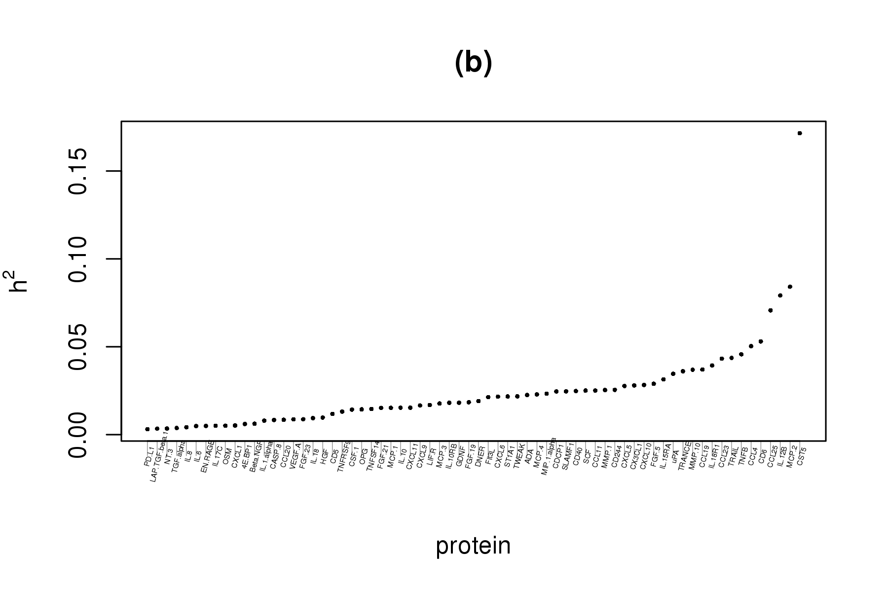
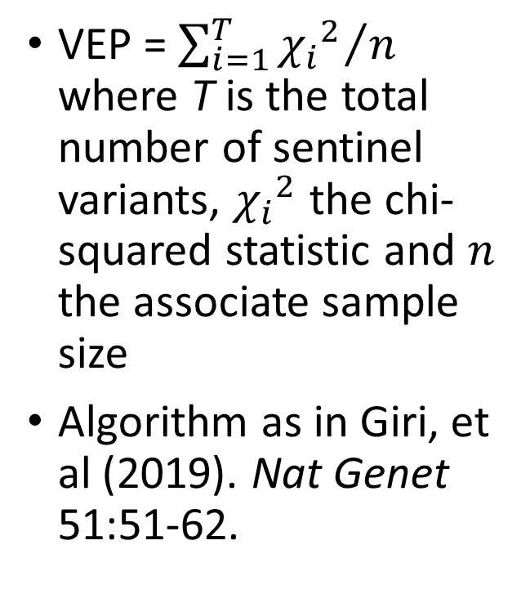
Variance explained by sentinels
VEP = $\sum_{i=1}^{T}{{{χ_{i}}^{2}}/n}$ where T is the total number of sentinel variants, ${χ_{i}}^{2}$ the chi-squared statistic and $n$ the associate sample size
Algorithm as in Giri, et al (2019). Nat Genet 51:51-62.

Slide 6
IL.18R1 example
Background. There are 15 cis signals (chr2) for this protein.
Aim. To understand independent signals obtained from GCTA –cojo-slct.
Approach. To use INTERVAL individual level data in a joint (linear regression) model containing SNPs from –cojo-slct.
Results (directory IL.18R1/INTERVAL/default). Four variants were identified from GCTA and three turned to be significant in the joint model.

Slide 7
finemap results
.snp, .config and .cred from the latest v1.3.1 while .log and .dose files are for information and a binary file for which only the format is described.
IL.6 (encoded by IL6 on Chr7) can be used as a benchmark – GWAS has confirmed no cis but a trans signal at Chr1.
The output (directory finemap/) has been assembled into .xlsx containing snpid-rsid correspondence, .snp, .c(on)f(i)g, .cred, respectively. Note the the sentinel is among the top of .snp and in .cred and configuration has posterior probability = 1 and the largest log10(BF). chr1:154464572_A_G (rs4478801, also the sentinel as in the LocusZoom plot), chr1:154492432_C_T (rs4518898), chr1:154504702_A_G (rs60255122), chr1:154512077_C_T (rs73023346), chr1:154514092_C_T (rs72999419). The huge odds in configurations 2 and 3 also contain the sentinel.

Slide 8
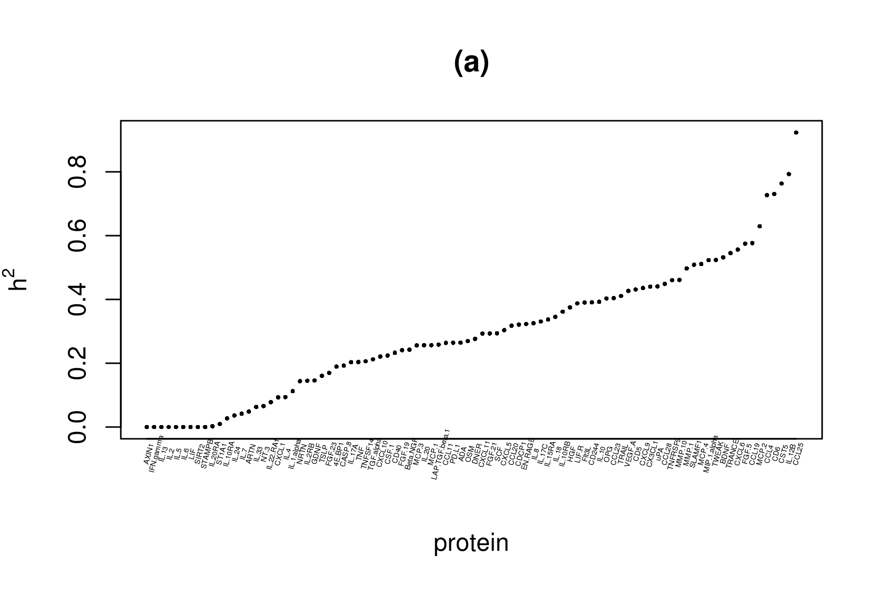
Related results – total heritability
Obtained through genomic heritability (INTERVAL) with adjustment for age, sex and PCs.

Slide 9
Related results -- PhenoScanner
Full set as with Cardio is yet to be established on csd3.
Nevertheless individual results can be done with R package from GitHub repository phenoscanner/phenoscanner and/or the web interface.

Slide 10
GSMR (directory gsmr/)
GSMR as part of GCTA can be quickly done before fine-tuning with R/MendelianRandomization and R/TwoSampleMR. However, overall the effect size plots appear to be largely suggestive.
The CAD summary statistics from Nikpey M, et al (2015). Nat Genet 47:1121-1130. Most striking with LIF.R
The UKB FEV1 summary statistics from Shrine et al. (2019). Nat Genet 51: 481–49. Most striking with CCL19 nevertheless only form seven variants so not shown on the effect size plots.
Possible candidate. IL.12B, PD.L1?

Slide 11
Experiment results
The compromise of genomewide joint/conditional analysis via approximately independent LD – the results were largely satisfactory but appeared suboptimal in cases such as IL.18R1 as verified by LocusZoom.
An attempt was made on a pruned reference panel (r2=0.8) to deal with the lack of –ld-r2 in GCTA –cojo-slct, the need of LD pruning for JAM, and the prospect of easier interpretation of finemap results.
For IL.18R1, four variants were obtained from INTERVAL GCTA –cojo-slct (directory IL.18R1/INTERVAL/r2-0.8-pruned/).
Pipeline works on all three software but not set as a priority since both GCTA and finemap already worked. Unfortunately JAM does not select the sentinel.
finemap credible sets contains the sentinel for in the pruned set.

Slide 12
Side results
sentinels() for sentinel selection is part of R/gap.
cs() for credible sets is part of R/gap.
With script using unpruned reference ready for GCTA and finemap, the pruned version is also OK to include JAM. The alignment of effect allele for finemap and use of R rbgen/plink2R for JAM reference file as with missing data imputation are eventually brought to control.
The handling of alleles should facilitate other downstream analysis such as MR/colocalisation otherwise seen to be difficult.

Slide 13
Other aspects
The CAD results were from both fixed and random effects model.
One GCTA --cojo-cond run (directory cojo-cond1/) does not select all the variants stochastically but for assurance and sentinel selection is required.
A version of –cojo-cond was implemented by the CKDGen (Wuttke, et al. (2019). Nat Genet 51: 957–972 ) which uses results from –cojo-slct followed by –cojo-cond on these to be used by R/gtx for credible sets. While this is more in line with the Maller et al (2012). Nat Genet 44: 1294–1301 and/or Wakefield’s approach of credible sets (i.e., independent contributions). It appears viable though –gcta-slct gives these.

