Slide 1
SCALLOP/INF1 analysis
https://github.com/jinghuazhao/INF
29/11/2018

Slide 2
Outlines
Further work on INTERVAL.
Meta-analysis:
Summary data from EGCUT, INTERVAL, NSPHS, ORCADES, STABILITY, STANLEY, VIS.
METAL (WEIGHTS >= 50, SCHEME STDERR).
Highlights:
PLINK –clump and GCTA –cojo-slct.
Shown for two benchmarks and cis-/trans- classifications (generic R function now available).

Slide 3
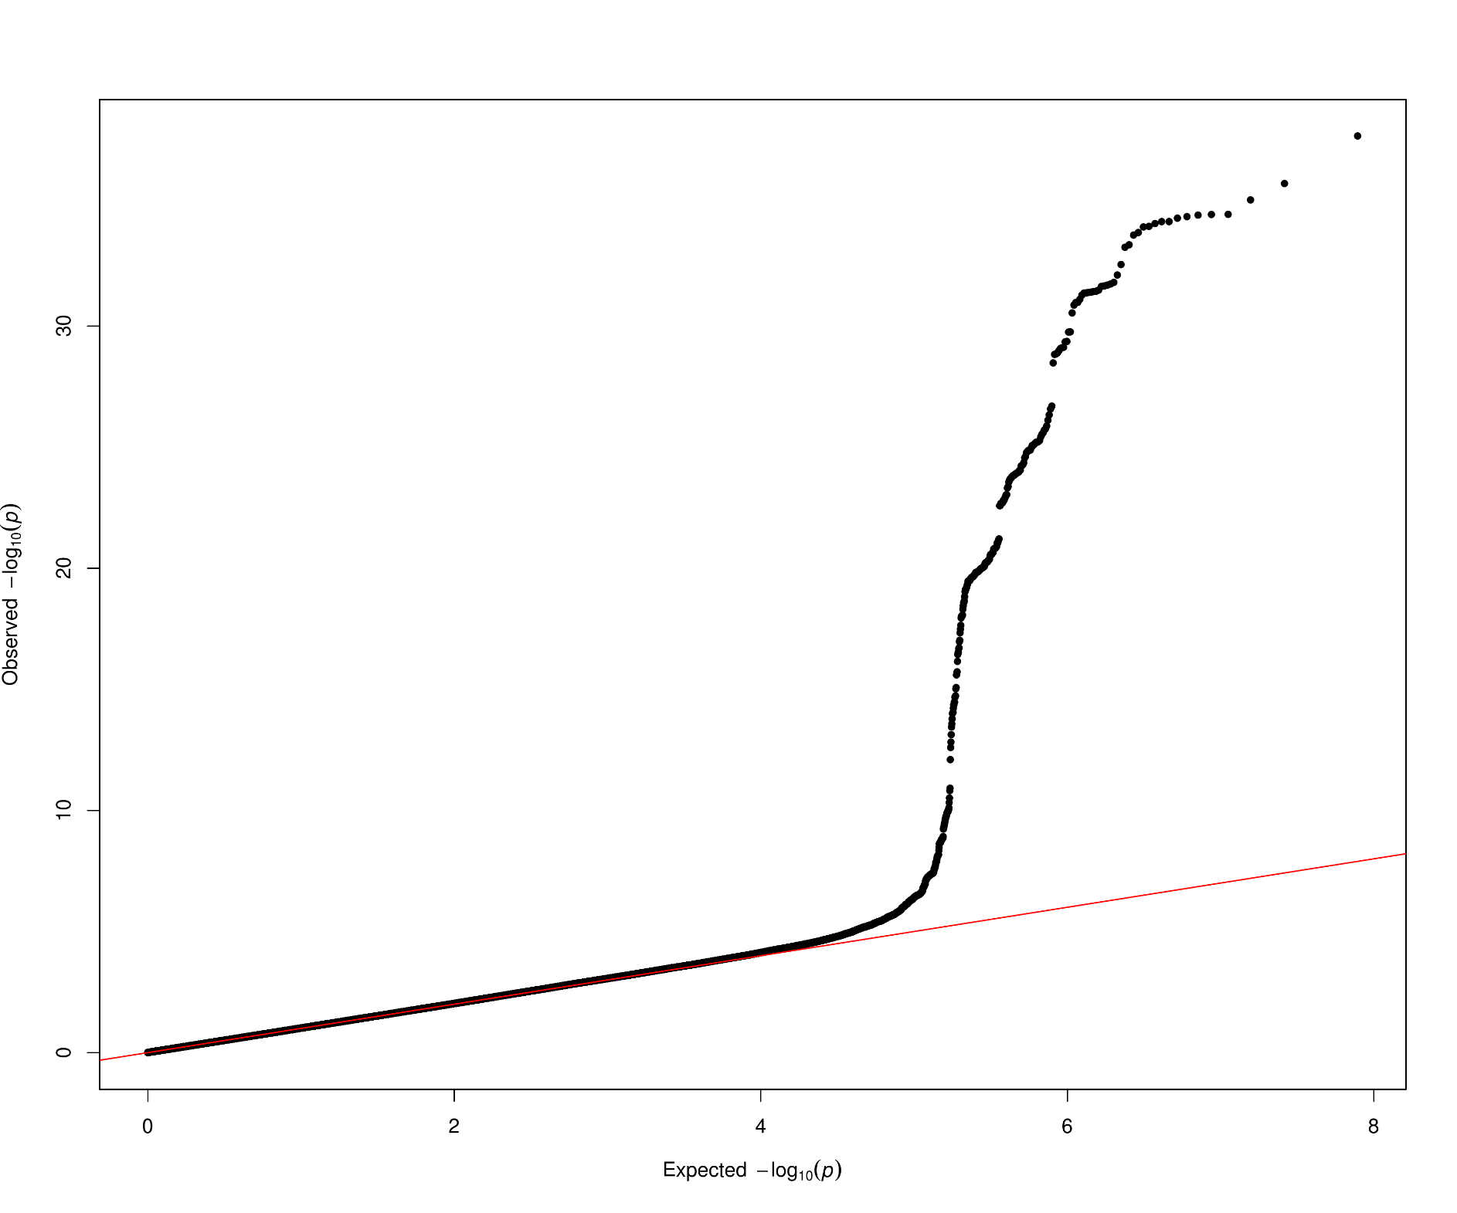
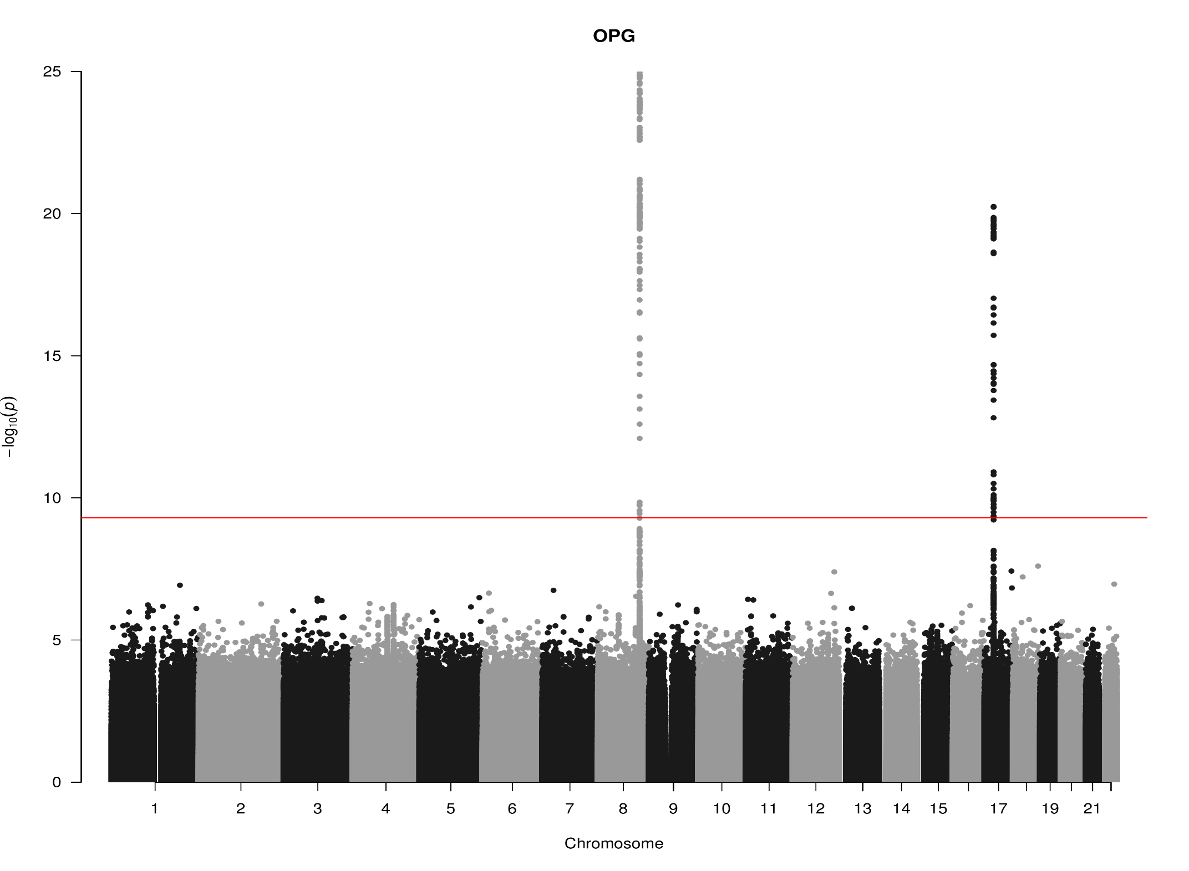
TNFRSF11B, chr8:119935796-119964439 (OPG)

Slide 4
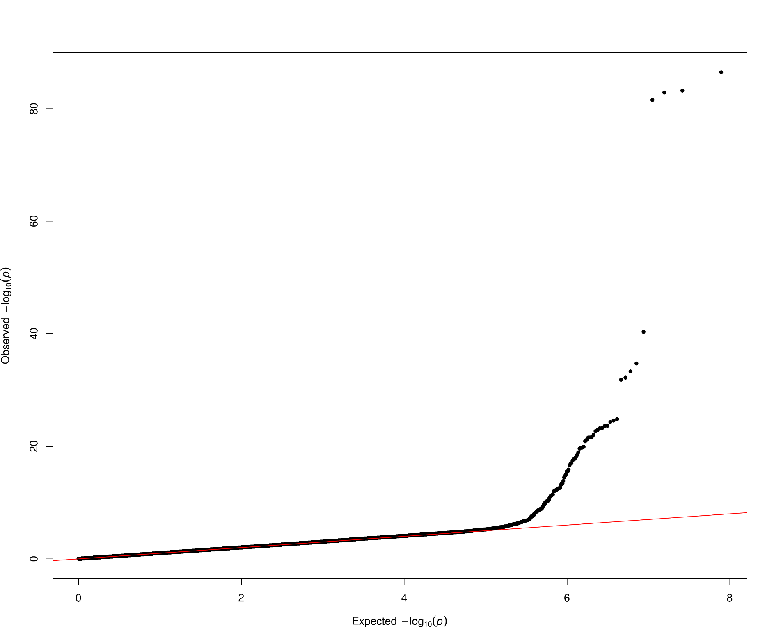
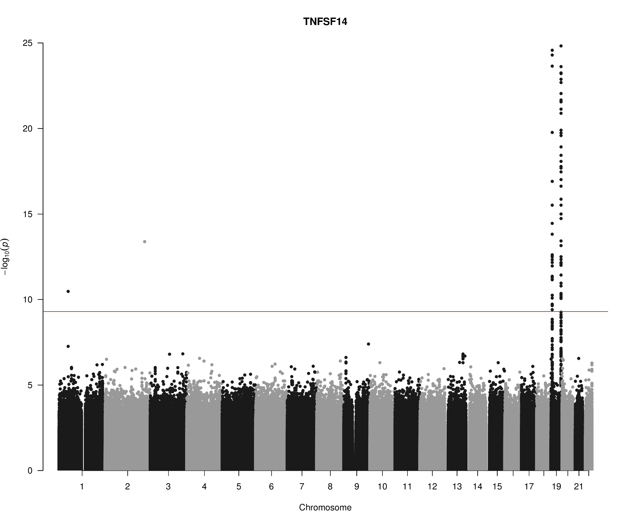
TNFSF14, chr19:6663148-6670599 (TNFSF14)

Slide 5
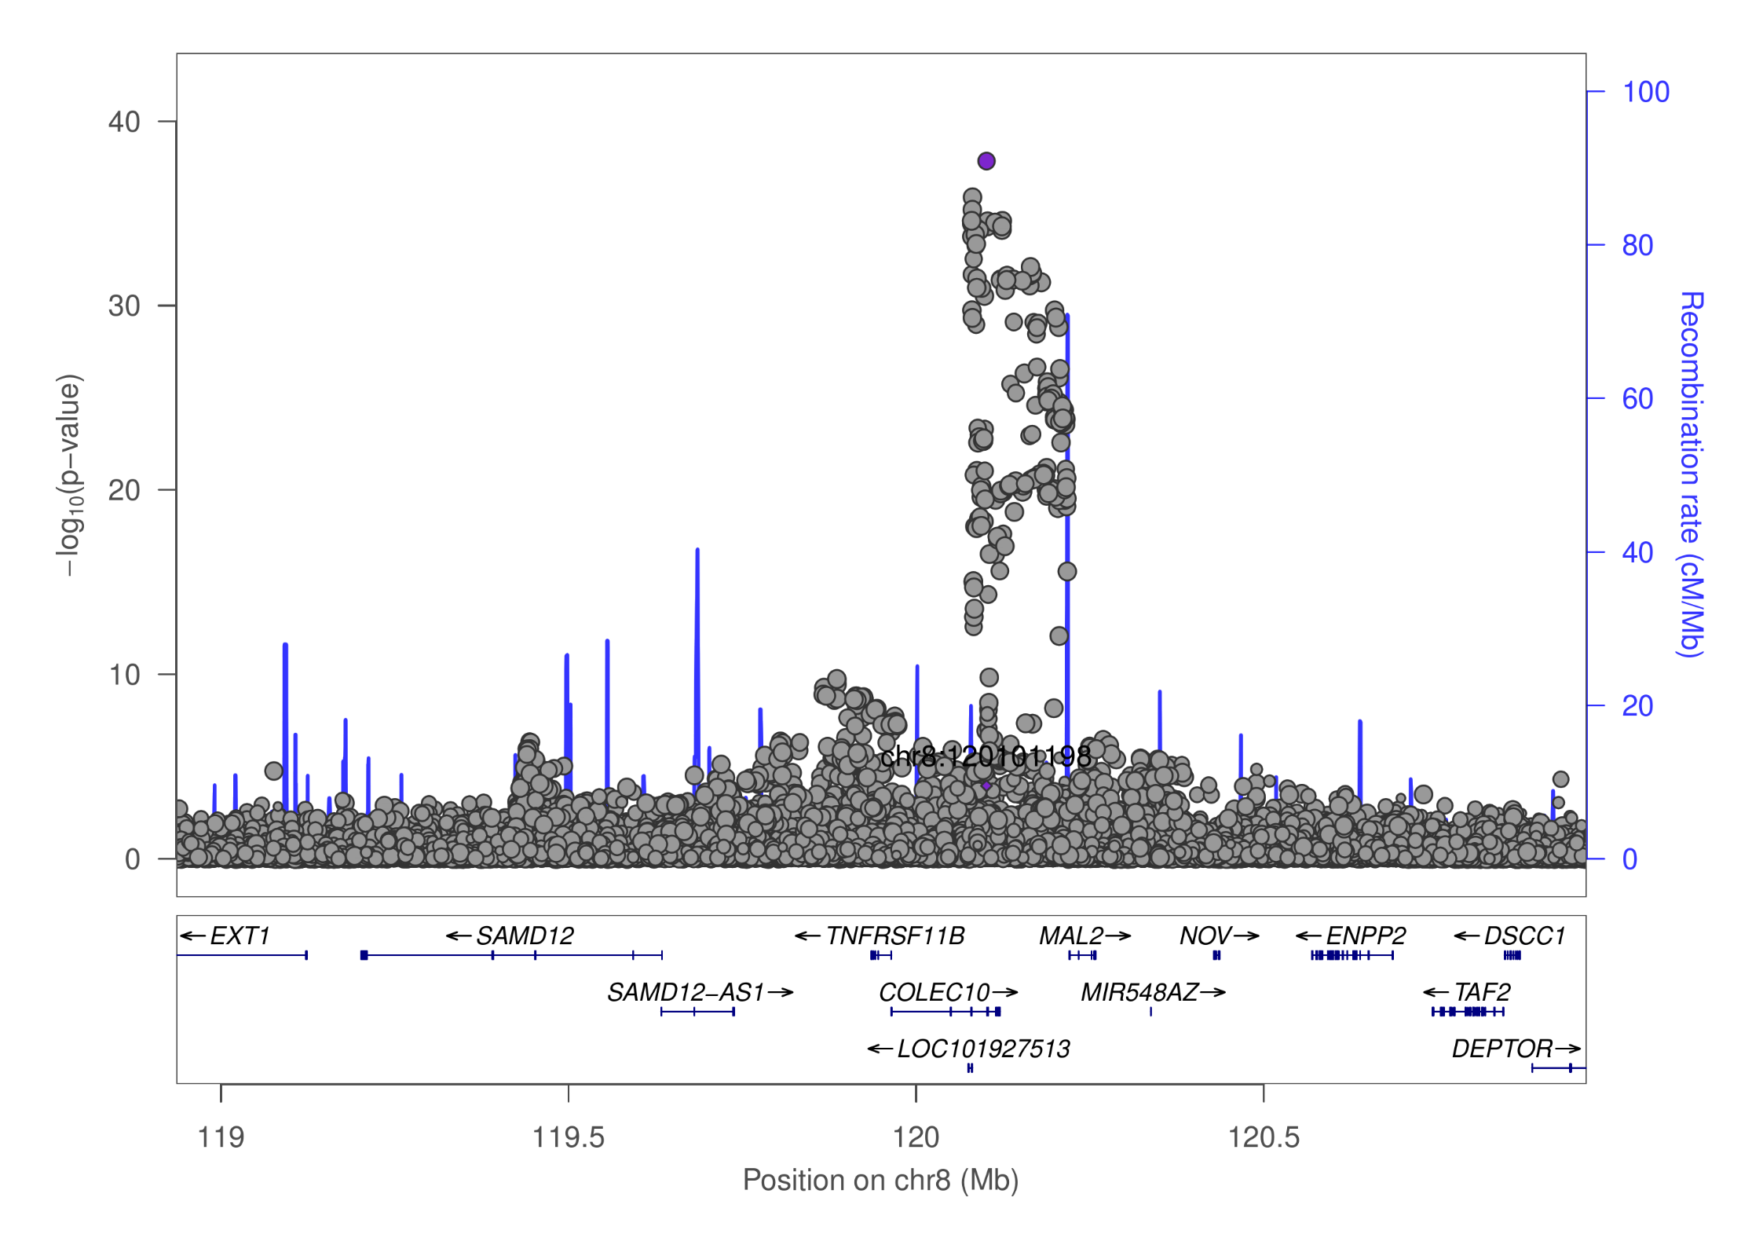
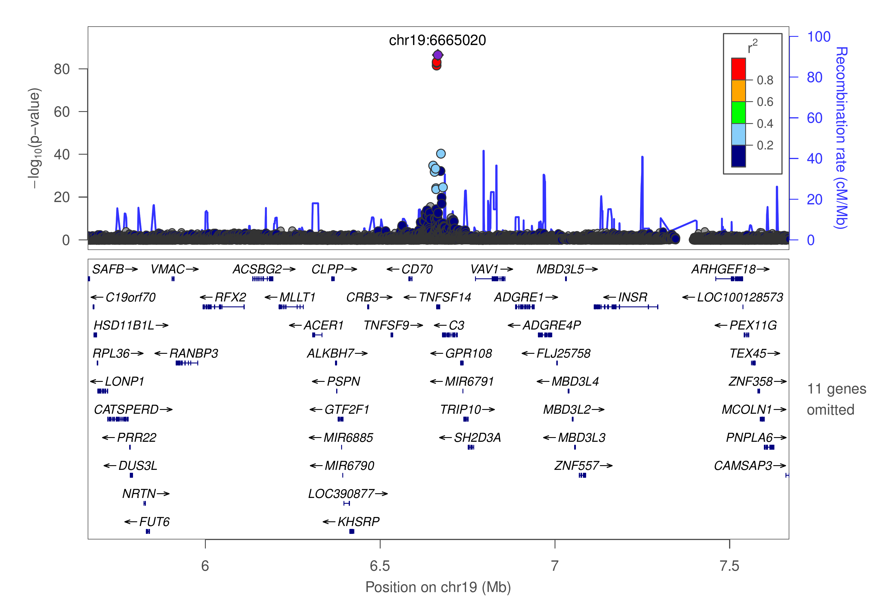
OPG/TNFSF14

Slide 6
GCTA –cojo-slct: A ~ increasing level (p=7.0e-21)
Protein | snp | refa | freq | b | se | p | n | bj | bj_se | pj
OPG | chr8:119867209_A_C | A | 0.1039 | 0.172 | 0.0277 | 5.22E-10 | 9892.77 | 0.206094 | 0.027873 | 1.42E-13
OPG | chr8:120081031_C_T | T | 0.5581 | -0.1588 | 0.0126 | 1.34E-36 | 17960.5 | -0.16752 | 0.01271 | 0
OPG | chr17:26694861_A_G | A | 0.4748 | -0.1165 | 0.0124 | 5.98E-21 | 18414.6 | -0.1165 | 0.012429 | 7.05E-21
TNFSF14 | chr19:593734_A_G | A | 0.0017 | 1.0699 | 0.2851 | 0.000175 | 5255.19 | 1.86978 | 0.290836 | 1.28E-10
TNFSF14 | chr19:1227505_C_T | T | 0.0038 | 0.5254 | 0.1936 | 0.006658 | 5115.54 | 8.7433 | 0.295469 | 0
TNFSF14 | chr19:1403959_C_G | C | 0.0396 | 0.0811 | 0.0425 | 0.05621 | 10576.4 | 0.359616 | 0.043192 | 8.37E-17
TNFSF14 | chr19:3932314_C_T | T | 0.0102 | 0.2737 | 0.1072 | 0.01071 | 6258.25 | 3.12785 | 0.137414 | 0
TNFSF14 | chr19:6641765_C_T | T | 0.0429 | -0.474 | 0.0648 | 2.46E-13 | 4162.6 | -1.58862 | 0.077673 | 0
TNFSF14 | chr19:6665020_C_T | T | 0.1024 | -0.5329 | 0.0269 | 0 | 10535.2 | -0.85562 | 0.033295 | 0
TNFSF14 | chr19:6673889_A_G | A | 0.1109 | -0.5374 | 0.0401 | 0 | 4404.95 | -0.76622 | 0.047387 | 0
TNFSF14 | chr19:6704670_C_T | T | 0.8479 | -0.1313 | 0.0219 | 2.10E-09 | 11714.3 | -0.26149 | 0.022204 | 5.14E-32
TNFSF14 | chr19:8094596_A_G | A | 0.0071 | 0.2025 | 0.1137 | 0.07481 | 7972.04 | 1.34322 | 0.117358 | 2.48E-30
TNFSF14 | chr19:8120283_A_G | A | 0.0025 | -0.7169 | 0.2159 | 0.000897 | 6241.91 | -13.3586 | 0.436703 | 0
TNFSF14 | chr19:13181330_A_G | A | 0.0065 | 0.2745 | 0.1308 | 0.03589 | 6574.33 | 8.92649 | 0.279624 | 0
TNFSF14 | chr19:14165598_C_T | T | 0.0631 | 0.0871 | 0.0505 | 0.08456 | 4818.25 | 0.548355 | 0.053235 | 6.99E-25
TNFSF14 | chr19:22506594_A_G | A | 0.0021 | -0.5409 | 0.2331 | 0.0203 | 6377.98 | -9.8455 | 0.36829 | 0
TNFSF14 | chr19:54324995_G_T | T | 0.2437 | 0.1635 | 0.0161 | 2.43E-24 | 15109.3 | 0.1635 | 0.016154 | 4.45E-24

Slide 7
SNP information (PhenoScanner) chr17:26694861 rs704: Kwan JS, et al. (2014), Hum Mol Genet, PMID25080503, allele G ~ decrease of Osteoprotegerin levels (p=1e-9).
SNP | rsID | Pos (hg19) | Alleles
chr8:119867209 | rs149577650 | chr8:119867209 | A/C
chr8:120081031 | rs2247769 | chr8:120081031 | C/T
chr17:26694861 | rs704 | chr17:26694861 | G/A
chr19:593734 | rs113083835 | chr19:593734 | A/G
chr19:1227505 | rs7259447 | chr19:1227505 | C/T
chr19:1403959 | chr19:1403959 | chr19:1403959 | C/G
chr19:3932314 | rs149200741 | chr19:3932314 | C/T
chr19:6641765 | rs56029314 | chr19:6641765 | C/T
chr19:6665020 | rs344560 | chr19:6665020 | T/C
chr19:6673889 | rs6510917 | chr19:6673889 | A/G
chr19:6704670 | rs11085195 | chr19:6704670 | T/C
chr19:8094596 | rs142682195 | chr19:8094596 | A/G
chr19:8120283 | chr19:8120283 | chr19:8120283 | NA
chr19:13181330 | chr19:13181330 | chr19:13181330 | NA
chr19:14165598 | rs56361194 | chr19:14165598 | C/T
chr19:22506594 | rs193135521 | chr19:22506594 | A/G
chr19:54324995 | rs4632248 | chr19:54324995 | G/T

Slide 8
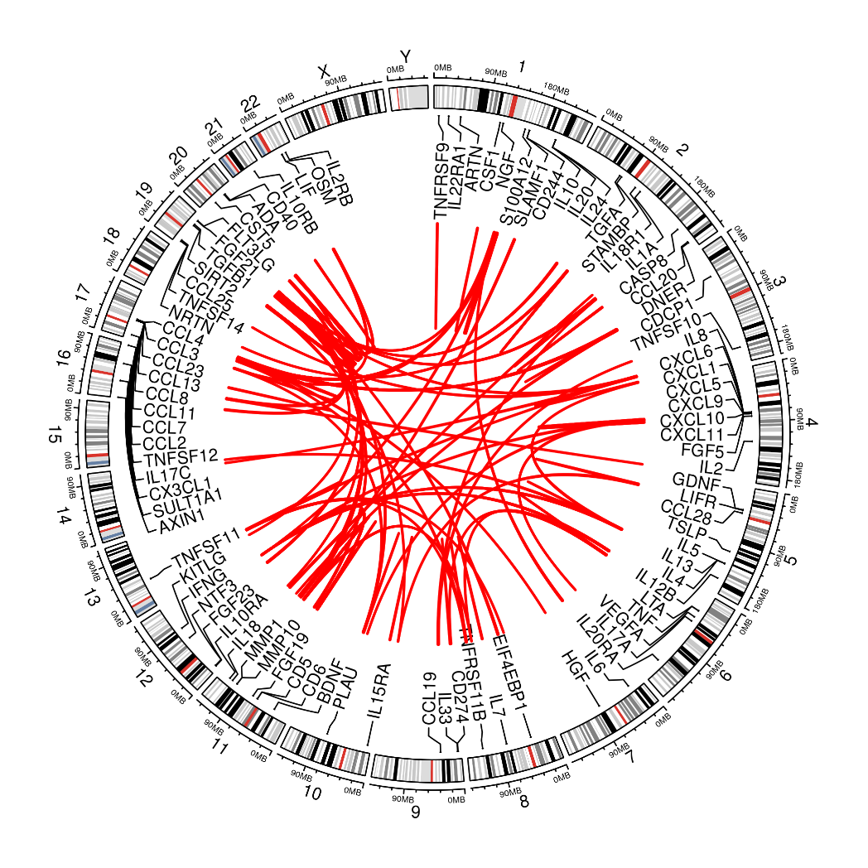
cis-/trans- classification (INTERVAL/)

Slide 9
A brief summary
INTERVAL follow-up and the benchmarks showed promising results from initial meta-analysis.
A particular problem with PLINK –clump procedure is its ability to handle small p-value, and a z-score based approach as in recent GCTA is more desirable. Stricter LD possibly can lead to conservative estimate of independent signals.
It is worthwhile to other explore approaches available.
There will be continuing endeavour to return to the meta-analysis QC.

Slide 10
On next steps
KORA individual level data analysis will be conducted centrally.
Additional studies such as COMBINE will be added.
For cohorts contributing results on PLINK, information such as effect allele (frequency), imputation quality is recommended on a per-cohort basis via qctool as noted in SCALLOP_INF_I_analysis_plan.md.
Refined QC and downstream analysis, as the results shown here were based on 1000Genomes extracted from LocusZoom 1.4 at tryggve when there was issues with the up-/down-load. A more desirable reference panel would be INTERVAL, UKBiobank. Finemapping is set to involve PLINK, GCTA, finemap, and JAM, among others.

