Slide 1
SCALLOP/INF1 analysis
https://github.com/jinghuazhao/INF
12/11/2018

Slide 2
Outlines
Summary data from EGCUT, INTERVAL, NSPHS, ORCADES, STABILITY, STANLEY, VIS.
METAL (WEIGHTS >= 50, SCHEME STDERR).
PLINK –clumping and GCTA –cojo-slct.
Shown for TNFRSF11B, chr8:119935796-119964439 (OPG) and TNFSF14, chr19:6663148-6670599 (TNFSF14).

Slide 3
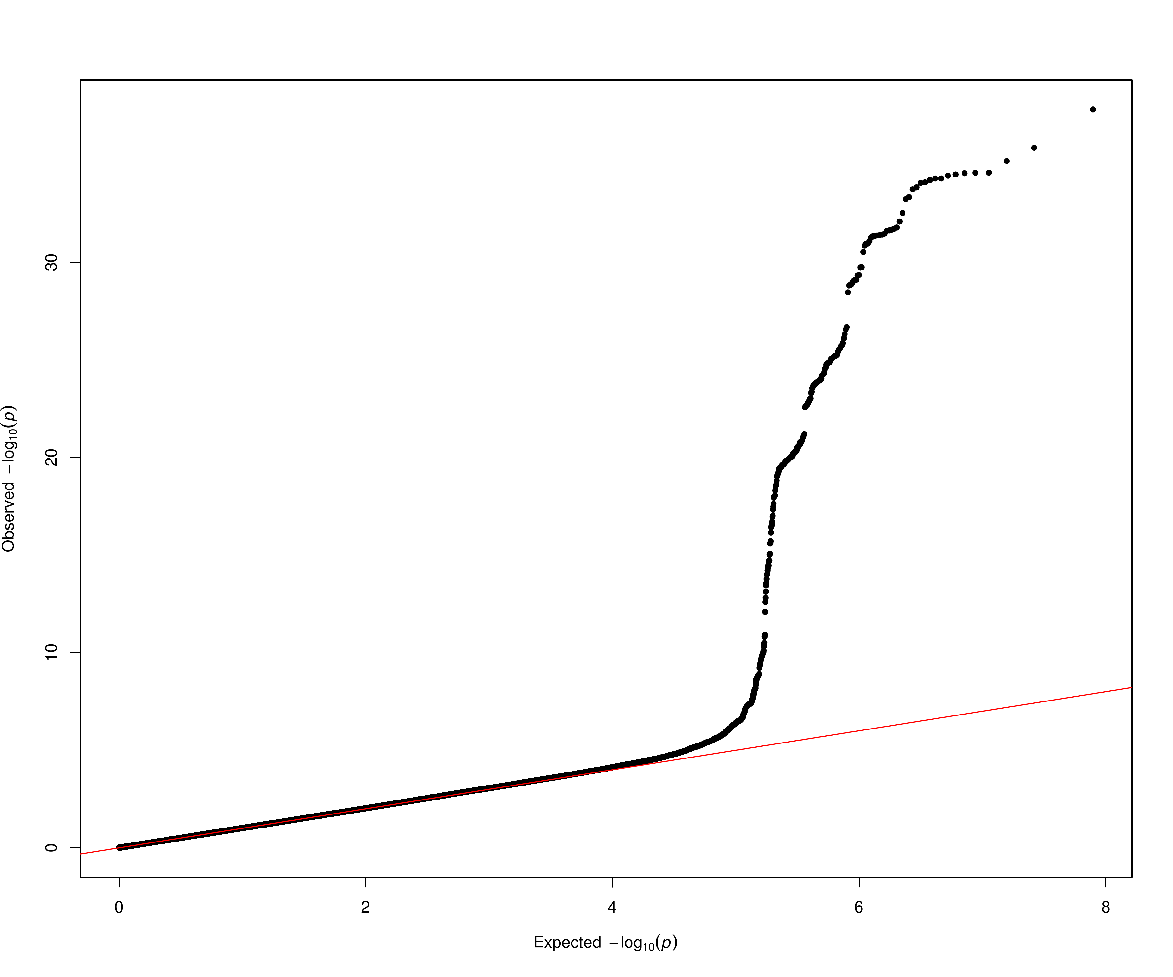
OPG

Slide 4
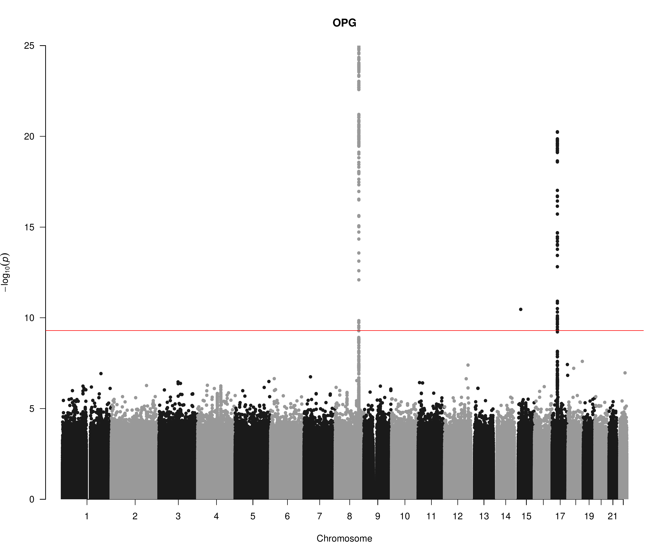
OPG

Slide 5
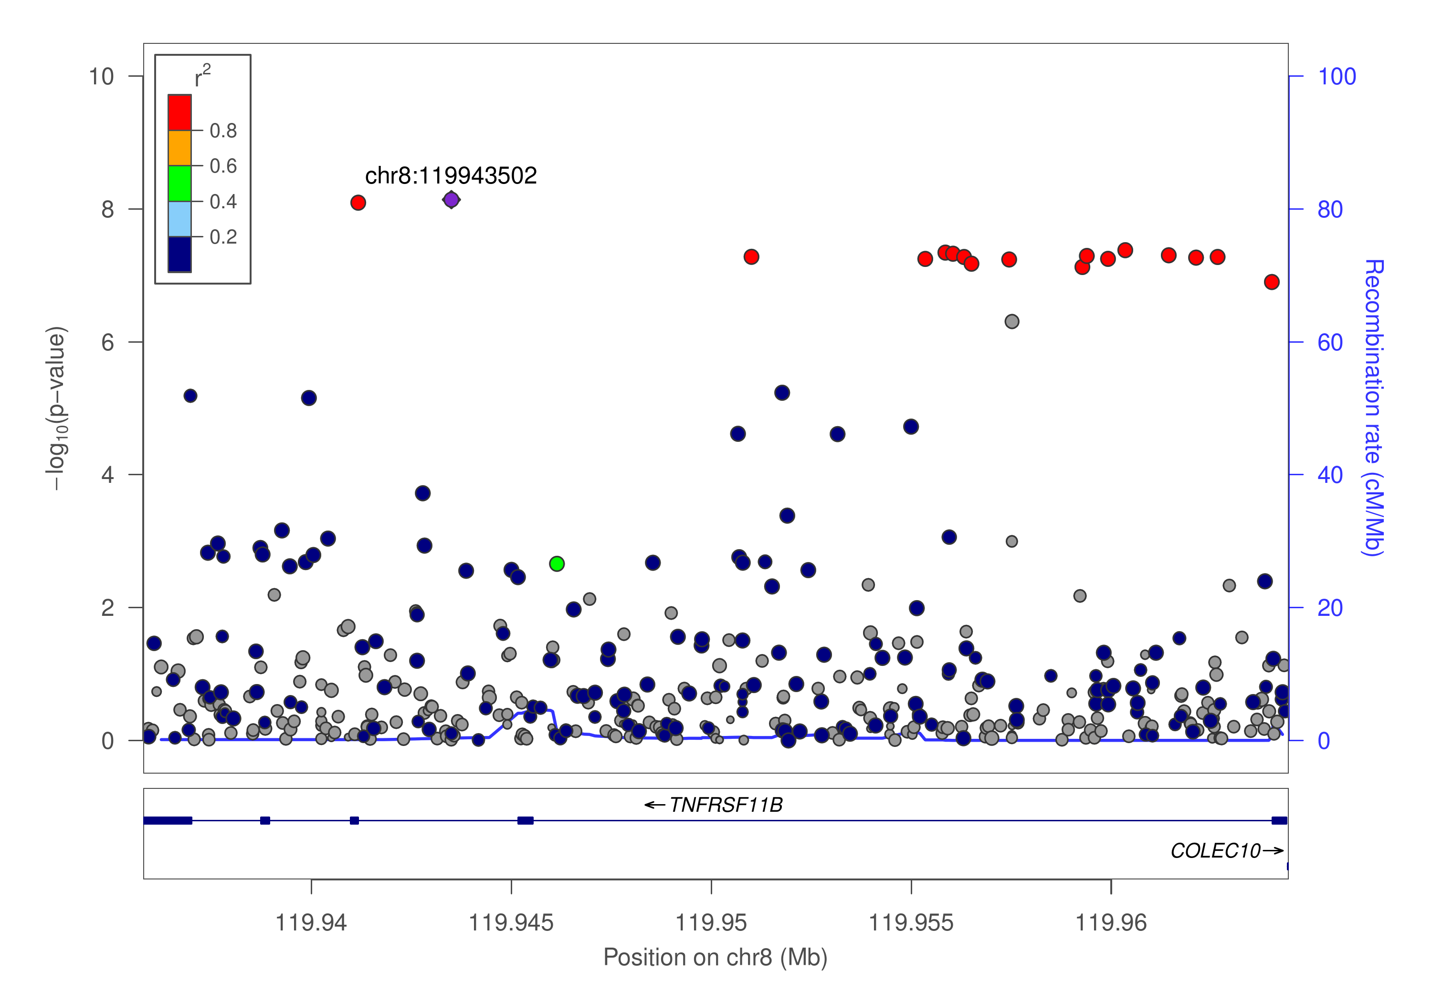
OPG

Slide 6
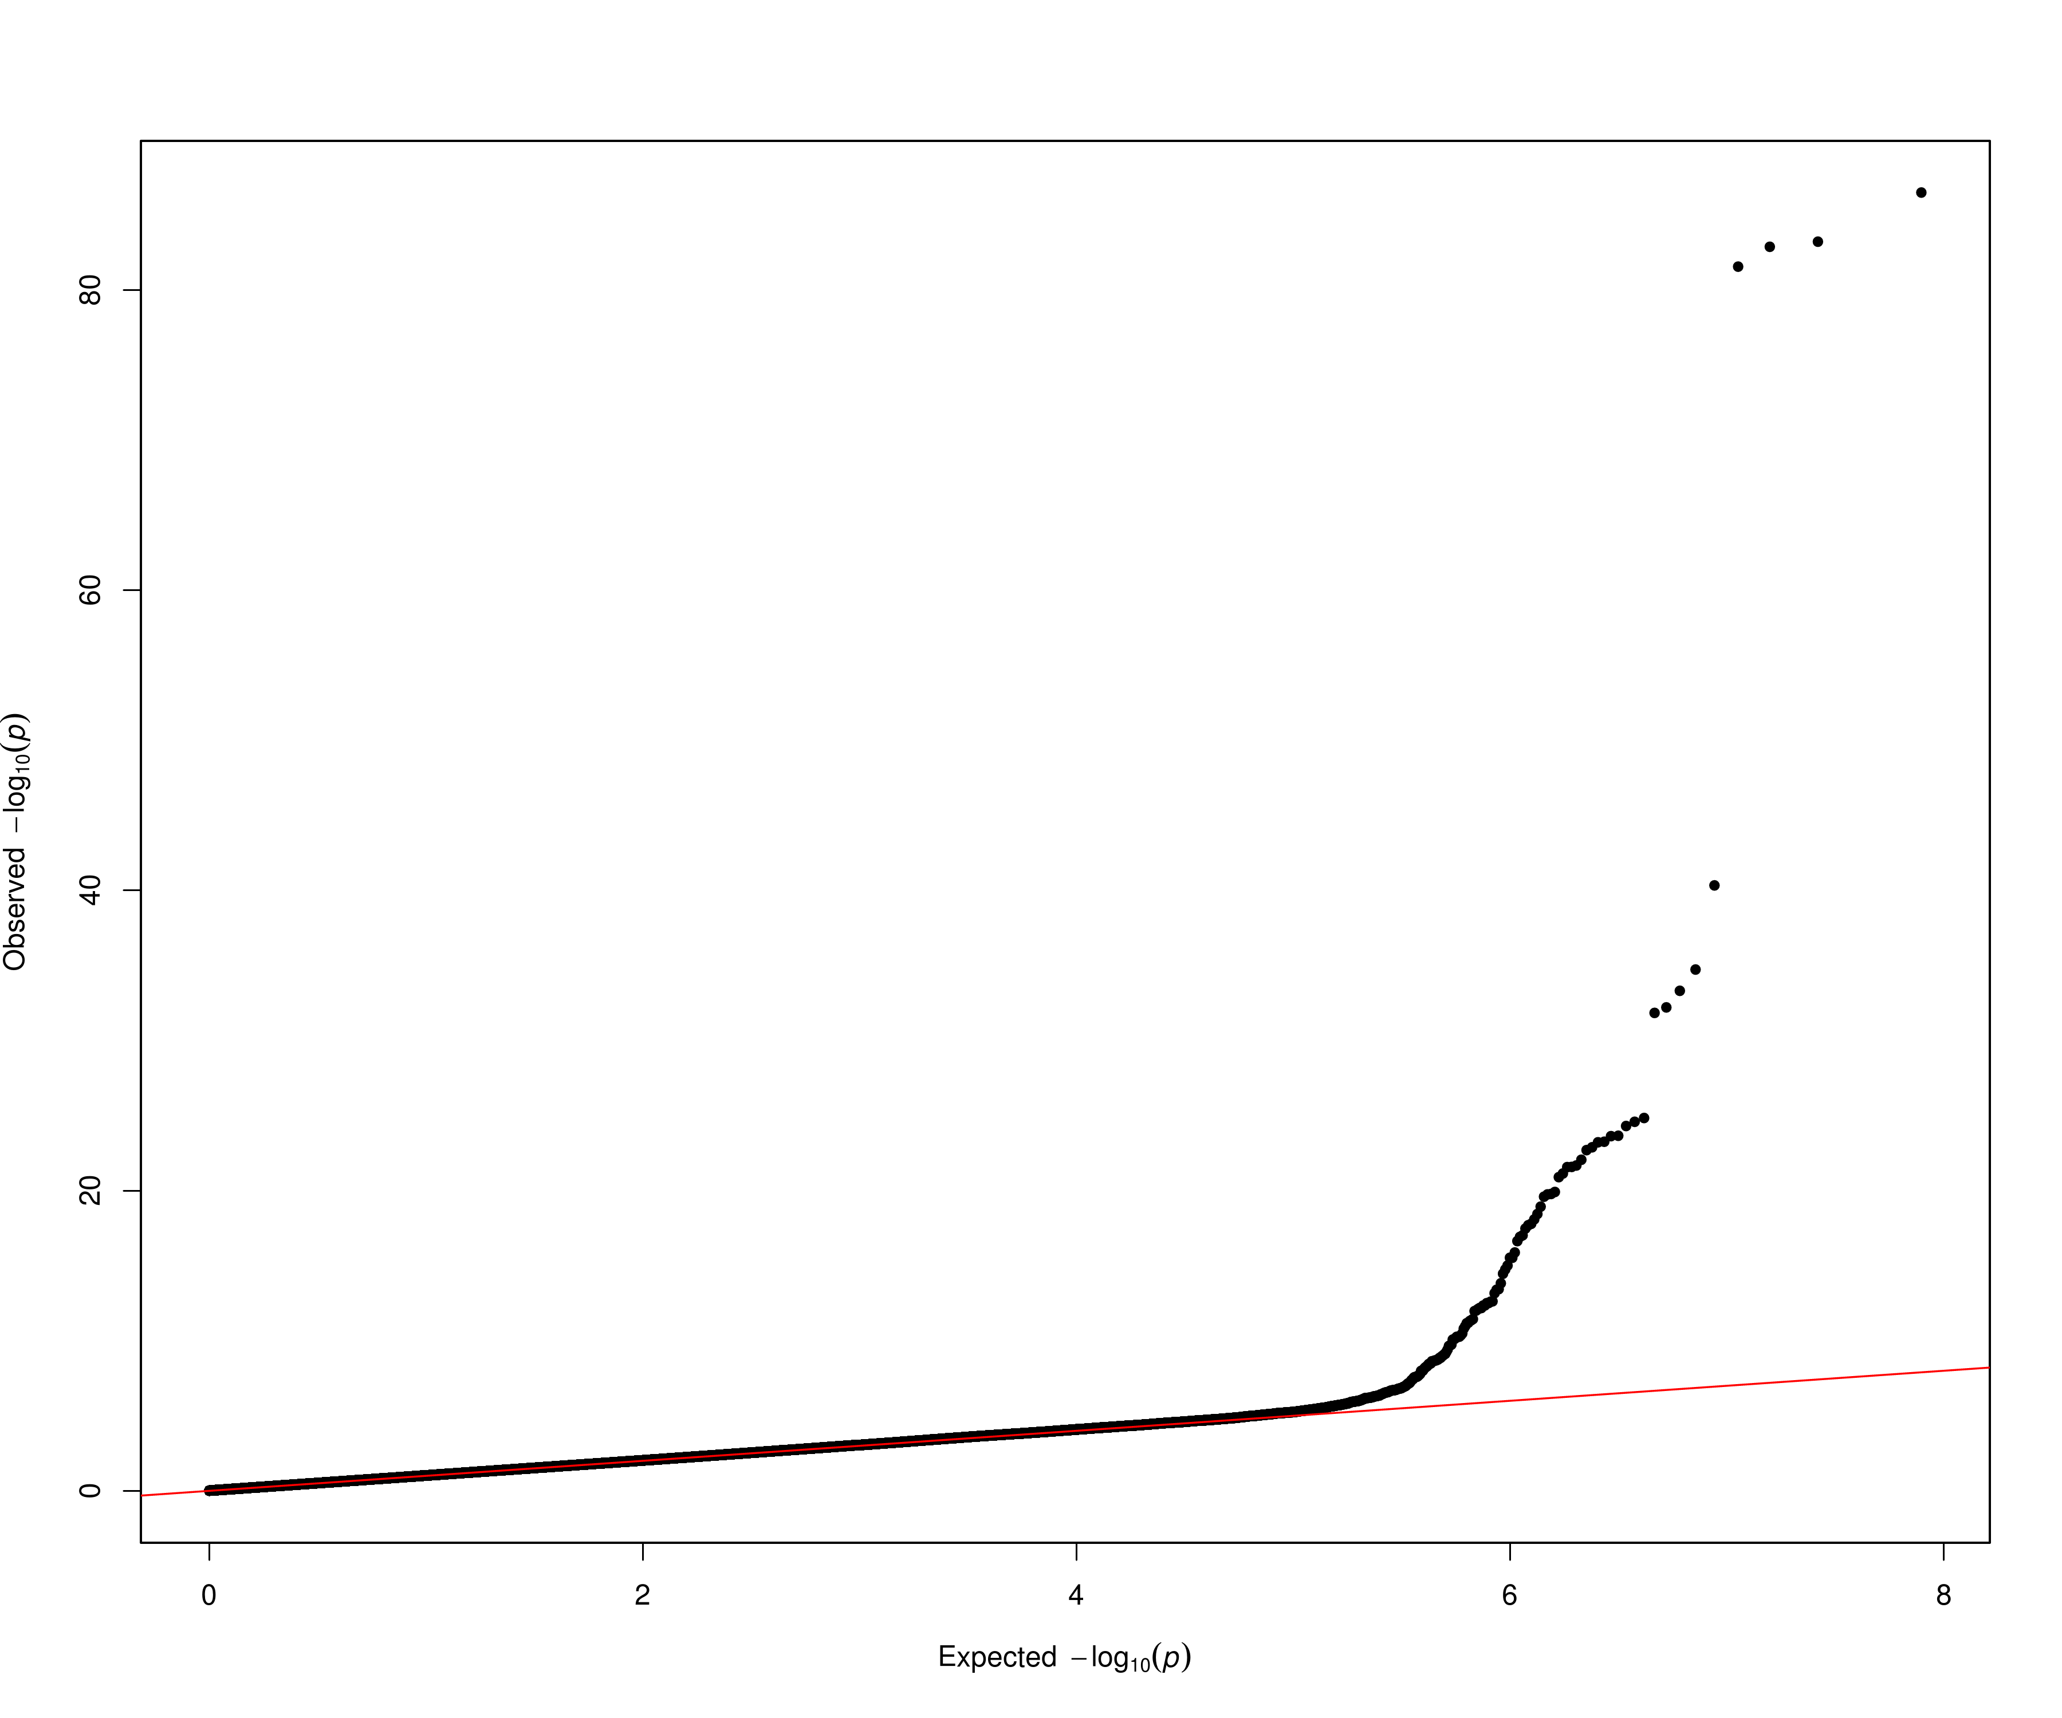
TNFSF14

Slide 7
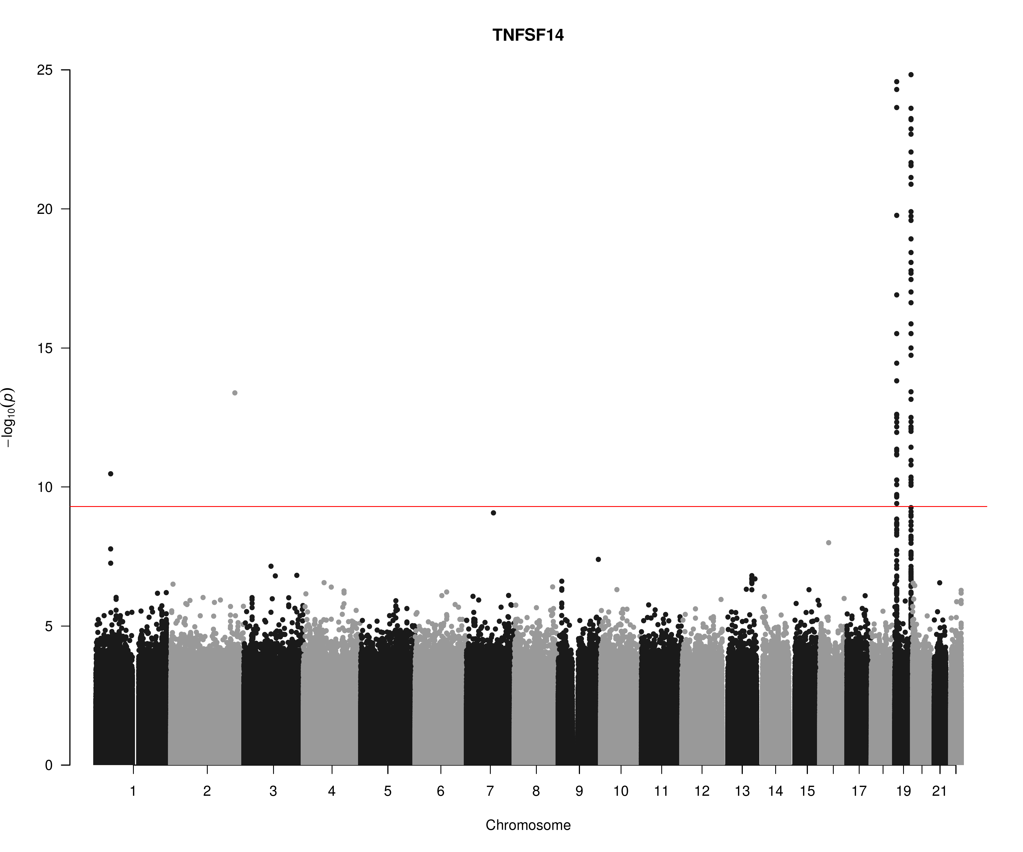
TNFSF14

Slide 8
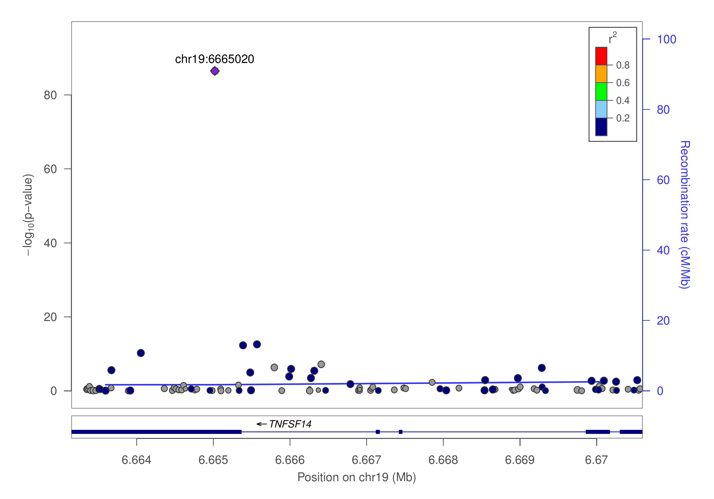
TNFSF14

Slide 9
cis/trans classification (jma.cojo results)
HGNC symbol (TARGET) | cis | trans | Total
TNFRSF11B (OPG) | 2 | 1 | 3
TNFSF14 (TNFSF14) | 4 | 9 | 13
Total | 6 | 10 | 16

Slide 10
GCTA –cojo-slct results: Allele A is associated with increasing level (p=7.0e-21)
prot | SNP | refA | freq | b | se | p | n | bJ | bJ_se | pJ
OPG | chr8:119867209_A_C | A | 0.1039 | 0.172 | 0.0277 | 5.22E-10 | 9922.26 | 0.206094 | 0.027873 | 1.42E-13
OPG | chr8:120081031_C_T | T | 0.5581 | -0.1588 | 0.0126 | 1.34E-36 | 18014.3 | -0.16752 | 0.01271 | 1.14E-39
OPG | chr17:26694861_A_G | A | 0.4748 | -0.1165 | 0.0124 | 5.98E-21 | 18469.6 | -0.1165 | 0.012429 | 7.05E-21
TNFSF14 | chr19:1227505_C_T | T | 0.0038 | 0.5254 | 0.1936 | 0.006658 | 5131.59 | 8.67037 | 0.29525 | 1.49E-189
TNFSF14 | chr19:1403959_C_G | C | 0.0396 | 0.0811 | 0.0425 | 0.05621 | 10609.6 | 0.355997 | 0.043189 | 1.68E-16
TNFSF14 | chr19:3932314_C_T | T | 0.0102 | 0.2737 | 0.1072 | 0.01071 | 6277.87 | 3.11423 | 0.137398 | 9.76E-114
TNFSF14 | chr19:6641765_C_T | T | 0.0429 | -0.474 | 0.0648 | 2.46E-13 | 4175.8 | -1.57162 | 0.077627 | 3.87E-91
TNFSF14 | chr19:6665020_C_T | T | 0.1024 | -0.5329 | 0.0269 | 3.31E-87 | 10569.4 | -0.86873 | 0.03323 | 1.18E-150
TNFSF14 | chr19:6673889_A_G | A | 0.1109 | -0.5374 | 0.0401 | 4.79E-41 | 4419.3 | -0.70832 | 0.046519 | 2.37E-52
TNFSF14 | chr19:6704670_C_T | T | 0.8479 | -0.1313 | 0.0219 | 2.10E-09 | 11751.1 | -0.25828 | 0.022198 | 2.73E-31
TNFSF14 | chr19:8094596_A_G | A | 0.0071 | 0.2025 | 0.1137 | 0.07481 | 7997.02 | 1.33156 | 0.117344 | 7.64E-30
TNFSF14 | chr19:8120283_A_G | A | 0.0025 | -0.7169 | 0.2159 | 0.000897 | 6261.49 | -13.282 | 0.43654 | 2.52E-203
TNFSF14 | chr19:13181330_A_G | A | 0.0065 | 0.2745 | 0.1308 | 0.03589 | 6594.93 | 8.86702 | 0.27947 | 6.40E-221
TNFSF14 | chr19:14165598_C_T | T | 0.0631 | 0.0871 | 0.0505 | 0.08456 | 4833.35 | 0.540685 | 0.053221 | 3.01E-24
TNFSF14 | chr19:22506594_A_G | A | 0.0021 | -0.5409 | 0.2331 | 0.0203 | 6397.97 | -9.78149 | 0.368155 | 1.55E-155
TNFSF14 | chr19:54324995_G_T | T | 0.2437 | 0.1635 | 0.0161 | 2.43E-24 | 15157 | 0.1635 | 0.016154 | 4.45E-24

Slide 11
SNP information (PhenoScanner) chr17:26694861 rs704: Kwan JS,2014, PMID25080503, allele G ~ decrease of Osteoprotegerin levels (p=1e-9).
SNP | rsID | Pos (hg19) | Alleles
chr8:119867209 | rs149577650 | chr8:119867209 | A/C
chr8:120081031 | rs2247769 | chr8:120081031 | C/T
chr17:26694861 | rs704 | chr17:26694861 | G/A
chr19:1227505 | rs7259447 | chr19:1227505 | C/T
chr19:1403959 | chr19:1403959 | chr19:1403959 | C/G
chr19:3932314 | rs149200741 | chr19:3932314 | C/T
chr19:6641765 | rs56029314 | chr19:6641765 | C/T
chr19:6665020 | rs344560 | chr19:6665020 | T/C
chr19:6673889 | rs6510917 | chr19:6673889 | A/G
chr19:6704670 | rs11085195 | chr19:6704670 | T/C
chr19:8094596 | rs142682195 | chr19:8094596 | A/G
chr19:8120283 | chr19:8120283 | chr19:8120283 | NA
chr19:13181330 | chr19:13181330 | chr19:13181330 | NA
chr19:14165598 | rs56361194 | chr19:14165598 | C/T
chr19:22506594 | rs193135521 | chr19:22506594 | A/G
chr19:54324995 | rs4632248 | chr19:54324995 | G/T

Slide 12
Points
KORA individual level data analysis will be conducted.
A couple of studies will be added.
Additional information, esp. results from PLINK as noted in SCALLOP_INF_I_analysis_plan.md at the GitHub.
Refined and downstream analysis, as the results shown were based on 1000Genomes extracted from LocusZoom 1.4 at tryggve.

