Slide 1
SCALLOP/INF1 analysis
https://github.com/jinghuazhao/INF
29/11/2018

Slide 2
Outlines
Summary data from EGCUT, INTERVAL, NSPHS, ORCADES, STABILITY, STANLEY, VIS.
METAL (WEIGHTS >= 50, SCHEME STDERR).
PLINK –clumping and GCTA –cojo-slct.
Shown for TNFRSF11B, chr8:119935796-119964439 (OPG) and TNFSF14, chr19:6663148-6670599 (TNFSF14).

Slide 3
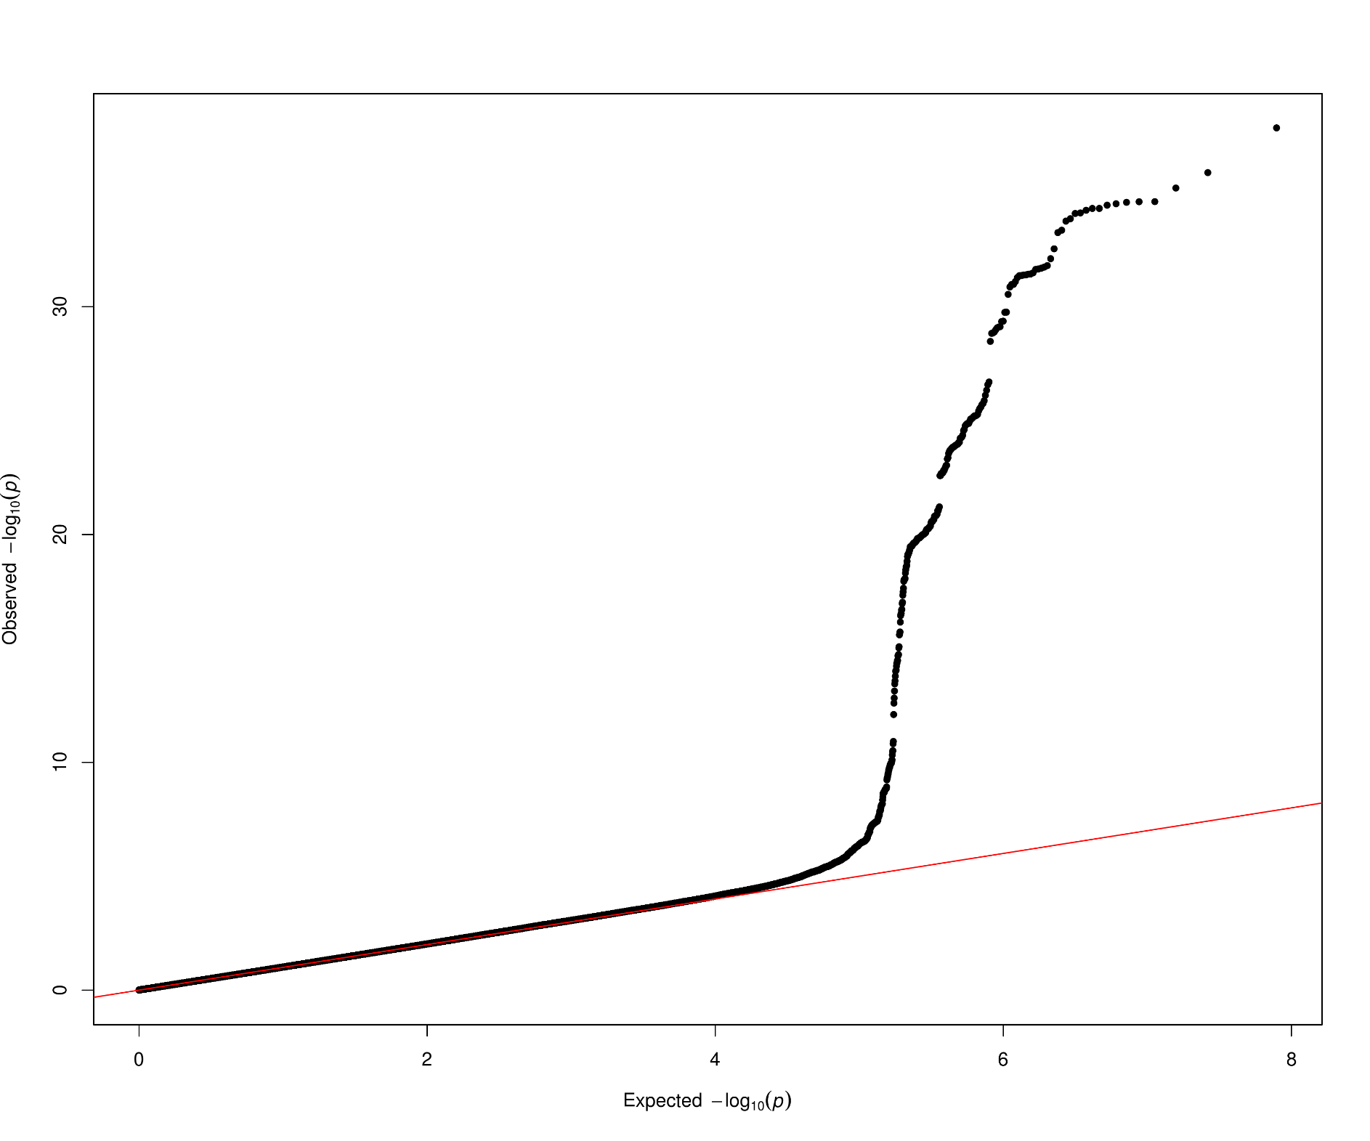
OPG

Slide 4
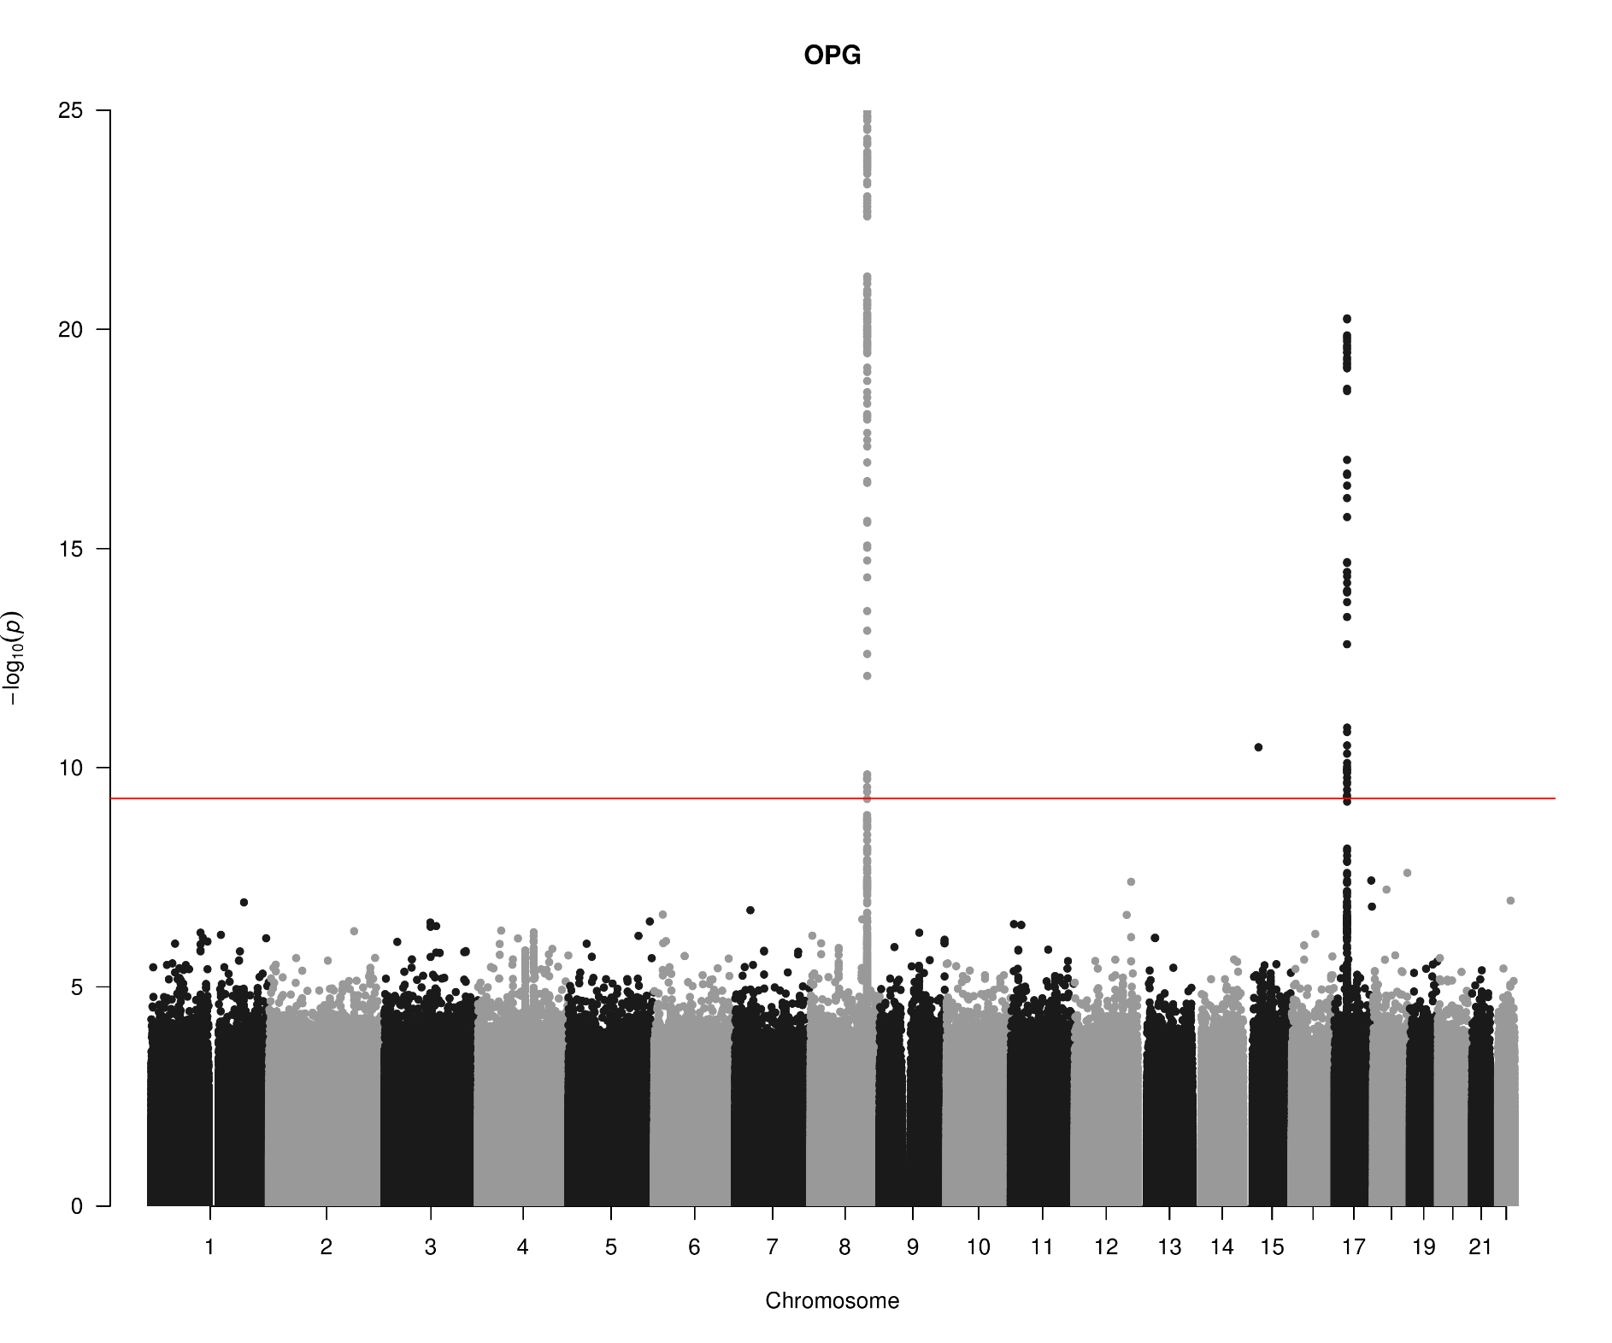
OPG

Slide 5
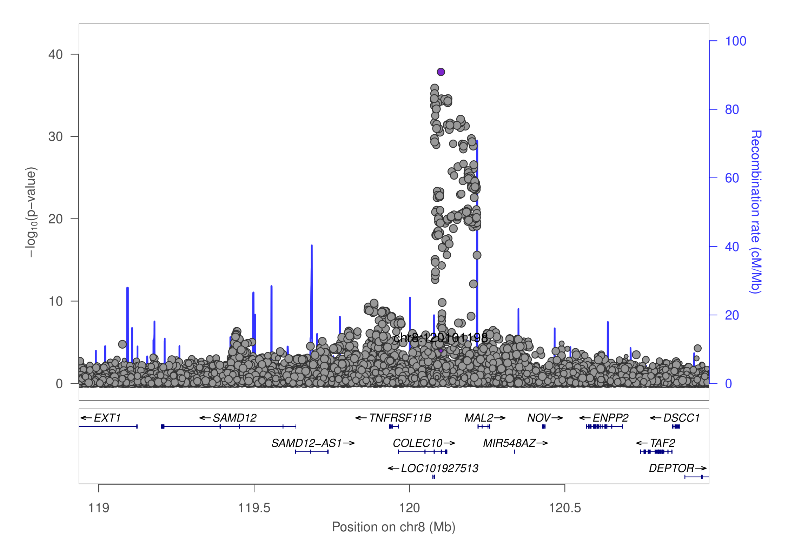
OPG

Slide 6
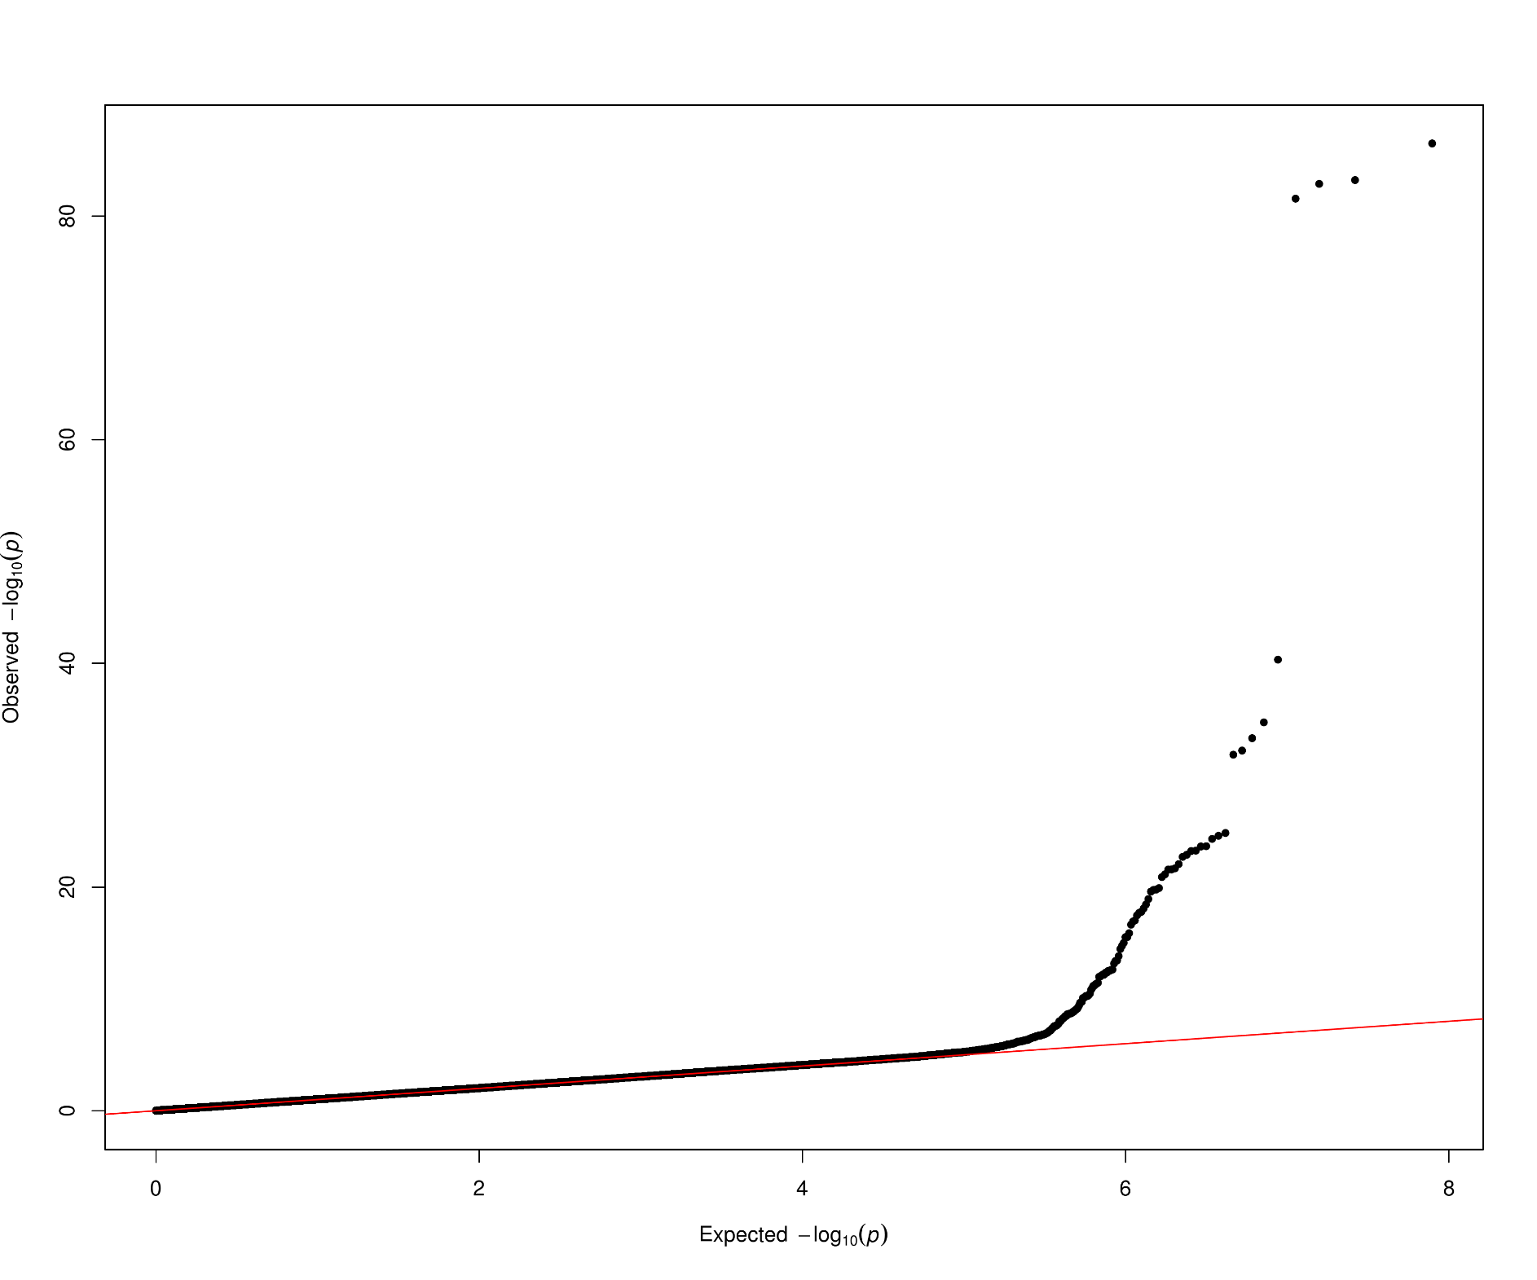
TNFSF14

Slide 7
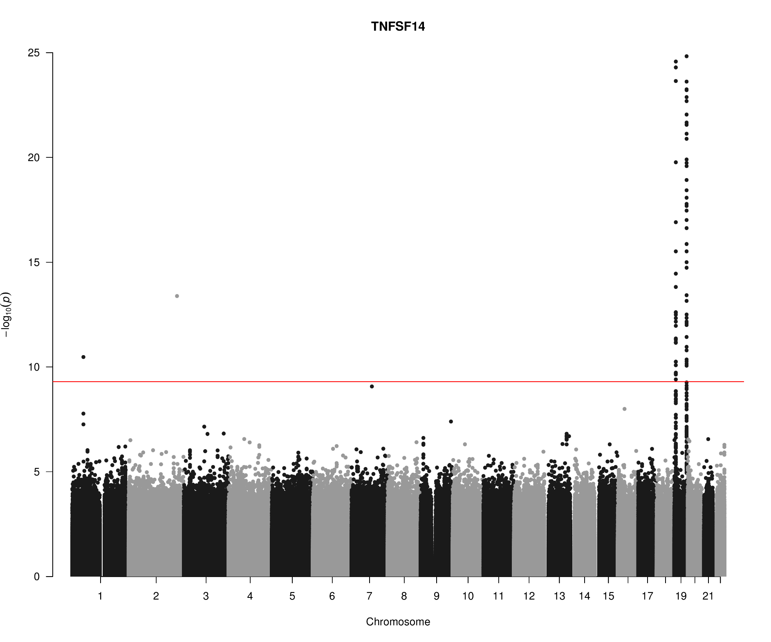
TNFSF14

Slide 8
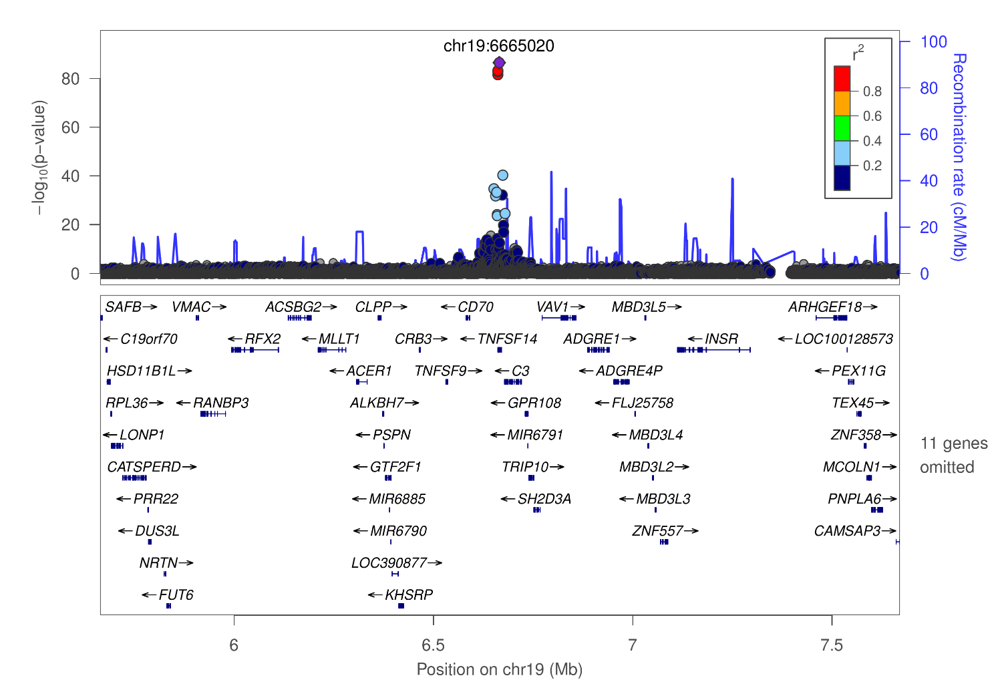
TNFSF14

Slide 9
GCTA –cojo-slct results: Allele A is associated with increasing level (p=7.0e-21)
prot | SNP | refA | freq | b | se | p | n | bJ | bJ_se | pJ
OPG | chr8:119867209_A_C | A | 0.1039 | 0.172 | 0.0277 | 5.22E-10 | 9922.26 | 0.206094 | 0.027873 | 1.42E-13
OPG | chr8:120081031_C_T | T | 0.5581 | -0.1588 | 0.0126 | 1.34E-36 | 18014.3 | -0.16752 | 0.01271 | 1.14E-39
OPG | chr17:26694861_A_G | A | 0.4748 | -0.1165 | 0.0124 | 5.98E-21 | 18469.6 | -0.1165 | 0.012429 | 7.05E-21
TNFSF14 | chr19:1227505_C_T | T | 0.0038 | 0.5254 | 0.1936 | 0.006658 | 5131.59 | 8.67037 | 0.29525 | 1.49E-189
TNFSF14 | chr19:1403959_C_G | C | 0.0396 | 0.0811 | 0.0425 | 0.05621 | 10609.6 | 0.355997 | 0.043189 | 1.68E-16
TNFSF14 | chr19:3932314_C_T | T | 0.0102 | 0.2737 | 0.1072 | 0.01071 | 6277.87 | 3.11423 | 0.137398 | 9.76E-114
TNFSF14 | chr19:6641765_C_T | T | 0.0429 | -0.474 | 0.0648 | 2.46E-13 | 4175.8 | -1.57162 | 0.077627 | 3.87E-91
TNFSF14 | chr19:6665020_C_T | T | 0.1024 | -0.5329 | 0.0269 | 3.31E-87 | 10569.4 | -0.86873 | 0.03323 | 1.18E-150
TNFSF14 | chr19:6673889_A_G | A | 0.1109 | -0.5374 | 0.0401 | 4.79E-41 | 4419.3 | -0.70832 | 0.046519 | 2.37E-52
TNFSF14 | chr19:6704670_C_T | T | 0.8479 | -0.1313 | 0.0219 | 2.10E-09 | 11751.1 | -0.25828 | 0.022198 | 2.73E-31
TNFSF14 | chr19:8094596_A_G | A | 0.0071 | 0.2025 | 0.1137 | 0.07481 | 7997.02 | 1.33156 | 0.117344 | 7.64E-30
TNFSF14 | chr19:8120283_A_G | A | 0.0025 | -0.7169 | 0.2159 | 0.000897 | 6261.49 | -13.282 | 0.43654 | 2.52E-203
TNFSF14 | chr19:13181330_A_G | A | 0.0065 | 0.2745 | 0.1308 | 0.03589 | 6594.93 | 8.86702 | 0.27947 | 6.40E-221
TNFSF14 | chr19:14165598_C_T | T | 0.0631 | 0.0871 | 0.0505 | 0.08456 | 4833.35 | 0.540685 | 0.053221 | 3.01E-24
TNFSF14 | chr19:22506594_A_G | A | 0.0021 | -0.5409 | 0.2331 | 0.0203 | 6397.97 | -9.78149 | 0.368155 | 1.55E-155
TNFSF14 | chr19:54324995_G_T | T | 0.2437 | 0.1635 | 0.0161 | 2.43E-24 | 15157 | 0.1635 | 0.016154 | 4.45E-24

Slide 10
SNP information (PhenoScanner) chr17:26694861 rs704: Kwan JS, et al. (2014), Hum Mol Genet, PMID25080503, allele G ~ decrease of Osteoprotegerin levels (p=1e-9).
SNP | rsID | Pos (hg19) | Alleles
chr8:119867209 | rs149577650 | chr8:119867209 | A/C
chr8:120081031 | rs2247769 | chr8:120081031 | C/T
chr17:26694861 | rs704 | chr17:26694861 | G/A
chr19:1227505 | rs7259447 | chr19:1227505 | C/T
chr19:1403959 | chr19:1403959 | chr19:1403959 | C/G
chr19:3932314 | rs149200741 | chr19:3932314 | C/T
chr19:6641765 | rs56029314 | chr19:6641765 | C/T
chr19:6665020 | rs344560 | chr19:6665020 | T/C
chr19:6673889 | rs6510917 | chr19:6673889 | A/G
chr19:6704670 | rs11085195 | chr19:6704670 | T/C
chr19:8094596 | rs142682195 | chr19:8094596 | A/G
chr19:8120283 | chr19:8120283 | chr19:8120283 | NA
chr19:13181330 | chr19:13181330 | chr19:13181330 | NA
chr19:14165598 | rs56361194 | chr19:14165598 | C/T
chr19:22506594 | rs193135521 | chr19:22506594 | A/G
chr19:54324995 | rs4632248 | chr19:54324995 | G/T

Slide 11
Points
KORA individual level data analysis will be conducted centrally.
Studies such as COMBINE will be added.
Additional information such as effect allele (frequency), imputation quality, esp. for cohorts with results from PLINK. As suggested this is on a per-cohort basis using qctool, as noted in SCALLOP_INF_I_analysis_plan.md at the GitHub.
Refined and downstream analysis, as the results shown were based on 1000Genomes extracted from LocusZoom 1.4 at tryggve when there was issues with the up/down-load. A more desirable panel would be INTERVAL, UKBiobank, for instance.

