Slide 1
SCALLOP/INF1 analysis
https://github.com/jinghuazhao/INF
12/11/2018

Slide 2
Outlines
Summary data from EGCUT, INTERVAL, NSPHS, ORCADES, STABILITY, STANLEY, VIS.
METAL (WEIGHTS >= 50, SCHEME STDERR).
PLINK –clumping and GCTA –cojo-slct.
Shown for TNFRSF11B, chr8:119935796-119964439 (OPG) and TNFSF14, chr19:6663148-6670599 (TNFSF14).

Slide 3
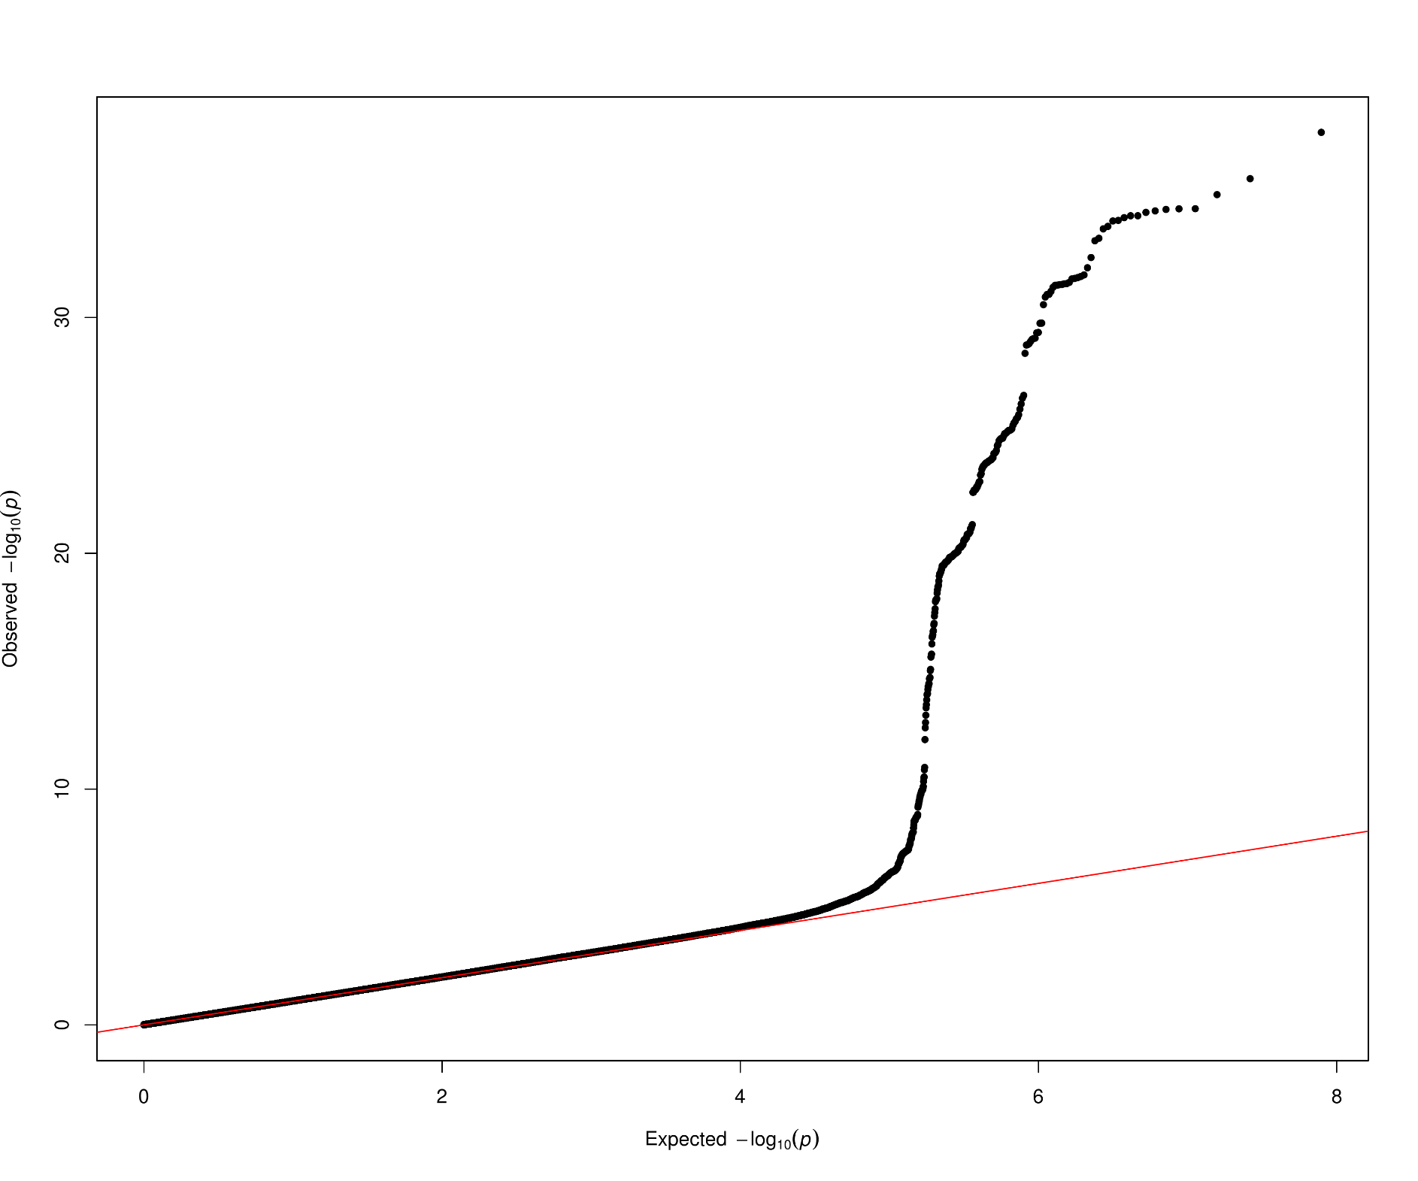
OPG

Slide 4
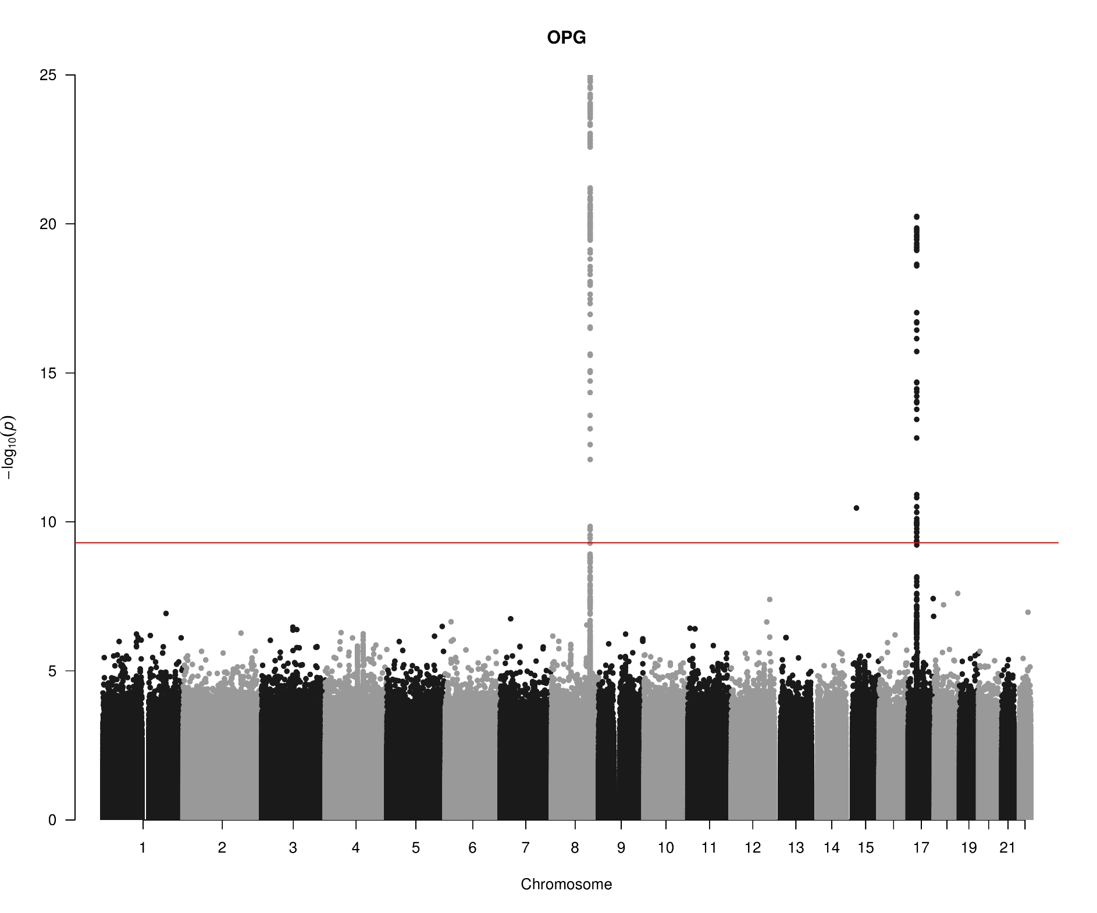
OPG

Slide 5
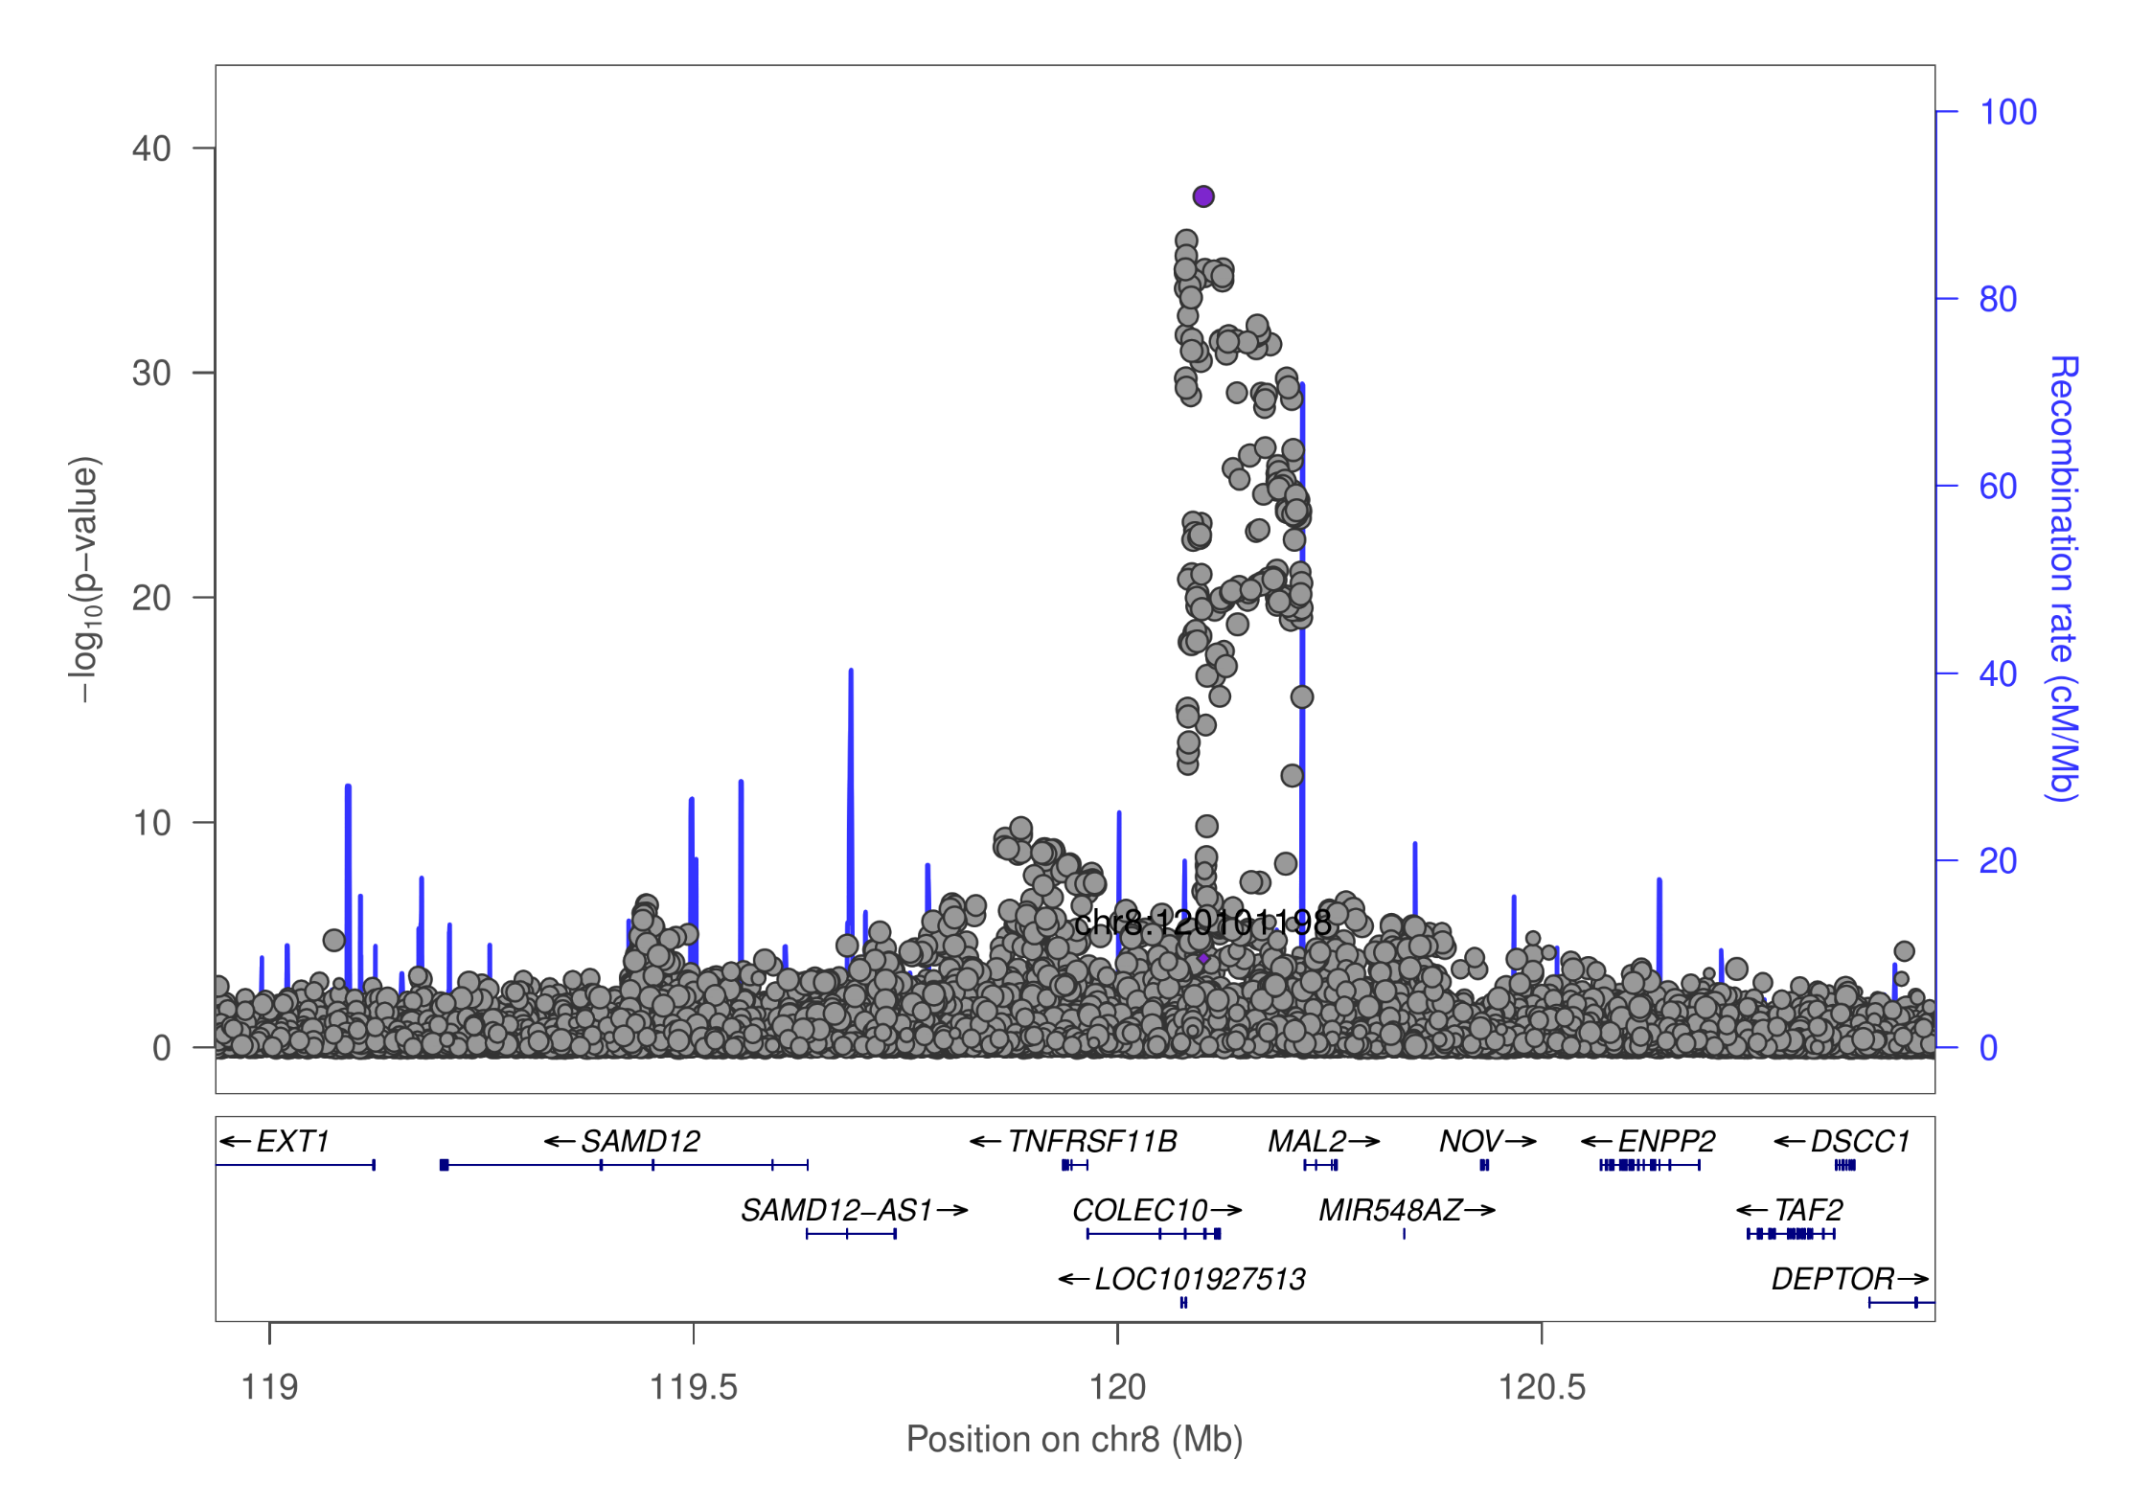
OPG

Slide 6
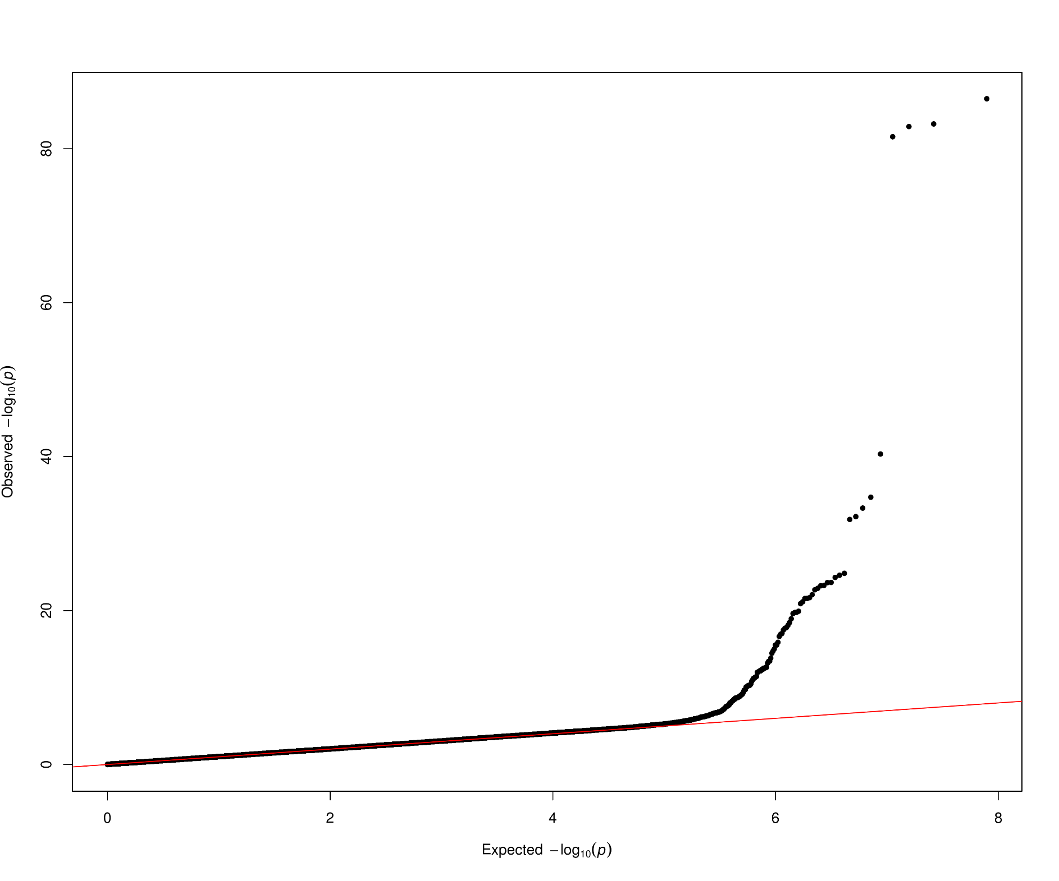
TNFSF14

Slide 7
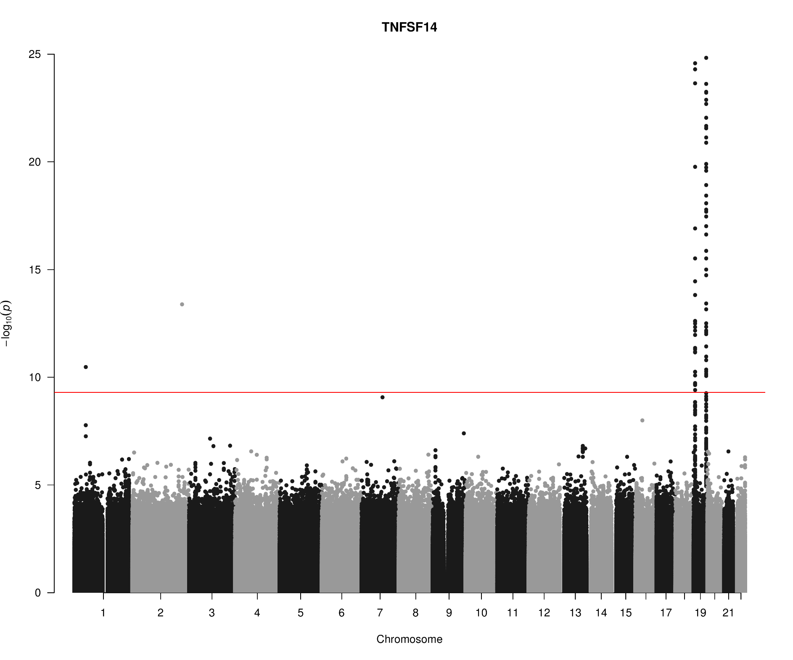
TNFSF14

Slide 8
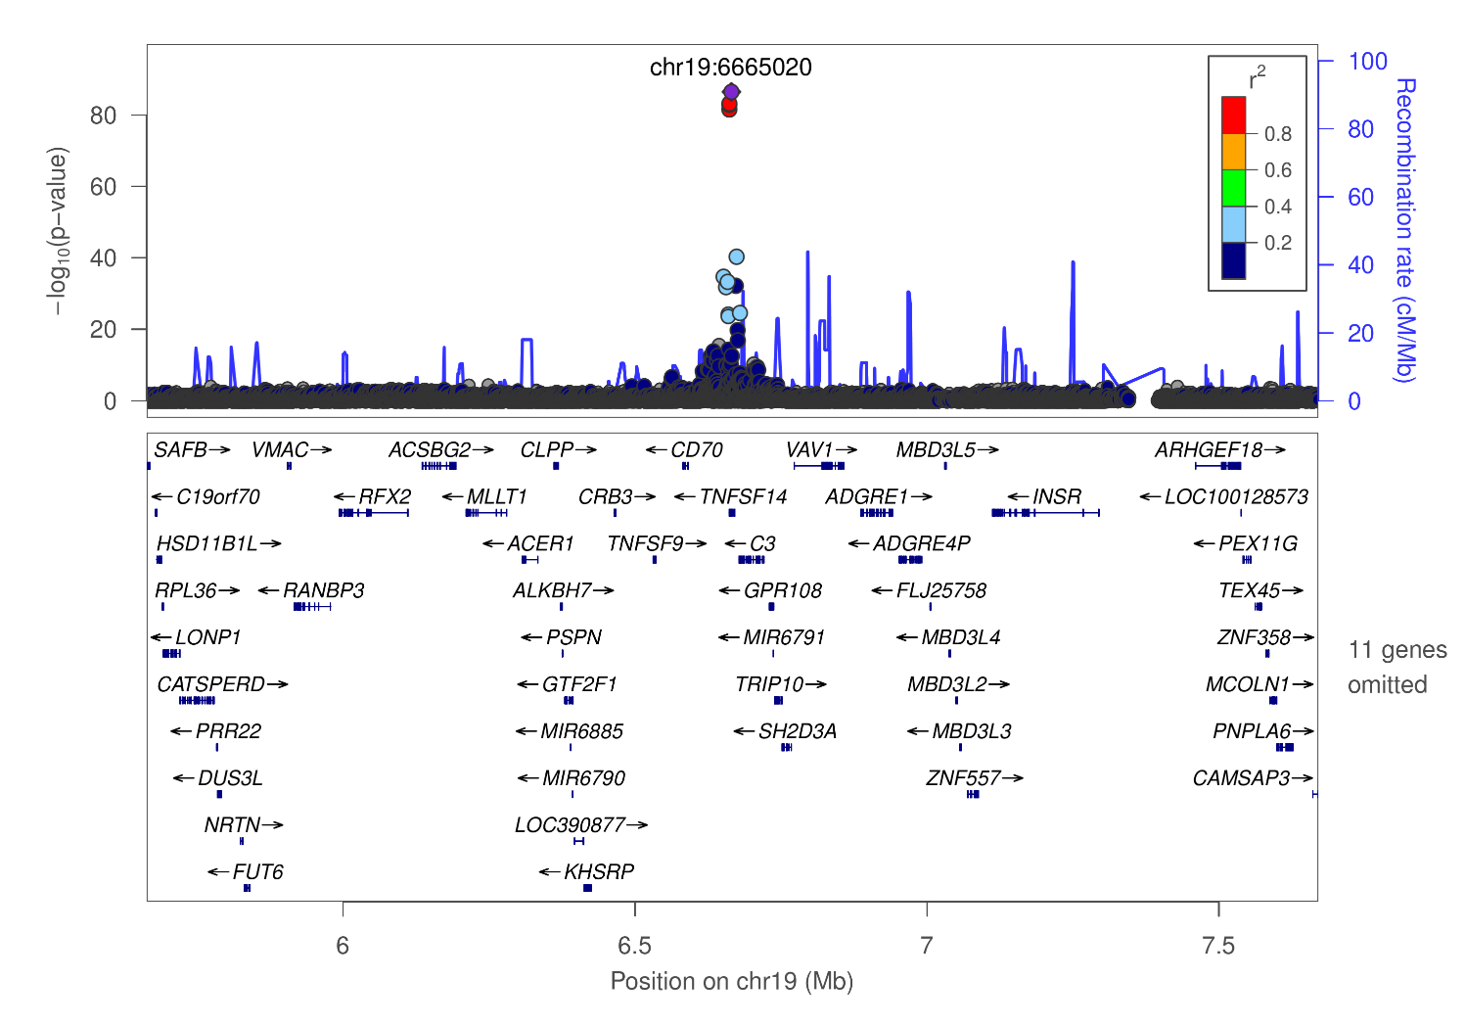
TNFSF14

Slide 9
cis/trans classification (hits/jma.cojo) results
HGNC symbol (TARGET) | cis | trans | Total
TNFRSF11B (OPG) | 196 | 0 | 196
TNFSF14 (TNFSF14) | 34 | 41 | 75
Total | 230 | 41 | 271
HGNC symbol (TARGET) | cis | trans | Total
TNFRSF11B (OPG) | 2 | 1 | 3
TNFSF14 (TNFSF14) | 4 | 9 | 13
Total | 6 | 10 | 16

Slide 10
GCTA –cojo-slct results: Allele A is associated with increasing level (p=7.0e-21)
prot | SNP | refA | freq | b | se | p | n | bJ | bJ_se | pJ
OPG | chr8:119867209_A_C | A | 0.1039 | 0.172 | 0.0277 | 5.22E-10 | 9922.26 | 0.206094 | 0.027873 | 1.42E-13
OPG | chr8:120081031_C_T | T | 0.5581 | -0.1588 | 0.0126 | 1.34E-36 | 18014.3 | -0.16752 | 0.01271 | 1.14E-39
OPG | chr17:26694861_A_G | A | 0.4748 | -0.1165 | 0.0124 | 5.98E-21 | 18469.6 | -0.1165 | 0.012429 | 7.05E-21
TNFSF14 | chr19:1227505_C_T | T | 0.0038 | 0.5254 | 0.1936 | 0.006658 | 5131.59 | 8.67037 | 0.29525 | 1.49E-189
TNFSF14 | chr19:1403959_C_G | C | 0.0396 | 0.0811 | 0.0425 | 0.05621 | 10609.6 | 0.355997 | 0.043189 | 1.68E-16
TNFSF14 | chr19:3932314_C_T | T | 0.0102 | 0.2737 | 0.1072 | 0.01071 | 6277.87 | 3.11423 | 0.137398 | 9.76E-114
TNFSF14 | chr19:6641765_C_T | T | 0.0429 | -0.474 | 0.0648 | 2.46E-13 | 4175.8 | -1.57162 | 0.077627 | 3.87E-91
TNFSF14 | chr19:6665020_C_T | T | 0.1024 | -0.5329 | 0.0269 | 3.31E-87 | 10569.4 | -0.86873 | 0.03323 | 1.18E-150
TNFSF14 | chr19:6673889_A_G | A | 0.1109 | -0.5374 | 0.0401 | 4.79E-41 | 4419.3 | -0.70832 | 0.046519 | 2.37E-52
TNFSF14 | chr19:6704670_C_T | T | 0.8479 | -0.1313 | 0.0219 | 2.10E-09 | 11751.1 | -0.25828 | 0.022198 | 2.73E-31
TNFSF14 | chr19:8094596_A_G | A | 0.0071 | 0.2025 | 0.1137 | 0.07481 | 7997.02 | 1.33156 | 0.117344 | 7.64E-30
TNFSF14 | chr19:8120283_A_G | A | 0.0025 | -0.7169 | 0.2159 | 0.000897 | 6261.49 | -13.282 | 0.43654 | 2.52E-203
TNFSF14 | chr19:13181330_A_G | A | 0.0065 | 0.2745 | 0.1308 | 0.03589 | 6594.93 | 8.86702 | 0.27947 | 6.40E-221
TNFSF14 | chr19:14165598_C_T | T | 0.0631 | 0.0871 | 0.0505 | 0.08456 | 4833.35 | 0.540685 | 0.053221 | 3.01E-24
TNFSF14 | chr19:22506594_A_G | A | 0.0021 | -0.5409 | 0.2331 | 0.0203 | 6397.97 | -9.78149 | 0.368155 | 1.55E-155
TNFSF14 | chr19:54324995_G_T | T | 0.2437 | 0.1635 | 0.0161 | 2.43E-24 | 15157 | 0.1635 | 0.016154 | 4.45E-24

Slide 11
SNP information (PhenoScanner) chr17:26694861 rs704: Kwan JS,2014, PMID25080503, allele G ~ decrease of Osteoprotegerin levels (p=1e-9).
SNP | rsID | Pos (hg19) | Alleles
chr8:119867209 | rs149577650 | chr8:119867209 | A/C
chr8:120081031 | rs2247769 | chr8:120081031 | C/T
chr17:26694861 | rs704 | chr17:26694861 | G/A
chr19:1227505 | rs7259447 | chr19:1227505 | C/T
chr19:1403959 | chr19:1403959 | chr19:1403959 | C/G
chr19:3932314 | rs149200741 | chr19:3932314 | C/T
chr19:6641765 | rs56029314 | chr19:6641765 | C/T
chr19:6665020 | rs344560 | chr19:6665020 | T/C
chr19:6673889 | rs6510917 | chr19:6673889 | A/G
chr19:6704670 | rs11085195 | chr19:6704670 | T/C
chr19:8094596 | rs142682195 | chr19:8094596 | A/G
chr19:8120283 | chr19:8120283 | chr19:8120283 | NA
chr19:13181330 | chr19:13181330 | chr19:13181330 | NA
chr19:14165598 | rs56361194 | chr19:14165598 | C/T
chr19:22506594 | rs193135521 | chr19:22506594 | A/G
chr19:54324995 | rs4632248 | chr19:54324995 | G/T

Slide 12
Points
KORA individual level data analysis will be conducted.
A couple of studies will be added.
Additional information, esp. results from PLINK as noted in SCALLOP_INF_I_analysis_plan.md at the GitHub. This should help to use full information from the cohort summary statistics.
Refined and downstream analysis, as the results shown were based on 1000Genomes extracted from LocusZoom 1.4 at tryggve.

