Slide 1
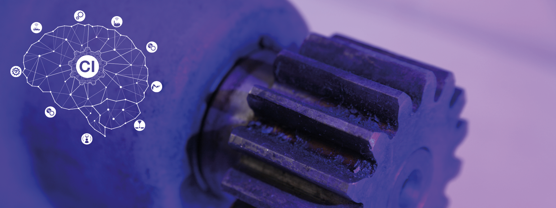
Project B: Cell classification using convolutional neural networks
Group 2

Slide 2
Team Members and Work Distribution
Team:
Abimathi Siva Subramanian 403592 (Member 1)
Anna Garoufali 405801 (Member 2)
Daria Gelbich 405860 (Member 3)
Rohan Krishna Balaji 403596 (Member 4)
Tasks:
1) Image Pre-processing – 1,2,3,4
2) Data Augmentation – 1,2,3,4
3) Training of CNN - 1,2,3,4
4) Presentation slides preparation – 1,2,3,4

Slide 3
Project Description
Aim: Classification of given images into Chondrocytes and Stem cells.
Machine learning algorithm used : Convolutional Neural Network
Initial Configuration
Image Pre-processing: Gray scale
Data Augmentation : Flipped Images
Architecture : LeNet-5
Result: Accuracy with / without Data Augmentation
**G. C. Lee, K. Haung, C. Sun and Y. Liao, "Stem cell detection based on Convolutional Neural Network via third harmonic generation microscopy images,"
Final configuration
Image Pre-processing : Gray scale
Data Augmentation : Flipped Images
Architecture : Architecture from research paper**

Slide 4
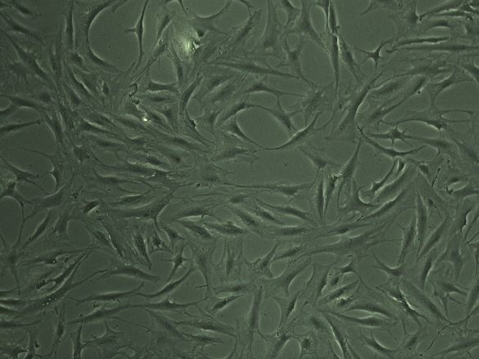
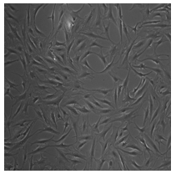
Image Preprocessing
Conversion of the image from image format to an array
Resizing of image to reduce number of pixels from 2560 x 1920 to 32 x 32 pixels
Conversion to Grayscale
Normalization of the grayscale value
Original Image
Preprocessed Image

Slide 5
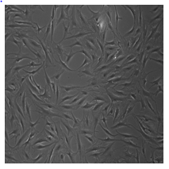
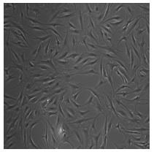
Data Augmentation
Purpose: Increase the amount of training data and the diversity of the image.
Method used : Flipped Images
Horizontal Flipped Image
Original Image
Vertical Flipped Image

Slide 6
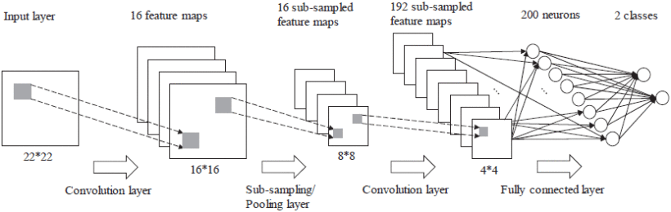
Implementation of a convolutional neural network for classification
Layer 1: Convolution layer
Kernel size = (7,7) , Stride = (1,1)
Layer 2: Max Pooling Layer
Pool size = (2,2) , Stride = 2
Layer 3: Convolution layer
Kernel size = (5,5) , Stride = (1,1)
Layer 4: Flattened Layer
Layer 5: Dense Fully Connected hidden layer
Number of neurons = 200, activation= ReLU
Layer 6: Output layer
Number of neurons = 1, activation = Sigmoid
G. C. Lee, K. Haung, C. Sun and Y. Liao, "Stem cell detection based on
Convolutional Neural Network via third harmonic generation microscopy images,"

Slide 7
Results
Metrics | LeNet-5 Without Data Augmentation | LeNet-5 With Data Augmentation | Optimized model without Data Augmentation | Optimized model with Data Augmentation
Training loss | 0.0043 | 2.6820e-06 | 0.0124 | 0.1651
Validation Loss | 0.3029 | 0.5089 | 0.7353 | 0.1537
Training accuracy | 1.0 | 1.0 | 1.0 | 0.9407
Validation accuracy | 0.907 | 0.929 | 0.907 | 0.9685

Slide 8
Results
LeNet-5 Without Data Augmentation | LeNet-5 with Data Augmentation | Optimized model without Data Augmentation | Optimized model with Data Augmentation
1 | 1 | 1 | 1
1 | 1 | 1 | 1
0 | 1 | 0 | 1
1 | 1 | 1 | 1
0 | 0 | 0 | 0
0 | 0 | 0 | 0
0 | 1 | 0 | 1
1 | 1 | 1 | 1
1 | 0 | 1 | 0
1 | 1 | 1 | 1
Chondrocytes = 1
Stem cells = 0

Slide 9
Discussion/Conclusion
Data Augmentation has significant influence in the accuracy of the model.
The number of fully connected layer does not influence greatly the performance of the model .
We can classify the image into Chondrocytes and Stem cells with an accuracy of 96.85% using the optimized model.

Slide 10
.
Thank You
.

