Slide 1

A brief introduction to Python & Anaconda
Jiayue Han
jyhan5-c@ad.cityu.edu.hk
School of Data Science

Slide 2
What is Python?

Slide 3

Python is a programming language.

Slide 4
Life is short, you need Python. ------Bruce Eckel

Slide 5
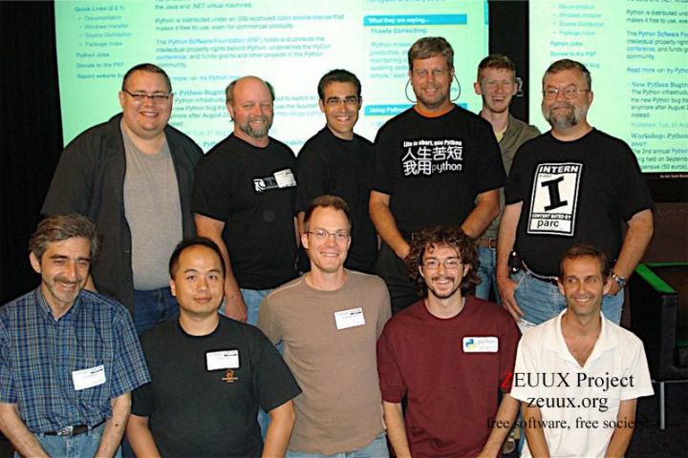
Guido van Rossum, father of python

Slide 6
Why Python?
Not C, C++, Java, PHP, R……

Slide 7
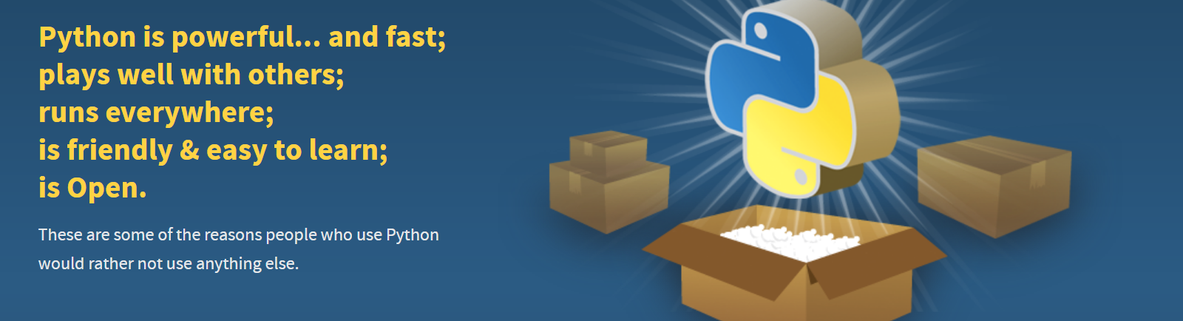
Everything is already packed up for you!
https://www.python.org/about/

Slide 8

Anaconda is the standard platform for
Python data science

Slide 9
Why Anaconda?

Slide 10
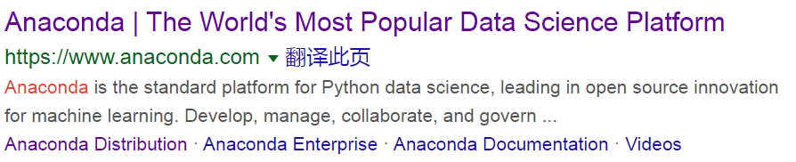

Slide 11
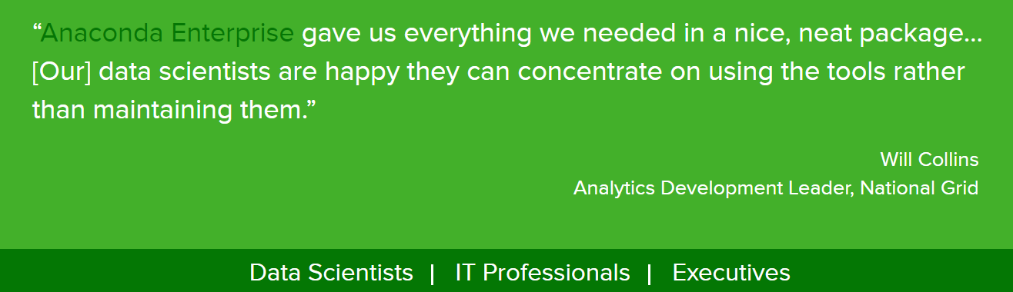
https://www.anaconda.com/why-anaconda/
Enough for beginners and support various operation system

Slide 12
Download & Install
For Windows & Mac os

Slide 13

For those using Linux, please install it yourself……
Installing Anaconda is much more easier than installing Linux☺

Slide 14

Go to https://www.anaconda.com/.

Slide 15
Click ‘Download’.

Slide 16
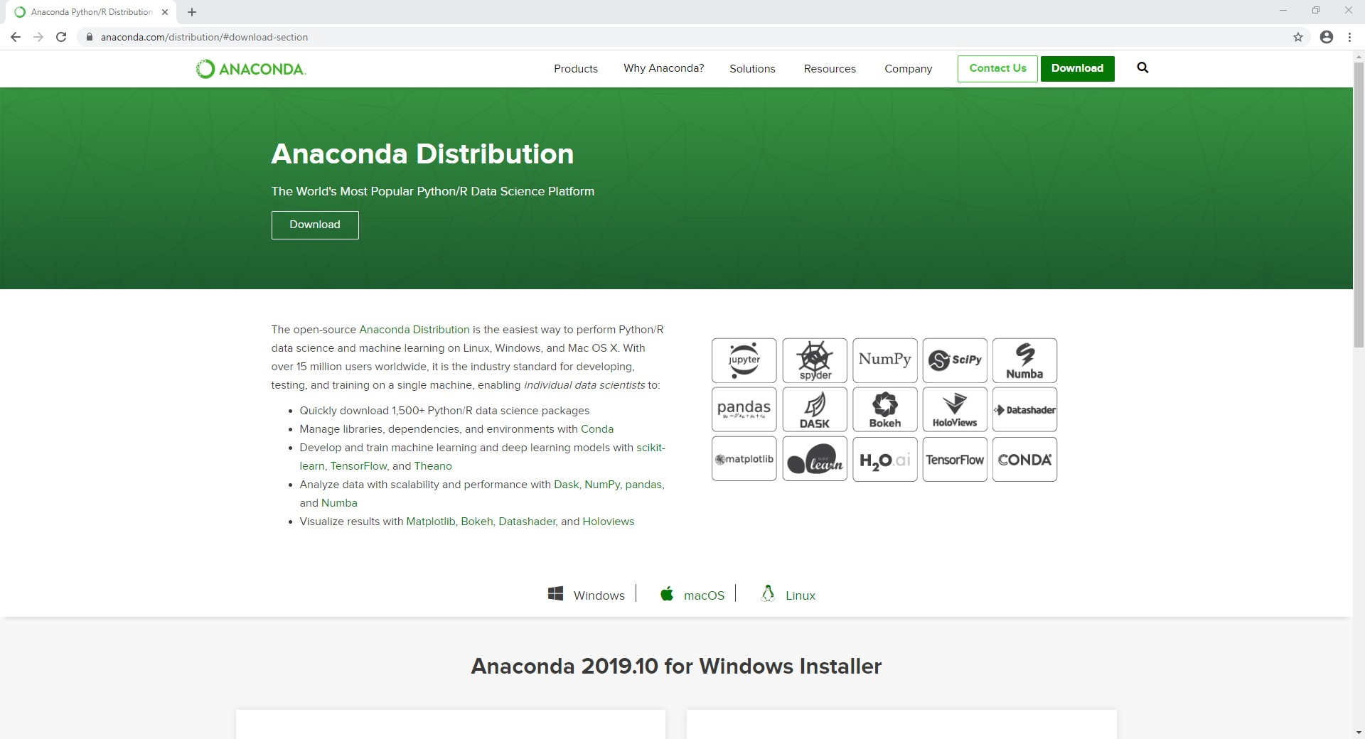
Click ‘Download’.

Slide 17
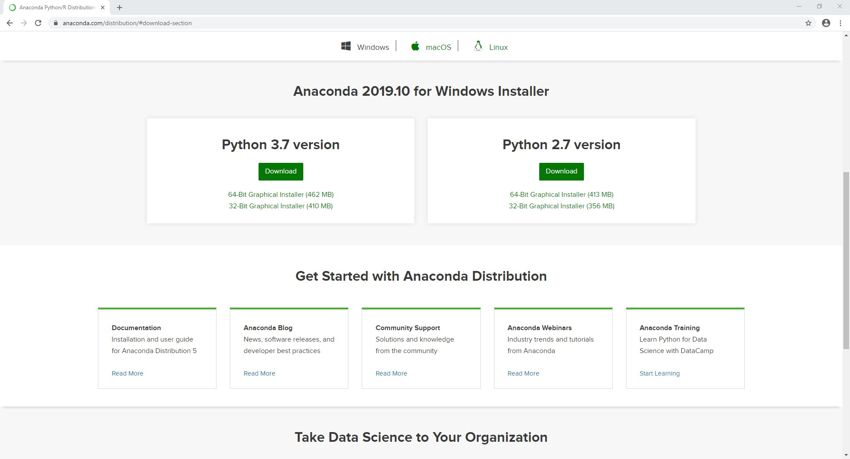
Choose your operation system
Click ‘Download’
Download ‘Python 3.7 version’.

Slide 18
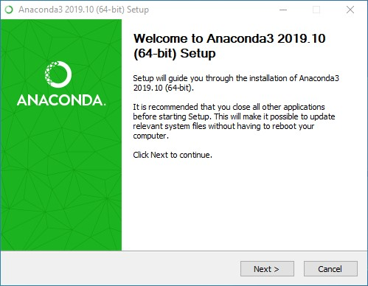
Click ‘Next’
Run the installation package.

Slide 19
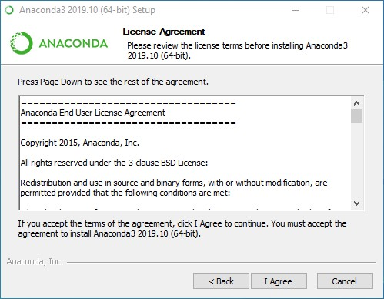
Click ‘I Agree’
Continue the installation.

Slide 20
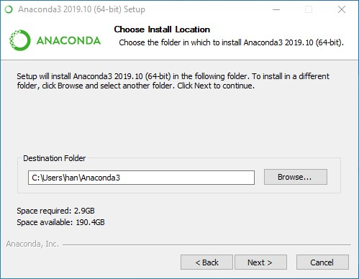
Choose your install location
Click ‘Next’
Continue the installation.

Slide 21
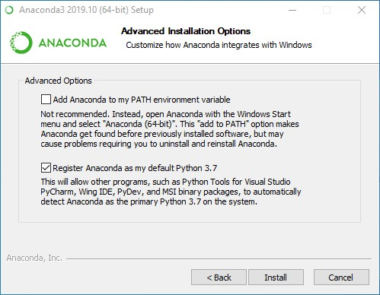
Click ‘Install’
Continue the installation.

Slide 22
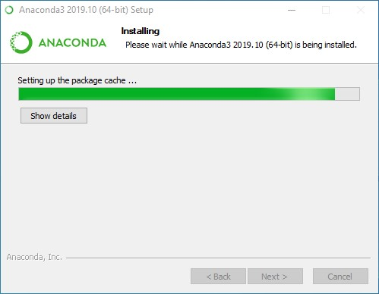
Wait for a few seconds.

Slide 23
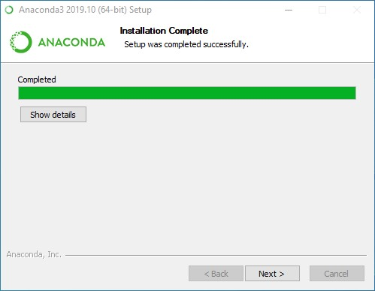
Click ‘Next’
Continue when the installation is complete.

Slide 24
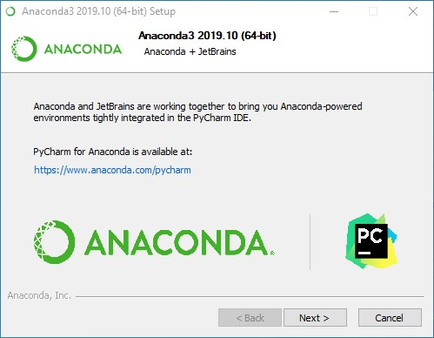
Click ‘Next’
Continue the installation.

Slide 25
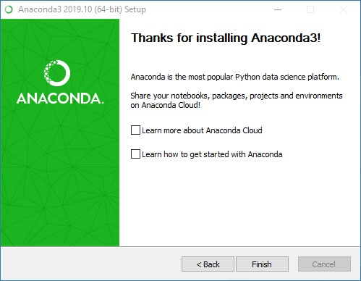
Click ‘Finish’
No ticking off
Complete the installation.

Slide 26
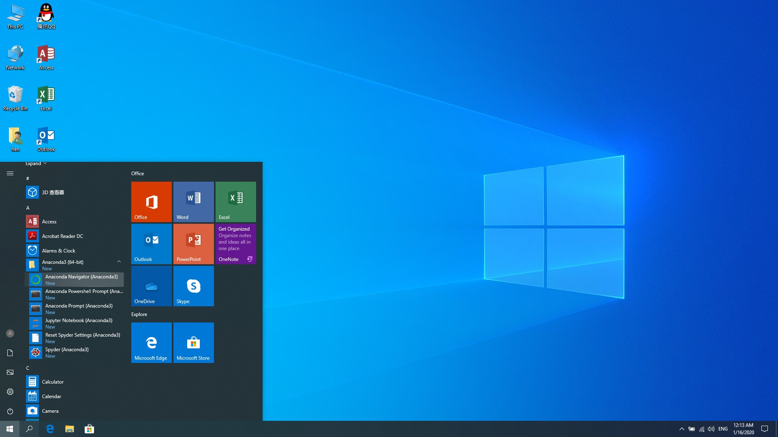
Find ‘Anaconda Navigator (Anaconda3)’ in your applications.

Slide 27
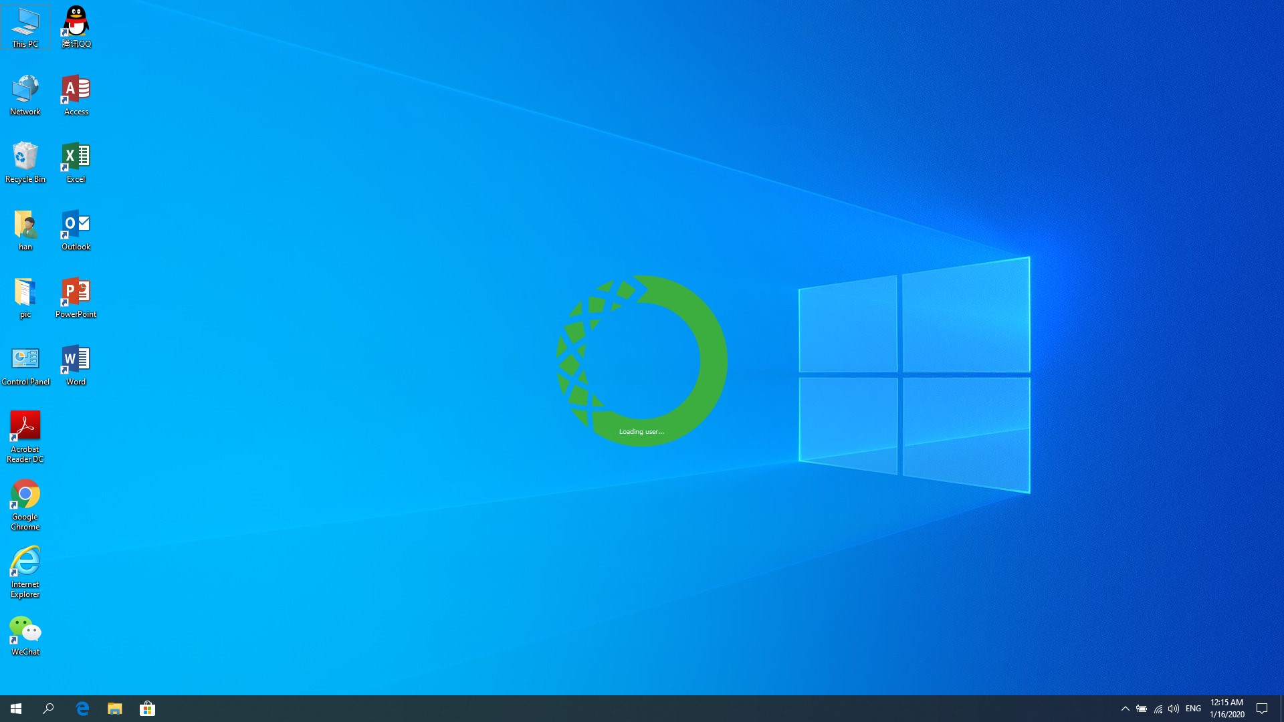
Run it.

Slide 28
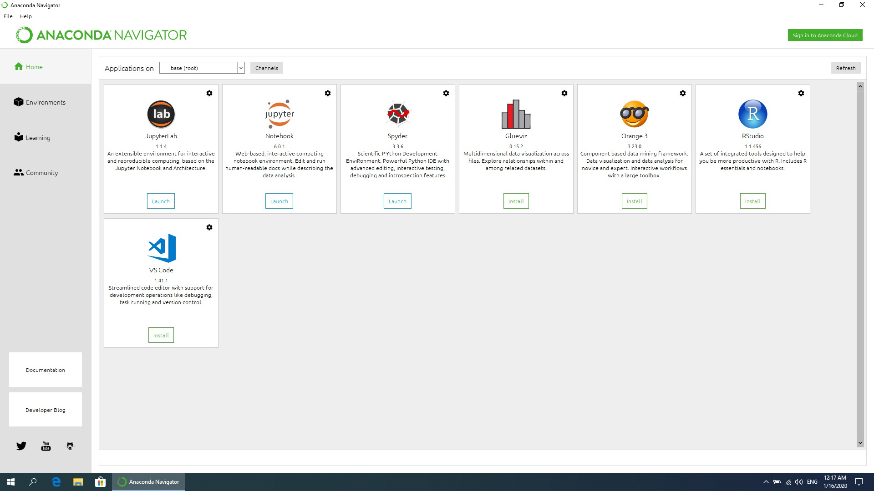
Congratulation, you’ve successfully installed Anaconda!

Slide 29
Let’s try writing some short commands using Python

Slide 30
These are the compilers of python.

Slide 31
Try lunching ‘JupyterLab’.

Slide 32
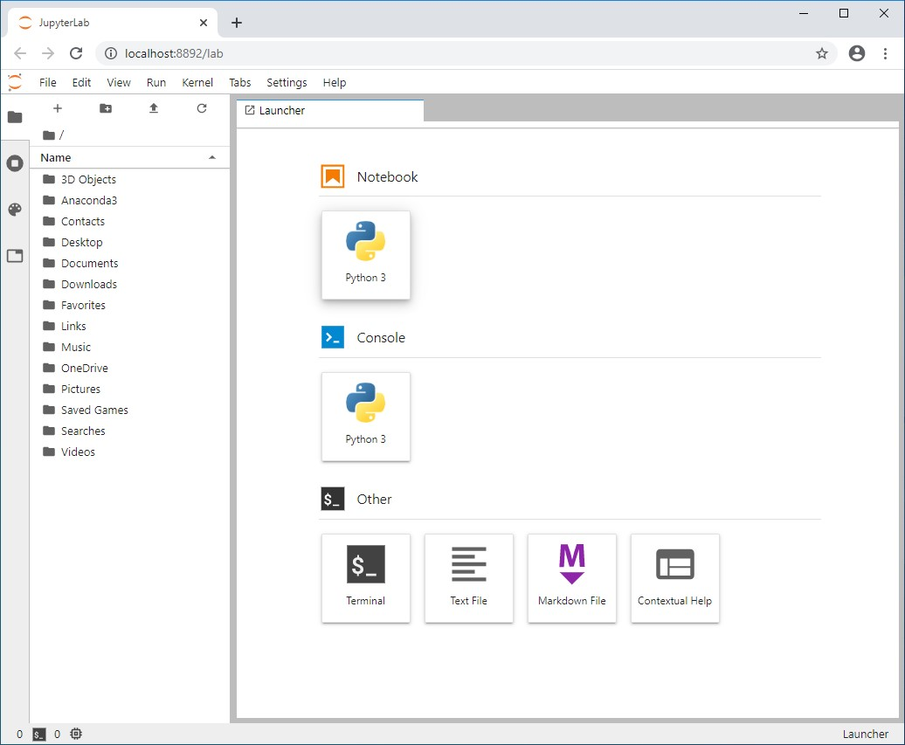
Click ‘Python3’ in ‘Notebook’.

Slide 33
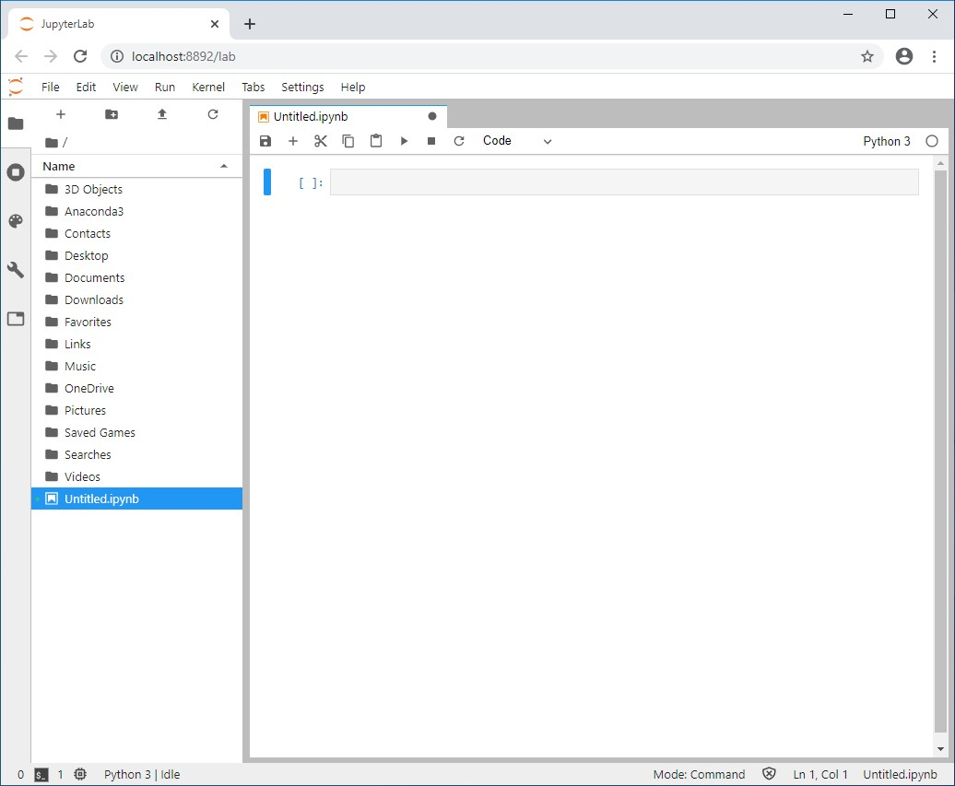
Here is where you enter your commands.

Slide 34

Try to enter something.

Slide 35
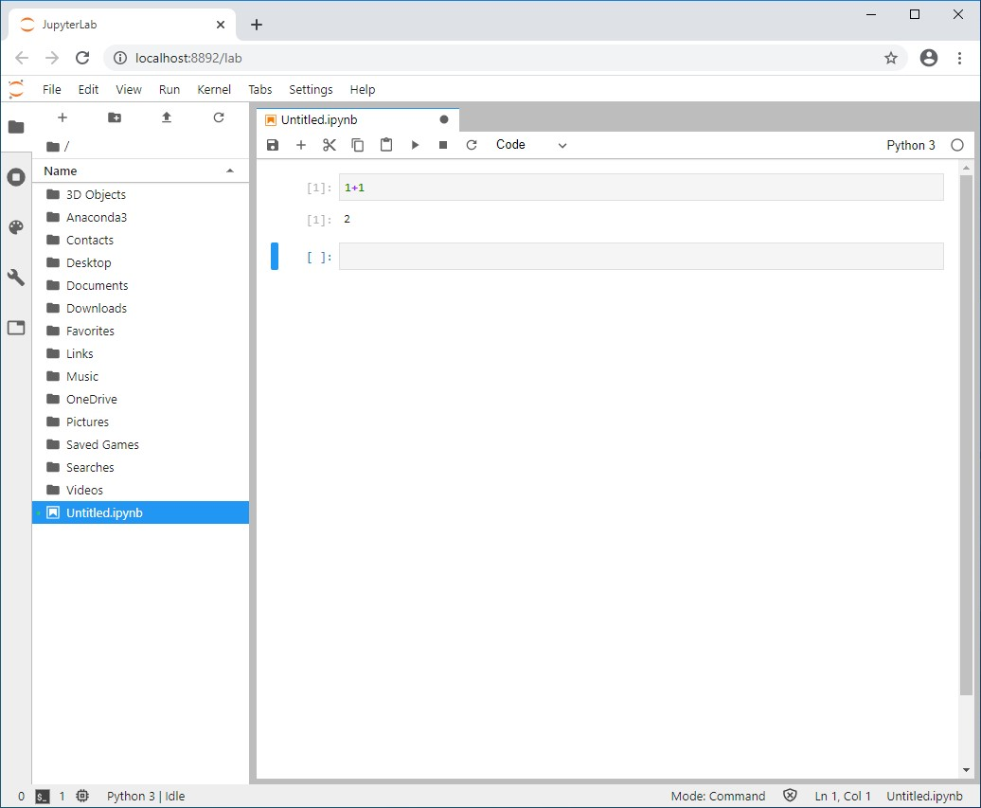
Press ‘Shift+Enter’ to run it.

Slide 36
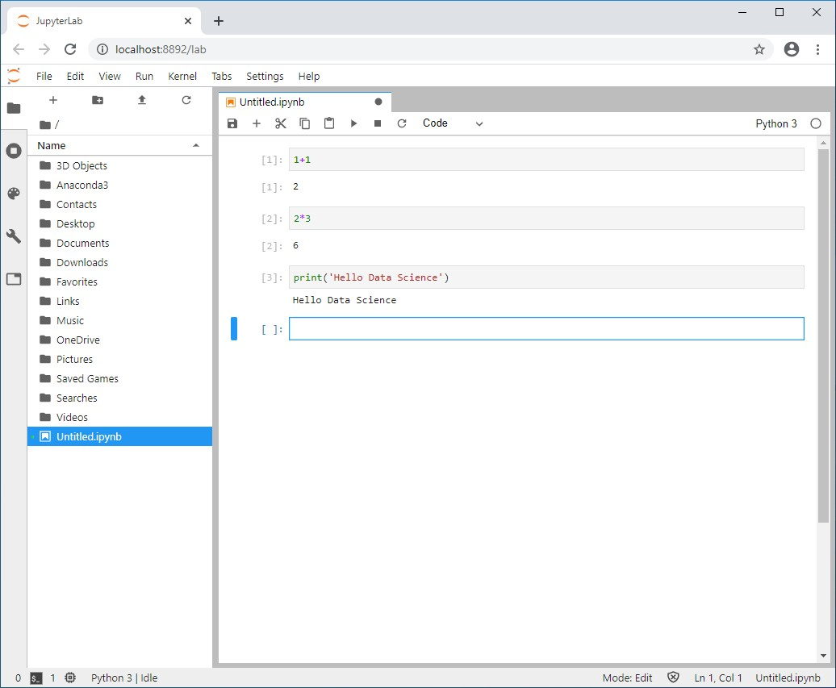
Try something else.

Slide 37
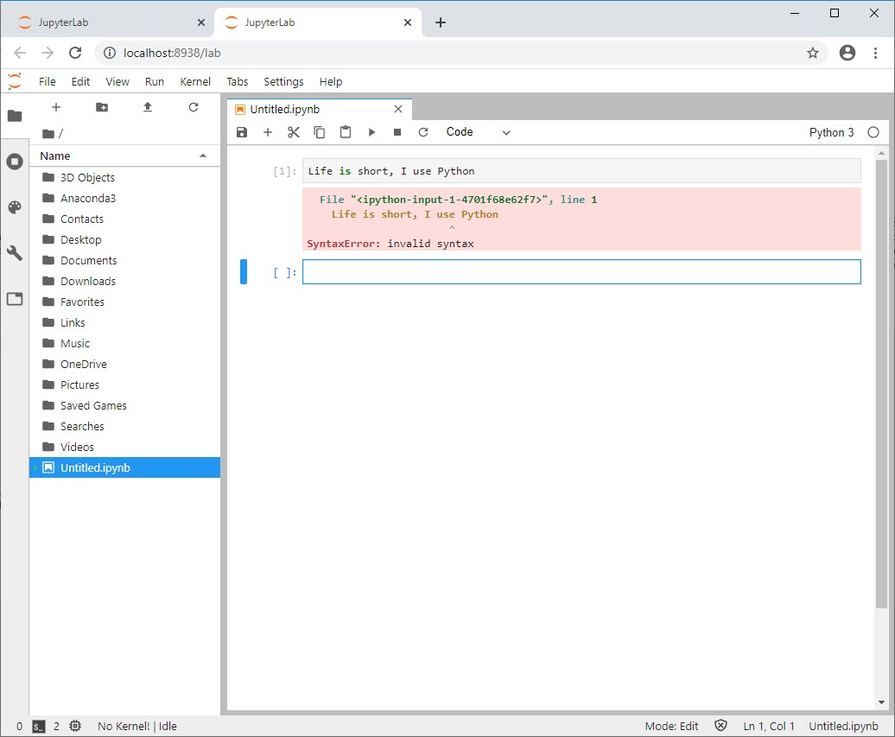
An error
But not everything will do.

Slide 38
An error
The commands you enter should obey Python syntax.

Slide 39
We will introduce Python syntax next time

Slide 40
Thank you!

Slide 41
If you have any question, feel free to send me an e-mail, my e-mail address is:
jyhan5-c@ad.cityu.edu.hk

