Slide 1
MTA Turnstile: Exploratory Data Analysis
Allison, Andrea, Anna

Slide 2
Objective
Optimize placement of street team to maximize outreach for the WomenTechWomenYes (WTWY) gala
Use MTA turnstile data to recommend stations the street team should target

Slide 3
Methodology
Metropolitan Transportation Authority Turnstile data
4 weeks of data (August 24th through September 20th)
Cleaned data
Grouped at station level

Slide 4
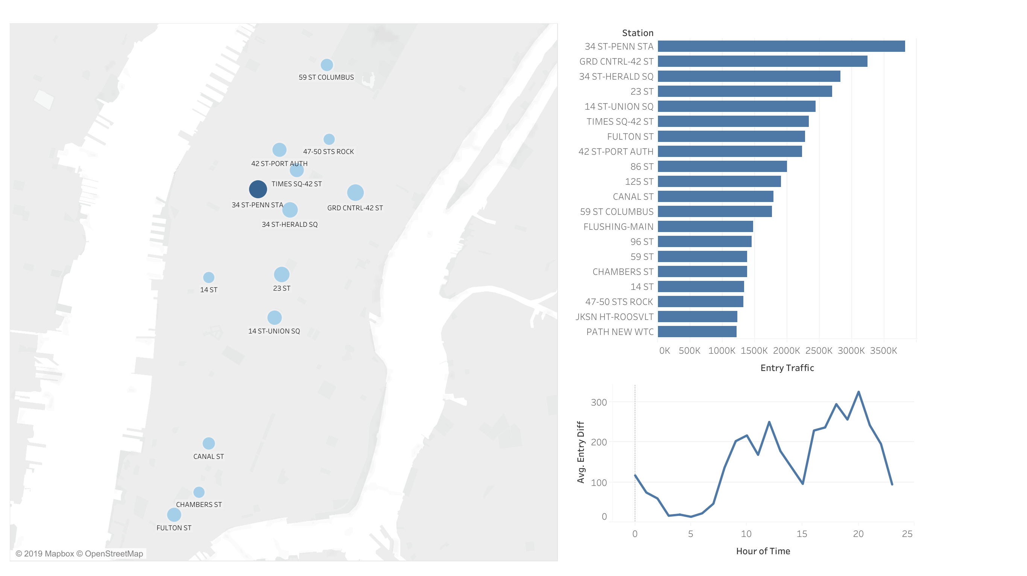
Results: Top Stations

Slide 5
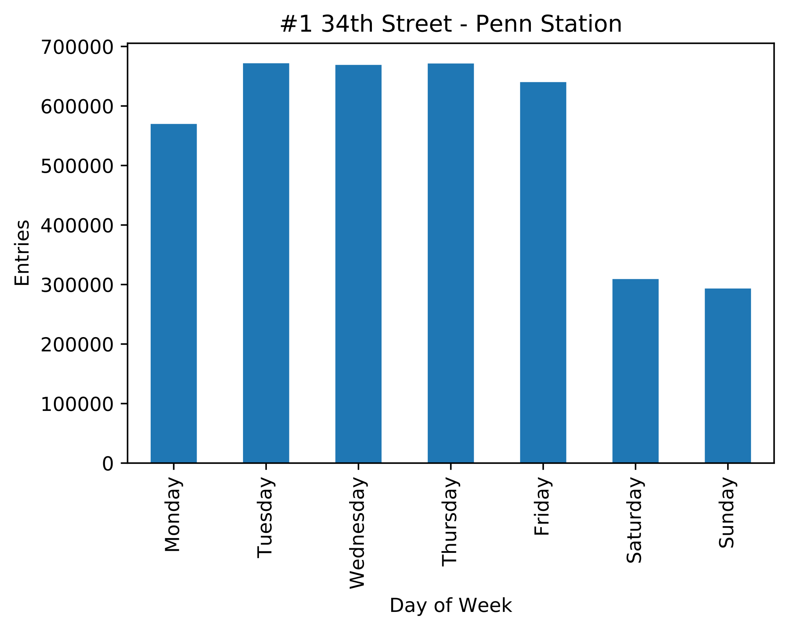
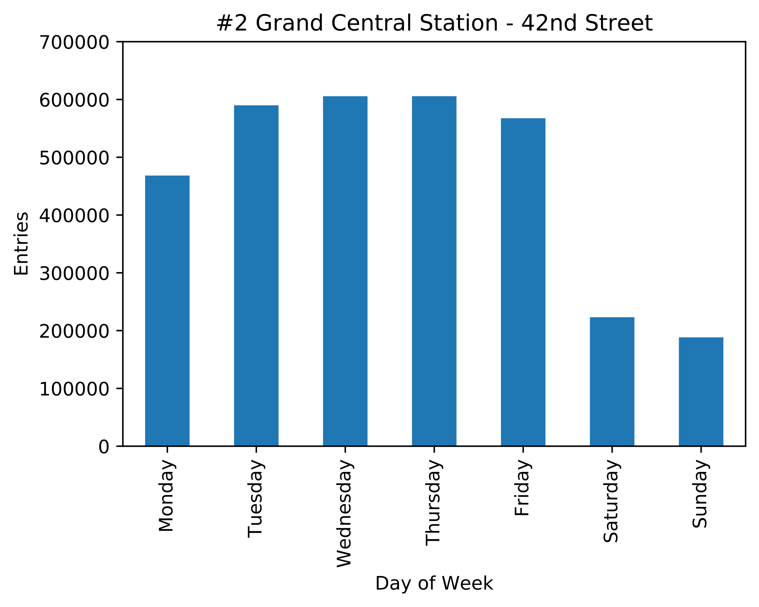
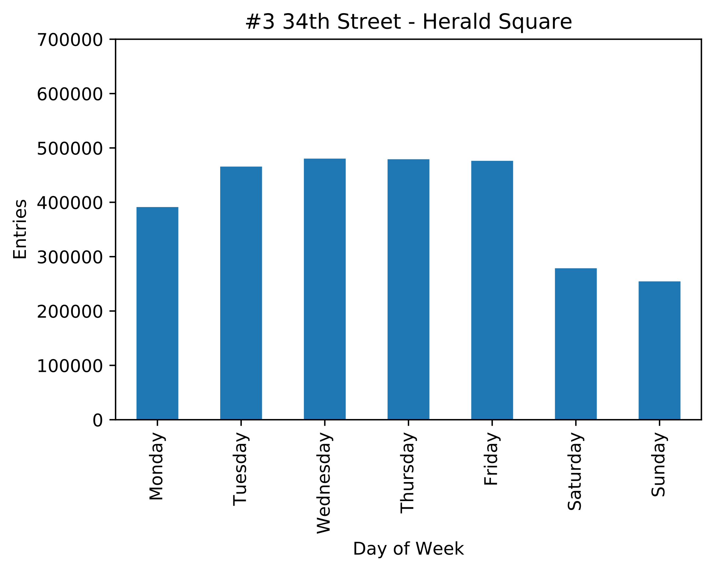
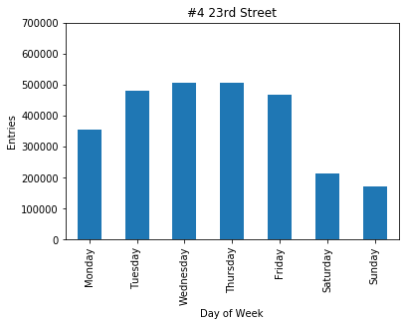
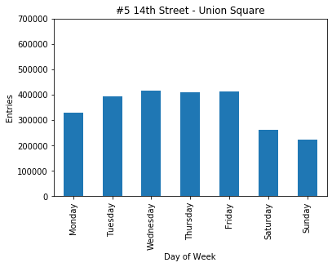
Results: By Day of Week
Higher number of entries during weekdays, particularly for Tuesday through Friday

Slide 6
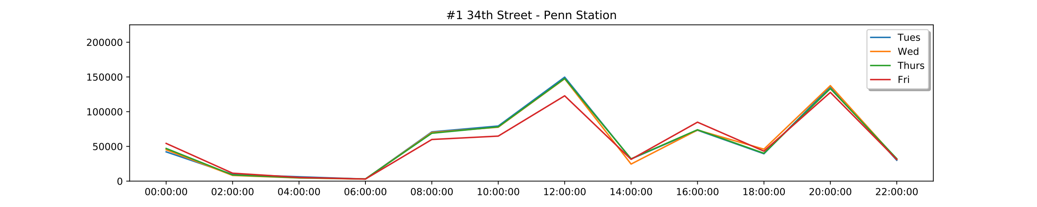
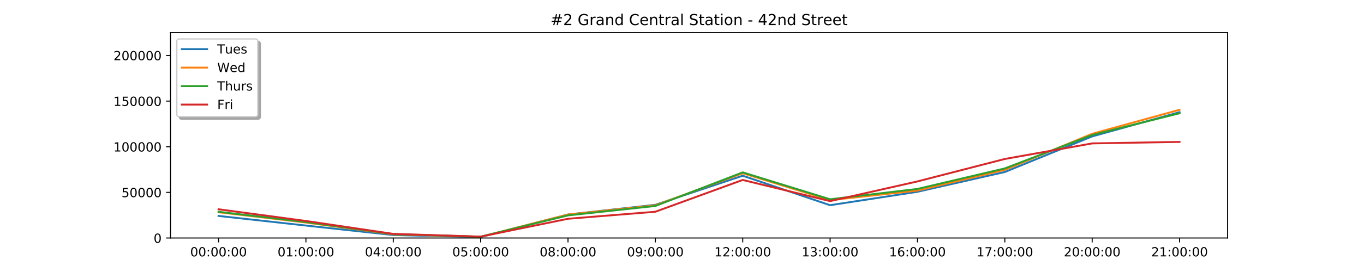
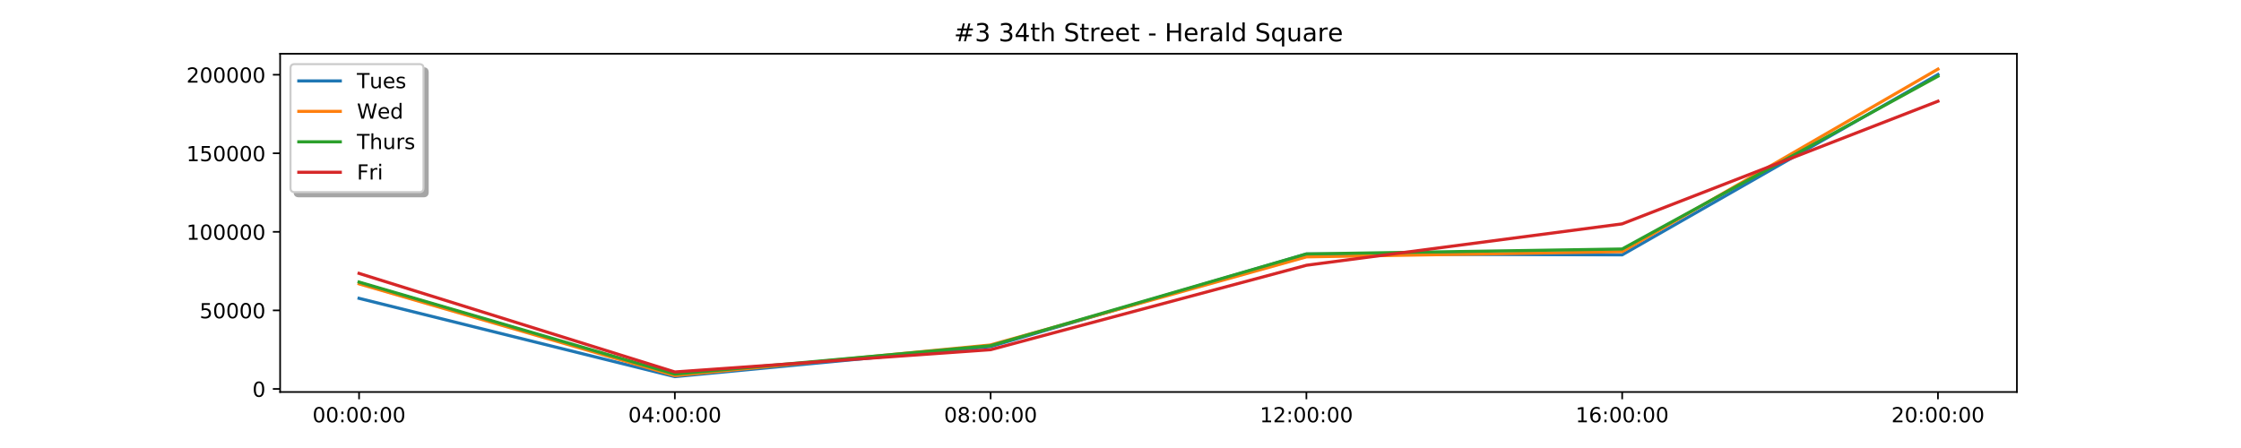
Results: By Time of Day

Slide 7
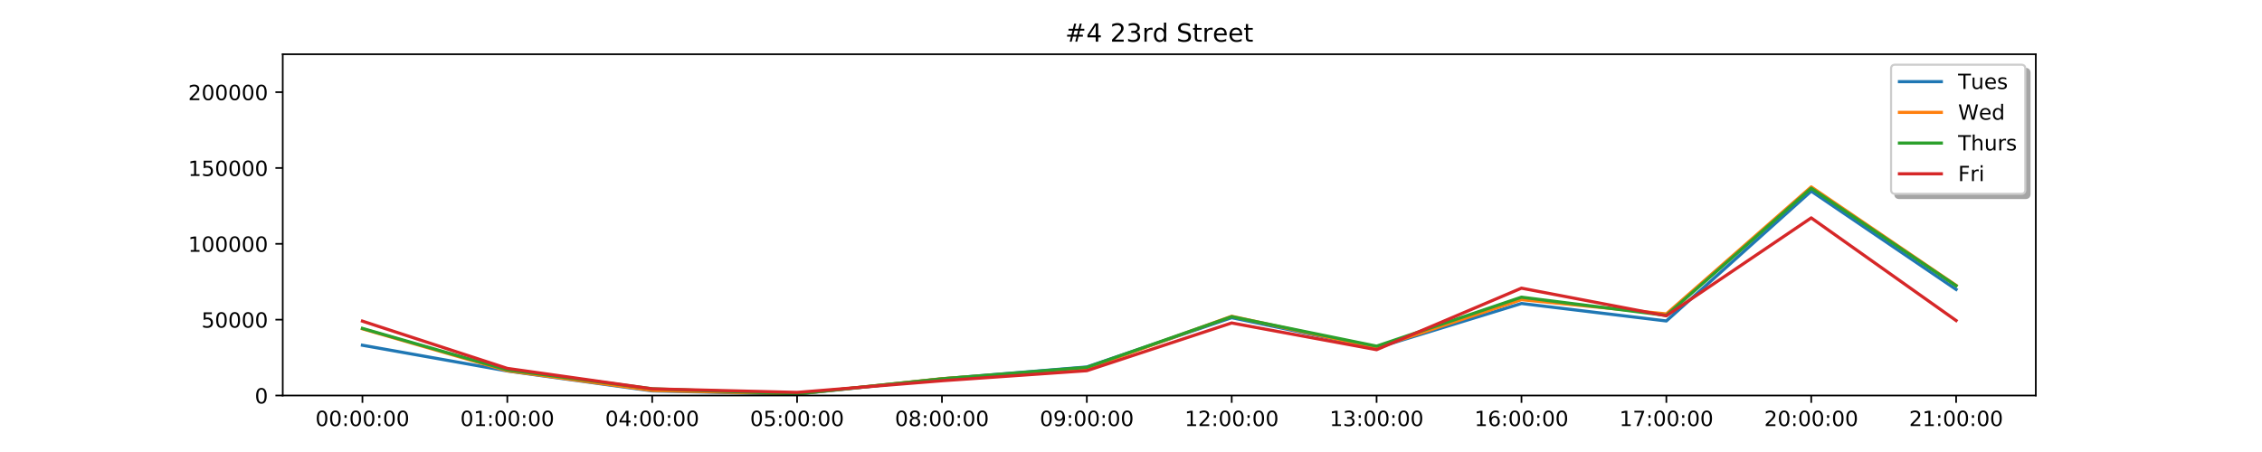
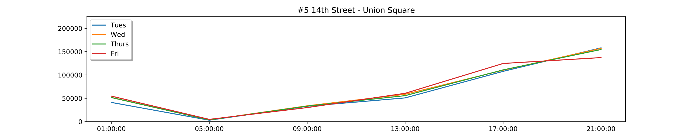
Results: By Time of Day

Slide 8
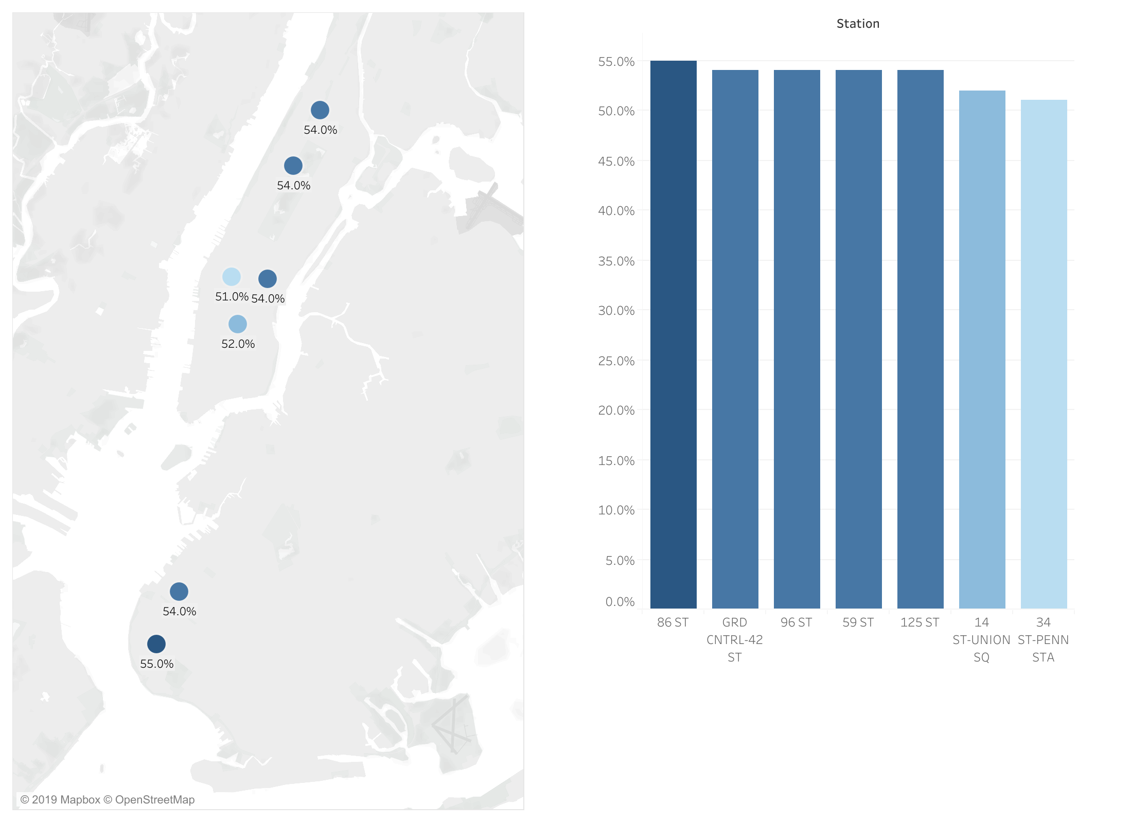
Demographic Information

Slide 9
Conclusions
Recommend targeting the top five stations during evening rush hour

Slide 10
Potential Future Enhancements
Target areas near:
Universities
Tech companies
Higher income areas
Target working professionals versus high tourism areas

