Slide 1
Introductory hands-on speech on Bayesian inference
Anna Bellido
Data Scientist, Netquest
Barcelona Data Science and Machine Learning Meetup

Slide 2
Bayesian paradigm VS Frequentist paradigm
Frequentist
Probability = frequency of the event we want to measure in an infinite sequence of observations
Parameter = fixed value we want to find from a random sample
Bayesian
Probability = subjective assignment of a coeficient in [0, 1] to the event, based on previous knowledge or experience
Parameter = random variable (with a probability density), we learn about through experimentation

Slide 3
Bayesian learning path
¿Event X?
What we know
about X
Experimentation with X
We update what we know about X

Slide 4
Bayesian learning path: iterative process
Previous knowledge
Experimentation with X
Updated knowledge
Previous knowledge
Experimentation with X
Updated knowledge
…

Slide 5
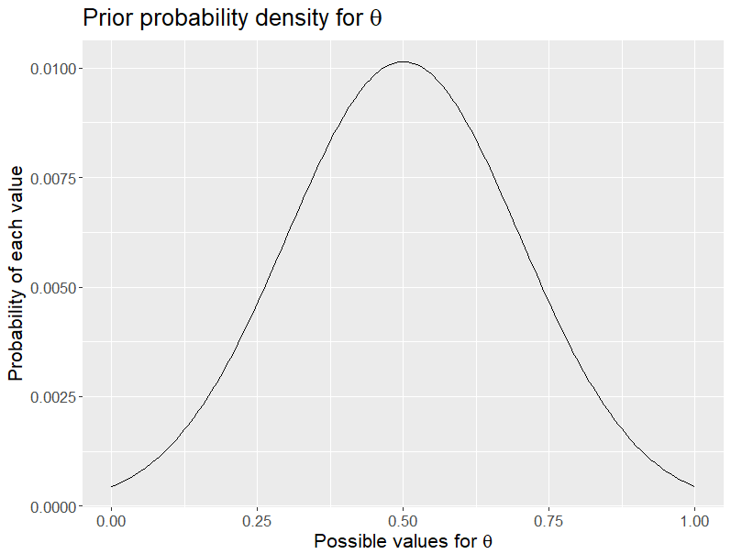

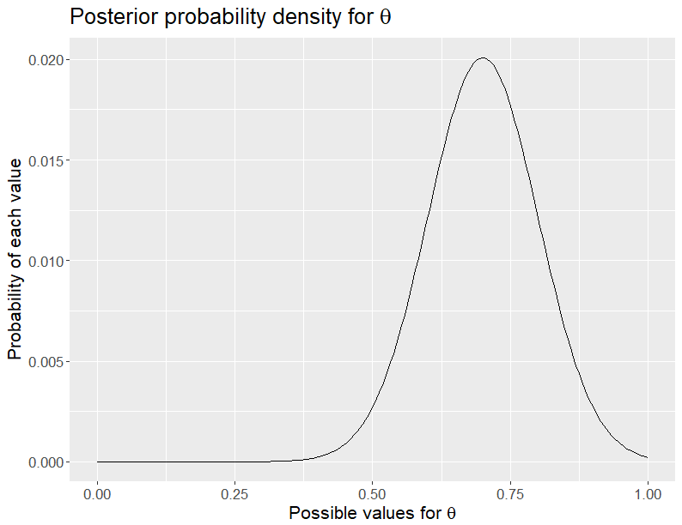
Bayesian learning path: coin toss
What we know about θ
We update what we know about θ
Toss the coin once

Slide 6
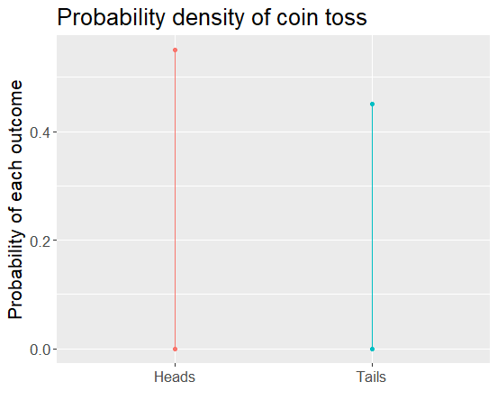
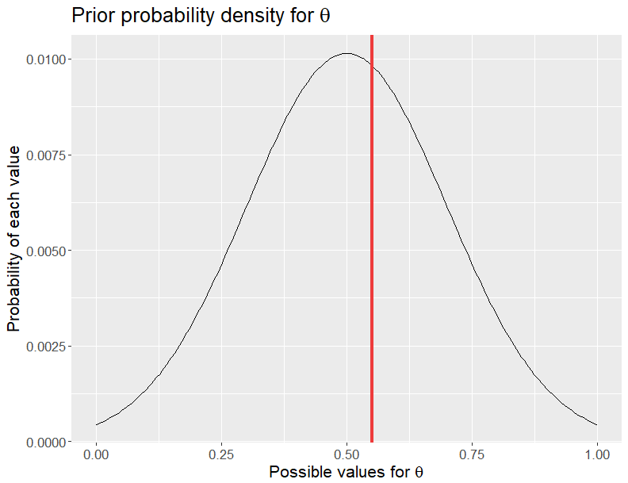
Bayesian learning path: coin toss
What we know about θ

Slide 7
Bayesian learning path: coin toss
What we know about θ
We update what we know about θ
Toss the coin once

Slide 8
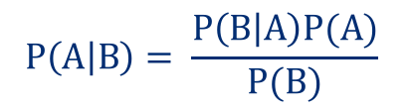
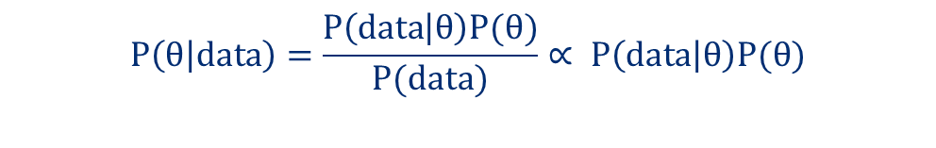
BAYES theorem: from experimentation to posterior
Explicit formula (from conditional probability):
$$P\left(A | B\right)= \frac{P\left(B | A\right)P(A)}{P(B)}$$
Bring it to our coin toss example:
$$P\left(θ | data\right)=\frac{P\left(data | θ\right)P(θ)}{P(data)}∝ P\left(data | θ\right)P(θ)$$

Slide 9
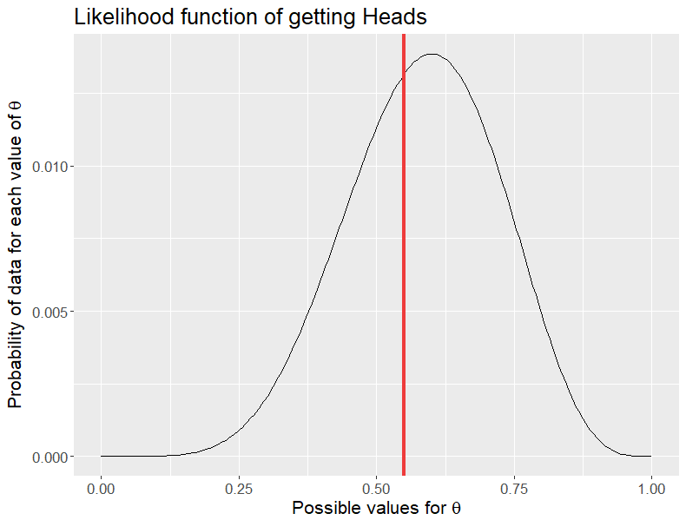
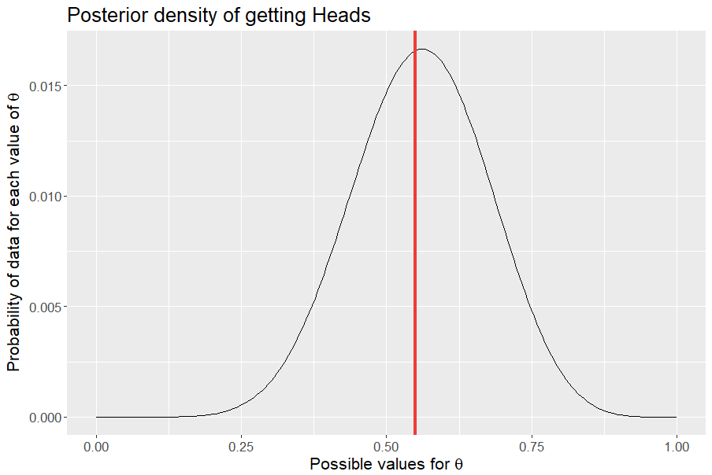


BAYES theorem: from experimentation to posterior
Bring it to our coin toss example:
$P\left(data | θ\right)P(θ)$ $∝P\left(θ | data\right)$
X
$$∝$$

Slide 10
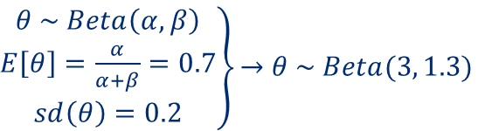

BAYES theorem: from experimentation to posterior
Likelihood function (n coin tosses):
$$P\left(data=y | θ\right)=B\left(n,θ\right)={\left(\begin{matrix}n \\ y\end{matrix}\right)θ}^{y}{(1−θ)}^{n−y},\begin{matrix} coin tosses=\left\{x_{1},…,x_{n}\right\} \\ y=\#Heads\end{matrix}$$
Prior distribution:
$\left.\begin{matrix}θ \sim Beta\left(α,β\right) \\ E\left[θ\right]=\frac{α}{α+β}=0.7 \\ sd\left(θ\right)=0.2\end{matrix}\right\}\underset{→}{}$ $θ \sim Beta(3, 1.3)$
Final expression:
$$P\left(θ | data\right) α B\left(n,θ\right) Beta(3, 1.3)$$

Slide 11
Coin toss example in R
Let’s go to RStudio!
From the posterior distribution, we can be the estimator which best fits our needs and understand the behaviour of the event under study

Slide 12
Getting the posterior distribution…
Not easy to compute the posterior distribution analitically
Some popular sampling methods (based on MCMC):
Gibbs sampler
Metropolis-Hastings
Hamiltonian Markov Chain
Each parameter value is sampled proportionally to its posterior probability

Slide 13
What’s Stan?
Probability programming language thought for Bayesian analysis
Works over: R (rstan), Python, Julia, Matlab, Mathematica, Stata…
Allows to define the model and compute the posterior distribution (using HMC)
likelihood functions for our data
priors for our parameters

Slide 14

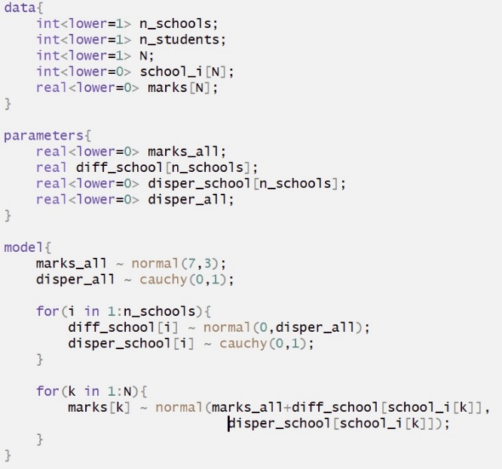
Stan blocks
Three most basic blocks:
data: data sent from R to Stan
parameters: bucket for Stan to fill in and send back to R (posterior distributions)
model: definition of likelihood and prior functions

Slide 15

Stan: first example
Linear regression:
distance related linearly to speed
$$distance= α+β speed+ε$$
$$ε \sim N(0, σ)$$
Let’s go to Rstudio!

Slide 16
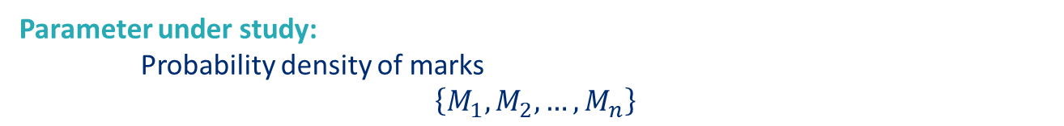
Hierarchical models
Parameter under study:
Probability density of marks
$$\left\{M_{1},M_{2},…,M_{n}\right\}$$
Design for our model:
schools marks: different school distributions
student marks: within each school

Slide 17
Hierarchical models: likelihood functions
Global population of marks
Marks in school 1
Marks in school 2
Marks in school 3
Marks in school 4
Marks in school 5
M₁
…
M_{n1}
M_{n1+1}
…
M_{n2}
M_{n2+1}
…
M_{n3}
M_{n3+1}
…
M_{n4}
M_{n4+1}
…
M_{n}

Slide 18
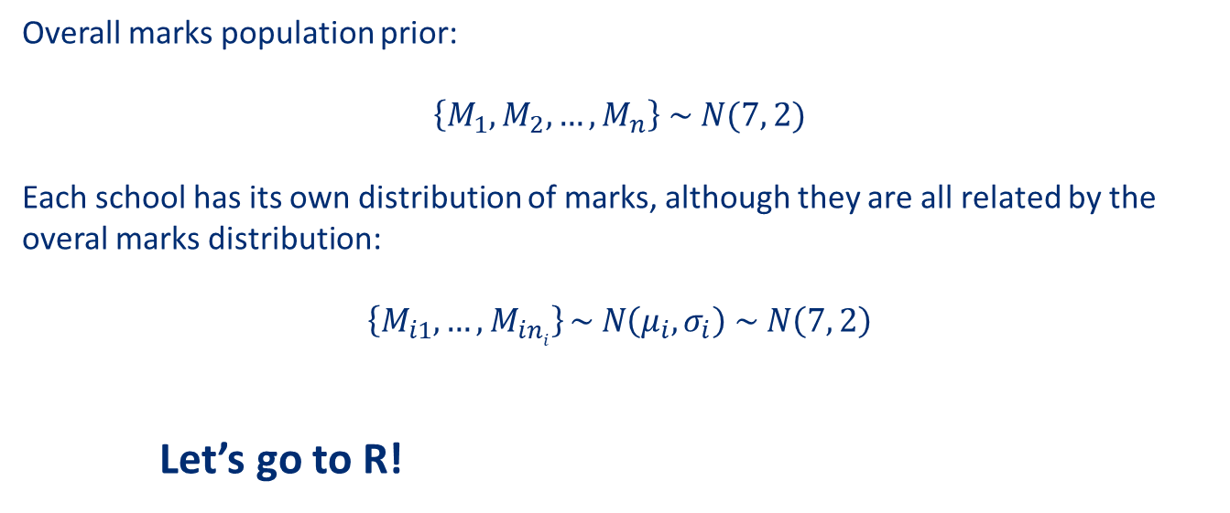
Hierarchical models: giving priors
Overall marks population prior:
$$\left\{M_{1},M_{2},…,M_{n}\right\} \sim N(7, 2)$$
Each school has its own distribution of marks, although they are all related by the overal marks distribution:
$$\left\{M_{i1}, …,M_{ini}\right\} \sim N\left(μ_{i},σ_{i}\right) \sim N\left(7, 2\right)$$
Let’s go to R!

Slide 19
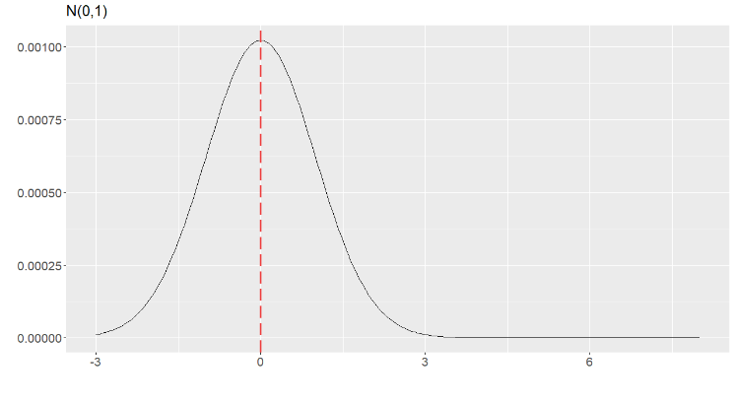
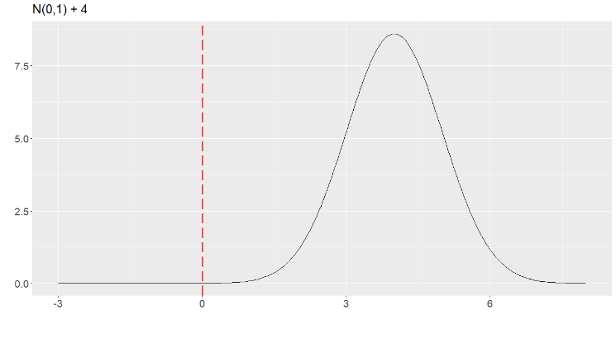
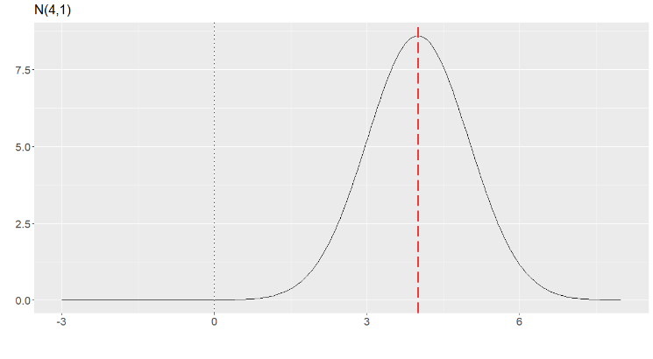
Hierarchical models
Property of the normal distribution: $N\left(μ, σ\right) \sim μ+ N\left(0, σ\right)$

Slide 20
Hierarchical models
We can model fixed effects and random effects (eg: each student may have an individual tendency to get a range of marks)
Marks of schools are pooled towards the general population of marks:
shrinkage effect
If we have few observations in a leaf, the other leafs compensate for that
It can deal with very unbalanced data sets.
Compensates for lack of observations by making assumptions
It can even run with fewer observations than parameters!
Informative priors

Slide 21
Overview of the speech
Main theoretical differences between Bayesian and Frequentist paradigms
Iterative process of knowledge acquisition
Stan and probability samplers
Basic example
Hierarchical methods
Marks model example
Most priors were N(μ,σ) for simplicity reasons, but any probability density is possible!

Slide 22
Thanks!
Any questions?
Anna Bellido
Data Scientist, Netquest
Barcelona Data Science and Machine Learning Meetup

Slide 23


Binomial distribution
If we have a dicotomous event, we can model it with a Bernoulli distribution:
$P\left(data=x | θ\right)=Ber\left(θ\right)=θ^{x}{(1−θ)}^{1−x}, x∈\{0, 1\}$
Thefore, the probability of observing the event is:
$$P\left(data=1 | θ\right)= θ$$
And the probability of not observing it must be:
$$P\left(data=0 | θ\right)=1 − θ$$

Slide 24
Binomial distribution
If we want to model the probability of finding y ocurrences of that dicotomous event over n observations in a given order (sequence):
$P\left(data=sequence | θ\right)=θ^{y}{(1−θ)}^{n−y}, y∈\{0, n\}$
But if we don’t care about the order, we’ll have to add up the probabilities of all the possible sequences with y occurrences of our event. Those probabilities are the same (product is commutative), so we only need to know how many sequences there are

Slide 25
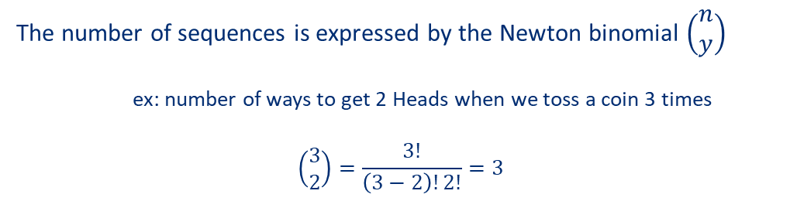
Binomial distribution
The number of sequences is expressed by the Newton binomial $\left(\begin{matrix}n \\ y\end{matrix}\right)$
ex: number of ways to get 2 Heads when we toss a coin 3 times
$$\left(\begin{matrix}3 \\ 2\end{matrix}\right)=\frac{3!}{\left(3−2\right)!2!}=3$$
Sequence 1: H H T
Sequence 2: H T H
Sequence 3: T H H
So, the probability of finding 2 Heads among 3 coin tosses would be:
$P\left(data=2 | θ\right)=B\left(3,θ\right)={\left(\begin{matrix}3 \\ 2\end{matrix}\right)θ}^{2}{(1−θ)}^{3−2}=3{ θ}^{2}$ $(1−θ)$

Slide 26
Binomial distribution
That results in the formula for the Binomial distribution:
$$P\left(data=y | θ\right)=B\left(n,θ\right)={\left(\begin{matrix}n \\ y\end{matrix}\right)θ}^{y}{(1−θ)}^{n−y},\begin{matrix} all observations=\left\{x_{1},…,x_{n}\right\} \\ y=\#ocurrences\end{matrix}$$

