Slide 1
Scagram:
a persistency layer for Corese based on graph databases

Slide 2
Agenda
Context
Graph Databases
Tinkerpop
Adding to Corese
Results with DBpedia.fr
Conclusion

Slide 3
Identity Card of the project
Project: ScaGram
Teams: SPARKS (UCA) / Wimmics (Inria)
Leaders : Johan Montagnat / Olivier Corby
Resources : 24 YM – Erwan Demairy (SED-CRISAM)
Goal : semantic web graph persistance in a graph database
Technical background:
Java, Graph Databases (tinkerpop: OrientDB, TitanDB, Neo4j), RDF, Semantic Web

Slide 4
Corese
Starting point
Corese Semantic Web Factory
Search engine for the semantic web
Limitation : graph of 30 million edges on a 16 GB computer
Technical choices made
Use a graph database
Use the abstraction layer Tinkerpop

Slide 5
Project Goals
Evaluate the Tinkerpop model (generic binding)
Binding SPARQL <-> Tinkerpop
Binding RDF <-> Tinkerpop
Test the feasability with a graph DB
Better understand pro/con of graph databases
Scale up the size of data processed by Corese

Slide 6
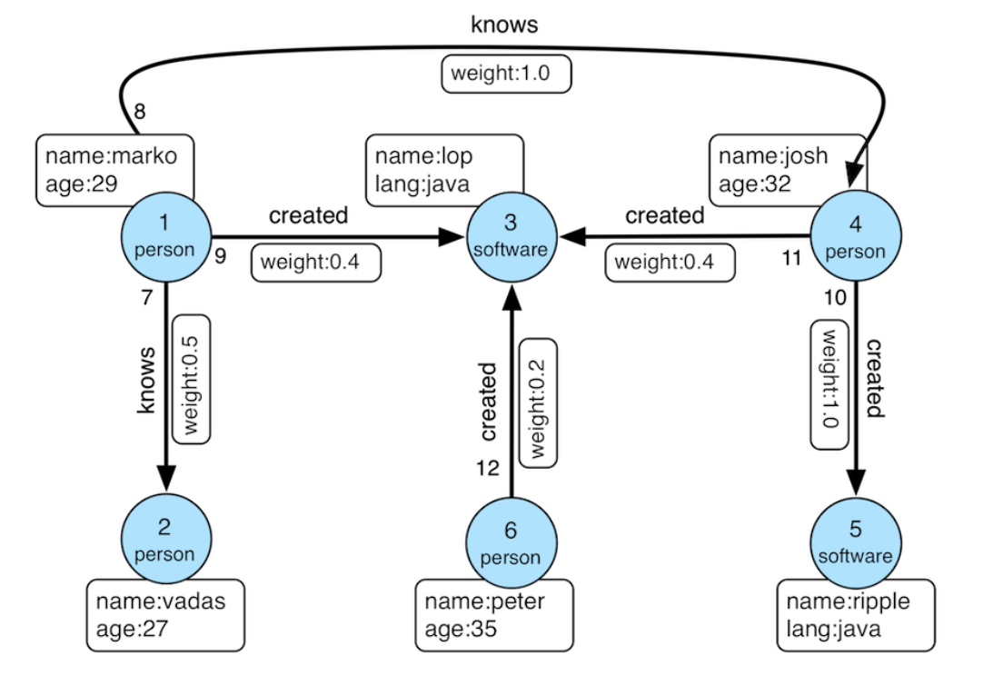
Basic Concepts of Graph Databases
Node and Edges
Id : 1, 2, 3…12
Label : person, software, knows, created
Properties (key / value ) : « weight: 0,4 », « name: josh », etc.

Slide 7
Tinkerpop
Abstraction API for graph DB traversals
Very expressive

Slide 8
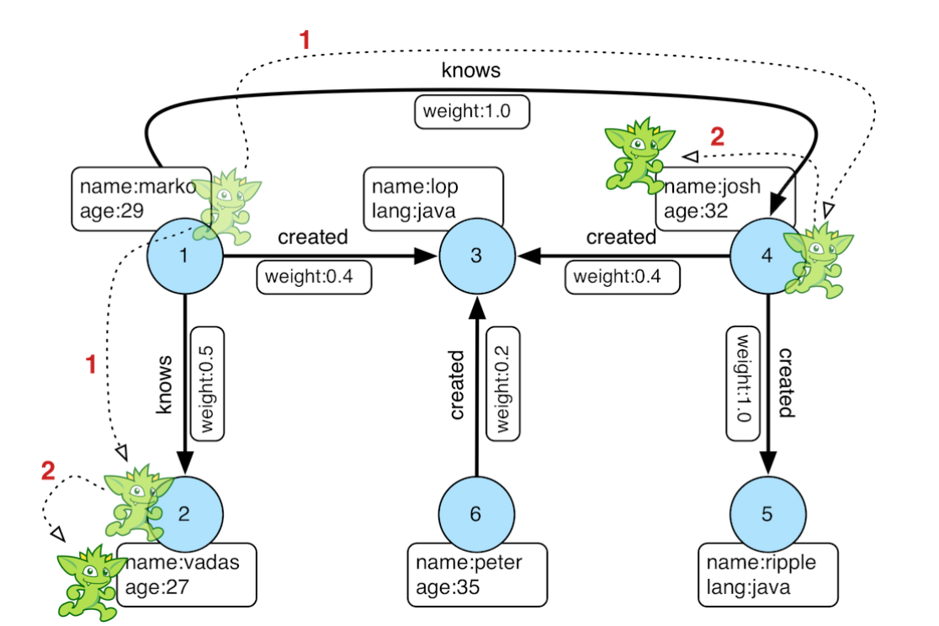
Tinkerpop Expressions
g.V().has('name','marko').out('knows').values('name’)

Slide 9
Tinkerpop Expressions
Graph Edition
addE, addV, property, remove, etc.
Traversals: returns an iterator<E> or iterator<V>
has( key, value), out, outE, outV, in, inE, inV
where(traversal(v))
Get the values (launch the search/iteration)
values(key), properties()
Branching, Iterations
choose(test), repeat(smthg).times(n), repeat / until

Slide 10

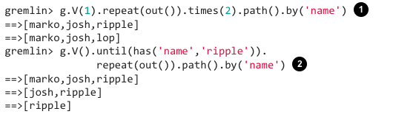
Tinkerpop expressivity
Returns projects having exactly one contributor
Returns projects having at least two contributors
Repeat two times the out step
Find paths ending in vertex with name « ripple »

Slide 11
Linking GraphDB to Corese
A graph DB (OrientDb, TitanDb, neo4j) = 1 plugin
Extends ProducerImpl
Method getEdges()
Property fr.inria.corese.tinkerpop.driver to switch between graph db plugin
Each plugin provides
A mapping from RDF data to the Graph DB used
A mapping of SPARQL requests to Tinkerpop
Journée des projets Inriahub du CRISAM – 22 novembre 2017

Slide 12
Linking GraphDB to Corese: Mapping RDF to a graph DB (first attempt)
S
p
O
RDF
[g]
Tinkerpop
:rdf_vertex
{v_value, kind, [lang]}
:rdf_vertex
{v_value, kind, [lang]}
:edge {p_value, g_value}

Slide 13
Linking GraphDB to Corese mapping SPARQL to tinkerpop
Select * where {
graph ?g {
?s ?p ?o
}
}
Tinkerpop translation :
t.E() // returns all edges of the graph

Slide 14
Linking GraphDB to Corese mapping SPARQL to tinkerpop
Select * where {
graph G {
S ?p ?o
}
}
Tinkerpop translation :
t.E().has(« g_value »,G).as(« e ») .inV().has(« s_value », S) .select(« e »)
// returns edges of the graph with G and S values

Slide 15
Linking GraphDB to Corese mapping SPARQL to tinkerpop
But: in neo4j, edges are not indexable, only vertices
Select (count(*) as ?c) where {
?s <http://fr.dbpedia.org/property/année> ?o
}
On DBpedia : more than 10 minutes
Why ? Whithout index: linear search With index (in neo4j): logarithmic search

Slide 16
Linking GraphDB to Corese: Mapping RDF to a graph DB
RDF :
Tinkerpop :
S
p
O
[g]
:rdf_edge {s_value, p_value, o_value, g_value}
:subject
:object
:rdf_vertex
{v_value, kind, [lang]}
:rdf_vertex
{v_value, kind, [lang]}
:edge {p_value, g_value}

Slide 17
Mapping SPARQL <-> Tinkerpop
select * where { ?s ?p ?o }
V().hasLabel(« rdf_edge »)
select * where { ?s ?p O }
V().hasLabel(« rdf_edge »). has(« o_value », O)
select * where { S ?p O }
V().hasLabel(« rdf_edge »). has(« s_value », S).
has(« o_value », O)

Slide 18
Linking GraphDB to Corese
Still problems:
No control on indexes in Tinkerpop
Implementation of Tinkerpop/neo4j use only the first index
V().hasLabel(« rdf_edge ») .has(« s_value », S) .has(« o_value », O)
Speed depends of the size of the result of the first has
Tinkerpop: V().hasLabel(« rdf_edge »).has(« p_value », « rdfs:label »).has(« o_value », « Antibes@fr ») : 120s
Cypher: match (e:rdf_edge{p_value:"http://www.w3.org/2000/01/rdf-schema#label"}) where e.o_value="Antibes return e : < 0,1 s

Slide 19
Figures with DBPedia
DBpedia : 219 million of edges
Time to build the database: 219 millions en 24h
Size of ttl input data: 36 Go
Size of the output databases: 482 Go

Slide 20
Conclusion
+ : binding RDF / Tinkerpop
+ : binding SPARQL / Tinkerpop in Corese
Validation of the Corese architecture
+ : for focused requests => immediate results
- : requests too slow when a lot of results.

Slide 21
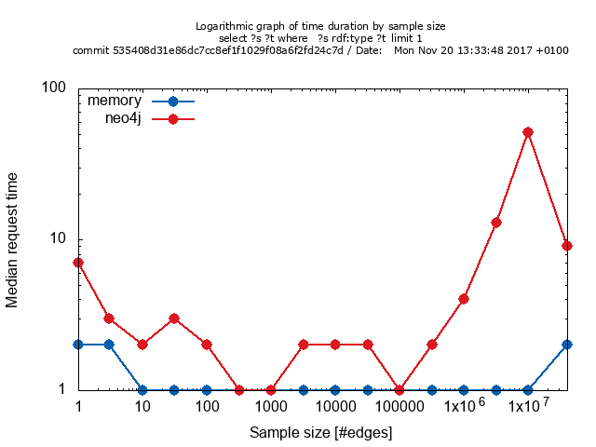

Slide 22
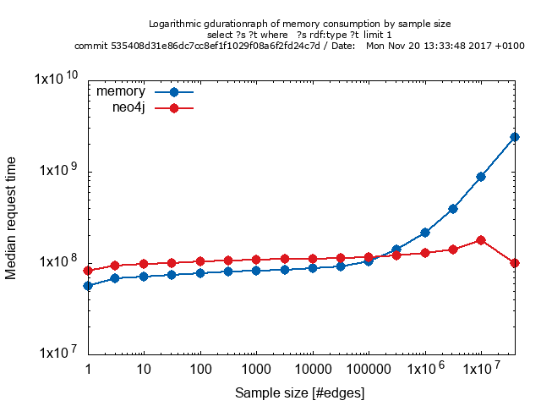

Slide 23
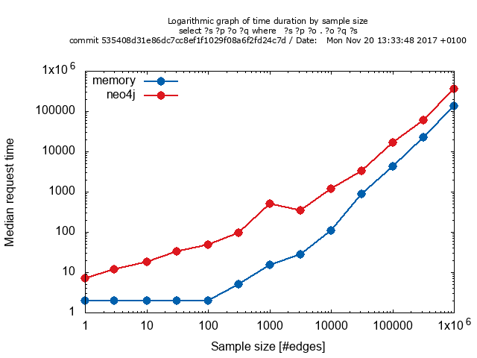

Slide 24
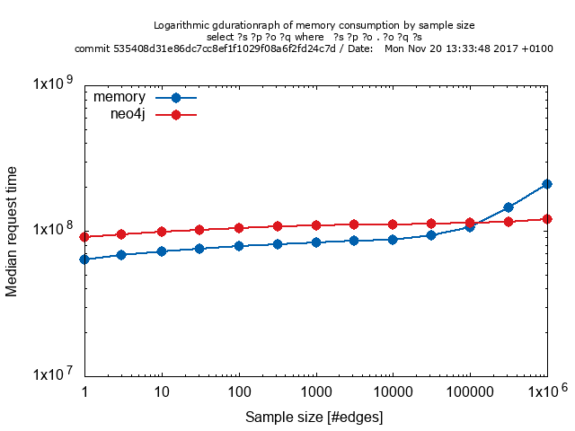

Slide 25
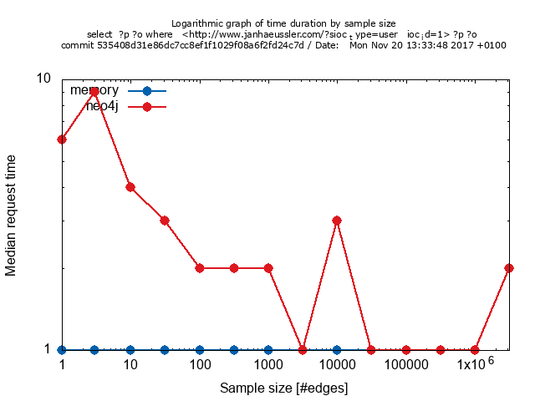

Slide 26
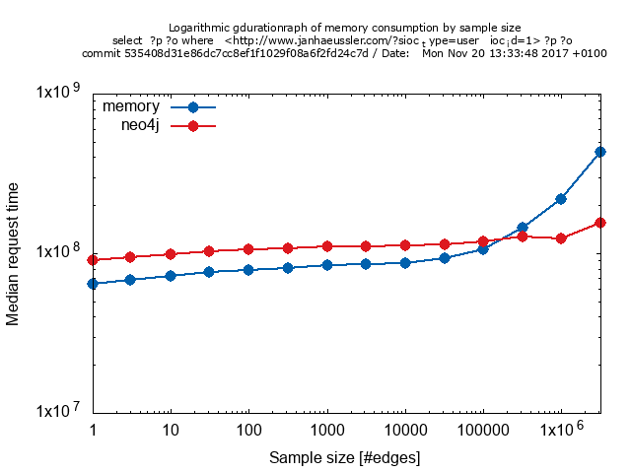

Slide 27
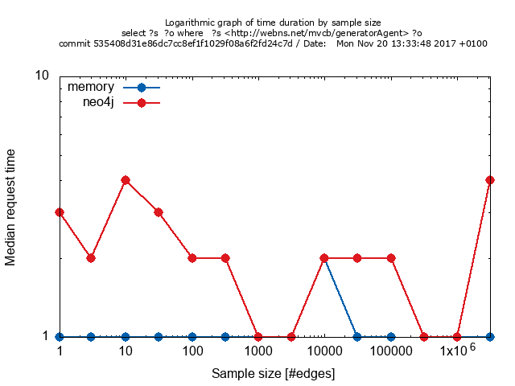

Slide 28
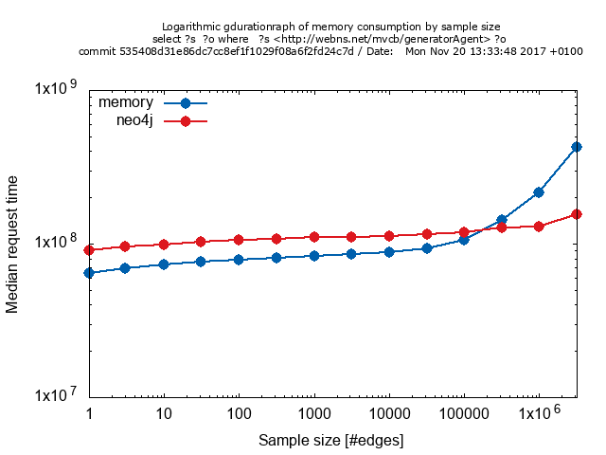

Slide 29
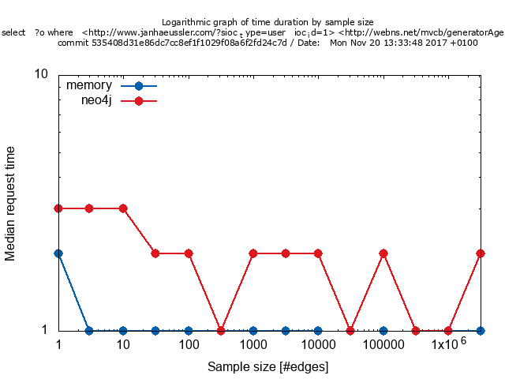

Slide 30
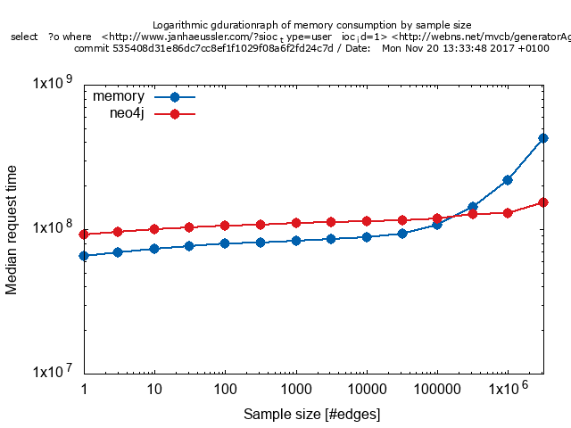

Slide 31
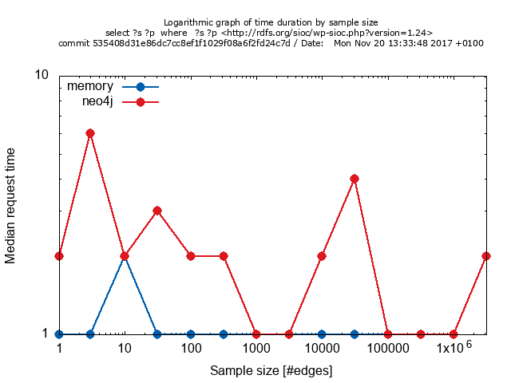

Slide 32


Slide 33
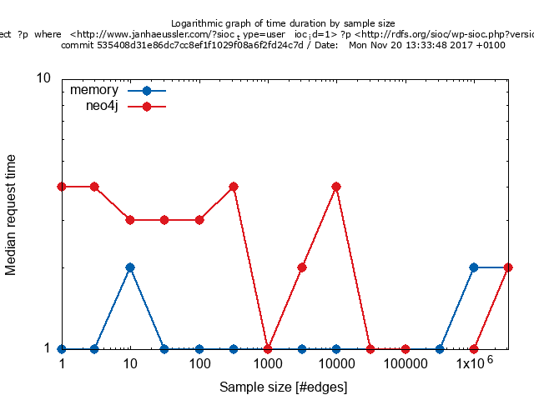

Slide 34
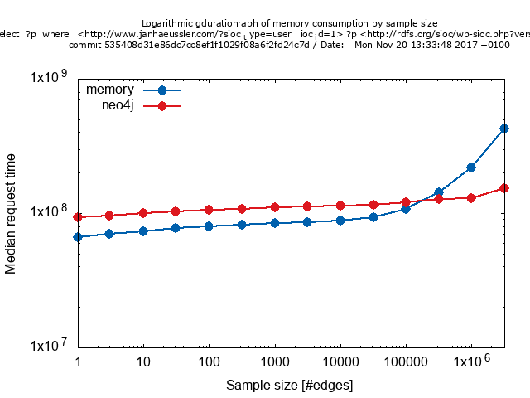

Slide 35
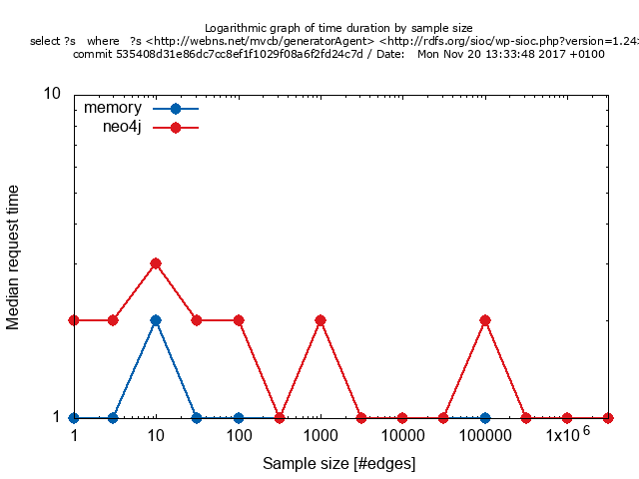

Slide 36


