Slide 1
Glaciology EESCGU4220
Practical 8: Age equation and data-model comparisons
Aims:
Get a feel for what controls age-depth
Learn how to ‘tune’ a model to observations.
Understand some of the limitations of this type of ‘inverse method’

Slide 2
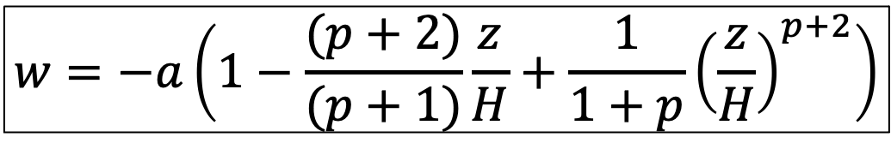
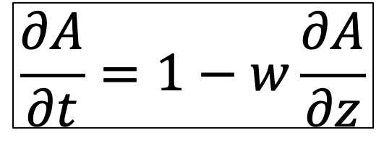
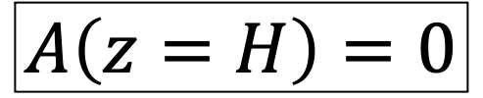
The age equation
$$\frac{∂A}{∂t}=1−w\frac{∂A}{∂z}$$
A is the age
t is time
w is vertical velocity (positive upwards)
z is vertical position (positive upwards)
$$A\left(z=H\right)=0$$
$$w=−a\left(1−\frac{(p+2)}{(p+1)}\frac{z}{H}+\frac{1}{1+p}{\left(\frac{z}{H}\right)}^{p+2}\right)$$

Slide 3
The age equation
$$\frac{∂A}{∂t}=1−w\frac{∂A}{∂z}$$
Model has two parameters
a, p
A is the age
t is time
w is vertical velocity (positive upwards)
z is vertical position (positive upwards)
$$A\left(z=H\right)=0$$
$$w=−a\left(1−\frac{(p+2)}{(p+1)}\frac{z}{H}+\frac{1}{1+p}{\left(\frac{z}{H}\right)}^{p+2}\right)$$

Slide 4
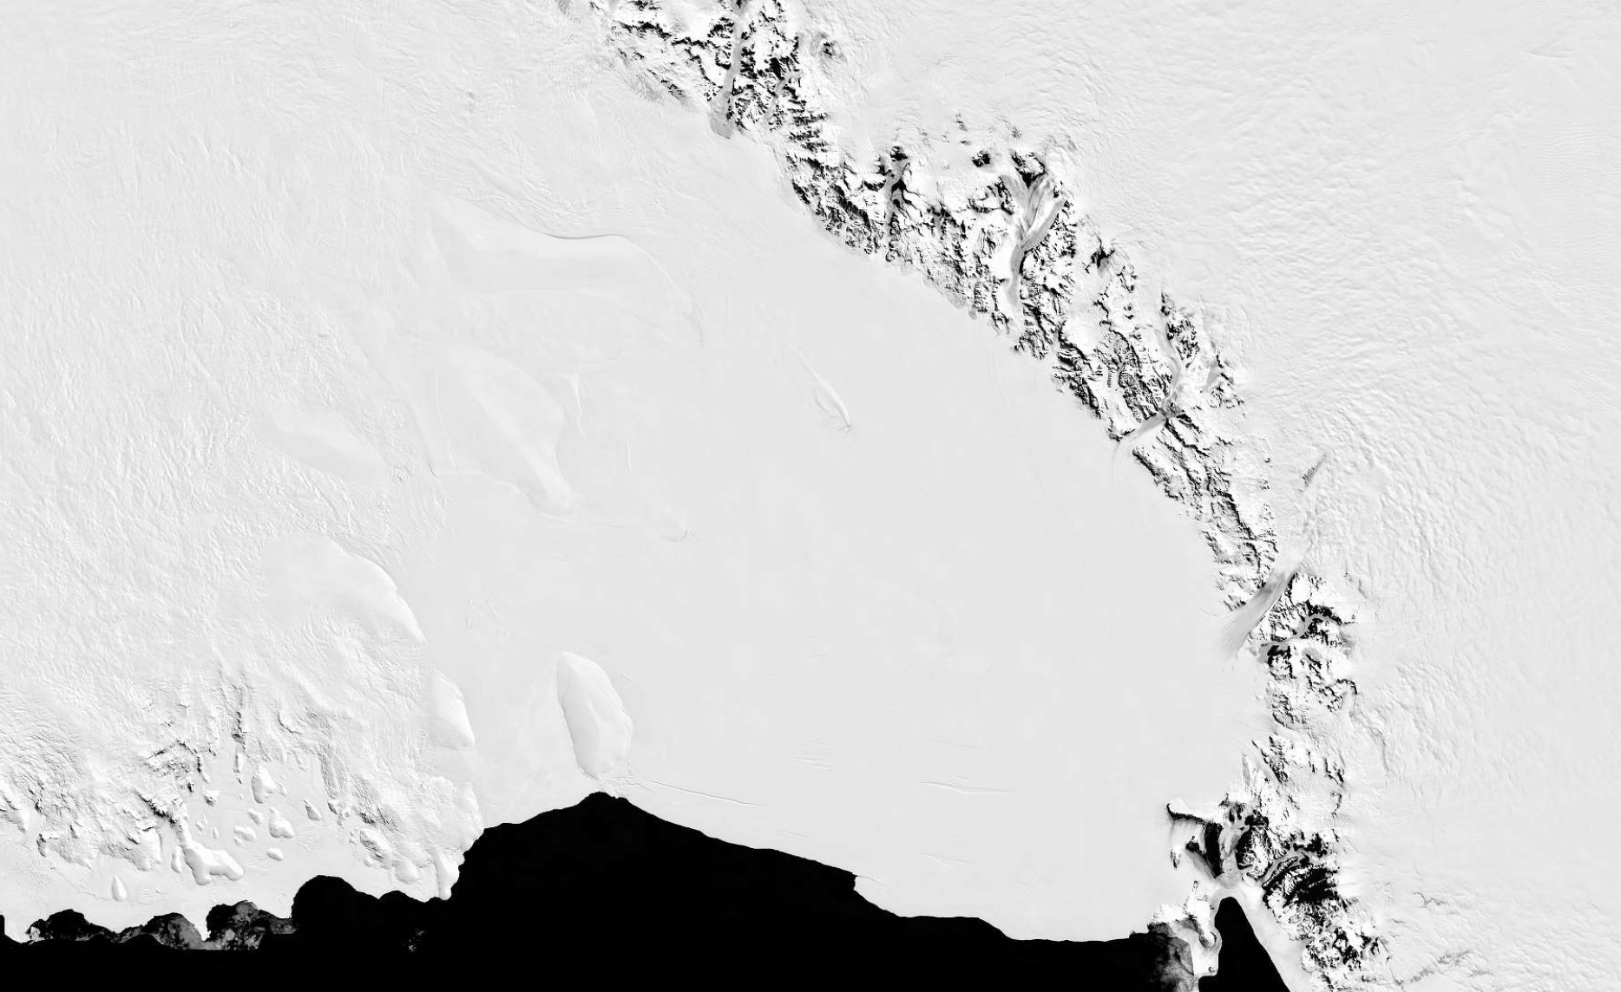
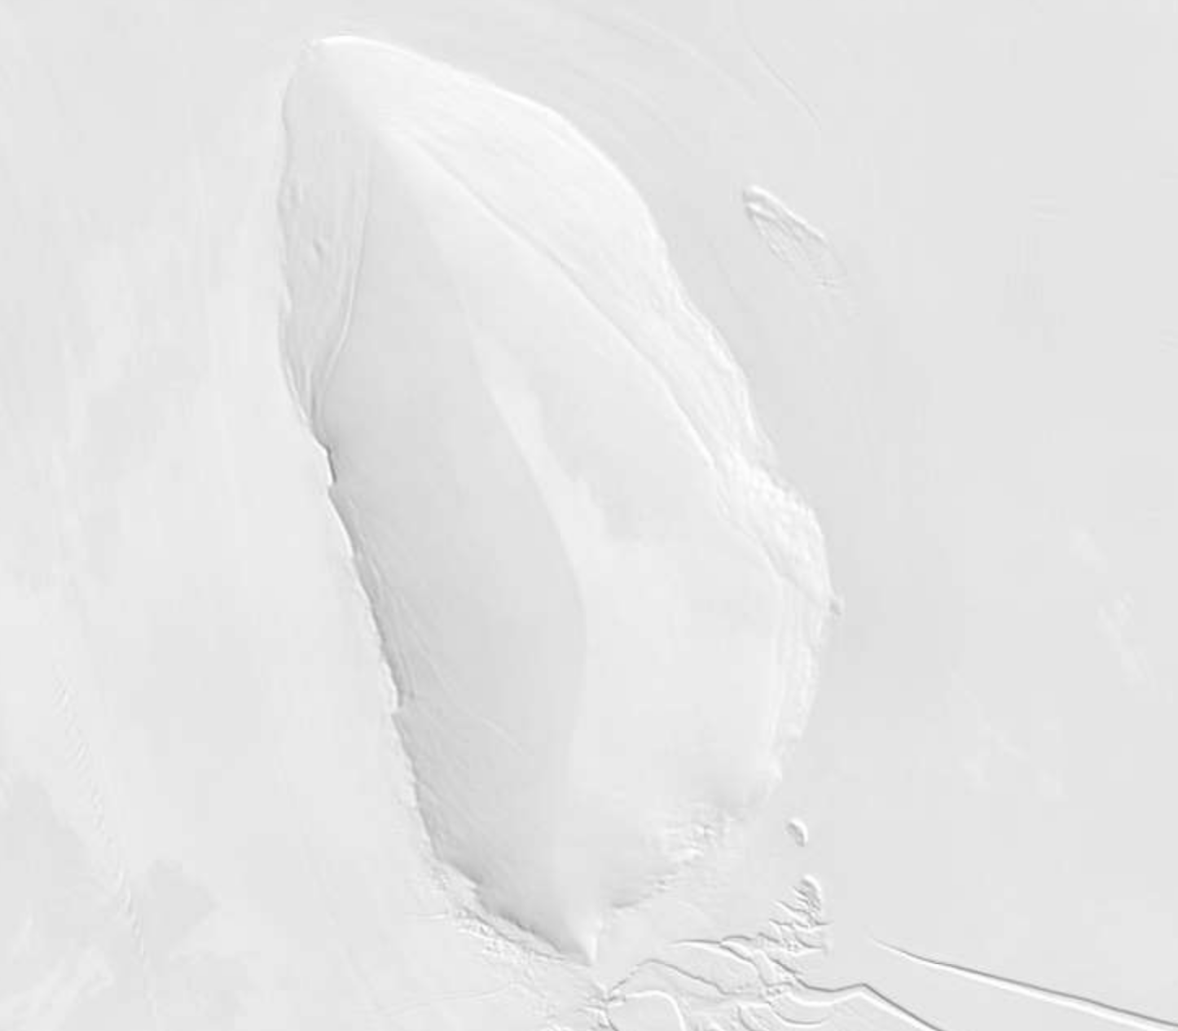
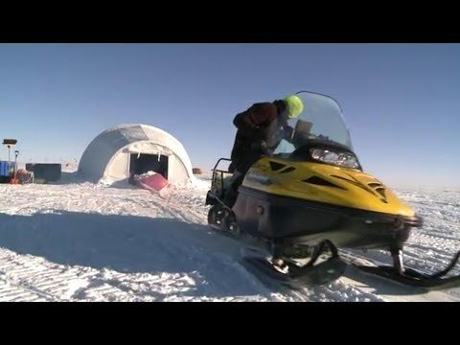
Observed age-depth from Roosevelt island

Slide 5
We have a model and we have data. Can we use this to learn something about climate or ice dynamics?

