Slide 1
Glaciology EESCGU4220
Practical 2: Antarctic surface accumulation
Purpose is to familiarize you with;
analyzing gridded data.
multi-dimensional arrays
regional climate model output
1. Download data from:
https://storage.googleapis.com/ldeo-glaciology/glaciology4220/practical_2/P2_RACMO.npz
2. Also download the txt file and csv file I send in a slack message earlier today.
3. Open a new notebook.
Notes:
Data is still there from last time! (as of Jan 2021)

Slide 2
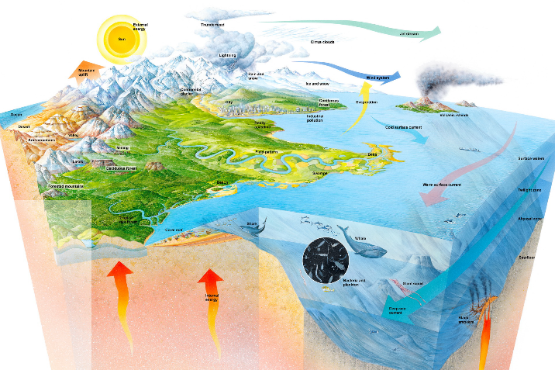
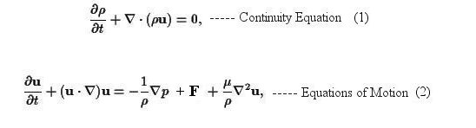
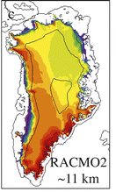
Climate Models
The real System
Mathematical model: e.g. Navier-stokes equations
Numerical model
Simulations

Slide 3



Descritization and numerical integration
Example: integrating the overburden pressure equation
$$P\left(z_{s}\right)=0$$
$$\frac{dP}{dz}=ρ\left(z\right)g$$
z_{s}
z
$$P\left(z\right)= ?$$
Notes:
To board

Slide 4
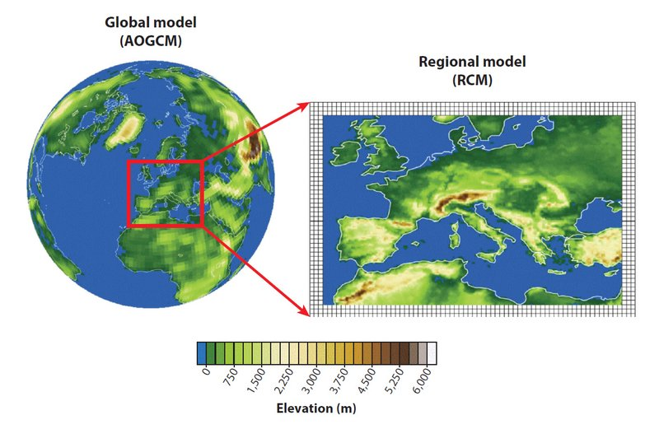
Regional Climate Models
Giorgi and Gutowski (2015)

Slide 5
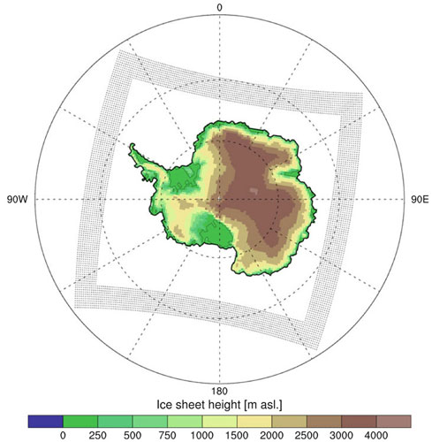
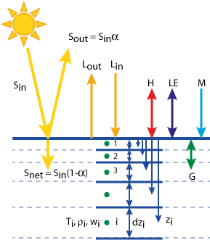
Regional Atmospheric Climate model (RACMO)
Includes atmospheric circulation and surface energy balance
Applied to Antarctica: RACMO/Ant

Slide 6
Regional Atmospheric Climate model (RACMO)
Surface mass balance
Applied to Antarctica: RACMO/Ant

Slide 7
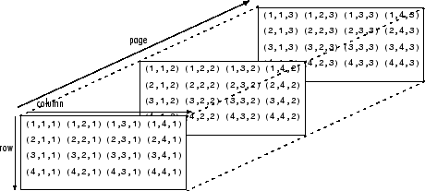
Racmo data
2 spatial dimensions + 1 time dimension
y
t
x

Slide 8
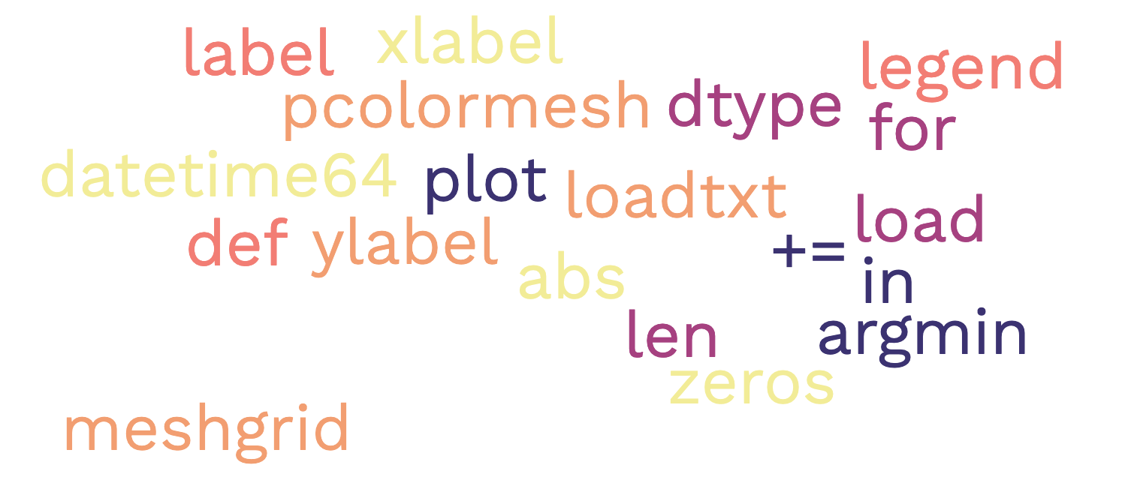
15 minutes
Free exploration of the data
load
dtype
len
for
in
plot
argmin
+=
zeros
xlabel
datetime64
abs
pcolormesh
meshgrid
ylabel
loadtxt
legend
label
def

Slide 9
Challenges (not easy! but try to get to at least number 5.)
Extract the 2-m temperature on day 1 of the model output at the site of the West Antarctic Ice Sheet Divide Core (WDC) X = -1063200, Y = -431430, Polar stereographic coordinates. What date does this correspond to?
Plot a time series of 2-m temperature at the WDC.
How does 2-m temperature at WDC compare to 2-m temperature at the South Pole Ice Core? (Make a scatter plot).
Plot on the same axis (different colors) time series from all the locations contained in the file StationLocations.xls
These are the locations of a few Norwegian, New Zealand and US Antarctic bases
Obviously you don’t want to have to enter all the coordinates by hand!
Plot a map of surface mass balance on 18th May 1991 of the model output (what happened on this date?).
Plot side-by-side maps of the mean surface temperature and the mean SMB as functions of space.
Does mean SMB correlate with mean 2-m temperature?
Create a gif animation of air temperature as it varies with time.
Notes:
Helen Sharman was the first British astronaut and the first woman to visit the Mir space station. They launched on 18 May 1991 from the Baikonur cosmodrome in the Soviet republic of Kazakhstan

Slide 10
Assignment, due Feb 21st :
Complete up to number 5.
Write a notebook that will load the data, do all the calculation and produce clearly labelled figures.
The figures produced should have labelled axes with units, and meaningful titles.
Add an abstract: What is an RCM? What does it do? What data have we looked at from what RCM? Broadly, what have we done with these data?
Name you notebook P2_yourname.ipynb and email it to me.

