Slide 1
Glaciology EESCGU4220
Practical 3:
Solving equations with the finite-difference method

Slide 2
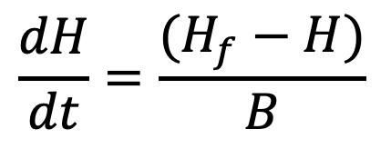
Imagine we have a model saying how ice thickness H varies in time.
H is ice thickness
T is time
H_f is final ice thickness
B is a constant
$$\frac{dH}{dt}=\frac{(H_{f}−H)}{B}$$
Solve numerically
Solve analytically and evaluate
Compare the results
How to quantify the comparison?
How does the comparison change with the resolution of the model?

Slide 3
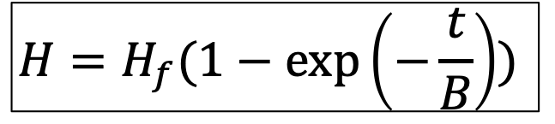
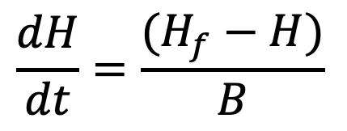
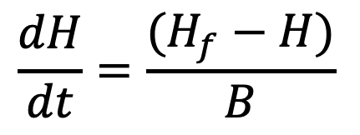
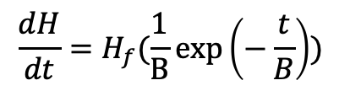
Solve analytically under the initial condition of H(t=0) = 0
H is ice thickness
T is time
H_f is final ice thickness
B is a constant
$$\frac{dH}{dt}=\frac{(H_{f}−H)}{B}$$
(1)
To check this:
Sub. this back into (1)
$$\frac{dH}{dt}=H_{f}(\frac{1}{B}exp\left(−\frac{t}{B}\right))$$
$$H=H_{f}(1−exp\left(−\frac{t}{B}\right))$$
$$\frac{dH}{dt}=\frac{(H_{f}−H)}{B}$$

Slide 4
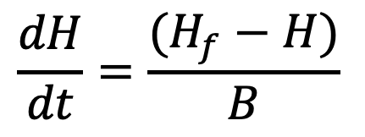
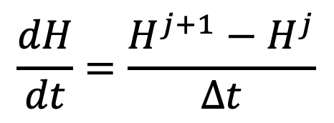
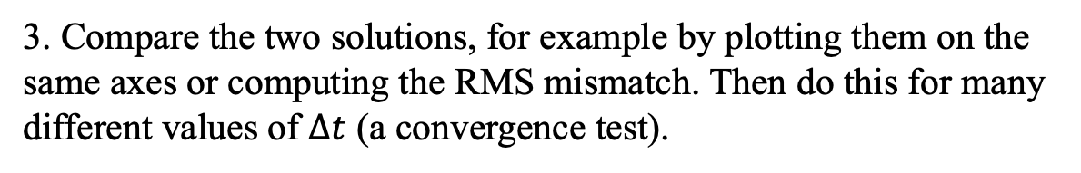
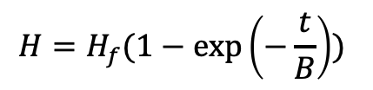
Today:
1. Compute H directly from the analytical solution.
2. Compute it numerically using the finite-difference approximation:
$$H=H_{f}(1−exp\left(−\frac{t}{B}\right))$$
Our model equation
Finite-difference approximation
$$\frac{dH}{dt}=\frac{(H_{f}−H)}{B}$$
$$\frac{dH}{dt}=\frac{H^{j+1}−H^{j}}{∆t}$$
?
3. Compare the two solutions, for example by plotting them on the same axes or computing the RMS mismatch. Then do this for many different values of $∆t$ (a convergence test).

