Slide 1
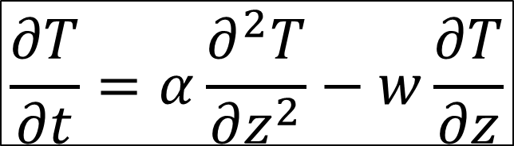
Glaciology EESCGU4220
Practical 7: Non-steady heat equation
Aims:
Learn about boundary conditions
Learn more about “parameter space” and how to search it.
Understand what controls temperature in cold-based ice sheets.
$$\frac{∂T}{∂t}=α\frac{∂^{2}T}{∂z^{2}}−w\frac{∂T}{∂z}$$

Slide 2

Boundary conditions
Surface energy balance (Lecture 4)
Basal energy balance
--- geothermal heat flux, friction: $τ_{b}u_{b}$, hydrology
Cold-based ice:
Geothermal heat flux is set at the base.
Neumann boundary condition (one that fixes the derivative of T)
Warm-based ice:
T_{b} = melting point
Dirichlet boundary condition (one that fixes the value of T)
z
z
0
0
T
T

Slide 3

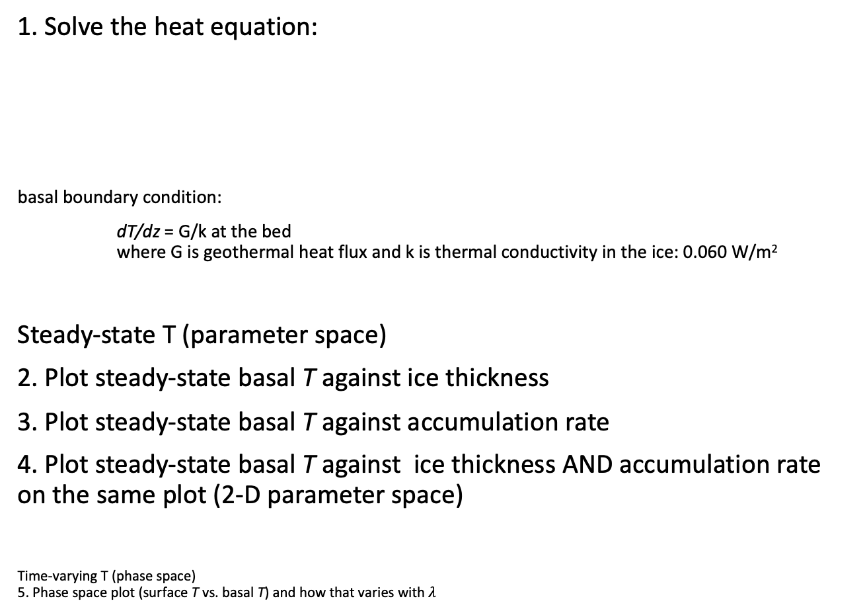
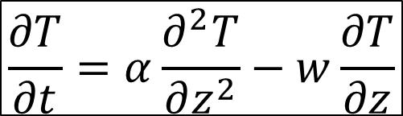
1. Solve the heat equation:
basal boundary condition:
dT/dz = G/k at the bed where G is geothermal heat flux and k is thermal conductivity in the ice: 0.060 W/m²
Steady-state T (parameter space)
2. Plot steady-state basal T against ice thickness
3. Plot steady-state basal T against accumulation rate
4. Plot steady-state basal T against ice thickness AND accumulation rate on the same plot (2-D parameter space)
Time-varying T (phase space) 5. Phase space plot (surface T vs. basal T) and how that varies with $λ$
$$\frac{∂T}{∂t}=α\frac{∂^{2}T}{∂z^{2}}−w\frac{∂T}{∂z}$$
z
0
Accumulation rate
a
w
$$T\left(0,t\right)=A sin⁡\left(\frac{2π}{λ}t\right)$$

