Slide 1
Glaciology EESCGU4220
Practical 6:
Comparing SIA to measured flow speeds

Slide 2
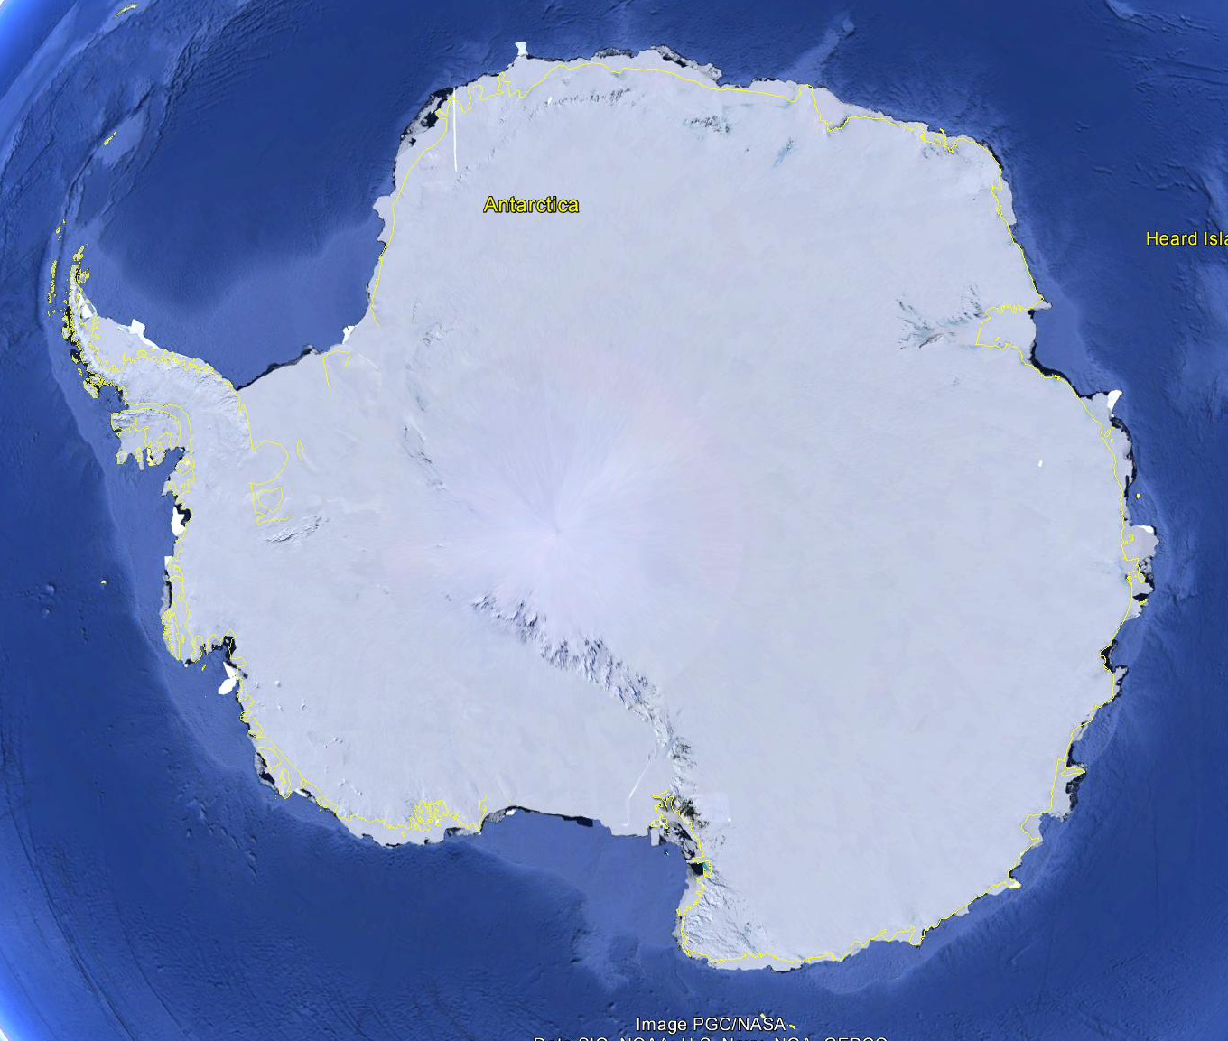

Slide 3
Download the data from here:
https://drive.google.com/file/d/1bh88YHW0iv-p3TwxseJRXXDO-2FZoBQ0/view?usp=sharing and https://drive.google.com/file/d/1Mbo6XzZjw1YCItBeA9DOXqW5iVpXzEUU/view?usp=sharing
Goal: create a script to compare measured speed (contained in MeasuredSpeed.mat) to speed computed using the SIA, along lines in Antarctica.
Notes:
MeasuredSpeed.mat
contains maps of the two components of horizontal surface velocity at the surface of the Antarctic ice sheet. x and y are polar stereographic coordinates in meters. Vx and Vy are the two horizontal components of surface speed in meters/year
Bedmap2.mat
contains maps of ice thickness and slope on a different grid to the speed data. x_bedmap and y_bedmap are polar stereographic coordinates in meters. thickness is ice thickness in meters. slope is surface slope (dimensionless).

