Slide 1
Glaciology EESCGU4220
Practical 5:
Examining and extending our shallow-ice model

Slide 2
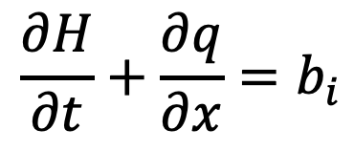

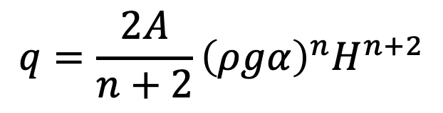

A steady state solution
mass conservation:
$$\frac{∂H}{∂t}+\frac{∂q}{∂x}=b_{i}$$
$$q(0)=0$$
$$b_{i}=2−{10}^{−4}x$$
$$q={\frac{2A}{n+2}\left(ρgα\right)}^{n}H^{n+2}$$

Slide 3
1. Sensitivity to model parameters
- make your code into a function so it can easily be called while varying A and recording some metric of the ice sheet once it is steady state.
- write a simple script to call the function many times with different physical parameters and plot the metric as a fn. of A (with A along the horizontal axis).
2. Transience
- write a new function called SIA_time_evolving.m (or similar) which runs the model with a sinusoidally-varying equilibrium line position.
-plot a time-varying metric (e.g. ice thickness at some location) above against time.
- plot it against equilibrium line position as both vary throughout a model run. (this is a phase- space plot).
- examine how the shape of the phase-space plot changes as you vary the period of the sinusoidal variation in equilibrium line position.
3. A spatially-varying bed
- write a new version of your code called SIA_VaryingBed.m (or similar) that allows the bed elevation to vary. This will require modifying the model equations a little.
-examine the affect of adding bedrock mounds on the ice dynamics.
.

