Slide 1
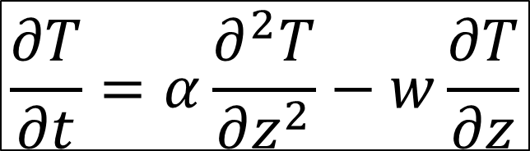
Glaciology EESCGU4220
Practical 7: Non-steady heat equation
Aims:
Learn about boundary conditions
Learn more about “parameter space” and how to search it.
Understand what controls temperature in cold-based ice sheets.
$$\frac{∂T}{∂t}=α\frac{∂^{2}T}{∂z^{2}}−w\frac{∂T}{∂z}$$

Slide 2

Boundary conditions
Surface energy balance (Lecture 4)
Basal energy balance
--- geothermal heat flux, friction: $τ_{b}u_{b}$, hydrology
Cold-based ice:
Geothermal heat flux is set at the base.
Neumann boundary condition (one that fixes the derivative of T)
Warm-based ice:
T_{b} = melting point
Dirichlet boundary condition (one that fixes the value of T)
z
z
0
0
T
T

Slide 3
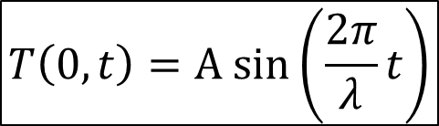
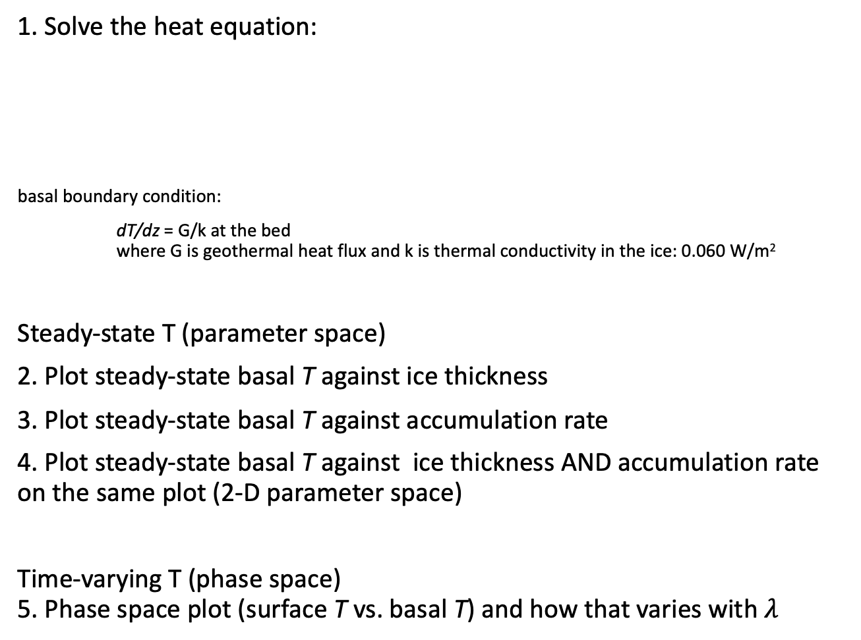
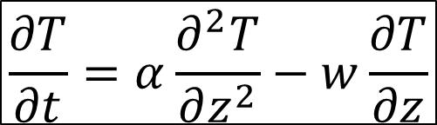
1. Solve the heat equation:
basal boundary condition:
dT/dz = G/k at the bed where G is geothermal heat flux and k is thermal conductivity in the ice: 0.060 W/m²
Steady-state T (parameter space)
2. Plot steady-state basal T against ice thickness
3. Plot steady-state basal T against accumulation rate
4. Plot steady-state basal T against ice thickness AND accumulation rate on the same plot (2-D parameter space)
Time-varying T (phase space) 5. Phase space plot (surface T vs. basal T) and how that varies with $λ$
$$\frac{∂T}{∂t}=α\frac{∂^{2}T}{∂z^{2}}−w\frac{∂T}{∂z}$$
z
0
Accumulation rate
a
w
$$T\left(0,t\right)=A sin⁡\left(\frac{2π}{λ}t\right)$$

Slide 4
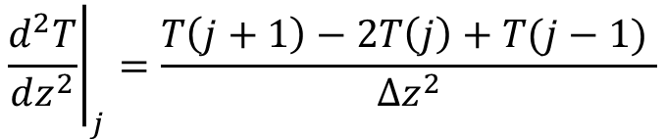
Hints
Be careful of the units [do everything in seconds]
Vectorize
Finite difference version of second derivative is:
think carefully about the basal boundary condition
When you have a script to evolve T forward in time, make another one that calls the first script with different values of the parameters.
Make many versions: ctrl+a, ctrl+c, ctrl+n, ctrl+v, ctrl+s
Structure your code sensibly
Comment
$${\left.\frac{d^{2}T}{dz^{2}}\right|}_{j}=\frac{T\left(j+1\right)−2T\left(j\right)+T(j−1) }{∆z^{2}}$$

