Slide 1
University Recruitment and Placement Status
Neha Annamalai, Anna Hubbard, Aaria Sethi

Slide 2
Motivation
A student's prior education and job history play a crucial role in university recruitment and campus acceptance.
Difficult college application process - standardized test scores, grades, extracurricular achievements
Every aspect of student involvement is utilized for university admissions.

Slide 3
Dataset
Features: serial number, gender, secondary education percentage (10th grade), secondary board of education, higher secondary education percentage (12th grade), higher secondary board of education, specialization in higher secondary education, degree percentage, undergrad degree type, work experience, employability test percentage, post-grad (MBA) specialization, MBA percentage, and salary offered by corporates (to the placed students)
Target: placement status (categorical)

Slide 4
Problem and Task
Problem: Given the different factors (in the last slide), does the student get placed or not?
Supervised ML Task: Use data preprocessing methods and then proceed to use the Naive Bayes Classifier, Decision Tree, and Random Forest algorithms (specific functions of each stated in next slide) to determine placement status.

Slide 5
Algorithms Used
One-Hot Encoding: to make the features numerical for feature selection
Filter Feature Selection: to isolate the features that play an important role in the classification
Naive Bayes: to predict the probability of placement based on different features
Decision Tree: to visually represent decision making
Random Forest: to help predict the classification of the large dataset

Slide 6
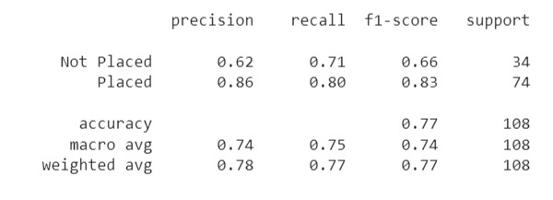
Naive Bayes Performance Matrix

Slide 7
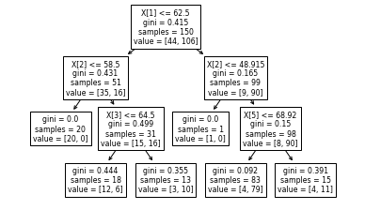
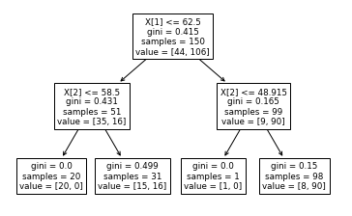
Decision Tree

Slide 8
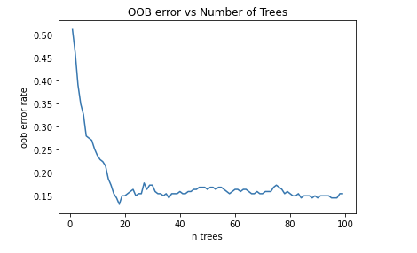
Random Forest Algorithm

Slide 9
Conclusion
Started with 15 features and were able to drop 2
Naive Bayes accuracy of 77% indicates a high ratio of correctly predicted observations to total observations.
Decision Tree model show ideal max_depth 2 and 3
Random Forest algorithm reveals optimal # of trees to be 17

Slide 10
Future Work
Determining what features affect the salary of those placed in the workforce
Gathering more data to find what other features might play an important role in determining the placement status or salary

