Slide 1
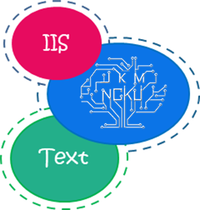
Neural Network Tutorial
IKM Laboratory

Slide 2
Outline
Introduction to NN
Feedforward
Fully Connect Layer
Activation Function
Backpropagation
Lost/Cost Function
Optimization
Simple text classification model
Data Preprocessing
Vectorization
Model building
2
Notes:
2

Slide 3
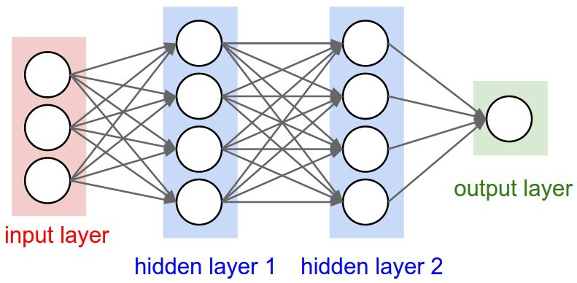
Neural Network
A neural network is an artificial neural network wherein connections between the nodes do not form a cycle. As such, it is different from recurrent neural networks. It is illustrated in the following figure
3
Notes:
3

Slide 4




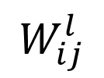
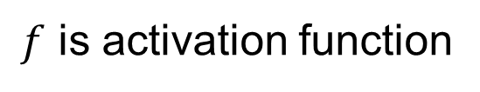



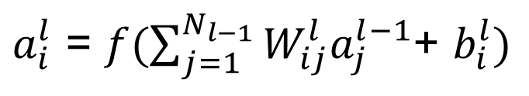



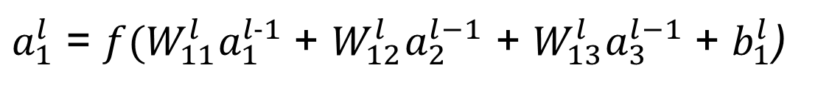
Neural Network
Fully connected layer
All neurons in this layer have full connections to all activations in the previous layer, as seen in regular Neural Networks. Their activations can hence be computed with a matrix multiplication followed by a bias offset.
$$a_{1}^{l}$$
$$W_{ij}^{l}$$
Layer $l−1$
to Layer $l$
$$a_{1}^{l−1}$$
$$a_{2}^{l}$$
$a_{1}^{l}$ = ${f(W}_{11}^{l}a_{1}^{l−1}$+ $W_{12}^{l}a_{2}^{l−1}$ + $W_{13}^{l}a_{3}^{l−1}$+ $b_{1}^{l}$)
$$a_{2}^{l−1}$$
$$a_{3}^{l}$$
$$a_{3}^{l−1}$$
We can define each neural in current layer by :
$$a_{4}^{l}$$
$a_{i}^{l}$ = $f(\sum_{j=1}^{N_{l−1}}{W_{ij}^{l}a_{j}^{l−1}}$+ $b_{i}^{l})$
1
Layer $l−1$
Layer $l$
$f$ is activation function
4
Notes:
4

Slide 5
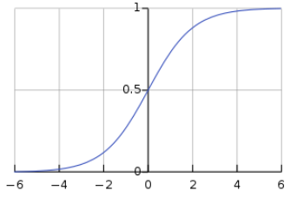
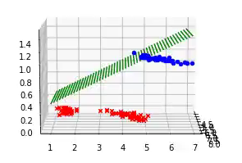
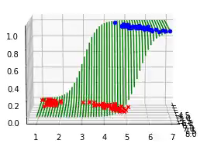
Neural Network
Activation Function
It’s just a thing that you add to the output end of any neural network. It is also known as Transfer Function. It can also be attached in between two Neural Networks. It is used to determine the output of neural network like yes or no. It maps the resulting values in between 0 to 1 (sigmoid) whatever the inputs are.
Sigmoid function
No activation
Activation
Notes:
5

Slide 6
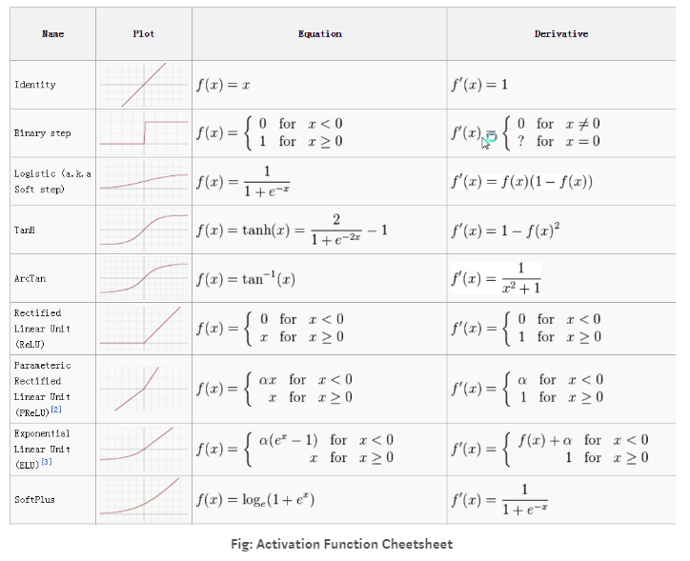
Neural Network
Different Activation Function
Notes:
6

Slide 7
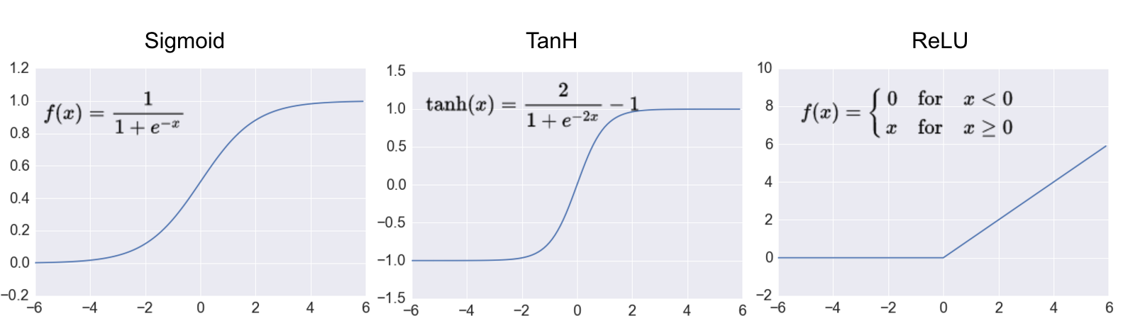
Neural Network
Commonly used activation function
The main reason why we use sigmoid function is because it exists between (0 to 1). Therefore, it is especially used for models where we have to predict the probability as an output.
The range of the Tanh function is from (-1 to 1). Tanh is also sigmoidal (s - shaped). The advantage is that the negative inputs will be mapped strongly negative and the zero inputs will be mapped near zero in the tanh graph.
The ReLU is the most used activation function in the world right now. Since, it is used in almost all the convolutional neural networks or deep learning.
Notes:
7

Slide 8
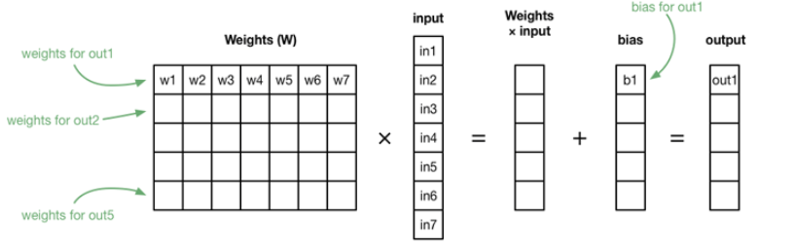
Neural Network
Feedforward
The formula can be implement by two multiplied matrices and plus a bias vector like this:
Notes:
8

Slide 9

Neural Network
Backward pass
How did we set our weights in forward pass ? We must define a loss function to decide what weights can decrease difference of outputs and label.
Loss function
In most learning networks, error is calculated as the difference between the actual output and the predicted output.
Different loss functions are used to deal with different type of tasks, for example
Regression
Mean Square Error
Classification
Cross Entropy
Notes:
9

Slide 10
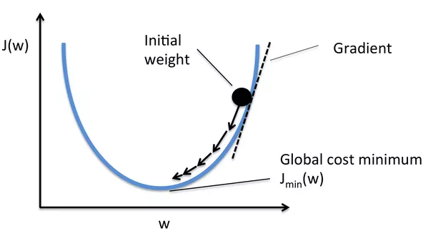

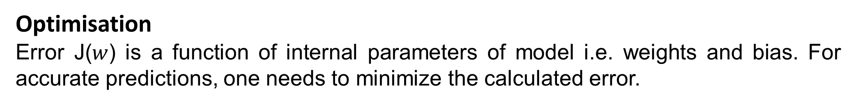
Neural Network
Optimisation
Error J($w$) is a function of internal parameters of model i.e. weights and bias. For accurate predictions, one needs to minimize the calculated error.
Optimisation usually calculate the gradient i.e. the partial derivative of loss function with respect to weights, and the weights are modified in the opposite direction of the calculated gradient. This cycle is repeated until we reach the minima of loss function.
Notes:
10

Slide 11

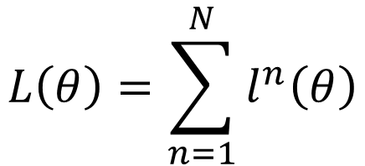





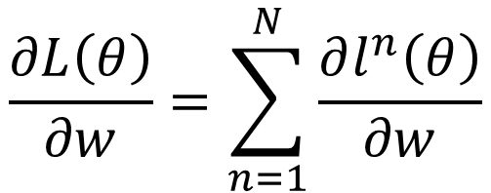

Neural Network
x^{n}
NN
$$θ$$
y^{n}
$${\hat{y}}^{n}$$
$$l^{n}$$
$$L\left(θ\right)=\sum_{n=1}^{N}{l^{n}\left(θ\right)}$$
$$\frac{∂L\left(θ\right)}{∂w}=\sum_{n=1}^{N}{\frac{∂l^{n}\left(θ\right)}{∂w}}$$
$$x_{1}$$
$$y_{1}$$
$$x_{2}$$
$$y_{2}$$
Notes:
11

Slide 12
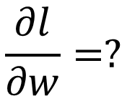


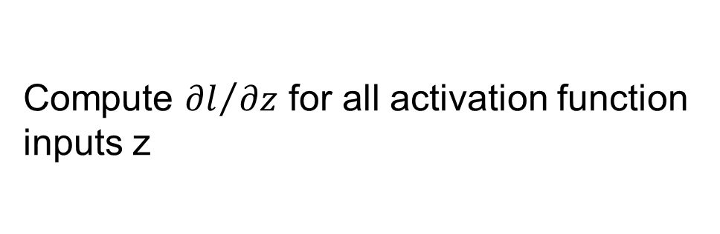



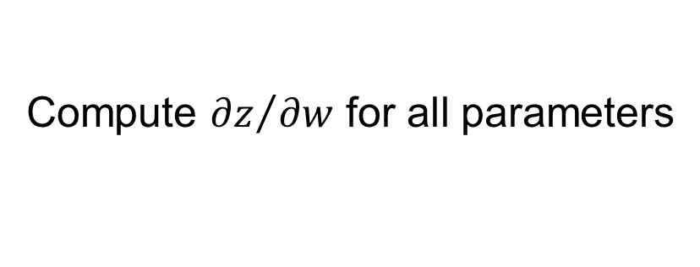


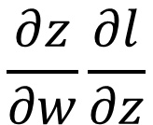

Neural Network
$$w_{1}$$
$$z$$
……
$$y_{1}$$
$$x_{1}$$
$$w_{2}$$
b
……
$$z=x_{1}w_{1}+x_{2}w_{2}+b$$
$$x_{2}$$
$$y_{2}$$
Forward pass:
$$\frac{∂l}{∂w}=?$$
$$\frac{∂z}{∂w}\frac{∂l}{∂z}$$
Compute ${∂z}/{∂w}$ for all parameters
Backward pass:
(Chain rule)
Compute ${∂l}/{∂z}$ for all activation function inputs z
Notes:
12

Slide 13












Neural Network
$$w_{1}$$
$$z$$
……
$$y_{1}$$
$$x_{1}$$
$$w_{2}$$
b
……
$$z=x_{1}w_{1}+x_{2}w_{2}+b$$
$$x_{2}$$
$$y_{2}$$
$${∂z}/{∂w_{1}}=?$$
$$x_{1}$$
The value of the input connected by the weight
$${∂z}/{∂w_{2}}=?$$
$$x_{2}$$
Notes:
13

Slide 14
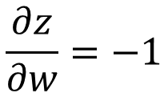

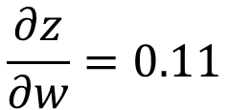
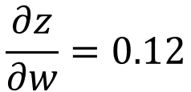
Neural Network
Compute ${∂z}/{∂w}$ for all parameters
1
0.98
2
0.86
3
1
-2
-1
-1
1
0
-2
-1
0.12
-2
0.11
-1
-1
-1
4
1
0
0
2
$$\frac{∂z}{∂w}=−1$$
$$\frac{∂z}{∂w}=0.12$$
$$\frac{∂z}{∂w}=0.11$$
Notes:
14

Slide 15
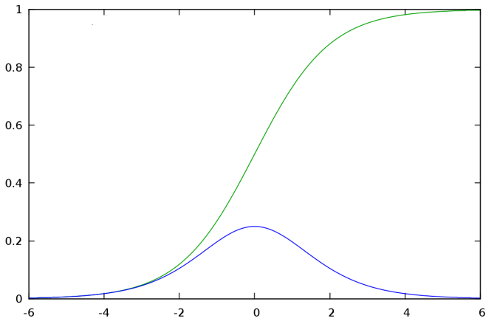











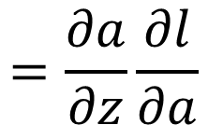
Neural Network
Compute ${∂l}/{∂z}$ for all activation function inputs z
$$w_{1}$$
$$z$$
$$a$$
$$x_{1}$$
$$a=σ\left(z\right)$$
$$w_{2}$$
b
$$x_{2}$$
$$σ\left(z\right)$$
$$\frac{∂l}{∂z}$$
$$=\frac{∂a}{∂z}\frac{∂l}{∂a}$$
$$σ′\left(z\right)$$
$$σ′\left(z\right)$$
Notes:
15

Slide 16





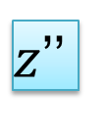

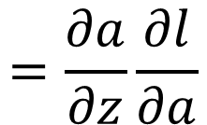








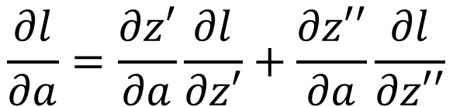
Neural Network
Compute ${∂l}/{∂z}$ for all activation function inputs z
$$w_{1}$$
$$z$$
$$a$$
$$w_{3}$$
$$z′$$
$$x_{1}$$
$$a=σ\left(z\right)$$
$$z′=aw_{3}+⋯$$
$$w_{2}$$
b
$$w_{4}$$
$z$’’
$$x_{2}$$
$$\frac{∂l}{∂z}$$
$$=\frac{∂a}{∂z}\frac{∂l}{∂a}$$
$$\frac{∂l}{∂a}=\frac{∂z′}{∂a}\frac{∂l}{∂z′}+\frac{∂z′′}{∂a}\frac{∂l}{∂z′′}$$
(Chain rule)
$$w_{3}$$
?
$$w_{4}$$
?
Assumed it’s known
Notes:
16

Slide 17



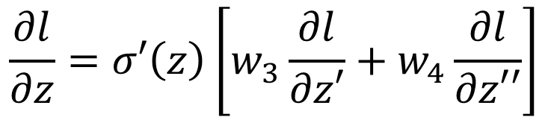







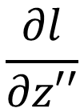


Neural Network
Compute ${∂l}/{∂z}$ for all activation function inputs z
$$w_{1}$$
$$z$$
$$a$$
$$w_{3}$$
$$z′$$
$$x_{1}$$
$$\frac{∂l}{∂z}$$
$$\frac{∂l}{∂z′}$$
$$w_{2}$$
b
$$w_{4}$$
$z$’’
$$x_{2}$$
$$\frac{∂l}{∂z′′}$$
$$\frac{∂l}{∂z}=σ′\left(z\right)\left[w_{3}\frac{∂l}{∂z′}+w_{4}\frac{∂l}{∂z′′}\right]$$
Notes:
17

Slide 18




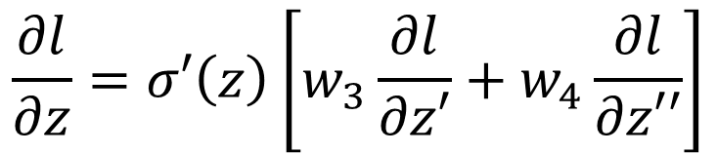

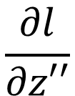
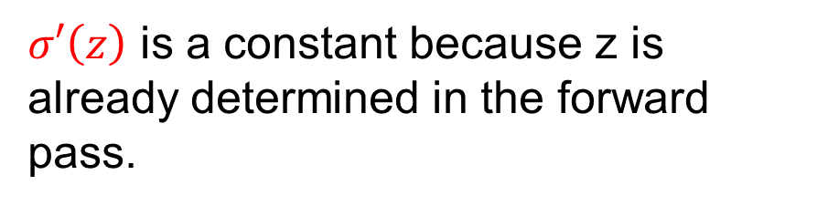
Neural Network
$$σ′\left(z\right)$$
$$w_{3}$$
$$\frac{∂l}{∂z}$$
$$\frac{∂l}{∂z′}$$
$$w_{4}$$
$σ′\left(z\right)$ is a constant because z is
already determined in the forward pass.
$$\frac{∂l}{∂z′′}$$
$$\frac{∂l}{∂z}=σ′\left(z\right)\left[w_{3}\frac{∂l}{∂z′}+w_{4}\frac{∂l}{∂z′′}\right]$$
Notes:
18

Slide 19






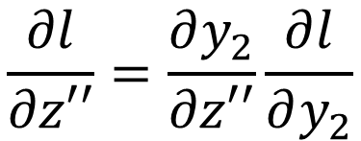



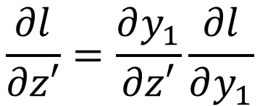


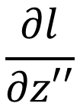



Neural Network
Compute ${∂l}/{∂z}$ for all activation function inputs z
$$w_{1}$$
$$z$$
$$a$$
$$w_{3}$$
$$z′$$
$$x_{1}$$
$$y_{1}$$
$$\frac{∂l}{∂z}$$
$$\frac{∂l}{∂z′}$$
$$w_{2}$$
b
$$w_{4}$$
$z$’’
$$y_{2}$$
$$x_{2}$$
Case 1. Output Layer
$$\frac{∂l}{∂z′′}$$
$$\frac{∂l}{∂z′}=\frac{∂y_{1}}{∂z′}\frac{∂l}{∂y_{1}}$$
$$\frac{∂l}{∂z′′}=\frac{∂y_{2}}{∂z′′}\frac{∂l}{∂y_{2}}$$
Done!
Notes:
19

Slide 20




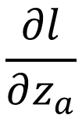


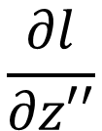

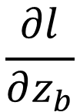


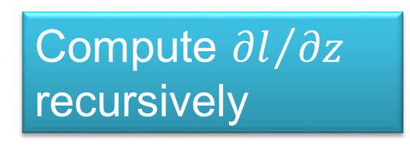
Neural Network
Compute ${∂l}/{∂z}$ for all activation function inputs z
Case 2. Not Output Layer
Compute ${∂l}/{∂z}$ recursively
$$z′$$
$$a′$$
$$w_{5}$$
$$z_{a}$$
$$\frac{∂l}{∂z′}$$
$$\frac{∂l}{∂z_{a}}$$
$$σ′\left(z′\right)$$
Until we reach the output layer ……
$$w_{6}$$
$z$’’
$$z_{b}$$
$$\frac{∂l}{∂z′′}$$
$$\frac{∂l}{∂z_{b}}$$
Notes:
20

Slide 21

















Neural Network
Compute ${∂l}/{∂z}$ for all activation function inputs z
Compute ${∂l}/{∂z}$ from the output layer
$$\frac{∂l}{∂z_{1}}$$
$$\frac{∂l}{∂z_{3}}$$
$$\frac{∂l}{∂z_{5}}$$
$$x_{1}$$
$$z_{1}$$
$$z_{3}$$
$$z_{5}$$
$$y_{1}$$
$$x_{2}$$
$$y_{2}$$
$$z_{2}$$
$$z_{4}$$
$$z_{6}$$
$$\frac{∂l}{∂z_{2}}$$
$$\frac{∂l}{∂z_{4}}$$
$$\frac{∂l}{∂z_{6}}$$
Notes:
21

Slide 22


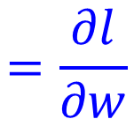


Neural Network
Forward Pass
Backward Pass
…
…
…
…
$$a$$
$$\frac{∂z}{∂w}$$
X
$$\frac{∂l}{∂z}$$
$$=\frac{∂l}{∂w}$$
$$=a$$
for all w
Notes:
22

Slide 23

Text Classification
A neural network can help us to classify the category of each text. Let’s define our problem
atheism
Classifier
graphics
motorcycles
Notes:
23

Slide 24

Text Classification
Data processing
The raw texts from 20 newsgroups dataset have many stop words and no-stemmed words. Therefore, we have to clean the data and preserve the significant information.
Stemming
Remove
Stop word
Raw data
Clean data
Stop word : Some extremely common words which would appear to be of little value in helping select documents matching a user need are excluded from the vocabulary entirely.
Stemming : For grammatical reasons, documents are going to use different forms of a word, such as organize, organizes, and organizing. If we don't stem the words in the raw text, we could not remove some stop words because of different forms not recorded in stop list.
Notes:
24

Slide 25
Text Classification
Vectorization
To use text data as our input in neural network, we must transfer texts of each news to a single vector. GloVe is an unsupervised learning algorithm for obtaining vector representations for words. We sum all vectors of all the words in the document.
Pre-trained
GloVe
Word
x
Text vector with Glove
Notes:
25

Slide 26
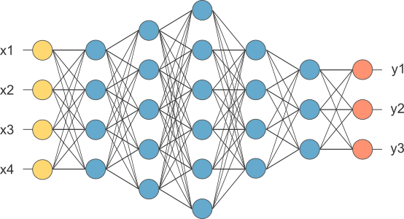
Text Classification
Then, we use a neural network model to help us classify this news belong which category. Through multiple fully-connected layers , the model can give us the probability of each category for the news.
Fully-connected layers
atheism
graphics
motorcycles
Vectorized input
Probability of each category
Notes:
26

Slide 27

Text Classification
Let’s start to practice building a text classification model
https://github.com/IKMLab/Feedforward-Tutorial/blob/master/text-classfication/text-classfication.ipynb
Notes:
27

