Slide 1
Travel aid for Blind
By
Anna Jomon
S6 MCA

Slide 2
Introduction
Visually impaired people face many problems in their day to day lives.
the propose a system by developing an Android App which would help a visually impaired person while traveling via the public transport system like Bus.
The proposed system uses an inbuilt feature of smart phone such as GPS location tracker to track the location of the user and Text to Speech converter.
The system also integrates Google Speech to Text converter for capturing the voice input and converts them to text.
This system recommends the requirement of installing a GPS module in buses for real time tracking.

Slide 3
Proposed system
propose a system develop a Mobile App, which could help a blind or visually impaired person to navigate in outdoor areas via public transport systems independently.
This App would act as a medium between the visually impaired and the society.
The App first tracks the location of the user via GPS and accept their destination via Google Speech to Text converter.
Based on the extracted destination, it retrieves the buses and guides the user.

Slide 4
Modules
1)Client side module
The working of the two modules associated with the Client side are:-
(a) User Module: It is installed on the smart phone of the user. When this module is activated, it automatically tracks the location of the user via GPS Locator. This information is then transferred to the Server along with the destination uttered to the module via Google Speech to Text converter.
(b) Bus Module: This module tracks the location of the bus and updates the Server, as latitude and longitude.
2)Server Side Module
Admin module, the Server side module which governs the bus database and the updates it. This module answers the query posted from the client modules which are connected in the network.

Slide 5
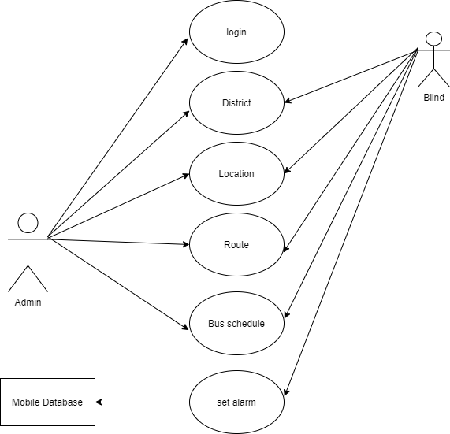
Diagrams Use Case Diagram

Slide 6
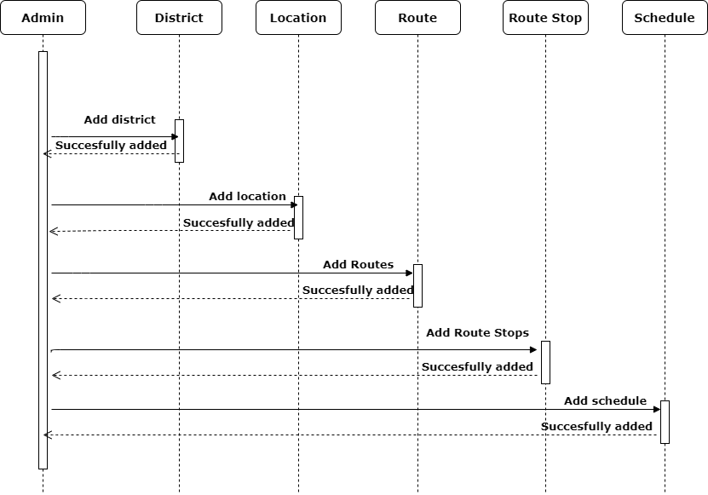
Sequence Diagram

Slide 7
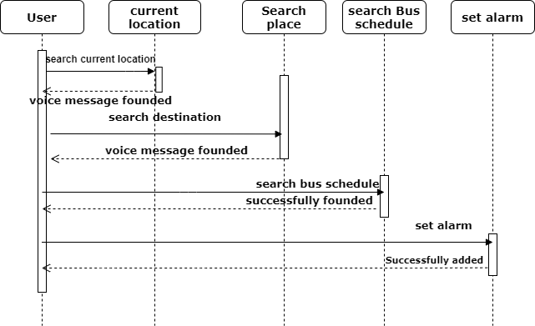

Slide 8
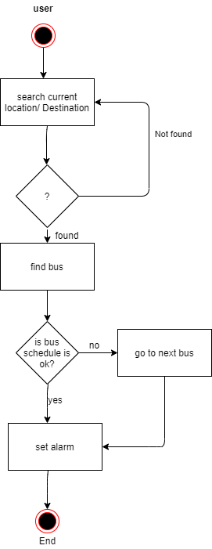
Activity Diagram

Slide 9
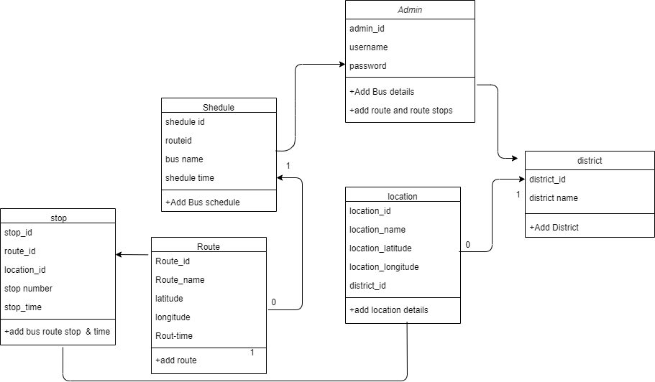
Class Diagram

Slide 10
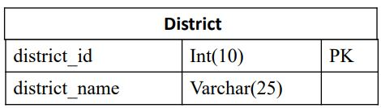
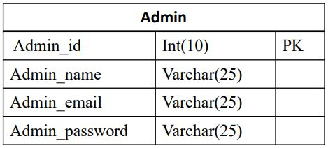
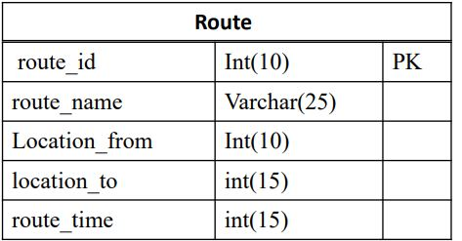
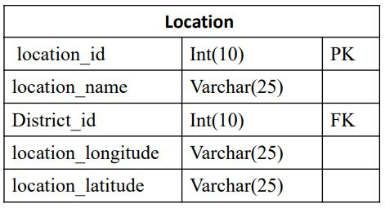
Table Design

Slide 11
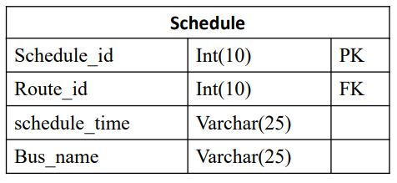
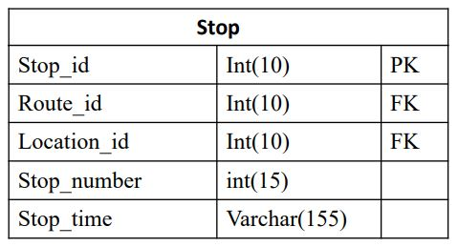

Slide 12
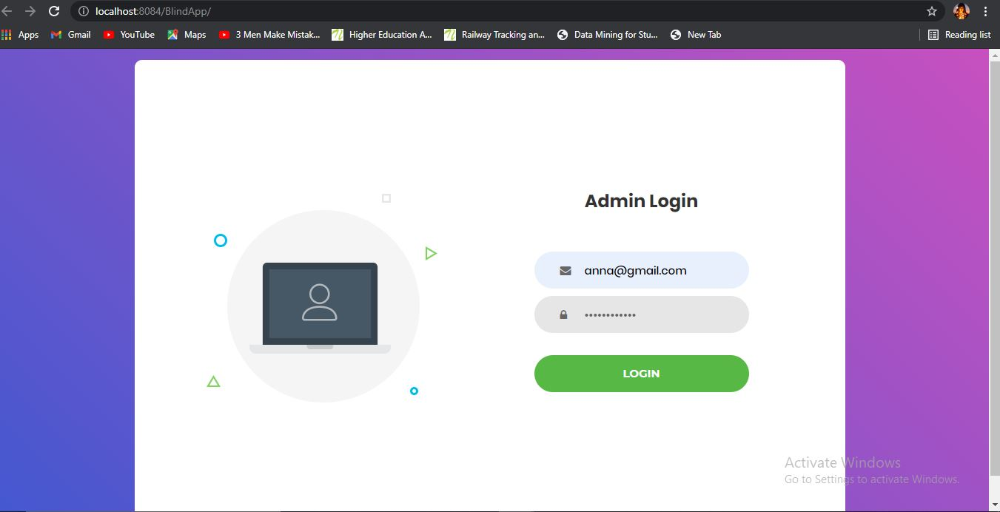
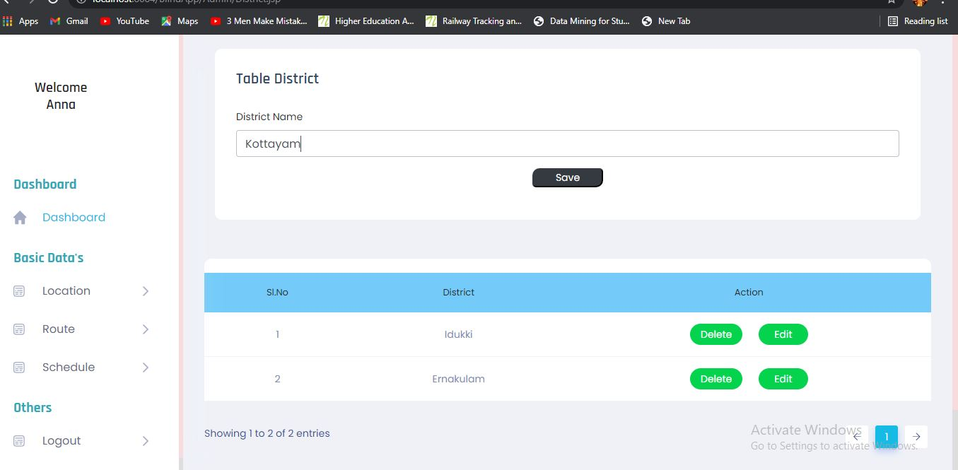
Screen Shorts

Slide 13
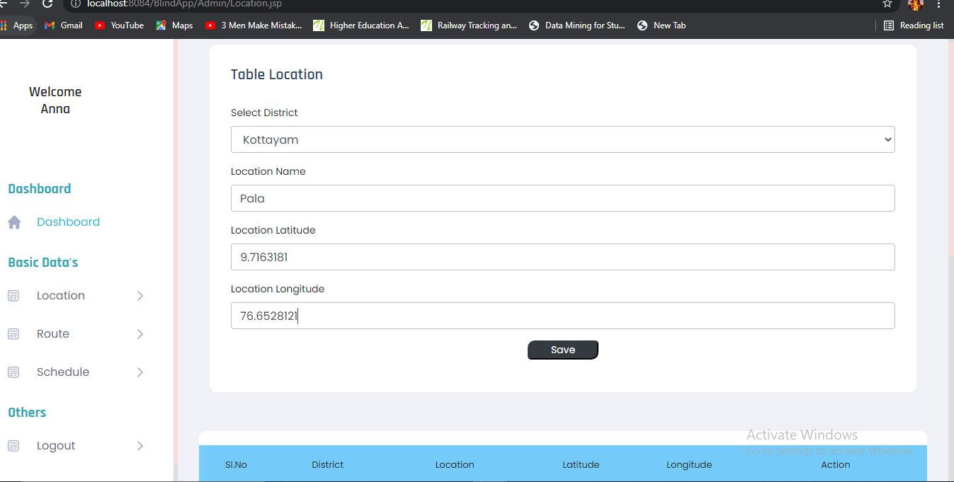
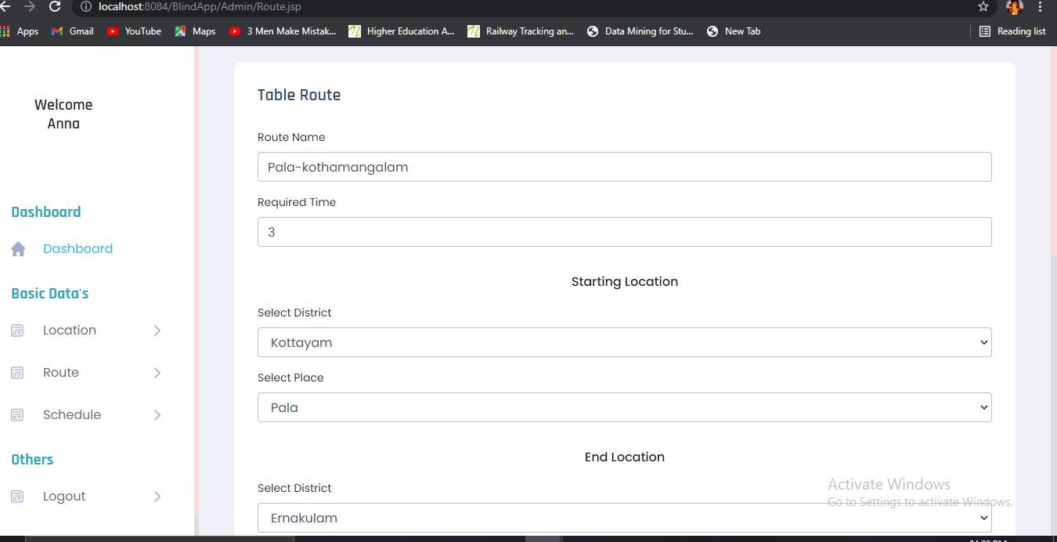

Slide 14
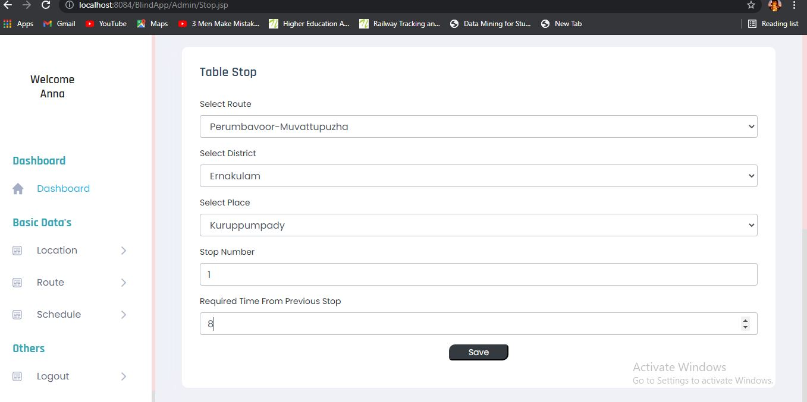
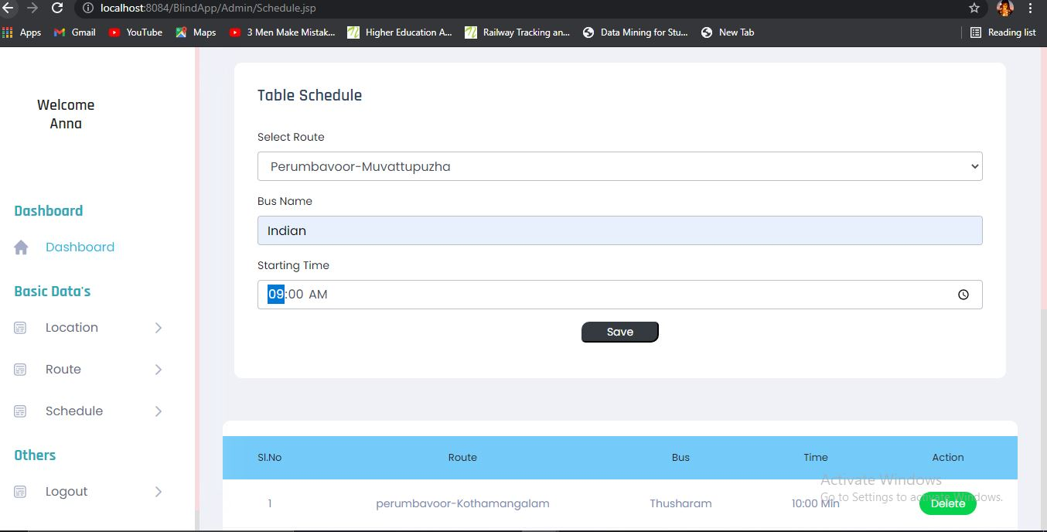

Slide 15
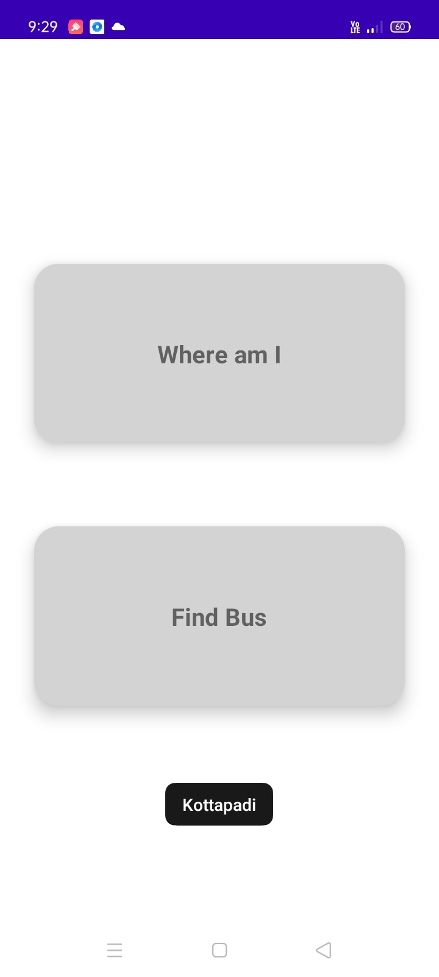
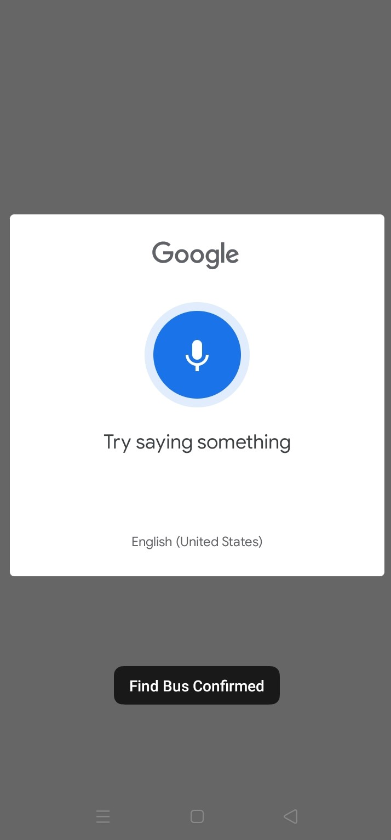
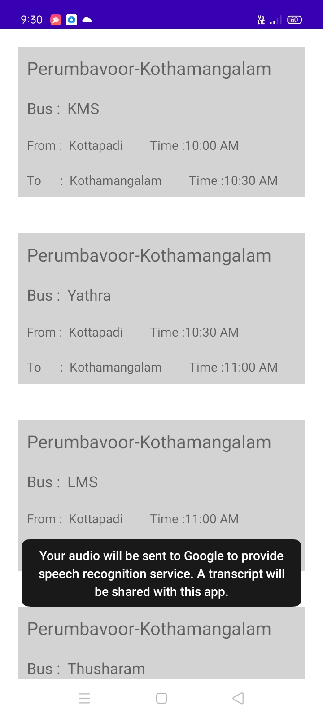
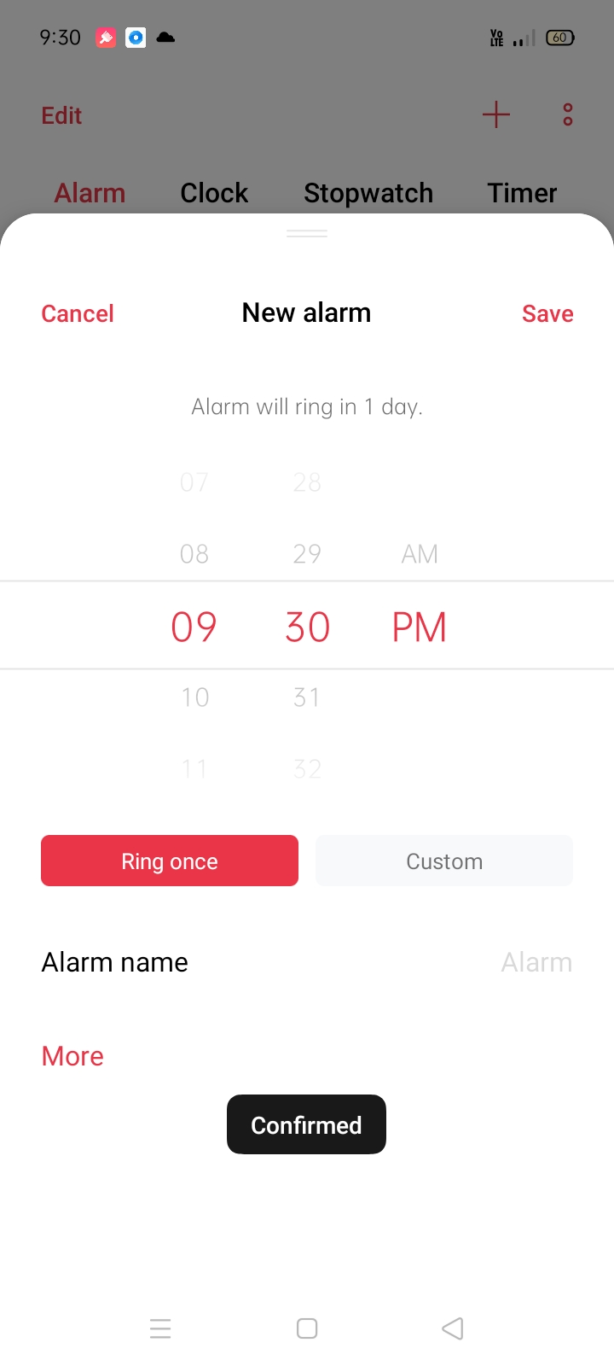

Slide 16
Thank you!!!

