Slide 1
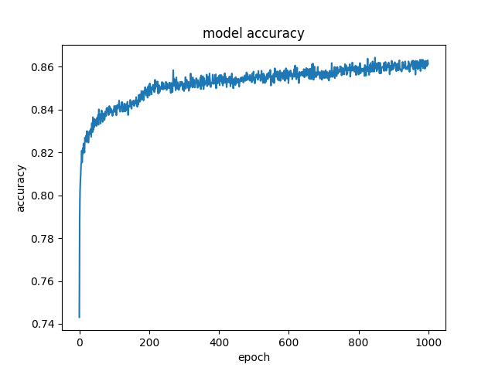
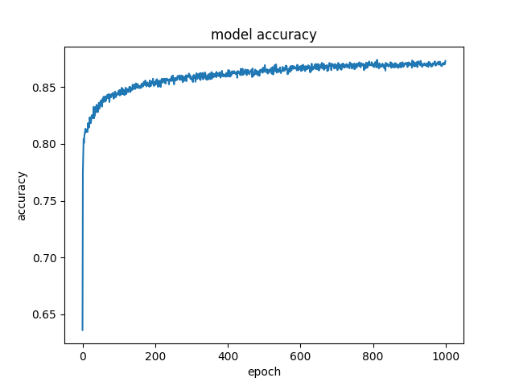
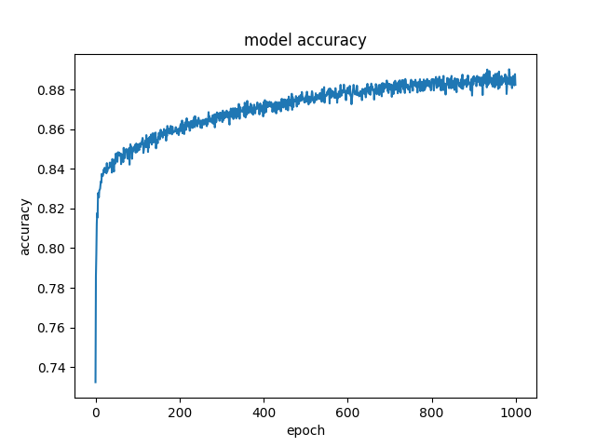
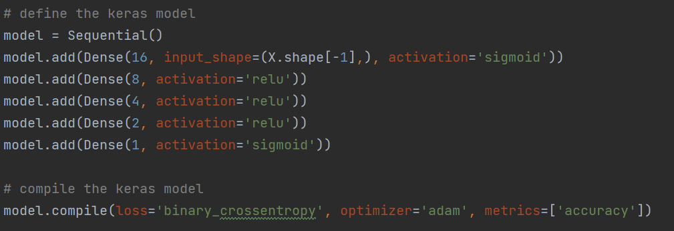
Neural Network
3 layer:
Accuracy = 0.87
4 layer:
Accuracy = 0.88
5 layer:
Accuracy = 0.89
Keras API for implementation
Dense layer:
output = activation(dot(input, kernel) + bias)
Different activation function were tried:
Combination of relu and sigmoid showed best result
Binary cross entropy for calculating loss
Input
Input
Input
16 Nodes (Relu)
16 Nodes (sigmoid)
16 Nodes (Relu)
8 Nodes (Relu)
8 Nodes (Relu)
8 Nodes (Relu)
4 Nodes (Relu)
4 Nodes (Relu)
1 Node (Sigmoid)
1 Node (Sigmoid)
2 Node (Relu)
1 Node (Sigmoid)
Output
Output
Output

