Slide 1
Outline
Stroke Prediction
Touchpoint Presentation 2
CS4641_B
Emma Long
Zhenming Liu
Anna Gardner
Yawen Tan
Background/Overview
Random Forest
SVM
Neural network
Interactive webpage

Slide 2
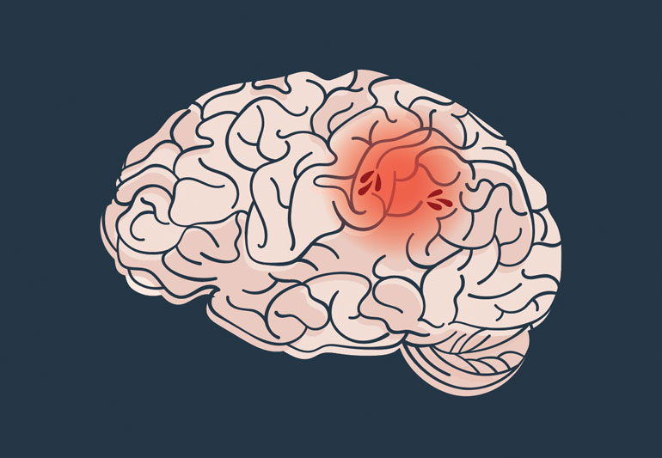
Background
Strokes are one of the most common diseases
Factors
Gender
Age
Smoking diabetes
Hypertension
Heart disease
high cholesterol levels
Marriage condition
Work type
Residence type
Avg. glucose level
BMI
Our results can also remind those who have high-risk health measurements to change their lifestyles to avoid stroke.

Slide 3
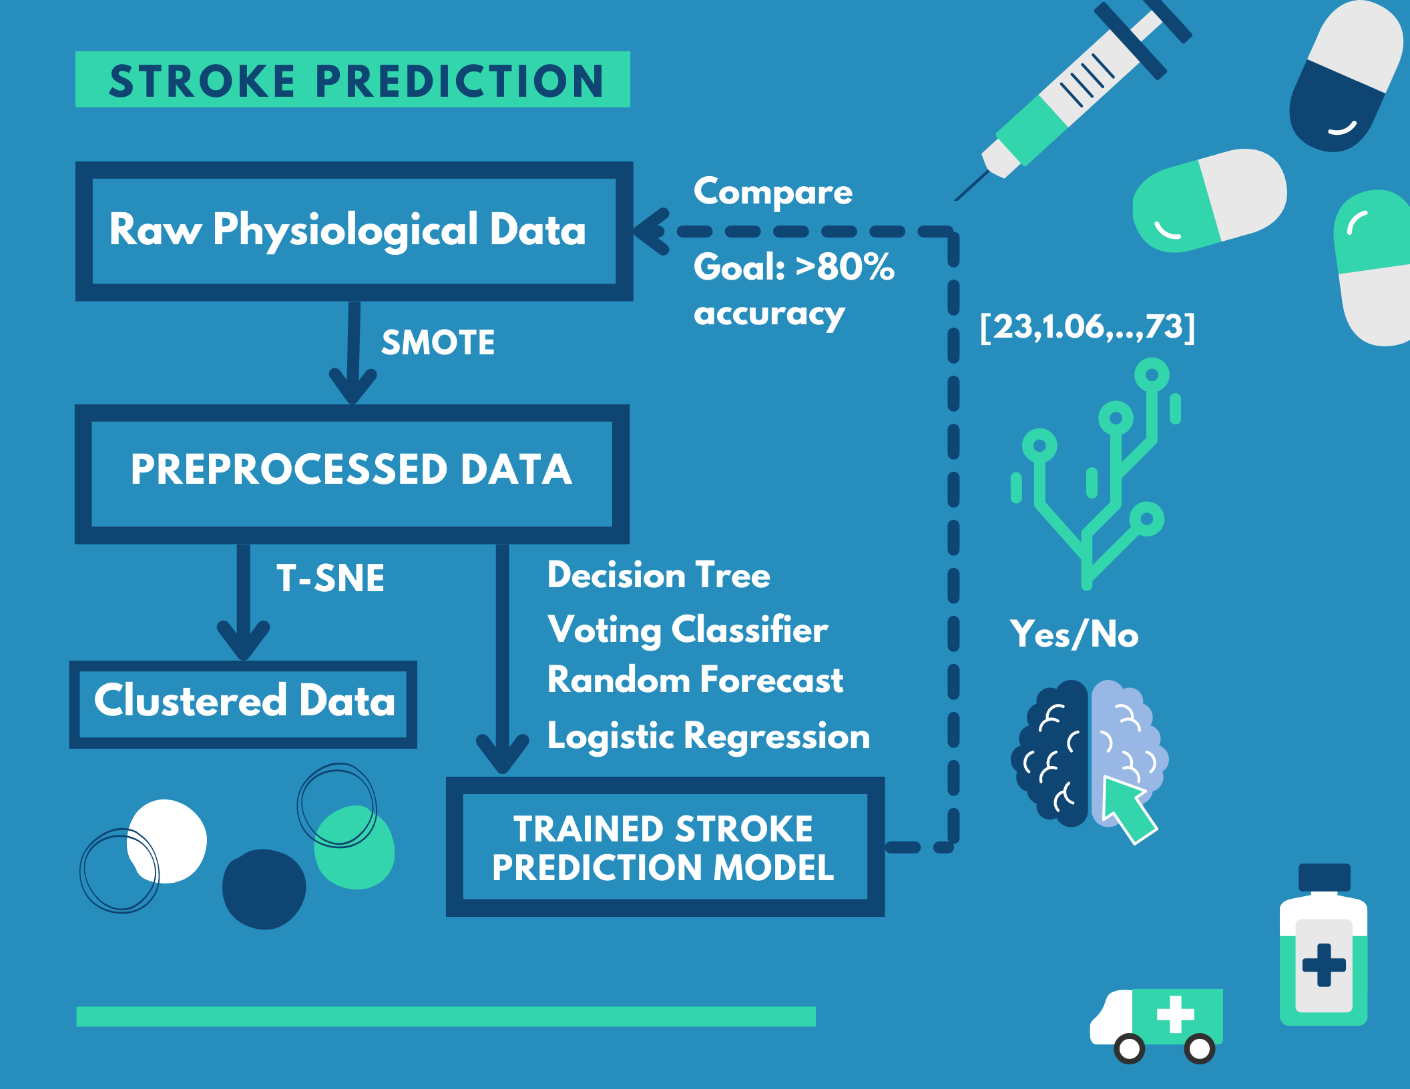

Slide 4
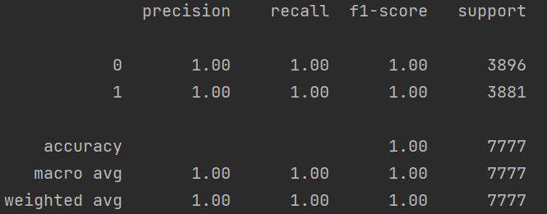
Random Forest
Tuned two hyperparameters:
n_estimator (number of random trees)
Max depth
If we have 100 trees and max depth =100 we can achieve 100 accuracy on test data!?

Slide 5
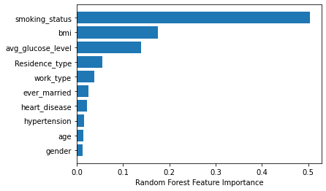
Feature Importance
The higher the feature importance value, the more important the feature is to predicting the target label.
Top three features for stroke
Smoking status
BMI
Glucose level

Slide 6
SVM
SMOTE Balanced & Feature Selected Data
Stroke positive: negative = 1:1
Removed gender feature
Test size is 20% of the original data. (1945)
Hard SVM
Simple SVM
Polynomial Kernel
Gaussian Kernel
Sigmoid Kernel
Radial Basis Function (RBF) Kernel
Soft SVM

Slide 7
Hard SVM
 | Precision |  | Recall |  | F1-score
Stroke (0/1) | 0 | 1 | 0 | 1 | 0 | 1
Simple SVM | 0.85 | 0.78 | 0.77 | 0.86 | 0.81 | 0.82
Polynomial Kernel (10) | 0.71 | 0.81 | 0.85 | 0.65 | 0.78 | 0.72
Gaussian Kernel | 0.85 | 0.72 | 0.67 | 0.87 | 0.75 | 0.79
Sigmoid Kernel | 0.41 | 0.40 | 0.40 | 0.40 | 0.40 | 0.40
RBF Kernel | 0.97 | 0.92 | 0.92 | 0.97 | 0.95 | 0.95
Important score
Recall (Since this is medical related problem, completion is most important)
Also evaluate precision and f-1 score
RBF kernel gives best score. (Which make sense, since it bring the data to infinite dimension space)

Slide 8
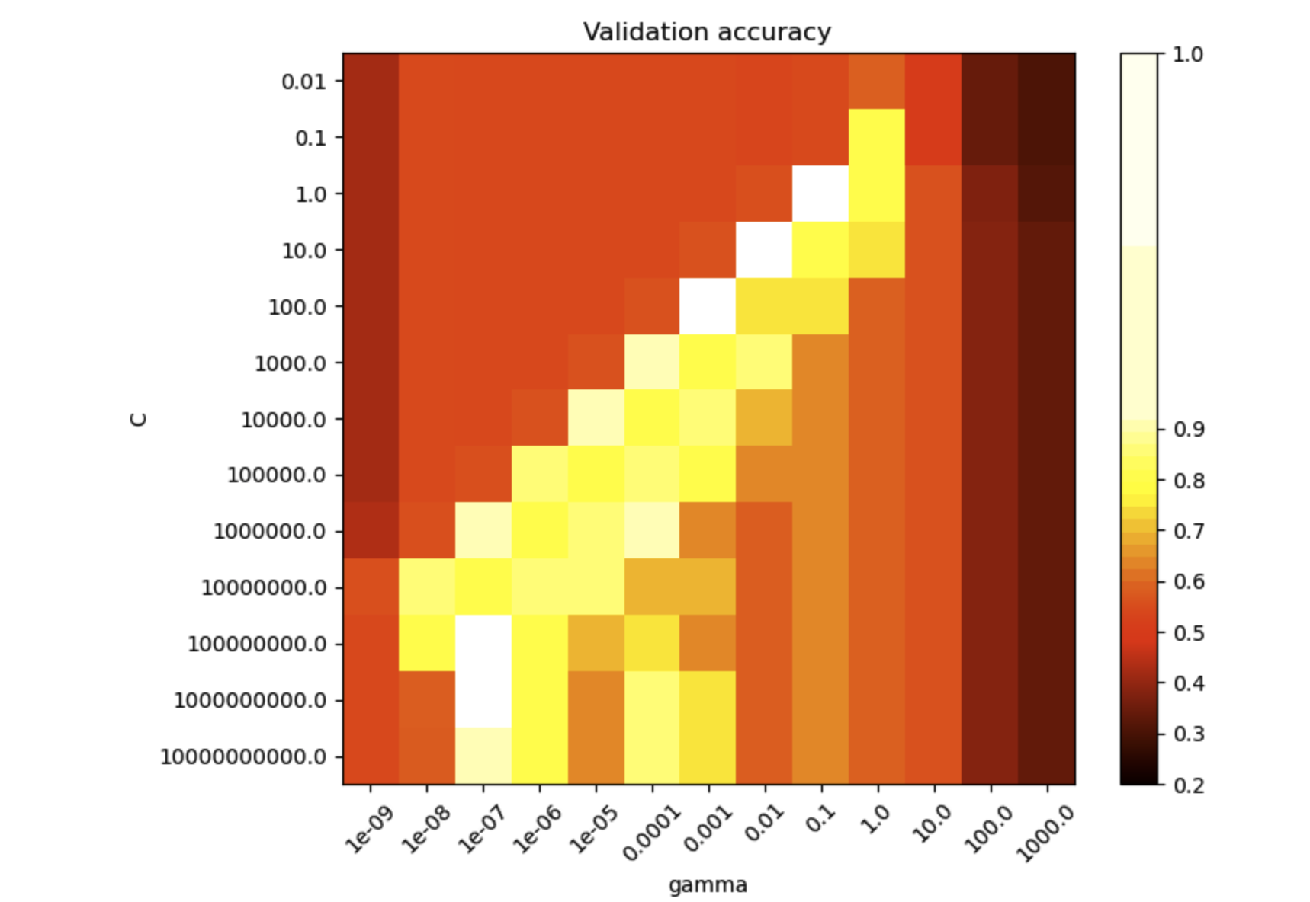
RBF hyperparameters tuning

Slide 9
SVM parameters tuning
Polynomial Kernel
Degree:
Precision increase
Recall decrease
F-1 decrease
Radial Basis Function (RBF) Kernel
Gamma: Inverse of the radius of influence of samples selected by the model as support vectors (low value means large radius).
Precision increase
Recall peak at around 0.1
F-1 peak at around 0.1

Slide 10
Soft SVM
C=0.01 | Precision |  | Recall |  | F1-score
Stroke (0/1) | 0 | 1 | 0 | 1 | 0 | 1
Simple SVM | 0.85 | 0.78 | 0.76 | 0.86 | 0.80 | 0.82
Polynomial Kernel (9) | 0.62 | 0.84 | 0.92 | 0.41 | 0.74 | 0.55
Gaussian Kernel | 0.86 | 0.69 | 0.61 | 0.90 | 0.71 | 0.78
Sigmoid Kernel | 0.38 | 0.43 | 0.25 | 0.58 | 0.30 | 0.49
RBF Kernel (C=0.1) | 0.82 | 0.93 | 0.94 | 0.78 | 0.87 | 0.85
C:
Trades off correct classification of training examples against maximization of the decision function’s margin.
Important score
Recall (Since this is medical related problem, completion is most important)
Also evaluate precision and f-1 score

Slide 11
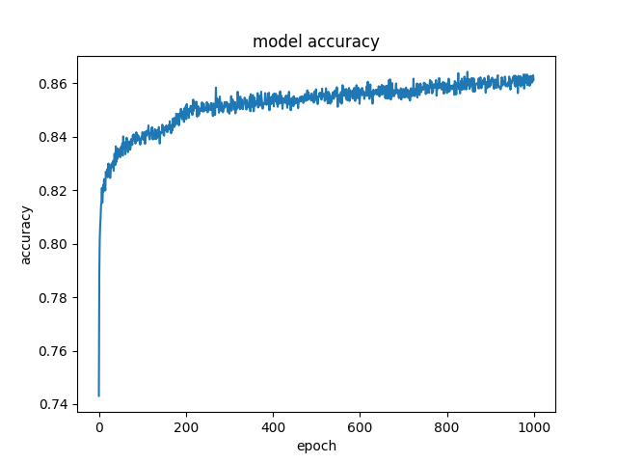
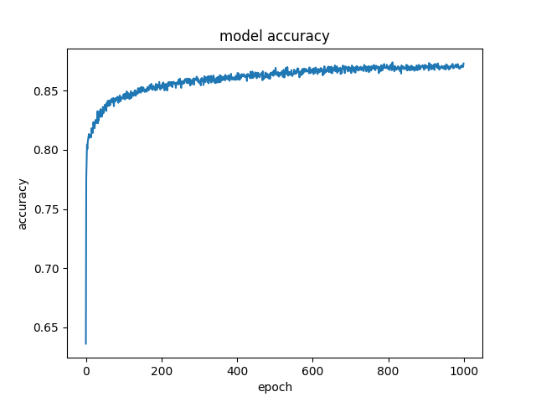
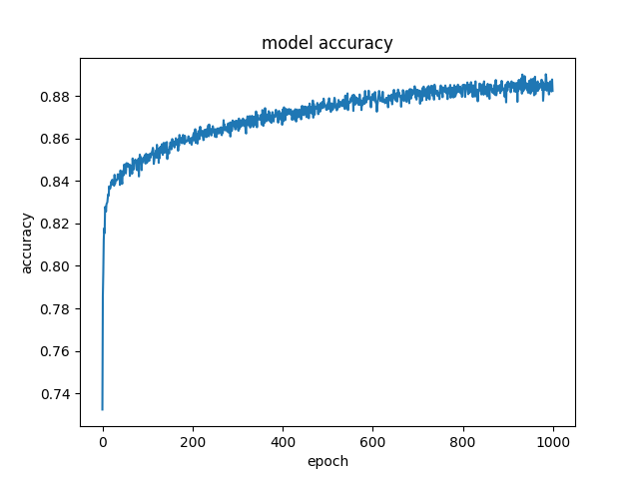
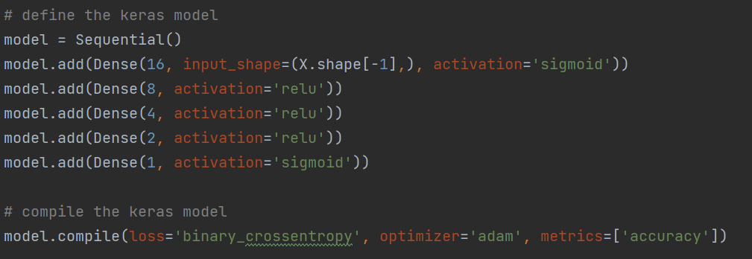
Neural Network
3 layer:
Accuracy = 0.87
4 layer:
Accuracy = 0.88
5 layer:
Accuracy = 0.89
Keras API for implementation
Dense layer:
output = activation(dot(input, kernel) + bias)
Different activation function were tried:
Combination of relu and sigmoid showed best result
Binary cross entropy for calculating loss
Input
Input
Input
16 Nodes (Relu)
16 Nodes (sigmoid)
16 Nodes (Relu)
8 Nodes (Relu)
8 Nodes (Relu)
8 Nodes (Relu)
4 Nodes (Relu)
4 Nodes (Relu)
1 Node (Sigmoid)
1 Node (Sigmoid)
2 Node (Relu)
1 Node (Sigmoid)
Output
Output
Output

Slide 12
Interactive webpage

