Slide 1
MICROSOFT
MOVIE CREATION ANALYSIS

Slide 2
APPROACH USED IN ANALYSIS
Exploring and investigating past movie data sets and checking what types of films are currently doing the best at the box office.
Translating those findings into actionable insights and give recommendations that the head of Microsoft's new movie studio can use to help decide what type of films to create.

Slide 3
BUSINESS PROBLEM STATEMENT
Microsoft sees all the big companies creating original video content and they want to get in on the fun.
Microsoft has decided to create a new movie studio, but they don’t know anything about creating movies.
We need to investigate, analyze and help decide what type of films to create in Microsoft's new movie studio

Slide 4
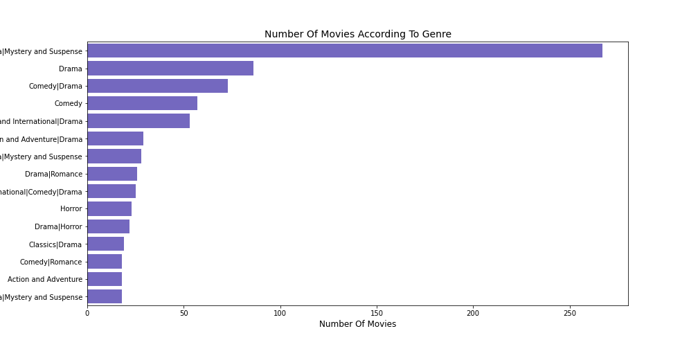
RECOMMENDATION 1
Drama with mystery and suspense, comedy, action and adventure are the leading produced genres .
Let’s look if these genres are profitable before we make a conclusion.

Slide 5
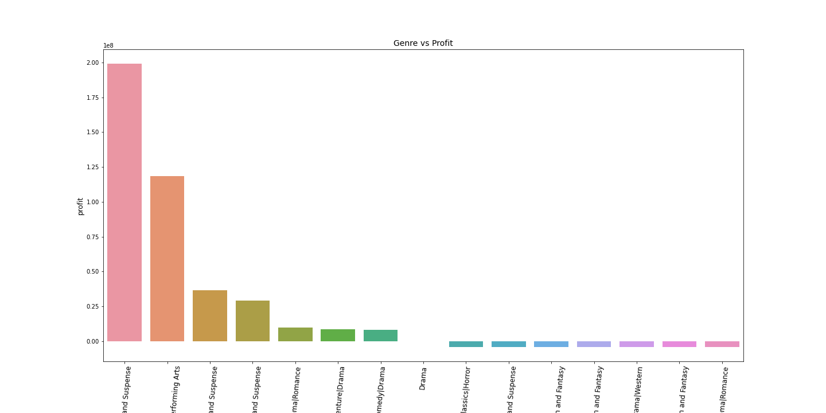
RECOMMENDATION 1 CONT..
Drama is indeed the most profitable genre, or drama related movies are very profitable in terms of the mean profit.
Action and comedy follow closely too.
I recommend Microsoft to look into producing drama related movies with comedy, Action, mystery and suspense because of the high returns they bring.

Slide 6
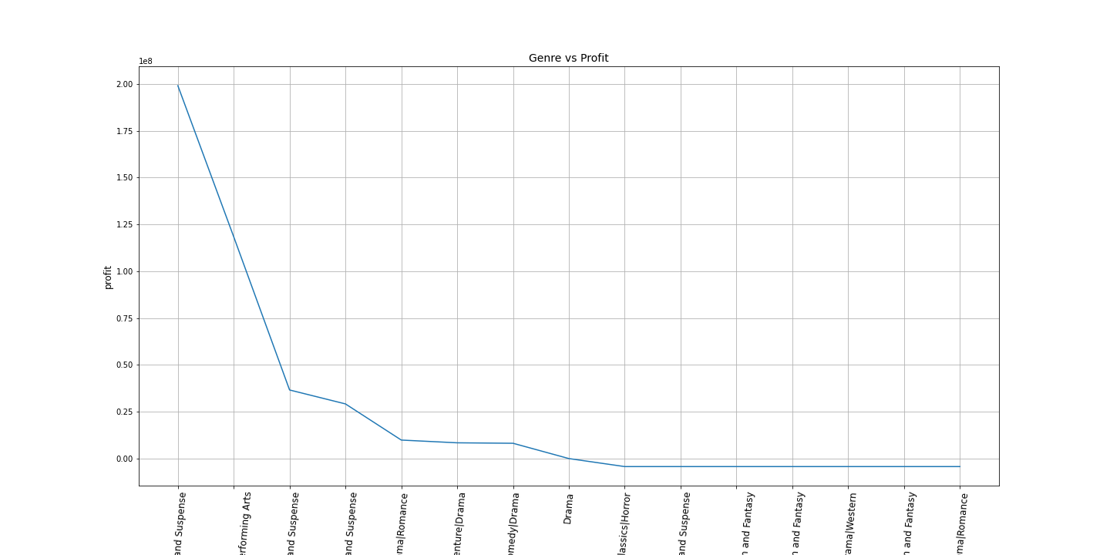
A bonus graph to show the genres that make the most money and to what extent in relation to the other genres.
Drama is indeed the most profitable genre, or drama related movies are very profitable and to a very great extent.

Slide 7
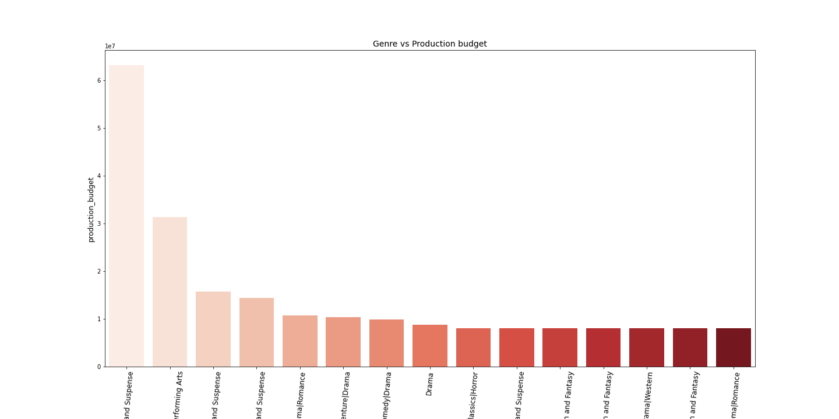
IMPORTANT TO NOTE ABOUT RECOMMENDATION 1
It is worth noting that the most profitable genres are also the most expensive genres to produce.

Slide 8
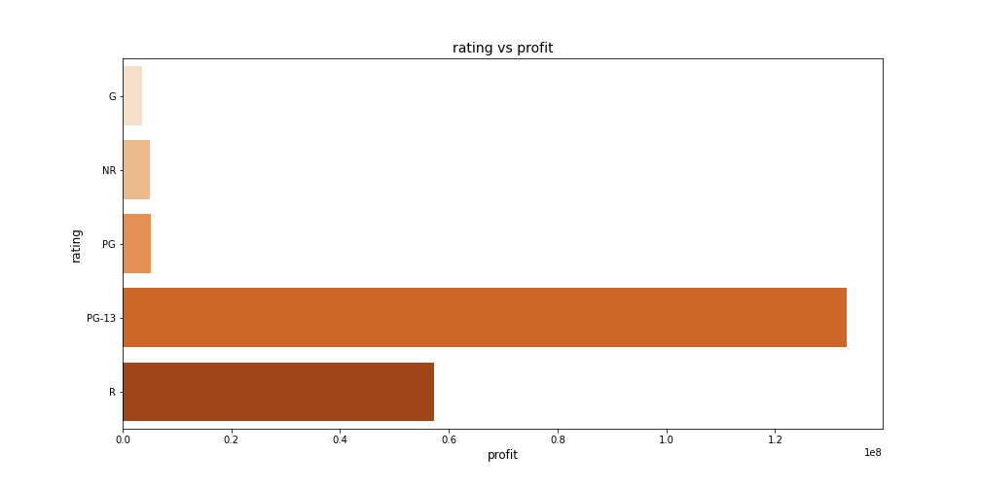
RECOMMENDATION 2
From this graph ,R-rated movies and PG-13 rated movies make the most profit as compared to G and NR movies.
Microsoft should consider the rating of the movie depending on the target market of course.
I recommend PG-13 and R rated movies because they make the highest returns.

Slide 9
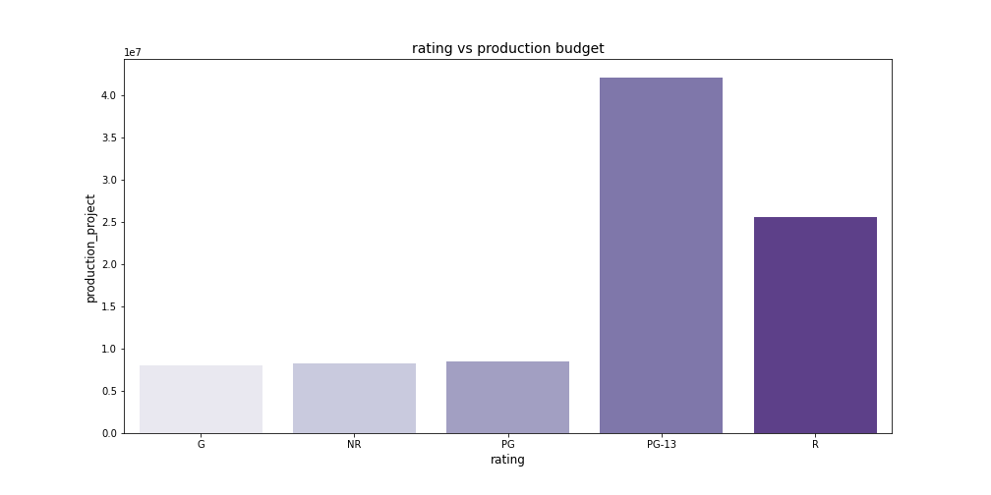
RECOMMENDATION 2 CONT..
The Rated movies are have a higher budget to produce but they also have the highest returns .

Slide 10
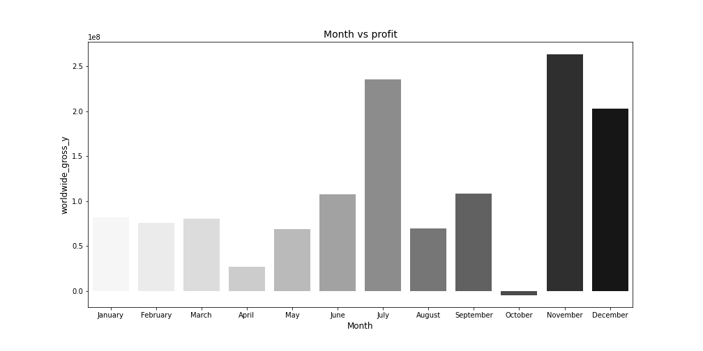
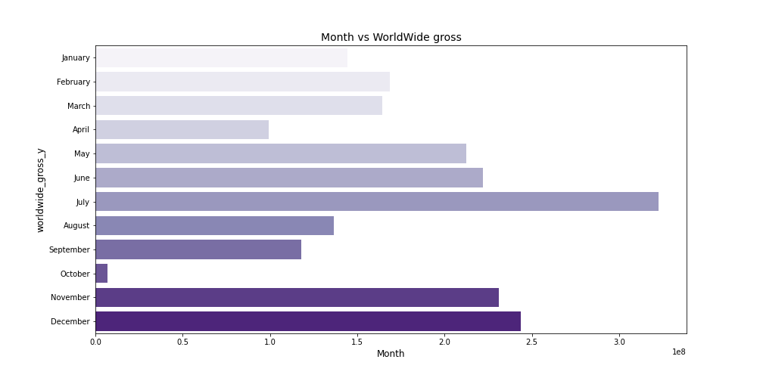
RECOMMENDATION 3
From the graphs above, most profits returns are in June , July , November and December .
I recommend Microsoft to be releasing most of their movies in the Month of June, July, November, December has the most profit makes the most returns .

Slide 11
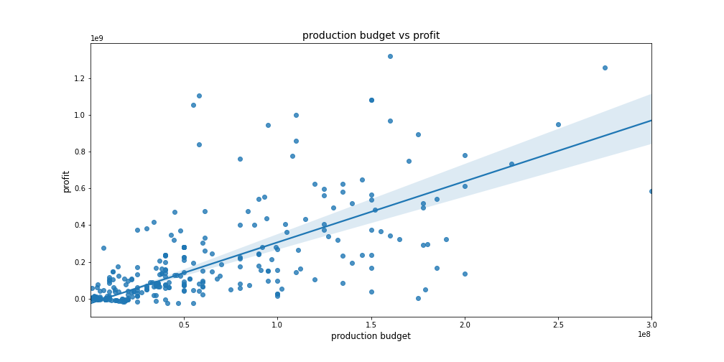
BONUS INFORMATION
This graph shows that the higher the production budget, the higher the profit returns.
Microsoft should keep this in mind when producing movies.

Slide 12
CONCLUSION
*Time in the year movie is produced is important in relation to the profit.
*Movie rating is an important factor to be considered(depending
on the audience of course) to make more returns.
*The most produced genres are indeed the most profitable genres with a highest production budget.

Slide 13
THANK YOU!!
By Anastacia Nyamoita

