Slide 1

Flappy Bird
Make your first game in a day!

Slide 2
Concepts you will learn
Variables
Functions
Loops
Conditionals
Arrays

Slide 3
Project repository
https://github.com/cambridgecoding/webapp-flappy
Fork
Clone in WebStorm
Add your pair as collaborator

Slide 4
Module 1
First steps: statements, functions, arguments

Slide 5
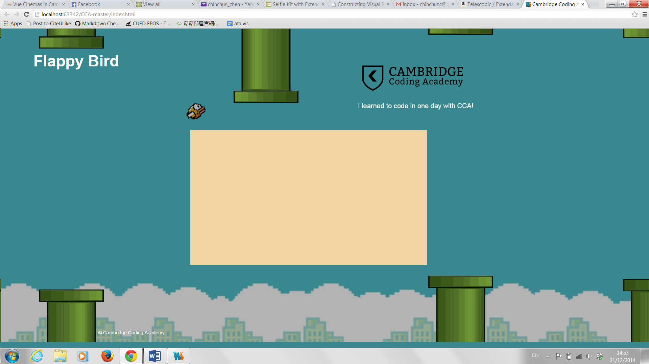
LA 1&2: Setting the background colour
game.stage.setBackgroundColor("#FFCC66");

Slide 6
LA 1&2: Setting the background colour
game.stage.setBackgroundColor("#FFCC66");
Six Characters: any letter A-F – any number 0-9

Slide 7
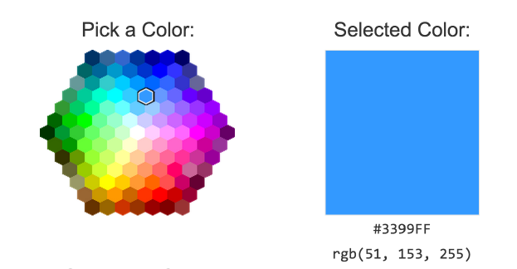
LA 1&2: Setting the background colour
game.stage.setBackgroundColor("#FFCC66");
Six Characters: any letter A-F – any number 0-9
http://www.w3schools.com/tags/
ref_colorpicker.asp

Slide 8
Quiz
What lines are valid statements?
game.stage.setBackgroundColor.("#F3D3A3");
game.stage.setbackgroundcolor("#F3D3A3");
game.stage.setBackgroundColor"#F3D3A3");
game..stage.setBackgroundColor("#F3D3A3");
game.stage.setBackgroundColor("#F3D3A3");
GAME.STAGE.SETBACKGROUNDCOLOR("#F3D3A3");
game.stage.set_background_color("#F3D3A3");

Slide 9
Answer
Line 5 is the only correct statement.

Slide 10
LA 3: Adding text

Slide 11
LA 3: Adding text
game.add.text(20, 20, "Welcome!");

Slide 12
Quiz
How many arguments are there in these function calls?
game.add.text(20, 20, "Welcome!");
game.add.text(20, 20, "Welcome!", {font: "30px Arial"});
game.add.text(20, 20, "Welcome!", {font: "30px Arial", fill: "#FFFFFF"});

Slide 13
Quiz
How many arguments are there in this function calls?
game.add.text(20, 20, "Welcome!");
game.add.text(20, 20, "Welcome!", {font: "30px"});
game.add.text(20, 20, "Welcome!", {font: "30px", fill: "#FFFFFF"});
Answer: 3, 4 and 4.

Slide 14
Load your picture…
preload(){
game.load.image("playerImg", "../assets/jamesBond.gif");
}

Slide 15
Load your picture…
preload(){
game.load.image("playerImg", "../assets/jamesBond.gif");
}
…then add it to the game!
create(){
….
game.add.sprite(10, 270, "playerImg");
}

Slide 16
Module 1 Wrap Up
A statement is an instruction for the computer.
A function has
a name,
parameters (between ()), and
a list of instructions (between {}).

Slide 17
Module 1 Wrap Up
A statement is an instruction for the computer.
A function has
a name,
parameters (between ()), and
a list of instructions (between {}).
Example – create function
function create() {
game.stage.setBackgroundColor("#F3D3A3");
game.add.text(20, 20, "Welcome to my game",{font: "30px Arial", fill: #FFFFFF"});
game.add.sprite(80, 200, "playerImg");
}

Slide 18
Module 1 Wrap Up
Call a function using its name and some arguments (between ()).

Slide 19
Module 1 Wrap Up
Call a function using its name and some arguments (between ()).
Example – Calling the function “game.add.text”:
game.add.text(20, 20, "Welcome!", {font: "30px Arial", fill: "#FFFFFF"});

Slide 20
Module 2
Events and user interactions

Slide 21
LA 1: Alerts
function clickHandler() {
alert("CLICK!");
}
game.input.onDown.add(clickHandler);

Slide 22
LA 1: Alerts
function clickHandler() {
alert("CLICK!");
}
game.input.onDown.add(clickHandler);
What to do.

Slide 23
LA 1: Alerts
function clickHandler() {
alert("CLICK!");
}
game.input.onDown.add(clickHandler);
When to do it.

Slide 24
Quiz
How many arguments are passed to the function game.input.onDown.add?
What sort of arguments are they?
game.input.onDown.add(clickHandler);

Slide 25
Quiz
The function receives one argument called clickHandler.
The argument clickHandler is a function.
game.input.onDown.add(clickHandler);

Slide 26
LA 2&3: Using event argument
function clickHandler(event) {
game.add.sprite(event.x, event.y,"img");
}

Slide 27
Quiz: Event argument
Where is the image displayed?
How is the value of event set? (Who sets it? When?)
function clickHandler(event) {
game.add.sprite(event.x, event.y,"img");
}
game.input.onDown.add(clickHandler);

Slide 28
Answer
The image appears where the user clicks.
The value of event is set
by the web browser
when the user clicks.

Slide 29
Module 3
Variables

Slide 30
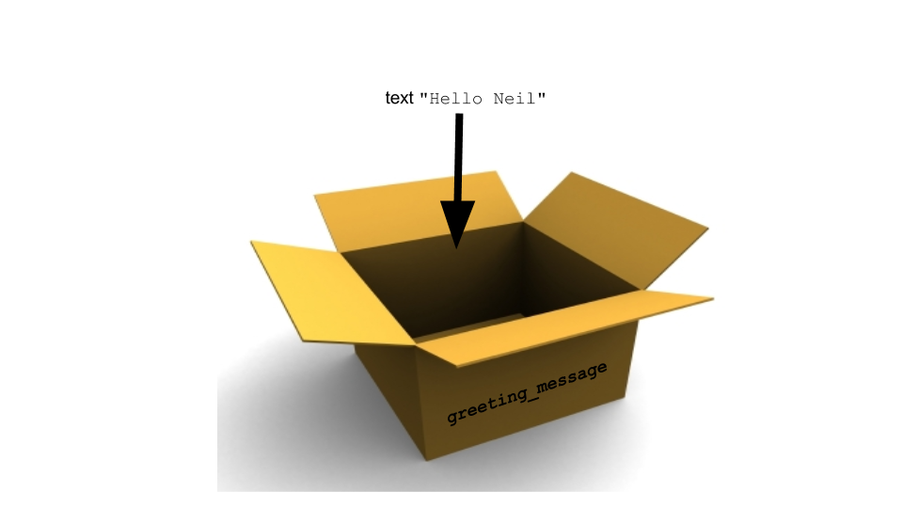
LA 1&2: Variables

Slide 31
Quiz: variables
How to declare a variable?
How to set the value of a variable?
How to retrieve the value of a variable?

Slide 32
Quiz: variables
How to declare a variable?
How to set the value of a variable?
How to retrieve the value of a variable?
var score; // use the var keyword
score = 0; // use the = operator
score // just write the variable

Slide 33
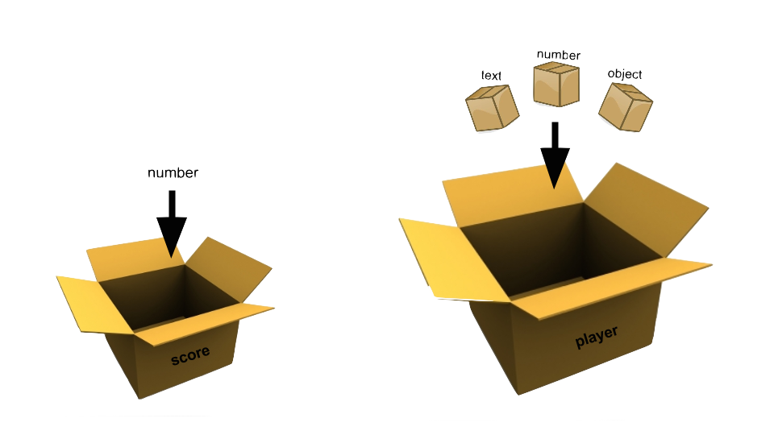
LA 3: Methods and members

Slide 34
Quiz: members and methods
How to access the value held inside a member of a variable?
How to call a method held inside a variable?

Slide 35
Quiz: members and methods
How to access the value held inside a member of a variable?
How to call a method held inside a variable?
//use . to access member
player.x = player.x + 1;
//use . and treat as a function
player.kill();

Slide 36
Syntactic “sugar”
player.x = player.x + 1;
player.x += 1;
player.x++

Slide 37
Syntactic “sugar”
player.x = 100
player.x += 2 → player.x = 102
player.x = player.x + 1;
player.x += 1;
player.x++

Slide 38
Syntactic “sugar”
player.x = 100
player.x += 2 → player.x = 102
player.x = 100
player.x *= 2 → ?
player.x = player.x + 1;
player.x += 1;
player.x++

Slide 39
Syntactic “sugar”
player.x = 100
player.x += 2 → player.x = 102
player.x = 100
player.x *= 2 → 200
player.x = player.x + 1;
player.x += 1;
player.x++

Slide 40
Syntactic “sugar”
player.x = 100
player.x += 2 → player.x = 102
player.x = 100
player.x *= 2 → 200
player.x = 300
player.x = player.x + 1;
player.x += 1;
player.x++

Slide 41
Syntactic “sugar”
player.x = 100
player.x += 2 → player.x = 102
player.x = 100
player.x *= 2 → 200
player.x = 300
player.x /= 2 → ?
player.x = player.x + 1;
player.x += 1;
player.x++

Slide 42
Syntactic “sugar”
player.x = 100
player.x += 2 → player.x = 102
player.x = 100
player.x *= 2 → 200
player.x = 300
player.x /= 2 → 150
player.x = player.x + 1;
player.x += 1;
player.x++

Slide 43
Syntactic “sugar”
player.x = 100
player.x += 2 → player.x = 102
player.x = 100
player.x *= 2 → 200
player.x = 300
player.x /= 2 → 150
player.x = 173
player.x = player.x + 1;
player.x += 1;
player.x++

Slide 44
Syntactic “sugar”
player.x = 100
player.x += 2 → player.x = 102
player.x = 100
player.x *= 2 → 200
player.x = 300
player.x /= 2 → 150
player.x = 173
player.x /2.5 → ??
player.x = player.x + 1;
player.x += 1;
player.x++

Slide 45
Syntactic “sugar”
player.x = 100
player.x += 2 → player.x = 102
player.x = 100
player.x *= 2 → 200
player.x = 300
player.x /= 2 → 150
player.x = 173
player.x /2.5 → 69.2
player.x = player.x + 1;
player.x += 1;
player.x++

Slide 46
Module 3 Wrap Up
A variable is a named container for a value.
Variables are only available for the length of their scope: global or local.
Variables can be nested. Use the . (dot) to access inner members.

Slide 47
Module 4
Loops and conditionals

Slide 48

LA 1: Producing vertical pipes
game.add.sprite(100, 50*0, "pipe");
(100,0)
790
0
400

Slide 49
LA 1: Producing vertical pipes
game.add.sprite(100, 50*0, "pipe");
game.add.sprite(100, 50*1, "pipe");
(100,50)
790
0
400

Slide 50
LA 1: Producing vertical pipes
game.add.sprite(100, 50*0, "pipe");
game.add.sprite(100, 50*1, "pipe");
game.add.sprite(100, 50*2, "pipe");
(100,100)
790
0
400

Slide 51
LA 1: Producing vertical pipes
game.add.sprite(100, 50*0, "pipe");
game.add.sprite(100, 50*1, "pipe");
game.add.sprite(100, 50*2, "pipe");
game.add.sprite(100, 50*3, "pipe");
game.add.sprite(100, 50*4, "pipe");
game.add.sprite(100, 50*5, "pipe");
game.add.sprite(100, 50*6, "pipe");
game.add.sprite(100, 50*7, "pipe")
(100,350)
790
0
400

Slide 52
LA 1: Producing vertical pipes with for loops
game.add.sprite(100, 50*0, "pipe");
game.add.sprite(100, 50*1, "pipe");
game.add.sprite(100, 50*2, "pipe");
…
game.add.sprite(100, 50*7, "pipe");
8 lines

Slide 53
LA 1: Producing vertical pipes with for loops
game.add.sprite(100, 50*0, "pipe");
game.add.sprite(100, 50*1, "pipe");
game.add.sprite(100, 50*2, "pipe");
…
game.add.sprite(100, 50*7, "pipe");
for(var count=0; count<8; count++){
game.add.sprite(100, 50*count, "pipe");
}
8 lines

Slide 54
LA 1: Producing vertical pipes with for loops
game.add.sprite(100, 50*0, "pipe");
game.add.sprite(100, 50*1, "pipe");
game.add.sprite(100, 50*2, "pipe");
…
game.add.sprite(100, 50*7, "pipe");
for(var count=0; count<8; count++){
game.add.sprite(100, 50*count, "pipe");
}
8 lines
3 lines

Slide 55
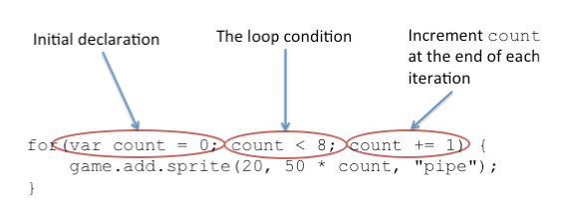
LA 1: Loops
for(var count=0; count<8; count++){
game.add.sprite(100, 50*count, "pipe");
}

Slide 56
LA 1: Loops
790
0
400

Slide 57
LA 1: Loops
for(var count=0; count<8; count++){
game.add.sprite(100, 50*count, "pipe");
}
790
0
400

Slide 58
LA 1: Loops
for(var count=0; count<8; count++){
game.add.sprite(100, 50*count, "pipe");
}
Count = 0 -> position: (100, 50*0)

Slide 59
LA 1: Loops
for(var count=0; count<8; count++){
game.add.sprite(100, 50*count, "pipe");
}
Count = 0 -> position: (100, 50*0)
(100,0)

Slide 60
LA 1: Loops
for(var count=0; count<8; count++){
game.add.sprite(100, 50*count, "pipe");
}
Count = 0 -> position: (100, 50*0)
Count = 1 -> position: (100, 50*1)

Slide 61
LA 1: Loops
for(var count=0; count<8; count++){
game.add.sprite(100, 50*count, "pipe");
}
Count = 0 -> position: (100, 50*0)
Count = 1 -> position: (100, 50*1)
(100,50)

Slide 62
LA 1: Loops
for(var count=0; count<8; count++){
game.add.sprite(100, 50*count, "pipe");
}
Count = 0 -> position: (100, 50*0)
Count = 1 -> position: (100, 50*1)
Count = 2 -> position: (100, 50*2)

Slide 63
LA 1: Loops
for(var count=0; count<8; count++){
game.add.sprite(100, 50*count, "pipe");
}
Count = 0 -> position: (100, 50*0)
Count = 1 -> position: (100, 50*1)
Count = 2 -> position: (100, 50*2)
(100,100)

Slide 64
LA 1: Loops
for(var count=0; count<8; count++){
game.add.sprite(100, 50*count, "pipe");
}
Count = 0 -> position: (100, 50*0)
Count = 1 -> position: (100, 50*1)
Count = 2 -> position: (100, 50*2)
…
…
Count = ? -> position: (100, 50*?)

Slide 65
LA 1: Loops
for(var count=0; count<8; count++){
game.add.sprite(100, 50*count, "pipe");
}
Count = 0 -> position: (100, 50*0)
Count = 1 -> position: (100, 50*1)
Count = 2 -> position: (100, 50*2)
…
…
Count = 7 -> position: (100, 50*7)
(100,350)

Slide 66
Quiz: loops
for(var i=0; i<10; i++){
console.log(i);
}
for(var i=10; i<20; i++){
console.log(i);
}
for(var i=0; i<10; i=i+2){
console.log(i);
}
How many iterations?
What gets printed on the console?

Slide 67
LA 2: Conditionals
if(x < 5) {
console.log("x is less than 5");
}
if(x == 10) {
console.log("x is 10");
}

Slide 68
LA 2: Conditionals
for(var i=0; i<10; i++){
if(i < 5) {
console.log(“i is less than 5");
}
if(i == 7) {
console.log(“i is 7");
}
}

Slide 69
LA 2: Conditionals
Output: ?!?
for(var i=0; i<10; i++){
if(i < 5) {
console.log(“i is less than 5");
}
if(i == 7) {
console.log(“i is 7");
}
}

Slide 70
LA 2: Conditionals
Output:
for(var i=0; i<10; i++){
if(i < 5) {
console.log(“i is less than 5");
}
if(i == 7) {
console.log(“i is 7");
}
}
i is less than 5
i is less than 5
i is less than 5
i is less than 5
i is less than 5
i is 7

Slide 71
LA 2: Conditionals
Output:
for(var i=0; i<10; i++){
if(i < 5) {
console.log(“i is less than 5");
}
if(i == 7) {
console.log(“i is 7");
}
}
i is less than 5
i is less than 5
i is less than 5
i is less than 5
i is less than 5
i is 7
i = 0
i = 1
i = 2
i = 3
i = 4
i = 5
i = 6
i = 7
i = 8
i = 9

Slide 72
LA 2: Arrays
//initialize the variable “arr” as an empty array
var arr = [];

Slide 73
LA 2: Arrays
//initialize the variable “arr” as an empty array
var arr = [];
//define your array
arr = [1,3,5];
1 3 5

Slide 74
LA 2: Arrays
//initialize the variable “arr” as an empty array
var arr = [];
//define your array
arr = [1,3,5];
//add “6” to the array
arr.push(6);
1 3 5
1 3 5 6

Slide 75
LA 2: Arrays
//initialize the variable “arr” as an empty array
var arr = [];
//define your array
arr = [1,3,5];
//add “6” to the array
arr.push(6);
//print the first and third elements
console.log(arr[0]) -> 1
console.log(arr[2]) -> 5
1 3 5
1 3 5 6

Slide 76
Module 4 Wrap Up
Loops execute the same block of instruction several times.
Conditionals (if-then-else) execute instruction only in certain cases.

Slide 77
Module 5
Physics and more events

Slide 78
LA 1-8: Physics and moving parts
Start engine.
Enable physics on each moving sprite.
Set speed and gravity on each sprite as needed.
Set up jump!

Slide 79
LA 9: Collisions
game.physics.arcade.overlap(
player,
pipes,
gameOver);

Slide 80
Module 5 Wrap Up
The physics engine takes care of the simulation aspect of the game.
The update function allows you to test and react to custom events in your game.
You can set-up as many handlers for as many events as you need to.

