Slide 1
Optimal coffee shop location in Seattle, WA

Slide 2
Problem at hand
Our client is looking to expand his business to the North, and he requested to explore the Seattle city’s neighborhoods and determine the best location for opening a coffee shop.
Researching the neighborhoods might significantly narrow the areas to consider for a coffee shop opening

Slide 3
Acquiring and cleaning Data
The Seattle neighborhood distribution data – collected from the Wikipedia page https://en.wikipedia.org/wiki/List_of_neighborhoods_in_Seattle
Location data (i.e. latitude and longitude) – collected from geopy Python library
Venues data for each neighborhood – collected from Foursquare
Neighborhood names were cleaned from extra symbols (like references, alternative names, etc.)
Removed large neighborhoods, which consist of smaller ones

Slide 4
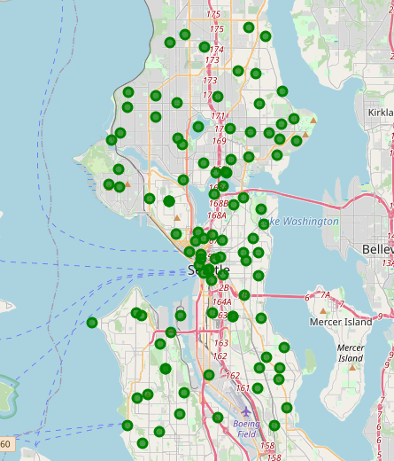
Neighborhoods visualization
The final dataset has
100 neighborhoods
310 unique venue categories

Slide 5
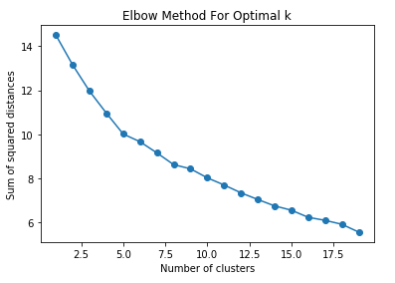
Number of Clusters
The Elbow method was used to determine the optimal number of clusters for the dataset
The number of clusters estimated for our research = 5

Slide 6
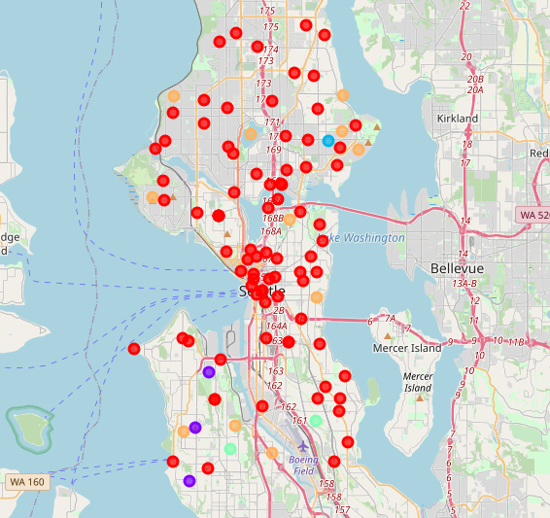
Clustering
The result of dividing Seattle neighborhoods into clusters based on most common venues
Most of the neighborhoods fell into one cluster, which means the infrastructure of the city is quite similar

Slide 7
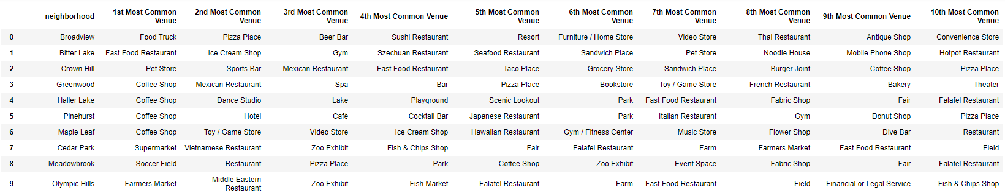
Cluster 0
Cluster 0 is the largest neighborhood cluster in Seattle
Its top venues are the ones for eating out, including coffee shops often being the hot spots

Slide 8
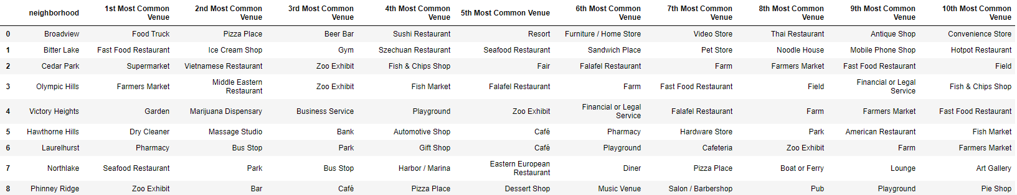
Cluster 0 Decomposition
Dropped the neighborhoods with coffee shops among the top venues
Filtered the rest on having other places to eat in the top venues (e.g. restaurants or bars)
Established 29 potential areas for opening a coffee shop

Slide 9
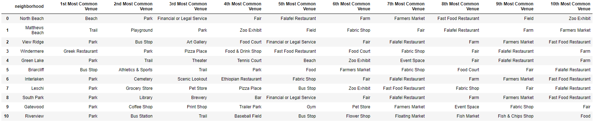
Cluster 4
Cluster 4 consists mainly of park areas with some recreation places to follow
There already are some food courts and fast food restaurants around, since people tend to stop by for snacks in between their walks
Established 11 potential areas for opening a coffee shop

Slide 10
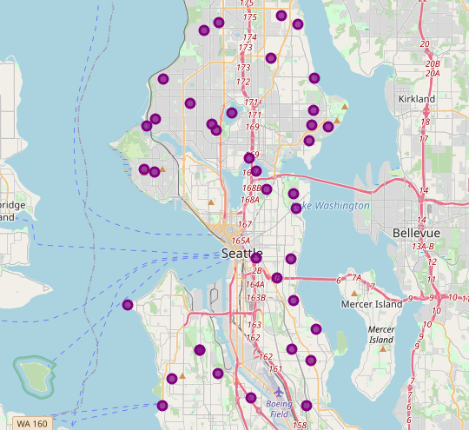
conclusions
Determined 40 optimal neighborhoods for opening a coffee shop
The recommendations would be later passed on to the stakeholder for consideration
The results of this research should be used for further additional exploration

