Slide 1
IBM Data Science Capstone Project: Battle of Neighborhoods
Anna Perelman • 06.01.2020

Slide 2
Agenda
Project goals:
Implement skills taught in the frame of IBM Data Science specialization
Come up with a problem and find a solution usign Foursquare location data along with the other sources and tools.

Slide 3
A problem to be solved
Hypothetical client
A big chain of private schools looking to open a new branch in San Francisco, CA
Every branch includes a preschools for ages 6 months - 5 years a school for grades K-8
Solution required:
A recommendation on a neighborhood to start with
Desired characteristics: enough population, reasonable competition, safe environment, parks and family friendly venues around

Slide 4
Data Sources
Independent search
Information on San Francisco, CA neighborhoods with their zip codes and population (can be found here )
The information on San Francisco schools with their zip codes, public/private type and grade levels (can be found here )
The information on the number of crimes committed in San Francisco along with their latitude and longitude to be converted into zip codes (can be found here)
The information on parks and playgrounds located in SF neighborhoods (can be found here)

Slide 5
Data Sources
Required - Foursquare
Foursquare location data contains information on different venues located in each neighborhood.
Using a free developer account their Places API offers real-time access to Foursquare’s global database of rich venue data and user content to power location-based experiences in an app or a website.

Slide 6
Preliminary analysis
Exploratory analysis
Combined database showing population, number of schools, crimes level and parks figures was built
Top and bottom five neighborhoods were presented for each parameter
Descriptive statistics
For each of population, number of preschools, number of schools, crime level and number of parks descriptive statistics (minimum, maximum, mean, 25th, 50th, 75th percentiles) were calculated

Slide 7
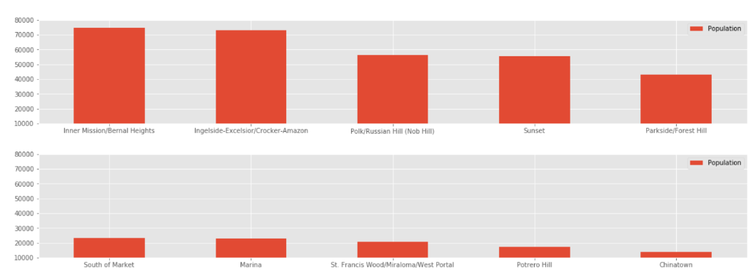
Top and bottom 5 neighborhoods in terms of population

Slide 8
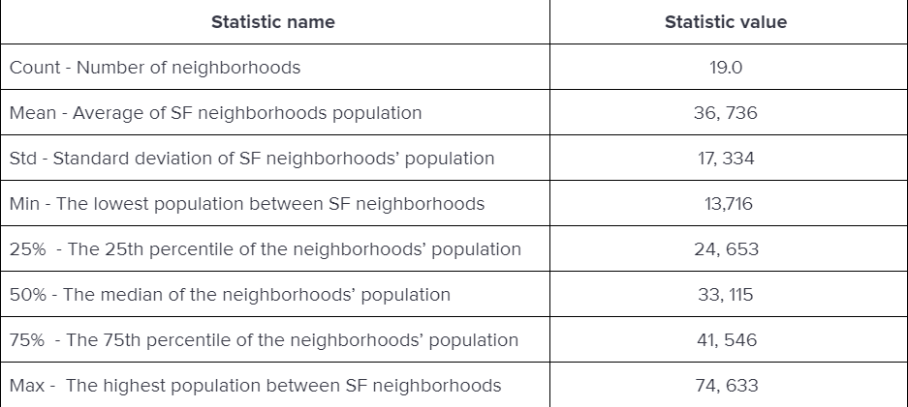
Population - descriptive statistics

Slide 9
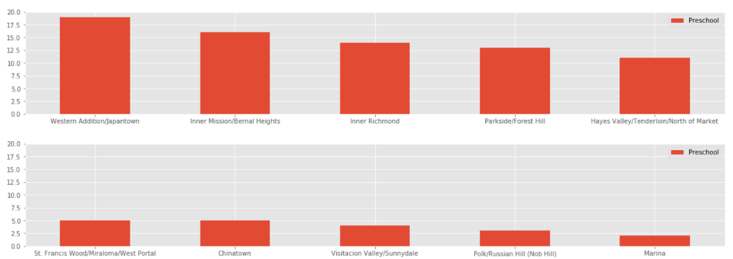
Top and bottom 5 neighborhoods in terms of number of preschools

Slide 10
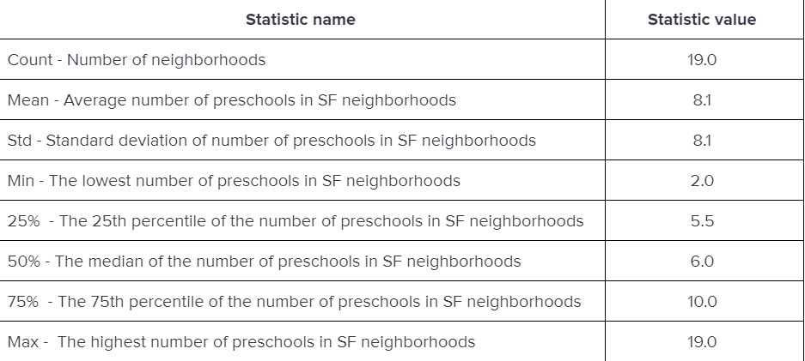
Number of preschools - descriptive statistics

Slide 11
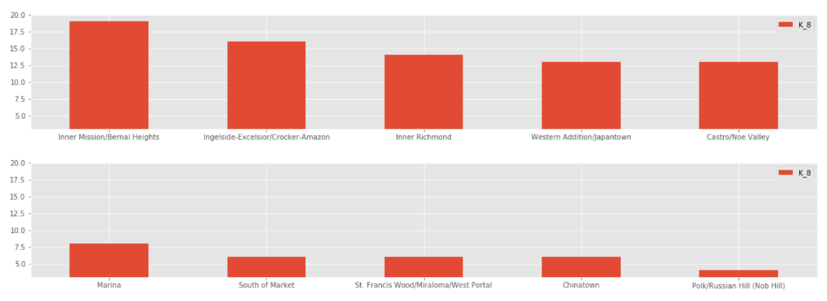
Top and bottom 5 neighborhoods in terms of number of K-8 schools

Slide 12
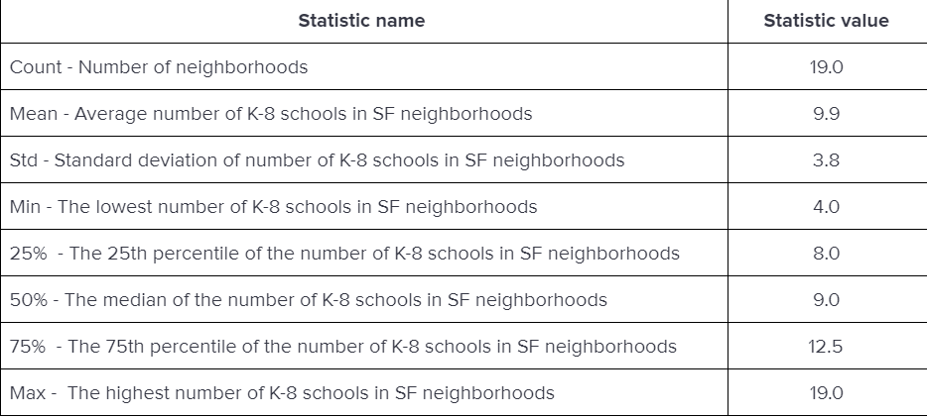
Number of K-8 schools - descriptive statistics

Slide 13
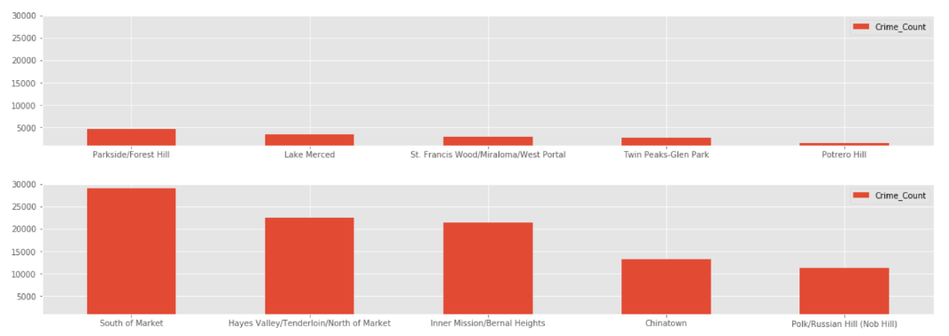
Top and bottom 5 neighborhoods in terms of number of crimes committed in 2018

Slide 14
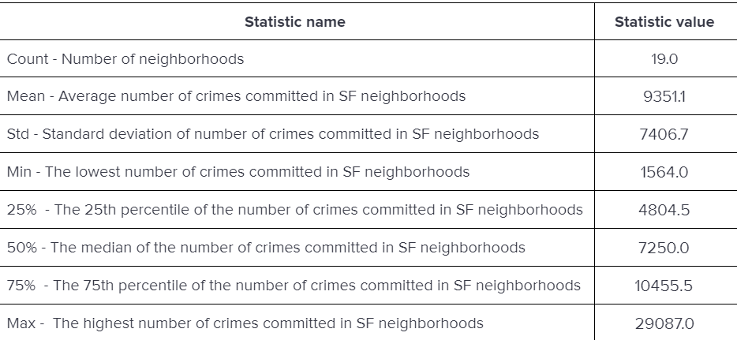
Number of crimes committed - descriptive statistics

Slide 15
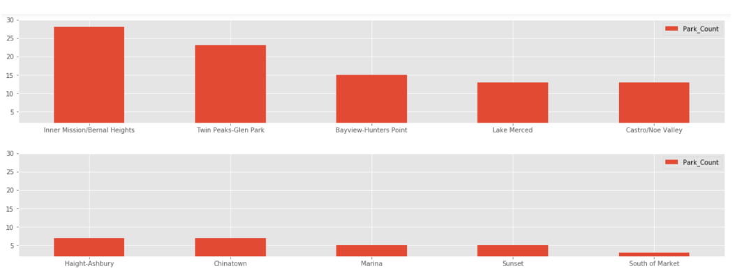
Top and bottom 5 neighborhoods in terms of number of parks and playgrounds

Slide 16
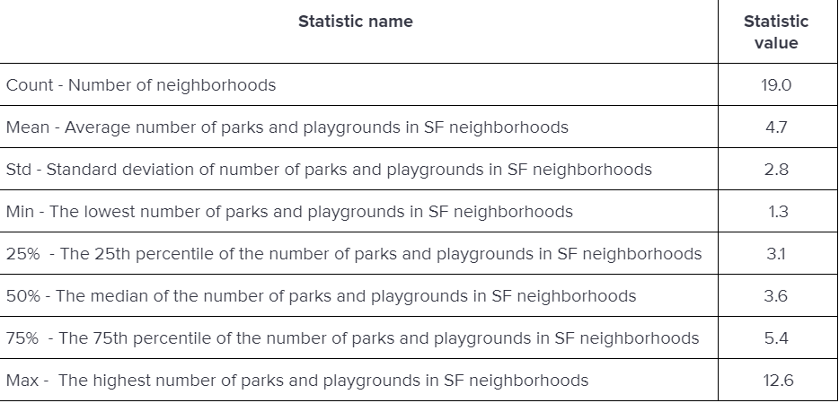
Number of parks and playgrounds - descriptive statistics

Slide 17
Main analysis
Unsupervised Machine Learning
The complexity of analyzing different quantitative characteristics may be decreased by creation of several clusters or groups of similar neighborhoods. This way the nature of their similarities can be understood and the most promising one can be chosen
K-Means algorithm has been proven to be fairly effective in such setting. This method ss vector quantization, originally from signal processing, that aims to partition n observations into k clusters in which each observation belongs to the cluster with the nearest mean, serving as a prototype of the cluster.
Let’s assume that domain knowledge and expertise, it was decided that the most reasonable number of clusters in this case is five.

Slide 18
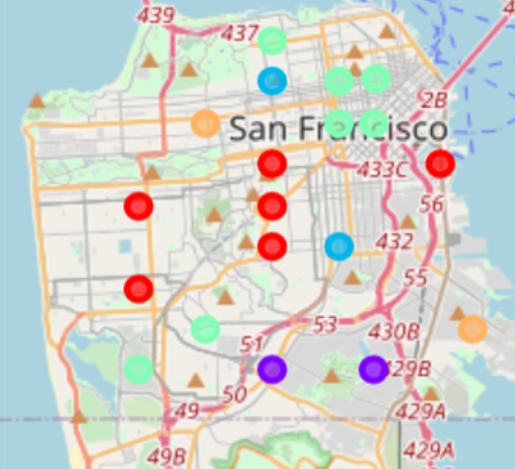
Five clusters - map

Slide 19
Recommendation
Twin Peaks/Glen Parks and St. Francis Wood/Miraloma/West Portal from the first cluster looks like a good candidate in respect to population, number of schools, parks and safety
St. Francis Wood/Miraloma/West Portal also is a good option by itself, but being a part of a fourth cluster that doesn’t appear to serve as an appropriate location, makes it less favorable option.

