Slide 1
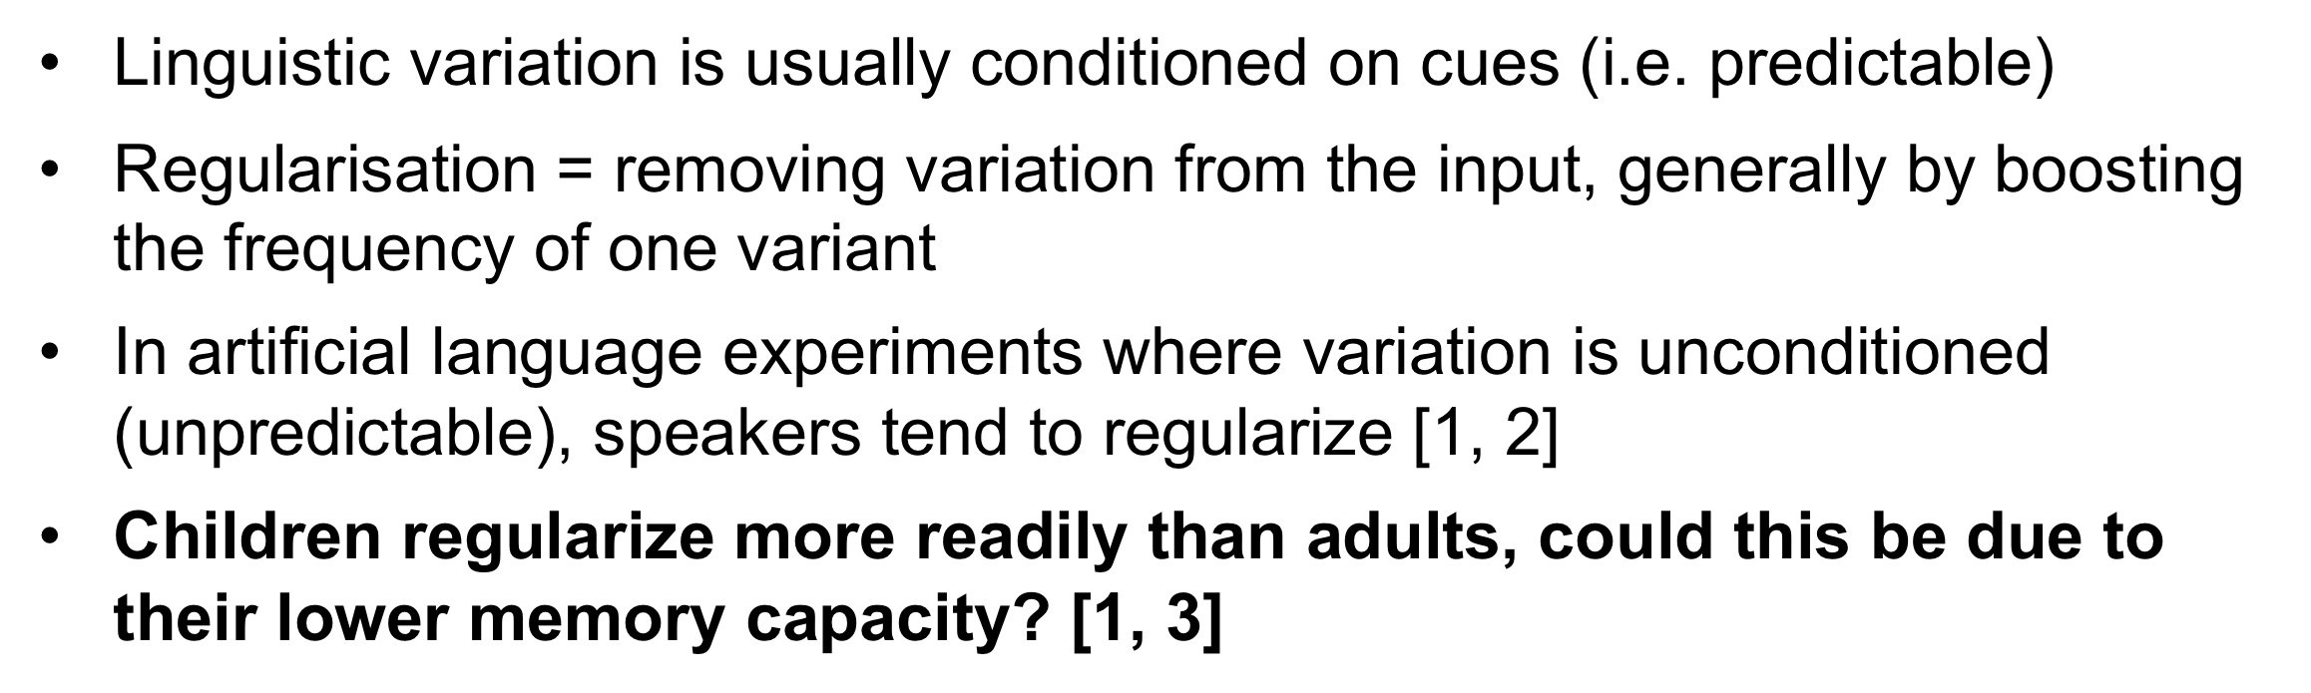
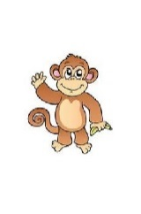


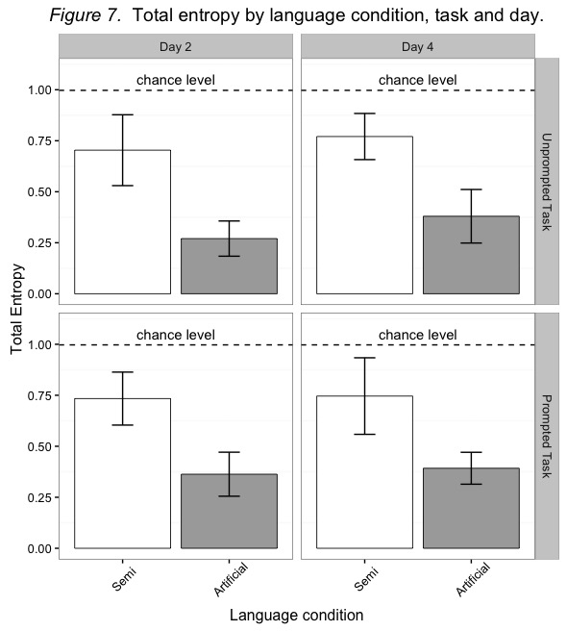
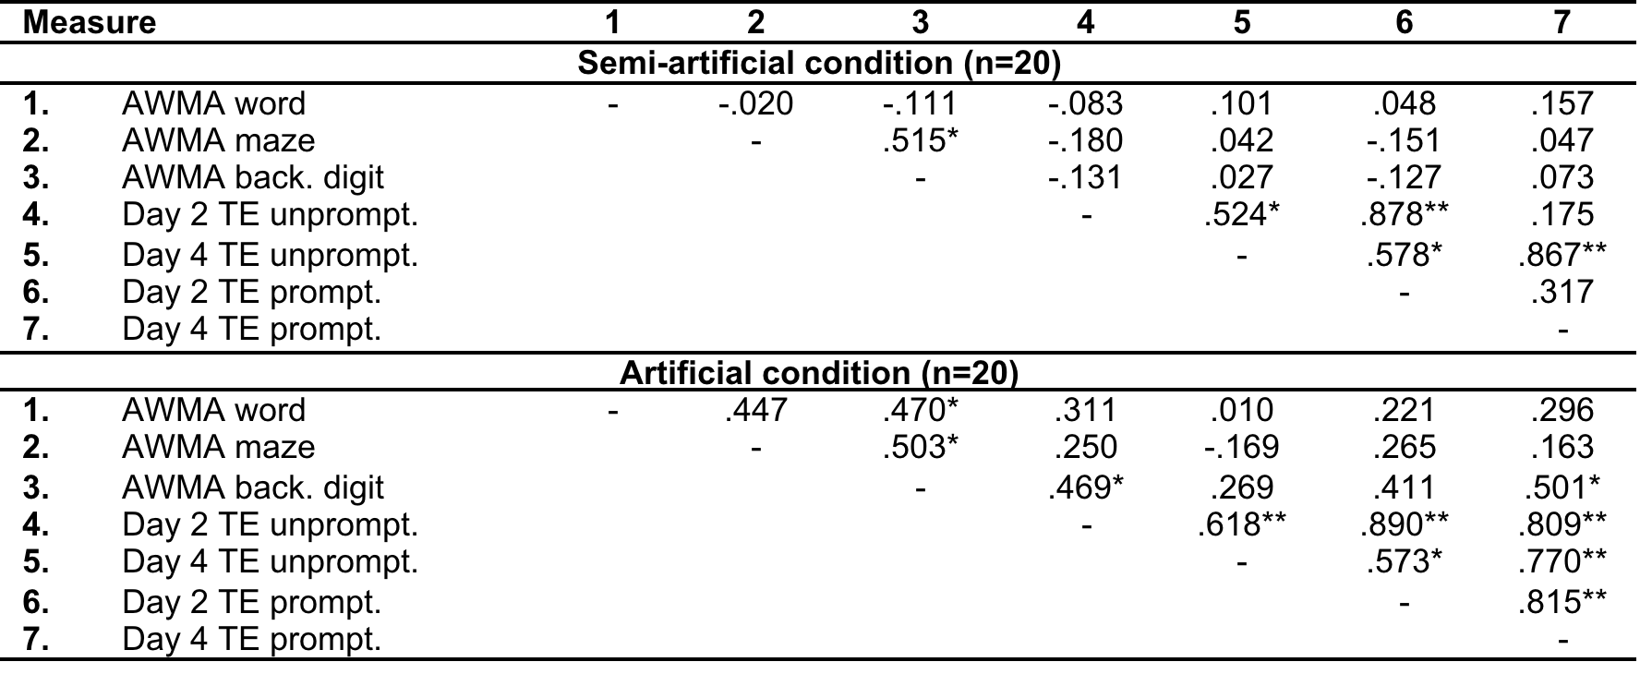
The role of memory constraints in regularization of unpredictable variation
Jo Saul¹, Anna Samara¹, Kenny Smith² & Elizabeth Wonnacott¹
¹ University College London; ² University of Edinburgh
Introduction
Semi-artificial language condition
Artificial language condition
Noun training
Vocabulary test
Noun training
Vocabulary test
Ellie is going to tell you the names of her friends:
monkey
Who is this?
Ellie is going to tell you the names of her friends:
coomo
Who is this?
Sentence training
Unprompted sentence production test
Sentence training
Unprompted sentence production test
Ellie is going to tell you some sentences in her language
Glim…
Ellie is going to tell you some sentences in her language
Glim…
Glim monkey bup
Glim monkey tid
Can you say the whole thing? Ellie will give you the first word.
Glim coomo bup
Glim coomo tid
Can you say the whole thing? Ellie will give you the first word.
Objectives
Prompted sentence production test
Prompted sentence production test
Compare child regularization effects in contrasting memory conditions: artificial and semi-artificial languages
In both conditions, investigate if regularization changes:
  Over time
  Depending on memory load of task
  When generalising to novel stimuli
Relate working memory measures to individual differences in regularization
75% of trials
25% of trials
Glim monkey…
75% of trials
25% of trials
Glim coomo…
Can you say the whole thing?
Ellie will give you the first two words.
Can you say the whole thing?
Ellie will give you the first two words.
Fig. 3: Example training and testing stimuli
Results
Vocab test confirmed that artificial language was sig. harder to learn than the semi-artificial one
Entropy measure derived from each child’s particle use pattern
Entropy is a measure of systematicity regardless of the pattern imposed (e.g. if a child uses all det1 or all det2)
Methods
Participants
40 monolingual children from 2 schools (mean age: 6;3, SD: 0;3, 18 girls)
Split into 2 equal groups matched on age and gender:
  Semi-artificial condition
  Artificial condition
Materials
Two simple languages were created which differed only in the nouns they contained (see Fig. 1)
Procedure
Language training and testing took place over 4 sessions within 5 days at school 1:1 with experimenter, using a laptop and headphones, following schedule in Fig. 2
Language Training
Participants were told they would be learning Ellie the Elephant’s language
Each day they were trained on the same 4 individual nouns (the old nouns)
For each noun, 75% of training sentences contained Particle 1 and 25% of sentences contained Particle 2
Thus particle use varied unpredictably (see Fig. 3 for examples)
Language Testing
Sentence production was tested on Days 2 and 4 in two separate tasks: unprompted and prompted production (see Fig. 3 for examples)
In the prompted task, both old and new nouns were tested
Working memory measures: Word recall, maze memory and backwards digit recall tests from Automated Working Memory Assessment [4]
Entropy = -∑ P(i) log2 P(i), where P(i) is the frequency of particle i in a participant’s productions (low entropy = high regularization)
1. Lower entropy (=greater regularization) in artificial vs. semi-artificial language, no sig. effect of time
Verb
Noun
Particle
2. Memory prompts did not sig. influence regularization (no effect of prompted vs. unprompted task)
Artificial
“glim”
meaning “there are two”
Used to introduce each sentence
12 two-syllable non words, corresponding with animal pictures, e.g. “meeper”, “panjol”
2 non-words with no meaning, e.g. “bup”, “tid”
Source of unpredictable variation (see below)
Semi-artificial
12 two-syllable English words, corresponding with animal pictures, e.g. “camel”, “tiger”
3. Word familiarity did not sig. influence regularization (no effect of old vs. new nouns in prompted task)
Fig. 1:Artificial and semi-artificial language structure
Fig. 4: total entropy by language, day and task, with 95% CI
Day 1
Day 2
Day 3
Day 4
4. Entropy correlated positively with backwards digit recall in the artificial language group = less regularization in children with stronger memory skills
Noun training &
Vocab test
Noun training &
Vocab test
Noun training &
Vocab test
Noun training &
Vocab test
AWMA word recall
Sentence Training
Sentence Training
Sentence Training
Table 1: Pearson correlations total entropy vs. working memory
Discussion
Unprompted sentence production test*
AWMA backwards digit & maze memory
Unprompted sentence production test*
Language condition influenced regularization: when variation is unpredictable, child regularization susceptible to task manipulation
No effect of day on regularization. May have emerged in longer experiment or if had an earlier baseline measure
No effect of memory prompt. Possible that although the prompts supported the task, production was still difficult for children, whereas for adults prompt may have sig. effect [5]
No effect of noun type on regularization. Previous contrary findings for adults [6] and children [2] may have been due to retrieval pressures of remembering new nouns, which did not apply here due to task design
Working memory is implicated in regularization of unpredictable variation in the lab, however additional constraints may also be present when such variation occurs in natural learning situations
Further investigation is needed to dissociate the mechanisms of encoding and retrieval for child learners
Prompted sentence production test*
Prompted sentence production test*
* Represents order A, in order B sentence production tasks were performed in reverse order
Fig. 2: Experiment procedure
References:
[1] Hudson Kam, C. L., & Newport, E. (2005). Language Learning and Development, 1 (2005), pp. 151-195
[2] Samara, A., Smith, K., Brown, H., & Wonnacott, L. (2017). Cognitive Psychology, 94, 85-114.
[3] Perfors, A. (2012). Journal of Memory and Language, 67, 486–506.
[4] Alloway, T. P. (2007). Automated Working Memory Assessment. London: Harcourt Assessment.
[5] Hudson Kam, C. L., & Chang, A. (2009). Journal of Experimental Psychology, 35(3), 815–821.
[6] Wonnacott, E., & Newport, E. L. (2005). In A. Brugos, M. Clark-Cotton, & S. Ha (Eds.), BUCLD 29: Proceedings of the 29th Annual Boston University Conference on Language Development. Somerville, MA: Cascadilla Press. 1-11.

