Slide 1


Spelling as statistical learning: evidence from artificial lexicon experiments with typically developing children
Anna Samara
University of Liverpool; University College London
Oxford University, 21/11/2017

Slide 2
Learning to spell in inconsistent orthographies
health
/ε/
eo
ie
e
ai
ea
good spelling involves more than pure memorization
Notes:
Morphological relationships among words (e.g., /ε/ in health may not be spelt with e, but ea is somewhat more expected considering that health is a derivative of the verb heal) provide one such cue.

Slide 3
Learning to spell in inconsistent orthographies
Spelling of inconsistent sound-letter correspondences is actually not that ‘chaotic’ if probabilistic orthographic patterns or ‘rules’ are taken into consideration
For example:
1) medial /ɛ/ is commonly spelled with an e (e.g., beg) but less frequently before /d/ (e.g., head)
2) most common spelling of medial /i/ is ea (e.g., beam), but not before /p/ (e.g., deep)
3) /ɝ/ is commonly spelled with ur (e.g., curd) but not after /w/ (e.g., work, worth)
Notes:
Don’t give ‘bed’ example: beg works fine. Find exact stats of how frequent /ɛ/ is e when followed by d
43% of the time word ends in /d/, it’s an ea
0% of the word ends in /g/ it’s an ea

Slide 4
Learning to spell in inconsistent orthographies
Naturalistic (e.g., Treiman, 1993) and some experimental work suggests that children’s early spelling attempts respect some properties of their orthography
pess vs. ppes
Children comply to such patterns in pseudoword spelling/2afc tasks (Cassar & Treiman (1997; Pacton et al., 2001)
Limitations
Little control over distributional properties of the input and children’s explicit knowledge
No insight into the underlying computational mechanisms
Incidental (statistical) learning mechanisms?
Notes:
E.g. they comply with them in pseudoword spelling tasks
Written language is no exception, it also shows a high degree of statistical structure.
In fact there is some evidence showing that even beginning spellers,
Early naturalistic work by Treiman … as young as kindergarten do not produce words where ck is an onset
More recent psycholinguistic work by Kessler and Treiman further suggests that the statistics are there. E.g.,
Given that these statistics are either too complex to be explicitly taught or simply not taught through explicit instruction, it has been recently assumed that children’s sensitivity to general properties of their orthography reflects…
However,

Slide 5
Statistical learning
General purpose learning device: Basis of humans’ ability to extract statistical patterns of varying complexity from the input
e.g., pair frequencies, conditional probabilities btw adjacent elements
Key role in language acquisition & development
e.g., phonotactics: Infants are sensitive to restrictions on which and where phonemes (or sequences of phonemes) can occur (Jusczyk et al., 1993)
English words do not begin with /ŋ/ (but Vietnamese words do)
Notes:
Statistical learning is general learning mechanism that forms the basis of … These can be relatively simple such patterns, e.g., pair frequencies or much more complicated, e.g., conditional probabilistic patterns.
Statistical learning occurs incidentally, so people are not instructed to compute these statistics and they receive no feedback on how well they do. in fact most people would probably report that they are not aware of the fact that they are engaged in any form of computation.
Statistical learning is highly efficient in highly complex but patterned domains of knowledge, a prime example of which is language.
zb is an illegal sound combination in English; str is allowed in English, but not in word endings). In a series of well-documented experiments, Jusczyk, Friederici, Wessels, Svenkerud, and Jusczyk (1993) provided evidence of 9-month-old infants’ listening preference for unfamiliar words that complied with phonotactic constraints in their native language over words that were legal in another language to which they had never been exposed. For example, American infants favored words that complied with English phonotactics (e.g., /pɪtʃɪz/), yet are illegal in Dutch. Conversely, Dutch infants listened longer to words embedding legal Dutch phoneme sequences (e.g., /opkomst/) which are not permitted in English.
By 10 months of age, they have become sensitive to how the individual speech sounds are combined to form the words of their input language (Friederici & Wessels, 1993; Jusczyk, Friederici, Wessels, Svenkerud, & Jusczyk, 1993), the relative frequen- cies with which the various speech sounds occur and co-occur (Jusczyk, Luce, & Charles-Luce, 1994),
Importantly, they can incidentally learn novel restrictions of this sort in an artificial system (e.g., /b/ cannot be an onset) (Onishi et al., 2002, 2010)

Slide 6
Statistical learning
Spoken language research suggests that restrictions on where sounds can occur and which sounds combinations are legal are learnt naturally from early in life
What about literacy?
Literacy acquisition is more protracted
Stage models of literacy development (e.g., Frith, 1985; Gentry, 1982)
Sensitivity to written language patterns develops at the latest stage of literacy development
Testable hypothesis: do statistical learning mechanisms operate in written language from early on?
Notes:
Acquisition of a natural language requires the extraction of a variety of types of distributional information from the ambient linguistic environment.

Slide 7


Artificial lexicon experiments
Popular methods in language acquisition research
Exposure to miniature linguistic systems
e.g., small lexicons
Provides complete control over input to learning
glim dog dak
…..golatudaropigolatutibudopabikudaropipabikutibudodaropitibudogolatupabikugolatu …..
glim dog bup
Saffran et al. (1996)
Samara et al. (2017)
Notes:
Surprisingly little with work with children
For example, the sequence /pf/ does not occur in Dutch words. Therefore, when /pf/ occurs in the speech stream, listeners know that /p/ and /f/ belong to separate words.

Slide 8
Today: 3 studies
Study 1
Validates these artificial methods in the written language domain
Study 2
Addresses further questions regarding orthographic sensitivity in childhood
Study 3
Explores constraints in children’s statistical learning abilities
Notes:
In the first part of my talk I will present on a series of experiments investigating the contribution of statistical learning processes in the development of reading and spelling skill and in the second part, I will present two experiments addressing whether impaired statistical learning skill can account for some of the difficulties that frequently occur among dyslexic individuals. I will give you the neat version of the story, so I won’t present absolutely everything.
I will not talk about the relationship between learning performance and literacy skill

Slide 9
Study 1: Incidental learning of novel positional and context-based patterns
Samara & Caravolas (2014). JECP
Notes:
Incidental Graphotactic Learning In Children And Adults

Slide 10

Design
7-year-olds (Year 2) vs. adults
Two types of constraints
Positional constraints: e.g., words do not begin with ll
Context-based patterns: e.g., gz and dz are illegal spellings of frequent word-final sound combinations in English; *bagz, *padz)
Can these be learnt through incidental brief exposure to visual stimuli that embed them?

Slide 11
The Incidental Graphotactic Learning task
Exposure phase
Test phase
“Which one of the letters is red?
“Consistent/Inconsistent with previous set?
fet
Fixation
(1000ms)
fon
Fixation
(1000ms)
+
Next stimulus appears
+
fos
tef
time (ms)
time (ms)

Slide 12
Stimuli: positional patterns
C
V
C
d, m, l ,f
o, e
t, n, p, s
d, m, l, f only occur in C₁ position (t, n, p, s cannot)
t, n, p, s only occur in C₂ position (d, m, l, f cannot)

Slide 13
Stimuli: positional patterns
d o t
l o t
LU
IL
d e n
l e n
d e t
t o d
d o p
l o p
d e s
l e s
m e t
f e t
m o n
f o n
m e p
f e p
m o s
f o s

Slide 14
Stimuli: context-based patterns
mo
me
ot
et
C
V
C
d, m, l ,f
o
t, n, p, s
t, n, p, s
e
d, m, l, f
pe
po
el
ol

Slide 15
Stimuli: context-based patterns
d o t
t e m
LU
IL
d o p
t e f
d o n
d e t
m o n
n e d
n e f
l e n
m o s
n e l
l o t
p e m
l o p
p e f
f o n
s e d
f o s
s e l

Slide 16
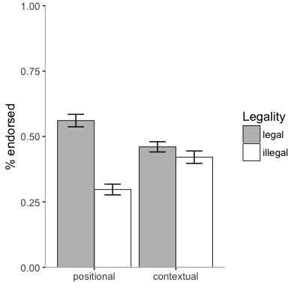
Results: Legality judgments
n = 137
mean = 7;5 [years;months]
p < .001
p = .022
Significant learning in both condition
Learning moderated by pattern complexity (although detection of single letters, e.g., det might have accentuated the difference)
Notes:
By a one sample t test….

Slide 17
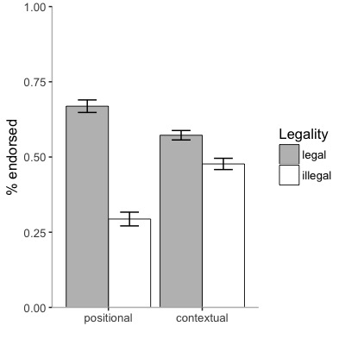
Same pattern of results in adults
p < .001
p < .001
Note: Positional patterns learned more reliably than contextual patterns (and adults are, overall, better learners than children)
Notes:
Adults > Children: Developmental effect in learning performance: pattern sensitivity strengthens as spellers progress towards more complete orthographic learning

Slide 18
In sum…
Study 1 provides evidence that novel positional and context-based patterns can be learn under brief incidental experimental conditions
Suggests that statistical learning processes operate among 7-year-olds and underlie this ability
Notes:
Say something about lack of explicit instruction
Elucidates the learning mechanisms by which some types of orthographic knowledge are acquired and shows that they operate among beginning spellers

Slide 19
Limitations
Redundancy of cues: Above chance learning under highly favourable conditions…
PC learning: constraints on the position of single letters, as well as body (CV) and rime-level unit constraints
CC learning: Constraints are exemplified both in word beginnings and ends
Are both word contexts necessary for learning to occur?
If not, are they equally beneficial to learners?
Notes:
Limitations on a separate slide

Slide 20
Study 2: Incidental learning of context-based patterns within word-initial (CV) vs. rime-level (VC) units: Evidence from English and Turkish
Samara, Singh, & Wonnacott (in preparation)

Slide 21
Study 2: Rationale
More naturalistic design: Can patterns in each position can be learned independently ?
Word-initial (CV) vs. rime-level (VC) comparison
Are rimes special?
Linguistic and psycholinguistic work suggests that syllables consist of two “blocks”: i) the onset, that contains the initial consonant(s), and ii) the rime, that contains the vowel and word-final consonant(s)
Many studies in reading and oral language have shown these units have behavioural relevance for developing and skilled literacy performance
If rimes are special, learning patterns from such units should be stronger than learning from CV units

Slide 22
Patterns in word-initial (CV) vs. rime (VC) units
E.g. 1: medial /ɛ/ is commonly spelled with an e (e.g., beg) but less frequently before /d/ (e.g., head)
E.g. 2: most common spelling of medial /i/ is ea (e.g., beam), but not before /p/ (e.g., deep)
E.g. 3: /ɝ/ is commonly spelled with ur (e.g., curd) but not after /w/ (e.g., work, worth)
VC (rime) patterns are far more common in English than CV (word-initial) patterns

Slide 23
Methods & Procedure
78 English-speaking children
CV condition: n = 45 (mean age = 7.14 years)
VC condition: n = 33 (mean age = 7.37 years)
37 Turkish-speaking children
CV condition: n = 19 (mean age = 6.71 years)
VC condition: n = 18 (mean age = 6.75 years)
Variant of the IGL task introduced in study 1
Learning spread across 2 days; tested on day 2
Exposure cover task: respond to the stimulus color
Notes:
Similar methods, won’t go into details…..

Slide 24
Stimuli
C
V
C
d, m
o
t, n, p, s
CV
t, n
e
t, n, p, s
o
d, m
VC
e
t, n
Notes:
CHANGE THE LETTERS SO THAT THEY MATCH WHAT DANIELA USED

Slide 25
Data analyses
Bayes Factor (BF) analyses
Indicates the relative strength of evidence for two theories/models (e.g., H1 vs. H0)
Allows for three type of conclusions:
Strong evidence for the alternative [BF > 3]
Strong evidence for the null [BF < 1/3]
Data insensitivity (i.e., the data does not favour either theory) [1/3 < BF < 3]

Slide 26
Data analyses
Model1: Model predicting above chance learning performance vs. model predicting chance performance in in CV condition
Model2: Model predicting above chance learning performance vs. model predicting chance performance in VC condition
Model3: Model predicting a performance advantage in the word-final (VC) relative to the word-initial (CV) condition vs. model predicting CV = VC performance

Slide 27
BF analyses
The BF is based on the principle that evidence supports the theory that most strongly predicts it
We know what the null predicts but we also need to know what H1 predicts…

Slide 28
BF analyses (cont.)
Model1:
H1: Predicted ES = learning equivalent to that reported for contextual learning in study 1
Model2:
H1: Predicted ES = learning equivalent to that reported for contextual learning in study 1
Model3:
H1: Rough maximum predicted ES = learning equivalent to that reported for contextual learning in study 1 in the word-final (VC) condition MINUS chance performance in the word-initial (CV) learning
Notes:
SAY: we don’t use defaults for priors
won’t go into details but we use a half normal following bayes which biases small values
To model H1 for models (i) and (ii), we specified a rough estimate of a predicted effect size on the basis of the contextual constraints learning effect in Samara and Caravolas (2014) (reanalysed using logistic mixed effect model analyses; see Appendix A) and used this value (0.19) to scale the size of the effect that could be expected. For these models, B_{N(0,x)} refers to a BF in which the predictions of H1 were modeled as a half-normal distribution with a SD of x (Dienes, 2014). H1 for model (iii) was modelled by estimating that a rough maximum predicted effect size would be a difference score capturing chance performance in the word-initial (CV) learning and learning equivalent to that reported in Samara and Caravolas (2014) in the word-final (VC) condition (⎢0-0.19⎢ =0.19). As recommended by Dienes (2014), for this model, B_{N(0,x)} refers to a BF in which the predictions of H1 were modeled as a half-normal distribution with a SD that has set as half the value of x (Dienes, 2014).

Slide 29
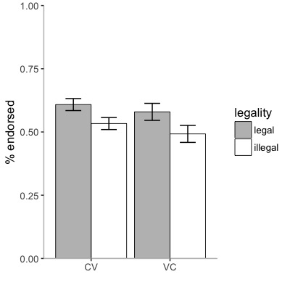
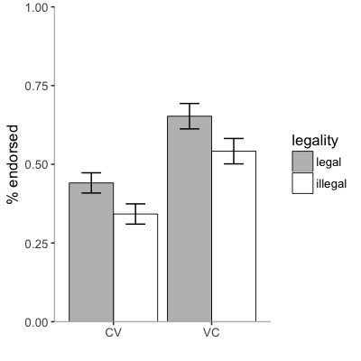
Results
English-speaking
Turkish-speaking
p = .913, BF = 0.85
p = .809, BF = 0.97
p = .047
BF = 4.13
p = .041
BF = 4.51
p = .031
BF = 4.36
p = .033
BF = 3.75
Notes:
-Explain what error bars are

Slide 30
In sum…
Substantial learning of novel context-based patterns both within CV (body) and VC (rime-level) units
Findings replicate in two linguistic contexts (and hold when we collapse across the 2 datasets)
Notes:
Graphotactics, phonotactics, or both?

Slide 31
In sum…
No evidence of the predicted word-final advantage
Power analyses show that, based on our current level of variance, approximately 700 (!) participants are needed to provide evidence of no difference in performance between conditions (i.e., if the true mean difference between conditions was actually zero)
Notes:
Limitations always in a separate slide

Slide 32
Study 3: Incidental learning of written patterns with no phonological counterpart
Samara, Singh, & Wonnacott (in preparation)

Slide 33
Incidental learning of written patterns with no phonological counterpart
Purely orthographic ‘rules’ that place constraints on where and when certain letters (or letter combinations) can occur
Some of them may be easy to verbalize and may be explicitly taught
e.g., gz and dz are illegal spellings of frequent word-final sound combinations in English; *bagz, *padz
But others are not….
Notes:
a doublet should be used if the vowel that precedes the medial consonant is short and a singleton should be used if the vowel is long or diphthongized”
gz wouldn’t get it anywhere

Slide 34
Incidental learning of graphotactics with no phonological counterpart
e.g., list1
C
V
C
d, g, m, r
u
f, l, ss, tt
e
ff, ll, s, t
note: incidental exposure in the context of one-back task

Slide 35
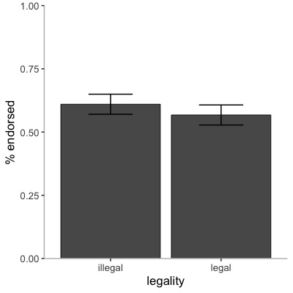
Results: Legality judgments (exp3a)
n = 25
mean = 7.25 years
p = .301 (BF = 0.22)
Predicted ES = learning equivalent to that reported for learning CVs and VCs in study 2
Notes:
Homophones HARD BF BASED ON BODY RIME ACROSS CONDITIONS (AND IS NOT HALFED)
THESE ARE DANIELA’S BF FACTORS IN THIS AND ALL SUBSEQUENT HOMOPHONE EXPERIMENTS

Slide 36
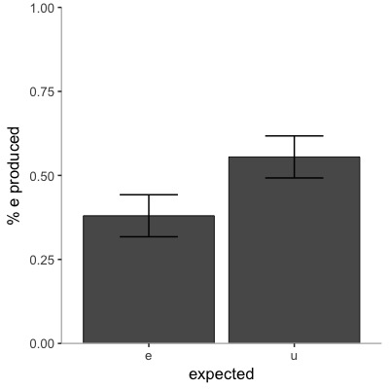
Results: Fill-in-the blanks (exp3a)
n = 25
mean = 7.25 years
difference in the opposite direction
(BF = 0.07)
Predicted ES = learning equivalent to that reported in a pilot study assessing contextual constraints learning in children: similar to study 1
Notes:
Fill-in the blanks
BF BASED ON A PILOT STUDY WHERE PPL LEARN CONTEXT BASED PATTERNS IDENTICAL TO MY ORIGINAL STUDY BUT THEY ALSO HEAR THE WORDS

Slide 37
Incidental learning of written patterns with no phonological counterpart (v.2)
e.g., list1
C
V
C
d, g, m, r
u
f, l, s, t
e
ff, ll, ss, tt

Slide 38
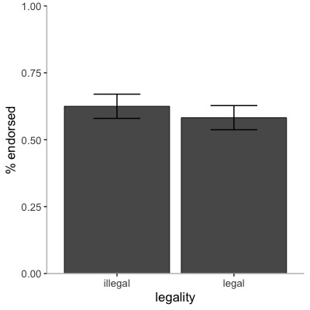
Results: Legality judgments (exp3b)
n = 25
mean = 7.24 years
p = .356 (BF = 0.30)
Predicted ES = learning equivalent to that reported for learning CVs and VCs in study 2
Notes:
Homophones easy BF IDENTICAL TO HARD VERSION

Slide 39
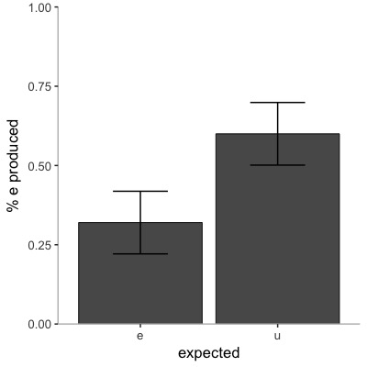
Results: Fill-in-the blanks (exp3b)
difference in the opposite direction
(BF = 0.09)
n = 25
mean = 7.24 years
Predicted ES = learning equivalent to that reported in a pilot study assessing context-based learning in children: similar to study 1
Notes:
Fill-in the blanks BF IDENTICAL TO HARD VERSION

Slide 40
Explicit learning of written patterns with no phonological counterpart
Identical design to exp.3b
Similar methods to exp.3b (1-back task)
Explicitly taught the patterns: “In Freddie’s language, double letters come after “u” and single letters come after “e”.
2 examples from exposure phase are provided
BFs calculated as in experiments 3a & 3b
Notes:
1-back task

Slide 41
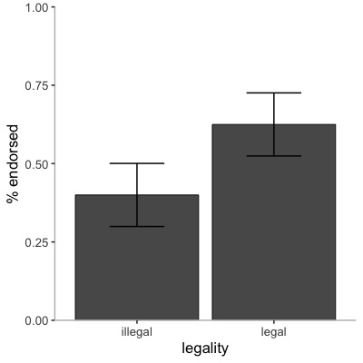
Results: Legality judgments (exp3c)
n = 25
mean = 7.19 years
p = .004 (BF = 4.60)
Predicted ES = learning equivalent to that reported for learning CVs and VCs in study 2
Notes:
Homophones explicit same body-rime average as estimate of learning for legality

Slide 42
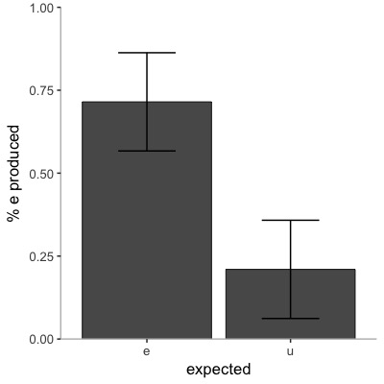
Results: Fill-in-the blanks (exp3c)
p < .001 (BF = 18.37)
n = 25
mean = 7.19 years
Predicted ES = learning equivalent to that reported in a pilot study assessing context-based learning in children: similar to study 1
Notes:
Fill-in the blanks
Homophones explicit pilot data as estimate of learning for fill in the gap

Slide 43
In sum…
Substantial evidence that novel context-based patterns with rime-level (VC) are not learnt by 7-year-olds when presented under incidental exposure conditions
Patterns of the ‘easier’ type are, however, are readily learnt under explicit training conditions
Notes:
SLIDE NEEDS MORE WORK TO REFLECT NEWEST FINDINGS…

Slide 44
Bringing it all together
Study 1
Validates methods in written language domain
Demonstrates that, from 7 years of age, children are sensitive to novel positional and context-based patterns
Study 2
Employs similar methods to address further questions regarding orthographic sensitivity in childhood
Establishes that redundant cues are not necessary for learning to occur
Study 3
Establishes some constraints on the statistical learning abilities of children: that is, some patterns that are easily learnt explicitly, are hard to acquire incidentally (at least, under brief experimental conditions)
Notes:
Three studies following well-established methods in spoken language acquisition research

Slide 45
Bringing it all together
Implications for theories of literacy development
Elucidate the learning mechanisms that allows ortho-phonographic learning to emerge in the absence of explicit instruction
Argues against “late” stage-based models of literacy development (Frith, 1985; Gentry, 1982) by showing that (at least some) orthographic learning occurs early
Corroborates a statistical learning account of learning to spell (Pollo et al., 2008; Treiman, 2017; Treiman & Boland, 2017)

Slide 46
Directions for future research
Exploring the role of statistics
Are children sensitive to conditional forward and backward probability (e.g., the probability that q is followed by u and that u is preceded by q), which may be more relevant for learning to spell than joint probability (e.g., frequency of qu)?
Are children sensitive to manipulations of (more naturalistic) probabilistic orthographic patterns? (head vs. bed)
Are these exceptions learnt best in a staged manner (i.e., whereby patterns are learnt and consolidated first before exceptions are introduced)?
Homophone learning
Are these patterns simply too hard to learn incidentally?
Can learning occur for the easier positional patterns that children are thought to have picked up from as early as kindergarten (e.g., pess vs. ppes)

Slide 47



Acknowledgements
Marketa Caravolas (Bangor)
Elizabeth Wonnacott (UCL)
Daniela Singh (UCL)

Slide 48



Acknowledgements
Marie Curie actions
Zoltan Dienes for advice on Bayes Factor analyses
The schools
Research assistants & students
Sam Crewe
Ayse Aktas
Thank you for listening!
anna.samara@ucl.ac.uk

Slide 49
Adults-study 1

Slide 50
Kids-study 1

Slide 51
Dyslexic adults

