Slide 1


Towards a PROPS ontology
W3C Linked Building Data Community Group
12th of March 2018
Mathias Bonduel – PhD researcher @ KU Leuven and Ugent
mathias.bonduel@kuleuven.be

Slide 2
Content
0. Introduction: scope of PROPS ontology
1. The need for standardization: existing approaches
Ontology structure: basic data structure / patterns
Ontology content
2. Considerations for ontology structure
Competency questions / functionality
New proposals: pros and cons
A range of solutions with different levels of complexity?
3. Next steps: standardization of:
Ontology structure
Ontology content
4. sparql-visualizer tool: functionality
Sources – further reading - links

Slide 3
0. Introduction Scope of PROPS ontology
Building-related properties of:
Building elements:
bot:Element: elements and parts of elements (bot:aggregates property)
PROD ontology classes: products and parts of products
Others:
bot:Zone (bot:Site, bot:Building, bot:BuildingStorey, bot:Space)
bot:Interface
Materials? (material-MTL ontology?)
Alignment to other domains: e-commerce, mechanical engineering, etc.

Slide 4

1. The need for standardization: existing approaches regarding basic data structure
IFC based
ifcOWL
IfcWoD and simpleBIM
BIM based (general)
BIMSO – BIMDO
E-commerce
Good Relations – schema.org
Sensor data?
Not based on traditional BIM?
Ontology
(Tbox)
Actual data (Abox)
Instance data
Classes
Literal values
Blank nodes

Slide 5
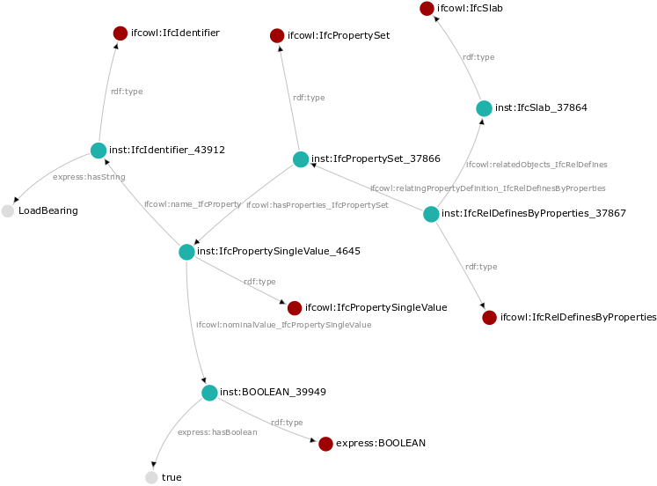
ifcOWL

Slide 6
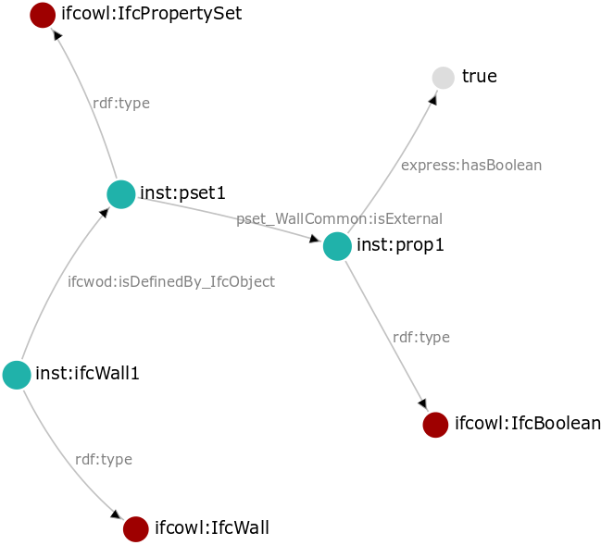
ifcWoD

Slide 7
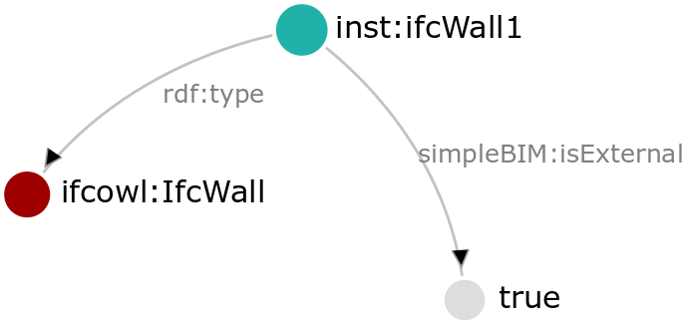
simpleBIM
(~PSET generator)

Slide 8
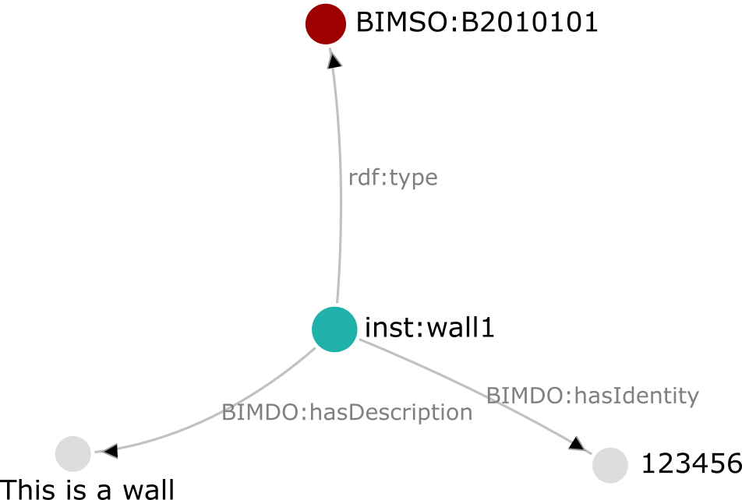
BIMSO-BIMDO

Slide 9
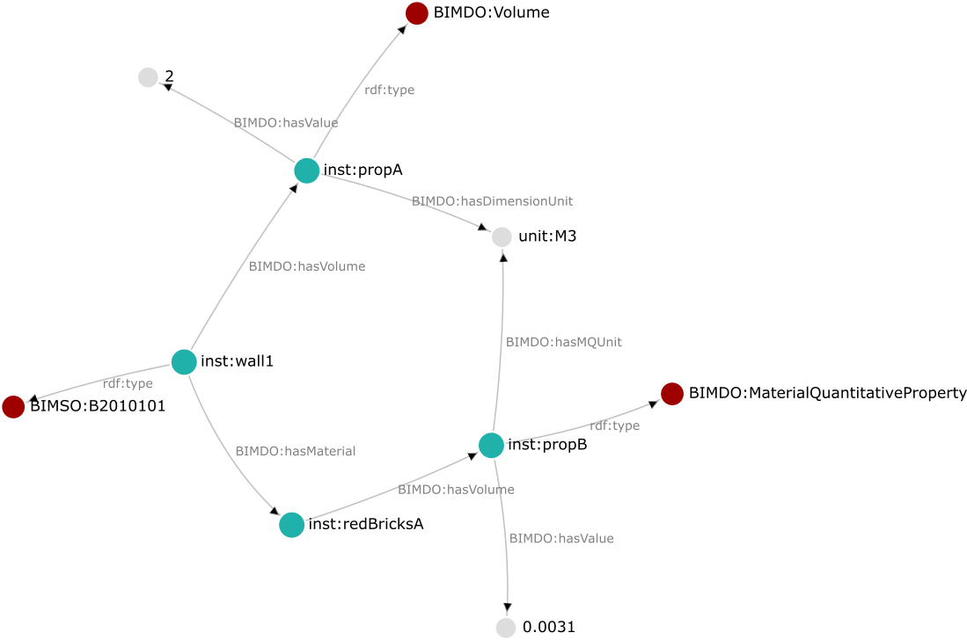
BIMSO-BIMDO

Slide 10
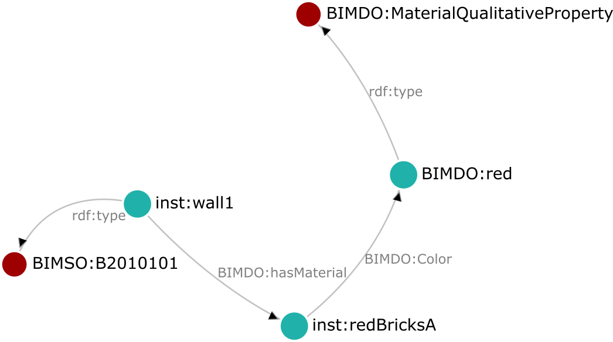
BIMSO-BIMDO

Slide 11
1. The need for standardization: existing approaches regarding basic data structure
IFC based
ifcOWL
IfcWoD and simpleBIM
BIM in general
BIMSO – BIMDO
E-commerce
Good Relations – schema.org
Sensor data?
Not based on traditional BIM?
Ontology
(Tbox)
Actual data (Abox)
Instance data
Classes
Literal values
Blank nodes

Slide 12
1. The need for standardization: existing approaches regarding ontology content
Based on IFC: PSET generator (Maxime)
Based on Wikipedia (PTO approach – implemented by Mads)
Based on Wikidata (Mads)
Custom properties (user defined): what should be provided + how to extend existing PROPS ontology?
QUDT ontology
Domains: construction / architecture / civil engineering is absent
Properties available, but contain no extra information (e.g. qudt:Volume)
OM ontology
Properties available with extra information (om:Volume)
Schema.org ontology (e.g. schema:width)
Limited to generic properties
Not OWL but rdf:Property (?)

Slide 13
2. Considerations for ontology structure
Possibilities:
Datatype properties?
Object properties?
Combination of (one or multiple) object and datatype properties?
Combination of (one or multiple) object and datatype properties, together with owl:Classes?

Slide 14
2. Considerations for ontology structure Competency questions - functionality
Query execution time
Easy/intuitive to discover properties
Reasoning
Alignment with other existing ontologies (e.g. schema.org)
PROPS ontology should be easy to maintain and extend
Extra information about a property (description, label, validity, etc.)
Grouping props (e.g. IFC psets)
Versioning of props
Units for props
literals: data typing (integer, float, boolean, strings, etc.) + language tags (strings)
Complex props: depending on other props via a math function + table of values
...?

Slide 15
2. Considerations for ontology structure New proposals (WIP)
IFCtoLBD converter: converts IFC files to LBD ontologies (BOT, PRODUCT and PROPS) (Jyrki)
Different conversion options investigated
1 step/relation => 1 object/datatype property
2 steps/relations => 1 object property + 1 object/datatype property
3 steps/relations => 2 object properties + 1 object/datatype property
Optionally: grouping of properties (e.g. IFC psets) + adding units
Optionally: versioning of properties of IFC elements
Building-related requirements (Mads)
Versioning of properties necessary + metadata (when, by who changed)
Differentiation between properties as required / designed / built / assumption / ...
Requirements: exact value ⬄ min value ⬄ max value
Units
Alignment to schema.org (swallowed GoodRelations) (Mads – Georg)

Slide 16
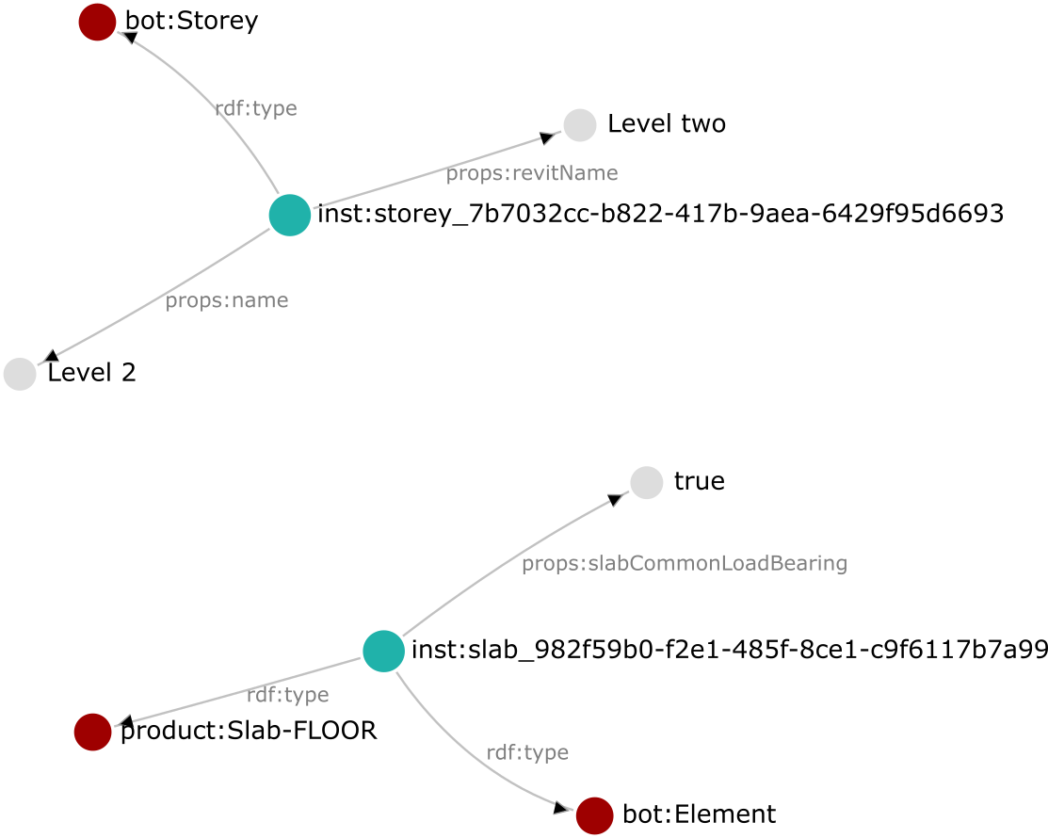
1 step/relation
(1 object/datatype property)
IFCtoLBD
converter

Slide 17
1 step/relation
(1 object/datatype property)
Remarks
Not easy to query for psets + hinders readability
Not easy to maintain ontology if IFC psets are in property name
No formal units
Workaround: mention units in ontology in
a rdfs:description string
No extra information about props
But: easy to discover + best query
execution times
IFCtoLBD
converter

Slide 18
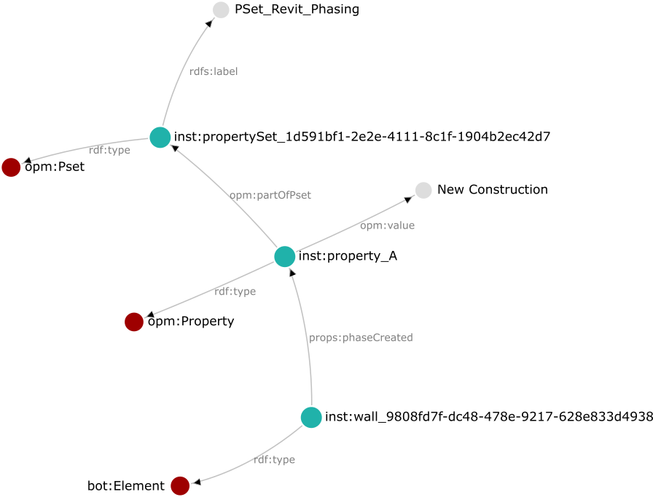
2 steps/relations
(1 object property + 1 object/datatype property)
IFCtoLBD
converter

Slide 19
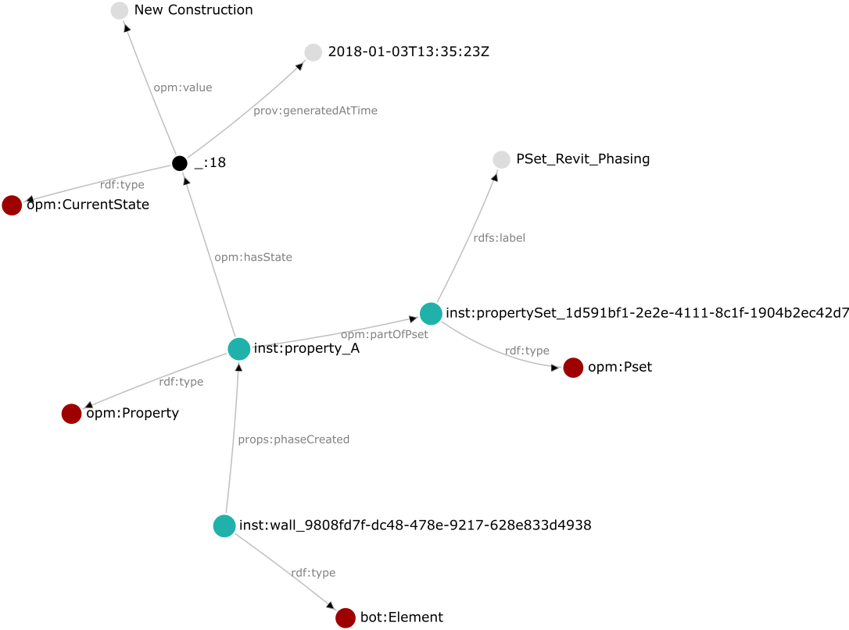
3 steps/relations
(2 object properties + 1 object/datatype property)
IFCtoLBD
converter

Slide 20
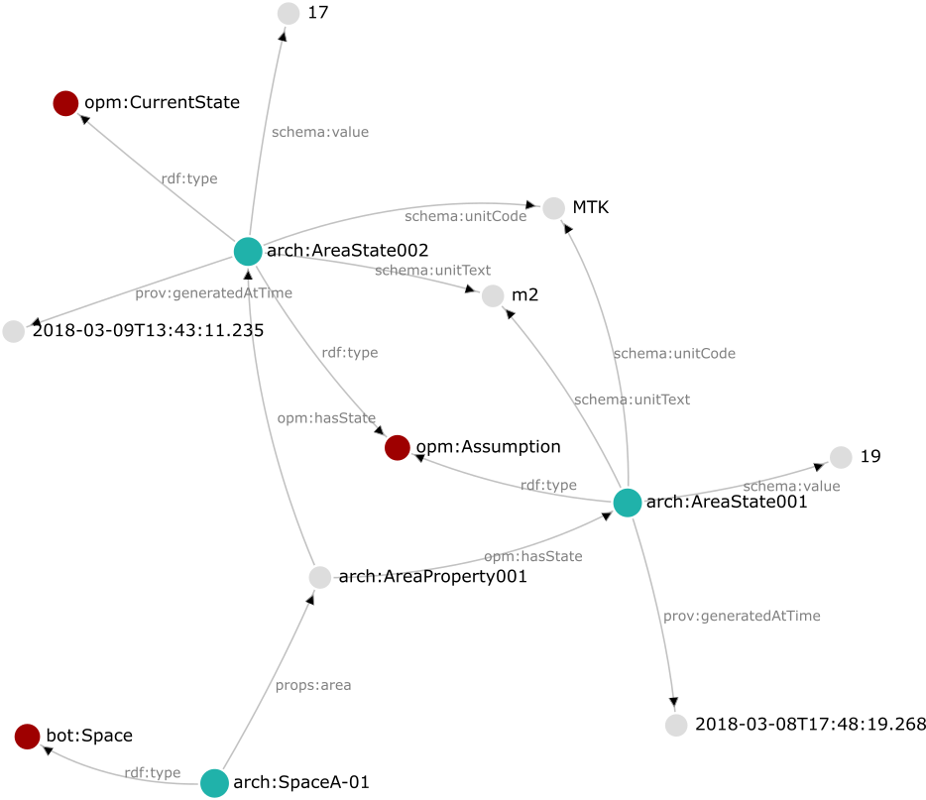
Building-related
requirements

Slide 21
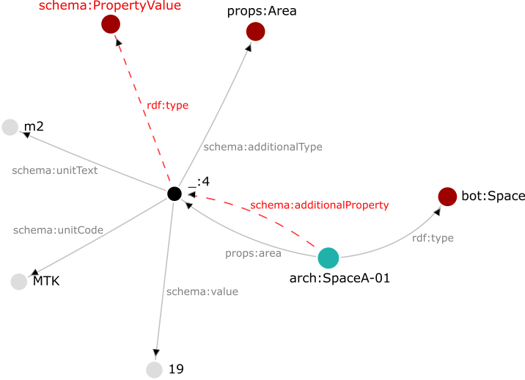
Measures to make the PROPS ontology compatible with schema.org
props:area is subproperty of schema:additionalProperty (which has as range schema:PropertyValue)
schema:additionalType (subproperty of rdf:type)
schema.org defines schema:value, schema:minValue and schema:maxValue => no need to duplicate this in OPM
Remarks/questions
schema:unitCode has text or URL as domain => not compatible with QUDT / OM?
Duplication of information: props:area (object property) and props:Area (class)
schema.org defines also direct object or datatype properties (e.g. schema:area) but they are not always very useful for buildings (e.g. schema:area => domain is schema:BroadcastService and range is schema:Place)
schema:additionalProperty expects a key-value pair (schema:value and schema:name)?
props:Area a subclass of schema:PropertyValue? (can also be inferred as the domain of schema:additionalProperty)
Alignment to schema.org

Slide 22
2. Considerations for ontology structure A range of solutions with different levels of complexity?
Not one ideal solution => depends on the case
Different levels of complexity?
All in one ontology ⬄ different PROPS ontology for each level?
Different levels of complexity in one db ⬄ one level of complexity per db?
E.g. ID property only needs one datatype property (no versioning, units, etc.)
One property cannot be an owl:DatatypeProperty / owl:ObjectProperty / owl:Class at the same time (?)

Slide 23
2. Considerations for ontology structure A range of solutions with different levels of complexity?
Level 1: (1 step => 1 object/datatype property)
searching in large database of e.g. products (public part of e-commerce)
All props that don’t need versioning, don’t have units, are not part of psets (e.g. ID, ...?)
Level 2: (2 steps => 1 object property + 1 object/datatype property)
manufacturer / reseller (private part of e-commerce)
During construction projects (shared part of project member)
Level 3: (3 steps => 2 object properties + 1 object/datatype property)
during construction projects (private part of project member)
Facility Management, LCA?

Slide 24
2. Considerations for ontology structure A range of solutions with different levels of complexity?
 | Level 1 | Level 2 | Level 3
Query execution time | +++ | ++ | +
Easy/intuitive to discover props | +++ | ++ | +
Reasoning | ? | ? | ?
Alignment to schema.org | ? | ? | ?
Ontology is easy to maintain and extend | ? | ? | ?
Extra information about property | /
Grouping of props | /
Versioning of props | / | /
Units for props | In rdfs:description (string) | QUDT, OM, other | QUDT, OM, other
Literals: data typing + language tags
Complex props | / | (?) | (?)

Slide 25
2. Considerations for ontology structure A range of solutions with different levels of complexity?
Not one ideal solution => depends on the case
Standardize conversion between different complexity levels
To lower complexity: selection (in the case of versioning)
To higher complexity: extra information needed
How? => conversions or reasoning
SPARQL queries (INSERT / CONSTRUCT) => possibility to place converted part in other DB
SWRL (rules) or inferencing/reasoning

Slide 26
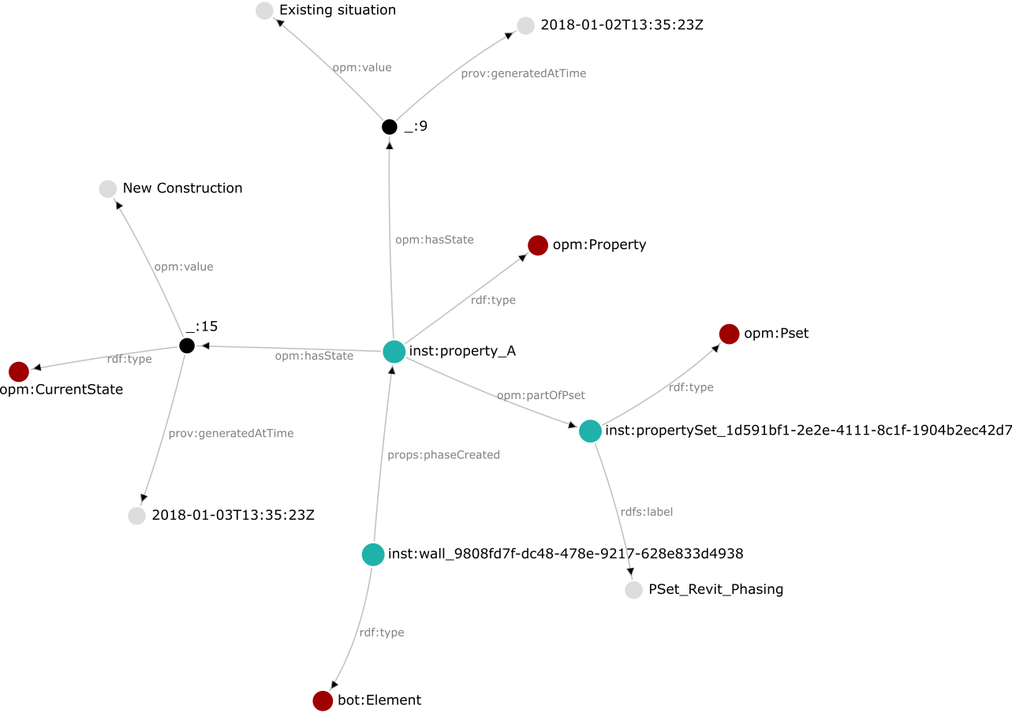
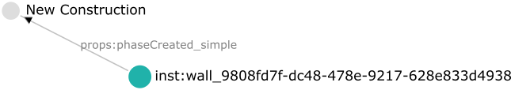
2. Considerations for ontology structure A range of solutions with different levels of complexity?
Datatype property
(⬄ props:phaseCreated as object property)
SPARQL INSERT or
CONSTRUCT

Slide 27
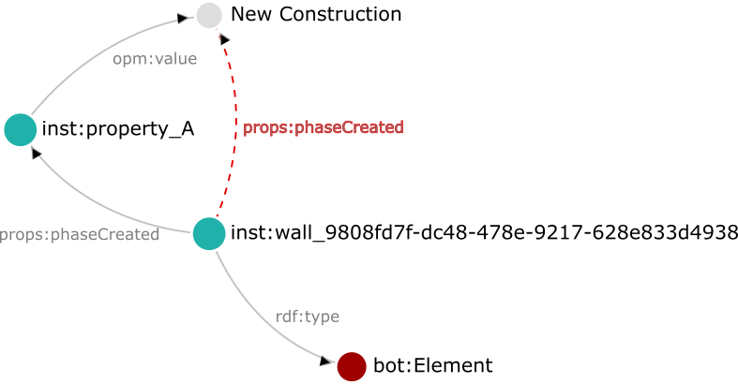
2. Considerations for ontology structure A range of solutions with different levels of complexity?
Only possible for viewing as Level 1, when in fact Level 2 (SWRL needed for Level 3)
Difficult to update the property (not clear for user if property is inferred or not)
Filter needed for instances of properties
owl DL reasoning

Slide 28
3. Next steps Open issues in ontology structure
Different levels of complexity (interchangeable) ⬄ most complex situation?
In the case of different levels of complexity:
How many levels?
Conversion methods?
one ontology for the three levels ⬄ one per level?
One level of complexity per DB ⬄ multiple levels?
What documented where?
PROPS ontology/ontologies ⬄ OPM ontology (not yet documented)?
Materials in separate ontology?
What?
Classes: Pset (and other grouping of properties)
Relations: partOfPset (and other grouping of properties)

Slide 29
3. Next steps Open issues in ontology structure
Level 1:
Information about units in rdfs:description string of the property in the PROPS ontology
Level 2:
Units
Choose for one units ontology? (QUDT, OM, ...)
Compatibility with schema.org? (schema:unitCode => range: text + URL)
Blank nodes for:
Instances of properties?
states?
Property name info in object property ⬄ class?
Level 3:
Same as level 2
Units and opm:Assumption/opm:asDesigned/opm:asBuilt/... => on state or property instance?
Not possible to refer to it from outside the DB => are properties/states supposed to be shared?

Slide 30
3. Next steps Open issues in ontology content
Ontology should restrict the kind of units that can be used?
Methods to extend the ontology with custom properties (will never be complete)
IFC properties (pset generator) as subproperties of more general properties?
Wikipedia?
Standards containing definitions?
Wikidata?
QUDT?
OM?
schema.org?
Custom made properties?
Results compatible with PROD derived from IFC (domain)
Probably combination of these sources
(+ alignments between them)?
CEN / TC 442
or others?

Slide 31
4. sparql-visualizer tool
What? => means to communicate during ontology engineering process between:
Domain expert
Application engineer
Ontology engineer
No installment necessary:
Online
Offline: download ready-to-use ZIP version
Easy to use + documentation online:
Github readme (quickstart + detailed functionality)
Tutorial videos: pt1. basics + pt2. running locally
Flexible:
Prepare samples in JSON and share one-click links via Dropbox or Github
connection with separate triple store possible (atm only Stardog)
Loading of turtle files
Open source: everyone can contribute
Intuitive graph visualization
Application of ontologies: Tbox + Abox
https://madsholten.github.io/sparql-visualizer/?file=https://dl.dropbox.com/s/x7z1aw4hzgtv0c9/ifcOWL-properties.json

Slide 32
Sources – links - further reading
PROPS discussion: https://github.com/w3c-lbd-cg/props/issues/2#issuecomment-371807503
PSET Generator (Maxime): https://github.com/w3c-lbd-cg/props
IFCtoLBD converter (Jyrki): https://github.com/jyrkioraskari/IFCtoLBD
Demo to get PROPS ontology from Wikipedia: https://objprops-gen.herokuapp.com/id/area
Ontologies:
ifcOWL: http://ifcowl.openbimstandards.org/
BOT: https://github.com/w3c-lbd-cg/bot
schema.org: http://schema.org/version/3.3/schema.ttl
QUDT (2.0)
General: http://www.qudt.org/release2/qudt-catalog.html
Disciplines: http://qudt.org/doc/2017/DOC_VOCAB-QUDT-DISCIPLINES-v2.0.html
OM (ontology of units of measure): https://github.com/HajoRijgersberg/OM

Slide 33
Sources – links - further reading Literature
Farias, T. M. De, Roxin, A.-M., & Nicolle, C. (2015). IfcWoD,Semantically Adapting IFC Model Relations into OWL Properties. In Proc. of the 32nd CIB W78 Conference 2015, 27th-29th October 2015, Eindhoven, The Netherlands (pp. 175–185).
Niknam, M., & Karshenas, S. (2017). A shared ontology approach to semantic representation of BIM data. Automation in Construction, 80, 22–36. https://doi.org/10.1016/j.autcon.2017.03.013
Pauwels, P., & Roxin, A. (2016). SimpleBIM : From full ifcOWL graphs to simplified building graphs. In S. Christodoulou & R. Scherer (Eds.), EWORK AND EBUSINESS IN ARCHITECTURE, ENGINEERING AND CONSTRUCTION (pp. 11–18). Limassol, Cyprus.
Pauwels, P., & Terkaj, W. (2016). EXPRESS to OWL for construction industry: Towards a recommendable and usable ifcOWL ontology. Automation in Construction, 63, 100–133. https://doi.org/10.1016/j.autcon.2015.12.003
Rasmussen, M. H., Pauwels, P., Hvidd, C. A., & Karlshøj, J. (2017). Proposing a Central AEC Ontology That Allows for Domain Specific Extensions. In LC3 2017: Proceedings of the Joint Conference on Computing in Construction (pp. 237–244). Heraklion, Greece.
Rasmussen, M. H., Pauwels, P., Lefrançois, M., Schneider, G. F., Hviid, C. A., & Karshøj, J. (2017). Recent changes in the Building Topology Ontology. In 5th LDAC workshop.

