Slide 1


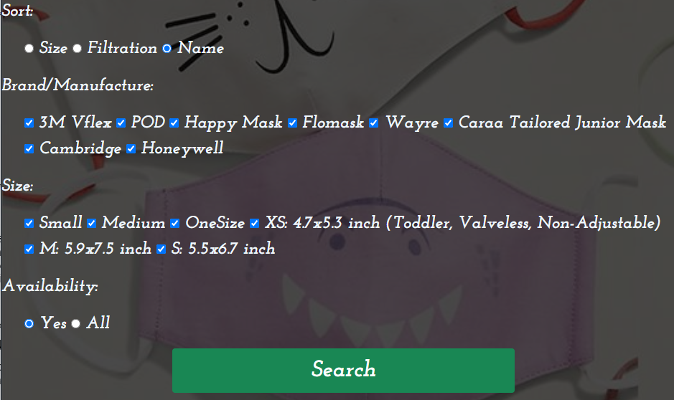
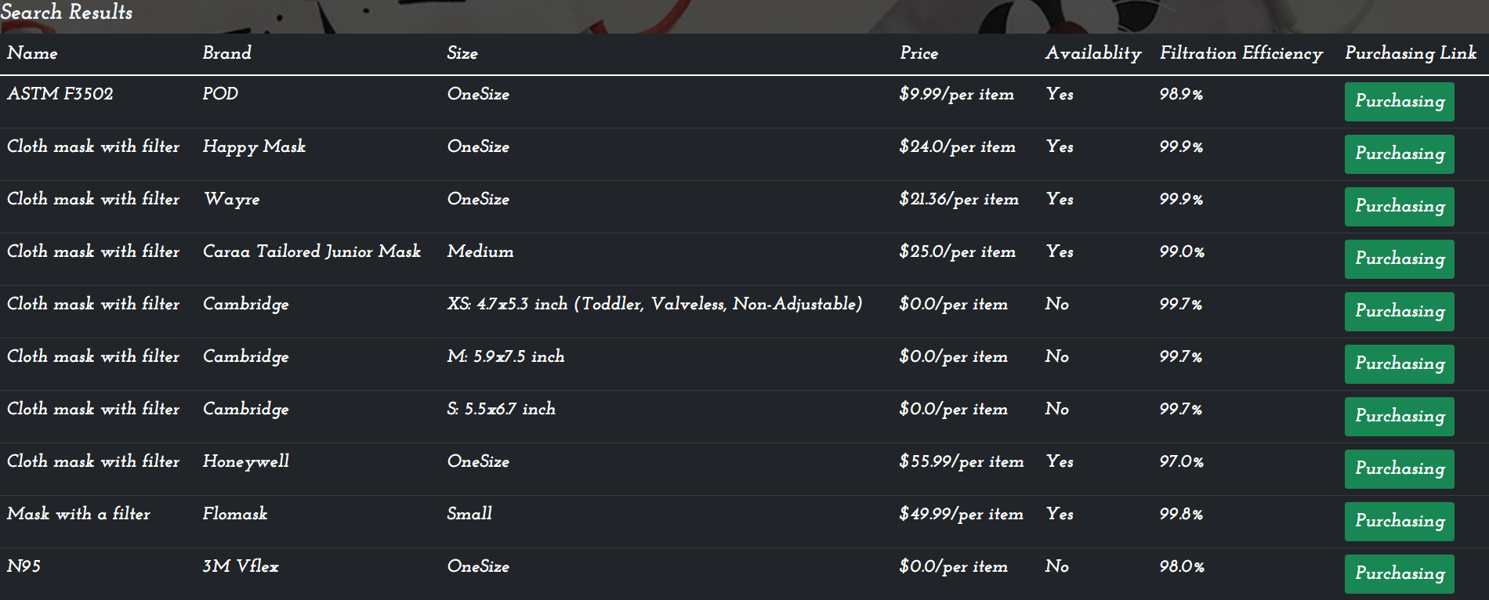
Kayak For Masks Website
CSCE 606/ Fall 2021
Department of Computer Science & Engineering
Texas A&M College Station
College Station, TX 77840, USA
Faculty Advisor
Prof. Duncan M.Walker
Keigo Ma
kxm175330@tamu.edu
Jingtun Zhang
zjt6791@tamu.edu
Yuncheng Yu
yyc@tamu.edu
Siqi Fan
sf26372@tamu.edu
Keqiang Yan
keqiangyan@tamu.edu
Hanzhou Liu
hanzhou1996@tamu.edu
Yingying Wang
wyytamu@tamu.edu
Abstract
When vaccines are unavailable, masks can be life-saving. However, currently there is no place to go where they can provide both availability and reliability of masks on the market. Therefore, issues start to play a role. Taking Amazon as an example, it is flooded with Chinese counterfeiters. The purpose of this project is to create a website coded by Python Django/Flask that allows parents to track the availability of children’s masks on the website. When a customer opens the webpage, the web should display a list of website to the user and the size will also be updated in the real time. The filtration efficiency will also be display on website. The customer can also sort and filter product items on the webpage.
Results
Architecture
Website developed using:
Python Django
HTML
CSS
JavaScript
Python Spider
HTML/CSS
Website
Dashboard
List
Dashboard
Performance
Major Features:
Sorting
The masks can be sorted in order of the size, filtration efficiency, and name.
Filtering
Three filters are implemented, which are the brand filter, size filter, and availability filter.
Web Crawling
This is a hidden function, used to retrieve real-time price data from websites.
The list of masks websites(default)
Conclusion
Impacts and Future Improvements
In this semester, we were able to create a website that allow users to browse detail information of a list of websites that provide masks for children. The Kayak masks website is able to:
Display clear and detail information of masks
Real-time price update
Data crawling from variety websites
We also implement something to improve the user experience:
Sorting and filtering masks on the websites
Purchasing link redirection
Availability searching
Lessons learned:
Being able to understand customer requirements, checking the project feasibility, design, testing, and maintenance.
Due to the high demand of the masks in the pandemic. People, especially children and their parents, are facing issues in finding high-quality, available, and properly-sized masks. Therefore, the team created a platform that can be implemented as a mask search engine which can help more people in future. However, a few challenges still exist after designing the website. Every website is built differently, then different websites have different formats, the web crawling method designed should be applicable for different sites. Also, due to the size limitation of the Heroku, a docker combined with the Heroku need to be included. As for future improvements, the design of a more efficient and suitable web crawling based on the current one is recommended.

