Slide 1


Git & GitHub
Gaurav Kolekar
Software Carpentry Workshop
University of Texas at Arlington
April 02-03, 2016
Many Slides adopted from 'Git & Github' by Daren Card

Slide 2
What is Git?
Git is a widely used source code management system… A distributed revision control system with an emphasis on speed, data integrity, and support for distributed, non-linear workflows. - Wikipedia

Slide 3
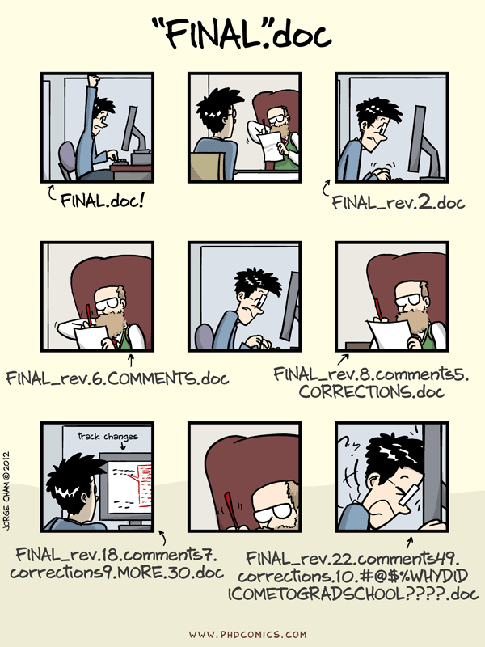
What is Git?

Slide 4
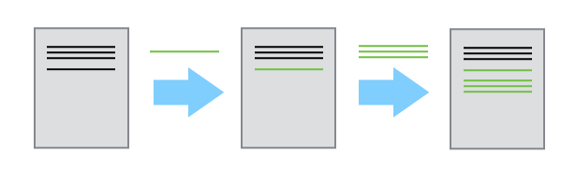
What is Git?

Slide 5
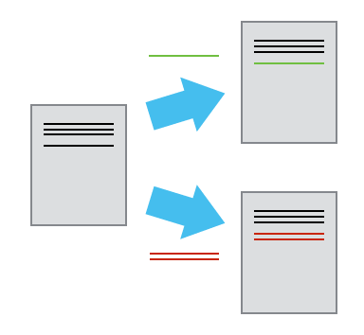
What is Git?

Slide 6
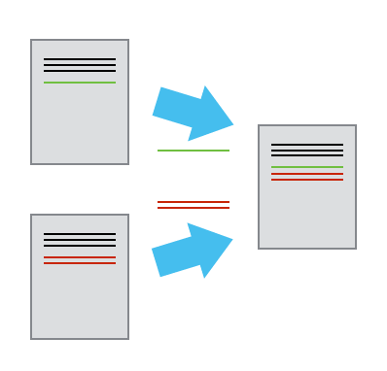
What is Git?

Slide 7
What is GitHub?
A web-based Git repository hosting service, combining the functionality of Git with additional features including a graphical interface, access control, bug tracking, feature requests, task management, wikis, and repository sharing. – Wikipedia

Slide 8
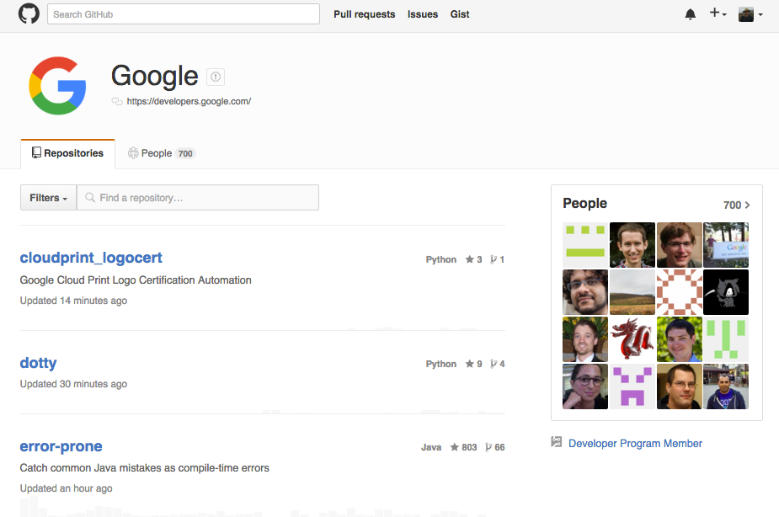
What is GitHub?

Slide 9
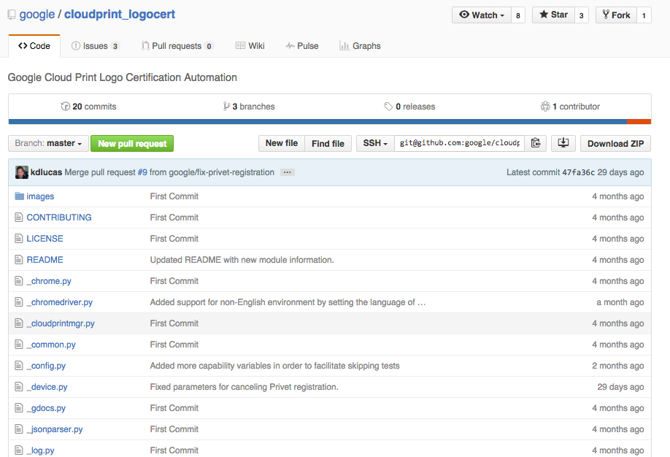
What is GitHub?

Slide 10
What is GitHub?

Slide 11
What is GitHub?

Slide 12
What is GitHub?

Slide 13
What is GitHub?

Slide 14
Overview of the lesson
Learners will complete the following broad tasks:
Fork a website template repository on GitHub and use Git locally to pull this repository onto their computer.
Make necessary changes to setup the website and then add content, using Markdown, while learning the basics of Git.
Push local changes back to remote repository at GitHub, which then automatically builds and displays the website.
Users will conclude by populating their website with all materials and overviews of the lessons for the Software Carpentry workshop they participated in. This will allow them to reference this information later.

Slide 15
Glance at all the commands
git config
git clone
git status
git add
git commit
git push

