Slide 1
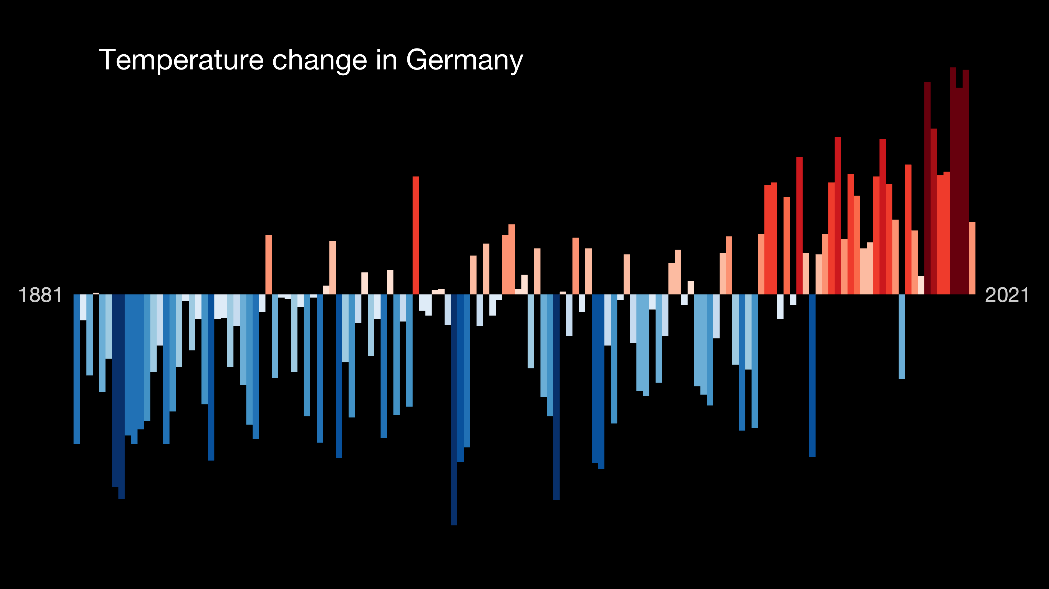

Slide 2

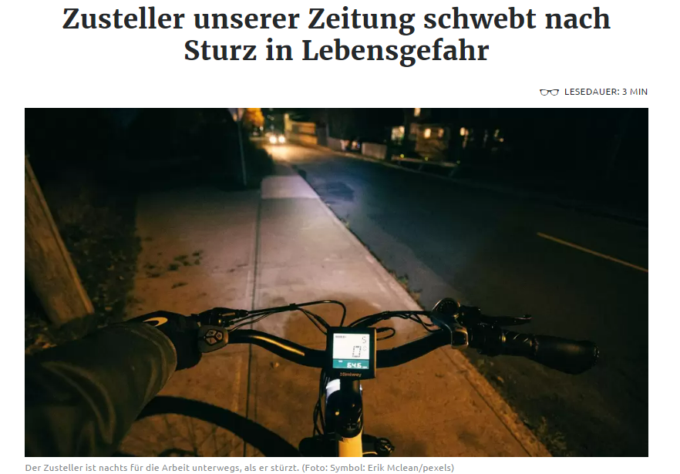

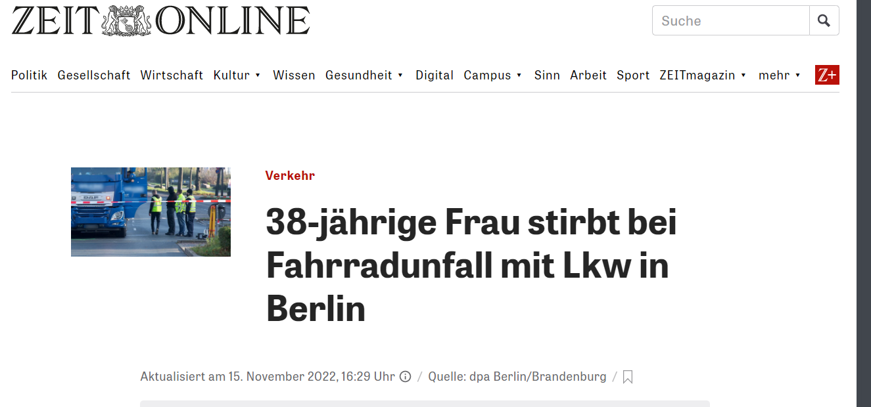
Just bike instead of using your car!

Slide 3
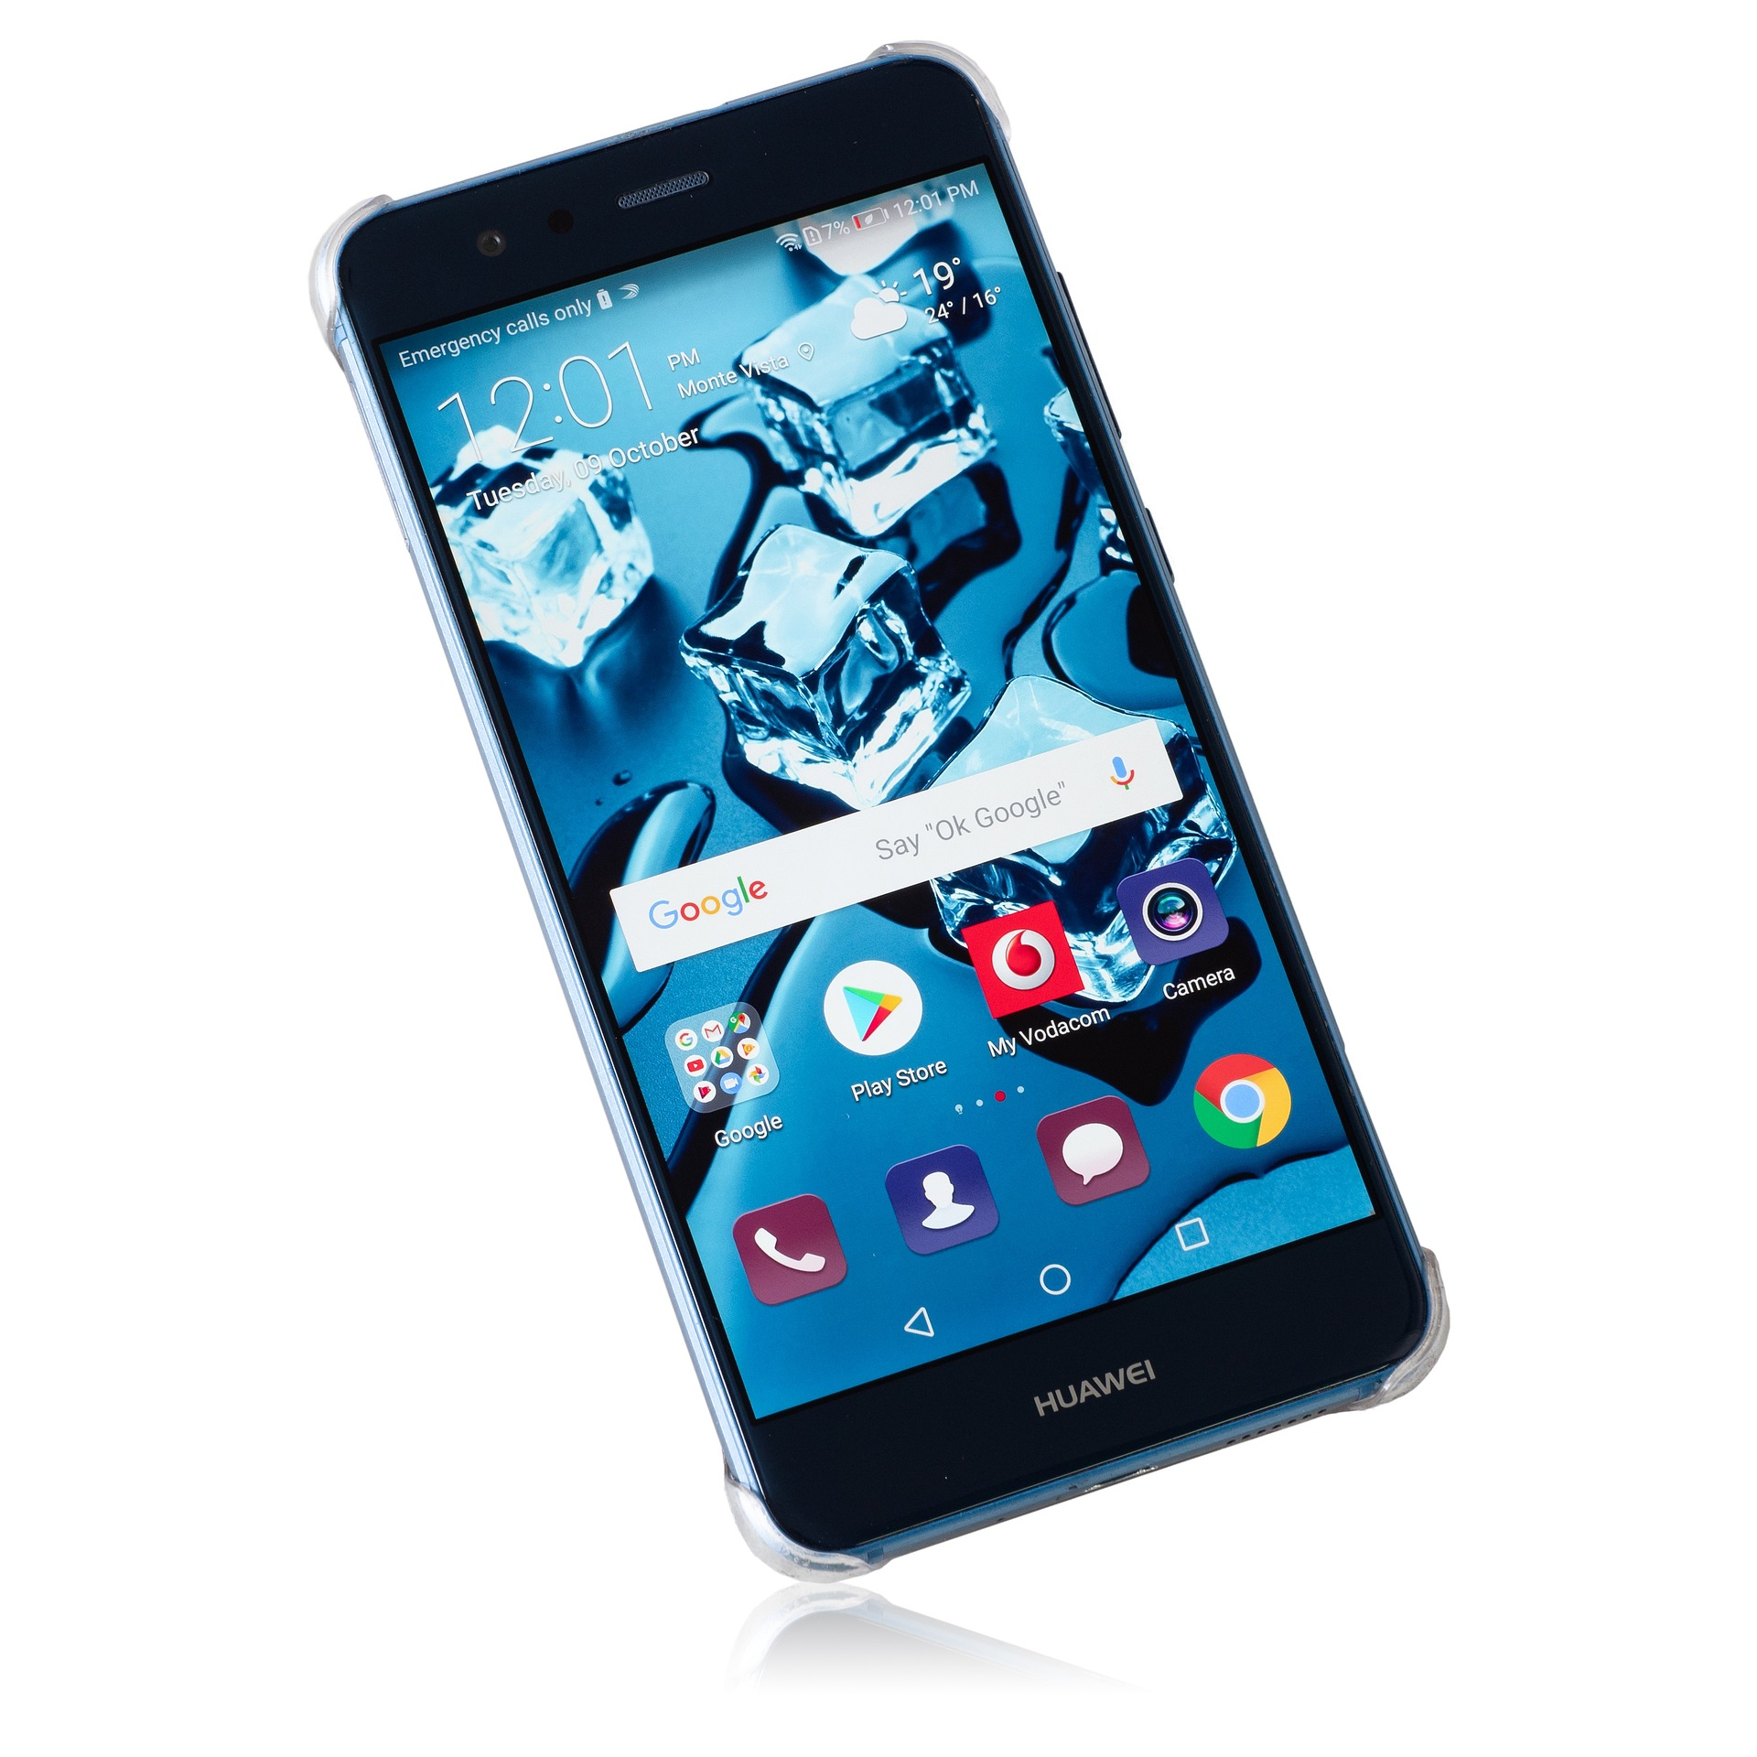
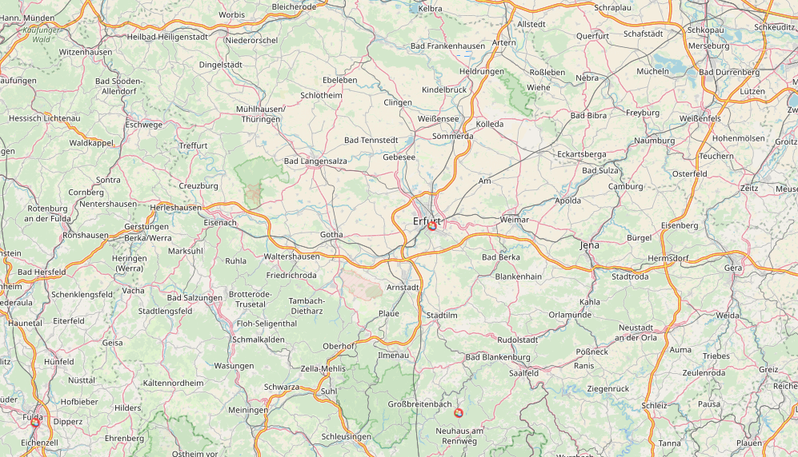


Slide 4

2 in 1
Appartment values based on a bike path quality scale which gets constantly updated based on new problems added by users
Notes:
Add main features of app

Slide 5
Region score for bikeability
MAP !
Notes:
Add map or classification for regions

Slide 6

Why you should use the app? Gamification
Add-ons to avatars
“monument” when an issue gets solved
Personal score
Social and political participation – feel good

Slide 7
Sources
University of Reading. Temperature of Germany. https://showyourstripes.info/b/europe/germany/all
Bike accidents: https://www.zeit.de/news/2022-11/15/radfahrer-bei-unfall-mit-lkw-getoetet?utm_referrer=https%3A%2F%2Fwww.google.com%2F
https://www.radiochemnitz.de/beitrag/schwerer-fahrradunfall-auf-der-zwickauer-strasse-747119/
https://uecker-randow.info/2022/11/12/fahrradunfall-in-torgelow-57-jaehrige-schwer-verletzt/
https://www.schwaebische.de/landkreis/landkreis-sigmaringen/sigmaringen_artikel,-zusteller-unserer-zeitung-schwebt-nach-sturz-in-lebensgefahr-_arid,11577010.html
Data source: https://www.munichways.de/
Issue tag source: Pajares, Elias. 2020. “Incorporating the four accessibility components into an interactive accessibility instrument”. TUM: München. Available at: https://mediatum.ub.tum.de/1542813
In-app avatar source https://www.freepik.com/free-vector/animal-avatars_766618.htm#query=avatar&position=24&from_view=keyword
Halo/map sources: https://www.clipartmax.com/middle/m2i8m2K9N4Z5A0A0_halo-clipart-hd-angel-guardian-angel-tattoo/
https://www.pngfind.com/freepng/angel-halo-png/
https://www.subpng.com/png-eenpe7/download.html#google_vignette

